Slide 1
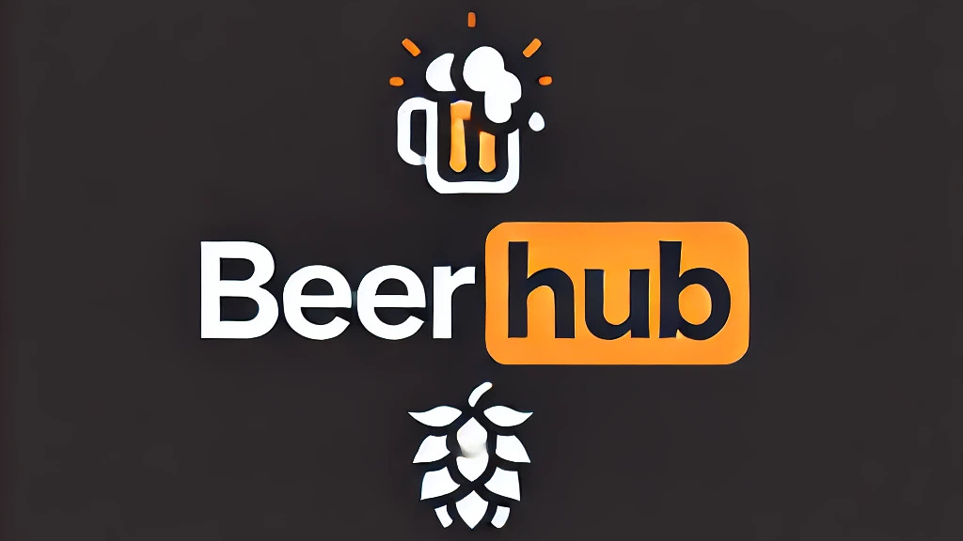
Django – Python – React

Slide 2
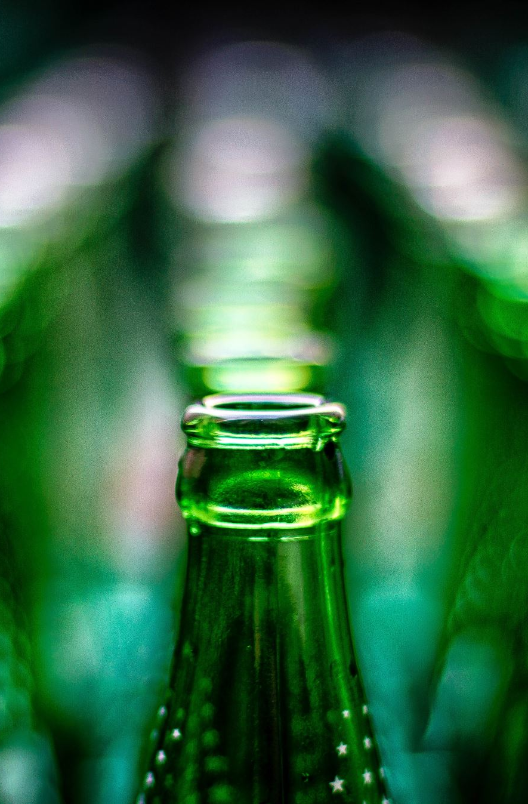
Domain
Manage different beers

Slide 3
Backend: Django
Model, Validation, Swagger, Authorization, Tests

Slide 4
TUI: Python
API-Usage, Tests

Slide 5
GUI: React
CRUD-Operations, Validation

Slide 6
Final Remarks

Slide 7
Thank you! Any questions?

