Slide 1
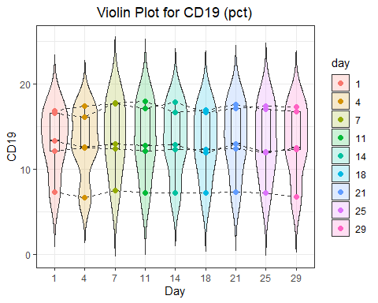
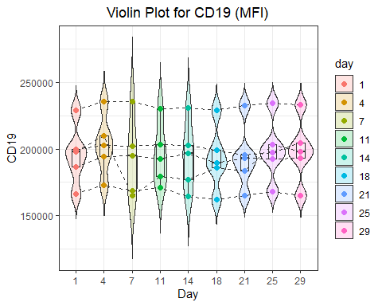
A
B
Fig 1 : expression of CD19 for 5 samples, in percent of positive cells (A) and as mean fluorescent intensity (B)

