Slide 1

DriverPass System Analysis
Damean Murphy-Short
Southern New Hampshire University
Notes:
Hello. My name is Damean Murphy-Short. Today, I’m going to be presenting the system we have designed to support DriverPass in their business endeavor.

Slide 2

System Requirements
Functional:
A user may book a reservation for driving instruction through a web interface.
A user is able to purchase practice exams and courses by using the web interface.
Non-Functional:
All webpages are loaded in under 1 second for responsiveness.
The system shall be implemented through an IaaS cloud service that provides for scalability based on traffic.
Notes:
In system design, we have two kinds of requirements that we are interested in: Requirements for what our system must do, which we call functional and requirements for qualities the system has, which we call non-functional.
The most important functional requirements we identified were the ability of a student to book a reservation and the ability of a student to purchase practice exams and courses online. These are core to the DriverPass business model, and without them, no other tasks can take place. These two functions are essentially the entry point of interaction with your customer base.
As for non-functional requirements, we want to ensure that customers and employees alike have a seemless experience using the web interface we create. For that reason, it is crucial that we have webpages load responsively to avoid user discouragement when visiting the site. To help us achieve this, we shall utilize an infrastructure that grows with the needs of DriverPass by taking advantage of cloud hosting. That means that the cloud provider will be able to dynamically adjust to the amount of computers we need to keep our performance goals aligned without us needing to be concerned for the exact details.

Slide 3
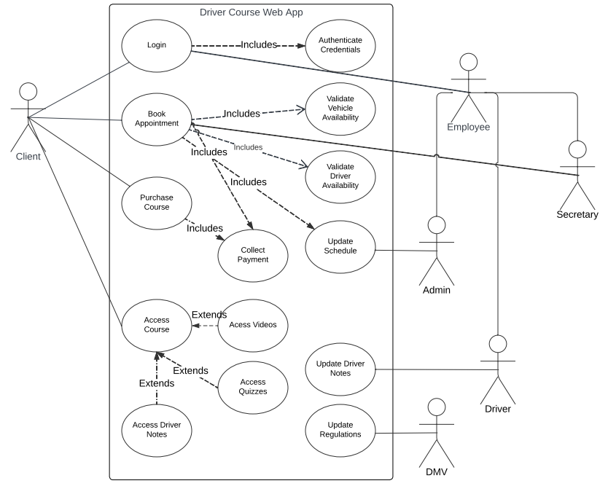
Use Case Diagram
Notes:
In this diagram, we lay out the people who are going to interact with our system, as well as the tasks they are going to be able to carry out. We can see that your clients, the students, will be able to purchase courses, book driving instruction, and login to the web interface. Meanwhile, Secretaries will also be able to book reservations for students over the phone. The system administrator will have full flexibility to manually adjust the schedule when needed. Driving instructors will be able to provide insight on student’s pages to provide more value to the customers. Finally, live updates from the DMV will be provided as notifications to all employees in order to better adhere to legal regulations.

Slide 4
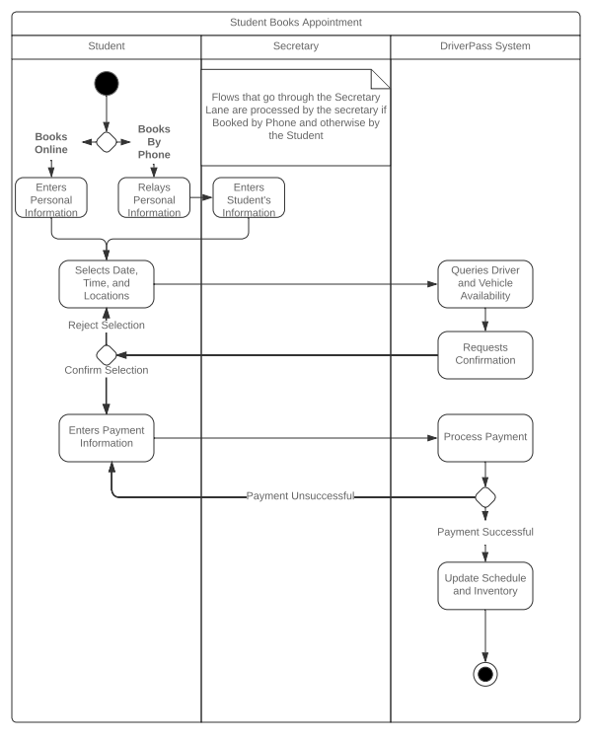
Activity Diagram
Notes:
In this diagram, we depict the act of a student booking an appointment for driving lessons. Knowing that flexibility in this task is essential to DriverPass’s success, we outline how this can be done both online and over the phone with a secretary.
The key steps that we have identified that make up this process are as follows: First the student will give their personal information. Then, they will select a time, date, and pickup location. If the appointment time chosen is available, they will proceed to tell us their payment information, and otherwise they will choose a new appointment time. Finally, once the payment has cleared, the system will notate the appointment in the schedule and the whole interaction is finalized.
As one of the key aspects of DriverPass’s business, we wanted to make this process as easy and simple as possible, while still retaining a robust and feature-filled experience.

Slide 5
Security
All users will require password authentication to access the system.
Accounting of all user actions on the system will occur for review by the Administrator.
Transfer of payment information to third-party processing shall be strictly encrypted.
User accounts will be authorized to different functionalities based on roles: client, administrator, secretary, driver, and technician.
The web interface should only be accessible through a secure HTTPS connection (an established certificate handshake).
Administrator, secretary, driver, and technician accounts will have their passwords expire every 90 days.
An account will be temporarily locked if more than 5 unsuccessful authentication attempts are made within 10 minutes.
Users may request an email to reset their password using an email that was established with the account after successful authentication.
Notes:
Since DriverPass is dedicated to the security of itself and its clients, we have taken a few things into consideration in system design. Firstly, the use of passwords will ensure that only the person who really owns the account can log into it. Passwords will be reset with an email that only the owner should have access to. This makes sure that no client can have their account stolen easily and that no company records can be tampered with by outsiders.
Every action performed will create a trail that can be followed in the case that malicious practices are discovered.
Encrypted communication is a phrase that means all payment processing stays hidden except to the partner and ourselves.
We also want to ensure that no one has access to any functionalities except those that they are supposed to. This is why the design accomodates for a separation between customer accounts and employee accounts.

Slide 6
System Limitations
Being cloud-based and off-site, the system will not provide all functionality if an internet connection is not available or the cloud provider is undergoing an outage or maintenance.
When clients miss appointments, a driver and car will be unavailable in the system, but not in reality.
Notes:
Every system has its limits, and it’s important for us to keep in mind what our system will not be able to do so that we can work around and anticipate any shortcomings.
Since our system is being hosted entirely in the cloud, there will be no way to perform our work tasks if there is no direct connection to the internet or to the cloud provider itself. In modern life, we seldom go without the internet, so we hope to mitigate this limitation by maintaining a constant connection.
Another limitation of our system is that it cannot account for human error. Suppose a client does not attend their reservation, then a vehicle and driving instructor, who are physically able to support another student, are still marked as unavailable in the schedule without manual intervention. In an attempt to reduce the impact of this, the administrator has been given full ability to manually adjust the schedule.

