Slide 1

Green Pace
Security Policy Presentation
Developer: Damean Murphy-Short
Notes:
Hello. My name is Damean and today I’ll be presenting the new security policy for Green Pace that will codify standards for development, encryption, Triple-A, and DevSecOps.

Slide 2

OVERVIEW: DEFENSE IN DEPTH
Codifying a standard produces uniform quality in defense.
Building with security as a day-one requirement saves the time, effort, money, and trust that would be lost from addressing problems ad-hoc.
Notes:
The policy document aims to create defense-in-depth, which is multiple layers of defense, to reduce the overall risk of security incidents. It does so by setting forth a list of standards and policy recommendations that will produce a relative uniformity across the codebase in terms of vulnerability. The reason it’s important to build a project with security as a starting point in the requirements is that the risk of attempted attacks is almost guaranteed and having measures already in place saves the time, money, and effort that would be required in the event that a breach requires a complete rewrite of insecure code that never accounted for security.

Slide 3
THREATS MATRIX
Likely Commonly exploited vulnerabilities: Memory mismanagement, stack smashing, etc | Priority Costly and difficult to remediate: Code Execution Exploits, Data breach
Low priority Not as costly, poses less immediate consequence: Non-critical process termination, etc | Unlikely Difficult to exploit or are not useful for attackers: Terminating incorrectly after an exception, etc
Assessing priority through risk allows for effective management of resources.
More testing and monitoring can be performed for higher priority security risks.
Notes:
One way to make sure this security policy directs resources in the right places is by assessing priority. The priorities are measured by how severe a potential explotation of vulnerability might be. Examples of low severity include the termination of non-critical processes, which isn’t likely to lead to further exploit and isn’t going to lead to legal repurcussions. These kinds of threats identify errors within the code, but don’t pose a high cost to repair. High severity issues include memory errors, code execution exploits, and data breaches. These are usually accompanied by further explotation, legal and financial repurcussions, a loss of trust from customers, and other undesireable outcomes. These types of exploits are likely to result from our ‘likely’ category on the threat matrix, which includes common vulnerabilities like memory mismanagement, stack smashing through overflow, and others.

Slide 4
10 PRINCIPLES
Validate input data (STD-011-C11, STD-012-C11)
Heed Compiler Warnings (STD-001-C11)
Architect and Design For Security Policies (All)
Keep It Simple (STD-001-C11, STD-002-C11, STD-013-C11, STD-003-C11)
Default Deny (STD-021-CPP, STD-004-C11)
Adhere to the Principle of Least Privilege (STD-021-C11)
Sanitize Data Sent to Other Systems (STD-003-C11)
Practice Defense in Depth (STD-021-C11)
Use Effective Quality Assurance (STD-031-CPP, STD-032-CPP)
Adopt a Secure Coding Standard (All)
Notes:
With these threats in mind, we put forward ten principles that best identify the security needs of the company and act as a set of guidelines for the standards that we will discuss on the next slide.
Input data is often the only data that is accepted from outside the program, and therefore the most common vector of attack. Validating input at every single entry point is important to avoid the most common vulnerabilities and ensure no malicious input makes it past the outside layers of defense.
Compiler warnings often provide relevant insight to edge cases that may not impact the operation of the code under compliant use, but could lead to vulnerabilities when attackers are searching for exploits. Ignored warnings can also frequently lead to code that works only under certain conditions and is difficult to debug or reproduce errors.
Architecting and designing for security from the start of a project ensures that a security infrastructure exists rather than security measures added on top of existing code. Integrating security measures into already-written code can be difficult, require rewrites, and overall require a greater time investment.
Keeping code simple makes it easier to read, understand, debug, and trace data flow. Difficult-to-read code is more prone to error and error is prone to exploitation, so a secure system should implement readable code.
The default state of every interaction should be to deny access to data. The physical security equivalent example is that a door should remain locked until the key is provided as evidence of authorized use. This helps prevent attacks that bypass authentication and authorization measures.
In the same spirit, the least amount of privilege required to perform the necessary tasks of the function should be given to the users and processes associated with that task. Restricting a process to only a subset of system resources and data limit the value in a successful attack on that process.
Just as input data is exploitable, we want to ensure data moving to other systems is cleaned of unwanted content, as well. This ensures that one system is not exploited through the manipulated output of another system.
Practicing defense in depth, as previously discussed, means layering multiple security measures in an attempt to reduce the impact of a single exploit. While one layer of security may be bypassed by an unpredictable zero-day attack, the other remaining layers can aid in preventing any further damage, and may possibly nullfiy the usefulness of the first exploit to the attacker.
Quality Assurance such as automation techniques, unit testing, penetration testing, and more contribute to the overall security of a project by identifying issues and errors early on and using these evaluations to correct them before breaches occur.
Finally, having a secure coding standard provides a baseline of expected security across the board and a reference for developers to use as they implement project requirements and features. Explicitly requiring these standards creates an environment where security can be tested for rather than remaining an implicit assumption.

Slide 5
CODING STANDARDS
Ordered by priority based on severity if exploited, cost of remediation, difficulty in addressing, and likelihood of being discovered and exploited if vulnerable.
STD-013-C11 – Memory Management – Use maximum one pointer for the same address per scope
STD-003-C11 – Data types – Prefer explicit bit-width types
STD-011-C11 – String Correctness – Check bounds of underlying data structure
STD-012-C11 – Memory Protection – Ensure sufficient size and location of memory
STD-002-C11 – Data Value – Avoid unintentional truncation patterns
STD-001-C11 – Data Type – Check bounds of return values
STD-021-CPP – SQL Injection -Parameterize Queries
STD-004-C11 – Data values – Initialize variables with default values
STD-031-CPP – Assertions – Use assertions to test platform-dependent values
STD-032-CPP – Exceptions – Always cleanly exit exception handling
Notes:
Now that we’ve established our security principles and how we measure priority of different threats, we have listed here the coding standards we wish to accept from highest to lowest priority. Importantly, low severity or low priority does not indicate zero severity. It simply indicates that the risk of ignoring higher priority items comes with much more severe consequences for the company due to their likelihood of becoming exploited. Within the Green Pace Security Policy document, our notation of risk assessment, priority level, and severity follow the SEI CERT guidelines. At the top, we see mostly memory management and bounds checking standards, due to the prevalence of vulnerabilities of this type. Pointer usage, especially, must follow the principle of ‘keeping it simple’ to avoid misinterpretation by the developer, which can cause double free errors, writes out of bounds, or other errors which can all lead to arbitrary code execution from the affected code. Using data types with known, consistent sizes, checking the bounds of memory arrays, and ensuring the size of allocated memory before operations are all highly important best practices that we are requiring in our codebase to secure the most common attack surfaces. Examples of each coding standard, compliant, and non-compliant code can be found in the accompanying Green Pace Security Policy document.

Slide 6
ENCRYPTION POLICIES
Encrypt whenever possible. Plain text data can be intercepted and read at any point between the sender and recipient. Use industry standards that are known to be currently unfeasible to break.
At rest, sensitive data such as Personal Identifying Information(PII) shall always be encrypted. Passwords should always be stored in their encrypted form. Devices on physical premises should have full disk encryption.
In flight, use secure standards that provide for two-way encryption such as HTTPS through TLS. Public-private keypairs with strong encryption standards such as 512-bit RSA are preferred. Never send plaintext data once the encryption key-pair handshake is complete.
In use, some data may be useful without decryption. This typically applies to password hashes, which can be calculated on the sender’s system and compared to a stored hash on the recipient’s system without the need for decryption.
Notes:
We also find encryption necessary to codify into policy due to its usefulness in protecting data from unauthorized access and its requirement by many legal jurisdictions. Our policy is to encrypt at all opportunities, especially as modern technology and encryption standards make the performance overhead of doing so very low, and the risk of not doing so can lead to data breaches.
Industry standard encryption protocols and standards provide encryption that is currently not possible to break with the computers that exist today, so industry standards should be used on all applicable data and updated frequently.
Data that is in storage, or at rest, is often important and sensitive. This kind of data could be personal identifying data, passwords, or other data that should not be exposed to unauthorized users. Some ways it can be protected are file encryption with a password and encryption key or full disk encryption, which ensures that attackers with physical access to the device are unable to retrieve information.
Data in transit, or in flight, can be protected with public-private keypairs that can be securely passed from sender to recipient in a handshake protocol. HTTPS, for example, uses TLS to provide end-to-end encryption in this manner.
Data in use may not always be useful if it is not in plain text, but when possible, it should also be encrypted. Password hashes are an example where the hash can be created on the client-side and sent to the server side to check for the stored matching hash without ever storing the decrypted password on the server machine. This type of irreversible encryption is favorable because it cannot lead to data theft when used in this manner.

Slide 7
TRIPLE-A POLICIES
Authenticate using multiple factors.
Always authenticate or require an authentication token before any step that requires authorization.
Time out authentication after a reasonable amount of time.
Authorization should follow the principle of least privilege.
Perform authorization in groups where possible to simplify permissions.
Authorize for each step. Do not assume authorization to one resource also grants access to another.
Perform accounting of these processes through monitoring sessions, network activity, intrusion detection systems, etc.
Notes:
The policy also sets guidelines for a triple-A framework, which is authentication, authorization, and accounting. Best practices for authentication include the implementation of multi-factor authentication, requiring proof of authentication for every transaction that requires authorization to a resource, and timing out authenticated sessions after an expected legitimate use time.
Authorization should follow the principle of least privilege, wherein no user or process is authorized to resources that they do not require to perform their intended tasks. User and system groups greatly simplify the implementation of authorization by providing a centralized set of rules that apply to multiple users rather than customizing the permissions of each user. This makes the authorization framework easier to understand, monitor, and enforce. Access to one resource should not bypass authorization for another resource, even if another user with ‘less’ privilege may access that resource. This ensures that each individual transaction is checked for permissions and holes in the authorization framework do not allow attacker to bypass it.
Accounting these measures means monitoring authentication and authorization activity per session, over the entire network, through different API usage, and with the aid of automated tools.

Slide 8
Unit Testing
Unit testing was developed to provide for automated quality assurance in adherence to the codified standards.
Tests are a mixture of positive and negative testing and cover varying standards.
Notes:
As part of quality assurance, which is one of our guiding principles, unit testing can be used as a tool to ensure compliance with security standards as well as code that is free of errors that can produce the intended output. We have developed a set of tests that utilize both positive and negative testing over a range of our coding standards.

Slide 9
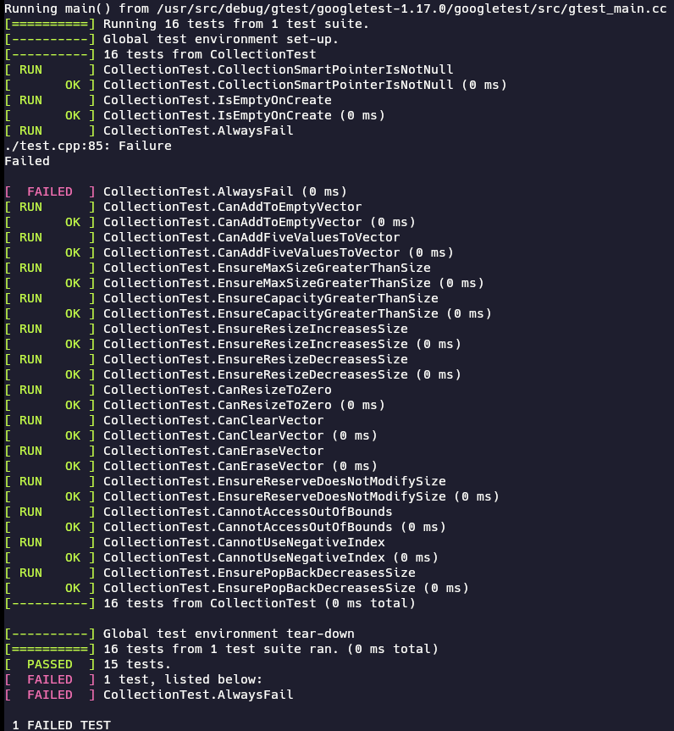
Unit Test Sample
Notes:
Here is an example of the output of running these tests and how it can be integrated into the dev sec ops pipeline as an automated tool. We will also take a look at some individual tests and how they promote the coding standards put in place.

Slide 10
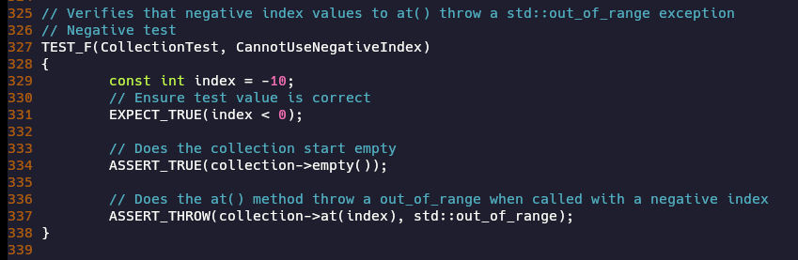
CannotUseNegativeIndex
Adheres to coding standards by checking bounds of memory data structures and cleanly exiting with exceptions.
Notes:
The test on this slide is checking to ensure an exception is thrown when a negative index is given to our data structure class. This ensures adherence to our bounds checking standards and our exception handling standards.

Slide 11
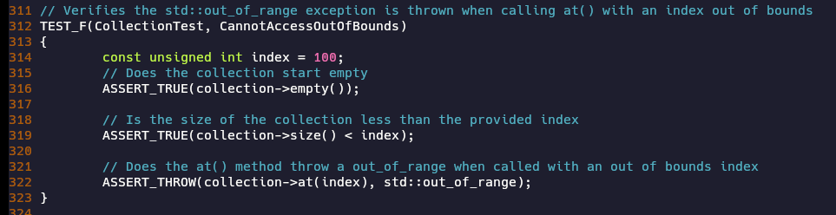
CannotAccessOutOfBounds
Adheres to coding standards by checking bounds of memory data structures and cleanly exiting with exceptions.
Notes:
To test the same standards in a different case, we test a positive out of bounds access. It is important to test multiple different values and test cases, as attacks can often come from malformed values that developers don’t expect to occur from good-intentioned use of the program.

Slide 12
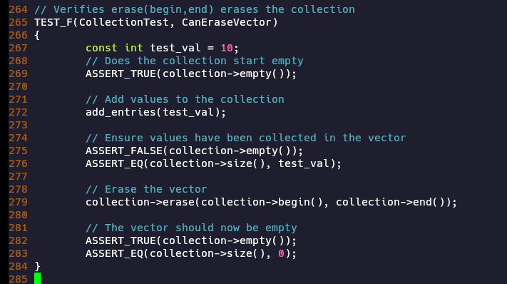
CanEraseVector
Verifies default intitialized values (vector→empty()), and ensures expected behavioral results of function ‘erase()’
Identifies potential misimplementation of data structures
Notes:
On this slide, the unit test ensures that the results of the ‘erase()’ function are predictable and produce expected behaviour, while also exemplifying the value of initializing the default values of variables in the case of vector→size being initialized to 0.

Slide 13
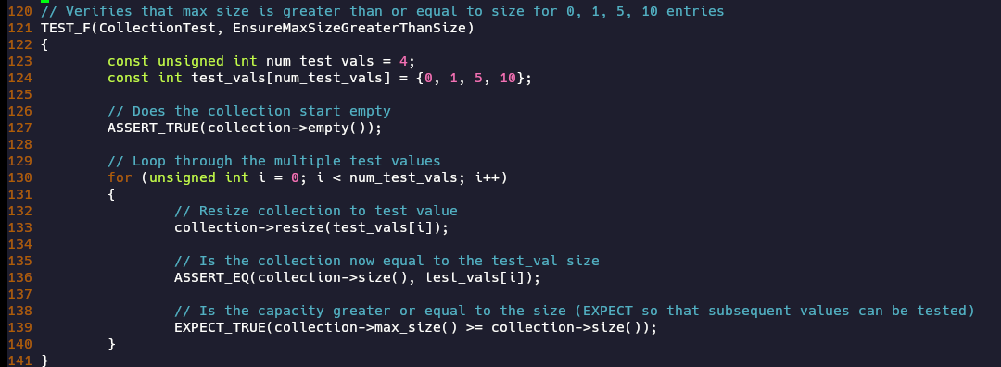
EnsureMaxSizeGreaterThanSize
Performs bounds checking on allocated memory in a data structure
Notes:
The final test we will demonstrate again performs bounds checking on the underlying data structure, ensuring that when this max_size function is used properly before writes, we can guarantee that the memory buffer does not overflow. Many of the tests address our high priority standards due to the importance of memory operations.

Slide 14

AUTOMATION SUMMARY
Notes:
This chart, which we will explain briefly, shows the flow of the dev sec ops pipeline from pre-production, release, and finally to production.

Slide 15
TOOLS
  DevSecOps is an iterative development cycle.
  Plan, design, build, test before production. Release. Transition, monitor, respond, stabilize after release. Repeat the process to improve upon the product.
  Automated static analysis tools(CPPCheck, IDE analyzers, compiler output), memory analysis tools(Valgrind), and automated unit testing tools(Google Test) provide feedback during the Verify and Test phase and the Mantain and Stabilize phase.
  Firewalls, intrustion detection systems, accounting measures, etc play a role in the Transition, Monitor, and Respond phases.
Notes:
Dev Sec Ops is an iterative process, hence the circular design on the previous diagram. This approach takes into account the necessity of continued development to improve and secure the product being developed.
As opposed to traditional dev ops, every phase of the process is accompanied by a security evaluation. The plan, design, and building phases are all part of the principle of architecting for security, while the testing phase falls under the principle of quality assurance measures that we have previously mentioned. After release of the product, automated monitoring tools can be used to find vulnerabilities that were not identified in the pre-production process and the respond and maintainence phases are the correctional policies and plans that lead back into the pre-production phases where, with enhanced security policies, plans can be made to address the new vulnerabilities.
In pre-production, we can utilize static analysis tools like cppcheck, IDE analysis, and compiler output as well as memory analysis tools like valgrind unit testing tools such as google test to strengthen our security process and aid in quality assurance.
In production, firewalls, intrustion detection, accounting systems, and other tools play a larger role in identifying potential attacks.

Slide 16
RISKS AND BENEFITS
Attacks are imminent on every public-facing networked device.
Proactive rather than reactive security measures reduce the time, effort, and cost of addressing security risks.
Legal and financial burdens are present for lack of proactive measures (such as the GDPR in Eurpoe).
Loss of trust when security breaches occur without mitigation.
Secure best practices often produce higher quality, debuggable code.
Notes:
Since the policy has been explained, we will now asses why we are adopting the policy and what the risks and benefits surrounding the policy entail.
Every system on a public network will eventually undergo attack. Preparing for this attack with proactive measures can reduce the impact of the attack and provide a better foundation for additions to security measures. Addressing these attacks with reactive measures could mean an entire rewrite of the program, depending on the nature of the exploit, leading to a huge increase in resources required to address the problem. The solution may also come after damage has already been done, both financially and reputationally.
In many jurisdictions, implementing security measures as an integral part of the program is required by law, such as in Europe to protect user data under the GDPR, and neglecting to do so can lead to legal and financial repurcussions.
Customers and partners may also lose trust in the company if breaches occur and are unable to be remedied or faced no mitigation during the attack.
Because many security vulnerabilites come from errors, secure code is often more error-free, more debuggable, and of higher quality than insecure code.
Overall, adopting a security standard helps avoid theft, legal issues, and loss of trust, while also promoting secure code that is less error-prone and better serves the needs of customers or users by protecting their data.

Slide 17
RECOMMENDATIONS
    The current policy sets standards for code, but not overall application security, network security, or physical security.
    The policy lacks recommendations related to accepting and managing project dependencies. Many exploits require constant reassessment and updates to dependent components. For example, many organizations had to quickly update Log4J versions used in their projects or be at risk of remote code exeuction after an exploit was discovered in 2021.
    The policy does not set requirements for penetration testing or third-party consultation.
    The policy, outside of requiring encryption, does not set forth standards for networked communication between services, different systems, different processes, or APIs.
Notes:
While the security policy we documented sets standards for development teams, it lacks in other areas, such as application security, network security, and physical security.
The document also provides no recommendations for project dependencies, which should also be considered as an attack surface of the project. In 2021, for example, a remote code execution exploit was discovered in Log4J, requiring many organizations that had code dependent on Log4J to immediately update to the patched version.
Guidelines for penetration testing and third-party assessments and consultation are also missing from the policy document, which are both valuable tools for identifying new vulnerabilities.
Finally, in our modern world which is highly connected over networks, the policy does not mention standards for communication between different services, systems, processes, and APIs. Setting forth such standards would better adhere to the principles of validating input data and sanitizing data sent to other systems.

Slide 18
CONCLUSIONS
A more wholistic assessment of security.
Project dependencies should be documented, approved by project leaders, and limited to only those that are strictly necessary.
Dependency versions should be updated regularly on stable releases.
A combination of black box testing and penetration testing should be regularly sheduled as part of the transition and health check phase in dev sec ops.
No data from the network should ever be trusted without validation.
Notes:
To conclude with some recommendations to ameliorate the deficiencies just listed, a new assessment of the broader security of the company should be undertaken. Some possible standards to consider are documentation of project dependencies, approval of dependencies by project leads, and taking in dependencies only when they are required for functionality. Regularly updating dependencies will also avoid retention of known exploits that have already been patched, and there are automation tools to help identify these, such as Maven.
Regularly scheduled penetration testing can be performed in the transition and health check phase of the dev sec ops process to help identify vulnerabilities before attackers find them and reduce the risk of a breach.
Finally, no data should be trusted from a network without validation and integration testing can be used to ensure that data being passed between systems meets security requirements.
With that note, the current state of the security policy will promote the goals of the company by reducing risk in security incidents, and these recommended updates will also contribute to that goal.

