Slide 1

LL4 – Model Car
Florian Mauracher
Christoph Griesbeck
Thomas Mauerer
Technische Universität München
Department of Computer Science
Garching, 08-01-2017

Slide 2
Outline
Setup
Requirements specification
Description of the components
  Mqtt
  Servo
  Controller
Demo
Conclusion

Slide 3
Goals of the project
Originally planned:
Hardware in the loop in combination with SpeedDreams
Genode with Fiasco.OC
Our part:
Interpretation of simulation data from SpeedDreams
Actuation of servos on the model car
Problem:
No sensors on the model car
Therefore, loop not closed

Slide 4
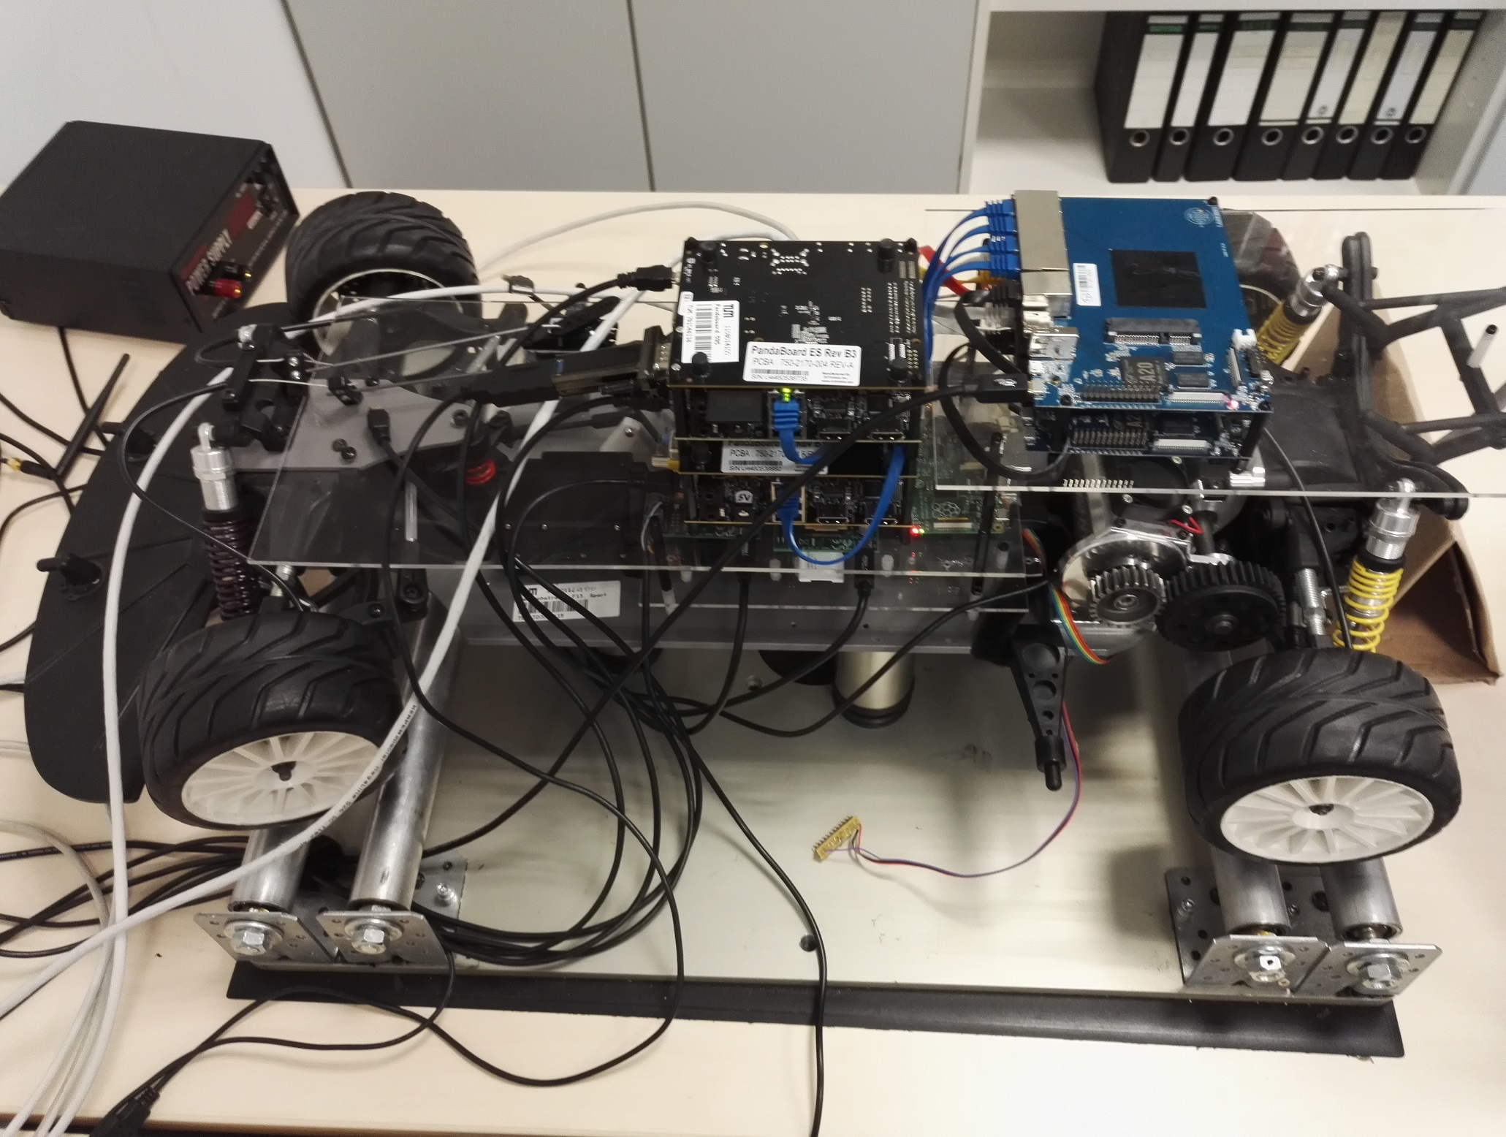
Description of the setup

Slide 5
1. Servos
Servos:
3 Braking Servos
1 Steering Servo
1 Engine
Tasks:
Control braking and steering servos
Control engine (optional)
✔

Slide 6
2. Servo Controller Board
Polulu Maestro Controller Board
12 channels
Controls servos via pwm signals
Serial protocol
Tasks:
Commissioning of the servo controller board
Connect servos to the controller board
Check functionality

Slide 7
3. Raspberry Pi
Tasks:
Install Genode with Fiasco.OC
Develop ProtoBuf by Google
Develop MQTT client
Connection with servo controller board
Implement Genode Servo controller application
Convert control commands into concrete servo values
Read sensor values (optional)

Slide 8
4. PandaBoard
Tasks:
Install Genode with Fiasco.OC
Develop MQTT client
Generate control commands

Slide 9
MQTT
Simulation → PandaBoard
topic: car-control
format: (command,value)
Command | Value Range | Meaning
0 | [ -1.0 ; 1.0 ] | Steering
1 | [ 0 ; 1.0 ] | Brake
2 | [ 0 ; 1.0 ] | Acceleration

Slide 10
MQTT
PandaBoard → RaspberryPi
topic: car-servo
format: (channel,value)
Channel:
0,1,2: Braking servos
6: Steering Servo
Values:
4500 – 7500
6000: neutral

Slide 11
PandaBoard
Genode Tasks:
Main component
Controller component
Main component:
setup network
subscribe to car-control mqtt topic
receive mqtt messages
call controller
publish message to car-servo mqtt topic
Controller component:
transforms control commands into concrete servo values

Slide 12
PandaBoard – Code Snippets

Slide 13
Raspberry Pi
Genode Tasks:
Main component
Servo component
Main component:
setup network
subscribe to car-servo mqtt topic
receive mqtt messages
call servo
Servo component:
sends command to servo controller board

Slide 14
Raspberry Pi – Code Snippets

Slide 15
Problems & Difficulties

Slide 16
Demo Video

