Slide 1
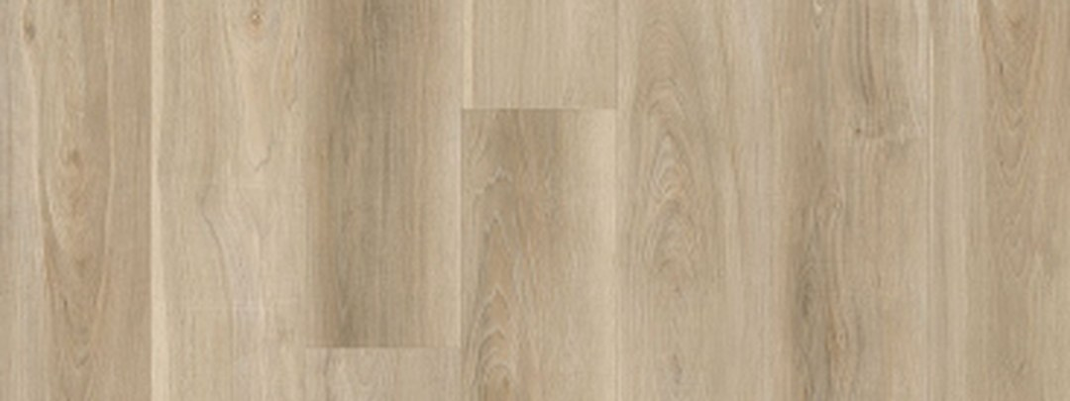

Clearance Prices,
While They Last
Cash and carry. When it is gone, it is gone.
Aqua Genius Rosario
$2.29/sq. ft.
Copper Summit 12x24
$1.99/sq. ft.
Verraterra Ash
$2.79/sq. ft.
Get in before it sells out
Nufloors Langley Outlet | Langley, BC | Ends 2026-09-30

