Slide 1
ReFund Intel
A data-driven tool to enable impactful social security support
4nN
Notes:
Social security matters.
The social security
The public sector is working on a thigh budget, this does also hold true for the City of St. Gallen. Nevertheless, they carry out tasks with deep impact on our society. One of those are social security. When everything goes wrong on the life of someone. The When everything goes wrong, the government is here to
Because of that,

Slide 2
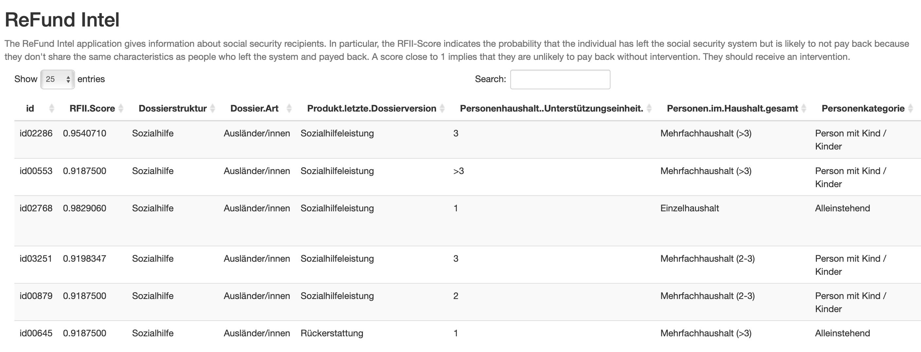
The Application
R-Shiny Web Application
Recommends targets for intervention
RFII-Score as a probability of unwillingness to pay back
4nN
Notes:
The goal in step two is to make the model accessible to social work professional who do not have an extensive background in statistics and programming. We are working on an R Shiny web application. With that application, the social workers can insert the characteristics of the concerned person and get an estimate on how likely they should be able to pay back the loan in comparison to social security recipients with similar characteristics. While this application cannot replace an individualised assessment of the situation by the social worker, it can serve as a data driven tool to support their evaluation.

Slide 3
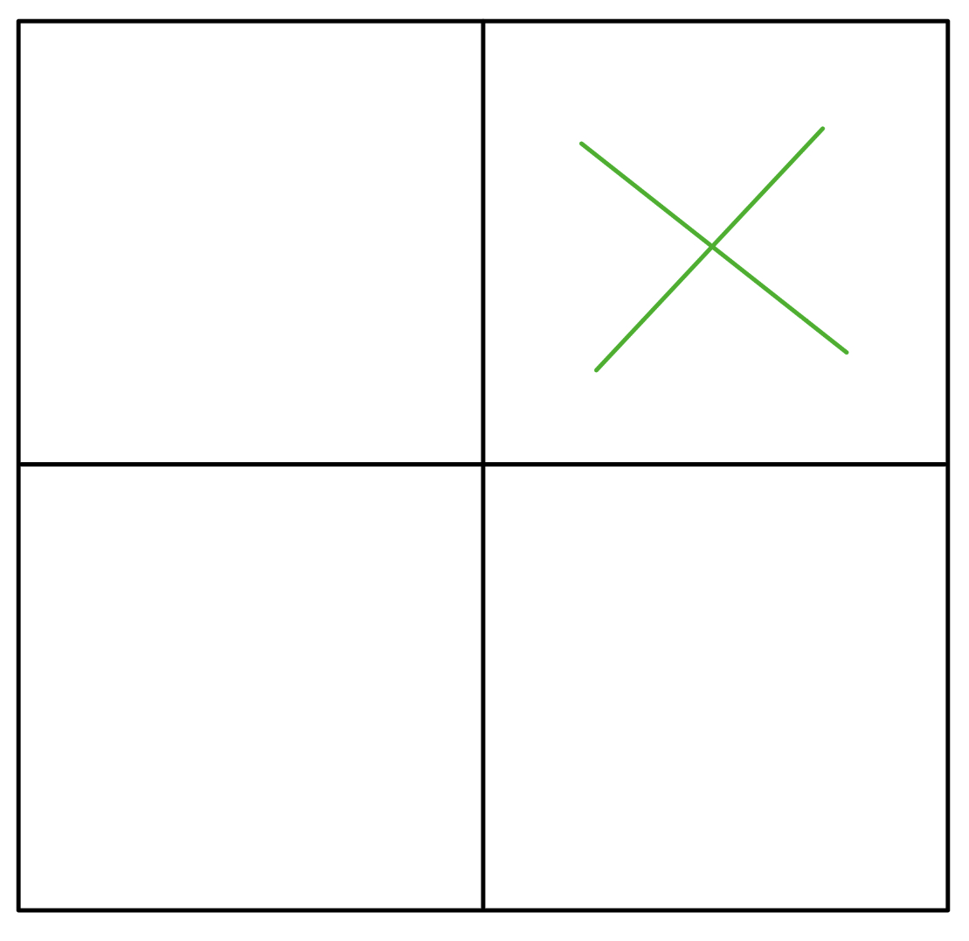
The Model
What do the people have in common who are able but not willing to pay back?
Can we find these people based on that similarities?
Willing
Not Willing
Able
Not Able
4nN
References:
Murphy, K. P. (2012). Machine learning: a probabilistic perspective. Cambridge, MA: MIT Press.
Hastie, T., Tibshirani, R.,, Friedman, J. (2001). The Elements of Statistical Learning. New York, NY, USA: Springer New York Inc..
Chang, W., Cheng, J., Allaire, J., Xie, Y., & McPherson, J. (2017). Shiny: web application framework for R. R package version, 1(5), 2017.
Notes:
We are working on a model to estimate the influence of the observed variables in the dataset on the repayment probability. The goal is to figure out what the people who pay back their loans have in come and look for these characteristics in the group of people who don’t pay back. We consider people who have the same characteristics but do not pay back as potential candidate for an intervention.
We’re working on estimates using logistic regressions and tree-based modelling. Comparing the outcomes of these two methods we’ll optimized the model to deliver the best accuracy possible. The model should tell how likely a person is going to pay back according to the variables we have in the data set.

Slide 4
The Intervention
Machine learning enabled communication strategy during consultations
Fundraising techniques as applied by NGOs
Harnessing group dynamics and gamification
4nN
Notes:
In order to increase the number of repayments, we suggest concentrating public resources on the individuals most likely to repay according to our model. This includes but is not limited to the following approaches:
Social workers should implement a proactive communication strategy during the meetings with the social security recipients. Using the information from the model, the topic of repayment should be brought up on a regular occasion and be given serious consideration.
Secondly, additional pressure could potentially be applied by using techniques used by NGOs for fundraising. This could include notifications or some sort of community building
Finally, allowing social workers to get access to the financial situation of the social security recipients could improve the repayment ration to a great extent, giving them facts which they could use in the discussion.

Slide 5





Thank you & give it a try!
Selcuk Taskin
Shangen Li
4nN
Jasmin Bürkler
Flurin Jacomet

