Slide 1


name
en_valueofproject

Slide 2
Problem
pic_description
en_problem

Slide 3
Description
pic_description
en_description

Slide 4
Solving
en_problemsolving

Slide 5
Market volume
TAM
tam
SAM
sam
SOM
som

Slide 6
Competitors
en_1opponent
en_2opponent
en_3opponent
en_totalopponents

Slide 7
Business model
en_businessmodeltxt

Slide 8
Pricing
en_businessmodeltxt

Slide 9
Traction and finance
Revenue:
revenue
Planned revenue on 2024:
futurerevenue
Cac:
cac
LTV:
ltv
en_businessmodeldescription

Slide 10
Investment
size
Using of investors money
en_sizetxt
en_usingtxt

Slide 11
roadmap
en_roadmaptxt

Slide 12
Contacts
en_contacts

Slide 13


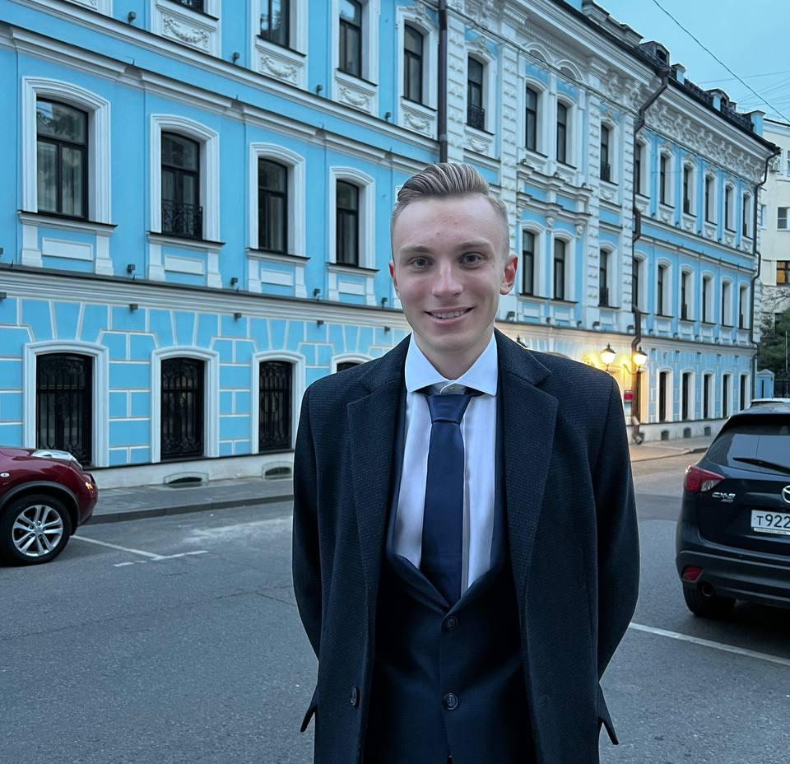

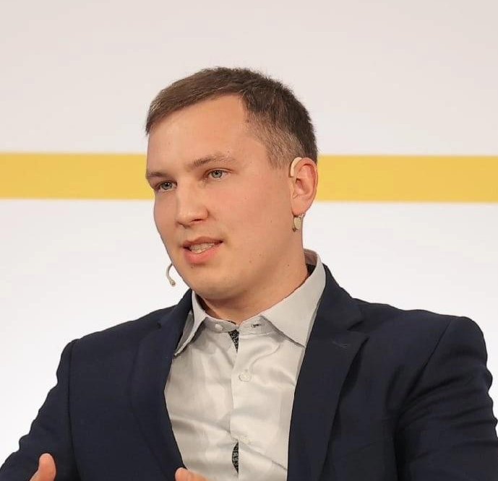

Our team
Фронт
Сергей
Дизайн
Артем
Backend
Дмитрий
Analyst
Михаил
backend
Григорий

