Slide 1

CAS Applied Data Science - Module 2
Statistical Inference for Data Science
PD Dr. Sigve Haug
Bern, 2018-08-27

Slide 2
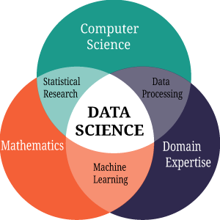
Mathematics / Statistics in Data Science
Data Science
Uses
Mathematics and Statistics
Computer Science
Domain expertise
on data to build information and extract knowledge (for decisions and actions)
Very general skills increasingly needed in all empirical research and business

Slide 3
Module 2
Overview
First day
Probability
Probability density functions, uncertainties
Descriptive statistics
Second day
Significance and p-values
Estimators and estimation paradigms
Third day
Hypothesis testing
Fourth day
Classification and clustering
Project
Poster session 2018-09-14

Slide 4
Teaching method
Inverted classroom based
Introduction lectures
Real content you learn yourself with the notebooks
Discussion sessions based on your questions and comments
Project : Poster with poster presentation
Why
Supposed to be better
More fun
Learning by doing

Slide 5
Module 2
First day
09:00 Introduction
Statistical inference
10:30 Break
11:00 Introduction
Probability
Descriptive statistics
12:30 Lunch
13:30 Self studies with notebook
17:00 End

Slide 6
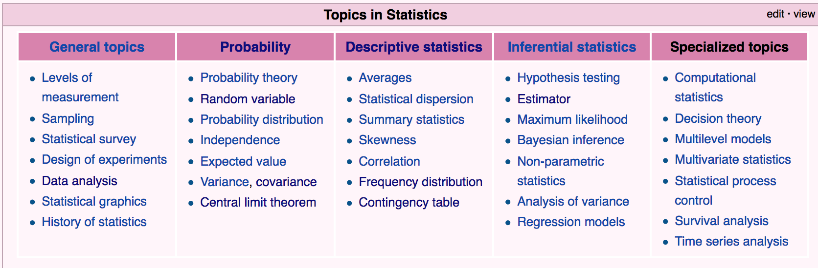
Descriptive statistics
Situation
We have data
We have a model describing the data (pdf or pmf)
The model has parameters
We want to estimate the parameters from the data

Slide 7
Describing Data
Why
Learn about the distributions
Features, patterns
Outliers, quality etc
No inference can be better than what the data gives
Create trust
Many possibilities
Listing it all
Words
Mathematics (statistics)
Tables
Graphs (visualisation)
Animations etc ...

Slide 8
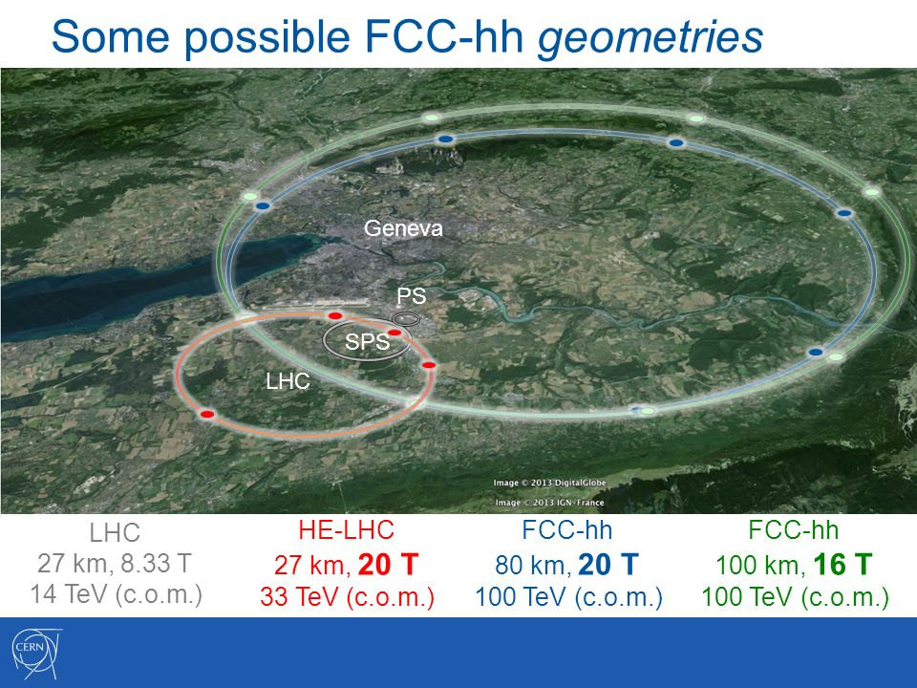
Good description is the basis for good inference
...
Descriptive statistics helps choosing a good model (with p.d.f.)
The model can then be used for inference
Interpolation
Extrapolation
Hypothesis testing
Discoveries and exclusions
Basis for good decisions
Do you want to build this ?

Slide 9
Descriptive statistics
Planning
Requirements
Some definition
Descriptive statistics are used to describe the basic features of the data in a study. They provide simple summaries about the sample and the measures. Together with simple graphics analysis, they form the basis of virtually every quantitative analysis of data.
D
A
T
A
A
N
A
L
Y
S
I
S
Data Collection
Preprocessing
Descriptive
Statistics
Classification, Discrimination, Clustering
Inferential
Statistics
(regression, tests)

Slide 10
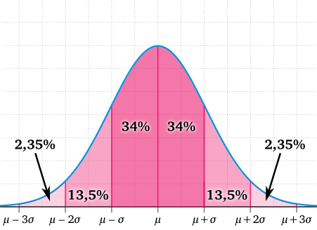
Descriptive statistics
Central topics
(Probability)
Random variables
Models: Probability density functions (continuous) or probability mass functions (discrete)
Moments (center, shape, dispersion)
Summary tables and graphs (visualisation)
Dependence
Normal distribution (symmetric shape, no skew)
μ mean (here also mode and median) of the random variable (center)
σ standard deviation (dispersion)

Slide 11



Probability interpretations
Objectivists
Relative frequency
Frequentist
Frequentist statistics
Subjectivists
Degree of belief
Bayesian
Bayesian statistics

Slide 12
Random variables
Why is it random?
Based on a sample, not the full population
Limited resolution
Quantum mechanics
Example
Amount of CHF on Swiss bank accounts
Sample by checking 1000 accounts
Get a (normal?) distribution
A new sample will not yield exactly the same distribution (statistical uncertainty)

Slide 13
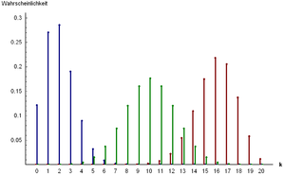
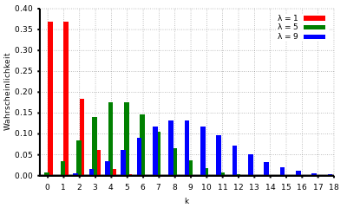
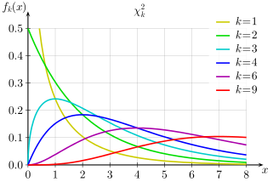
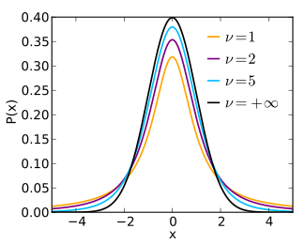
Probability mass/density distributions - examples

Slide 14


Moments
First moments
1. Moment: Mean
2. Moment: Variance σ**2
Standard deviation σ
(Skew)
(Kurtosis)
The moments are used to describe the data.

Slide 15
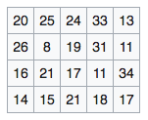
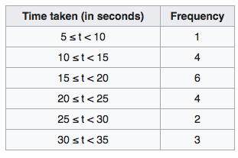
Summary tables
Grouped data
Frequency of data in defined bins/ groups
The graph to the table would be a histogram

Slide 16
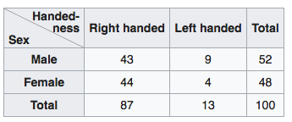
Summary tables
Contingency tables
Frequency of multivariate data in a matrix format
Here two random variables (sex and handedness)
The graph to the table would be a scatter plot

Slide 17


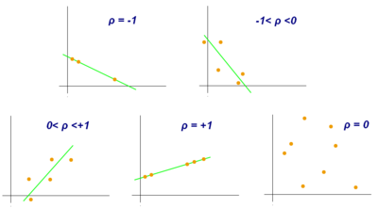
Dependence
Covariance matrix
Two random variables with covariance = 0 are said to be uncorrelated
Two random variables with positive covariance are said to be correlated (negativ is anti-correlated)
If the variables are the same, we get the variance
The normalised covariance is the correlation

Slide 18
Good practices
What statistics to show
Study as much of the descriptive statistics as possible on your own
Prepare a few tables and plots for others (for most interesting findings or creating trust)

Slide 19
Demonstration
Open today’s notebook and
Exercise 0
10:30 Break
11:00 Likelihoods
17:0

Slide 20
CAS Applied Data Science - Module 2
Thanks !
Bern, 2018-08-27

