Slide 1

Pitch
Matthias Lüft
Andrea Semrau
Mohammed Sameeyuddeen
PLAIN Text-to-Prototype

Slide 2
Problem
Cumulocity is powerful - but every piece of custom logic still needs a developer.
Custom logic = a dev project
Those who know can’t build
AI agents have no hands
Every KPI, rule or data transform means writing, testing and deploying a microservice. Days, not minutes.
Operators, analysts and domain experts know exactly what they need — then file a ticket and wait.
Agents can reason over IoT data, but every action they take must first be hand-built as a tool.
The result: a backlog of small, high-value functions that never get built.

Slide 3
Solution
Text-to-Edge-Function: describe what you want in plain English - get a live function.
1
Describe
Type what you want. No code, no schema.
Why it works
Self-healing - the agent reads dry-run errors and repairs the code by itself.
Secure by design - sandboxed, no network, allowlisted paths, the caller’s own permissions.
Anyone can build - domain experts ship logic without waiting on developers.
2
Author
The c8y-fn-author agent (Claude Sonnet) writes the function.
3
Validate
It is dry-run in a secure sandbox; the agent fixes its own errors.
4
Deploy
Stored instantly as a callable URL and a reusable MCP tool.

Slide 4
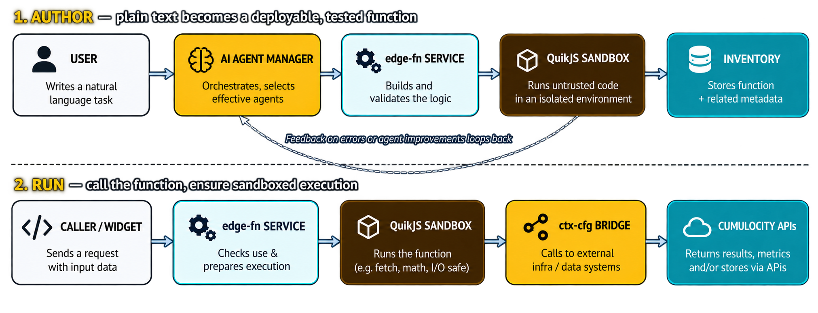
architecture
One microservice: an AI agent authors functions, deploys them through an MCP tool; a QuickJS sandbox runs them with the caller’s own Cumulocity permissions.

Slide 5
Live demo

Slide 6
Questions?

