Slide 1
Collections Wrapper
Chandrakant Singh

Slide 2
Agenda
Overview
Structure
Functionality
Future considerations

Slide 3
Overview
The performance problems we have at hand can be solved through horizontal scaling.
Making the application horizontally scalable would also address scalability issues that might appear in the future due to large volumes of input data.
The collections wrapper is a set of web services and modules that wrap around the collections application making it distributed.

Slide 4
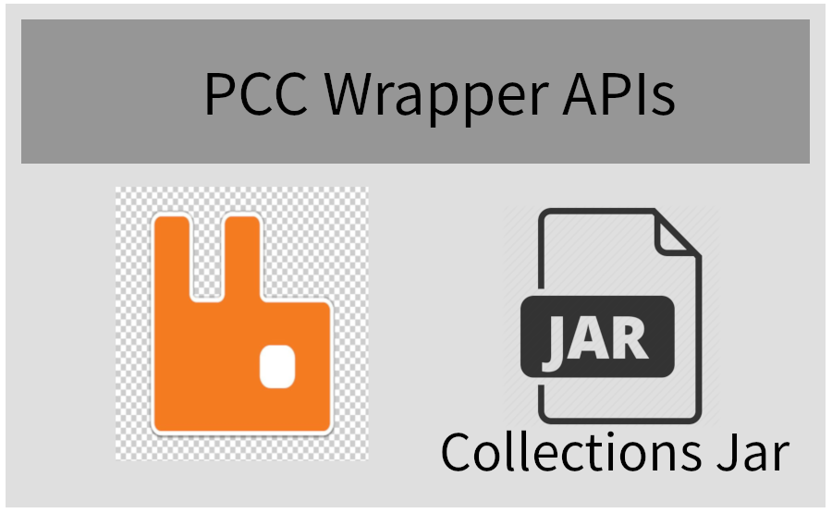
Structure
The collections wrapper consists of two parts:
The REST APIs that provide an interface to the collections application
Rabbit MQ for asynchronous execution capabilities
The bundle of the REST APIs, Rabbit MQ and the collections application jar is a single deployable unit.
To manager larger work loads, multiple AWS instances can be started and the above mentioned bundle deployed in each one of these instances.

Slide 5
The Wrapper APIs
Two APIs are exposed by the Collections Wrapper:
Run Process API – This API starts of a process. The API accepts the name of the process and command line arguments as parameters. These are same as the name and arguments we are currently passing to the application.
Get Logs API – This API retrieves the logs that are produces while the process(Process Interface, Segmentation etc.) is running.
The Run Process API pushes the execute request to a queue and returns immediately
The Get logs API is polled to fetch the latest lines logged by the application

Slide 6
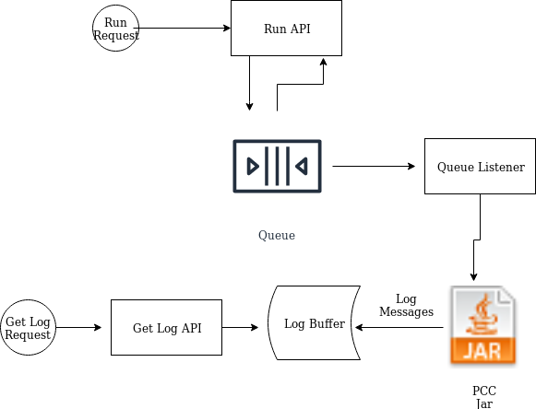
Functionality
A request to run a process is received by the REST API.
The request alongwith parameters is pushed to Rabbit MQ.
The API returns
A Listener picks the execution request from queue and runs the process
Logs are buffered in a Log Buffer.
As and when the get logs API is called, the current logs are returned and the logs are cleared. This happens till the application terminates.

Slide 7
The Client
The client is a simple app that has a list of nodes on which wrappers are running.
When the client is run and the name of process and command line arguments are provided to it, it makes parallel calls the execute API on all the nodes that are present in its configuration
The client also sets up as many threads as there are nodes to fetch logs from the nodes and display them on the console.
The client accepts the same set of parameters that we currently pass to the executable jar so there would be no change in the execution process.

Slide 8
Considerations
The wrapper does not necessarily solve the performance/scaling issue. It complements the same.
Alongwith the wrapper, we need to have input data divided into segments and passed onto the individual nodes.
In order to tackle database throttling due to parallel requests, the database needs to be sharded.
Execution of collections for batch processing is one of the several ways in which collections can be executed. This proposed solution solves only this problem. In case other workflows like REST/SOAP or legacy UI also suffer from performance issues, this solution would not be covering them.

Slide 9
Thank you

