Slide 1
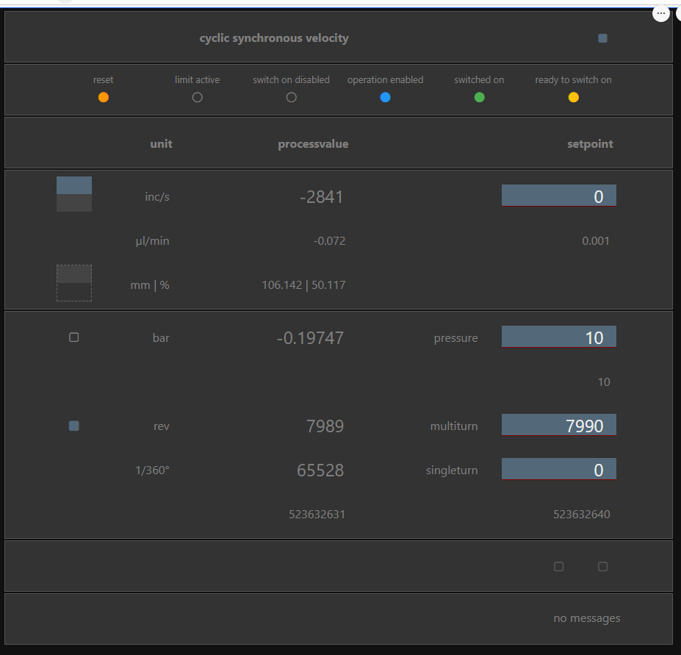
drive mode
drive state machine
direction indicator
Velocity setpoint
volume indicator
enable pressure pid
pressure setpoint
enable position pid
position setpoint
stroke valve switch

