Slide 1
Introduction to
Assertion Based Verification with PSL
(VHDL flavor)
Bert Molenkamp
Jan Kuper

Slide 2
Implementation Coverage
Line coverage: is this line executed during simulation?
Toggle Coverage: is this bit changed from 0 to 1 and 1 to 0?
Combinational Coverage: are all possible combinations of an expression simulated?
FSM coverage: are all states reached and did it traverse all possible paths?
Notes:
2.2 Toggle CoverageToggle coverage answers the question, "Did this bit of this wire/register change from a value of zero (0) to one (1) and back from one (1) to zero (0) during simulation?"A bit is said to be fully covered when it toggles back and forth at least once. This metric does not indicate to the user that every value of a multi-bit vector was seen. For example, if we have a two bit vector called "foo", toggle coverage will not tell you that the value of foo was set to the values of 0, 1, 2 and 3. However, it will tell you that all bits in that vector were toggled back and forth.2.2.1 ExampleExampleSuppose that a DUT was comprised of the following modulemodule test;
reg [2:0] a;
initial
begin
a = 3'b0;
#10;
a = 3'b110;
#10;
a = 3'b010;
#10;
end
endmoduleThe register called "a", after being simulated, would have achieved a total toggle percentage of 50% (or 3 out of 6). Can you see which toggles are missing?Bit 0 has never toggled to 1 (and has never been at a value of 1 and toggled to 0); therefore, bit-0 has toggled 0% (0 out of 2). Bit 1 has toggled from a value of 0 to 1, but has not toggled from a value of 1 to 0; therefore, bit-1 has toggled 50% (0 out of 2). Bit 2 is the only bit that has fully toggled, achieving a toggle percentage of 100% (2 out of 2). If you add all of the possible toggles to the number of achieved toggles, you end up with 3 out of 6 (or 50% total toggle coverage).2.2.2 RecommendationsRecommendationsFor a design to pass full coverage, it is recommended that the toggle coverage for all modules in a design received 100% coverage. If a bit is never changes value, it is usually an indication that a mode is not being exercised in the design or a datapath has a stuck-at issue.
++++
2.3 Combinational CoverageCombinational logic coverage answers the question, "What values did an expression (or subexpression) evaluate to (or not evaluate to) during the course of the simulation?"This type of coverage is extremely useful in determining logical combinations of signals that were not tried during simulation, exposing potential holes in verification.2.3.1 ExampleExampleSuppose the DUT comprised of the following modulemodule test;
reg a;
reg b;
wire c;
initial
begin
a = 1'b0;
b = 1'b1;
#10;
a = 1'b1;
#10;
end
assign c = a | b;
endmoduleThis module comprises of only one expression: a | b. If this module were simulated it would result in a combinational coverage value of 50% (2 out of 4). Can you determine which cases are not being covered?The expression "a | b" can result in two values, 0 and 1, but can do so in four combinations:
a = 0, b = 0, c = 0
a = 0, b = 1, c = 1
a = 1, b = 0, c = 1
a = 1, b = 1, c = 1
Noticing the values assigned to a and b during simulation, shows that combinations (2) and (4) were hit during execution while combinations (1) and (3) were not (2 out of 4 - 50%). This also shows us that the value of c was never 0 during simulation.2.3.2 RecommendationsRecommendationsFor a design to pass full coverage, it is recommended that the combinational logic coverage for all modules be 80% or higher. If the expression coverage for an expression is not 100%, it is recommended that the verification engineer closely examine these missed cases to determine if more testing is required. Sometimes certain combinations of signals are unachievable due to design constraints, keeping the expression coverage from ever reaching a value of 100% but still can be considered fully covered.
++++++++++
2.4 Finite State Machine (FSM) CoverageFinite state machine (FSM) coverage answers the question, "Did I reach all of the states and traverse all possible paths through a given state machine?"There are two types of coverage detail for FSMs that Covered can handle:
State coverage - answers the question "Were all states of an FSM hit during simulation?"
State transition coverage - answers the question "Did the FSM transition between all states (that are achievable) in simulation?"
2.4.1 ExampleExampleSuppose the DUT comprised of the following finite state machine.module test( clock );
input clock;
reg [1:0] state;
reg req, gnt;
parameter IDLE 2'b00;
parameter REQ 2'b01;
parameter WAIT 2'b10;
parameter GNT 2'b11;
initial
begin
req = 1'b0;
gnt = 1'b0;
repeat(4) @(posedge clock);
req <= 1'b1;
@(posedge clock);
req <= 1'b0;
gnt <= 1'b1;
@(posedge clock);
gnt <= 1'b0;
repeat(2) @(posedge clock);
end
always @(posedge clock)
case( state )
IDLE : state <= req ? REQ : IDLE;
REQ : state <= gnt ? GNT : WAIT;
WAIT : state <= gnt ? GNT : WAIT;
GNT : state <= IDLE;
default : state <= 2'bx;
endcase
endmodule To help visualize this state machine, let's also display it as a digraph.
This state machine has four states: IDLE, REQ, WAIT, GNT. During simulation, 75% of the states were hit (3 out of 4) including IDLE, REQ and GNT. You can see that the WAIT state was never hit during simulation since the gnt signal was asserted the clock period after the req signal asserted.
Additionally, this state machine contains 7 state "arcs" which are represented in the digraph as arrowed lines. They are the following:
IDLE -> IDLE (HIT)
IDLE -> REQ (HIT)
REQ -> WAIT (MISSED)
REQ -> GNT (HIT)
WAIT -> WAIT (MISSED)
WAIT -> GNT (MISSED)
GNT -> IDLE (HIT)
Counting the number of traversed arcs during simulation, we can see that we have covered 4 out of 7 (or 57%) of the possible arcs in this state machine.
2.4.2 Recommendations
Recommendations
For a design to pass full coverage, it is recommended that the FSM coverage for all finite state machines in the design to receive 100% coverage for the state coverage and 100% for all achievable state transitions. Since Covered will not determine which state transitions are achievable, it is up to the verification engineer to examine the executed state transitions to determine if 100% of possible transitions occurred.

Slide 3
Why functional verification?
implementation coverage: does not cover the functional intent.
Survey of Collett International (2000): 74% of all re-spins are caused due to a functional error.
Assertion Based Verification
  Assertions capture the designers intent
  Can specify legal and illegal behavior
  During simulation assertions are verified
➔ PSL (Property Specification Language)

Slide 4
Assertion
An assertion is a statement about the behavior intended by the designer; can be true or false
VHDL already supports assertions.
  assert (a>=b) report “message” severity note;
  Use of VHDL assertions becomes complex in case of behavior over time.

Slide 5

communication
Requirement:
ack between 2 and 4
clock cycles after req
req
M
S
ack
How can this timing constraint be verified?
ARCHITECTURE ….
…
BEGIN
verify_protocol(req,ack,clk,2,4);
…
Concurrent procedure call

Slide 6
PROCEDURE verify_protocol (SIGNAL req, ack, clk : IN std_logic; min, max : IN natural) IS
VARIABLE nmb : natural;
BEGIN
ASSERT max >= min REPORT "max is lower than min";
LOOP
WAIT UNTIL rising_edge(clk);
nmb := 0;
IF req='1' THEN
WHILE nmb <= max-1 LOOP
nmb := nmb+1;
EXIT WHEN ack='1';
WAIT UNTIL rising_edge(clk);
END LOOP;
IF (nmb <= min) THEN REPORT "ack too early";
ELSIF (nmb = max) AND (ack='0') THEN REPORT "ack too late";
ELSE REPORT "passed";
END IF;
END IF;
END LOOP;
END verify_protocol;
Notes:
vhdl_psl.vhd

Slide 7
communication
Requirement:
ack between 2 and 4
clock cycles after req
req
M
S
ack
How can this timing constraint be verified?
ARCHITECTURE ….
…
BEGIN
-- PSL assert
always (req -> next_e [2 to 4] (ack))
…
PSL statement

Slide 8
Logic
Proposition logic
not, and, or, implies, iff
Predicate logic
forall, exists, variables
Temporal logic
Next, Always, Never, Until, …

Slide 9
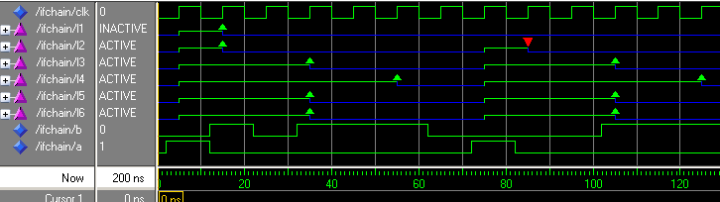
Next operator
-- PSL default clock is rising_edge(clk);
-- PSL l1: assert ( a -> next b);
-- PSL l2: assert always ( a -> next b);
-- PSL l3: assert always ( a -> next[3] (b) );
-- PSL l4: assert always ( a -> next_a[3 to 5] (b) );
-- PSL l5: assert always ( a -> next_e[3 to 5] (b) );
-- PSL l6: assert always ( a -> next_e![3 to 5] (b) );
L1: only at cycle 0; if a then next b
L2: if a then next b
L3: if a then 3 cycles later b
L4: next_all. b true in cycles 3 until 5
L5: next_exists. There exists at least one b in cycles 3 to 5
Notes:
Example1b.vhd

Slide 10
More variations of next
a -> next_event(b) (c)
a -> next_event(b)[n] (c)
a -> next_event_a(b)[i to j] (c)
a -> next_event_e(b)[i to j] (c)

Slide 11
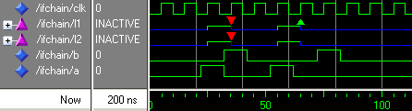
Always/Never
-- PSL l1: assert always ( a -> next (not b) );
-- PSL l2: assert never ( a and (next b) ) ;

Slide 12
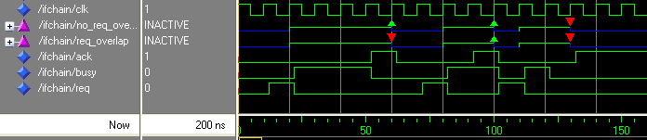
until and until_
-- psl no_req_overlap: assert always ( req -> next ( busy until ack ) );
-- psl req_overlap: assert always ( req -> next ( busy until_ ack ) );
If req then busy should be true until ack is true.
The until_ requires an overlap between the last busy and ack.
Note: also a strong version is possible (until!)
Notes:
Example5.vhd/sim.do

Slide 13
eventually!
-- psl property protocol is
-- always ( req -> eventually! ack )
-- psl protocol _lbl: assert protocol;
Eventually!
The request must always be honored with an acknowledge.
But .. two requests can share the same acknowledge!
  How to prevent two consecutive requests?

Slide 14
before
-- psl property ack_follows_req is
-- always ( req -> next (ack before req) )
-- psl ack_follows_req _lbl: assert ack_follows_req;
How to prevent two consecutive requests?
  before
  This requires that after a request first an acknowledge should occur before a new request is applied.
If the simulation is finished this assertion will not respond that a request is still waiting for an acknowledge.

Slide 15
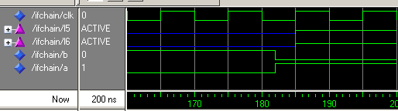
Weak and Strong!
-- PSL l5: assert always ( a -> next_e[3 to 5] (b) );
-- PSL l6: assert always ( a -> next_e![3 to 5] (b) );
A simulation is time constrained
Do the properties l5 and l6 hold when simulation finishes at 200 ns?
A strong operator (!) requires that if the enabling condition is true then the fulfilling condition should occur before the end of the simulation
Many operators have a weak and strong version
Notes:
Example1b.vhd

Slide 16
Weak and strong!
next – next!
until – until!
before – before!
eventually! only strong
always, never: only weak

Slide 17
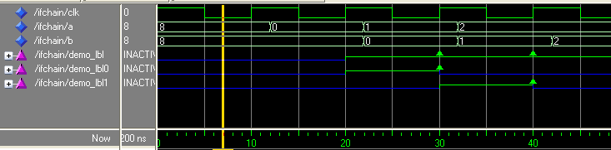
forall
Check values? Can be simplified with forall.
-- psl demo_lbl0: assert always ( (a=0 -> eventually! b=0));
-- psl demo_lbl1: assert always ( (a=1 -> eventually! b=1));
Is equivalent with:
-- psl demo_lbl: assert forall i IN {0 TO 1} : always ( (a=i -> eventually! b=i));

Slide 18
SEREs
A sugared building block of PSL is a SERE (Sequential Extended Regular Expression). A SERE describes a set of sequences of states
A sequence of states, in which req is high on the first cycle, busy on the second, and gnt on the third.
  {req; busy; gnt}
Notes:
Set of sequences of states. One SERE can define multiple sequences .. ..;busy[*];

Slide 19





SEREs - Examples
signal holds 4 times

Slide 20
SEREs - Example
{req; busy[*3 to 5]; gnt}
signal busy holds any number of times between 3 to 5
req;busy;busy;busy;gnt
req;busy;busy;busy;busy;gnt
req;busy;busy;busy;busy;busy;gnt
{req; busy[*]; gnt}
req;gnt
req;busy;gnt
req;busy;busy;gnt
req;busy;busy;busy;gnt
req;busy;busy;busy;busy;gnt
….
Signal busy holds any number of times
Signal busy holds any number of times; but at least once
{req; busy[+]; gnt}

Slide 21
SEREs - Example
{req; busy[*3 to inf]; gnt}
Signal busy holds any number of times between 3 to infinite
{req; busy[=2]; gnt}
signal busy holds exactly twice before gnt (not necessarily consecutive)
req;busy;not busy;busy;gnt
req;busy;not busy;busy;not busy; gnt
req;busy;busy;gnt
….

Slide 22
SEREs - Example
{req; busy[=2]; gnt}
signal busy holds exactly twice before gnt (not necessarily consecutive)
req;busy;not busy;busy;gnt
req;busy;not busy;busy;not busy; gnt
req;busy;busy;gnt
….
{req; busy[->2]; gnt}
signal busy holds exactly twice before gnt (not necessarily consecutive) But gnt should occur immediately after the last occurrence of busy.
req;busy;not busy;busy;gnt
req;busy;busy;gnt
….
busy[->1] is equal to
busy[->]

Slide 23
SERE; boolean
  {req; busy; gnt}
The strong typing mechanism is relaxed:
  req, busy and gnt are booleans but also type bit, std_logic is allowed with
    ‘1’ is TRUE and ‘0’ is FALSE.
If req, busy and gnt are of type std_logic the previous SERE is equal to
{(req=‘1’); (busy=‘1’); (gnt=‘1’)}

Slide 24
suffix implication operators
-- SERE_A |=> SERE_B
-- SERE_A |-> SERE_B
if the path starting matches SERE_A
then its continuation should match SERE_B
|=> non-overlapping
|-> overlapping

Slide 25


Slide 28




PSL Sugar Properties – Example1
-- psl property name_of_property is
-- always ( {req;ack} |=> {start; busy[*]; end} )
-- @rising_edge(clk);
Note: clk is omitted
if
then

Slide 29
PSL Sugar Properties – Example1
if
then
if
then

Slide 30
PSL Sugar Properties – Example1
if
then
if
then

Slide 31
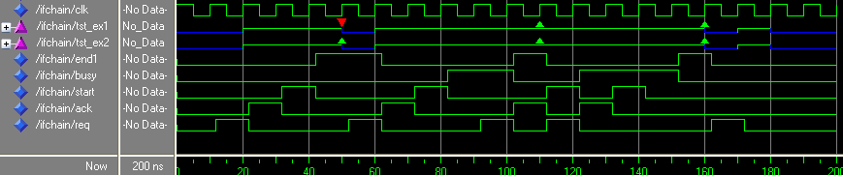
Example1
ARCHITECTURE …
BEGIN
-- psl property ex1 is
-- always ( {req;ack} |=> {start; busy[+]; end1} )
-- @rising_edge(clk);
-- psl tst_ex1: assert ex1;
-- psl property ex2 is
-- always ( {req;ack} |=> {start; busy[*]; end1} )
-- @rising_edge(clk);
-- psl tst_ex2: assert ex2;
Blue line indicates assertion is inactive.
Red triangle indicates that tst_ex1 fails (no busy signal). Green indicates a pass.
Note:
  the overlapping of {req;ack} start time 60 ns and 100 ns
  {req;ack} start time 100 ns and 120 ns have the same end1 (at 160 ns).
  Since the req (at 170 ns) is not followed with ack the starting SERE does not occur and the assertion is inactive.
Notes:
Example1.vhd/sim.do

Slide 32
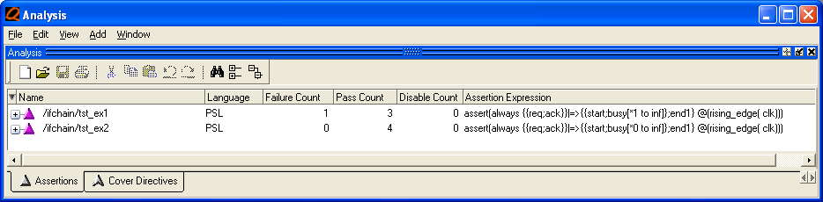
Also informative tables are generated
In this table the same end of {req;ack} start time 100 ns and 120 ns is counted.
Notice the translation of the assertion [*] is equal to [*0 to inf]

Slide 37
PSL Sugar Properties
SERE1 |-> SERE2
  If a sequence matches SERE1, then SERE2 should be matched, starting from the last element of the sequence matching SERE1
  So there is one cycle of overlap in the middle
SERE1 |=> SERE2
  If a sequence matches SERE1, then continuation SERE2 is
  So there is no overlap of SERE1 and SERE2
As a consequence:
SERE1 |=> SERE2 ≡
SERE1 |-> { true; SERE2} ≡
SERE1 |-> { [*1]; SERE2}

Slide 38
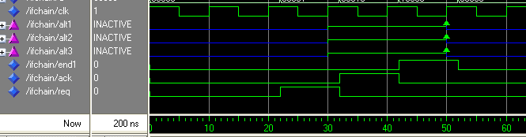
Example; |=>, |->
ARCHITECTURE …
BEGIN
-- PSL default clock is rising_edge(clk);
-- PSL alt1:assert always ( {req;ack} |=> {end1} );
-- PSL alt2:assert always ( {req;ack} |-> { [*1]; end1} );
-- PSL alt3:assert always ( {req;ack} |-> {true; end1} );
Default clock is possible
Assertions may be labeled.
Notes:
Example1a.vhd

Slide 39
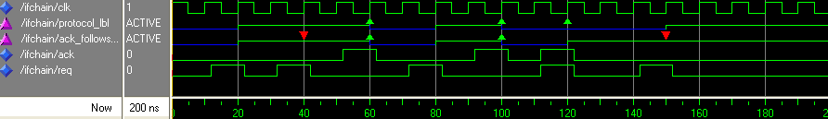
Assertions for a protocol
For communication the following protocol can be used. After a request the system has to wait for an acknowledge.
  Two consecutive request without an acknowledge is not allowed
  A request must always be served
Notes:
Example3.vhd/sim.do

Slide 40
PSL
-- psl property protocol is
-- always ( req -> eventually! ack )
-- @rising_edge(clk);
-- psl protocol _lbl: assert protocol;
Eventually!
The request must always be honored with an acknowledge.
But .. two requests can share the same acknowledge!
  How to prevent two consecutive requests?
What happens if a request is not honored with an acknowledge (at the end of the simulation run)?
  If the simulation is finished (QuestaSim: quit –sim) the simulator responds with:
quit -sim
# ** Error: Assertion failed
# Time: 200 ns Started: 150 ns Scope: /ifchain/ protocol_lbl File:
….Line: 23 Expr: ack

Slide 41
PSL, cont.
-- psl property ack_follows_req is
-- always ( req -> next (ack before req) )
-- @rising_edge(clk);
-- psl ack_follows_req _lbl: assert ack_follows_req;
How to prevent two consecutive requests?
  Before
  This requires that after a request first an acknowledge should occur before a new request is applied.
If the simulation is finished (QuestaSim: quit –sim) this assertion will not respond that a request is still waiting for an acknowledge. But this is taken care of with the assertion on the previous slide (eventually!)

Slide 42
Next operator
-- PSL default clock is rising_edge(clk);
-- PSL l1:assert ( a -> next b);
-- PSL l2:assert always ( a -> next b);
-- PSL l3:assert always ( a -> next[3] (b) );
-- PSL l4:assert always ( a -> next_a[3 to 5] (b) );
-- PSL l5:assert always ( a -> next_e[3 to 5] (b) );
-- PSL l6:assert always ( a -> next_e![3 to 5] (b) );
L1: only at cycle 0; if a then next b
L2: if a then next b
L3: if a then 3 cycles later b
L4: next_all. b true in cycles 3 until 5
L5: next_exists. There exists at least one b in cycles 3 to 5
Notes:
Example1b.vhd

Slide 43
Weak and Strong!
-- PSL l5:assert always ( a -> next_e[3 to 5] (b) );
-- PSL l6:assert always ( a -> next_e![3 to 5] (b) );
A simulation is time constraint
Do the properties l5 and l6 hold when simulation finishes at 200 ns?
A strong operator (!) requires that if the enabling condition is true there should the fulfilling condition should occur
Many operators have a weak and strong version
quit -sim
# ** Error: Assertion failed
# Time: 200 ns Started: 185 ns Scope: /ifchain/l6 File: ….. Line: 21
# ** Error: Assertion failed
# Time: 200 ns Started: 195 ns Scope: /ifchain/l6 File: ….. Line: 21
Notes:
Example1b.vhd

Slide 44
Always/Never
-- PSL default clock is rising_edge(clk);
-- PSL l1:assert always ( a -> next not(b) );
-- PSL l2:assert never {a; b} ;

Slide 45
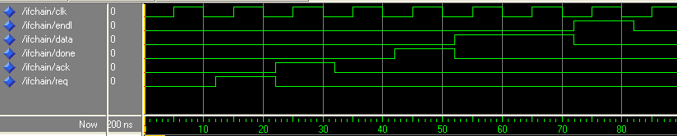
example
Assume the protocol for reading data is:
  Request for data (req)
  next cycle (ack), then after 1 but at most 4 clock cycles done followed with
  data (any number) finalized with
  endl
How would you write the assertion?
Notes:
Example1d.vhd

Slide 46
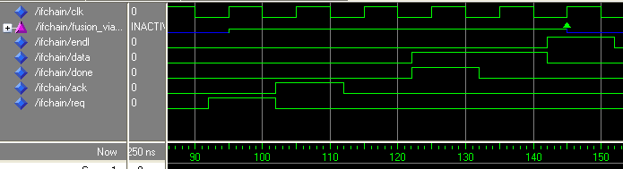
Easy …
-- PSL default clock is rising_edge(clk);
-- PSL sequence ack_seq is { ack;[*1 to 4]; done }; -- named sequence!!
-- PSL sequence data_transfer is { data[*]; endl };
-- PSL concatenation:assert always ( req |=> {{ack_seq}; {data_transfer}} ) ;
This protocol is improved: the first data is send at the same time as done.
How would you write the assertion?
Notes:
Example1d.vhd

Slide 47
Easy …
-- PSL default clock is rising_edge(clk);
-- PSL fusion_via_concat:assert always ( req |=> { {ack;[*1 to 4]};
-- (done AND data) ; {data[*];endl}} ) ;
Alternative: FUSION (:)
It is similar to concatenation but a single cycle overlap is required
(last element of first sequence and first element of second sequence)
-- PSL default clock is rising_edge(clk);
-- PSL sequence ack_seq is { ack;[*1 to 4]; done };
-- PSL sequence data_transfer is { data[*]; endl }; -- endl after last done
-- PSL fusion:assert always ( req |=> {{ack_seq}:{data_transfer}} ) ;
The protocol is improved again: endl is send at the the same as last data.
How would you write the assertion?
Notes:
Example1d.vhd

Slide 48

Fusion
-- PSL default clock is rising_edge(clk);
-- PSL sequence ack_seq is { ack;[*1 to 4]; done };
-- PSL sequence data_transfer_f is { data[*]: endl }; -- endl with last data
-- PSL optimal:assert always ( req |=> {{ack_seq}:{data_transfer_f}} ) ;
Notes:
Example1d.vhd

Slide 49
until and until_
-- psl no_req_overlap: assert always ( req -> next ( busy until ack ) );
-- psl req_overlap: assert always ( req -> next ( busy until_ ack ) );
If req then busy should be true until ack is true.
The until_ requires an overlap between the last busy and ack.
Note: also a strong version is possible (until!)
Notes:
Example5.vhd/sim.do

Slide 50
forall
Check values? Can be simplified with forall.
-- psl demo_lbl0: assert always ( (a=0 -> eventually! b=0));
-- psl demo_lbl1: assert always ( (a=1 -> eventually! b=1));
Is equivalent with:
-- psl demo_lbl: assert forall i IN {0 TO 1} : always ( (a=i -> eventually! b=i));

Slide 51
PSL embedded in VHDL
This was only a brief introduction to PSL.
Simulation tools do not yet support all of PSL.
Try to use it .. you can start with a simple assertion.

Slide 52
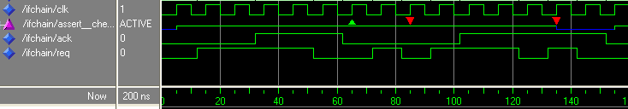
four-phase handshake
Write an assertion for the four-phase handshake protocol
Notes:
handshake.vhd/sim.do

Slide 53
A solution
ARCHITECTURE ..
BEGIN
-- PSL sequence request IS {not (req or ack); req};
-- PSL sequence start_s IS {req[*]; req AND ack};
-- PSL sequence middle_s IS {(req AND ack)[*]};
-- PSL sequence end_s IS {(not req)[*]; (not req) and (not ack)};
-- PSL property check_handshake is
-- always ({request} |=> {start_s; middle_s; end_s}) @rising_edge(clk);
-- PSL assert check_handshake;
But what if an ack occurs when there was not req at all?
-- psl property illegal_ack is
-- never { (not (req or ack));ack }
-- @rising_edge(clk);
-- psl assert illegal_ack;

Slide 54
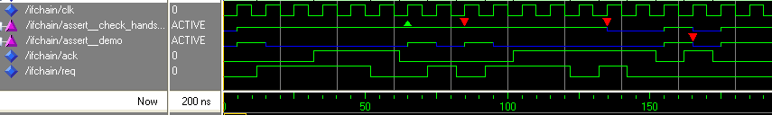

Slide 55
Next_event(_e _a)
Simple subset (ifchain22.vhd)
Ended (file28); not yet supported (new in std 1850-2005)
Async/sync not supported yet (2005)
forall

