Slide 1
Electric Schematic to simulinK
Cem Gülsan – Hamburg University of Technology
Thomas Frei – University of Applied Sciences Northwestern Switzerland
Christian Vecsei – RWTH Aachen
Andreas Boltres – Karlsruhe Institute of technology

Slide 2
Idea
Complicated electric circuits confuse unexperienced engineers
Circuit behavior unpredictable
SIMULINK allows to simulate this behavior
This is where Computer Vision comes is:
Analyze the schematic
Find objects and connections
Generate SIMSCAPE, a SIMULINK library, model

Slide 3
Steps
Image Preprocessing
Image Analysis
Output Generation

Slide 4
LTSpice Schmatics

Slide 5
Image Preprocessing

Slide 6
Image Analysis Algorithm
Optical character recognition (OCR)
Find and remove Text
Hough transform
Find scale
Object detection
Find, classify and remove electrical elements
Wire detection

Slide 7
Optical character detection (OCR)

Slide 8
Hough transforms

Slide 9
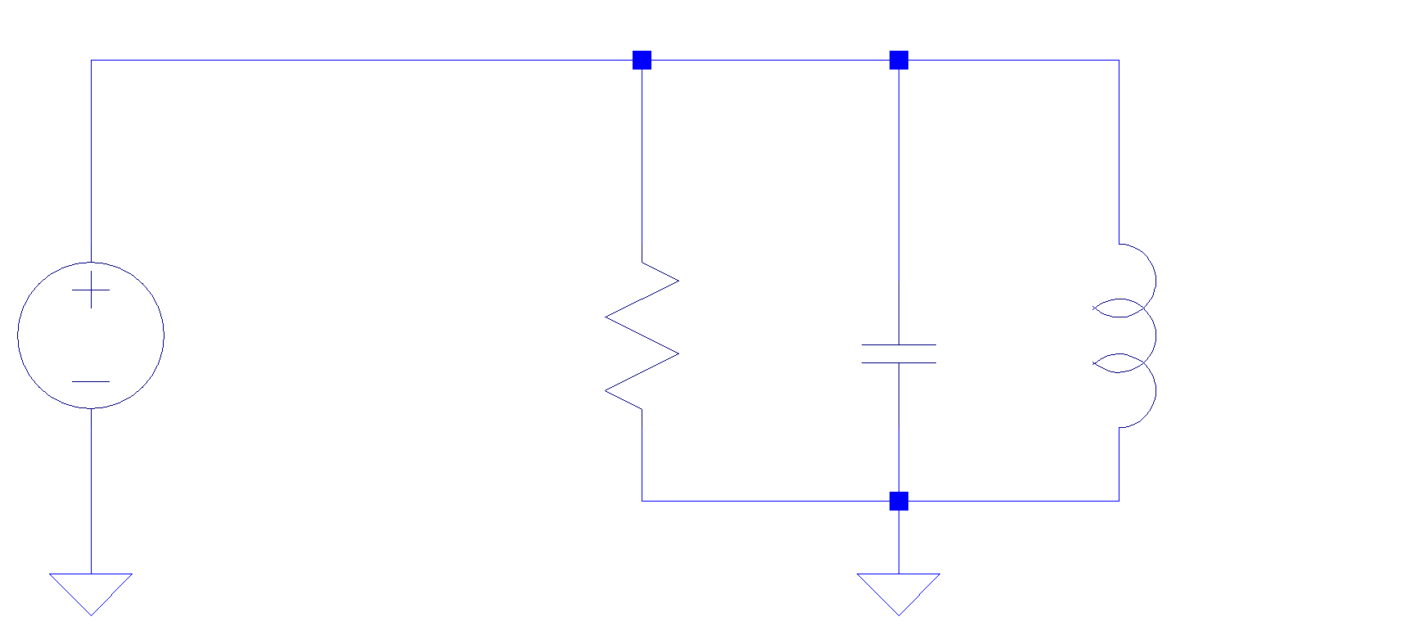
Object detection

Slide 10
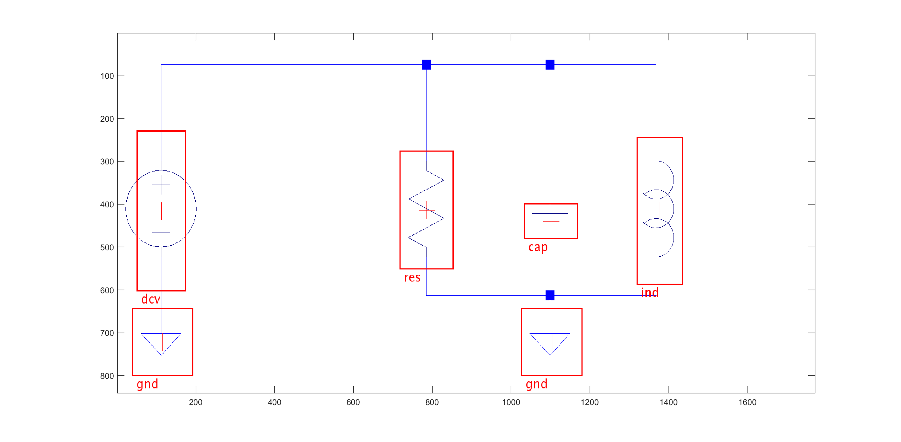
Object detection

Slide 11
Object detection
Problems
Scale
Rotation
Perspective
Uncertainty
Confusion
Problems
Scale
Rotation
Perspective
Uncertainty
Confusion

Slide 12
Wire detection

Slide 13
Output generation
Objects in the SIMSCAPE electrical component library have:
Coordinates
Size
Orientation
Ports
Specific parameters like Ohm, Henry or sinus wave with amplitude and frequency

Slide 14
Simscape model

Slide 15
Computer vision Concepts
Preprocessing
Rectifying
Object detection
Sliding window algorithm

