Slide 1
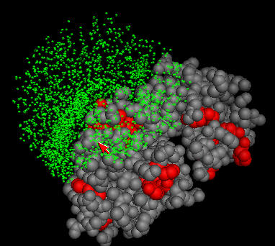
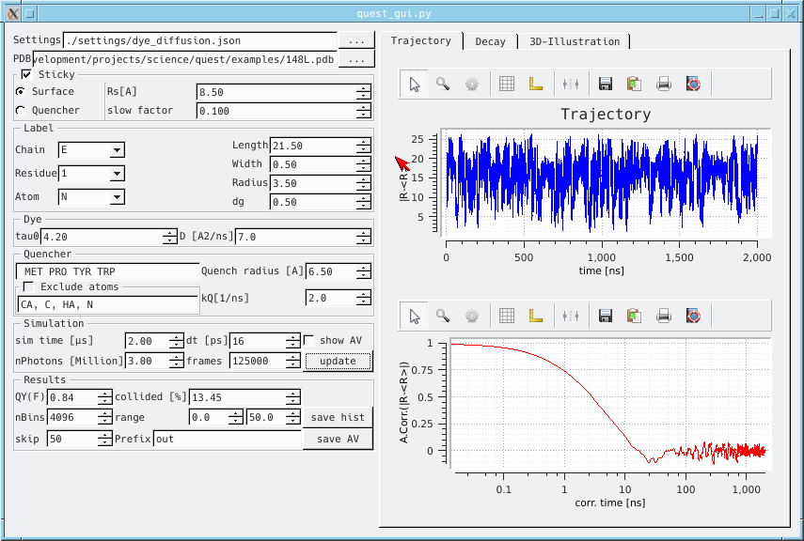
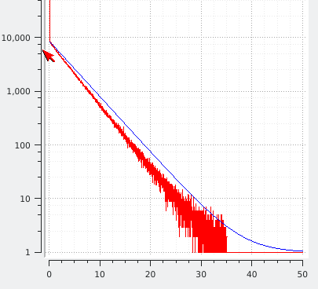
1. AV calculation
2. Diffusion simulation
3. Fluorescence decay
Red: Quenching amino acids
Distance from mean dye position
Autocorrelation of dye trajectory
Unquenched fluorescence decay
Decay of dynamically quenched dye

