Slide 1

Protein: ALAD 5- Amino Laevulinic Acid Dehydratase
BIO 392 Bioinformatics of Molecular Sequence Variations
Presentation by Lars & Sabrina

Slide 2
Overview
Protein Structure
Location (Genome, Cell)
Protein Function
Disease
Disease-Related Variants

Slide 3
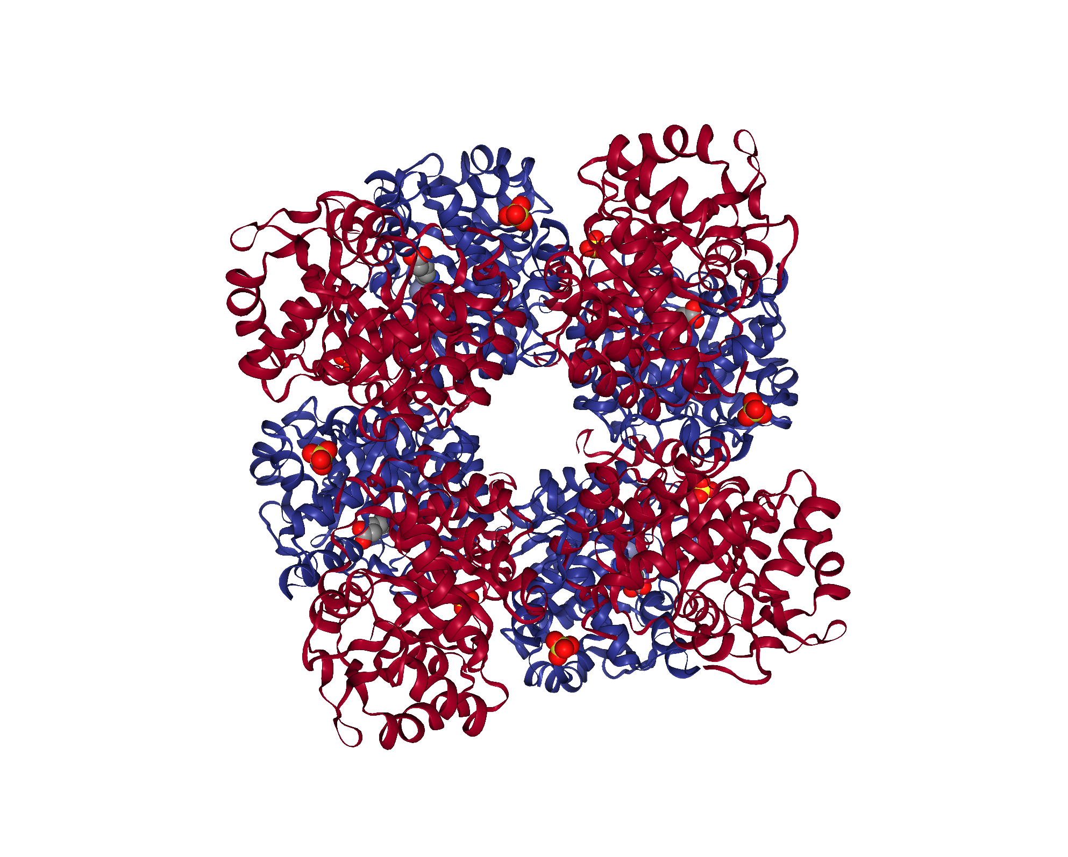
Protein Structure
Oligomeric, with 2 possible structures:
Homooctamer (A8)
Normal; active
Homohexamer (A6)
Pathogenic; mostly inactive
Uniprot ID: P13716
5HNR octamer (PDB structure)
■/■ Chains
■■ Zinc Ions
■■ Substrates

Slide 4
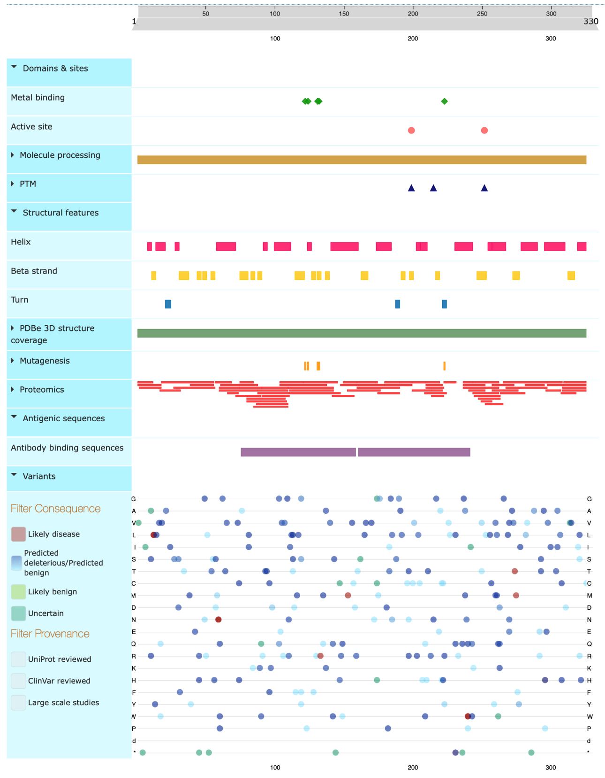
Protein
UniProt: Feature Viewer
Sites:
5 metal binding sites for 2 zinc ions
1 ion as enzymatic cofactor, 1 ion contributes to stabilizing oligomer
2 active sites: Schiff-base intermediates with substrate molecules
2 additional substrate binding sites per active site improve affinity

Slide 5
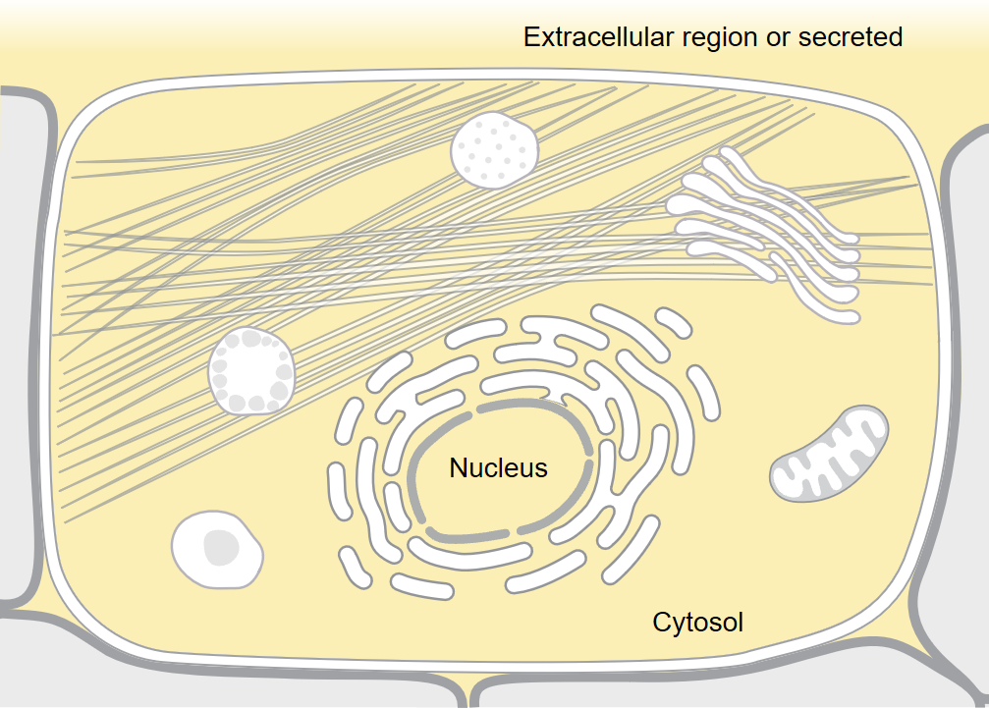
Location
Genome: Chromosome 9
Positions 113'386'312-113'401'290, reverse strand (GRCh38.p12)
In liver cells:
Nucleus
Cytosol
Extracellular region
UniProt: Subcellular Location

Slide 6
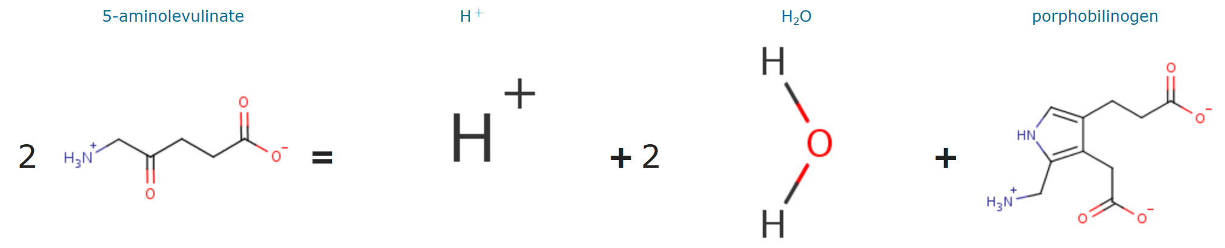
Protein Function
Enzymatic; catalyzed reaction: 2 5-aminolevulinate → H⁺ + 2 H₂O + porphobilinogen
5-aminolevulinate: Non-proteinogenic amino acid
Porphobilinogen: Intermediate in biosynthesis of porphyrins (ex. hemoglobin)

Slide 7
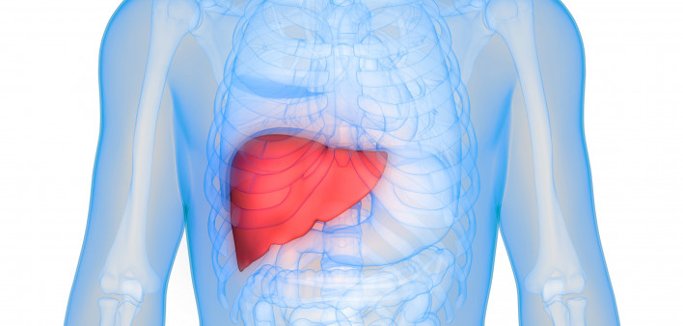
Disease
Acute hepatic porphyria (AHEPP)
Caused by reduction in octamer population and increase in hexamer population, reducing ALAD activity
Accumulation of precursors of porphyrins in the liver
Recessive
Very rare: prevalence <1/1'000'000, <10 described cases

Slide 8
Disease
Disease
Symptoms:
Acute neuro-visceral attacks
Attacks may be recurrent and incapacitating
Potentially, motor paralysis or death
Impaired cellular response to lead ions: Susceptibility to lead poisoning
Onset typically in childhood or adolescence, progressive
Disease-related variants:
Most are close to the active or metal binding sites
Single nucleotide variants

Slide 9
Uniprot:
Feature Viewer
https://www.uniprot.org/uniprot/P13716

Slide 11
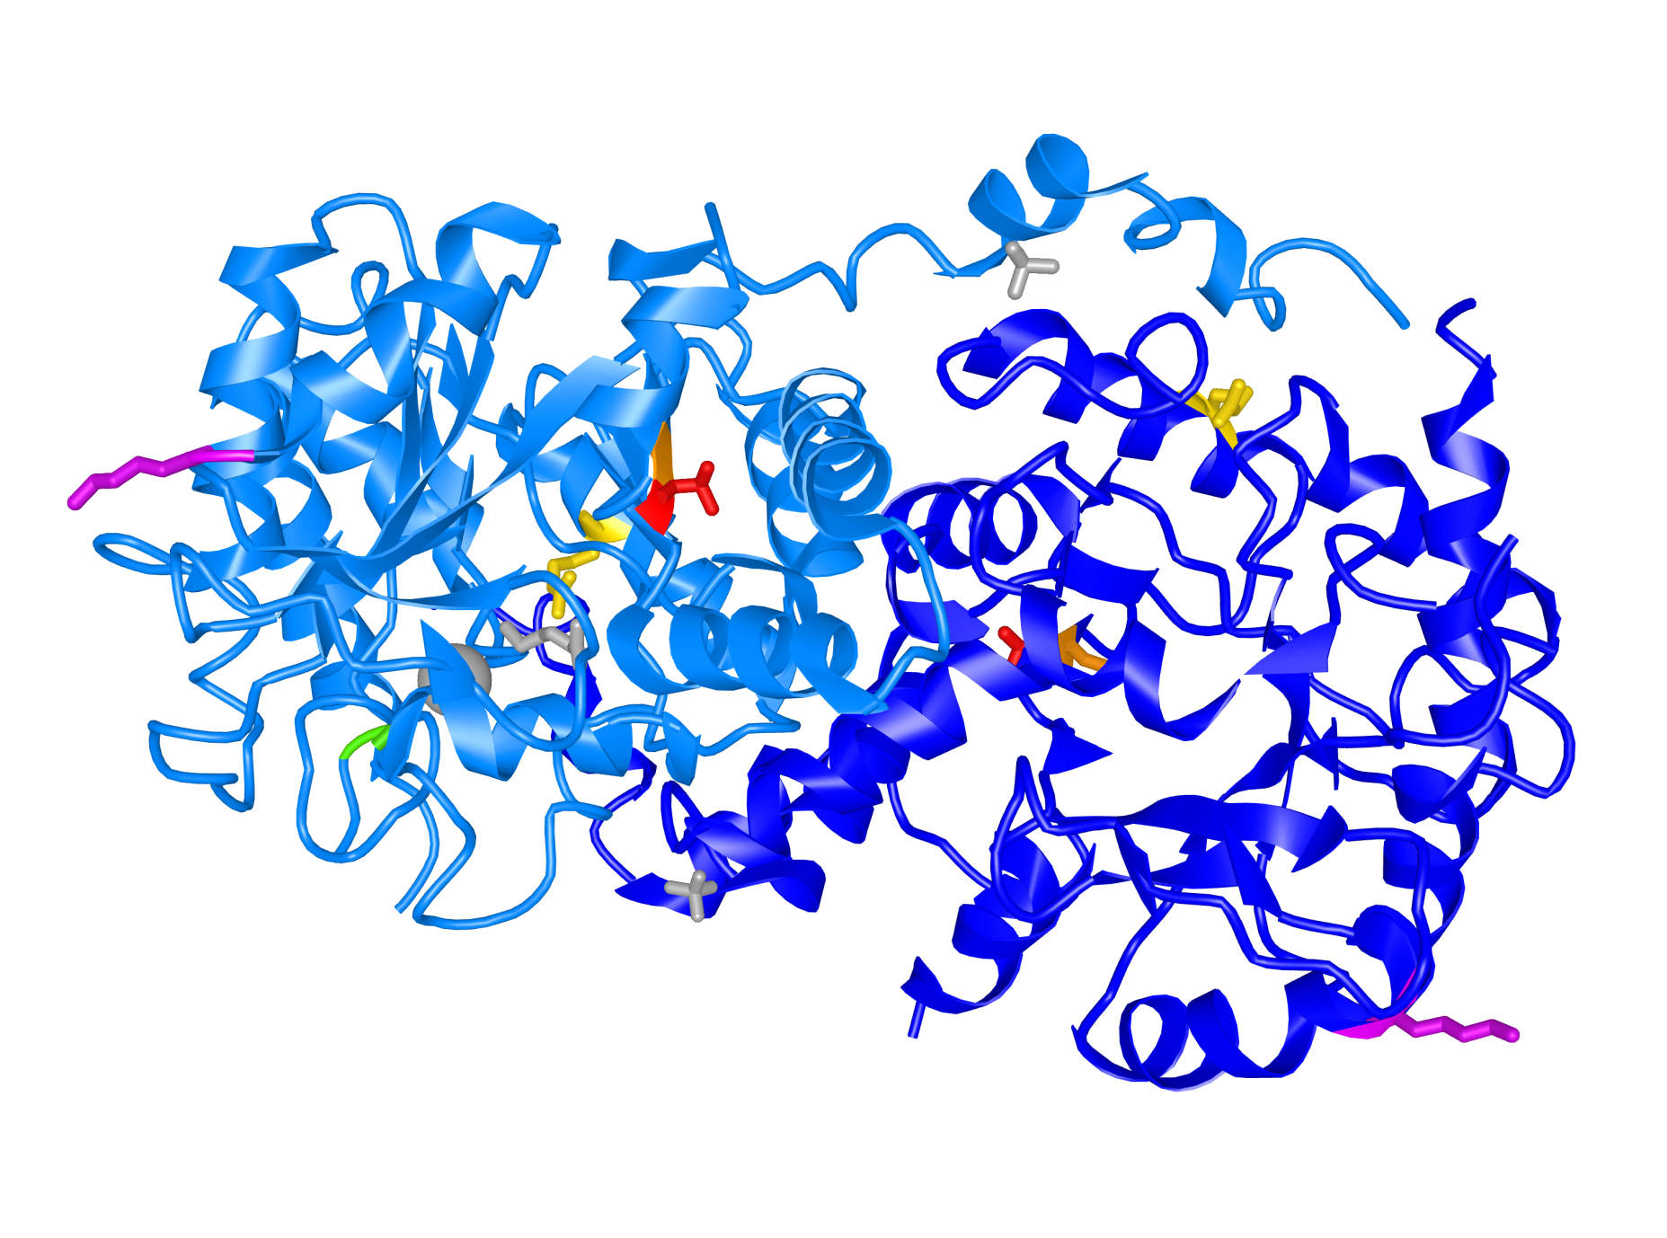
Disease-Related Variants
5HNR dimer (iCn3D modified PDB structure figure)
■/■ Chains
■ Ions + substrates
■ 275 Val → Met
■ 274 Ala → Thr
■ 240 Arg → Trp
■ 133 Gly → Arg
■ 59 Lys → Asn
}
+ hexamer - octamer
→
Weakened lead response, but fully active octamer

Slide 12
References
https://www.rcsb.org/structure/5HNR
https://www.uniprot.org/uniprot/P13716
https://www.ncbi.nlm.nih.gov/Structure/icn3d/full.html?pdbid=P13716
https://www.porphyria.com/about-ahp
https://www.hepmag.com/article/givosiran-shows-promise-treatment-acute-hepatic-porphyrias

Slide 13
Thanks. for your Attention

