Slide 1

DocNotes
The quickest and most organized way to keep track of patient's records.

Slide 2

The Problem
Doctors face difficulties keeping track of a single patient health record.

Slide 3

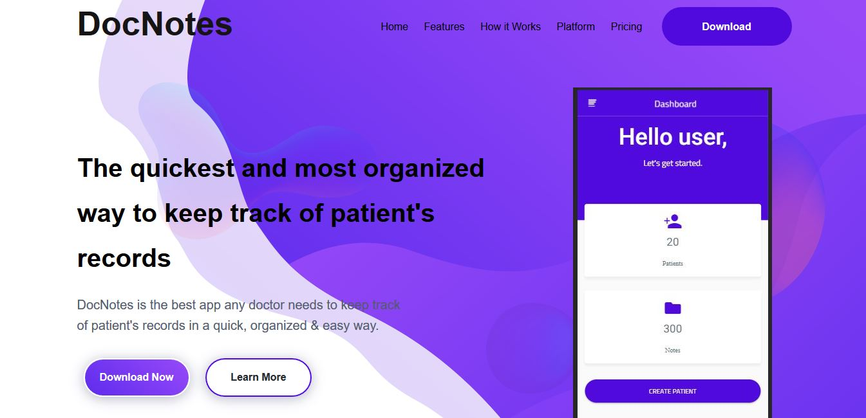
Our Solution
A mobile application which aids doctors to keep track of patient's records in a quick, organized & easy way.
It features a user friendly interface which makes it easy to operate.
It also saves records to the cloud which allows records to be managed from anywhere on the globe.

Slide 4
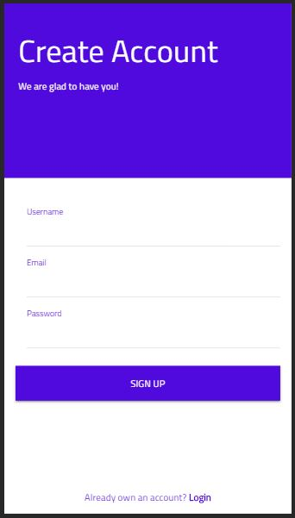
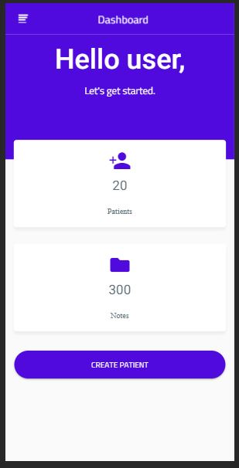
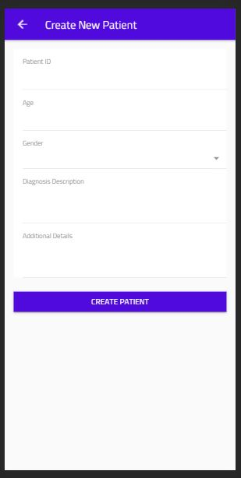
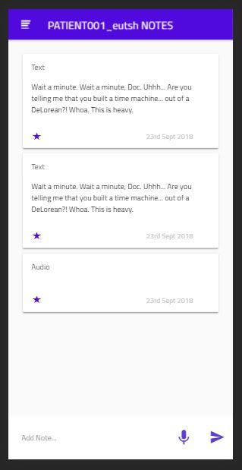
Our Product

Slide 5

Number of hospitals in Nigeria - 2017
3.3K
Number of doctors in Nigeria - 2018
72K

Slide 6
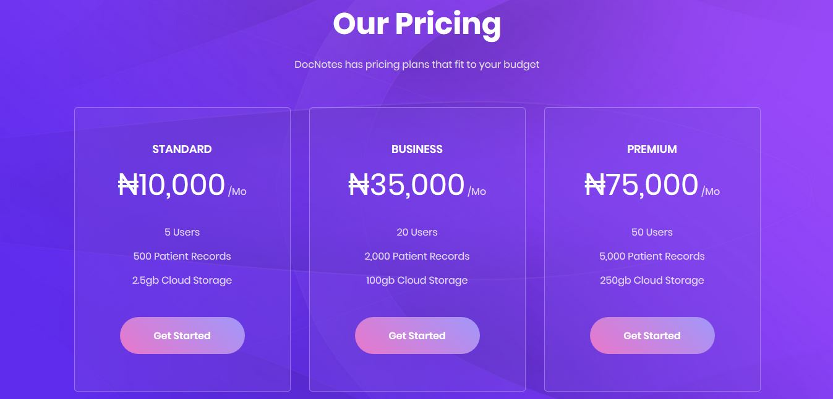
Business Model
We charge subscription fees for the platform’s usage

Slide 7
Thank You!

