Slide 1
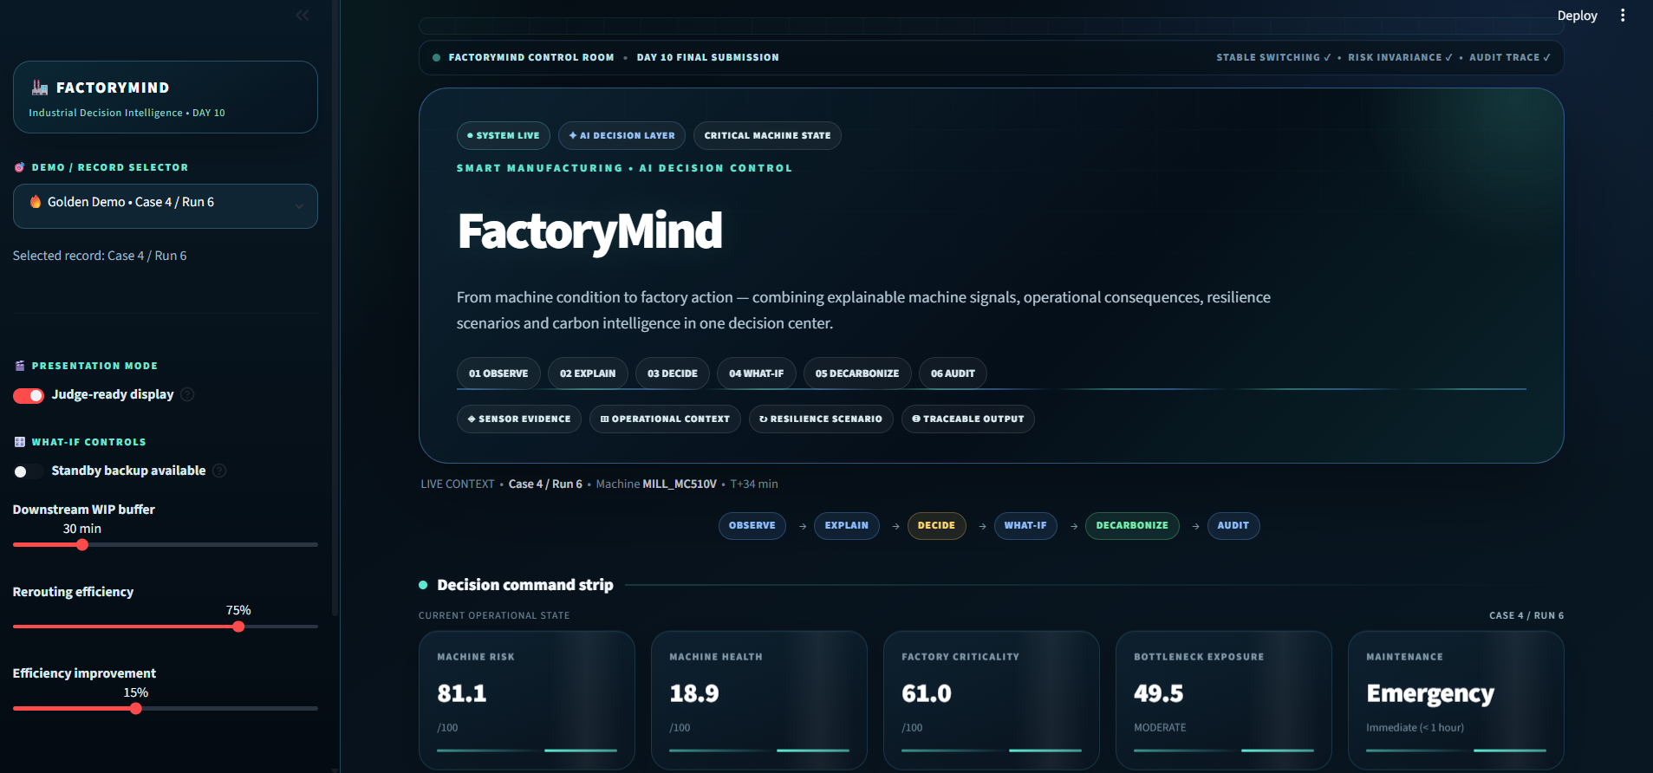
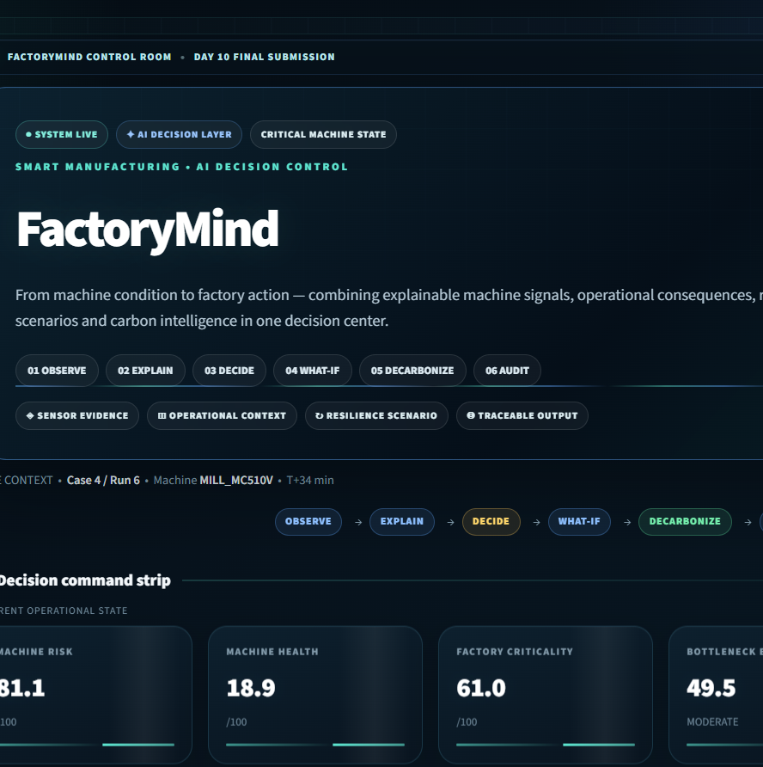
FACTORYMIND
SMART MANUFACTURING • INDUSTRIAL ENERGY & PROCESS EFFICIENCY
FactoryMind
From machine risk to factory decarbonisation.
An operating decision center for Indian SMEs that connects machine condition, factory consequence, energy efficiency and carbon intelligence in one loop.
OBSERVE → EXPLAIN → DECIDE → OPTIMIZE
LIVE PRODUCT VIEW • GOLDEN DEMO / CASE 4 • RUN 6
Built for the decision moment
Not just “is the machine risky?” — but “what should the factory do next?”
TEAM FLUXFORGE
Ronit • Yogik • Rakesh • Shrikant
FactoryMind • final 12-slide pitch
CHALLENGE 04 • INDUSTRIAL ENERGY & PROCESS EFFICIENCY

Slide 2
FACTORYMIND
01 • PROBLEM
02
The factory does not need another alert — it needs a better decision.
Challenge 04 is about affordable, real-time energy visibility, predictive maintenance, process optimisation and decarbonisation without sacrificing competitiveness.
THE DECISION GAP
Today, signals live in separate worlds.
CHALLENGE 04 • WHAT SUCCESS LOOKS LIKE
Reduce specific energy use — while protecting throughput, quality and competitiveness.
Machine alert
“Something looks wrong.”
35–40%
15–30%
REAL-TIME
Production context
“What happens if it stops?”
of India’s energy is consumed by industry
of production costs can come from energy
energy monitoring is missing in many SMEs
Energy insight
“Where is efficiency lost?”
FactoryMind’s positioning
Connect the four decisions in one loop.
WHO ACTUALLY USES THE DECISION?
Plant Manager
Maintenance Lead
Operator
Energy Lead
business consequence
intervention window
next action
energy + carbon
Challenge fit • user context
TEAM FLUXFORGE

Slide 3
FACTORYMIND
02 • SOLUTION
03
One operating loop from signal → explanation → action.
FactoryMind turns fragmented machine, operational and energy evidence into one traceable decision.
01
02
03
04
05
SENSE
EXPLAIN
CONTEXT
DECIDE
OPTIMIZE
Machine + process signals
Risk, anomaly, wear, health
Criticality, backup, buffer
Priority, SLA, action
What-If + carbon
THE OUTPUT
A factory-ready answer to four questions:
Why is it risky?
Evidence + reasons
How important is it?
Factory context
What should we do?
Action + response window
What changes under scenarios?
Resilience + carbon
OBSERVE → EXPLAIN → DECIDE → WHAT-IF → DECARBONIZE → AUDIT
FactoryMind decision loop

Slide 4
FACTORYMIND
03 • TECHNICAL APPROACH
04
A modular architecture built around “one source of truth”.
Machine intelligence is consumed as frozen evidence; the decision layer adds factory context without changing the machine state.
MACHINE INTELLIGENCE
Signals → anomaly/wear → Prototype Risk Index → health
↓
OPERATIONAL INTELLIGENCE
Dependency → backup → priority → line position → throughput
↓
DECISION INTERFACE
Priority → SLA → What-If → carbon → audit export
DATA CONTRACT
exact Case / Run record • traceable provenance
DEPLOYMENT READY
plant meter + MES / maintenance data can replace proxies
Architecture • modular contracts • traceability
Technical deep dive

Slide 5
FACTORYMIND
04 • USER JOURNEY
05
The operator sees the “so what?” — not the raw telemetry.
A decision-centered UX keeps the experience fast: see state → understand why → see business impact → act.
PLANT MANAGER
MAINTENANCE LEAD
OPERATOR
ENERGY LEAD
Business impact
Intervention
Immediate action
Efficiency
“Do we risk the line?”
“When can I service it?”
“What should I do now?”
“What energy lever is available?”
ONE SCREEN, FOUR LAYERS
Machine condition + Factory consequence + Resilience scenario + Carbon lens
No alert overload. No black box handoff. One decision moment.
Target users • value journey
Human-centered product design

Slide 6
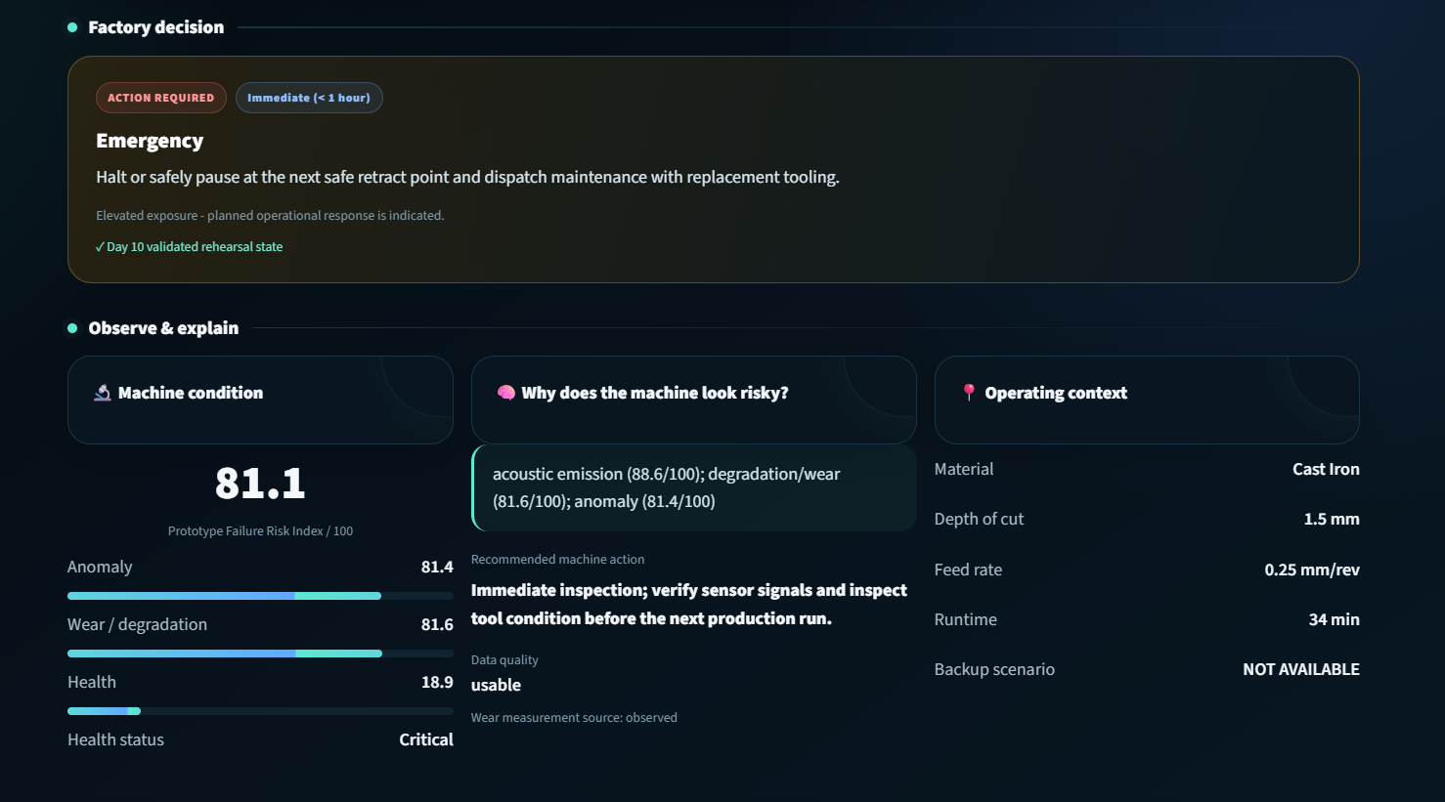
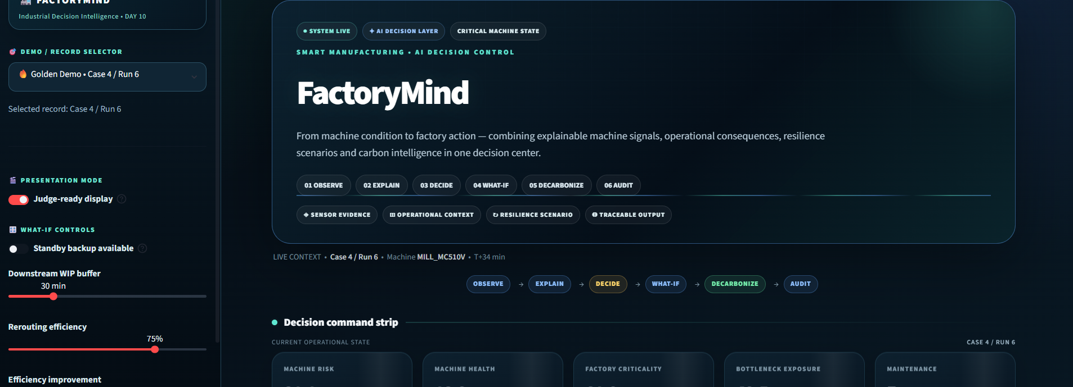
FACTORYMIND
05 • PRODUCT PROOF
06
The live dashboard makes the decision visible in seconds.
Wide product view: machine state, factory context, scenario controls and traceability in one command center.
DASHBOARD EVIDENCE • MACHINE CONDITION + WHY
01 OBSERVE
02 EXPLAIN
03 DECIDE
04 WHAT-IF
05 DECARBONIZE
06 AUDIT
Judge-ready mode • atomic Case/Run selector • frozen representative states
Actual dashboard screenshot • wide crop for readability
Live prototype evidence

Slide 7
FACTORYMIND
06 • GOLDEN DEMO
07
Case 4 / Run 6: strong machine evidence, then a business decision.
The machine state is frozen; operational context determines the response window.
RISK INDEX
HEALTH
WHY?
BASELINE FACTORY SCENARIO
81.1
18.9
Acoustic emission + wear + anomaly evidence combine into the machine-risk view.
Emergency
prototype indicator
critical band
Criticality 61.0 PBRI 49.5
ANOMALY
WEAR
Machine action
81.4
81.6
Immediate response • < 1 hour
Verify sensor signals and inspect tool condition before the next production run.
The machine is risky. The factory consequence makes it urgent.
signal pattern
VB ≈ 0.40 mm
Core insight: machine risk is an input to the business decision — not the decision itself.
Golden Demo • frozen and validated
Case 4 / Run 6

Slide 8
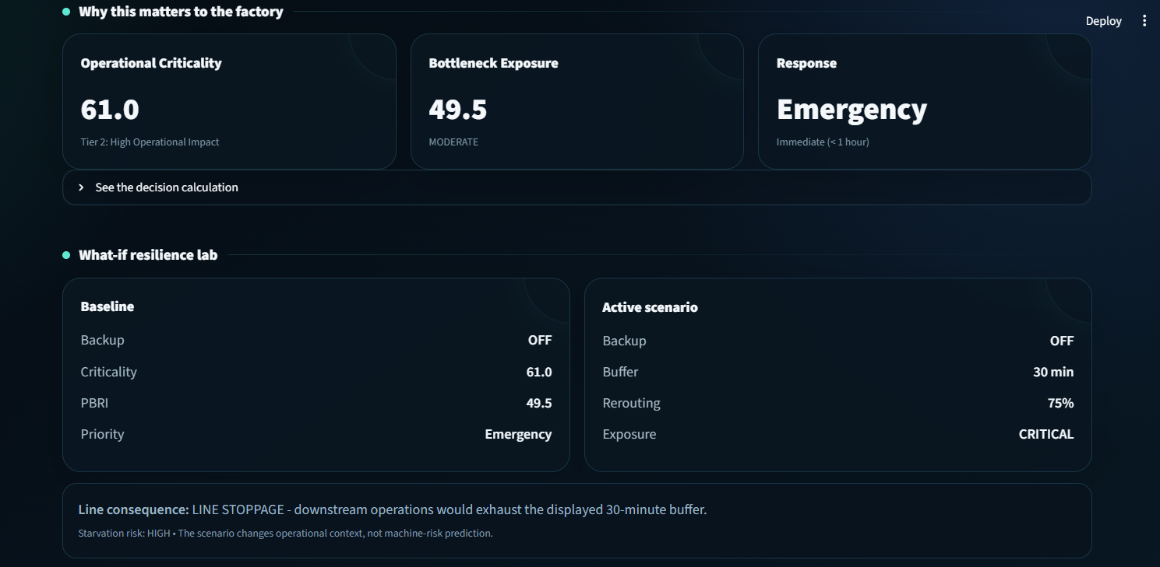
FACTORYMIND
07 • INNOVATION
08
Same machine. Different factory context. Different response.
The What-If engine tests resilience without rewriting the underlying machine evidence.
THE BUSINESS DIFFERENCE
Same machine state • different factory response
BACKUP ON
Planned window
< 24h response
Criticality 44.8 • PBRI 36.3
BACKUP OFF
Emergency
< 1h response
Criticality 61.0 • PBRI 49.5
LIVE WHAT-IF VIEW
Operational consequence changes • machine evidence does not
RISK STAYS 81.1 • ONLY FACTORY CONSEQUENCE MOVES
Validated What-If proof • operational context changes, machine evidence does not
Innovation

Slide 9
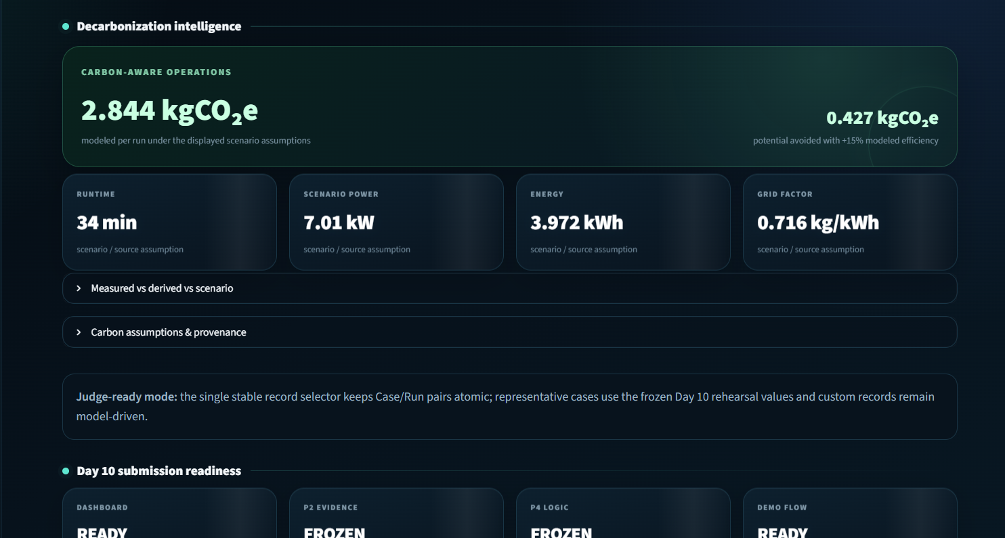
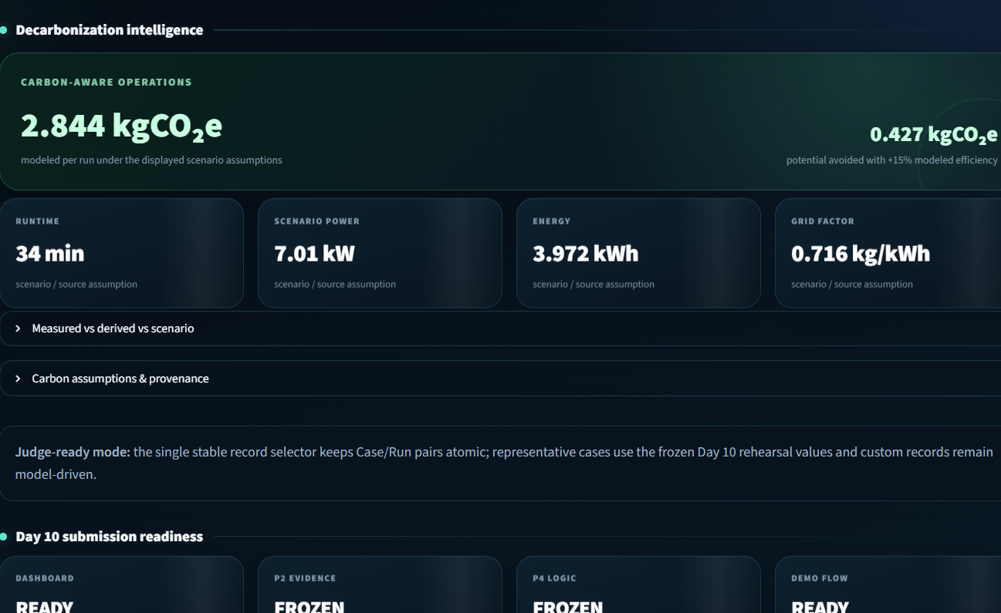
FACTORYMIND
08 • DECARBONISATION
09
Decarbonisation is the operating outcome — not a side dashboard.
FactoryMind puts energy, maintenance and production decisions into the same workflow — with transparent scenario assumptions.
GOLDEN DEMO • CASE 4 / RUN 6
ENERGY
CO₂E
3.972
2.844
kWh / run
kg / run
EFFICIENCY
AVOIDED
15%
0.427
modeled lever
kgCO₂e / run
DEPLOYMENT KPI
kWh / unit output
Measured: runtime • Assumed: power + grid factor + efficiency opportunity
Carbon figures are scenario estimates until plant electricity-meter data is connected.
FactoryMind • energy + carbon intelligence

Slide 10
FACTORYMIND
09 • BUSINESS CASE
10
A low-friction path from decarbonisation pilot to plant-wide intelligence.
We are deliberately not inventing ROI or pricing. The pilot is designed to produce the evidence needed for a real business case.
PILOT
0–30 days
INTEGRATE
30–60 days
SCALE
60–90 days
Sensors + meter + baseline KPIs
MES + maintenance + topology
Calibrate + expand lines
Low-friction proof on one line
Connect decisions to work orders
Turn validated KPIs into rollout evidence
PILOT KPIs TO VERIFY ON REAL PLANT DATA
Specific energy
Unplanned downtime
Scrap / rework
Decision speed
kWh / unit output
hours / month
% / cost
time-to-action
Business promise: make energy, maintenance and operational resilience measurable in the same workflow.
Adoption path • measurable KPIs • no unsupported ROI claims
Business case

Slide 11
FACTORYMIND
10 • JUDGING PROOF
11
Built to be demonstrated, tested and trusted.
The final package is deliberately conservative about claims and explicit about provenance.
167
Case/Run records resolved
10/10
P4 stress-test checks
81.1
Golden machine state restored
61.0 → 44.8
Criticality shift with backup
VALIDATED
Atomic record selection • frozen Golden Demo • What-If invariance
TRACEABLE
Measured / derived / model / scenario labels
BOUNDED
No calibrated probability claim • no fabricated observed values
DEPLOYABLE
Scenario proxies can be replaced by plant meters + MES
JUDGE MESSAGE
We expose uncertainty, preserve machine truth, and make the decision logic auditable.
Validation status • PASS
Judging proof

Slide 12
FACTORYMIND
TEAM FLUXFORGE
12
FluxForge — four strengths, one end-to-end product.
Product, machine intelligence, operational intelligence and frontend execution were built as one system.
TEAM FLUXFORGE
RONIT GODARA
TEAM FLUXFORGE
YOGIK SHARMA
Team Lead • UI / Dashboard Design • Frontend Engineering
ML • Backend Engineering • Machine Intelligence
TEAM FLUXFORGE
RAKESH KUMAR
TEAM FLUXFORGE
SHRIKANT JOSHI
Operational Intelligence • Validation • Backend Integration
Product Strategy • Presentation • Storytelling
THE FACTORYMIND PROMISE
Predict the risk. Explain the cause. Understand the consequence. Choose the right action.
TEAM FLUXFORGE
Ronit Godara • Yogik Sharma • Rakesh Kumar • Shrikant Joshi
FINAL SUBMISSION • THANK YOU

