Slide 2
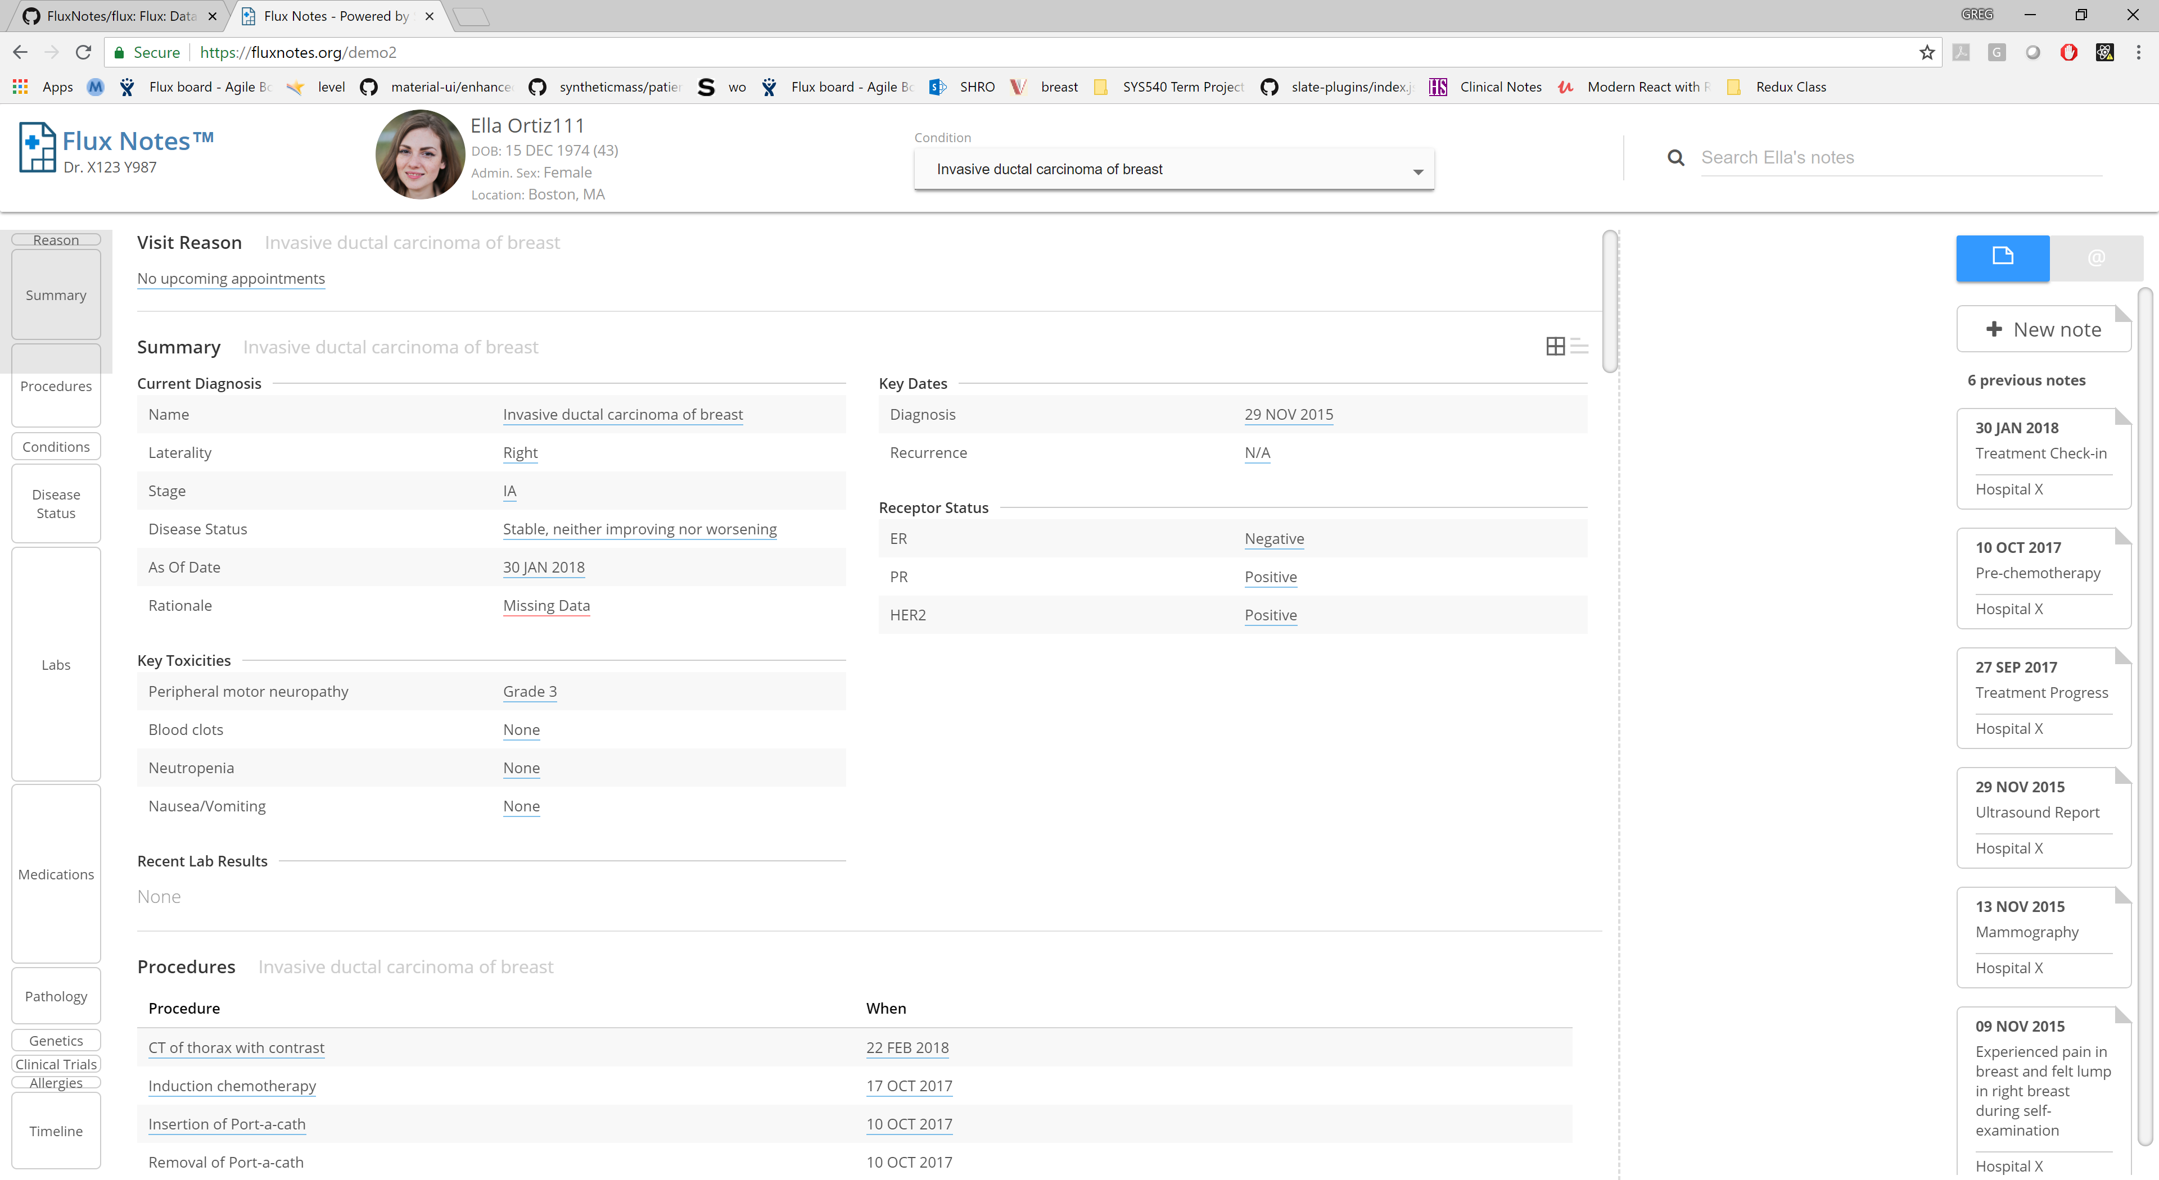
Patient Context
Note
Area
Patient Care
Summary

Slide 3
