Slide 1

Paper & Pencil Exercise

Slide 2

Paper & Pencil Exercise
For this exercise you will need:
PC with Excel
Handout of instructions and equations
File of raw data: ts_data.xls
You may work with a partner
Pen or pencil to write down answers to questions

Slide 3
Paper & Pencil Exercise
After reading the handout, load the excel file with the raw data called “ts_data.xls”. For convenience many constants have already been entered at the top of the spreadsheet. After fixing the time stamps, it should look like this:
TOA5 | EC_Traini | CR3000 | 5 | CR3000.S | CPU:OPE | 45110 | ts_data
TIMESTAMP | RECORD | Ux | Uy | Uz | Ts | CO2 | H2O | press | diag | t_hmp | e_hmp
TS | RN | m/s | m/s | m/s | C | mg/m^3 | g/m^3 | kPa | unitless | C | kPa
 |  | Smp | Smp | Smp | Smp | Smp | Smp | Smp | Smp | Smp | Smp
07/31/2006 13:30:05.60 | 486055 | 3.547 | 0.69925 | -1.12025 | 36.98642 | 565.2 | 18.58873 | 96.81443 | 0 | 35.26781 | 2.53213
07/31/2006 13:30:05.70 | 486056 | 2.2745 | 0.70625 | 0.38325 | 37.22717 | 565.7916 | 18.4914 | 96.77935 | 0 | 35.28106 | 2.53976
07/31/2006 13:30:05.80 | 486057 | 2.293 | 1.32075 | 1.291 | 38.31616 | 566.7679 | 18.36722 | 96.76249 | 0 | 35.26614 | 2.53388
07/31/2006 13:30:05.90 | 486058 | 2.3285 | -0.1185 | 1.476 | 38.32498 | 566.2795 | 18.45295 | 96.82288 | 0 | 35.23963 | 2.53735
07/31/2006 13:30:06.00 | 486059 | 1.888 | 0.608 | 1.69725 | 38.20349 | 564.3044 | 18.79247 | 96.82288 | 0 | 35.26946 | 2.53908
07/31/2006 13:30:06.10 | 486060 | 3.48225 | -0.097 | 0.24 | 37.45572 | 565.1694 | 18.62318 | 96.79691 | 0 | 35.25455 | 2.53784
07/31/2006 13:30:06.20 | 486061 | 4.22875 | 0.92 | 1.0575 | 37.88666 | 566.1586 | 18.52571 | 96.82288 | 0 | 35.21146 | 2.53473
07/31/2006 13:30:06.30 | 486062 | 5.57875 | -0.145 | 0.65225 | 36.96359 | 566.9932 | 18.40635 | 96.82288 | 0 | 35.30095 | 2.54615
07/31/2006 13:30:06.40 | 486063 | 5.1615 | 0.747 | -0.66425 | 36.7774 | 569.1312 | 18.06692 | 96.82288 | 0 | 35.24129 | 2.53863
07/31/2006 13:30:06.50 | 486064 | 5.17225 | 0.68325 | -0.47875 | 36.78088 | 569.8299 | 18.33245 | 96.82288 | 0 | 35.28272 | 2.53876

Slide 4
Paper & Pencil Exercise
Answer parts 1, 2, and 3:
Part 1: In order to align data from all sensors, does any of the data need be lagged/unlagged? Why or why not? Which data must be lagged/unlagged? Will the data be lagged or unlagged? By how much will the data be lagged/unlagged?
Part 2: Is there any other reason that data would be lagged or unlagged? In this example, how important or significant do you think perfectly aligned data are?
Part 3: If the data are aligned, how many useful records will remain in the file?

Slide 5
Paper & Pencil Exercise
Part 4: Align data so timestamp is when all measurements actually took place. Calculate Tc_irga, Tc_hmp, Xc, and Xv.
Hint: Use equation 2 in the handout to find e_irga, and use t_hmp for “T”. Then use equation 1 to find Tc_irga and Tc_hmp. Use equations 3 and 4 to calculate Xc and Xv, respectively; equations 5-7 may also be used for convenience.
TIMESTAMP | RECORD | Ux | Uy | Uz | Ts | Tc_irga | Tc_hmp | CO2 | Xc | H2O | Xv | e_irga | press | diag | t_hmp | e_hmp
TS | RN | m/s | m/s | m/s | C | C | C | mg/m^3 | umol/mol | g/m^3 | mmol/mol | kPa | kPa | unitless | C | kPa
 |  | Smp | Smp | Smp | Smp |  |  | Smp |  | Smp |  |  | Smp | Smp | Smp | Smp
07/31/06 13:30:05.60 | 486055 | 2.293 | 1.32075 | 1.291 | 38.31616 | 35.64409 | 35.72963 | 566.7679 | 351.2858 | 18.36722 | 27.8278 | 2.616592 | 96.76249 | 0 | 35.26781 | 2.53213
07/31/06 13:30:05.70 | 486056 | 2.3285 | -0.1185 | 1.476 | 38.32498 | 35.64201 | 35.73225 | 566.2795 | 350.8012 | 18.45295 | 27.9432 | 2.628918 | 96.82288 | 0 | 35.28106 | 2.53976
07/31/06 13:30:05.80 | 486057 | 1.888 | 0.608 | 1.69725 | 38.20349 | 35.47279 | 35.61772 | 564.3044 | 349.5603 | 18.79247 | 28.45593 | 2.677159 | 96.82288 | 0 | 35.26614 | 2.53388
07/31/06 13:30:05.90 | 486058 | 3.48225 | -0.097 | 0.24 | 37.45572 | 34.75542 | 34.87197 | 565.1694 | 349.2663 | 18.62318 | 28.13274 | 2.652814 | 96.79691 | 0 | 35.23963 | 2.53735
07/31/06 13:30:06.00 | 486059 | 4.22875 | 0.92 | 1.0575 | 37.88666 | 35.1971 | 35.29826 | 566.1586 | 350.2454 | 18.52571 | 28.01492 | 2.639185 | 96.82288 | 0 | 35.26946 | 2.53908
07/31/06 13:30:06.10 | 486060 | 5.57875 | -0.145 | 0.65225 | 36.96359 | 34.29927 | 34.38413 | 566.9932 | 349.6489 | 18.40635 | 27.74611 | 2.622054 | 96.82288 | 0 | 35.25455 | 2.53784
07/31/06 13:30:06.20 | 486061 | 5.1615 | 0.747 | -0.66425 | 36.7774 | 34.16373 | 34.20262 | 569.1312 | 350.629 | 18.06692 | 27.2082 | 2.573341 | 96.82288 | 0 | 35.21146 | 2.53473
07/31/06 13:30:06.30 | 486062 | 5.17225 | 0.68325 | -0.47875 | 36.78088 | 34.12833 | 34.19456 | 569.8299 | 351.1583 | 18.33245 | 27.61585 | 2.61192 | 96.82288 | 0 | 35.30095 | 2.54615

Slide 6
Paper & Pencil Exercise
Hint: Use equation 8 from handout.
Part 5: Calculate the % difference between Tc_hmp and Tc_irga. Explain possible reasons for difference.
Part 6: Why might we prefer units of molar mixing ratio to mass density? Are there any concerns for using molar missing ratio in this example?
Part 7: If we left gas measurements in mass density, what extra considerations must we make?
Tc_irga | Tc_hmp | % diff between Tc
C | C | %
35.64409 | 35.72963 | 0.239975
35.64201 | 35.73225 | 0.253167
35.47279 | 35.61772 | 0.408569
34.75542 | 34.87197 | 0.335353
35.1971 | 35.29826 | 0.287429
34.29927 | 34.38413 | 0.24741
34.16373 | 34.20262 | 0.113836
34.12833 | 34.19456 | 0.194077
 | Average: | 0.259977

Slide 7
Paper & Pencil Exercise
Part 8: Compute the mean and standard deviation for …
U_{x}, U_{y} , & U_{z} (w) - the three components of wind;
T_{s} - sonic temperature;
T_{c} - air temperature using sonic temperature and humidity from the gas analyzer;
X_{c} - CO₂ molar mixing ratio;
X_{v} - H₂O molar mixing ratio;
P - atmospheric pressure.
Hint: See equations 9 and 11 for definitions of mean and standard deviation, but
use Excel AVERAGE() and STDEV() functions for convenience.
Variable: | Ux | Uy | Uz | Ts | Tc_irga | Xc | Xv | press
Units: | m/s | m/s | m/s | C | C | umol/mol | mmol/mol | kPa
Mean: | 3.766625 | 0.489813 | 0.658875 | 37.58861 | 34.91284 | 350.3244 | 27.86809 | 96.81209
StDev: | 1.476903 | 0.549081 | 0.888397 | 0.682148 | 0.658857 | 0.765854 | 0.370015 | 0.022004

Slide 8
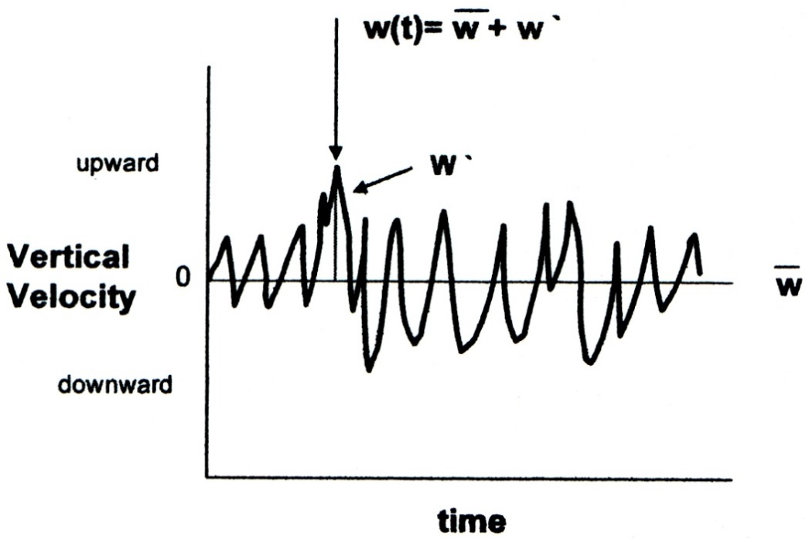
Paper & Pencil Exercise
Part 9:
Show fluctuations about the mean for each 10Hz sample of Uz, Tc, Xc, and Xv (i.e., find Uz’, Tc’, Xc’, and Xv’).
Find the product of fluctuations of Uz with fluctuations of the other variables (i.e., find Uz’Tc’, Uz’Xc’, and Uz’Xv’).
Find the means of Uz’, Tc’, Xc’, Xv’, Uz’Tc’, Uz’Xc’, and Uz’Xv’.
Step 10: Do the means of Uz’, Tc’, and Xc’ make sense?
 | Uz' | Tc' | Xc' | Xv' | Uz'Tc' | Uz'Xc' | Uz'Xv'
 | m/s | C' | umol/mol | mmol/mol | C m/s | umol m/s/mol | mmol m/s/mol
 | 0.632125 | 0.731248 | 0.961376 | -0.04029 | 0.46224 | 0.60771 | -0.02547
 | 0.817125 | 0.729173 | 0.476774 | 0.075108 | 0.595826 | 0.389584 | 0.061373
 | 1.038375 | 0.559948 | -0.76408 | 0.587833 | 0.581436 | -0.7934 | 0.610391
 | -0.41888 | -0.15742 | -1.0581 | 0.264647 | 0.065941 | 0.443213 | -0.11085
 | 0.398625 | 0.284256 | -0.07903 | 0.146823 | 0.113312 | -0.0315 | 0.058527
 | -0.00662 | -0.61358 | -0.67549 | -0.12198 | 0.004065 | 0.004475 | 0.000808
 | -1.32313 | -0.74911 | 0.304613 | -0.6599 | 0.991172 | -0.40304 | 0.873127
 | -1.13763 | -0.78451 | 0.833934 | -0.25224 | 0.89248 | -0.9487 | 0.286958
Mean: | 0 | 0 | 0 | -1.3E-15 | 0.463309 | -0.09146 | 0.219358
Hint: Recall that the instantaneous value is equal to the mean plus a fluctuation term, denoted with a prime. In this case, we want to find Uz’, Tc’, Xc’, and Xv’.

Slide 9
Paper & Pencil Exercise
Step 11: Use Excel’s covariance function to find average covariances between Uz and Tc, Xc, and Xv; e.g. CoVar(Uz,Tc). How do these compare to mean covariances found in step 10?
 | Uz'Tc' | Uz'Xc' | Uz'Xv'
 | C m/s | umol m/s/mol | mmol m/s/mol
Mean | 0.463309 | -0.091457732 | 0.219357695
CoVar() | 0.463309 | -0.091457732 | 0.219357695

Slide 10
Paper & Pencil Exercise
Step 12: Use mean covariances to calculate fluxes in the following units:
H - sensible heat flux (W/m²)
F_{c} - carbon dioxide flux (mg/(m³ s)
LE - latent heat flux (W/m²)
Hint: Use equations 13 and 14 to convert covariance units. Then use
equations 15-18 to calculate final fluxes.
 | Uz'Tc' | Uz'Xc' | Uz'Xv'
Units | C m/s | (m/s)(umol/mol) | (m/s)(mmol/mol)
Mean Covariance | 0.46330905 | -0.091457732 | 0.219357695
Units |  | (m/s)(mg/m^3) | (m/s)(g/m^3)
Mean Covariance |  | -0.152102962 | 0.149241617
Hc | 512.18815 | W/m^2
Fc | -0.152103 | mg/m^2/s
LE | 364.149546 | W/m^2

Slide 11
Paper & Pencil Exercise
Step 13: Did you apply the WPL (1980) correction? Why or why not?
Step 14: Are there any other processing procedures or corrections that would be appropriate to apply to these data? Why or why not?
Step 15: Does a negative flux mean uptake or emission from the ecosystem? Based on the fluxes, what kind of ecosystem do you think this could be?
Hint: See equations 19-20.

Slide 12
Finished! Good Job!

