Slide 1
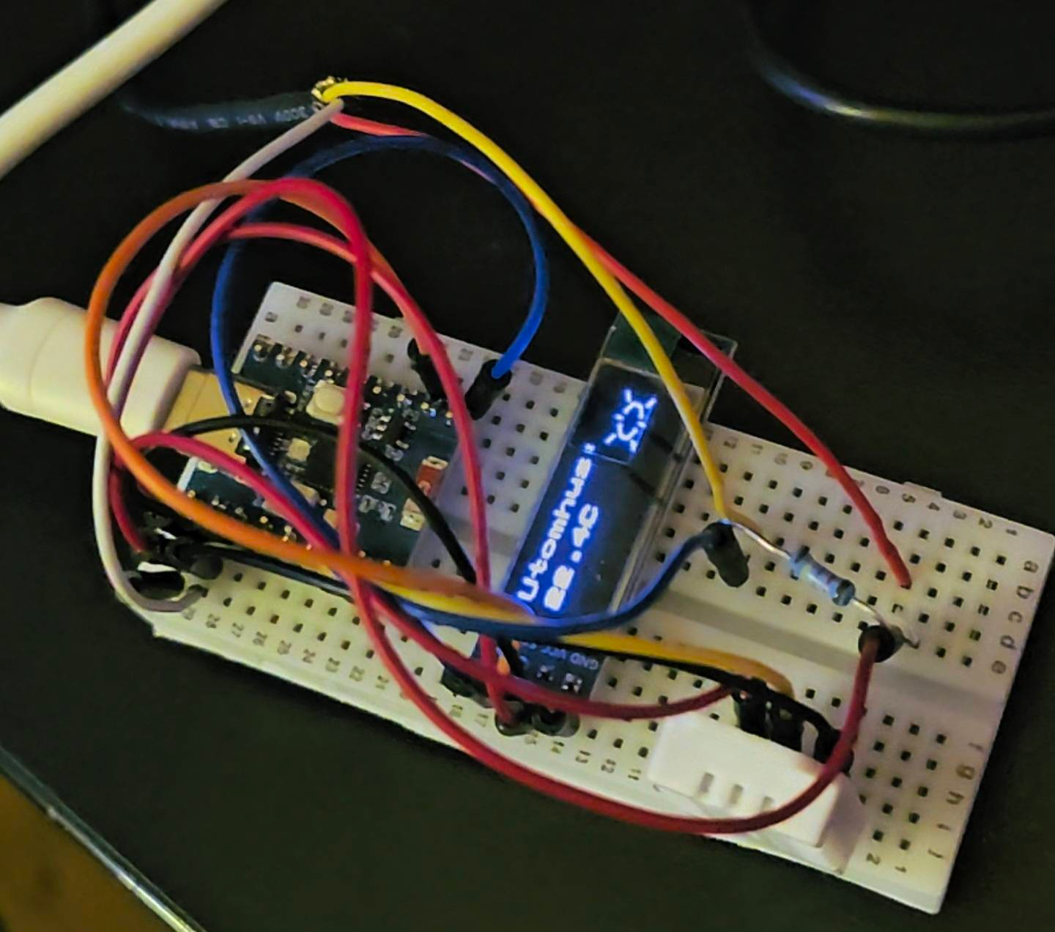

Thermometer
Elis Engström

Slide 2
Idea and Concept
Air source heat pump, radiator and water leak
Indoors temperature
Humidity
Outdoors
Real-time data on a phone APP
Cheap

Slide 3
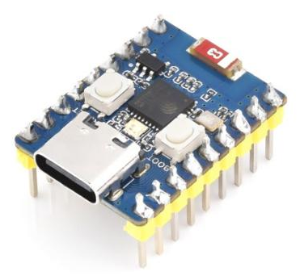

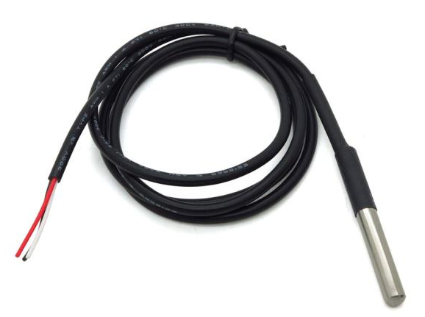
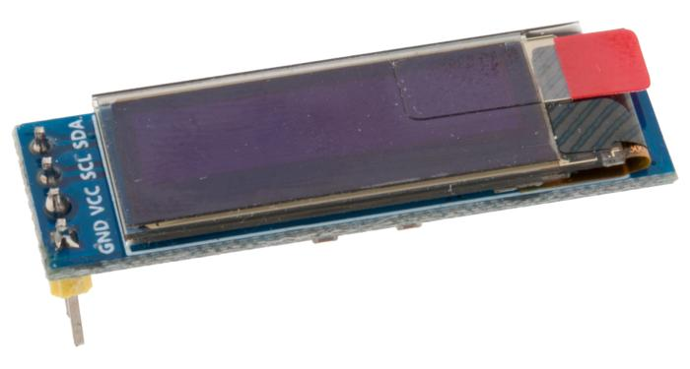


Components & Tools
ESP32-C3 Mini
DHT22 -40 to +80 °C
DS18B20 -10 to +85 °C
LCD OLED Screen
ThingSpeak
GitHub

Slide 4
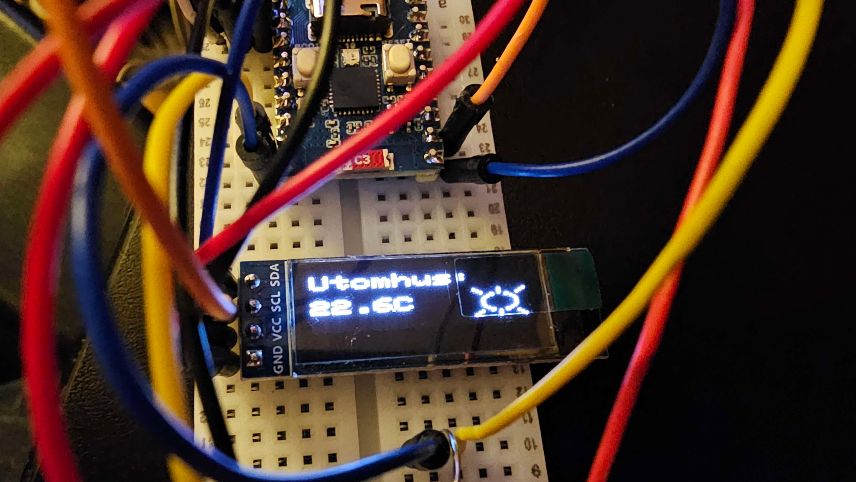
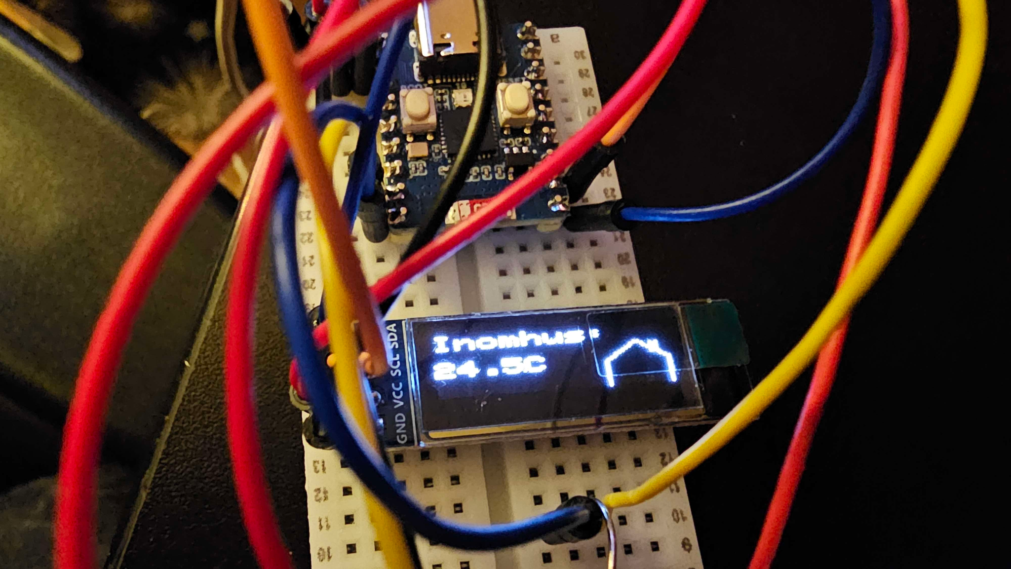
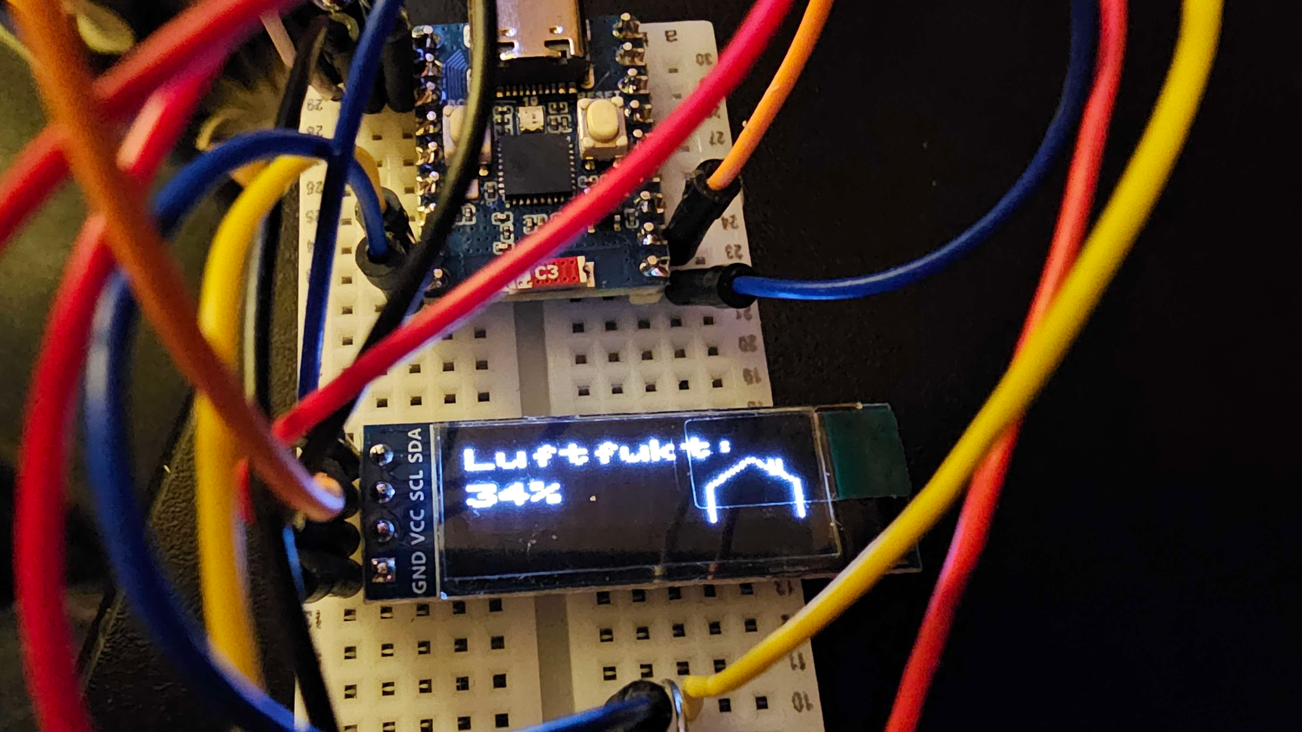
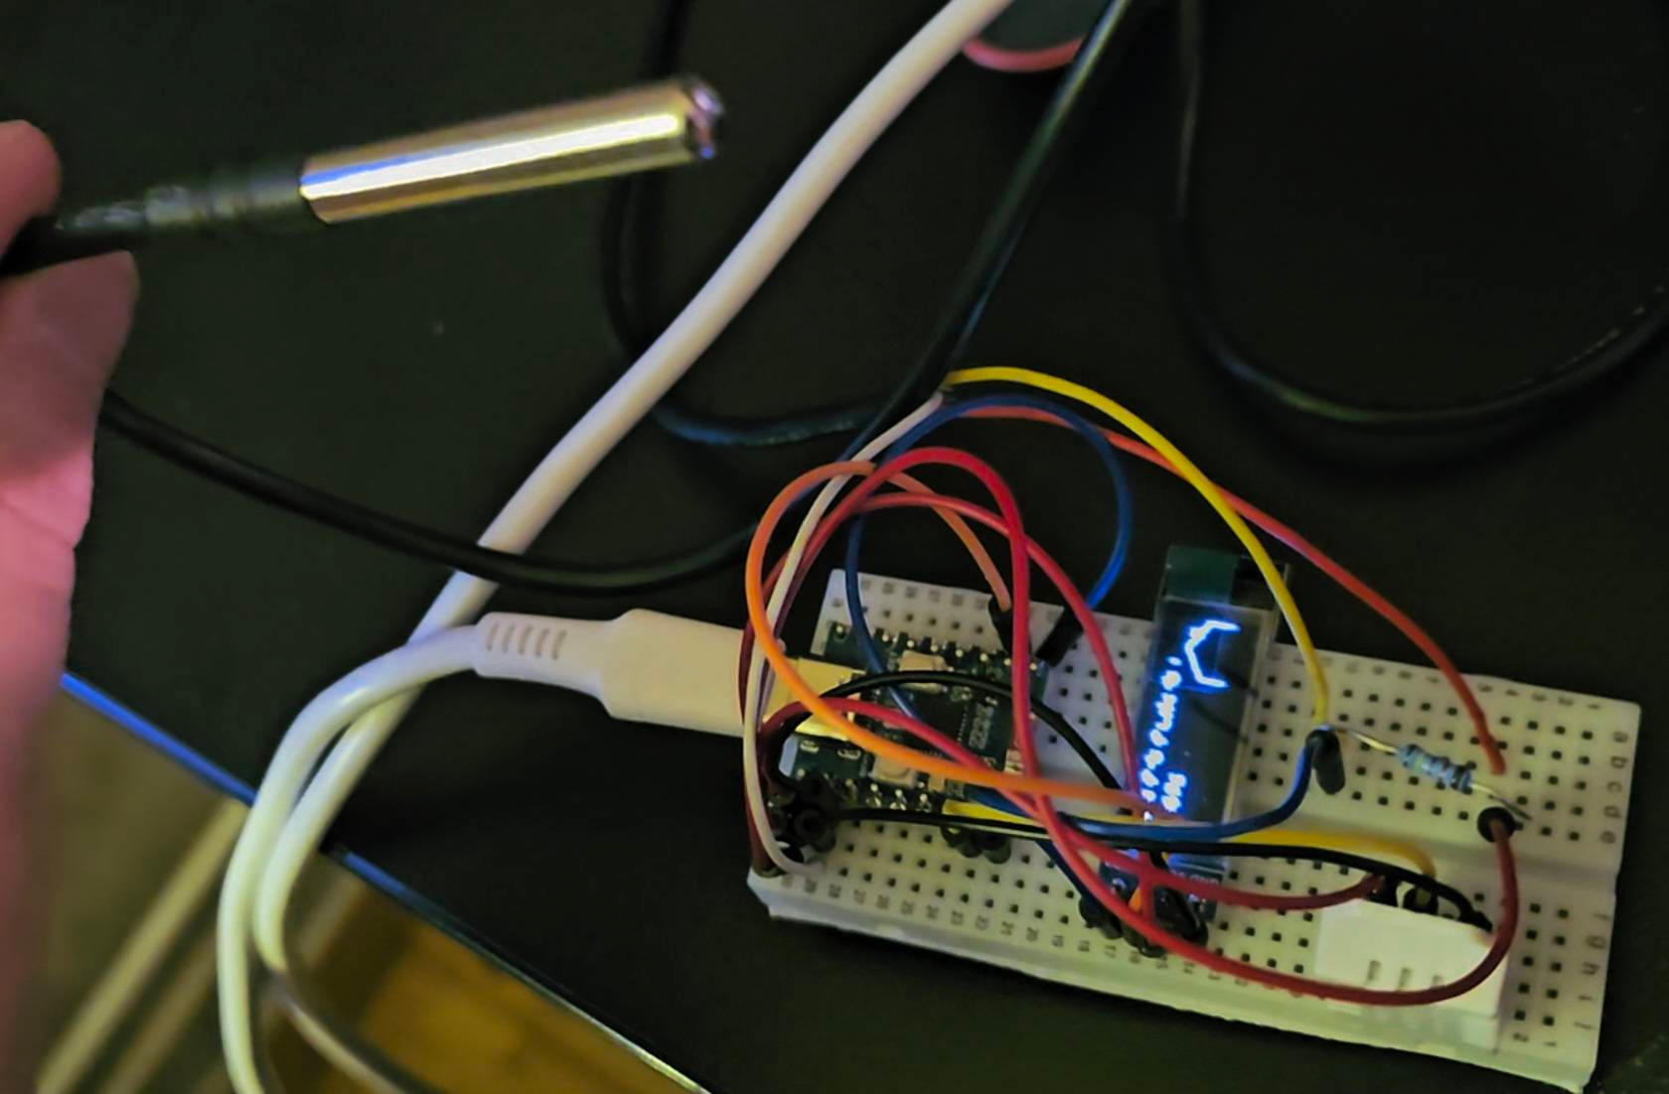
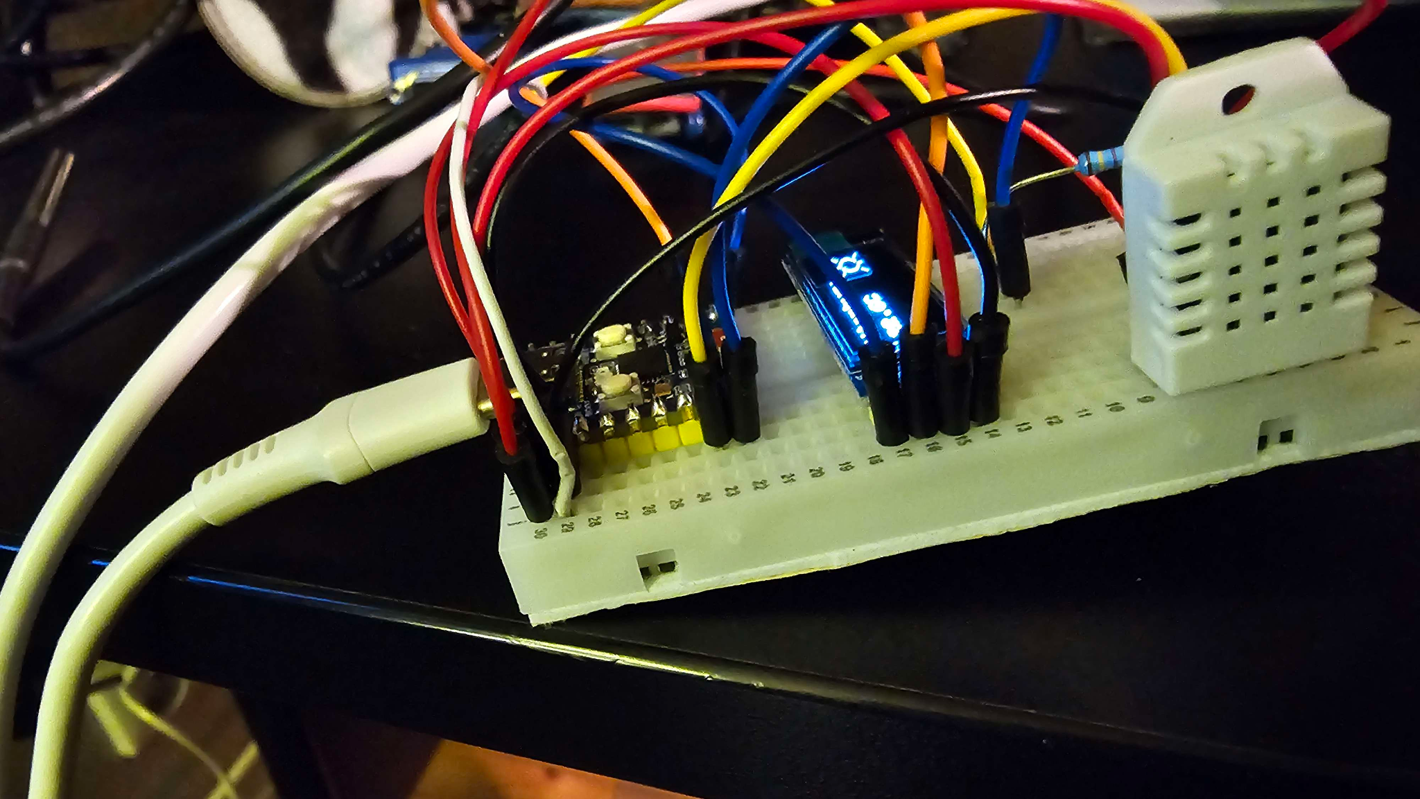
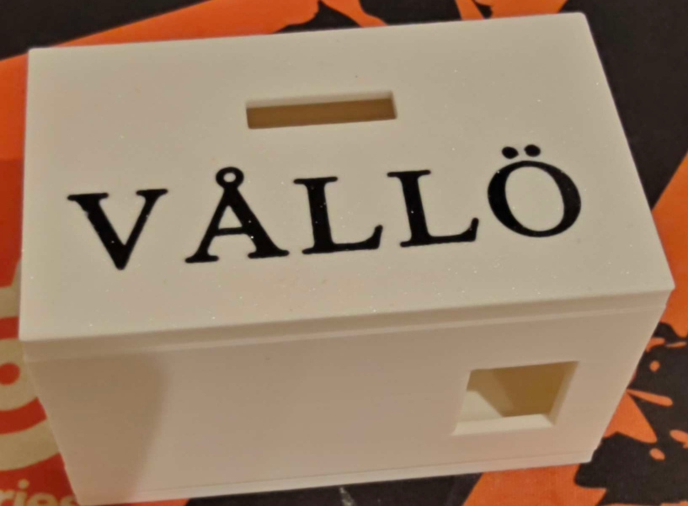
Prototype Photos

Slide 5
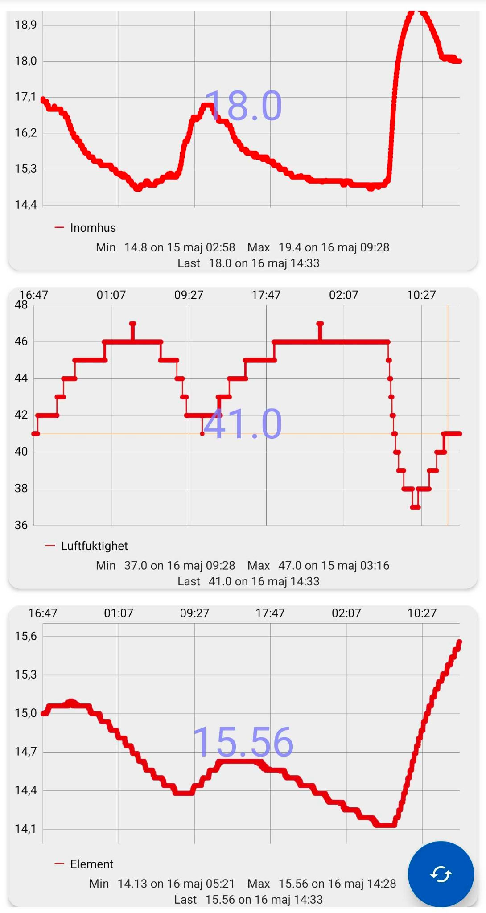
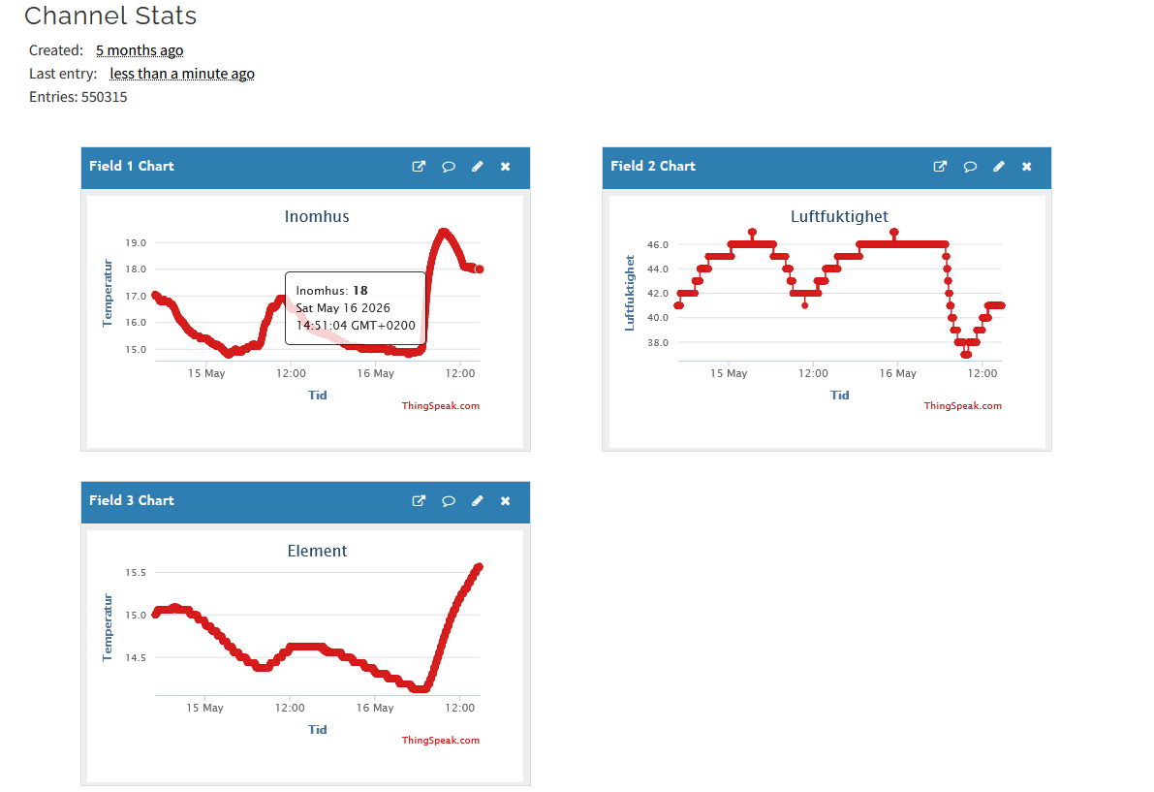
ThingSpeak Web and APP

Slide 6
Thanks!

