Slide 1
Resource Optimisation based Cloud Gaming
Authors: Amanpreet Singh Mankoo
Prashant Mishra
Keyur Pawaskar
Prashant Sawant
Affiliation: Mumbai University

Slide 2
Introduction
Cloud Computing: Cloud computing is the delivery of on-demand computing services from applications to storage and processing power typically over the internet and on a pay-as-you-go basis [11].
Basic Service Models[11]: IaaS, SaaS, PaaS
Anything as a Service (XaaS): Communication as a Service, Network as a Service, Gaming as a Service.
Gaming As a Service: Games as a service are ways to monetize video games either after their initial sale, or to support a free-to-play model [11].
Rate of Game Graphic and Resource Utilization updation | >> 1
Rate of Hardware Updation

Slide 3
Network conditions like jitter and packet loss on the end- user's cloud gaming experience as an investigation, is not considered[1]
The game cloud application coding structure based on using multiple frame sending mechanism[2]
The game cloud application gives the latency of around 190 ~ 200 ms[3]
The execution of the gaming engine is carried at cloud servers, and the user’s gaming commands are delivered to the servers through mobile devices[6]

Slide 4
Research Question
Compatibility of Video streaming over sharing of Gameplay frame.
Deployment of whole gaming mechanism over Cloud [3].
Reducing the latency [3].
To implement Mobile Gaming as also the prime focus in Cloud based Gaming [6].

Slide 5
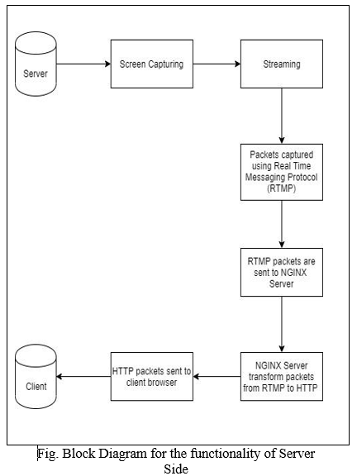
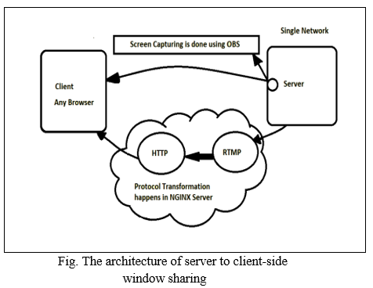
Methodology

Slide 6
Models and Techniques
Present implementations: TCP/IP [5],[8].
Our paper proposes “Socket Connection mechanism”, supports bidirectional exchanges of the packet’s packages.
The two way communication of packet exchange enables both keyboard input and resource sharing on single server reducing the network consumption.
Gameplay is streamed over network rather than sharing game frame.
“Video streaming” mechanism same as Youtube live stream, requirement :- low network usage compared to existing methods which transfer entire game frame.

Slide 7
Experimental Setting
Server Side | Client Side (User’s end)
The server is deployed on Virtualbox Ubuntu OS setted up over 8GB ram and 2GB graphic configured system. | And for testing, the client system is a system with Window Os with 2GB ram and no graphic card in it.

Slide 8
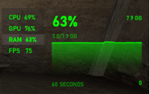
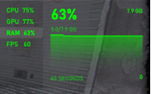
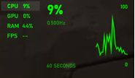
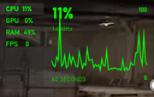
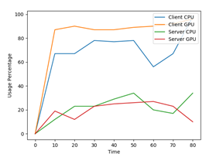
Results and Discussion
Normal Gaming for CSGO
Using Cloud Services
Graphical representation of
Resource utilization

Slide 9
Conclusions and Future Research
Proposal of a revolutionary remote gaming platform.
Cloud Containers gaining edge over traditional virtualisation technology.
Planning to examine the QoE in more depth through subjective studies.
Investigating the feasibility of Mobile Cloud Gaming with minimising bandwidth usage and latency.
The above point can be extended to mobile browser playing and controlling to make the play system independent.
More research work on resource allocation.

Slide 10
References
[1] R. Shea et al., "Cloud gaming: architecture and performance", IEEE Network, vol. 27, no.4, pp. 16-21, 2013.
[2] D. Ren et al., "Coding structure and replication optimization for interactive Multiview video streaming", IEEE Transactions on Multimedia, vol. 16, no. 7, pp. 1874-1887, 2014.
[3] Z. Zhao, K. Hwang, J. Villeta, "Game Cloud Design with Virtualized CPU/GPU Servers and Initial Performance Results", Proc. 3rd Wksp. Scientific Cloud Computing Date, pp. 23-30, 2012.
[4] W. Cai et al., "Quality of experience optimization for cloud gaming system with ad-hoc cloudlet assistance", IEEE Transactions on Circuits and Systems for Video Technology, vol. 25, no. 12, pp. 1-14, 2015.
[5] Yiling, Xu, Qiu Shen, Xin Li, Zhan ma, “A Cost-Efficient Cloud Gaming System at Scale”, IEEE Network, vol. 32, no. 1, pp. 42-47, 2018.

Slide 11
[6] S. Wang, S. Dey, "Cloud mobile gaming: Modelling and measuring user experience in mobile wireless networks", Mobile Computing and Communications Review, vol. 16, no. 1, pp. 10-21, 2012.
[7] Kuan-Ta Chen, Chung-Ying Huang, and Cheng-Hsin Hsu, "Cloud Gaming Onward: Research Opportunities and Outlook," Proceedings of IEEE C-Game 2014.
[8] M. Claypool, K. Claypool, "Latency and player actions in online games", Communications of the ACM, vol. 49, no. 11, pp. 40-45, November 2006.
[9] Wang, "Nvidia Geforce Grid: A Glimpse at the Future of Gaming", [online] Available: http://www.geforce.com/whats-new/arti-cles/geforce-grid.
[10] T. Kämäräinen, M. Siekkinen, A. Ylä-Jääski, W. Zhang, P. Hui, "A measurement study on achieving imperceptible latency in mobile cloud gaming", To Appear in the Proceedings of the ACM Multimedia Systems Conference, 2017
[11] http://ieeexplore.ieee.org.library.somaiya.edu/document/8270630?arnumber=8270630&SID=EBSCO:edsee Accessed on 26 March 2019.

Slide 12
[12] https://www.encoding.com/h-265/ on 11 September 2019.
[13] https://github.com/strukturag/libde265 Accessed on 05 November 2019.
[14] https://www.iis.sinica.edu.tw/~swc/pub/gaming_anywhere_open_source_system.html Accessed on 12 December 2019.
[15] http://Ffmpeg.org/Ffmpeg.html Accessed on 15 January 2020.
[16] Cook, Adam (January 15, 2018). "How games as a service are changing the way we play". Red Bull. Retrieved September 17, 2018.

Slide 13
Appendices
GaaS- Gaming as a Service
IaaS-Infrastructure as a Service
SaaS-Software as a Service
PaaS-Platform as a Service
RTMP-Real Time Messaging Protocol
QoE-Quality of User Experience
QoS-Quality of Service

