Slide 1

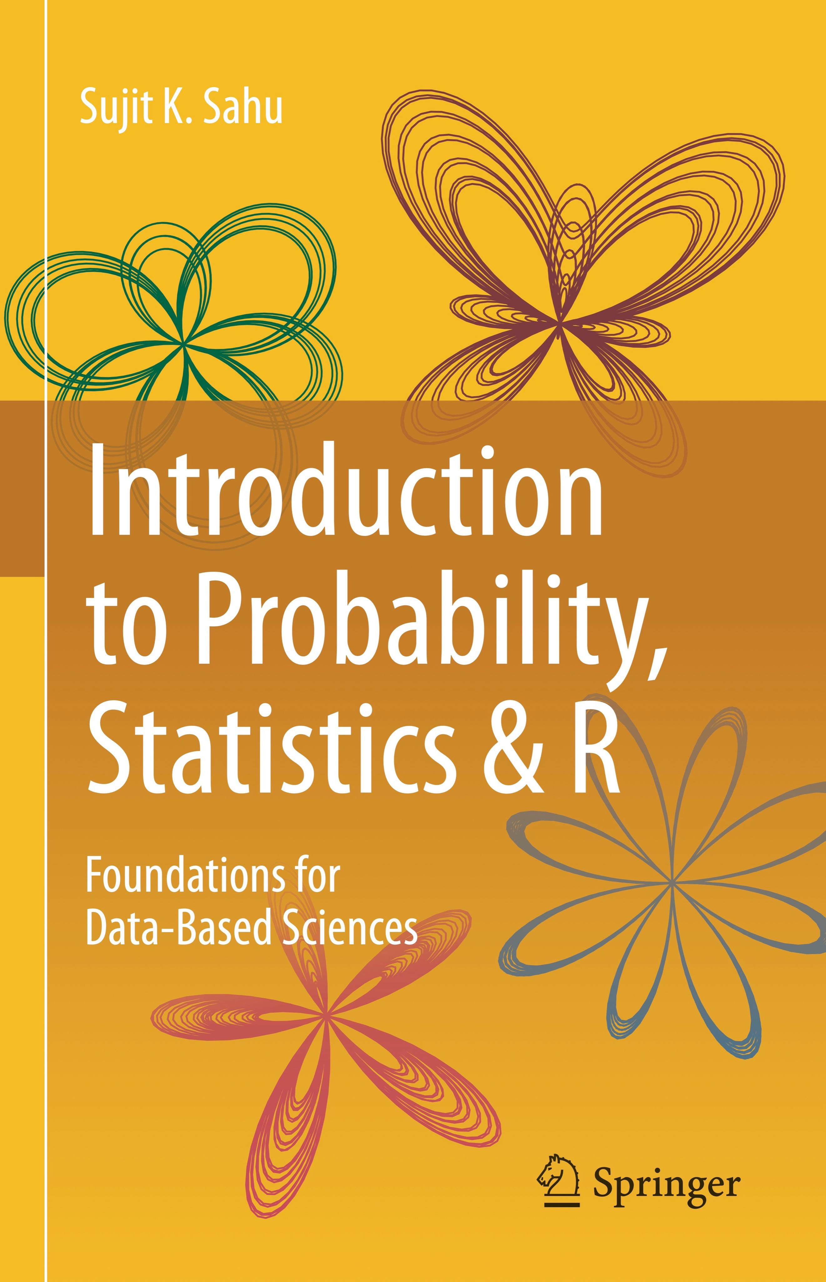

Mathematics Tester Lecture : Probability and Statistics
Prof Sujit Sahu
https://www.sujitsahu.com
Mathematical Sciences, Southampton, 8/9/2024

Slide 2
Plan of the presentation
1
Introduction to the nature of statistics:
Definition of statistics.
Why should I bother learning statistics and statistical methods?
Interesting excerpts from the book, Statistics and Truth by Prof C R Rao.
2
Examples of statistical ideas in everyday life:
Winning the national lottery, playing the Monty Hall game.
Probability of disease given symptom using the Bayes theorem.
Statistics catches serial killer British GP Harold Shipman.
Disease mapping of cancer rates in NHS health boards.

Slide 3
Definition of statistics
The Oxford English Dictionary defines statistics as: “The practice or science of collecting and analysing numerical data in large quantities, especially for the purpose of inferring proportions in a whole from those in a representative sample.”
Is eating red meat harmful to health - causes cancer?
Is smoking harmful during pregnancy?
Is the new therapy/treatment better than the old?
For a better career prospect should I study Maths or Medicine?
Why isn’t it easy to decide one way or the other?

Slide 4
Uncertainty: the main obstacle to decision making
Uncertainty means: lack of one-to-one correspondence between cause and effect.
For example, having a diet of (well-cooked) red meat is not going to kill me immediately.
The only trouble with a sure thing is uncertainty.
Uncertainty is the only certainty there is, ..
It is clear that we may never be able to get to the bottom of every case to learn the full truth and so will have to make a decision under uncertainty; thus mistakes cannot be avoided!
If mistakes cannot be avoided, it is better to know how often we make mistakes (which provides knowledge of the amount of uncertainty) by following a particular rule of decision making: (a statistical method!)
Such knowledge could be put to use in finding a rule of decision making which does not betray us too often!

Slide 5
Statistics tames uncertainty!
Everyone (scientists, experts) has their full right to make guesses which can be wild.
But remember: to guess is cheap, to guess wrongly is expensive!
Statistical methods allow us to evaluate uncertainty! We have the equation:
Uncertain knowledge
Knowledge of the extent of uncertainty in it
Usable knowledge
+
=
Expressed differently:
Noisy data
+ =
Statistical methods
Sound decision
Whenever we have uncertain & noisy data, we need to call an uncertainty doctor, i.e., a statistician.

Slide 6

Why should a young person study/care about statistics?
Studying statistics will equip the learner with the basic skills in doing science with data, i.e. data analysis.
A decent level of statistical knowledge is required no matter what branch of mathematics, engineering, science or medicine a young person will be studying.
Learning statistical theories gives the maths students the opportunity to practice their deductive mathematical skills on real life problems.
In this way, Mathematics students will improve at their mathematical methods while studying statistical methods.

Slide 7
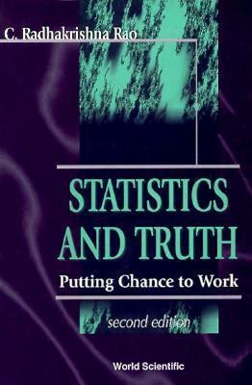
What is statistics?
Statistics is more a way of thinking or reasoning than a bunch of prescriptions for beating data to elicit answers.
Statistics: an inevitable instrument in search of truth.
Statistical methods are results of dialogues between statisticians and practitioners.
Statistics, here, is not meant to represent just a bunch of numbers or rates!

Slide 8
Nature of statistics
Statistics is a peculiar subject without any subject matter of its own. It seems to exist and thrive by solving problems in other areas.
Statistics is basically parasite: it lives on the work of others. ... Some animals could not digest their food. So it is with many fields of human endeavors, they may not die but they would certainly be a lot weaker without statistics. – Leonard J. Savage.

Slide 9
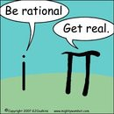
Lies, Damned Lies and Statistics?
You can prove anything in statistics!
Statistics is like a bikini bathing suit. It reveals the obvious but conceals the vital.
Every number is guilty unless proved innocent.
I know the answer, give me statistics to substantiate it.
Figures won’t lie, but liars can figure! – General Charles Grosvenor

Slide 10
Statistics is an inevitable instrument in search of truth!
The χ²-test in statistics is one of the top 20 scientific discoveries!
Statistical methods prove that cigarette smoking is harmful!
According to statistics, males who remain unmarried die ten years younger.
Statistically speaking tall parents have tall children.
A statistical survey has revealed that a tablet of aspirin every alternate day reduces the risk of a second heart attack.
Statistics confirm that an intake of 500mg of vitamin C everyday prolongs life by six years.

Slide 11
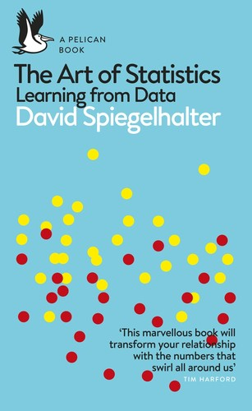
Examples of Statistical ideas
1
A theory book: Introduction to Probability, Statistics & R by myself.
A wonderful book: The Art of Statistics: Learning from Data by Sir David Spiegelhalter.
2

Slide 12
Probability concepts
If an experiment has N equally likely possible outcomes then, for any event A,
_{P(A) =} number of outcomes in A .
total number of possible outcomes of the experiment
♡ Suppose 4 male and 6 female students are applying for a job, but there are only 3 posts available. How many possible combinations can be formed? How many of those will be female only?
♡ The UK National Lottery selects 6 numbers at random from 1 to 49. I bought one ticket - what is the probability that I will win the jackpot?

Slide 13
♡ Winning the National Lottery
In Lotto, a winning ticket has six numbers from 1 to 49 matching those on the balls drawn on a Wednesday or Saturday evening.
The ‘experiment’ consists of drawing the balls from a box containing 49 balls.
The ‘randomness’, the equal chance of any set of six numbers being drawn, is ensured by the spinning machine, which rotates the balls during the selection process.
What is the probability of winning the jackpot?
Total number of possible selections of six balls/numbers is given by ⁴⁹C₆.
There is only 1 selection for winning the jackpot. Hence
49_{C6}
which is roughly 1 in 13.98 (≈ 14) million.
P(jackpot) = ¹ = 7.15 × 10⁻⁸.

Slide 14
♡ Winning the National Lottery
Other prizes are given for fewer matches.
6_{C5} 43_{C1}
49_{C6}
P(5 matches) =
−5
= 1.84 × 10 .
6_{C4} 43_{C2}
49_{C6}
P(4 matches) =
= 0.0009686197
6_{C3} 43_{C3}
49_{C6}
P(3 matches) =
= 0.0176504
Matching 5 of 6 balls & matching the bonus ball.
49_{C6}
Adding all these probabilities of winning some kind of prize
P(winning any prize) ≈ 0.0186 ≈ 1/53.7.
So a player buying one ticket each week would expect to win a prize, (most likely a £10 prize for matching three numbers) about once a year
P(5 matches + bonus) = ⁶ = 4.29 × 10⁻⁷.

Slide 15
Examples
Finding probabilities of events conditional on additional information, i.e. something else has happened.
Find probability of having a disease given that I have the symptom.
Another example: Die throw.
A = (a number greater than 3) = (4, 5, 6),
B = (an even number) = (2, 4, 6).
It is clear that P(B) = 3/6 = 1/2. This is the unconditional probability of the event B.
It is sometimes called the prior probability of B.
We want to find probability of B given that A has already occurred.

Slide 16
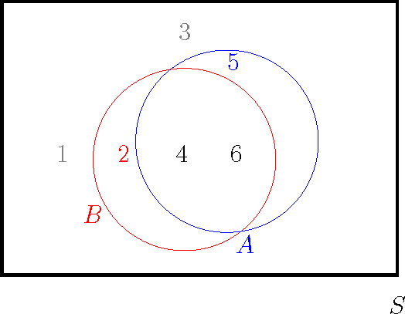
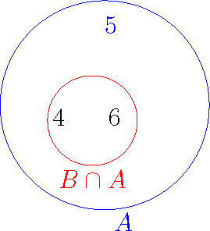
Example: Conditional probability
The left panel shows the two events A and B in the sample space S.
The right panel shows the event A, which contains three possibilities, two of which are also in the event B.
To calculate P(B|A), we consider the right panel, where the three events in A {4, 5, 6} constitute the whole sample space since we have to assume that A has alreday occurred - the other events 1, 2 and 3 are no longer possible.

Slide 17
Example: Conditional probability...
Given the partial knowledge that event A has occurred, only the n_{A} = 3 outcomes in A = (4, 5, 6) could have occurred.
However, only some of the outcomes in B among these n_{A} outcomes in A will make event B occur; the number of such outcomes is given by the number of outcomes n_{A∩B} in both A and B, i.e., A ∩ B, and equal to 2.
Hence the probability of B, given the partial knowledge that event A has occurred, is equal to
2 n_{A∩B} n_{A∩B}/n P(A ∩ B)
3 ⁼ n_{A} ⁼ n_{A}/n ⁼ P(A) .
Hence we say that P(B|A) = ² , which is often interpreted
3
as the posterior probability of B given A.
The additional knowledge that A has already occurred has helped us to revise the prior probability of 1/2 to 2/3.
17

Slide 18
Practical (phone) problem
♡ 3 manufacturing companies: B₁ Pale, B₂ Sung and B₃
Windows.
Their market shares are respectively 30, 40 and 30 percent.
Suppose also that respectively 5, 8, and 10 percent of their phones become faulty within one year.
Q1 If I buy a phone randomly (ignoring the manufacturer), what is the probability that my phone will develop a fault within one year?
Q2 Suppose that the phone I bought developed a fault in the first year - what is the probability that it was made by B₁ Pale?Summary table of information:
Company Market share Percent defective
B₁ Pale | 30% | 5%
B₂ Sung | 40% | 8%
B₃ Windows | 30% | 10%

Slide 19
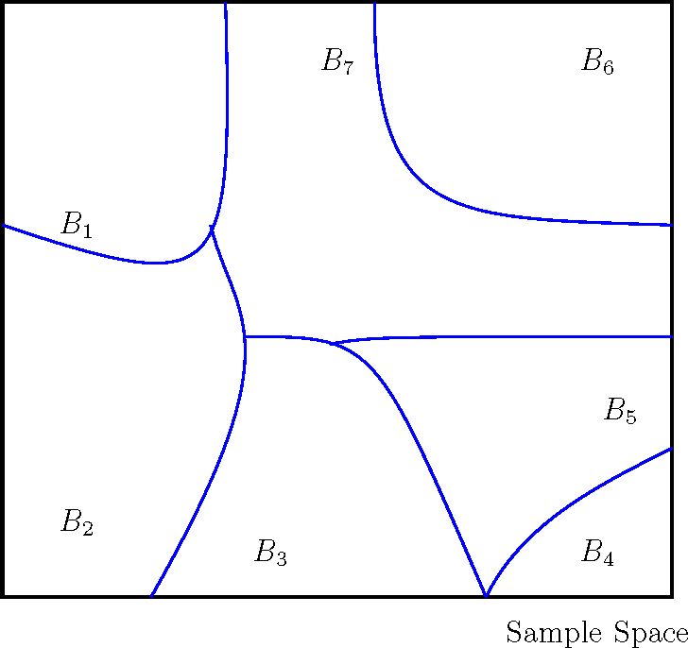
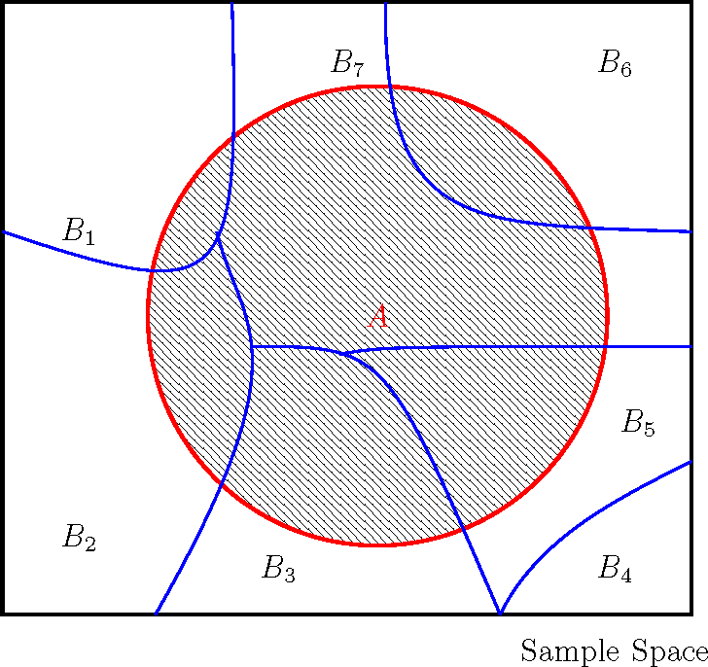
A partition of the sample space, S
Let B₁, . . . , B_{k} denote a set of mutually exclusive (cannot occur together) and exhaustive (fill the whole space) events.
That is, they are disjoint events and together make up the whole sample space, S.
Figure: The left figure shows the mutually exclusive and exhaustive events B₁, . . . , B₇ (they form a partition of the sample space); the right figure shows a possible new event A.

Slide 20
Total probability formula
Let B₁, B₂, . . . , B_{k} be a set of mutually exclusive, i.e.
B_{i} ∩ B_{j} = ∅ for all 1 ≤ i ̸= j ≤ k
and exhaustive events, i.e.: B₁ ∪ B₂ ∪ . . . ∪ B_{k} = S.
Now any event A can be represented by
A = A ∩ S = (A ∩ B₁) ∪ (A ∩ B₂) ∪ . . . ∪ (A ∩ B_{k} )
where (A ∩ B₁), (A ∩ B₂), . . . , (A ∩ B_{k} ) are mutually exclusive events.
Hence one of the three Axioms (Universal truth) of probability gives the the total probability formula for P(A).
P(A) = P(A ∩ B₁) + P(A ∩ B₂) + . . . + P(A ∩ B_{k} )
= P(B₁)P(A|B₁) + P(B₂)P(A|B₂) + . . . + P(B_{k} )P(A|B_{k} ).

Slide 21
♡ Return to the phone problem
We can now find the probability of the event, say A, that a randomly selected phone develops a fault within one year.
Let B₁, B₂, B₃ be the events that the phone is manufactured respectively by companies B₁ Pale, B₂ Sung and B₃ Windows.
Then we have:
P(A) = P(B₁)P(A|B₁) + P(B₂)P(A|B₂) + P(B₃)P(A|B₃)
= 0.30 × 0.05 + 0.40 × 0.08 + 0.30 × 0.10
= 0.077.
Now suppose that my phone has developed a fault within one year.
What is the probability that it was manufactured by B₁
Pale?
To answer this we need to introduce the Bayes Theorem.

Slide 22
The Bayes theorem
Let A be an event, and let B₁, B₂, . . . , B_{k} be a set of mutually exclusive and exhaustive events.
Then, for any i = 1, . . . , k ,
_{P(Bi |A) =} P(B_{i} )P(A|B_{i} ) ,
P(B₁)P(A|B₁) + P(B₂)P(A|B₂) + · · · + P(B_{k} )P(A|B_{k} )
The Bayes theorem is used to update the probability of a possible cause, B_{i} , given that an effect, A, has already taken place.
For example, a murder has already taken place and then trying to investigate “who dunnit!”

Slide 23
The Bayes theorem...
The probability, P(B_{i} |A) is called the posterior probability of
B_{i} and P(B_{i} ) is called the prior probability.
The Bayes theorem is the rule that converts the prior probability into the posterior probability by using the additional information that some other event, A above, has already occurred.
♡ The probability that my faulty phone was manufactured by B₁ Pale is
P(B₁)P(A|B₁)
P(B₁|A) =
=
P(A)
0.30×0.05 _{= 0.1948.}
0.077
Similarly, the probability that the faulty phone was manufactured by B₂ Sung is 0.4156,
and the probability that it was manufactured by B₃
Windows is 0.3896.
Note that P(B₁|A) + P(B₂|A) + P(B₃|A) = 1. Why?

Slide 24
♡ Example: Disease given symptom
In medical statistics, the Bayes theorem determines the probability that someone has the disease given that they have the symptom.
♡ Consider a disease that is thought to occur in 1% of the population.
Using a particular blood test a physician observes that out of the patients with disease 98% possess a particular symptom.
Also assume that 0.1% of the population without the disease have the same symptom.
A randomly chosen person from the population is blood tested and is shown to have the symptom.
What is the conditional probability that the person has the disease?
Example taken from youtube: search Bayesian trap.
24

Slide 25
♡ Example: Disease given symptom
Here k = 2 and let B₁ be the event that a randomly chosen person has the disease and B₂ is the complement of B₁.
Let A be the event that a randomly chosen person has the symptom. The problem is to determine Pr (B₁|A).
We have Pr (B₁) = 0.01 since 1% of the population has the disease, and Pr (A|B₁) = 0.98.
Also Pr (B₂) = 0.99 and Pr (A|B₂) = 0.001, this is the probability of having the symptom without having the disease. Now Pr (disease | symptom) =
Pr (D | S) = Pr (B₁|A) =
=
Pr (A|B₁) Pr (B₁)
Pr (A|B₁) Pr (B₁)+Pr (A|B₂) Pr (B₂)
0.98×0.01
0.98×0.01+0.001×0.99
= 0.9082.
Thus, Pr (disease) = Pr (B₁) = 0.01 gets revised to:
Pr (disease | symptom) = Pr (B₁|A) = 0.9082.

Slide 26
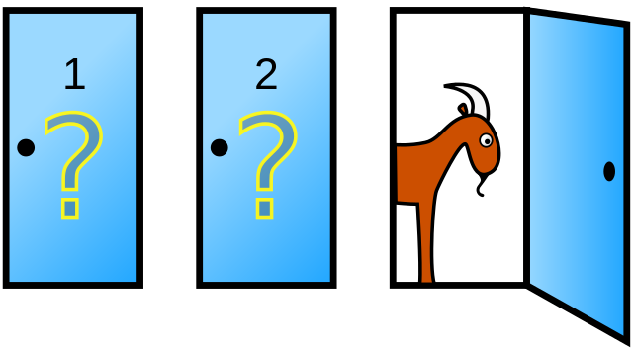
Monty Hall: TV Game
Three doors: only one has a brand new car behind it. The other two have goats.
You are asked to choose one door to win the prize behind. The host then reveals one of the other two and reveals a goat behind it.
Now do you stick with your choice, swap or choose again randomly between the two?

Slide 27
Probability calculation for the Monty Hall problem.
1
Note that the player can win under two mutually exclusive ways if initially they choose:
the car (C) which has probability 1/3 and
a goat(G) which has probability 2/3.
Hence probability of eventual win (W):
P(W ) = P(W ∩ C) + P(W ∩ G) since C ∪ G = S
= P(W |C)P(C) + P(W |G)P(G)
2
= P(W |C) ¹ + P(W |G) ²
3 3
The two probabilities P(W |C) and P(W |G) will depend on their strategy after the initial selection. Three possible strategies: Stay, Swap and Randomly choose again.
3
Strategy Stay
P(W |C) P(W |G) P(W)
1 0 1 × ¹ + 0 × ² = ¹
3 3 3
Swap Random
0
1
1
1
0 × ¹ + 1 × ² = ²
3
3 3
1 1 1 2 1
× + × =
2 2 2 3 2 3 2
4
The ‘Swap’ strategy maximises the chance of winning.

Slide 28
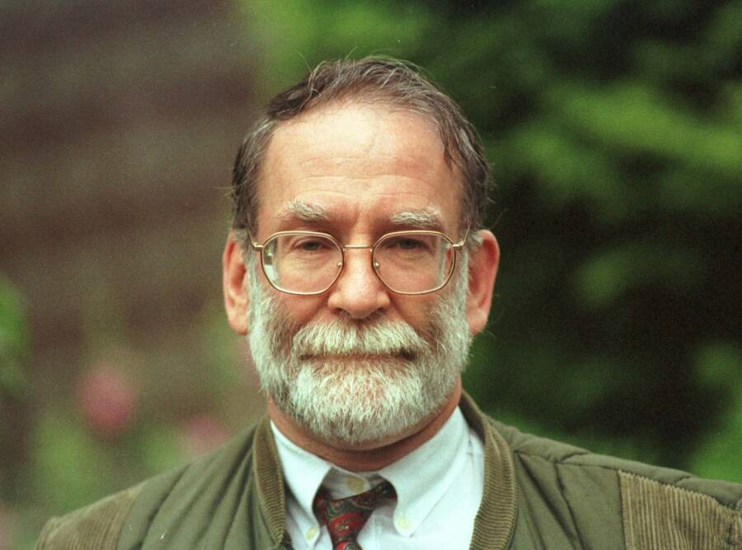
Harold Shipman : Serial murder example
Shipman was a British family doctor (GP) and serial killer who killed at least 215 of his most elderly patients by injecting opium between 1975 and 1998.
His killing spree went undetected until an enquiry was launched during 1998-1999 and convicted in 2000.

Slide 29
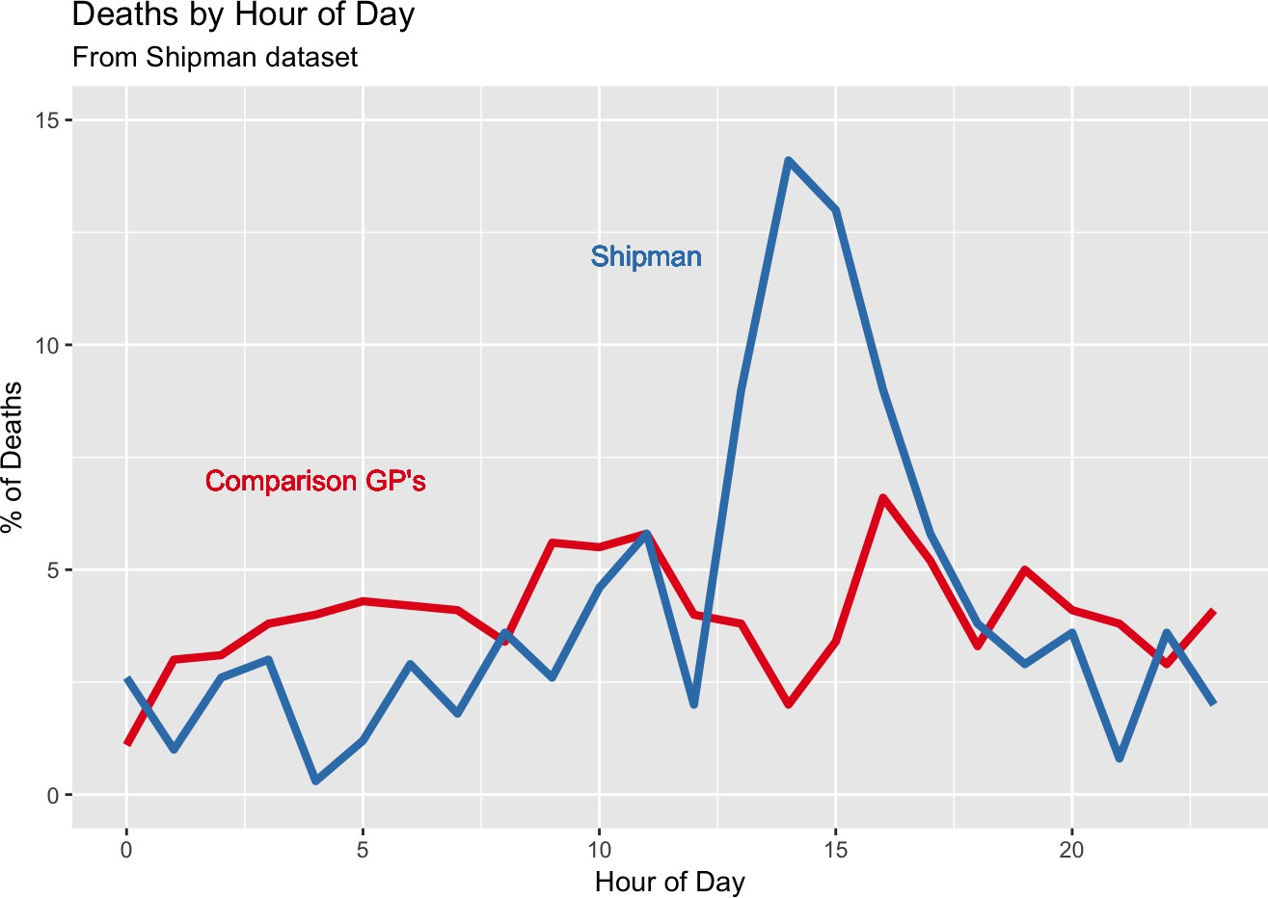
Harold Shipman : Serial murder example ...
Figure: The time at which Shipman’s patients died, compared to the times at which patients of other local family doctors died.
This is Figure 1.1 in my introduction to probability and statistics book.
2PM is the very unusual peak time of death for Shipman’s patients.
No sophisticated statistical analysis is required to detect the obvious pattern in the data.

Slide 30
Disease mapping of cancer rates in the NHS regions
The slides are based on the work of Ms Iona Baxter, a BSc third year project student.
Iona is interested in assessing spatio-temporal trends in cancer incidence in English health regions during the period 2001-2018.
One in two people in the UK will develop some form of cancer in their lifetime.
Cancer rates are associated with characteristics such as hereditary, lifestyle and health related factors.
Iona’s project studies the effect of such factors on geographical and temporal variations in the incidence rates.

Slide 31
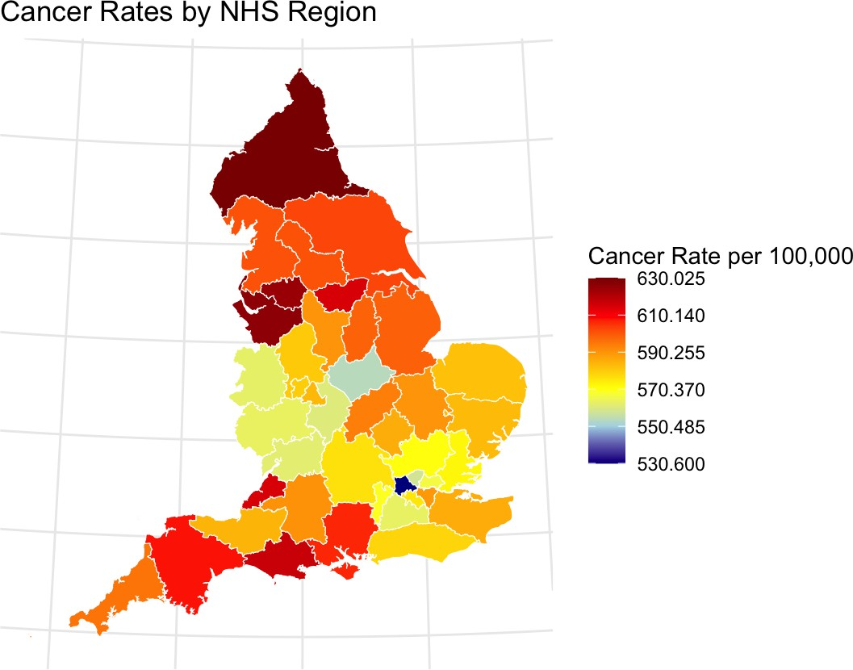
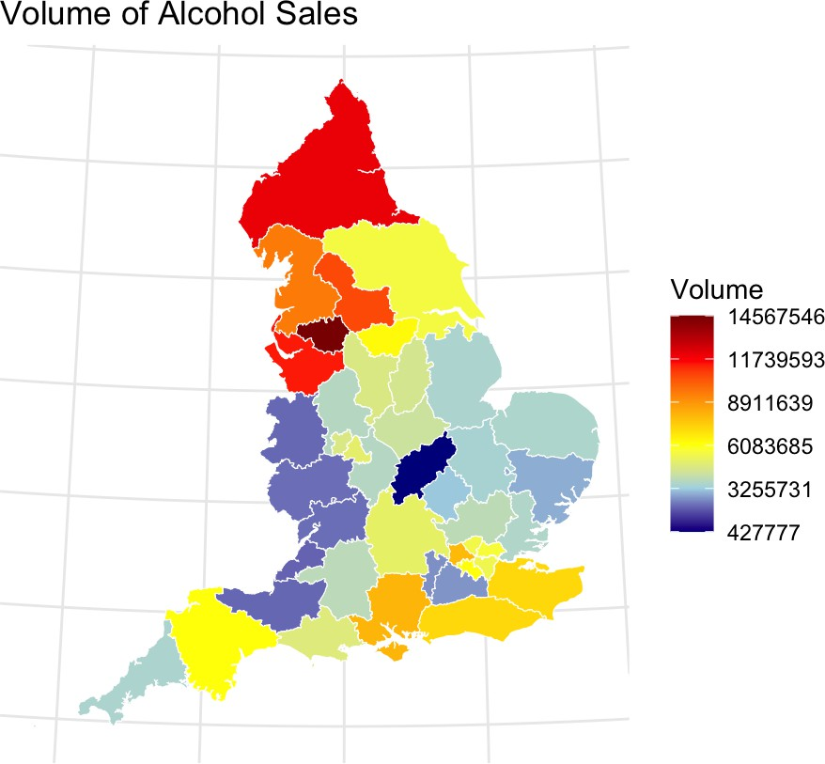
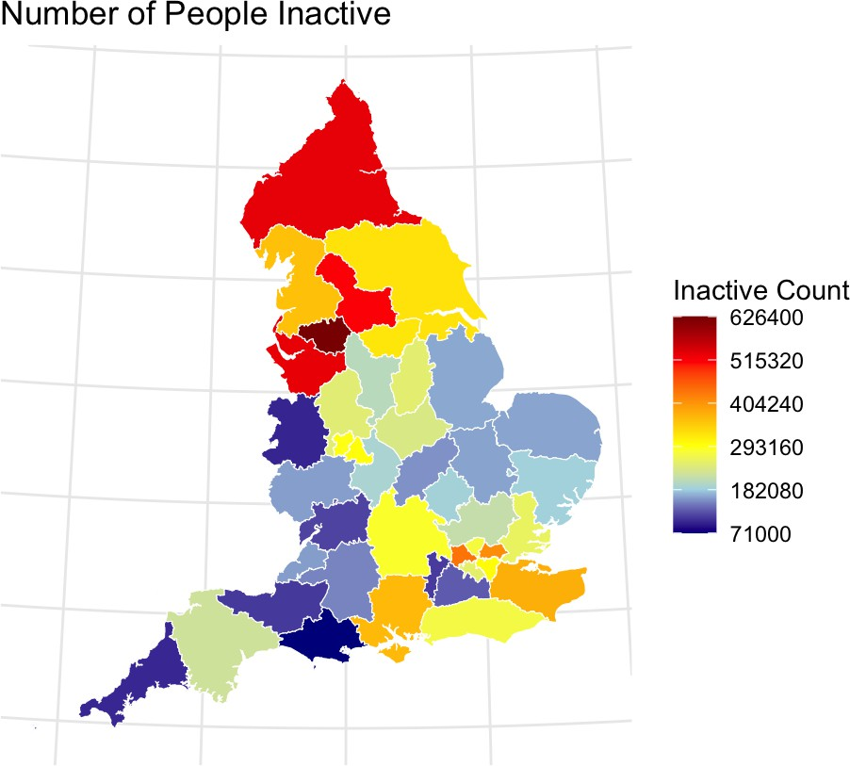
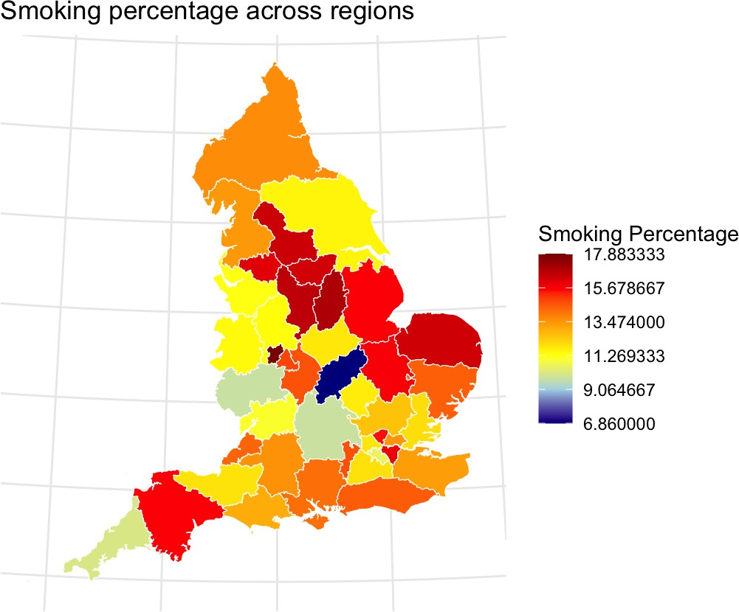
Disease mapping of cancer rates in the NHS regions

Slide 32
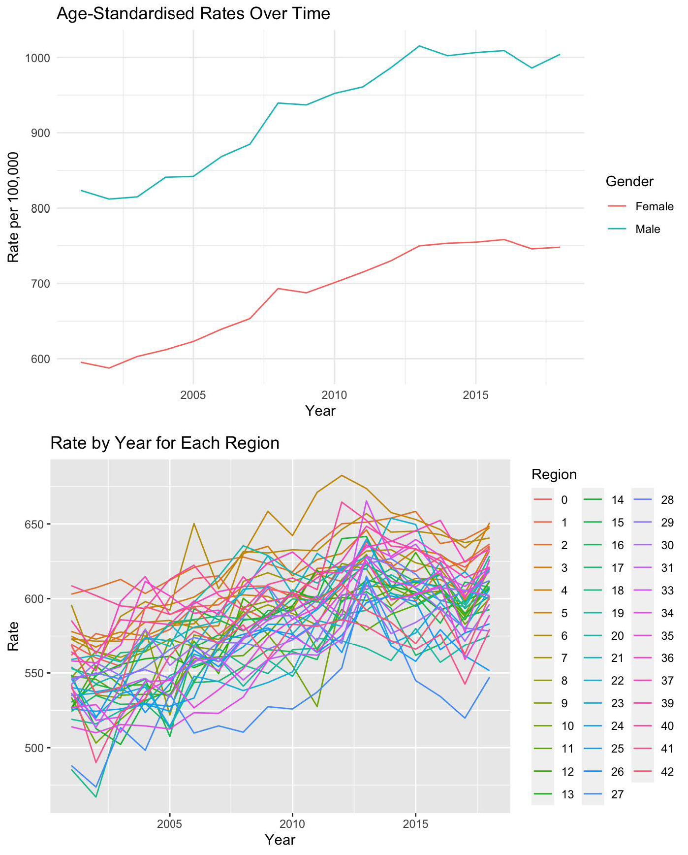
Trend in cancer rates: Graphs from Iona’s dissertation

Slide 33
Discussion
The subject of statistics is vast, powerful and essential in public life.
A serious study (and devotion) of statistics can both be challenging and rewarding.
A mathematics department, such as ours, is the best place to study statistics.
“All knowledge is, in final analysis, history. All sciences are, in the abstract, mathematics. All judgements are, in their rationale, statistics.”
Statistics and statistical methods bring Unity in Diversity.

Slide 34
Take home summary slide
1
Search youtube: Joy of Statistics.
Bayes theorem: search youtube : Bayesian Trap
Search: For Today’s Graduate, Just One Word: Statistics Learn more about the Harold Shipman murder enquiry.
Read the book: The Art of Statistics by Sir David Spiegelhalter.
Find these slides from my website: https://www.sujitsahu.com/bookipsrdbs/resources/
2
3
4
5
6

Slide 35

Personalise: Butterfly/Starfish picture
Start learning R (a free to use computer programme). R allows you to be creative: For example, you can re-draw the following (cover image) of my book (see my website).

