Slide 1
生态位模型的原理与应用（二）
The Principles and Applications of Ecological Niche Model
中科院动物所 乔慧捷
2026-9

Slide 2
生态位建模方法
使用原始发生数据
使用栅格环境数据集
在模型中结合这两类数据流
使用该模型制作地图
地图被解释为物种“存在概率”
很简单，对不？

Slide 3
显然，没那么简单！

Slide 4
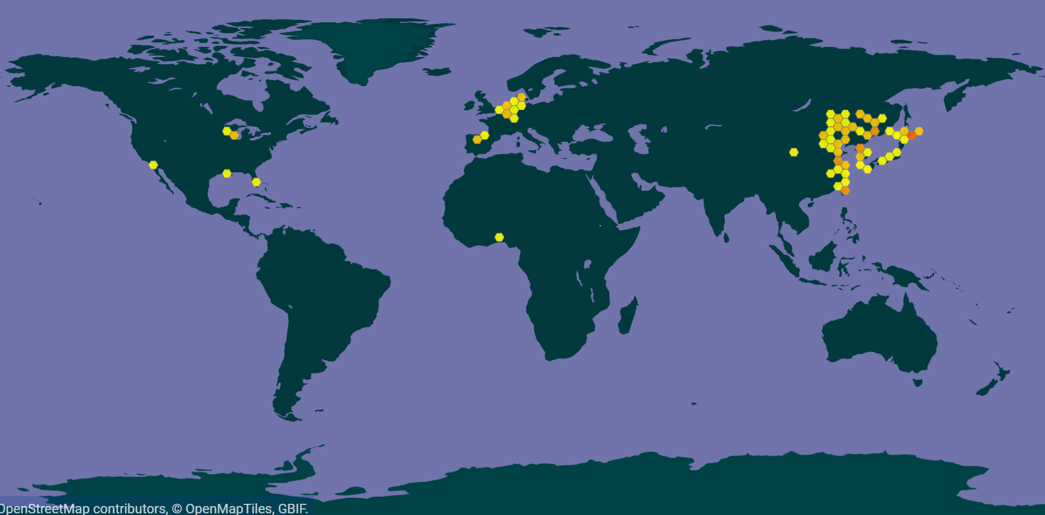
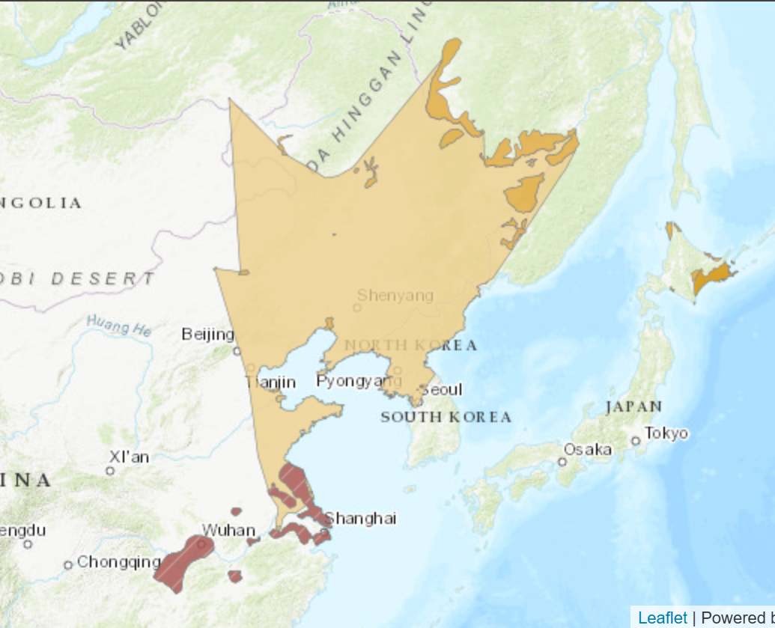
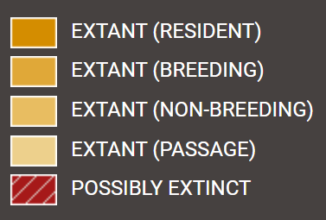
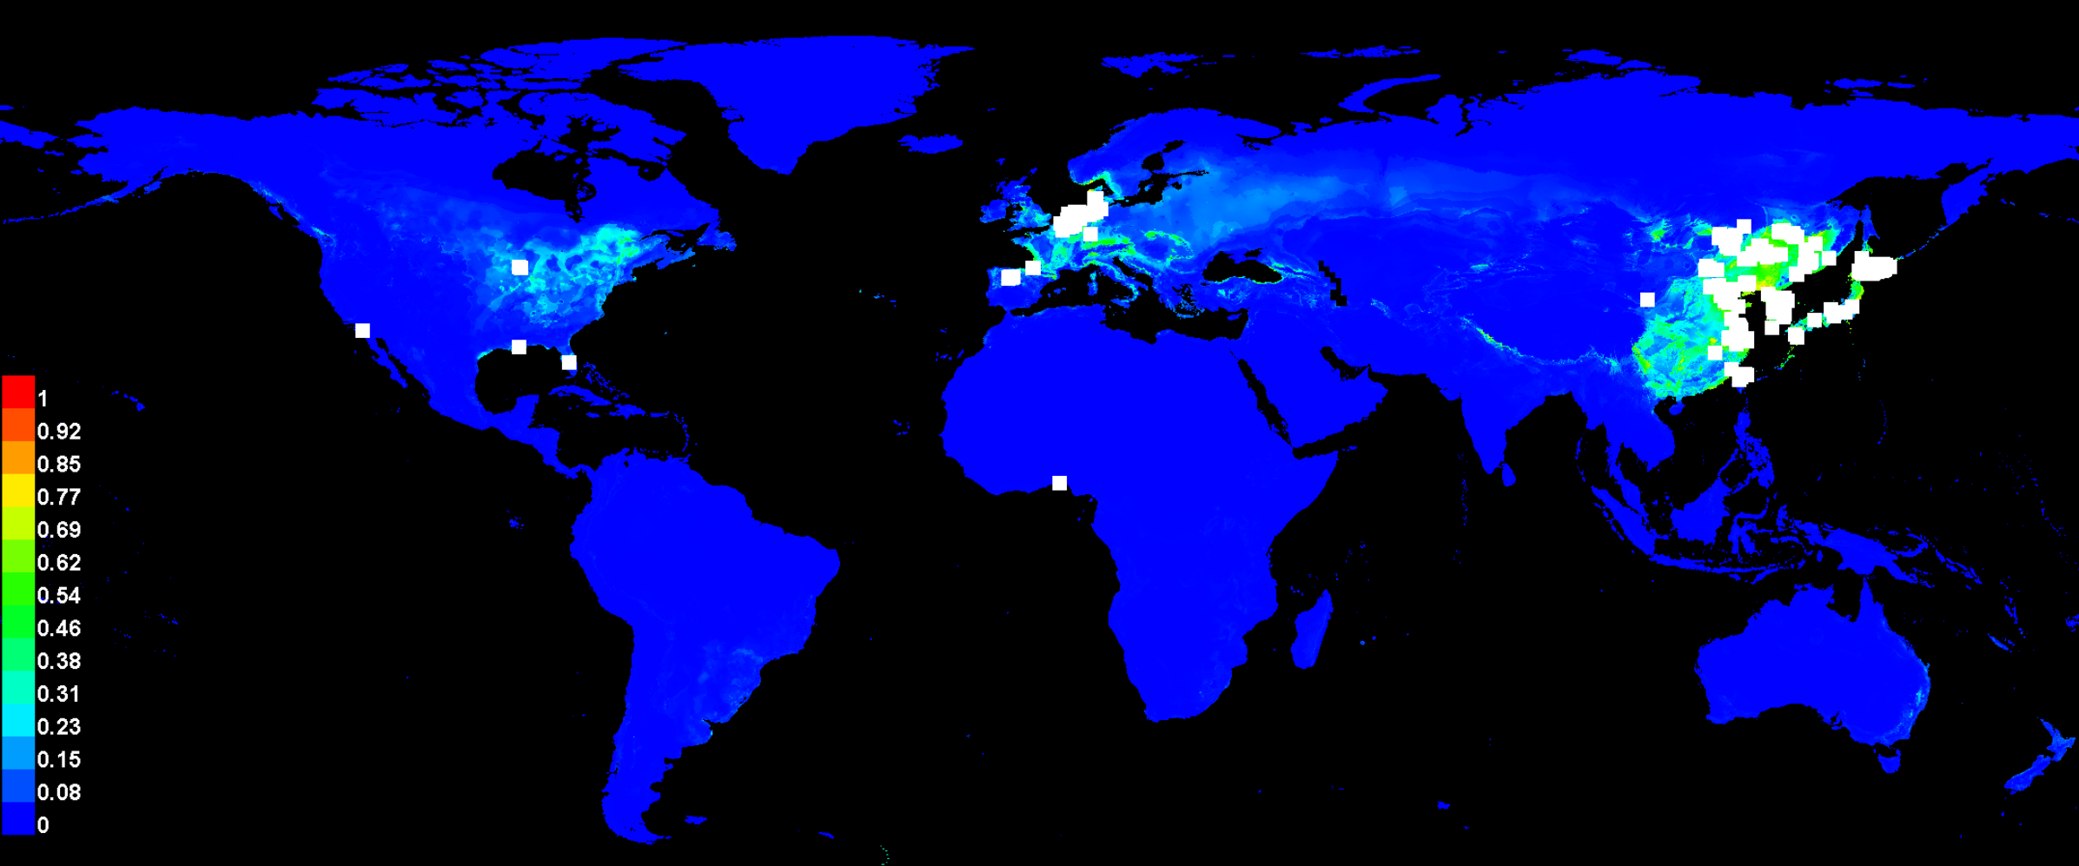
我们重新回顾一下前面做的事情

Slide 5
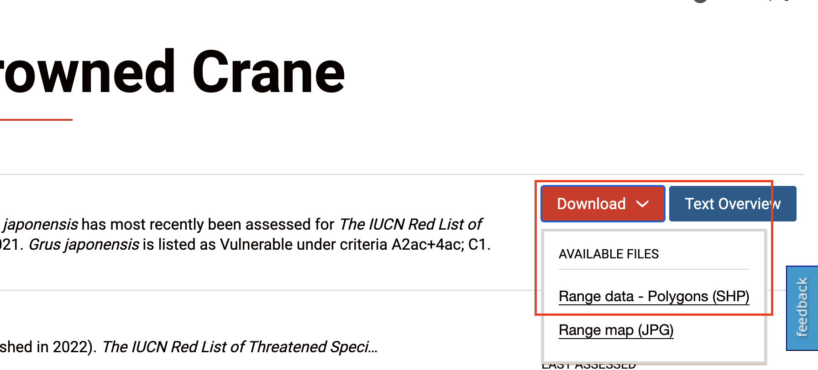
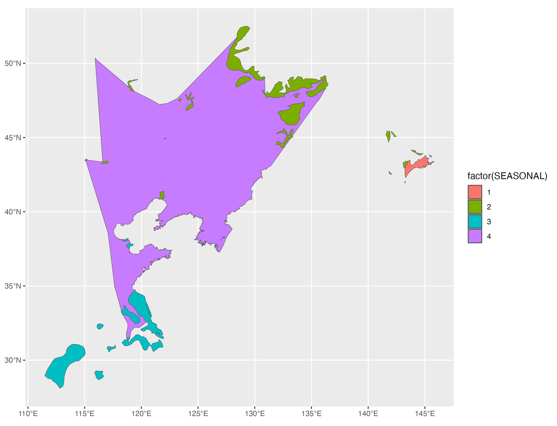
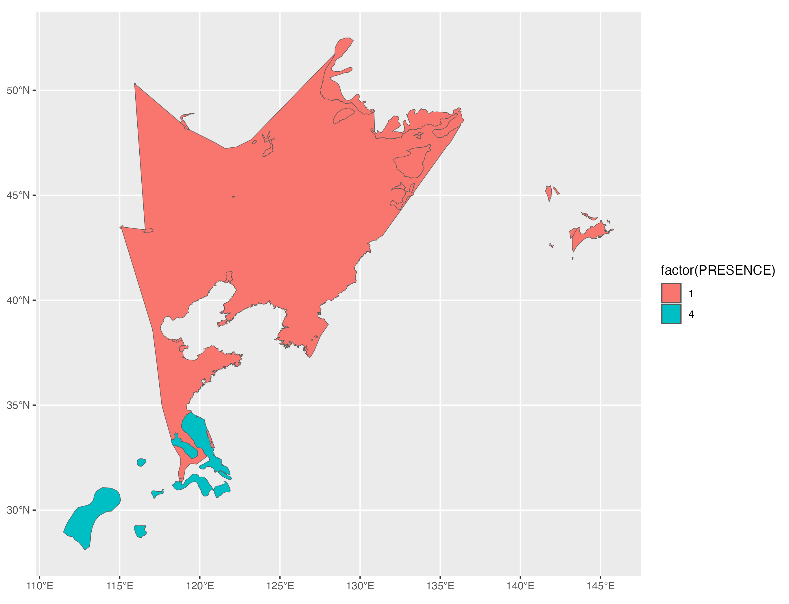
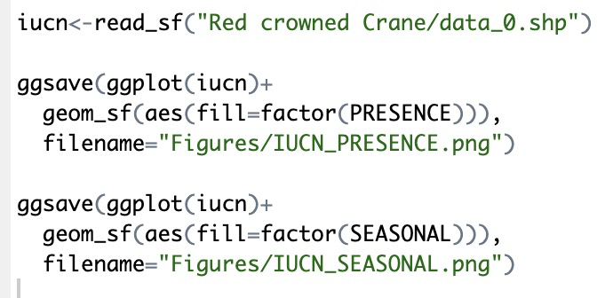
过滤物种发生数据

Slide 6
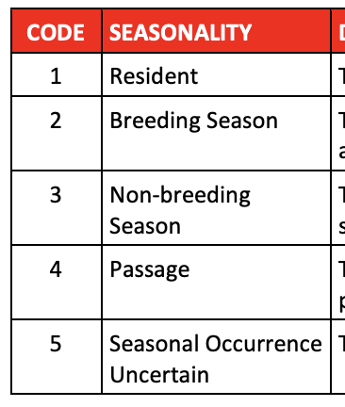
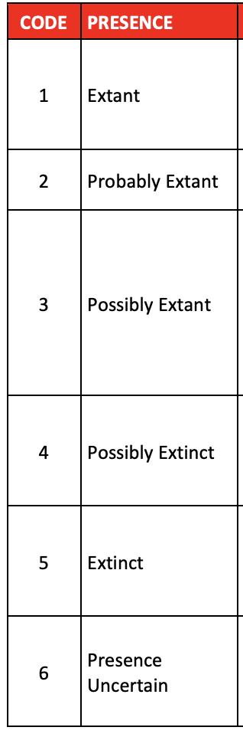
过滤物种发生数据
https://nc.iucnredlist.org/redlist/resources/files/1539614211-Mapping_attribute_codes_v1.16_2018.pdf

Slide 7
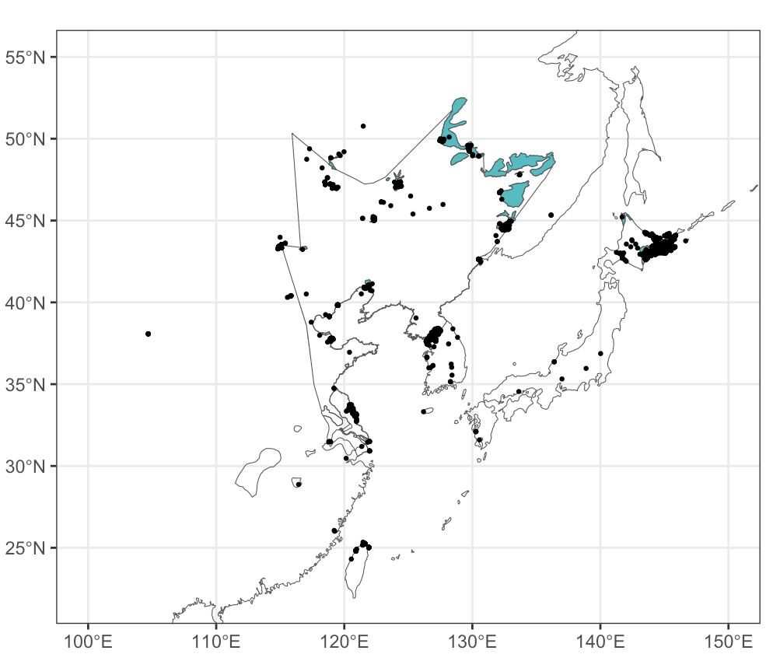
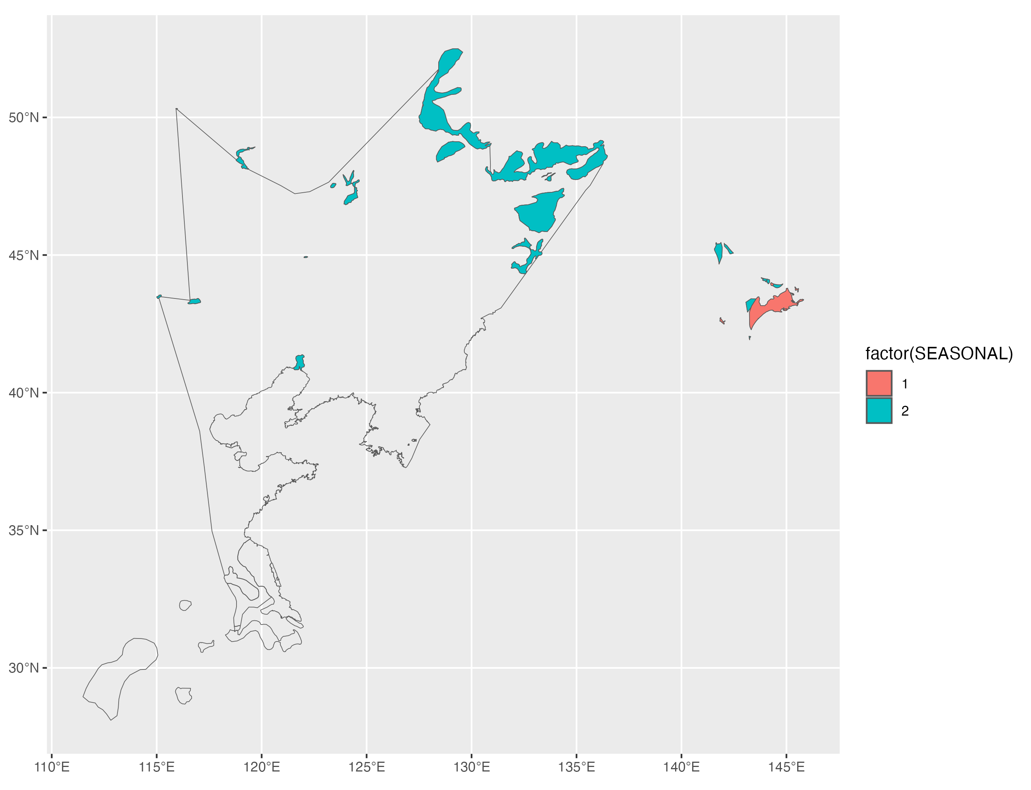
过滤物种发生数据

Slide 8
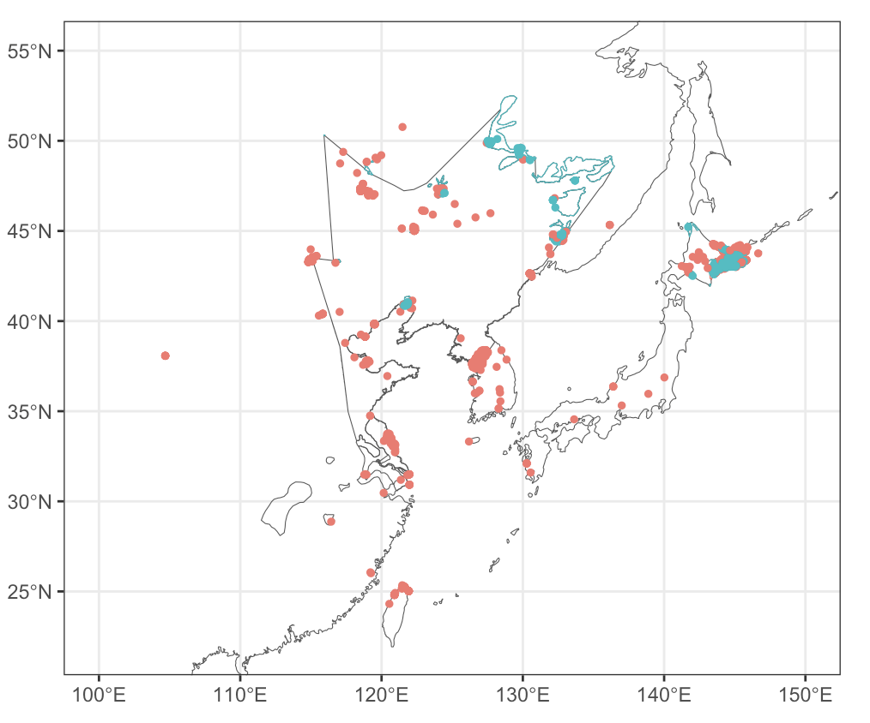
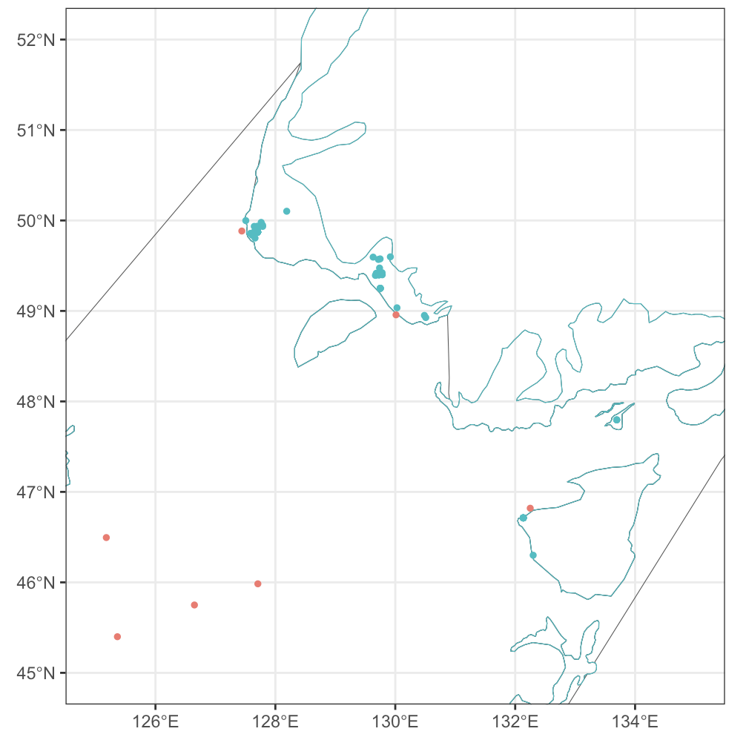
过滤物种发生数据

Slide 9
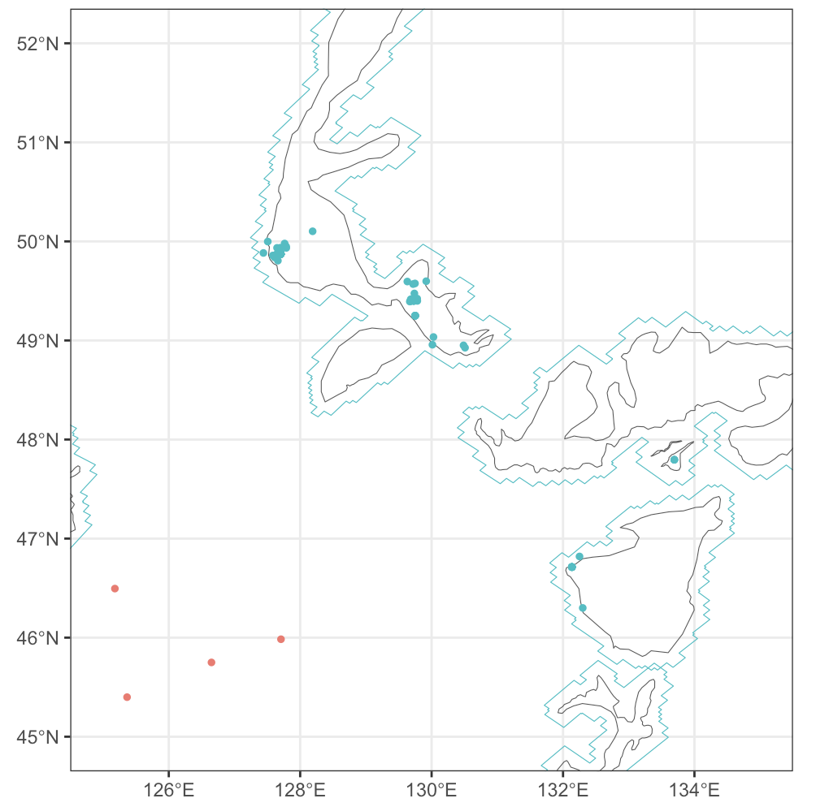
过滤物种发生数据

Slide 10

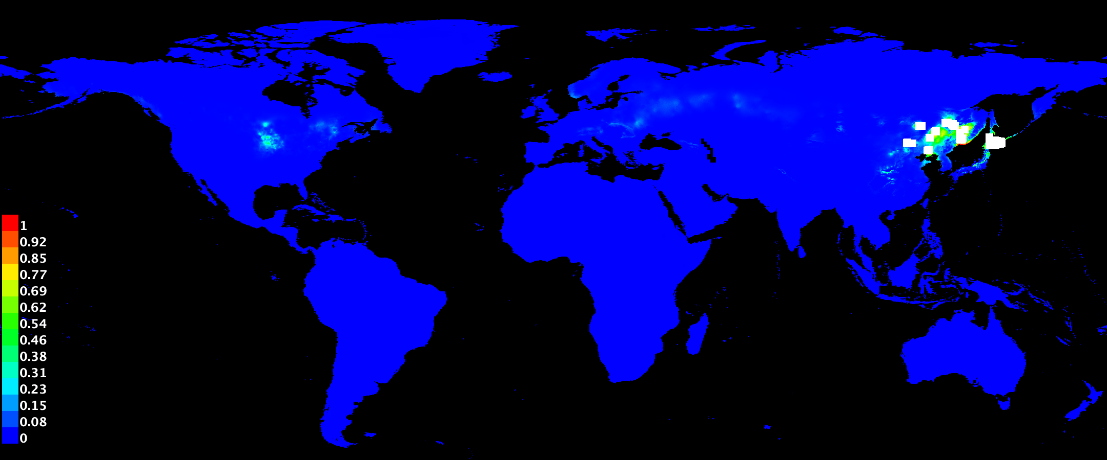
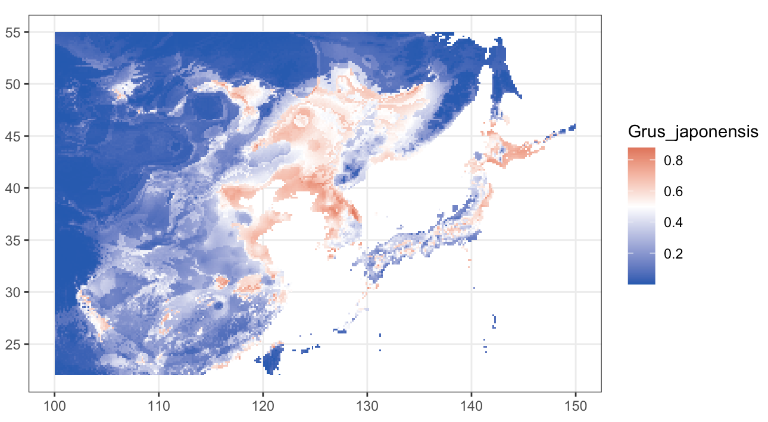
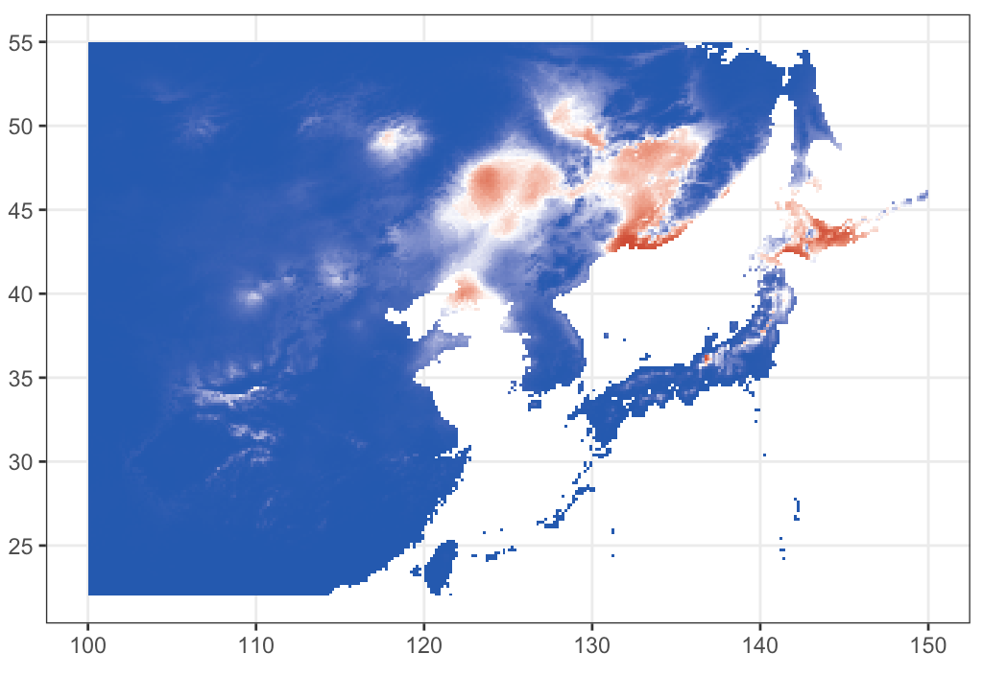
新的MAXENT模型

Slide 11

这就足够了吗？
NO!

Slide 12
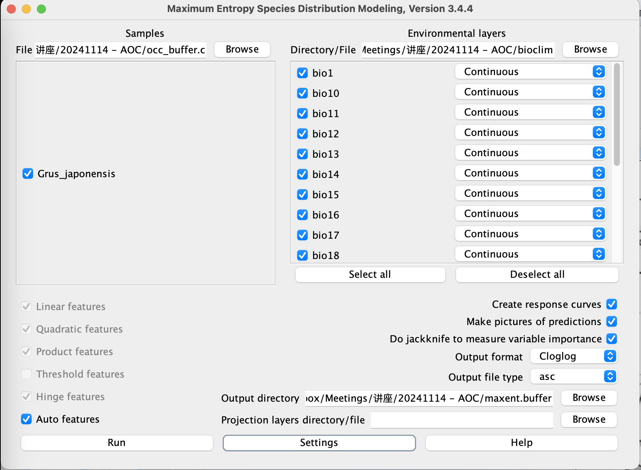
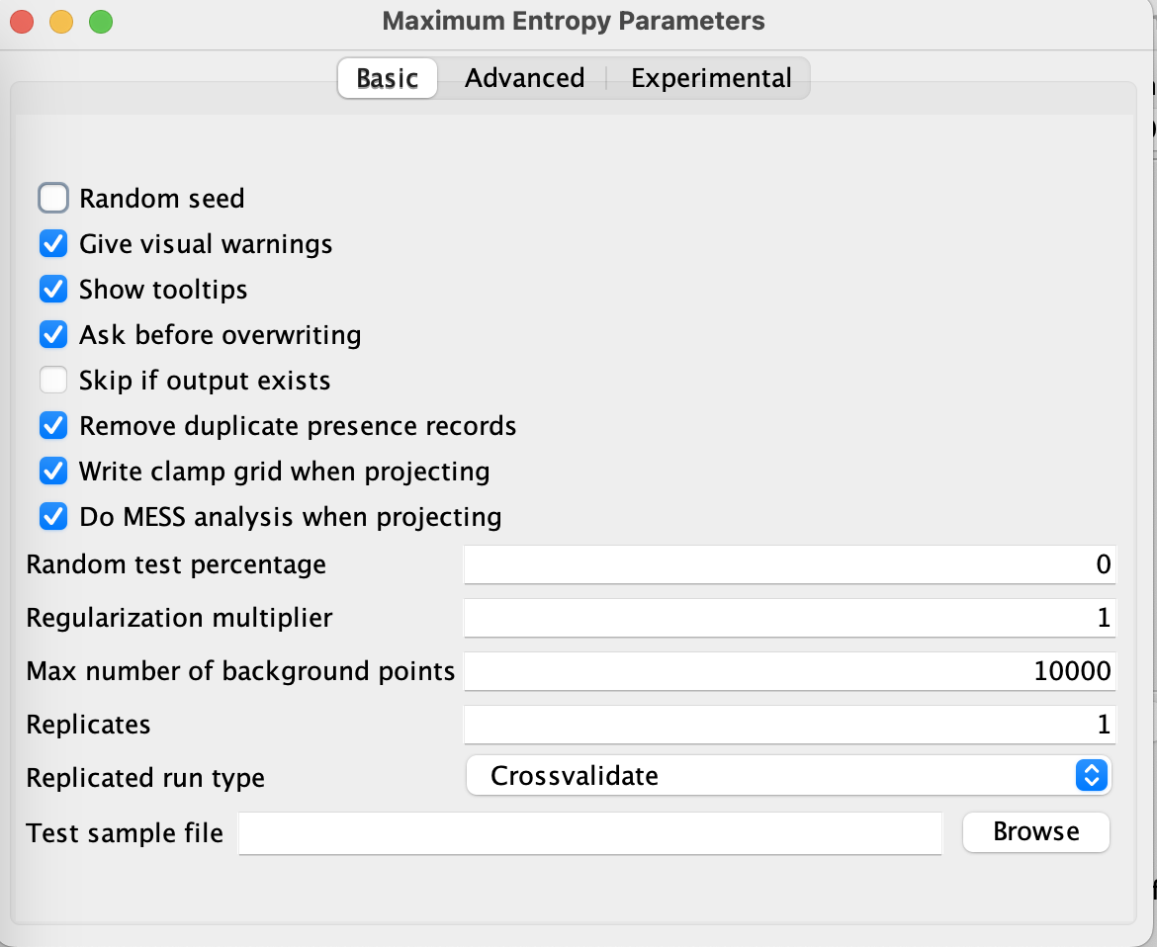

Slide 13
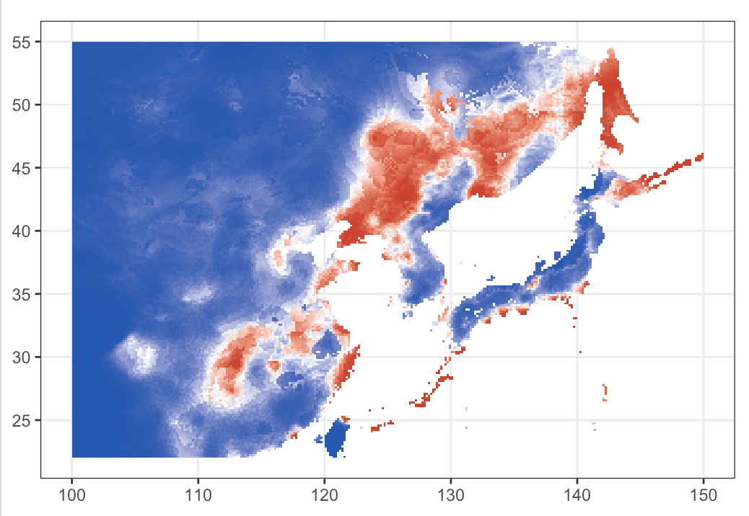
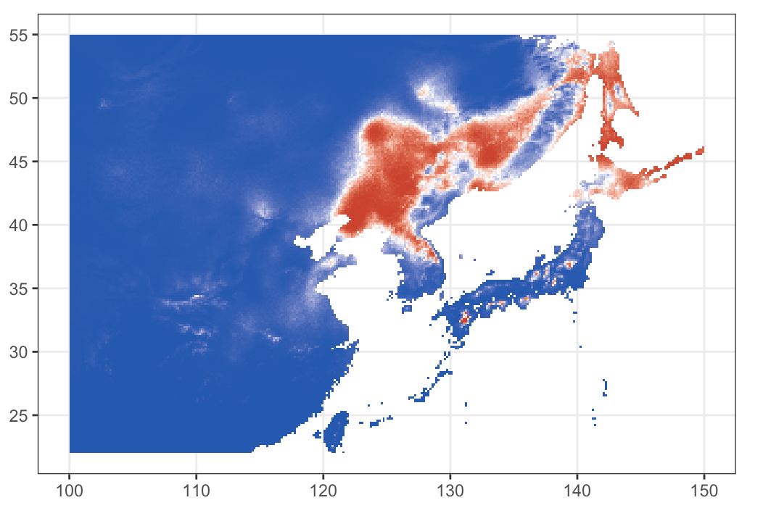
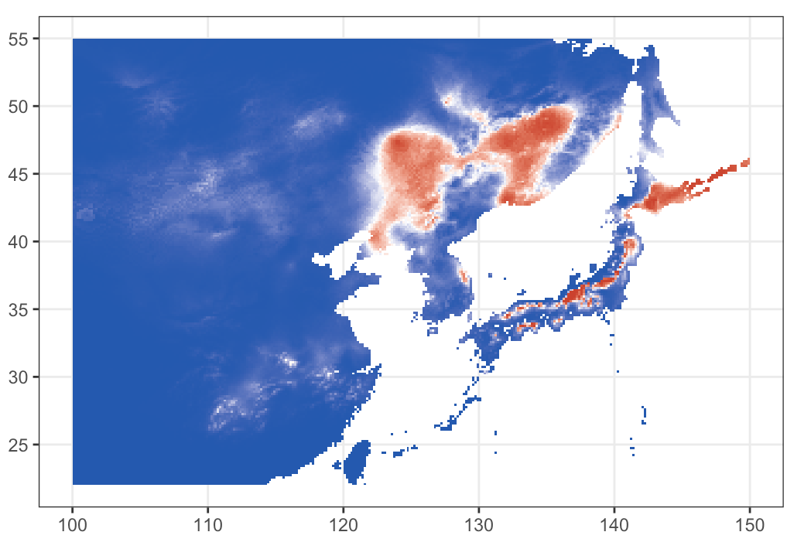
Auto
Linear
Quadratic
Product

Slide 14
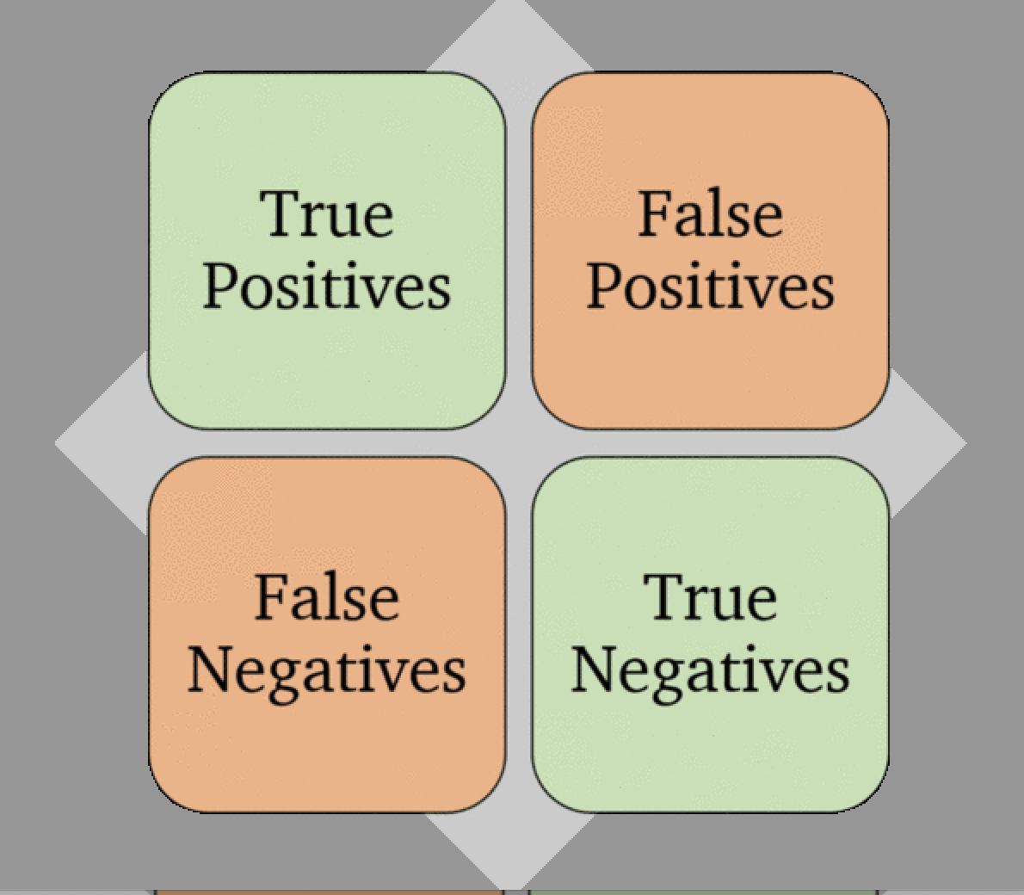
Specificity
Accuracy
ROC AUC
Sensitivity
AICc/BIC
KAPPA
TSS

Slide 15
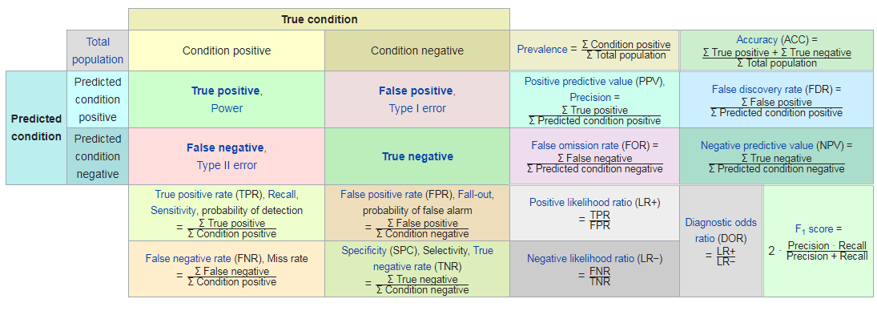
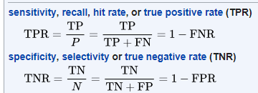
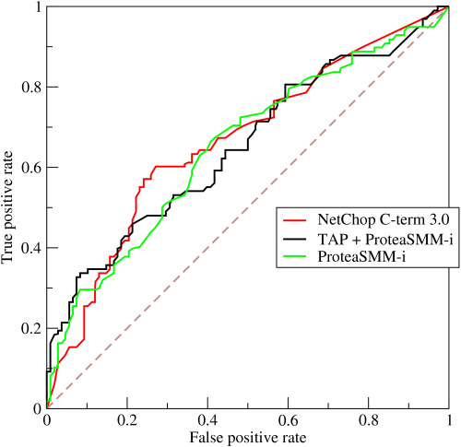

模型评估
https://en.wikipedia.org/wiki/Confusion_matrix

Slide 16
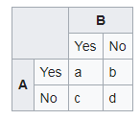
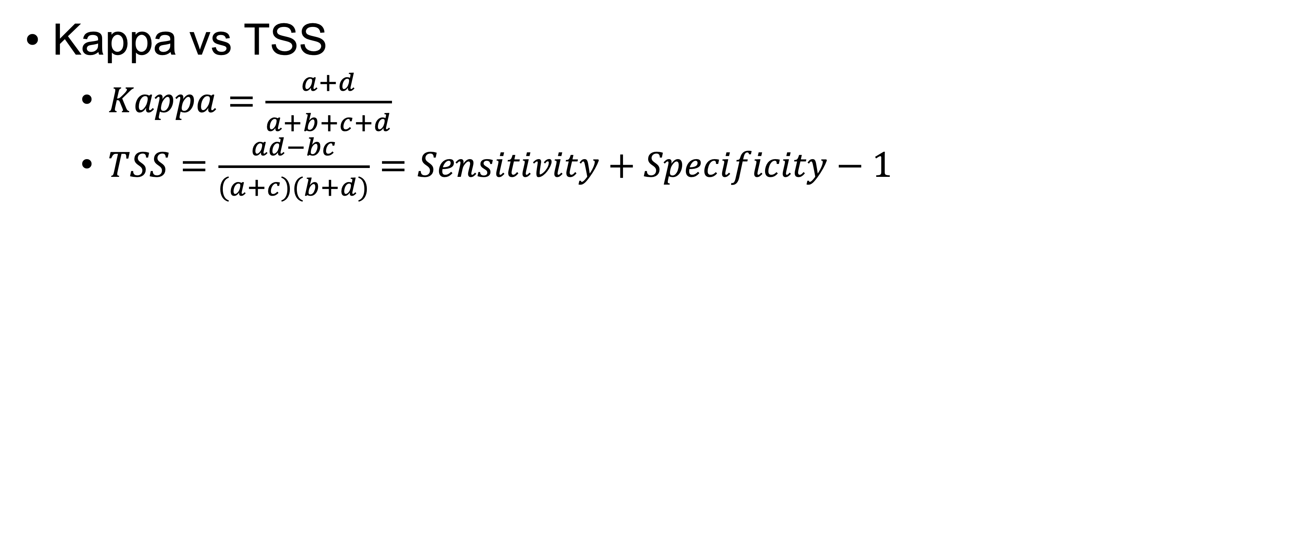
模型评估
Kappa vs TSS
  $Kappa=\frac{a+d}{a+b+c+d}$
  $TSS=\frac{ad−bc}{(a+c)(b+d)}=Sensitivity+Specificity−1$
Allouche, O., et al. (2006). Assessing the accuracy of species distribution models: prevalence, kappa and the true skill statistic (TSS). Journal of Applied Ecology 43(6): 1223-1232.

Slide 17
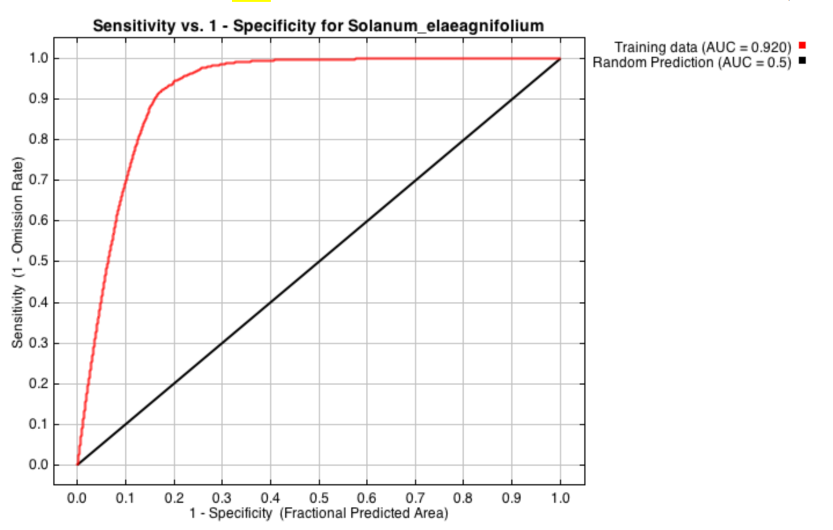
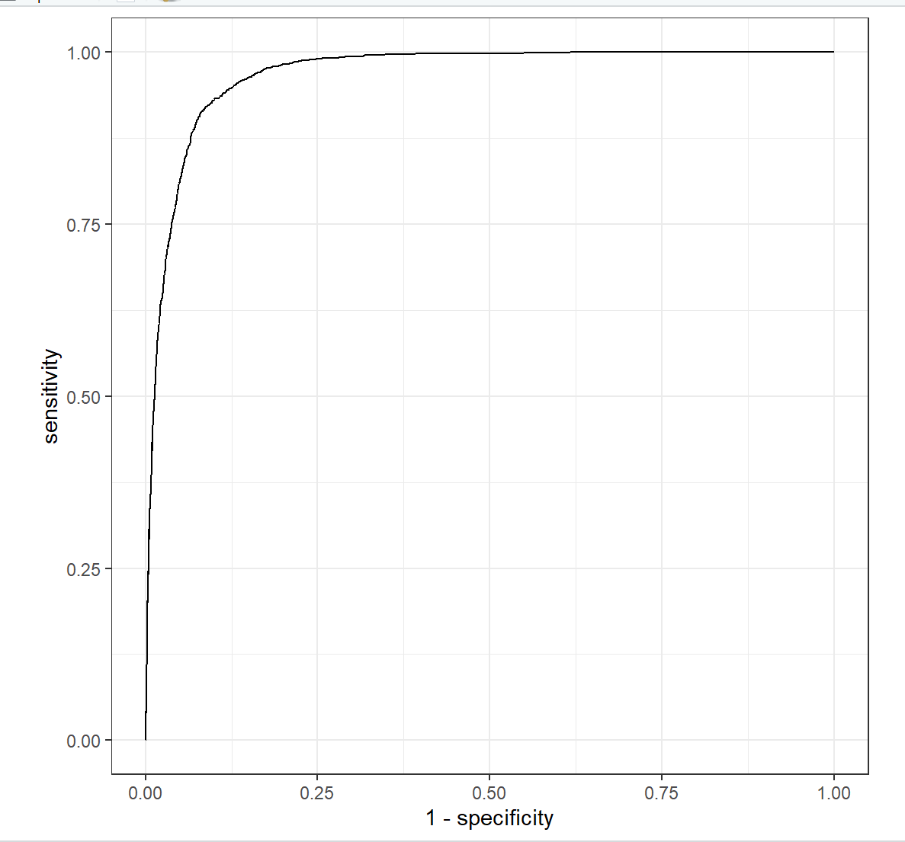
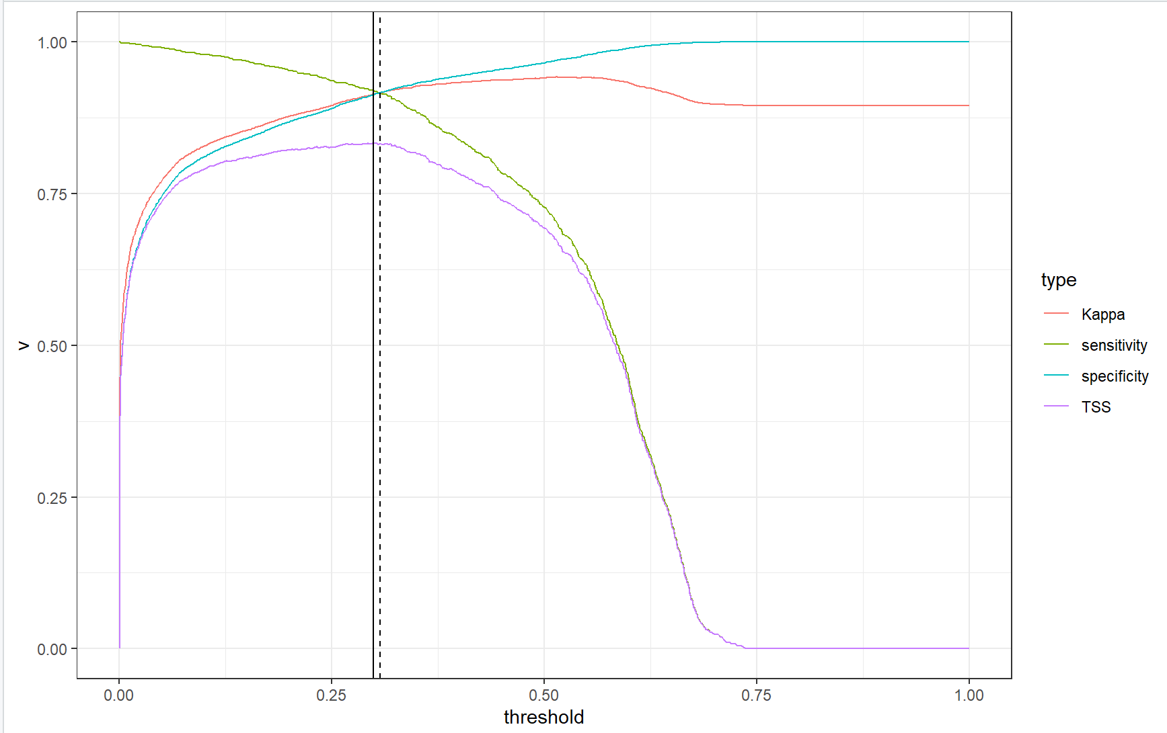
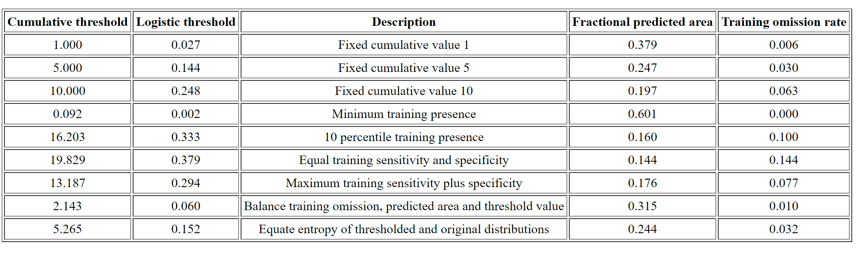

Slide 18
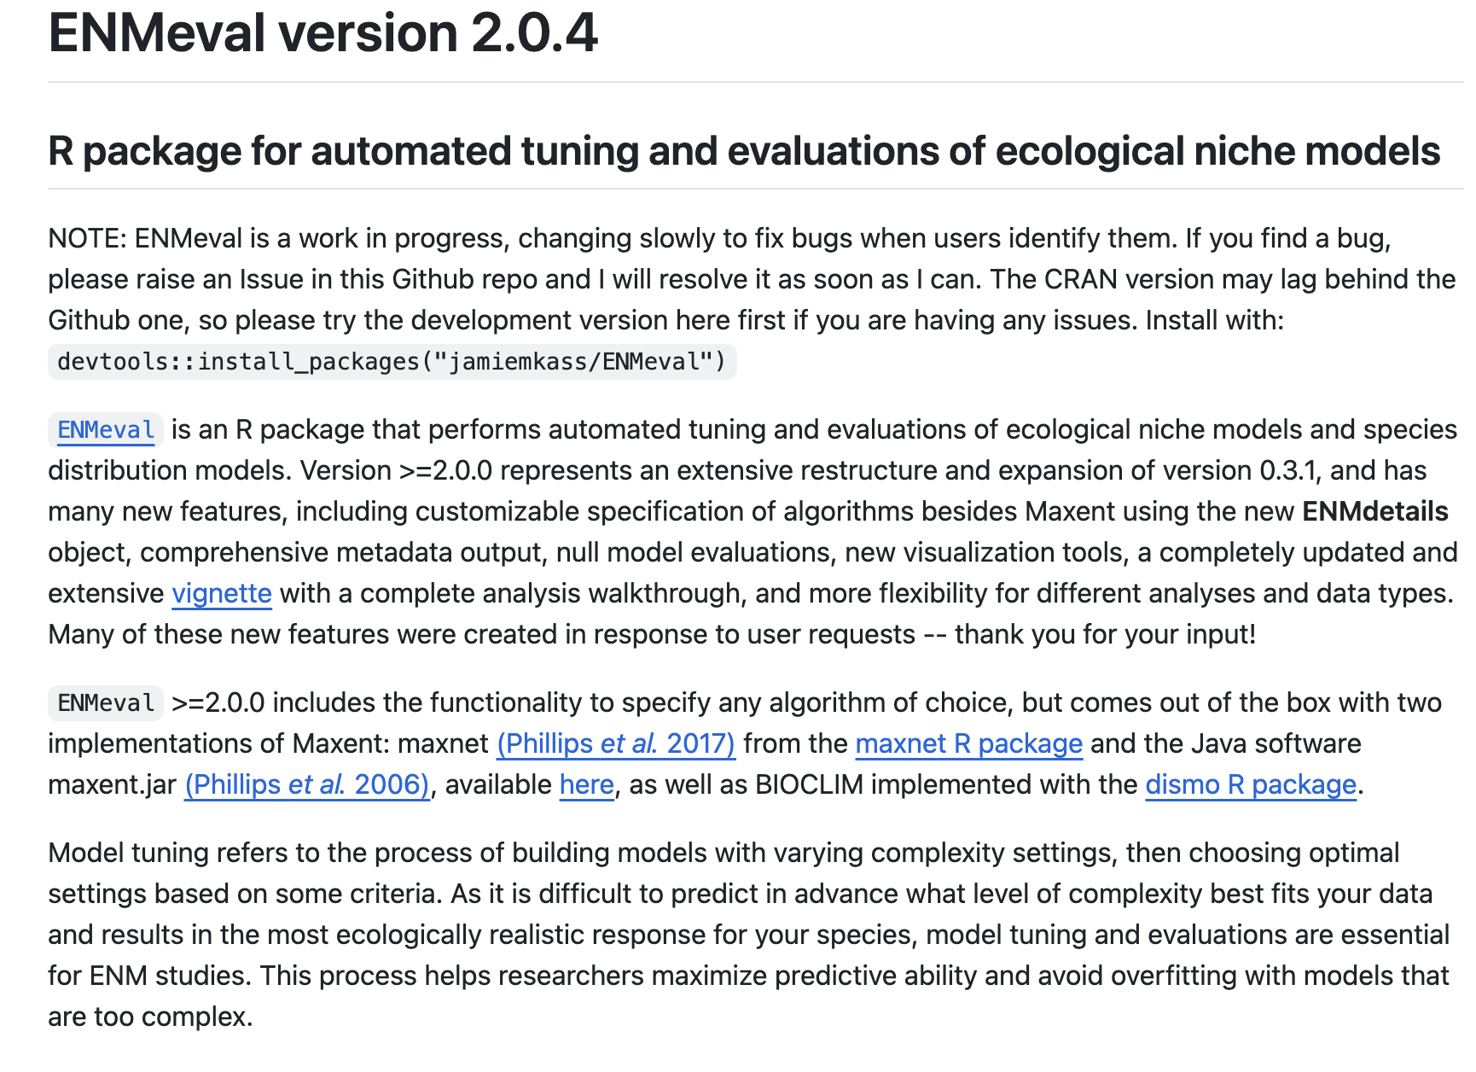
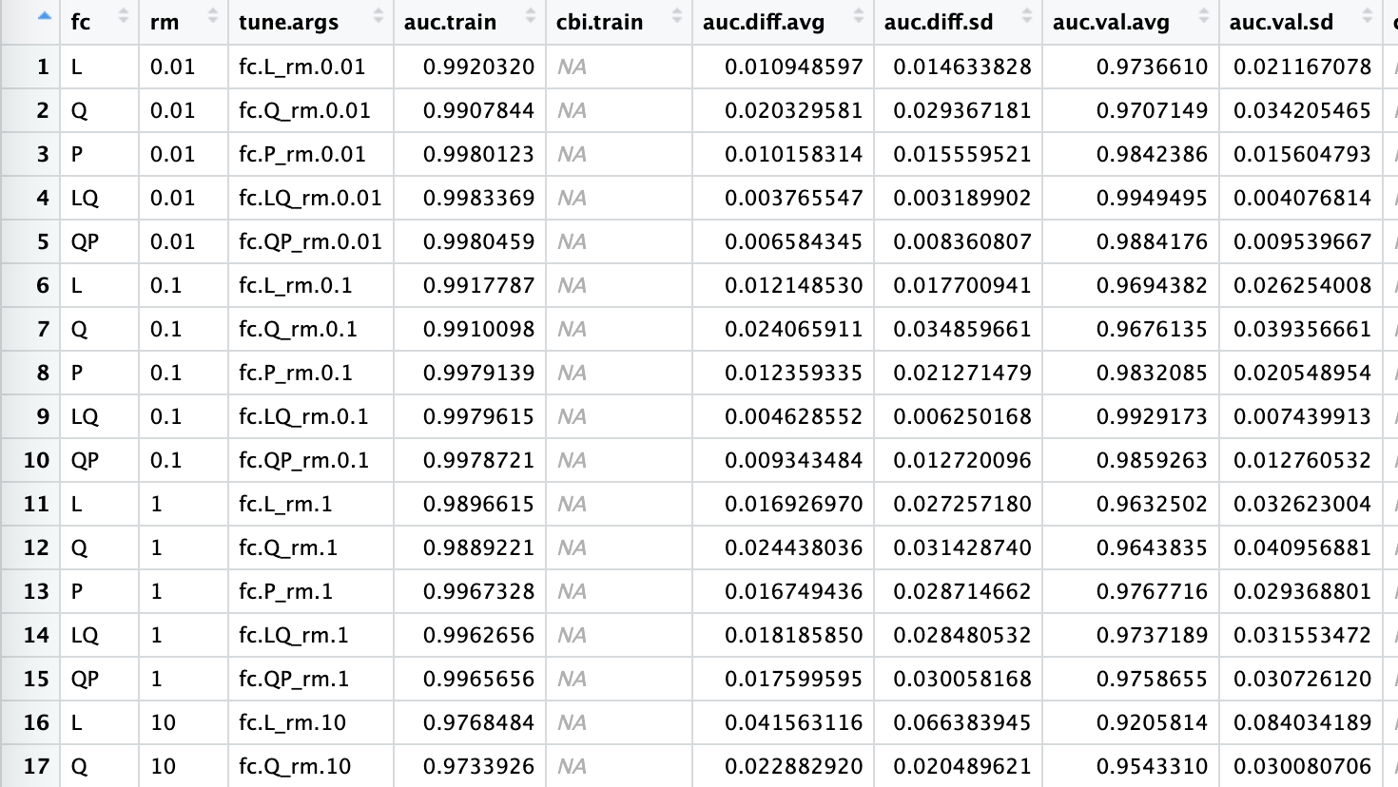
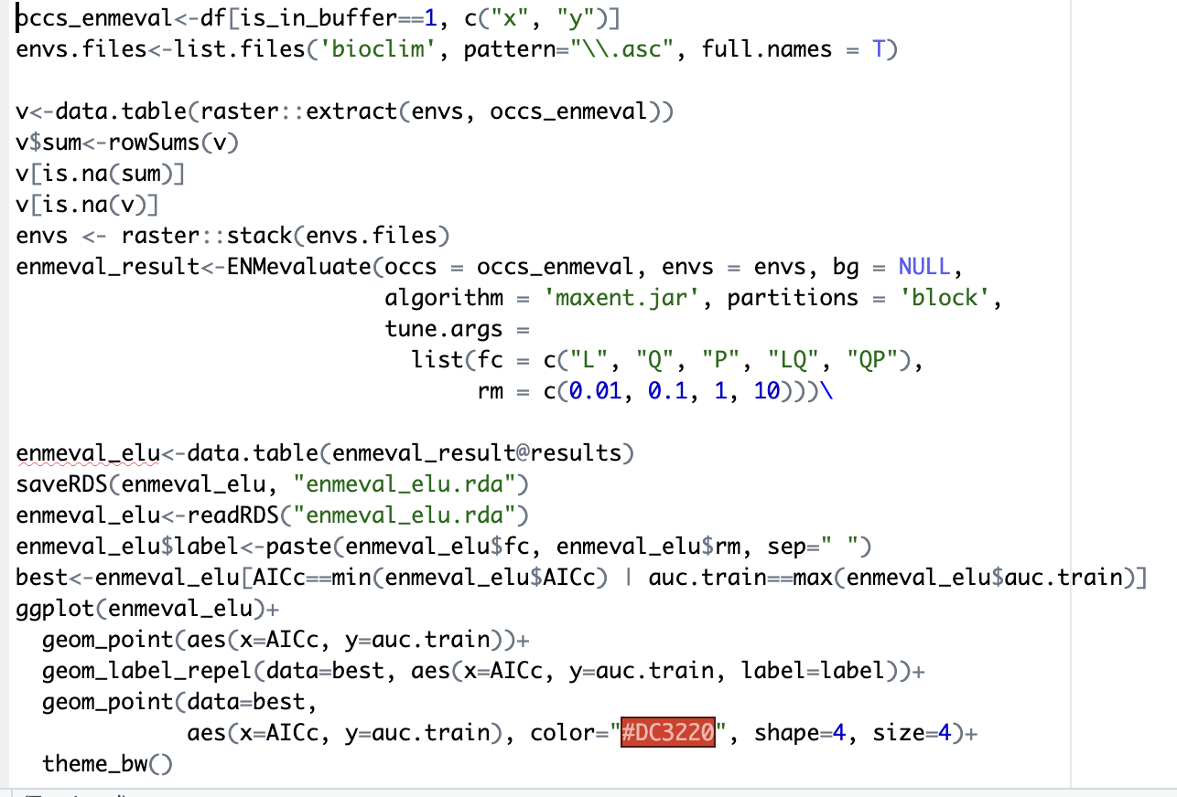
https://github.com/jamiemkass/ENMeval

Slide 19
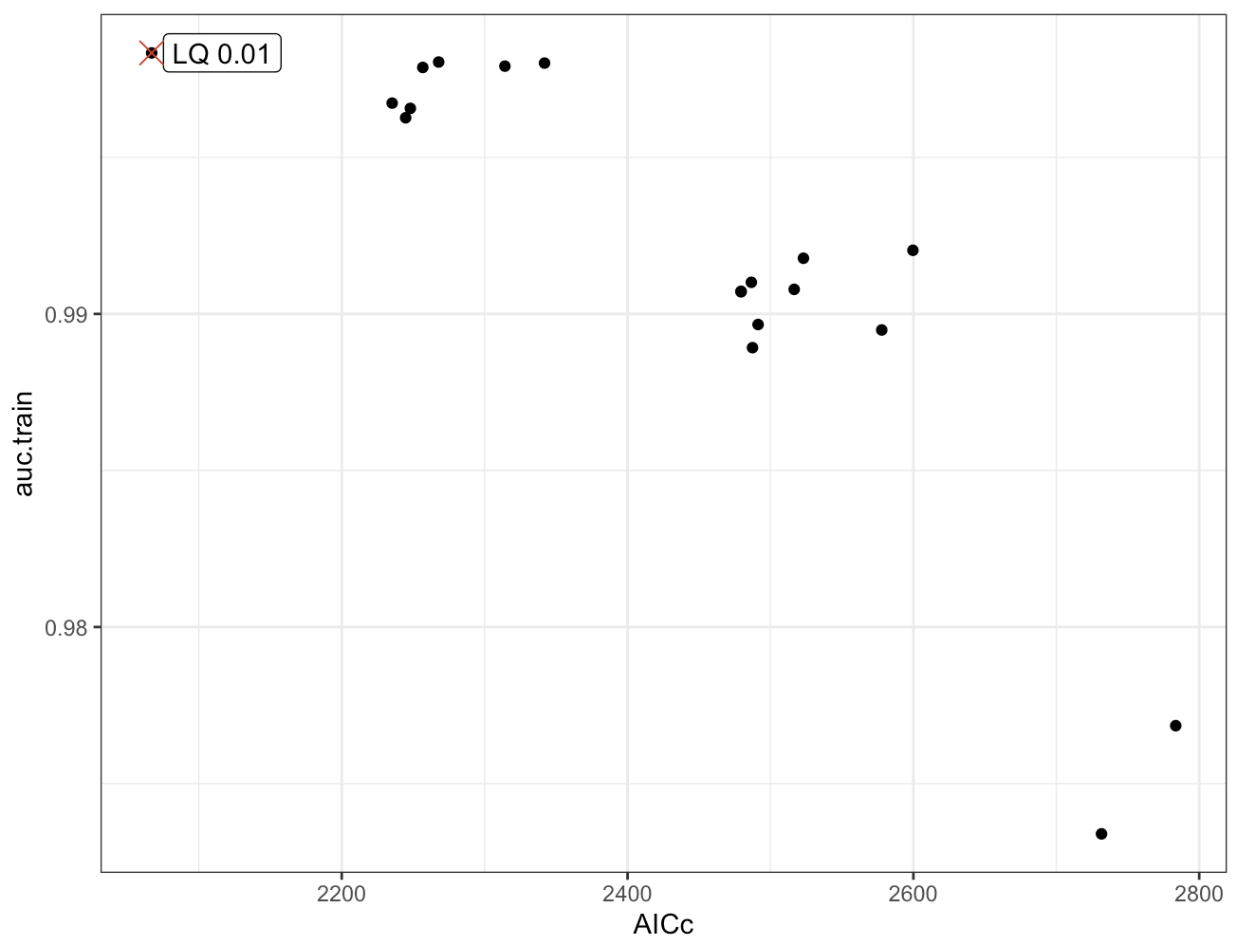
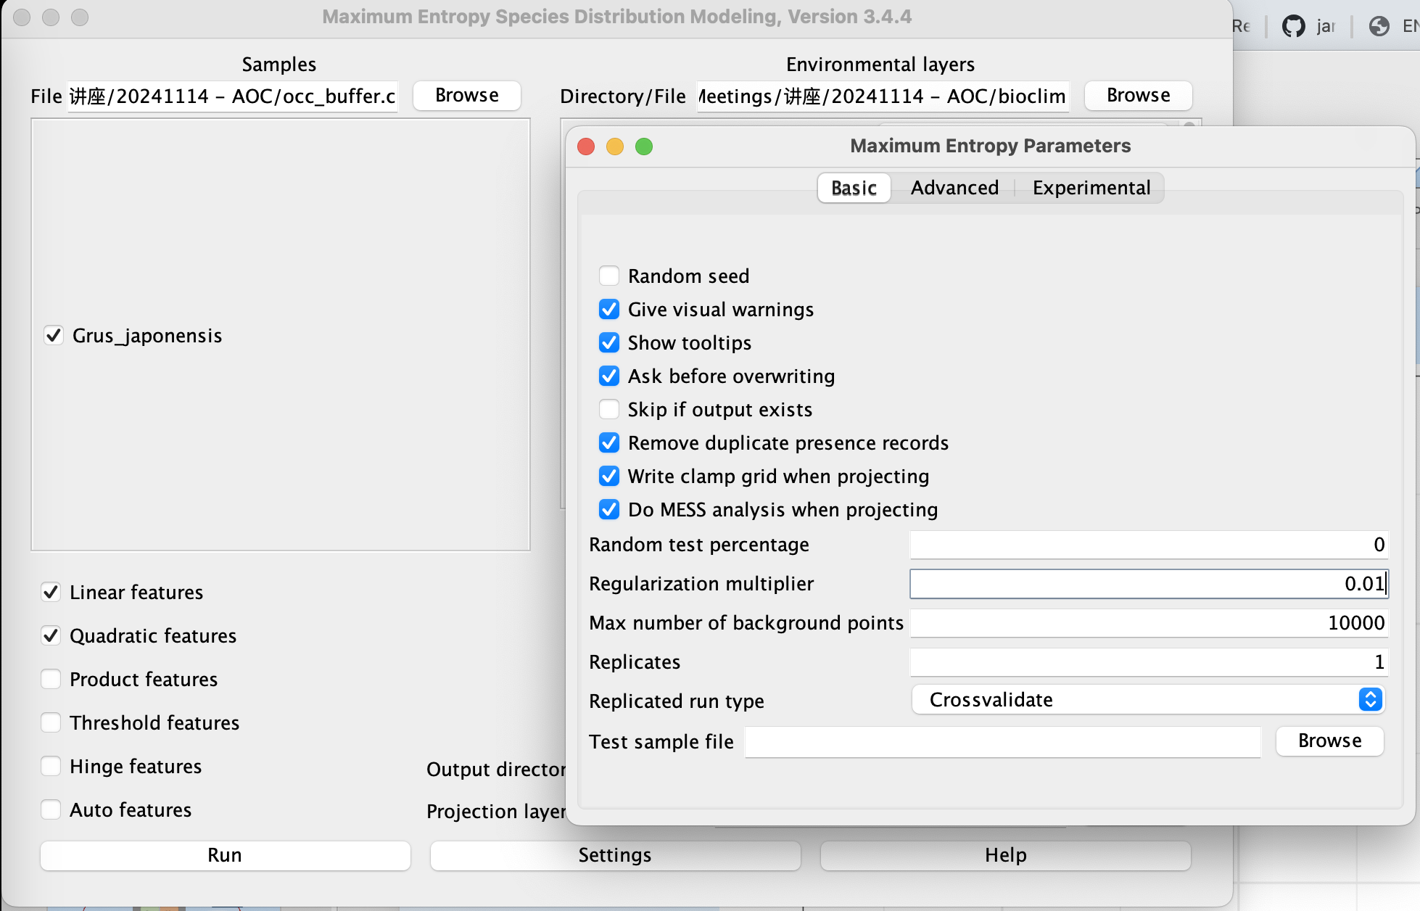

Slide 20
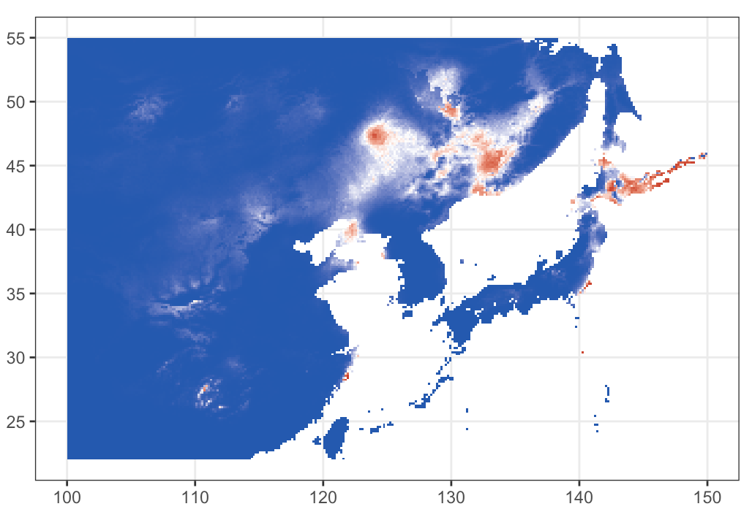
Auto
LQ + RM=0.01

Slide 21
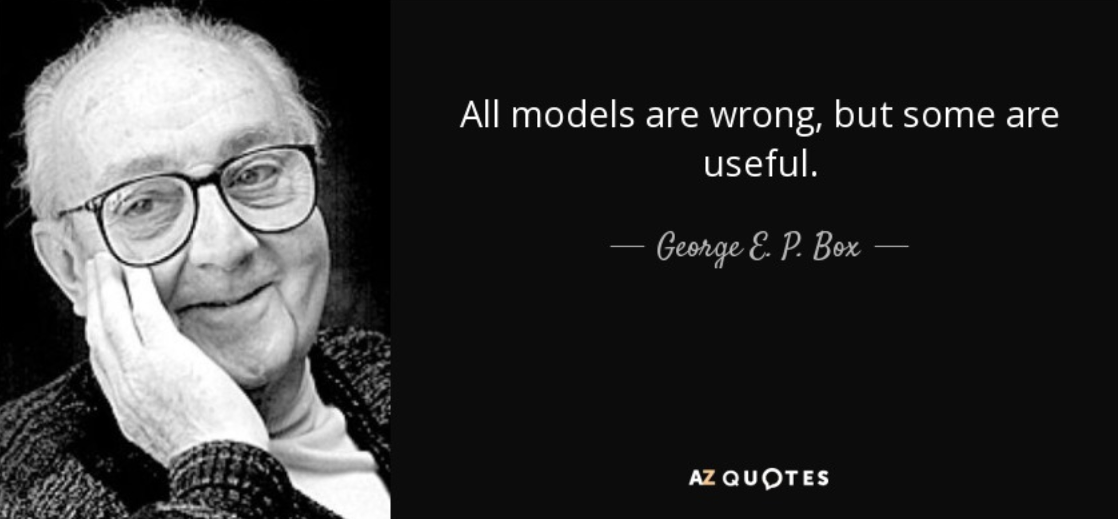
那么我们得到最好的模型了吗？

Slide 22
接下来还需要做些什么？
更多的生态位模型
环境变量选择
如何生成伪负样本/背景点
缓冲区
等等……

Slide 23
流行的生态位模型/物种分布模型
Model | Algorithm | Key Features
Maxent | Maximum Entropy | - Presence-only data - Robust and user-friendly - Handles complex interactions well
GLM | Generalized Linear Model | - Regression-based - Models linear relationships - Flexible and interpretable
GAM | Generalized Additive Model | - Nonlinear extensions of GLM - Captures complex environmental interactions
BRT | Boosted Regression Trees | - Ensemble of regression trees - Handles complex and large datasets - High predictive power
Random Forest | Ensemble Decision Trees | - Builds multiple decision trees - Effective for nonlinear and high-dimensional data
ENFA | Ecological Niche Factor Analysis | - Presence-only data - Calculates niche in environmental space - Good for limited data
BIOCLIM | Bioclimatic Envelope Model | - Bioclimatic variables - Simple and interpretable - Best for preliminary analyses
GARP | Genetic Algorithm | - Uses genetic algorithms - Builds rule sets from environmental variables
MARS | Multivariate Adaptive Regression Splines | - Flexible regression model - Handles nonlinear interactions - Suitable for small datasets
CLIMEX | Mechanistic Model | - Uses climatic and physiological data - Often applied in agriculture and invasion studies
SDM Frameworks | Various (e.g., Biomod2, Wallace, dismo) | - Combines multiple SDMs - Ensemble modeling - Increases robustness and accuracy

Slide 24
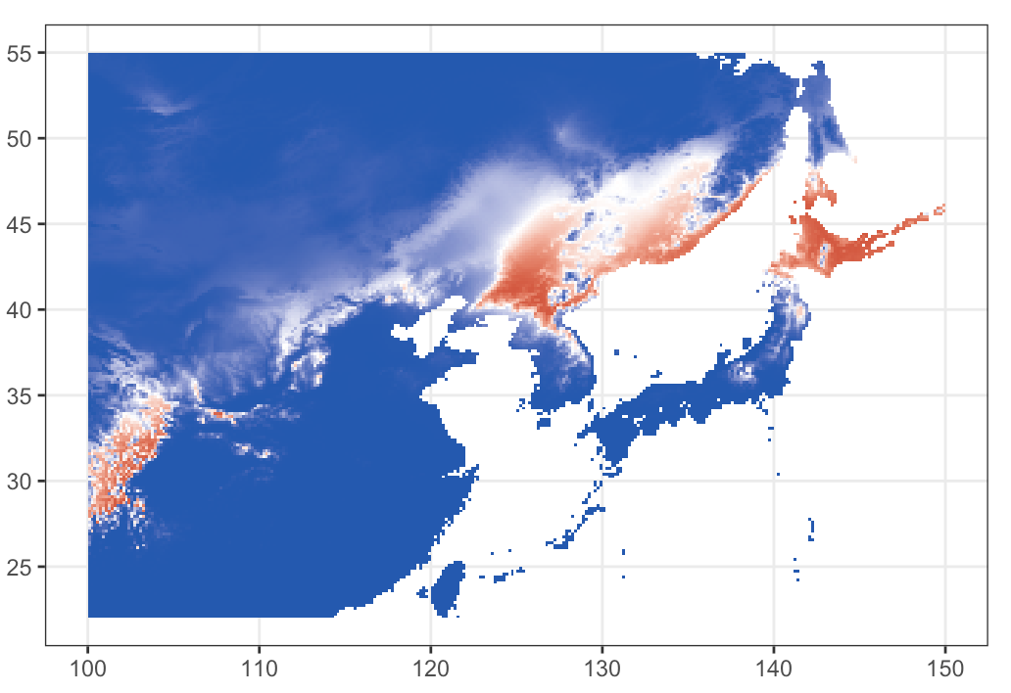
环境变量
BIO1 = Annual Mean Temperature
BIO2 = Mean Diurnal Range (Mean of monthly (max temp - min temp))
BIO3 = Isothermality (BIO2/BIO7) (×100)
BIO4 = Temperature Seasonality (standard deviation ×100)
BIO5 = Max Temperature of Warmest Month
BIO6 = Min Temperature of Coldest Month
BIO7 = Temperature Annual Range (BIO5-BIO6)
BIO8 = Mean Temperature of Wettest Quarter
BIO9 = Mean Temperature of Driest Quarter
BIO10 = Mean Temperature of Warmest Quarter
BIO11 = Mean Temperature of Coldest Quarter
BIO12 = Annual Precipitation
BIO13 = Precipitation of Wettest Month
BIO14 = Precipitation of Driest Month
BIO15 = Precipitation Seasonality (Coefficient of Variation)
BIO16 = Precipitation of Wettest Quarter
BIO17 = Precipitation of Driest Quarter
BIO18 = Precipitation of Warmest Quarter
BIO19 = Precipitation of Coldest Quarter
19 variables
1 & 12 only

Slide 25
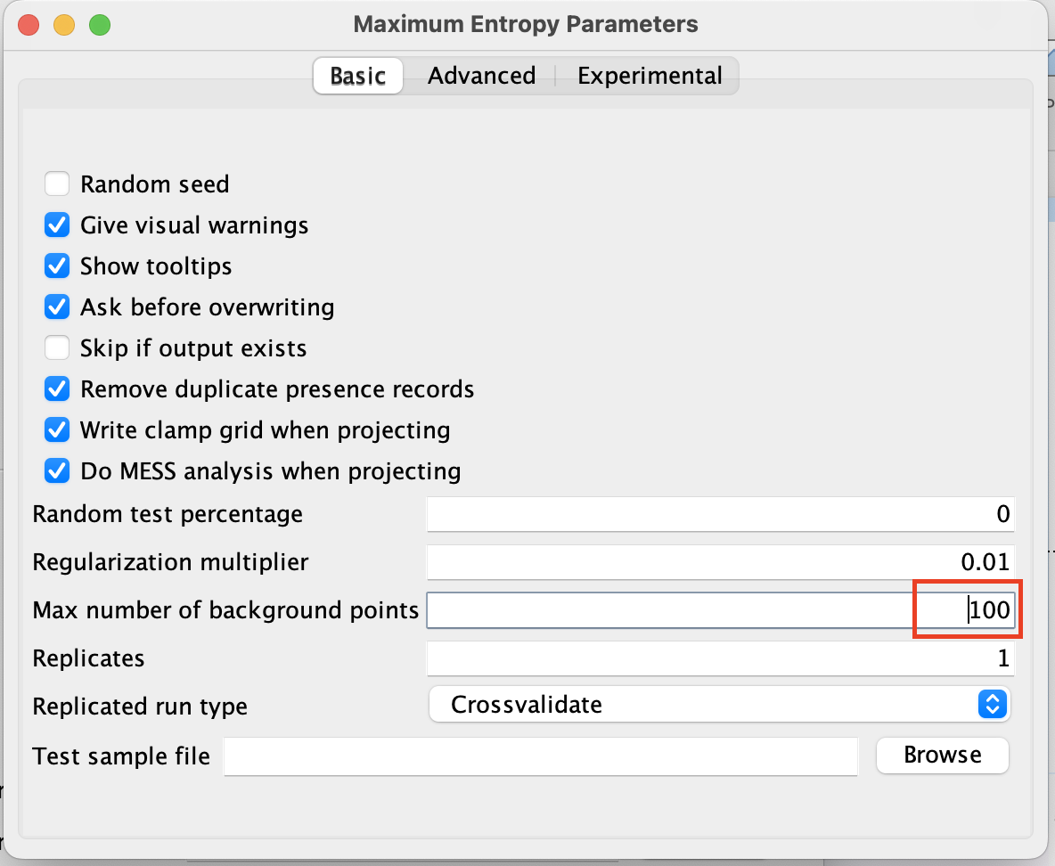
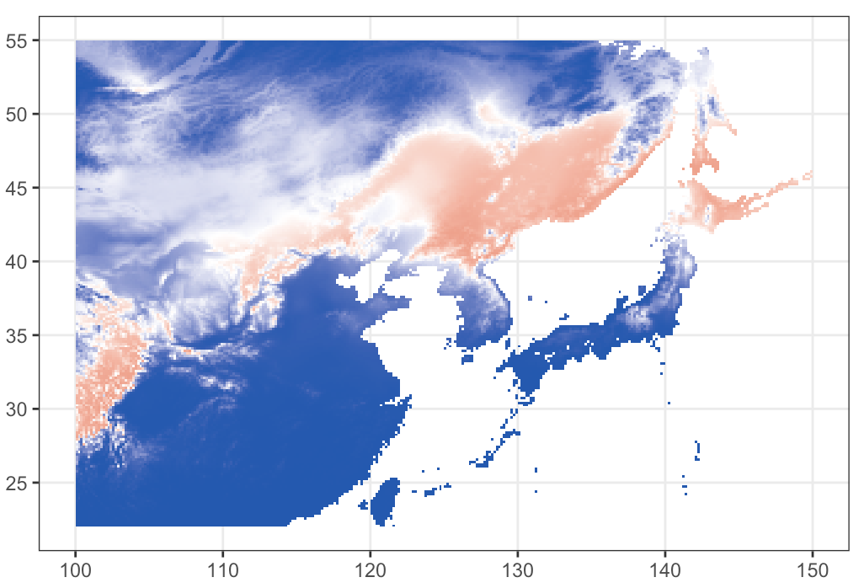
背景点数目
10000 bg
100 bg

Slide 26
核心信息
生态位模型概念上简单，但在实践中复杂
生态位模型不仅限于 Maxent 模型
不存在万能解决方案
生态学洞察力至关重要
数据是核心
生态位模型只是生态研究中的一个工具
谨慎选择环境变量
模型评估至关重要
推荐使用 R 语言进行生态位模型分析

