Slide 1
生态位模型的原理与应用（三）
The Principles and Applications of Ecological Niche Model
中科院动物所 乔慧捷
2026-9

Slide 2
如何在研究工作中使用生态位模型

Slide 3
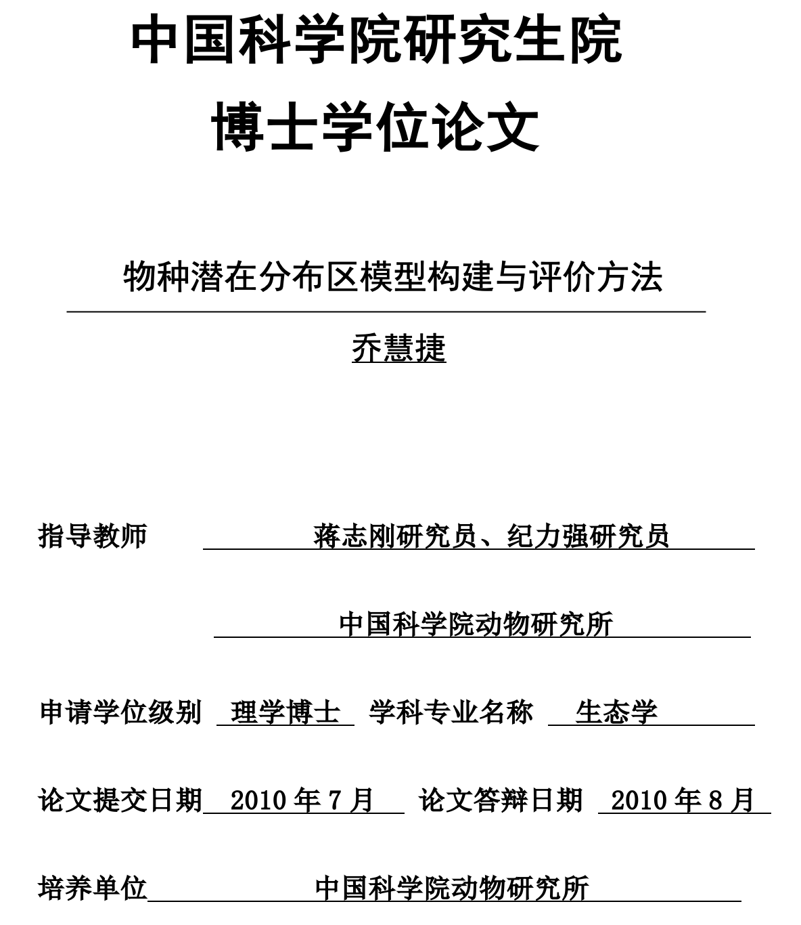
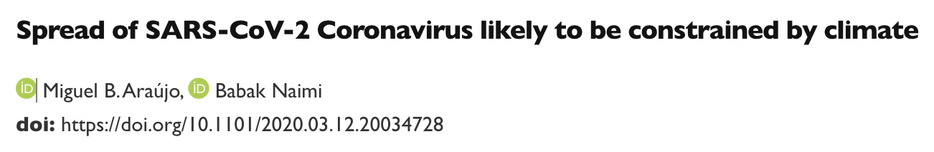
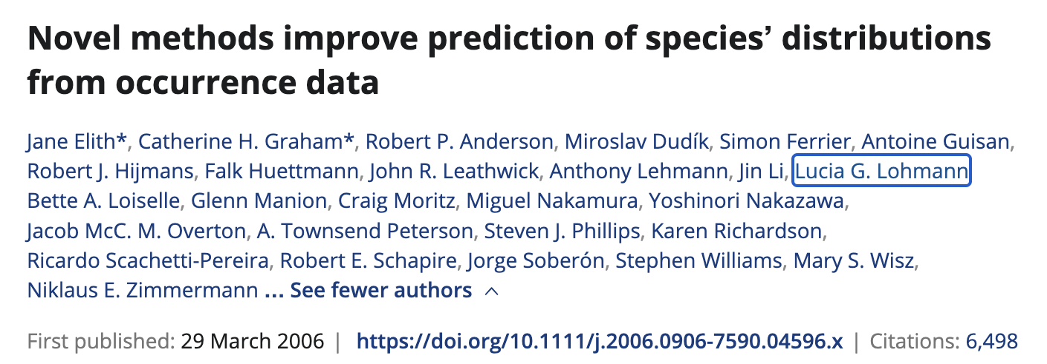
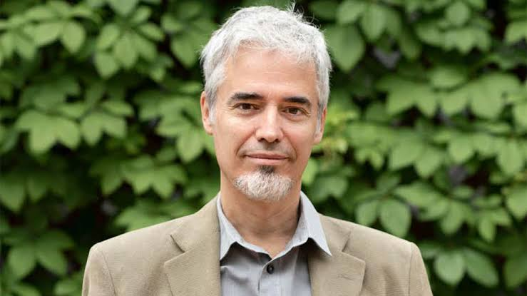
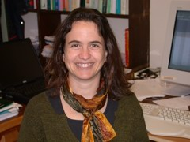

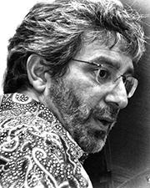
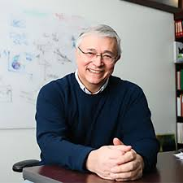
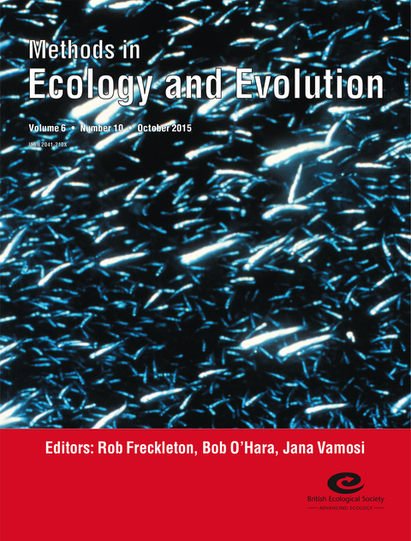
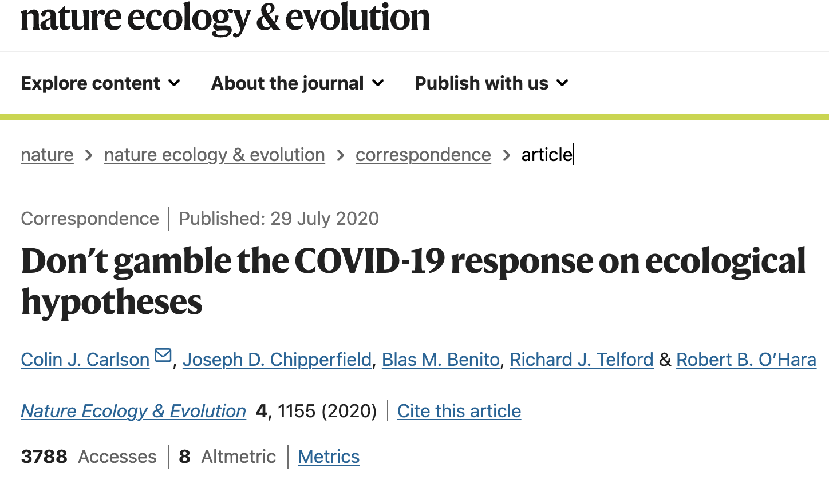
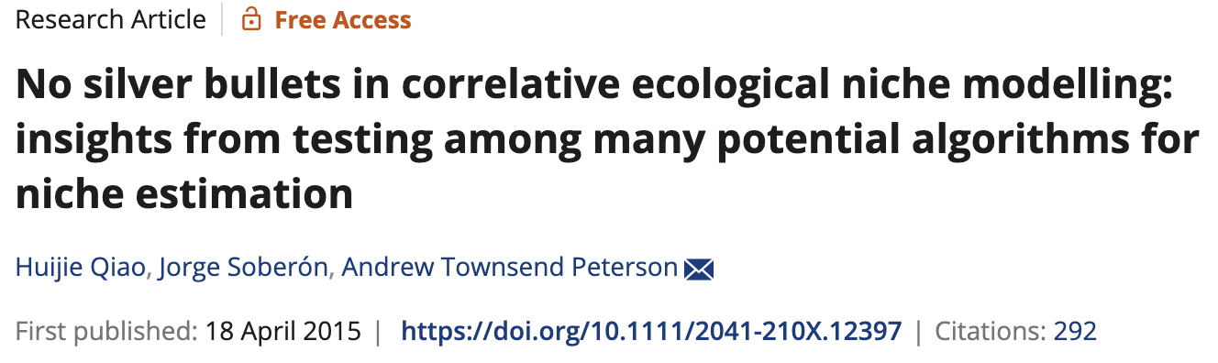

Slide 4
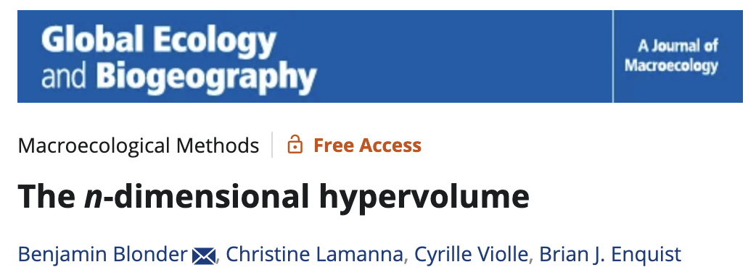

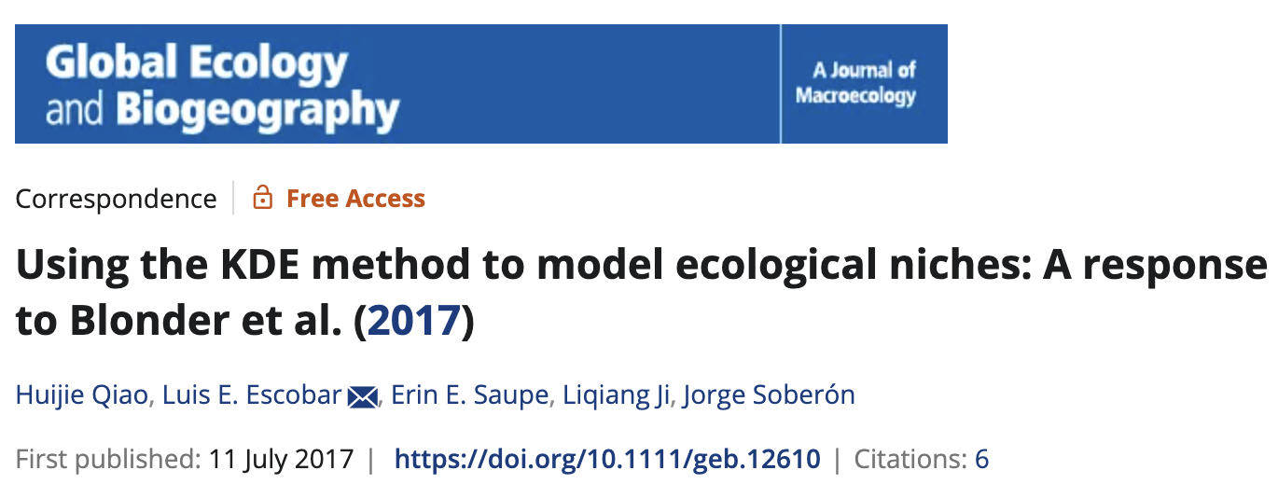
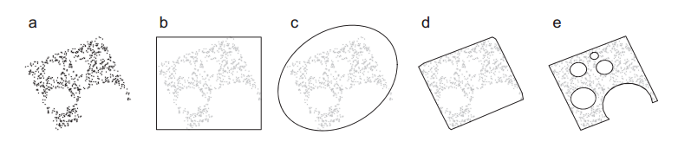

Slide 5
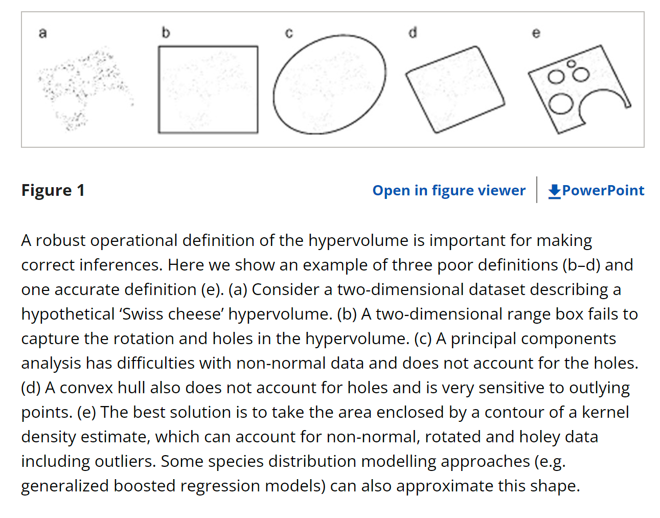
生态位模型前沿应用
Blonder et al., 2014 GEB
https://onlinelibrary.wiley.com/doi/full/10.1111/geb.12146

Slide 6
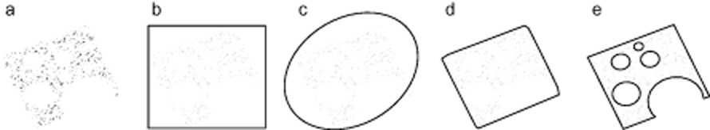
生态位模型前沿应用
复杂
简单

Slide 7
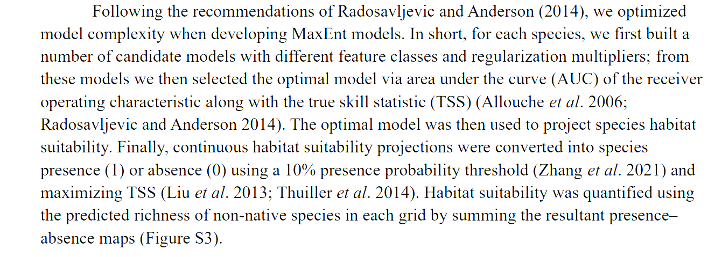
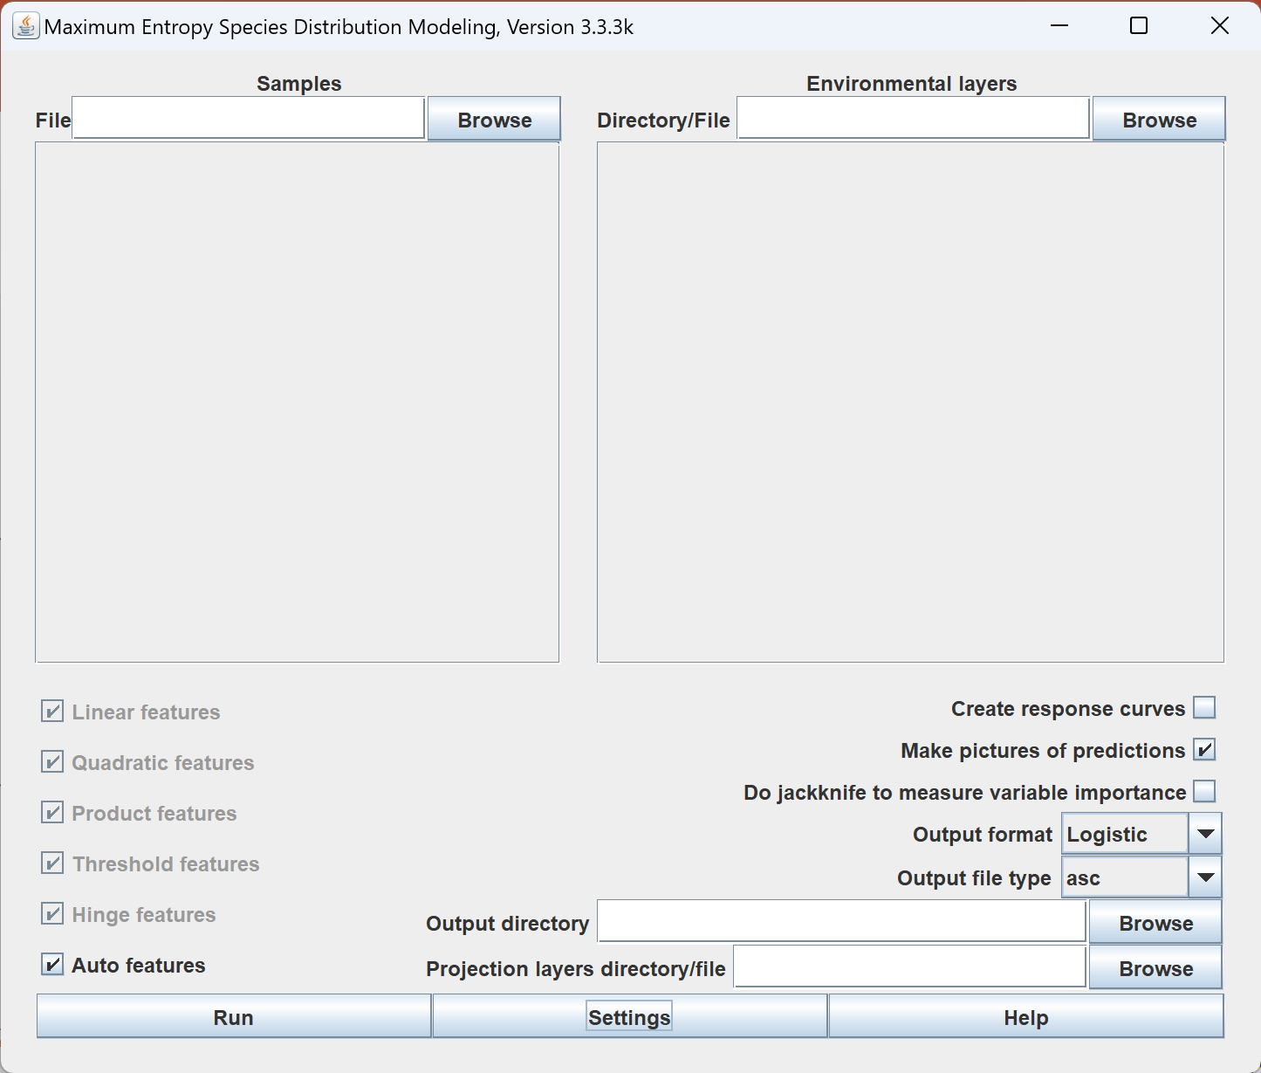
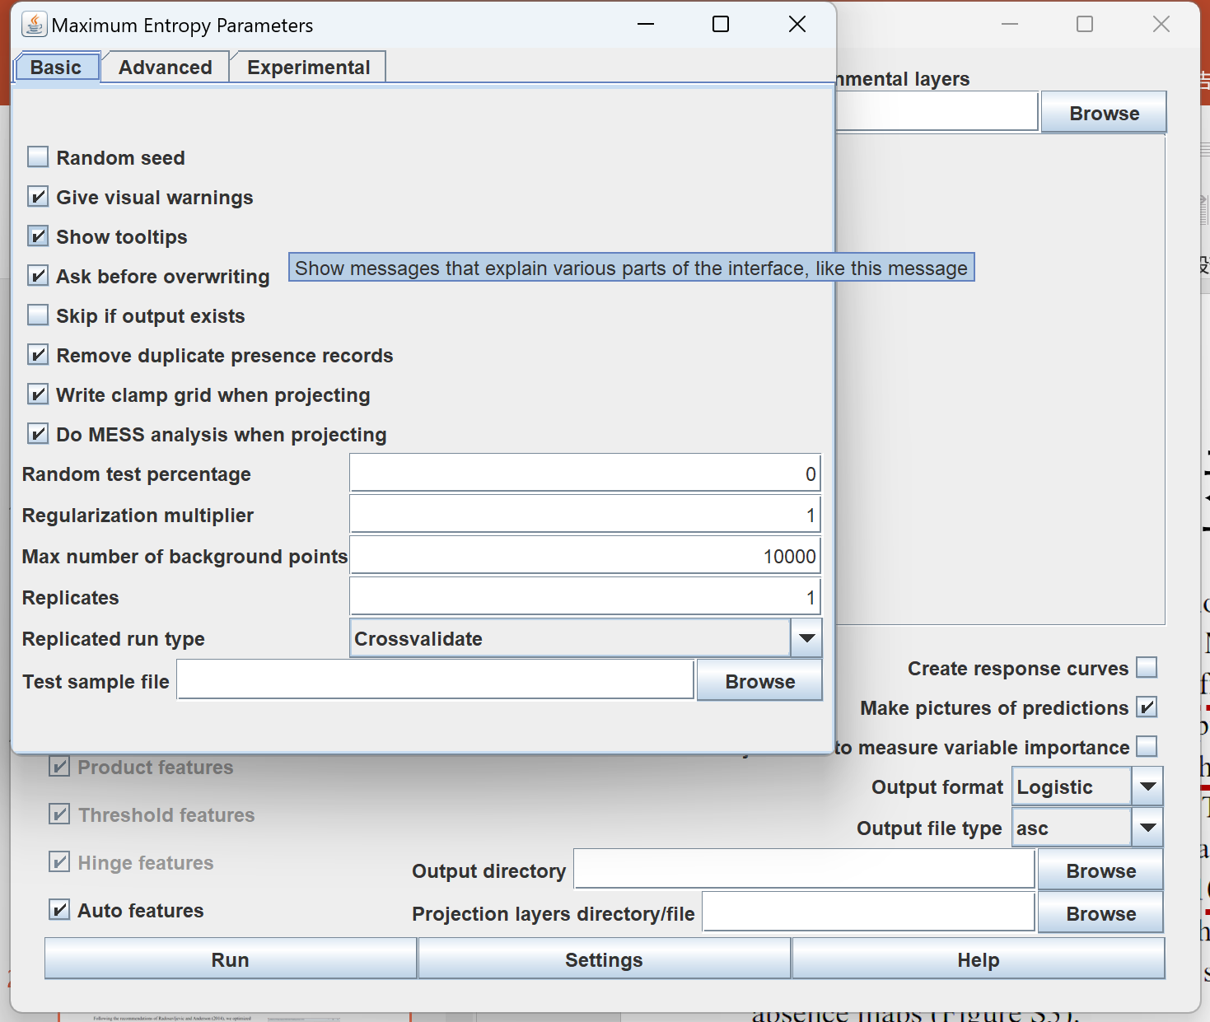
生态位模型前沿应用
MAXENT
ENMEvel
Binary
Feature/RM
10% TP/MAX TSS
AUC/TSS
YB Du, et al, 2023, FEE

Slide 8
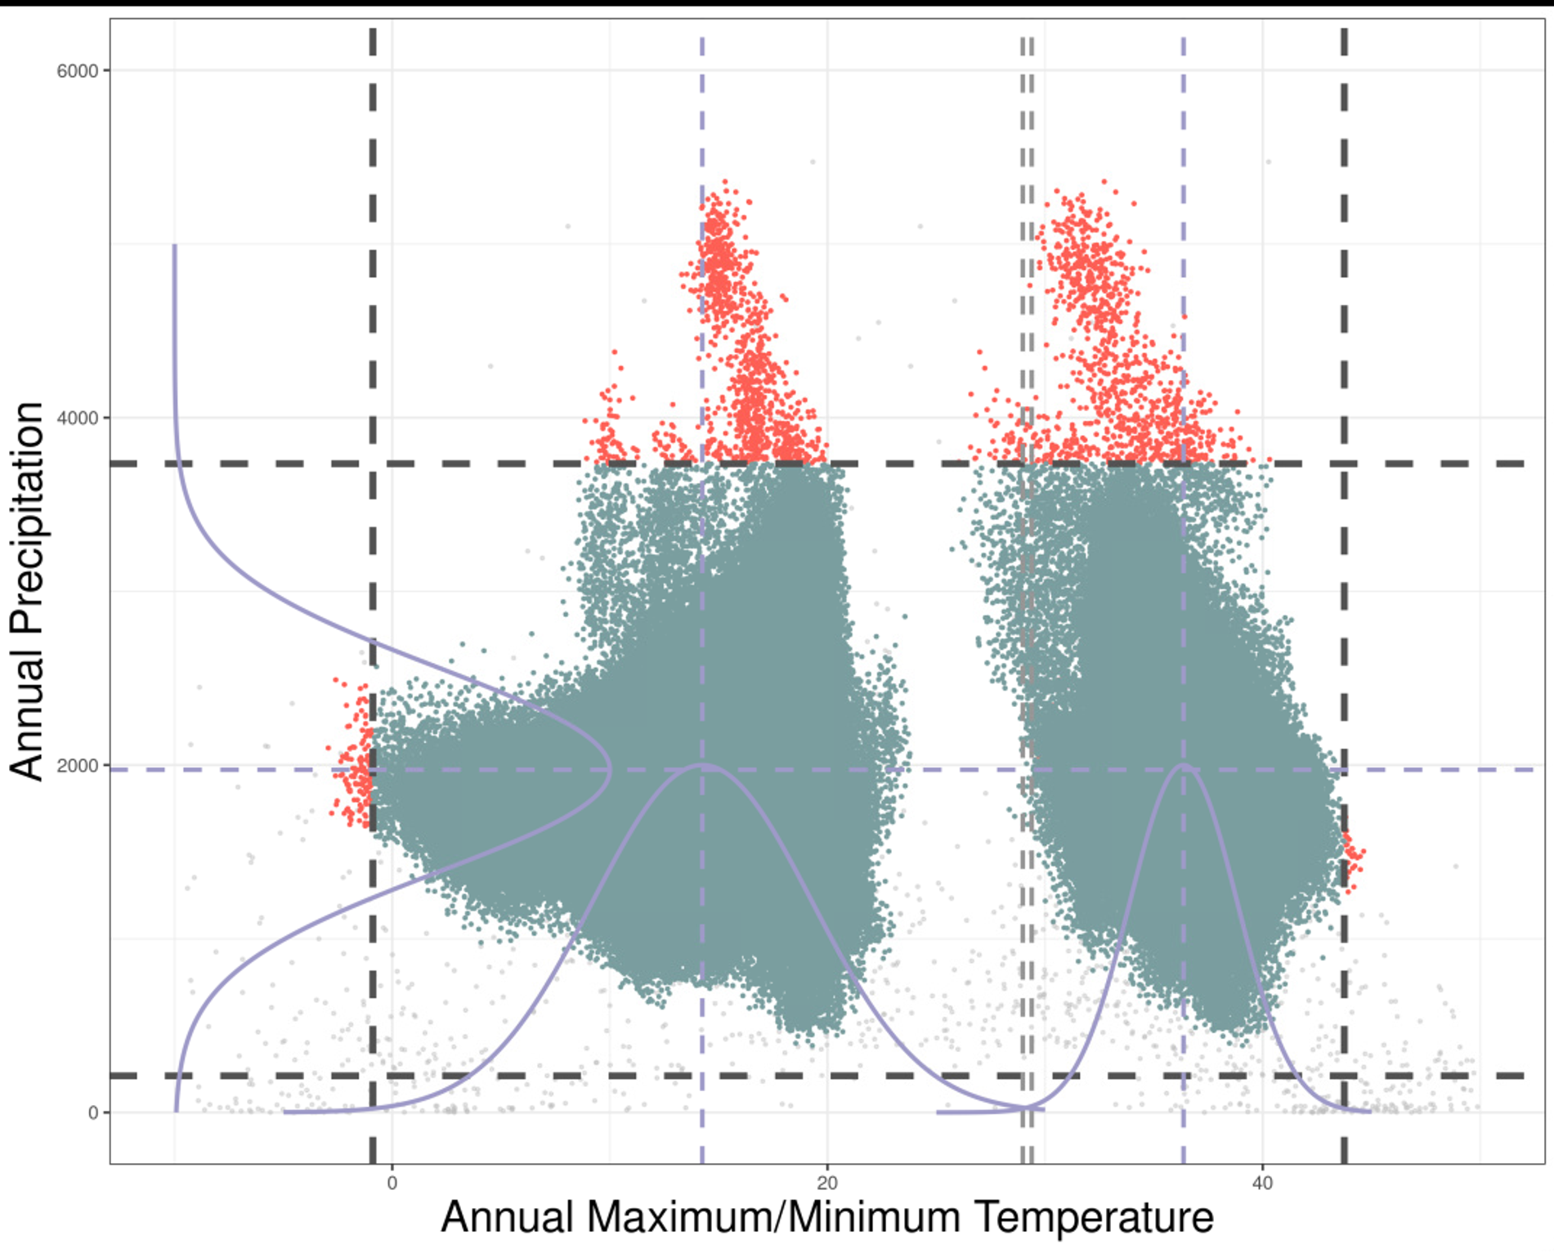
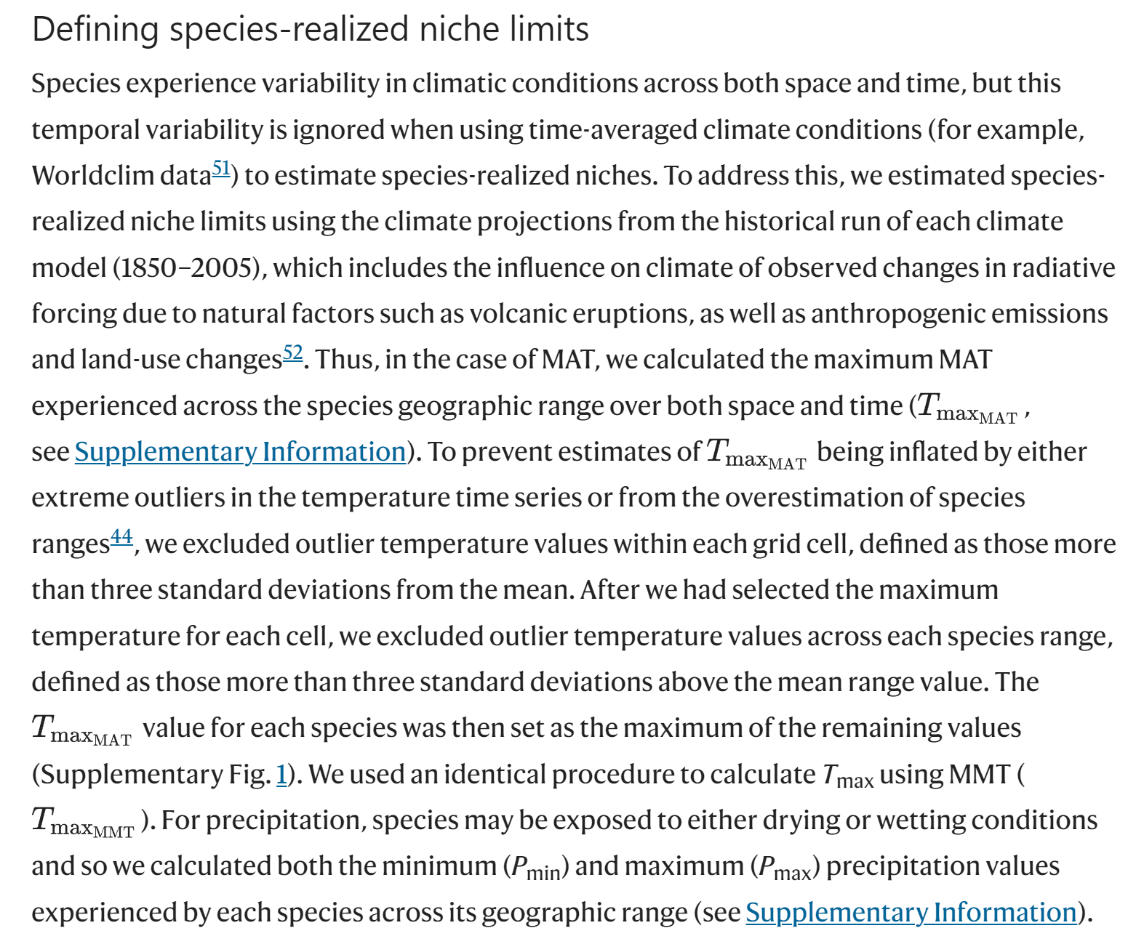
生态位模型前沿应用
CH Trisos et al., 2020 Nature
https://www.nature.com/articles/s41586-020-2189-9

Slide 9
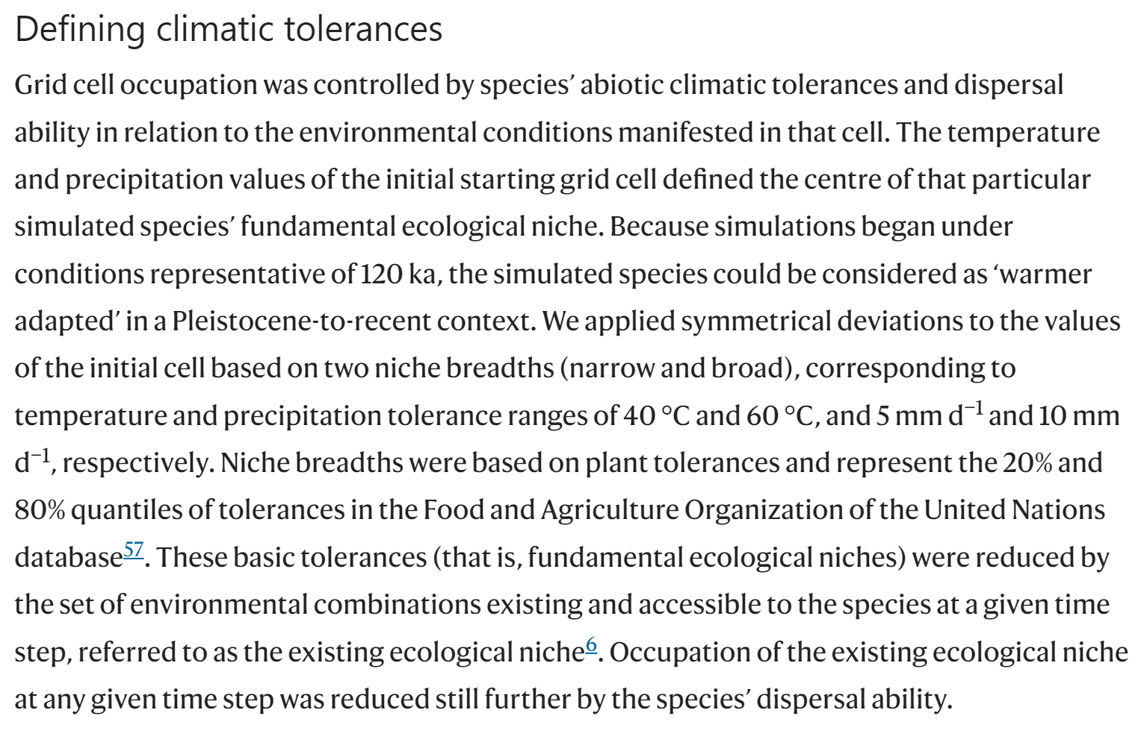
生态位模型前沿应用
HJ Qiao et al., 2024, NEE
https://www.nature.com/articles/s41559-024-02344-5

Slide 10
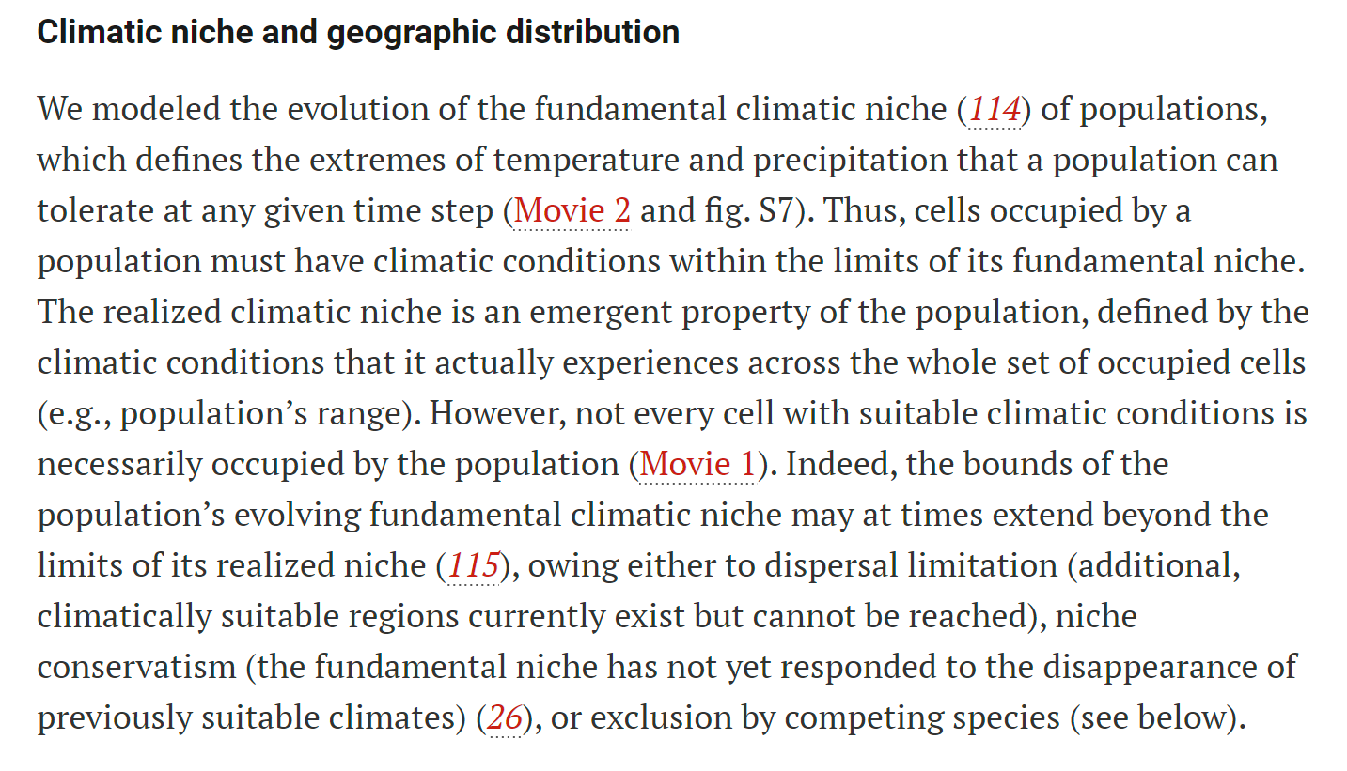
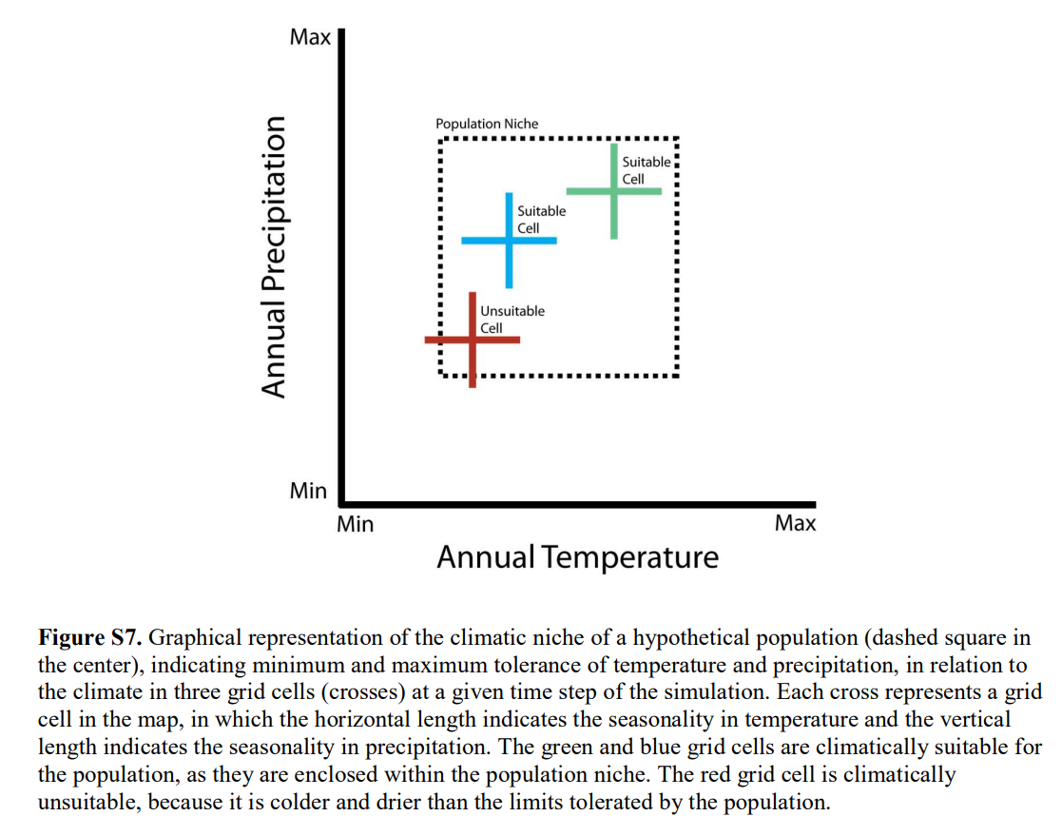
TF RANGEL et al., 2018, Science
https://www.science.org/doi/full/10.1126/science.aar5452

Slide 11

重剑无锋 大巧不工
高端的食材，往往只需要最朴素的烹饪方式

Slide 12
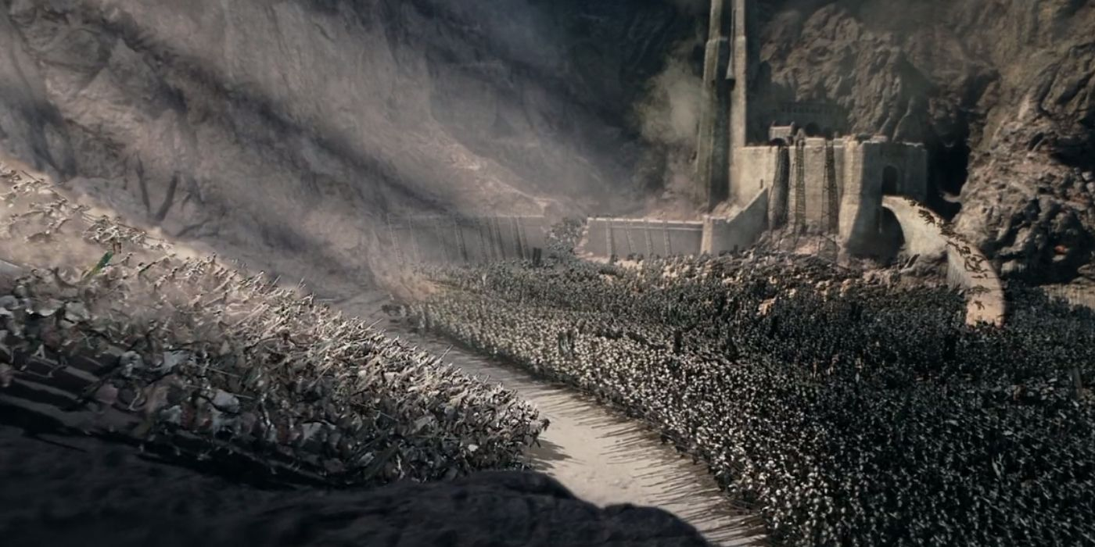


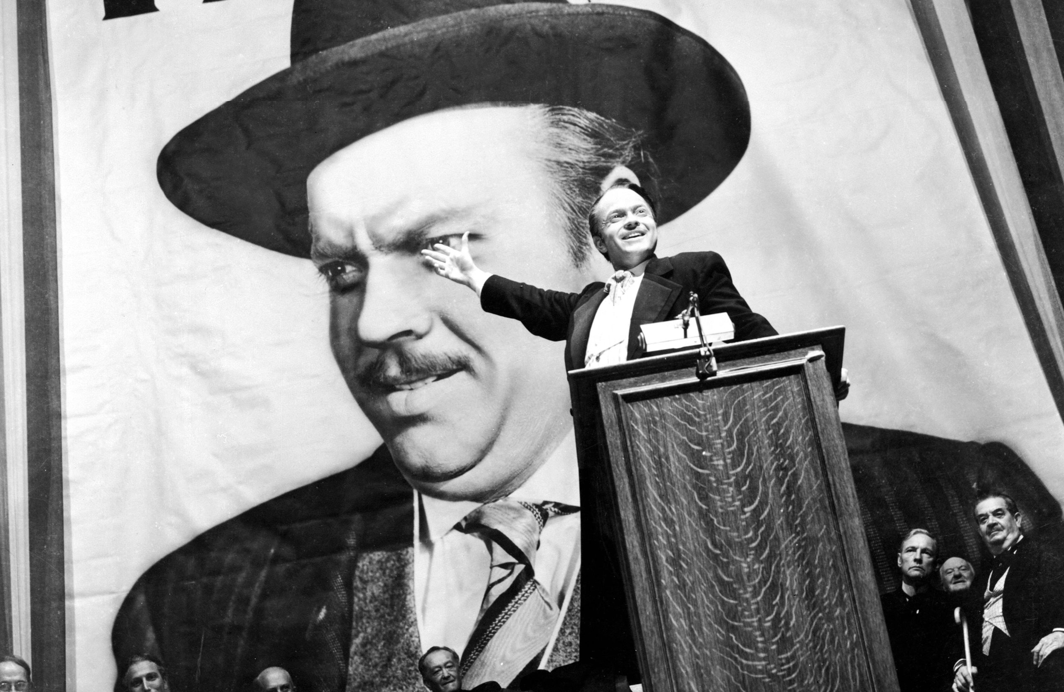


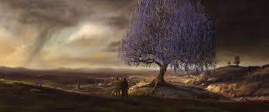
普通厅
IMAX厅
杜比全景声厅
3D/4D厅
巨幕厅

Slide 13
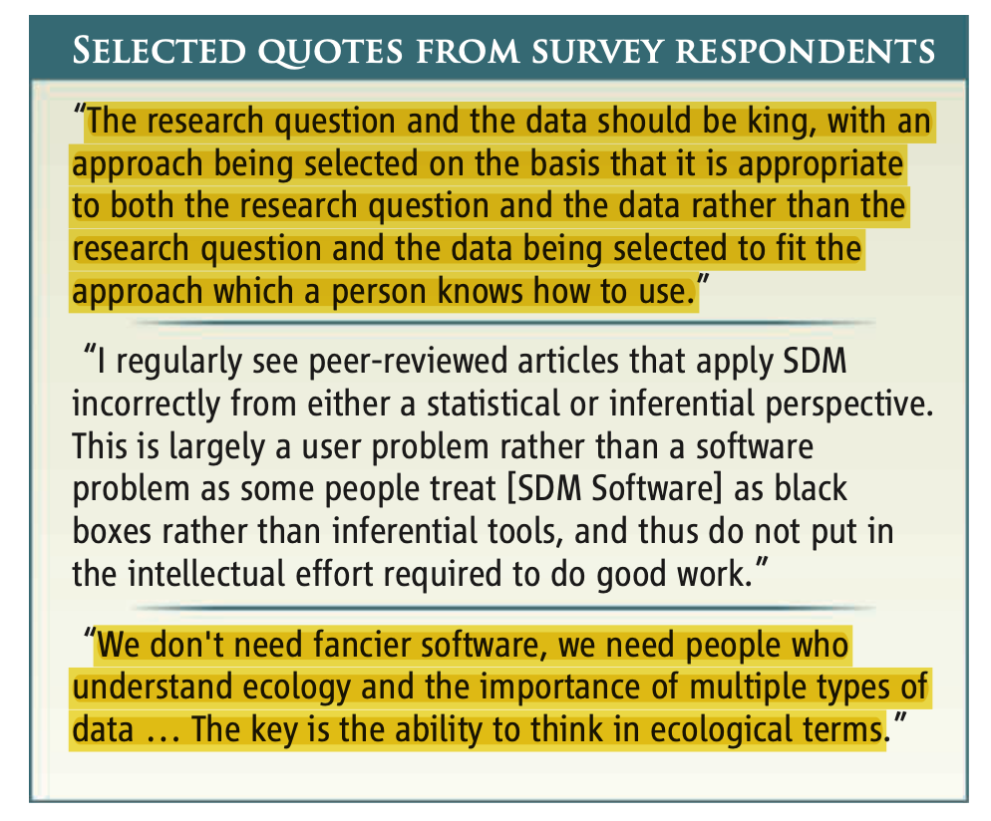
https://www.science.org/doi/abs/10.1126/science.1231535

Slide 14
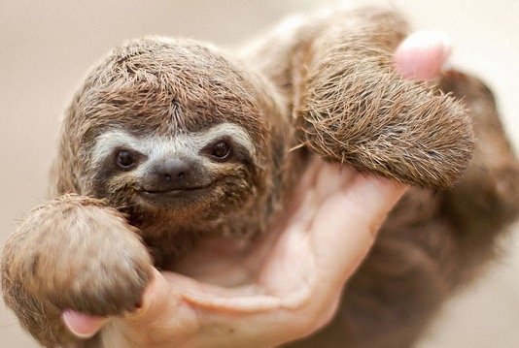
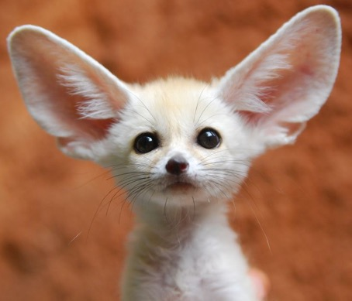
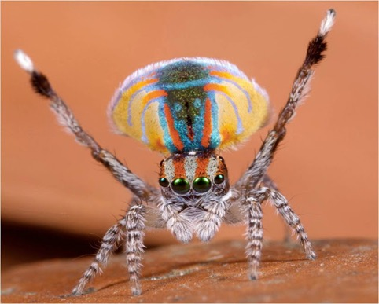
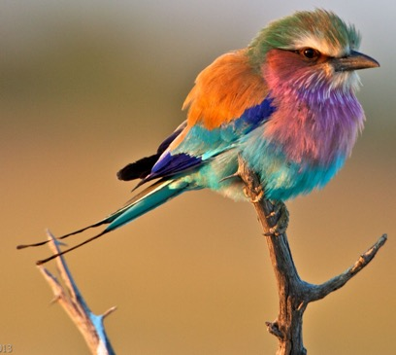
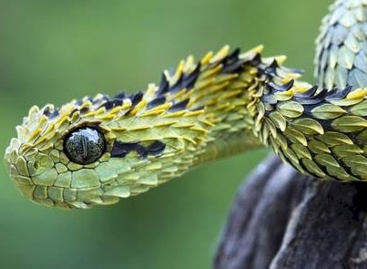
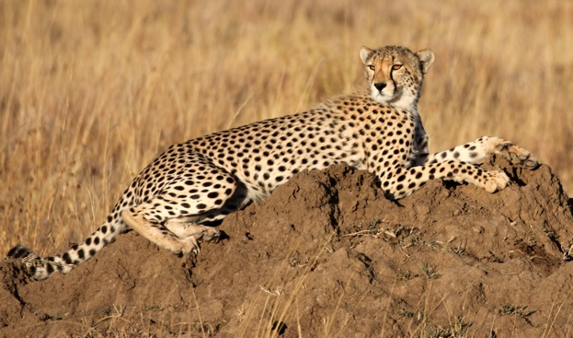
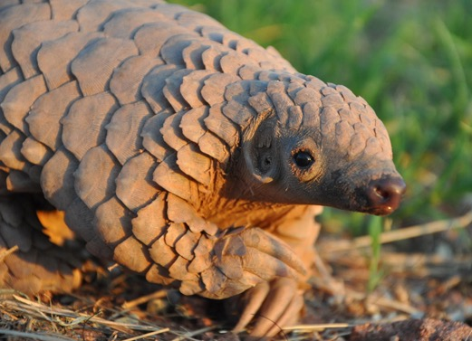
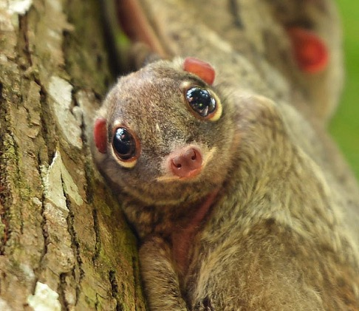
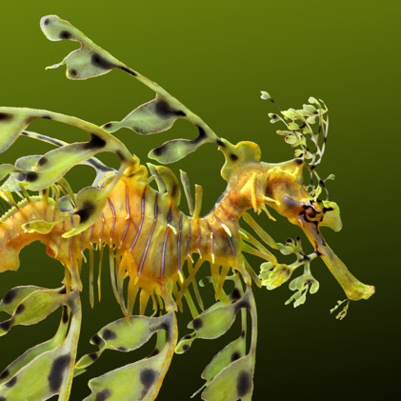
Thank You!
Notes:
So, with that, I’d like to thank you for your attention.
Please don’t hesitate to get in contact with me – I’m always happy to discuss science and potential collaborations!

