Slide 1
Variables for SDM
Characteristics and source of environmental data
Processing environmental data for ENM/SDM
Gengping Zhu
gengping.zhu@wsu.edu

Slide 2
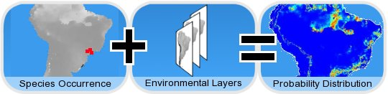
Correlative approach:
openModeller
http://openmodeller.sourceforge.net

Slide 3
Environmental data/Raster data:
Why call it layer?
Demonstrating → ArcGIS/ArcPro, QGIS
Format:
  .asc
  .tif
  .bil,
  .rst,
  .txt,
  .img,
  .netCDF,

Slide 4
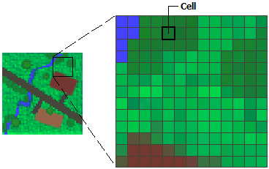
What is a raster data looks like?
Latitude
Longitude
Longitude

Slide 5
Raster data
Data structures and object types in R

Slide 6
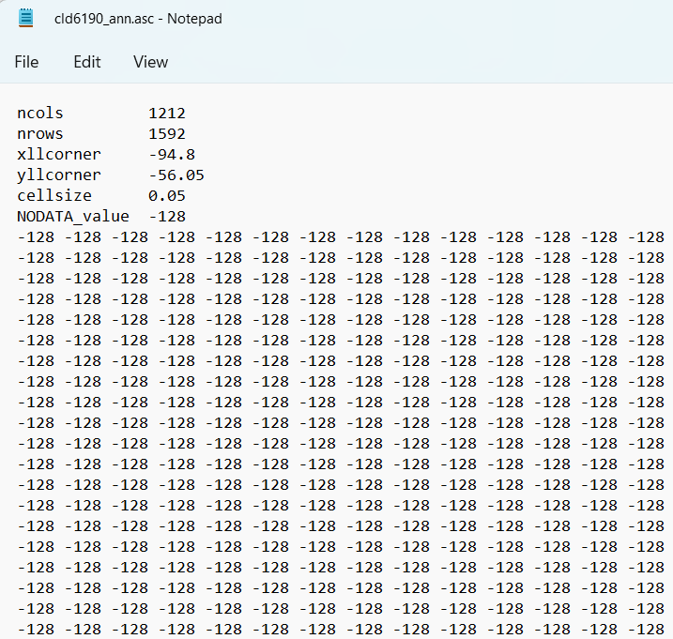
What is a raster data looks like?

Slide 7
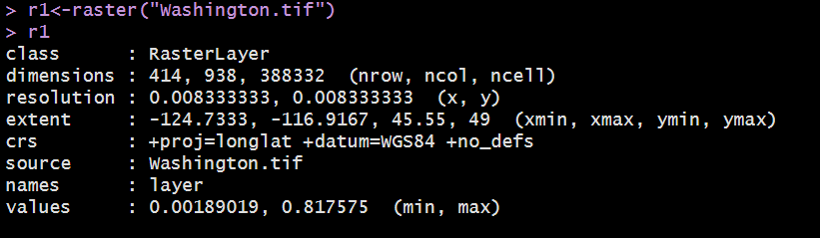
General characteristics of raster data

Slide 8
Unifying raster layers-why?
Many times, we are using environmental variables from different sources;
e.g., climate, topographic, landcover, et al., these variables are provided red by different originations, they use their unique way to deposit/organize the data...
These variables/data have different extent and resolution.., you need to unify them before fitting the model;

Slide 9
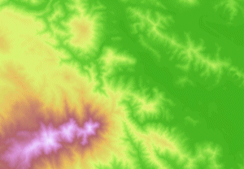
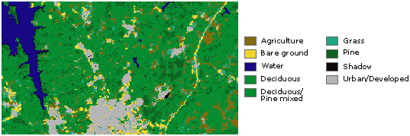
Raster as surface maps---continuous data
Reclassify
Raster as thematic maps--- categorized data

Slide 10
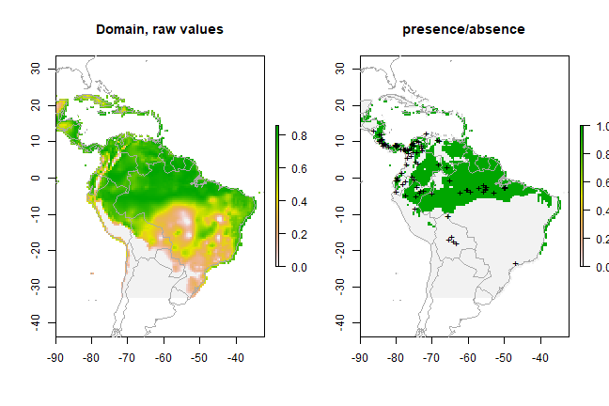
Reclassify-
suitability prediction → binary prediction
Threshold

Slide 11
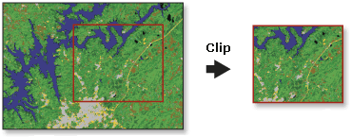
Change extent-- clip

Slide 12
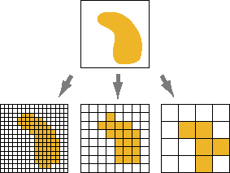
Change resolution--resample

Slide 13
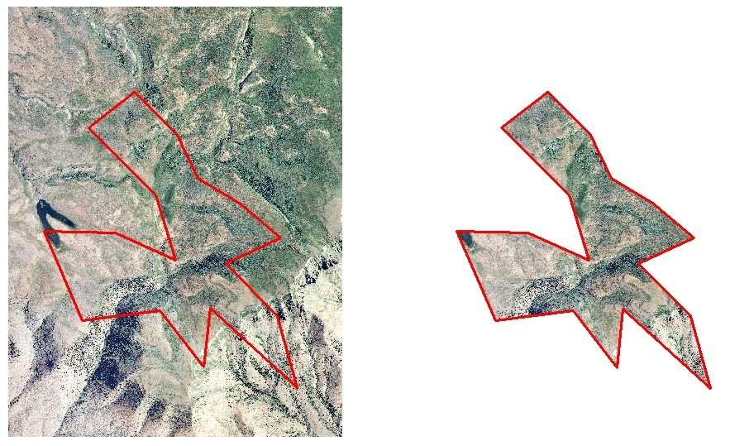
Extract by mask– raster and polygon

Slide 14
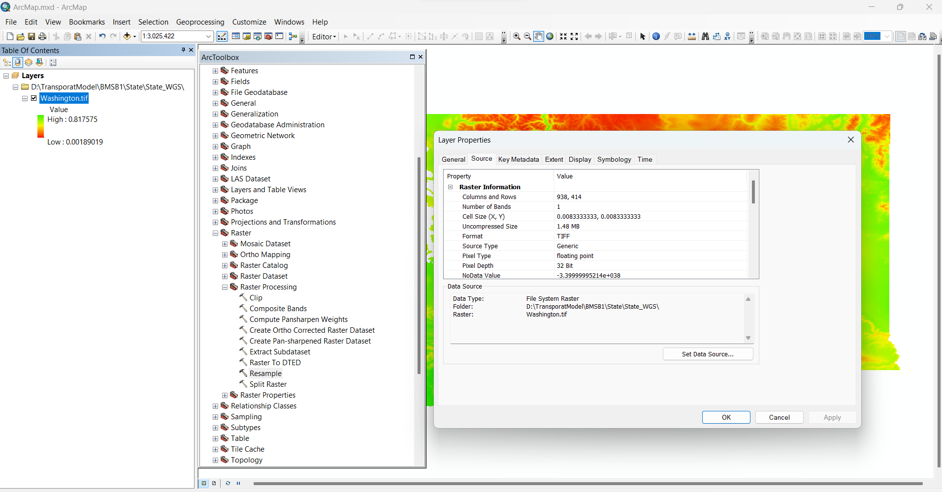

Slide 15
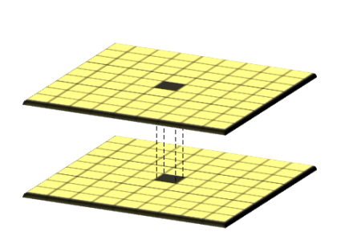
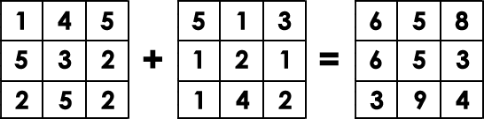
Classical map algebra
-local analysis
Local: cell-by-cell basis

Slide 16
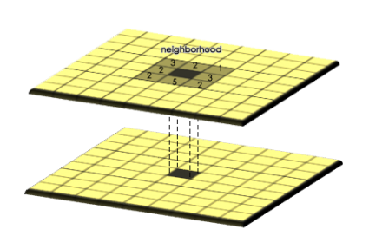
Classical map algebra
-Focal analysis
Focal:
compute an output value of each cell using neighborhood values.

Slide 17
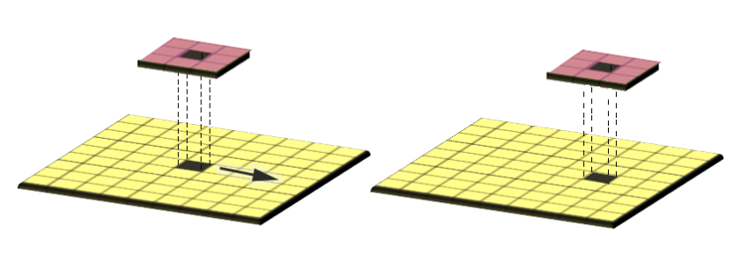
Map algebra/Raster Math-Focal
Focal:
compute an output value of each cell using neighborhood values.

Slide 18
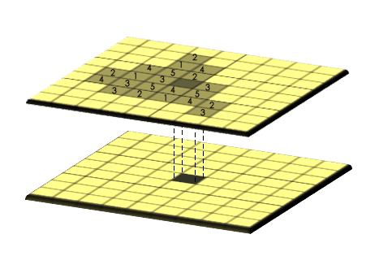
Map algebra-Zonal Operation
Zonal operations apply a math function to a group of cells within a specified zone.

Slide 19
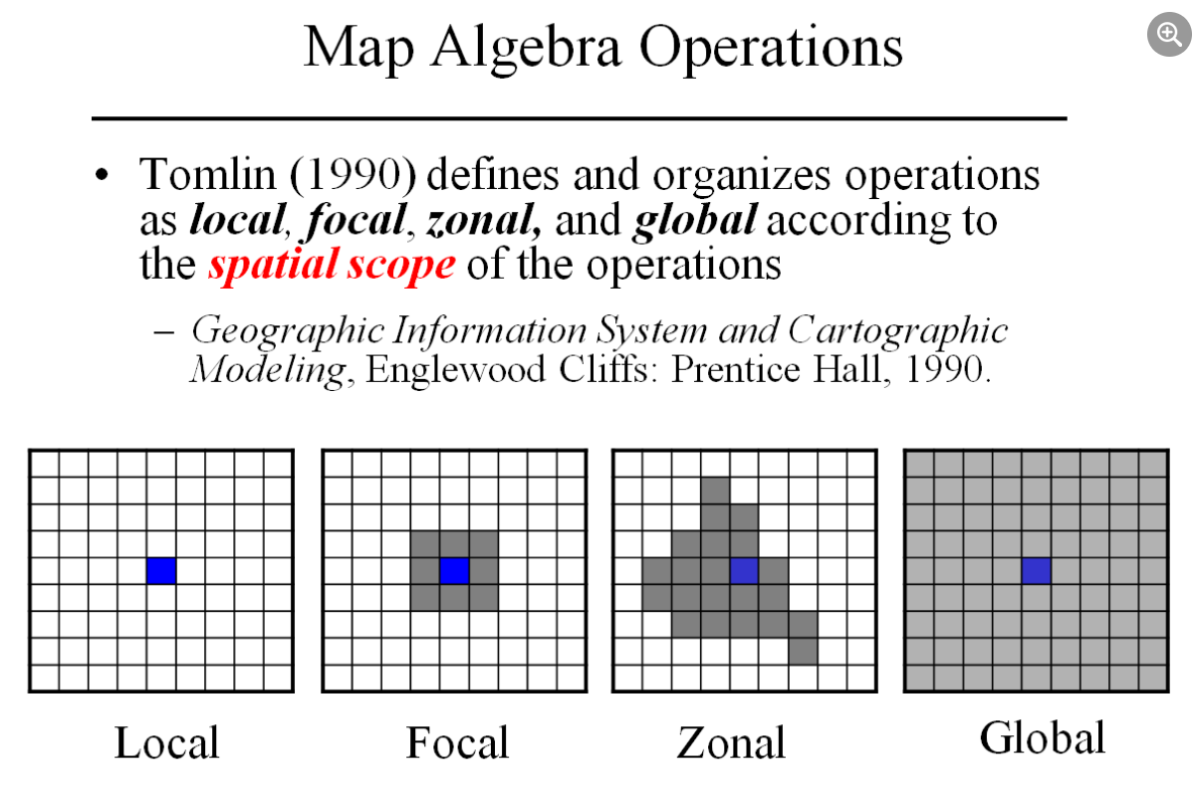

Slide 20
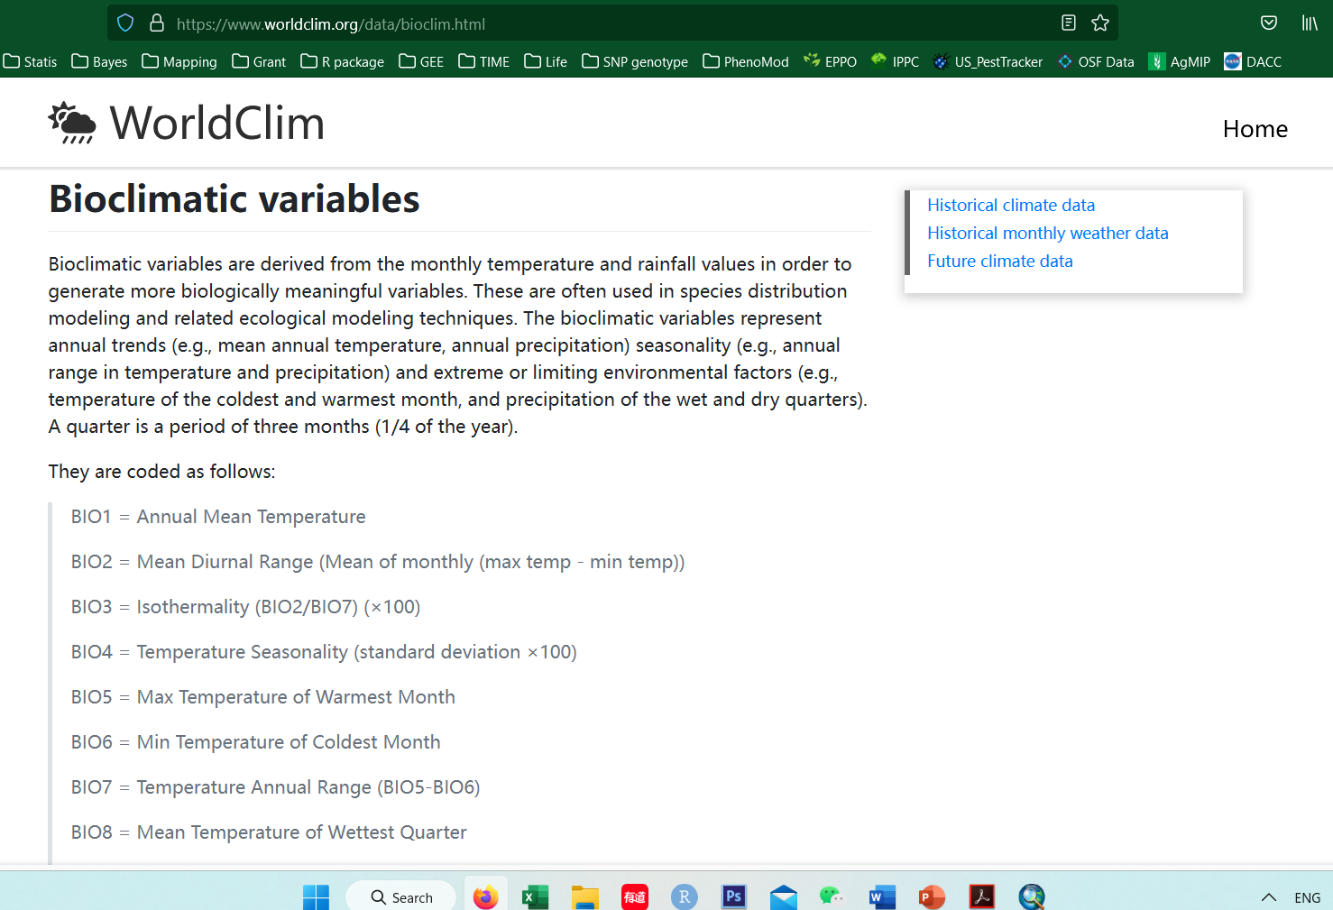
Source of environmental/raster data for model: WorldClim-bioclimate data
https://www.worldclim.org

Slide 21
BIO1 = Annual Mean Temperature
BIO2 = Mean Diurnal Range (Mean of monthly (max temp - min temp))
BIO3 = Isothermality (BIO2/BIO7) (×100)
BIO4 = Temperature Seasonality (standard deviation ×100)
BIO5 = Max Temperature of Warmest Month
BIO6 = Min Temperature of Coldest Month
BIO7 = Temperature Annual Range (BIO5-BIO6)
BIO8 = Mean Temperature of Wettest Quarter
BIO9 = Mean Temperature of Driest Quarter
BIO10 = Mean Temperature of Warmest Quarter
BIO11 = Mean Temperature of Coldest Quarter
BIO12 = Annual Precipitation
BIO13 = Precipitation of Wettest Month
BIO14 = Precipitation of Driest Month
BIO15 = Precipitation Seasonality (Coefficient of Variation)
BIO16 = Precipitation of Wettest Quarter
BIO17 = Precipitation of Driest Quarter
BIO18 = Precipitation of Warmest Quarter
BIO19 = Precipitation of Coldest Quarter
www.worldclim.org
19 Bioclimatic variables
Temperature and precipitation combination
Temperature and precipitation combination

Slide 22
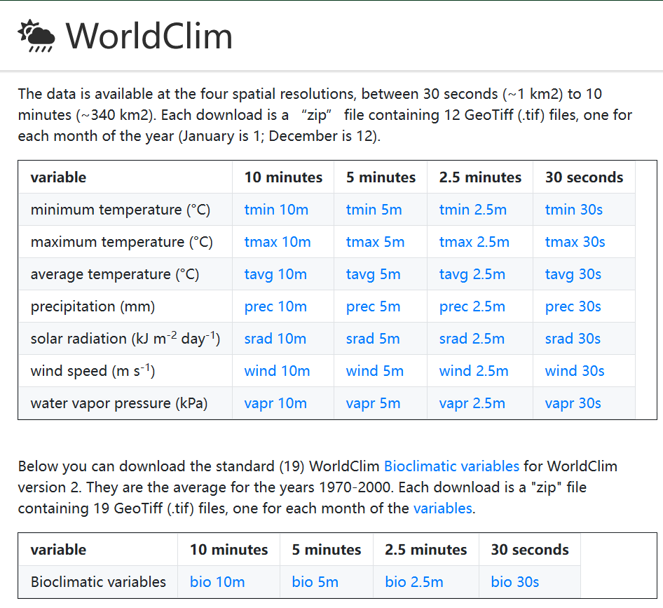
WorldClim present data

Slide 23
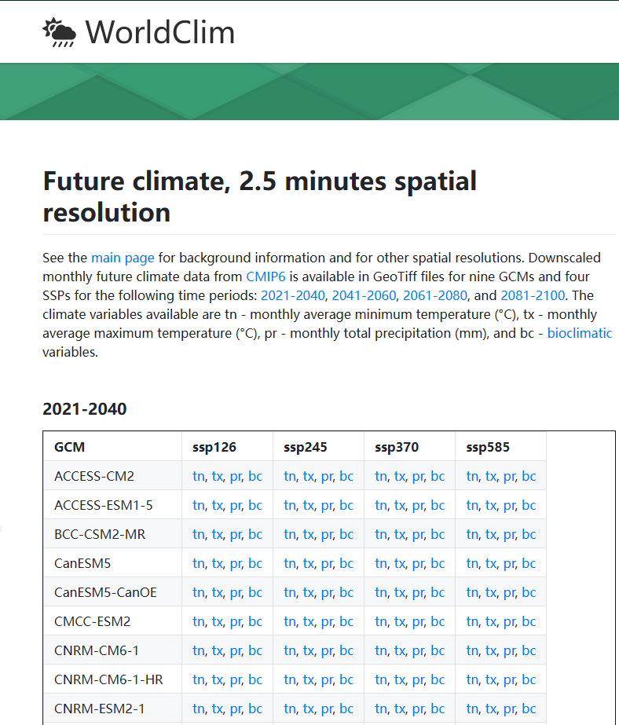
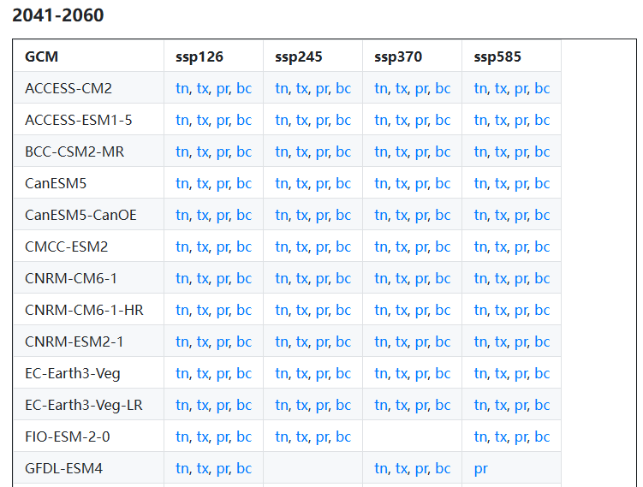
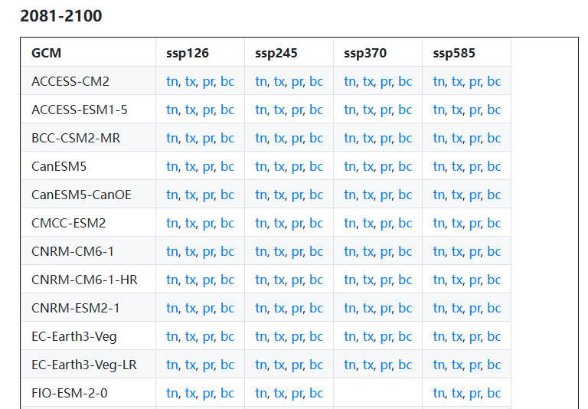
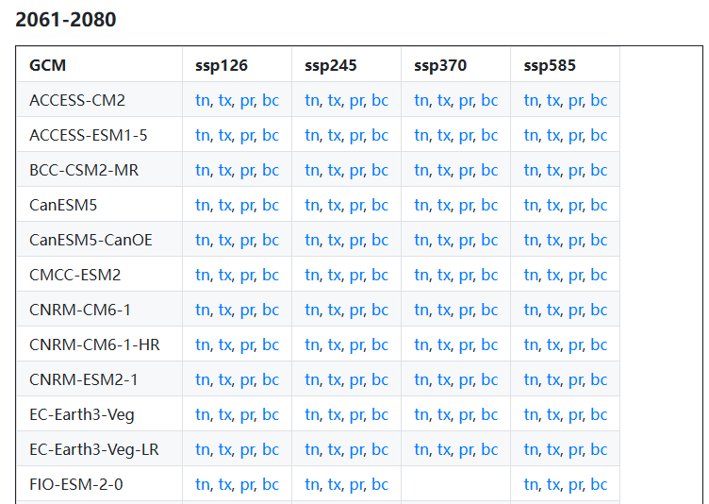
WorldClim future data

Slide 24
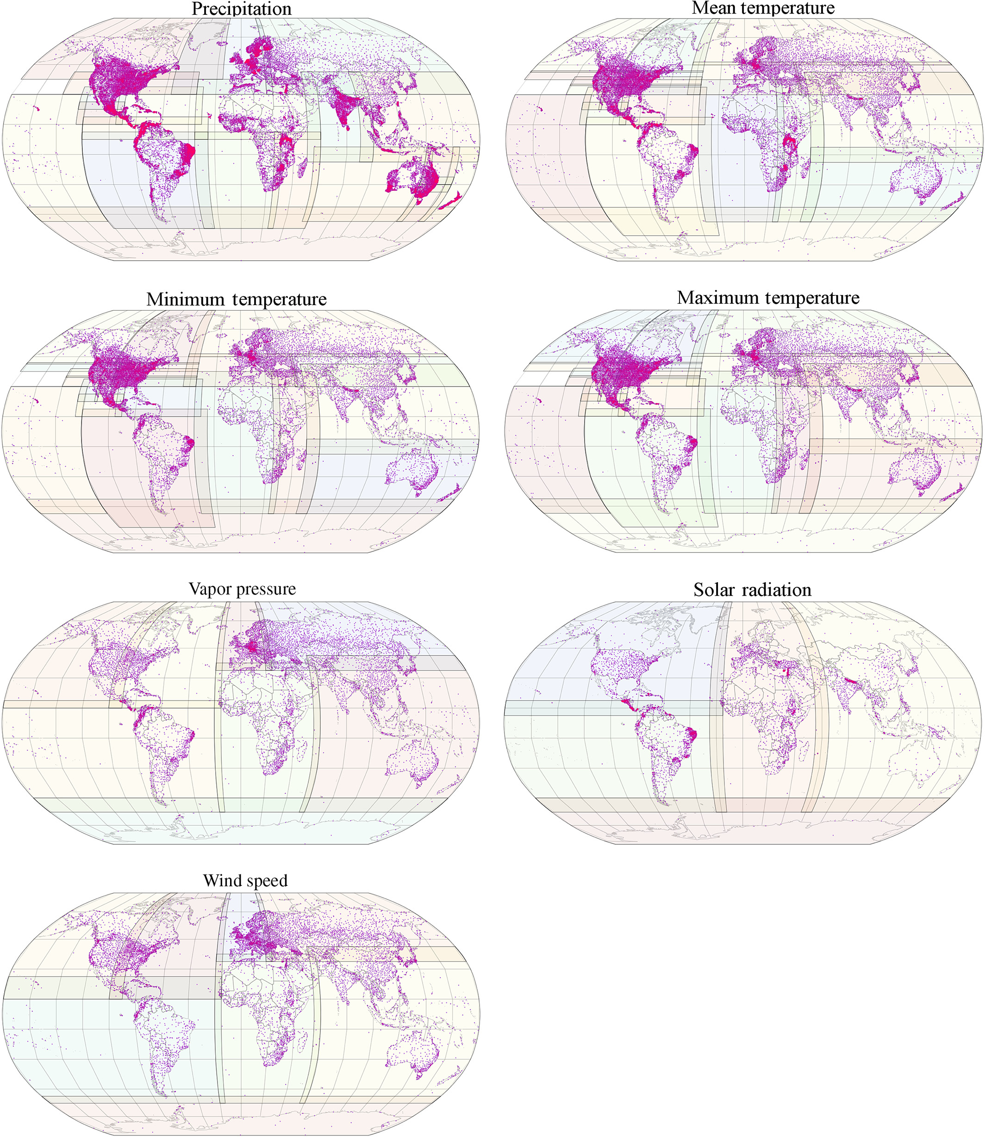
How these data generated?
From weather station by interpolation method.
WorldClim 2
There is spatial uncertainty…
Global spatial distribution of weather stations

Slide 25
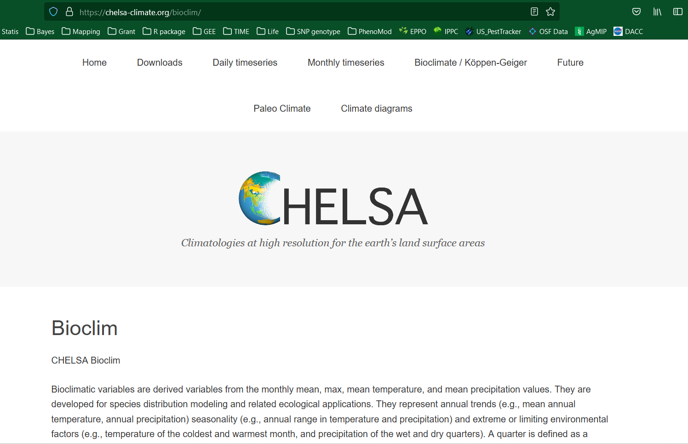
https://chelsa-climate.org/bioclim/

Slide 26
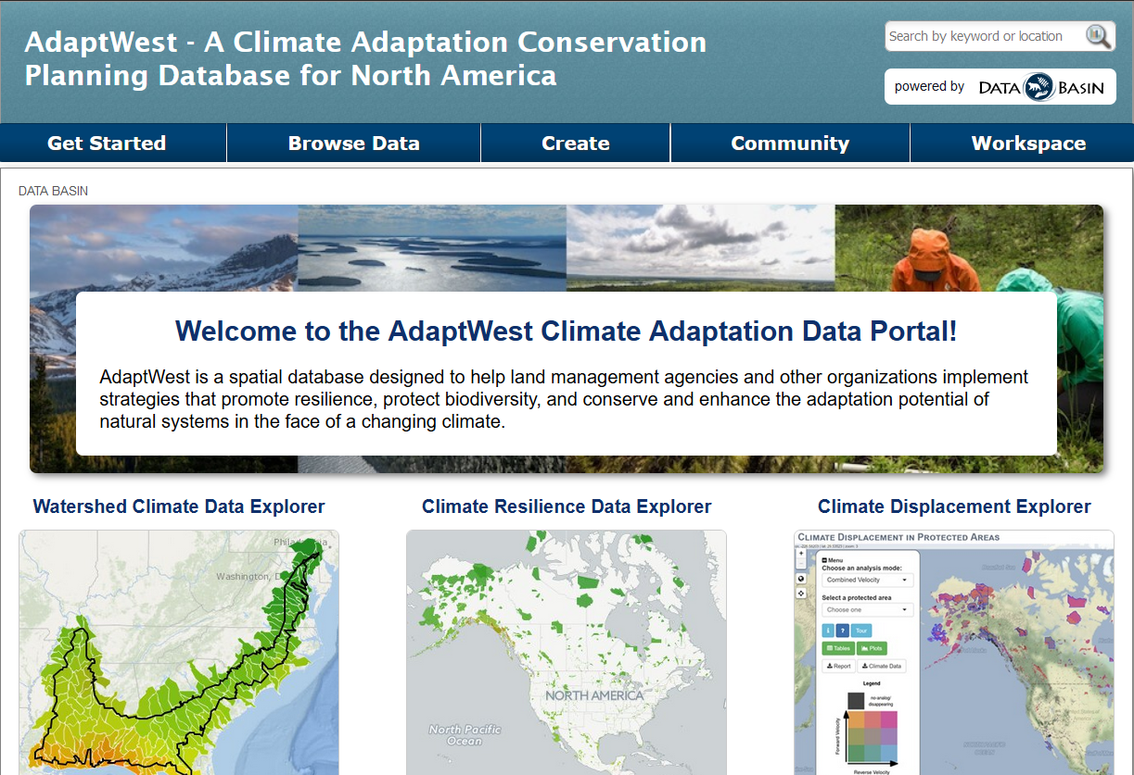
https://adaptwest.databasin.org/

Slide 27
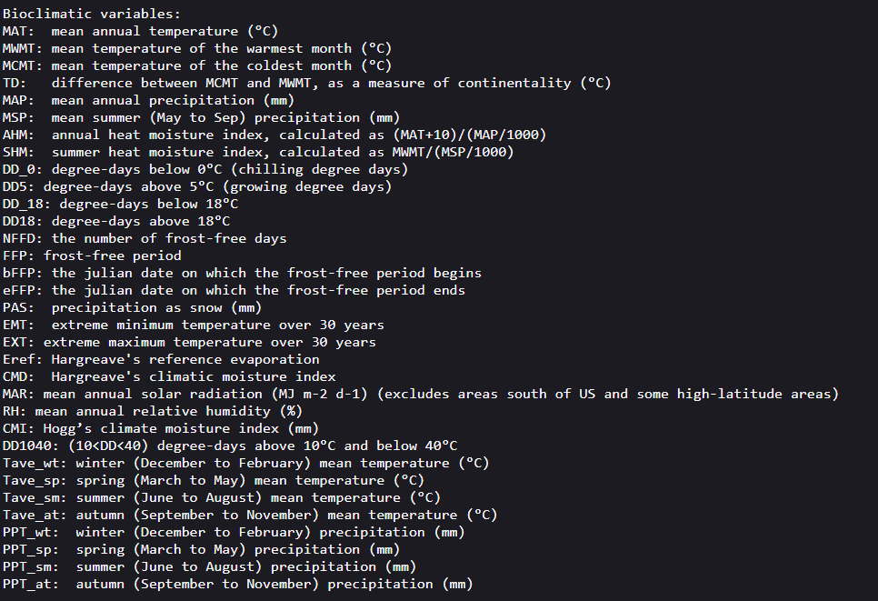
Bioclimatic variables in AdaptWest Climate center

Slide 28


Slide 29
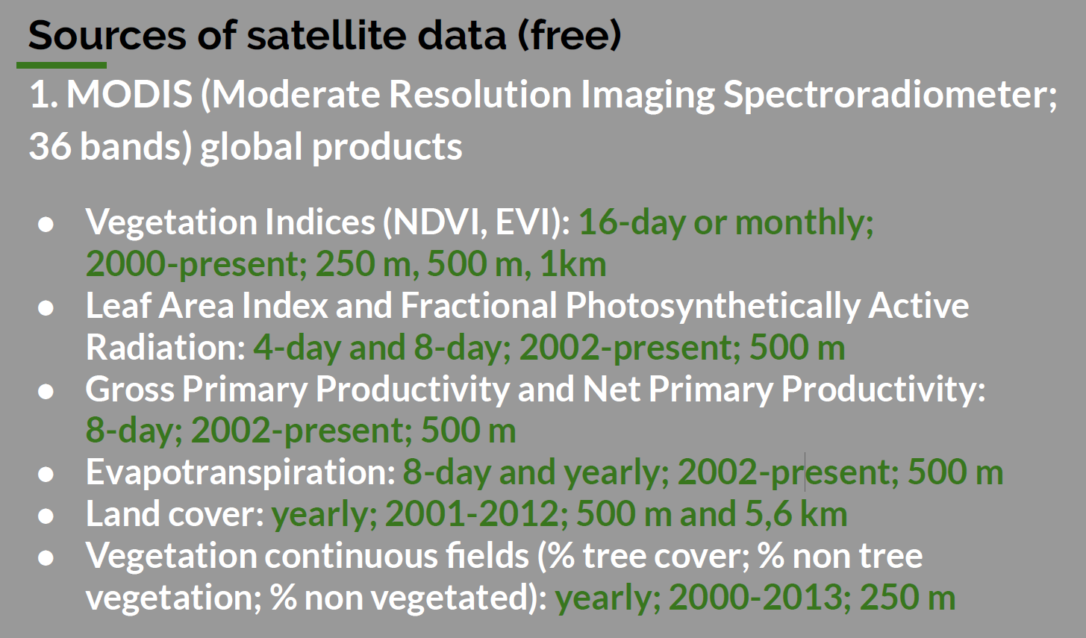
Satellite data

Slide 30
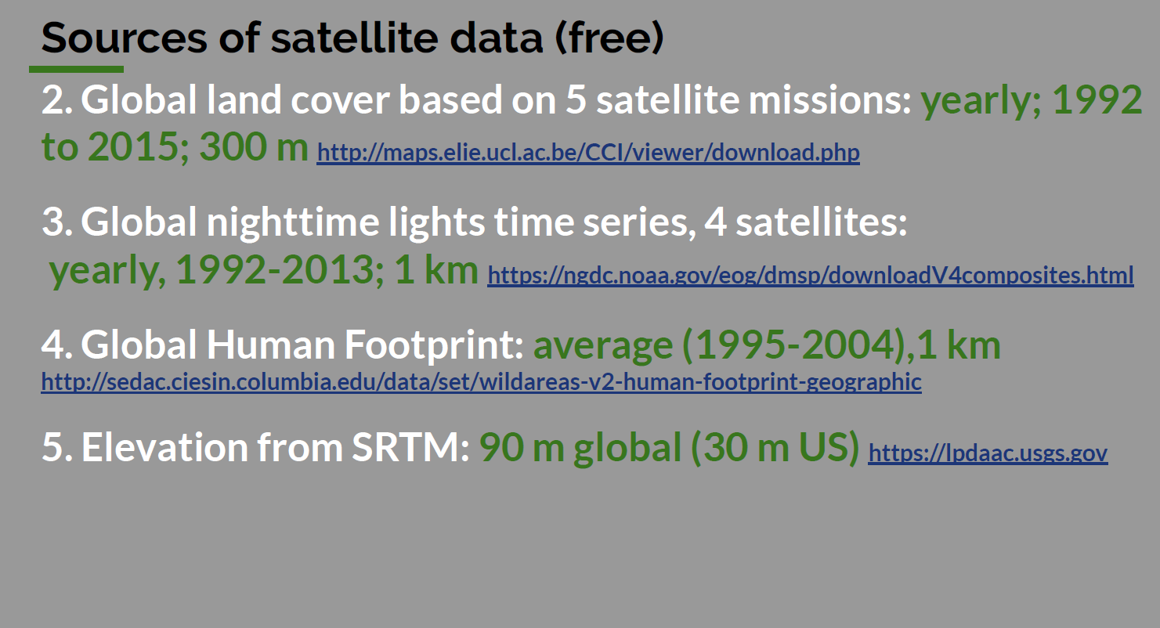
Satellite data

Slide 31
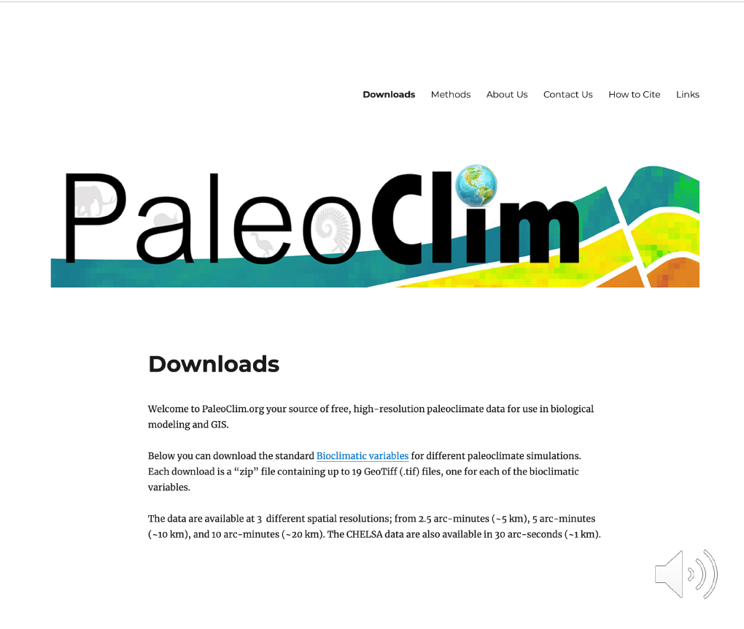
Paleoclimate data---reconstruction historical distribution
www.paleoclim.org

Slide 32
How to use these database?
Go through database official website, read instructions/practice tutorial materials carefully;
What are these dat? check data structure and frame;
What is the resolution, extent, coordinate system et al.?
Are there specific software that used to download their data? they will recommend ways to process their data..

Slide 33
Ecological Niche Model
How many variables should be used?
Too many variables
variable might be highly correlated…
Too less variables
Might not enough to characterize species ecological requirement and potential distribution…

Slide 34
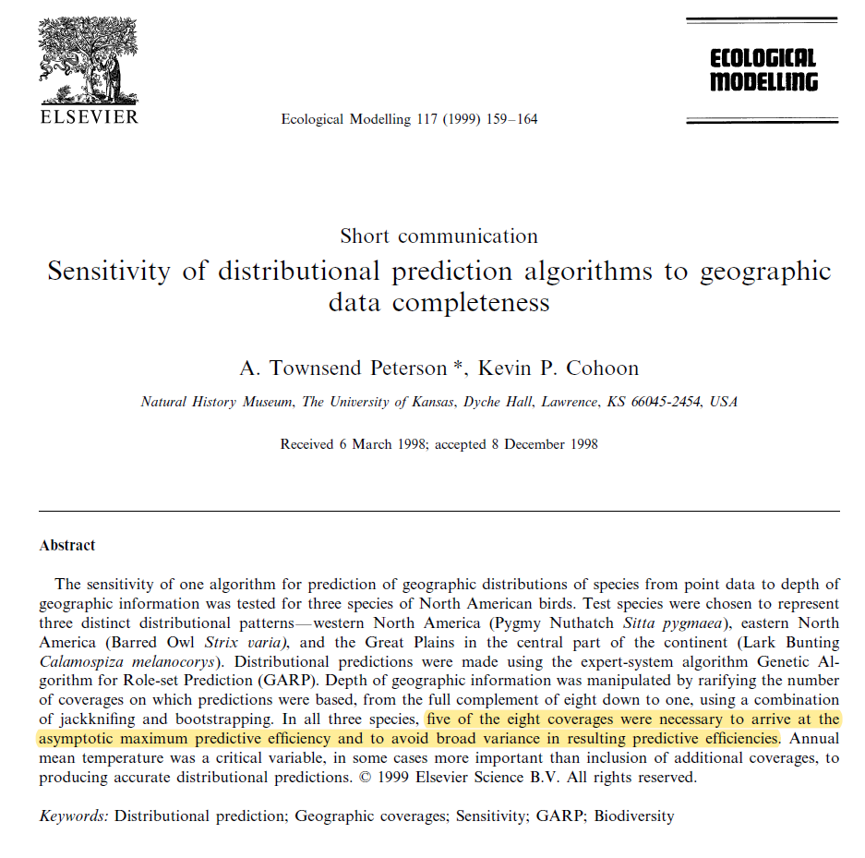
5-8 variables would be enough

Slide 35
How to select environmental variables?
Ecological relevance:
How to rank variable importance?
expert opinion,
Many statistical approach,…
Correlation: Pearson < 0.7
Resolution: cell size--resample
Extent: clip/crop, extract by mask

Slide 36
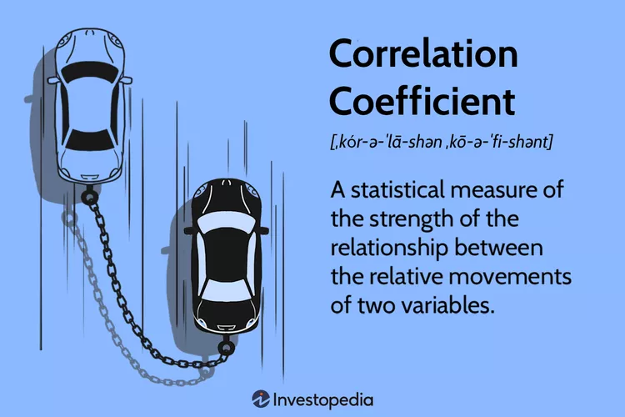
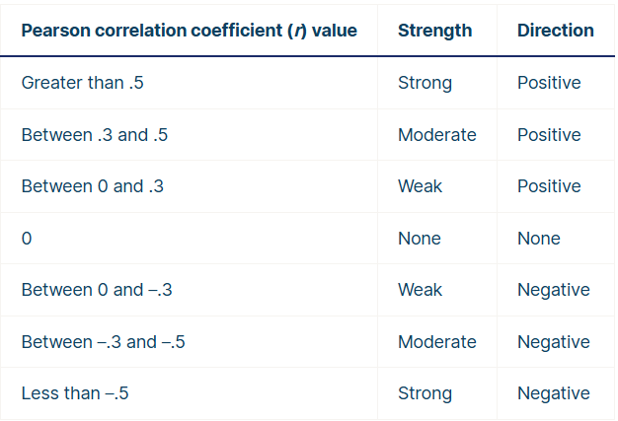
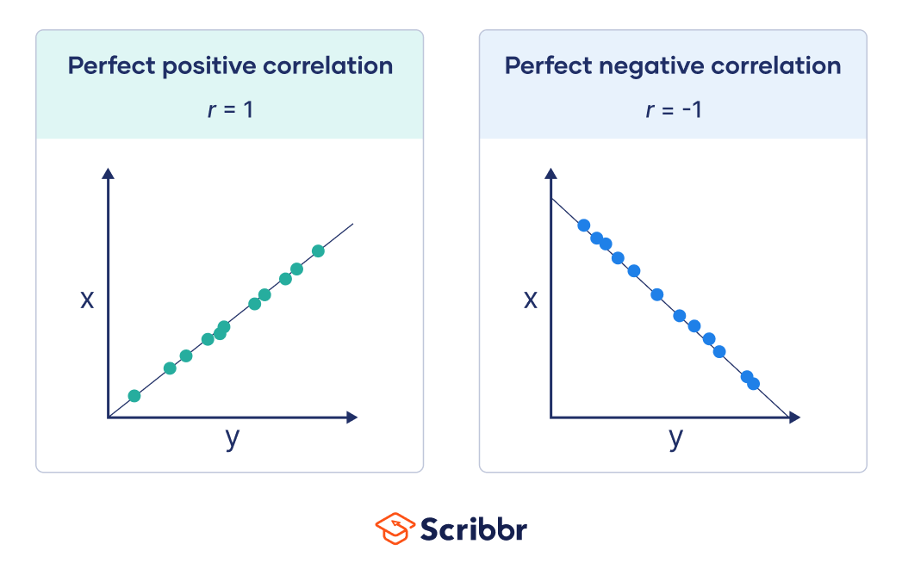
Pearson correlation
The Pearson correlation coefficient (r) is the most common way of measuring a linear correlation.
It is a number between –1 and 1 that measures the strength and direction of the relationship between two variables.
Pearson < 0.7 is acceptable in our model!

Slide 37
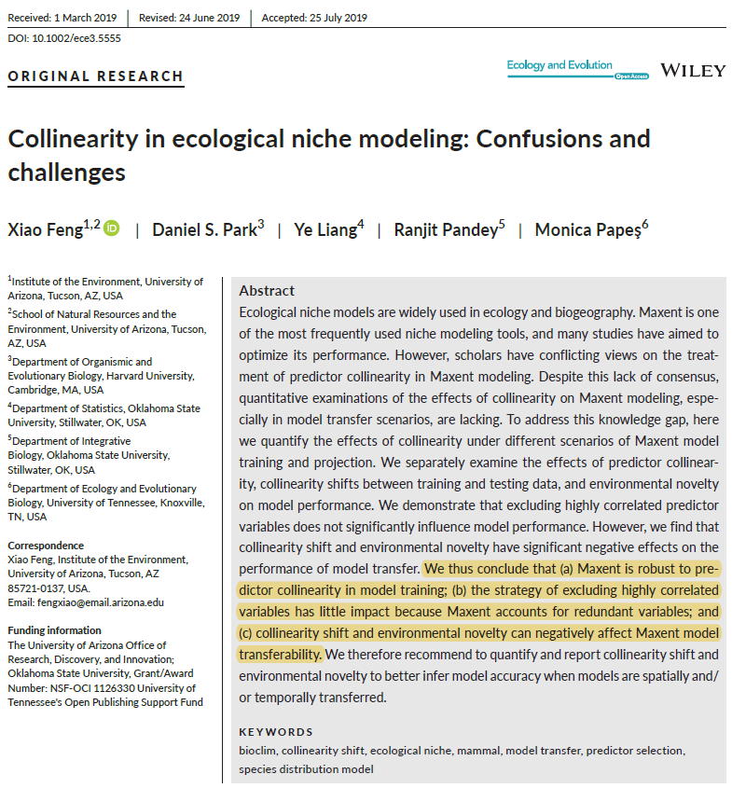
Correlation is not an issue in Maxent “calibrating” prediction;
Feng et al. 2019 Eco & Evo

Slide 38
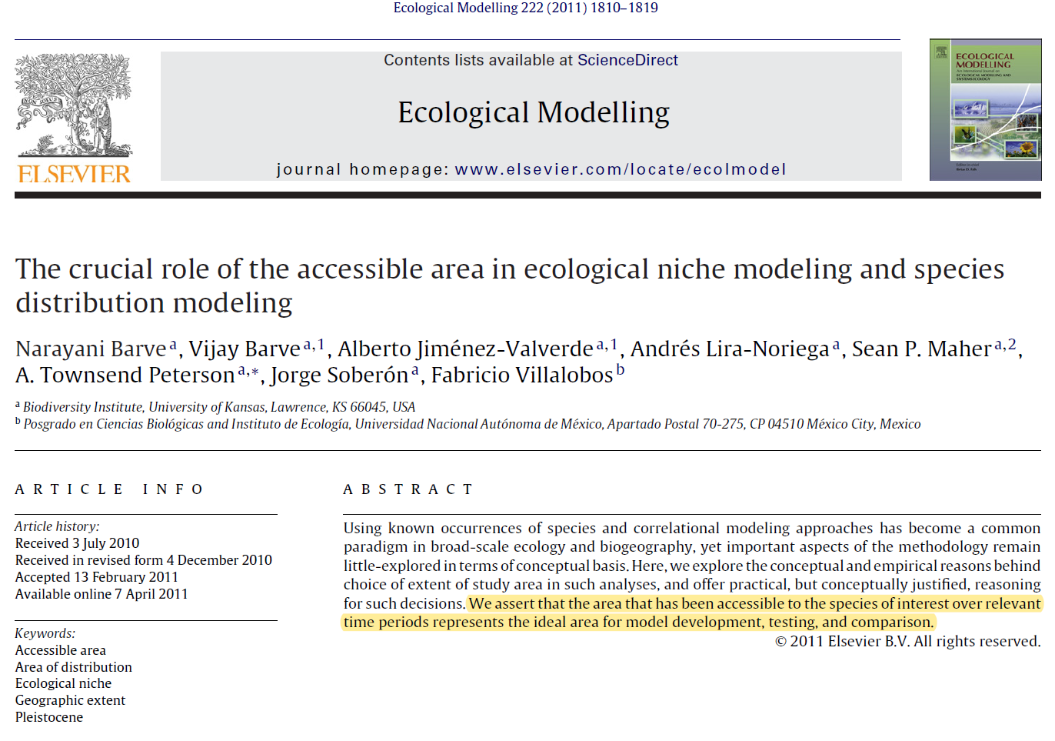
Why can’t every model calibrate on global extent?

Slide 39
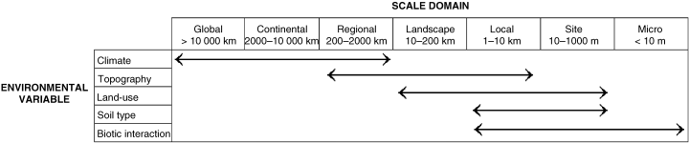
Different factors operating species distribution at different scales !!!
Schematic example of how different factors may affect the distribution of species across varying spatial scales.
Pearson & Dawson 2003

Slide 40
Scale effect
Non-climate factor
Biotic interaction
Bioclimate envelope
Climate factor

Slide 41
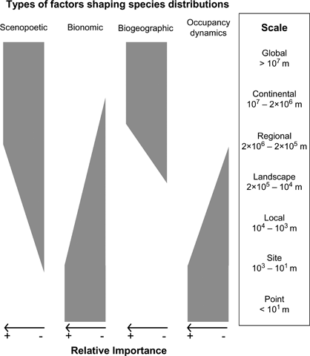
Understanding (insect) species distributions across spatial scales
Hortal et al. 2010 Ecography

