Slide 1
GEE variables for SDM
Gengping Zhu
gengping.zhu@wsu.edu

Slide 2
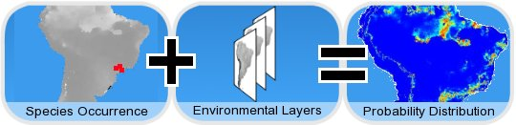
Correlative approach:
openModeller
http://openmodeller.sourceforge.net

Slide 3
GEE intro
https://earthengine.google.com/
Here, I am providing two approaches for using GEE to process data for our SDM

Slide 4
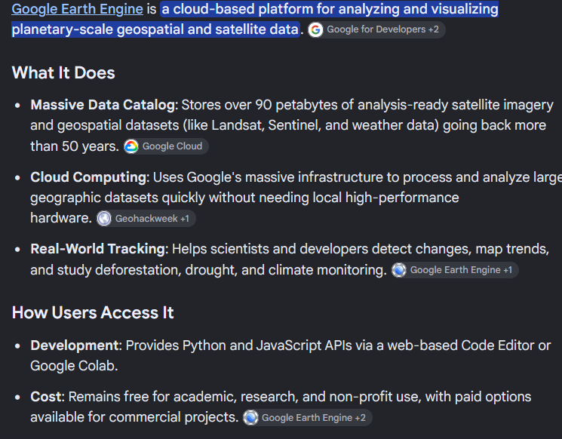

Slide 5
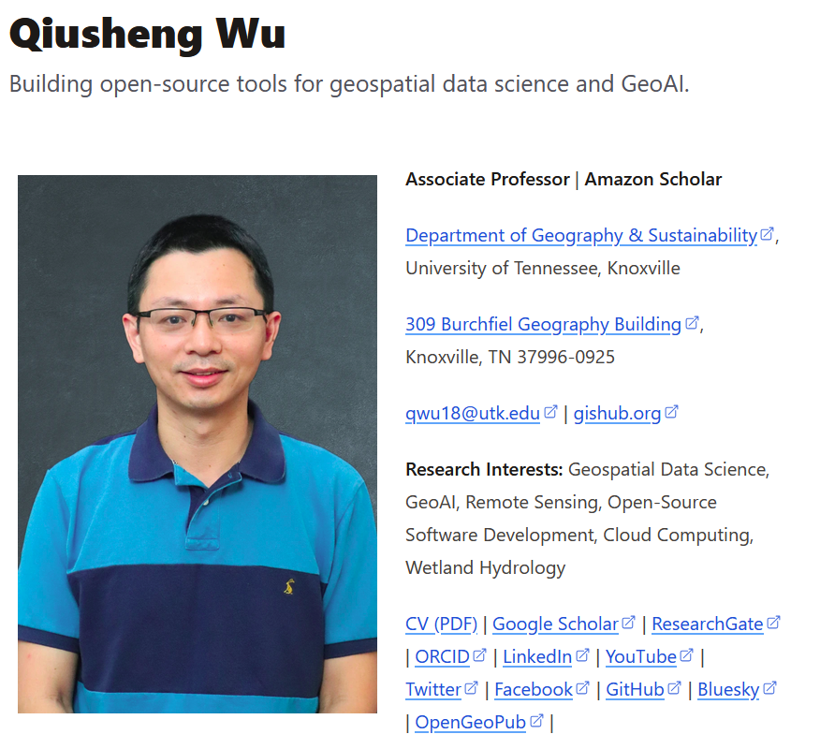
Approach I: GEE in QGIS
https://github.com/opengeos/qgis-gee-data-catalogs-plugin
https://www.youtube.com/watch?v=nZ3D6wLKJQw

Slide 6
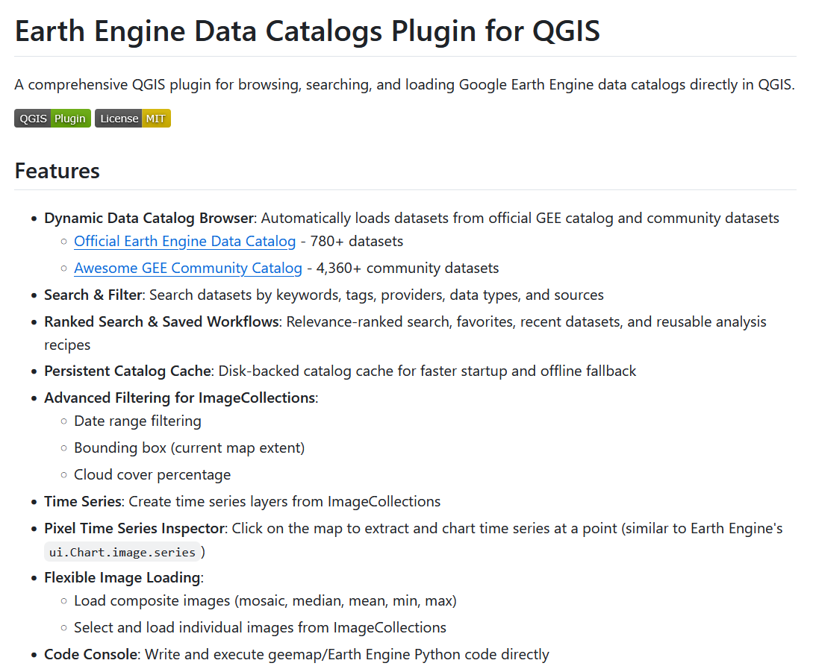

Slide 7
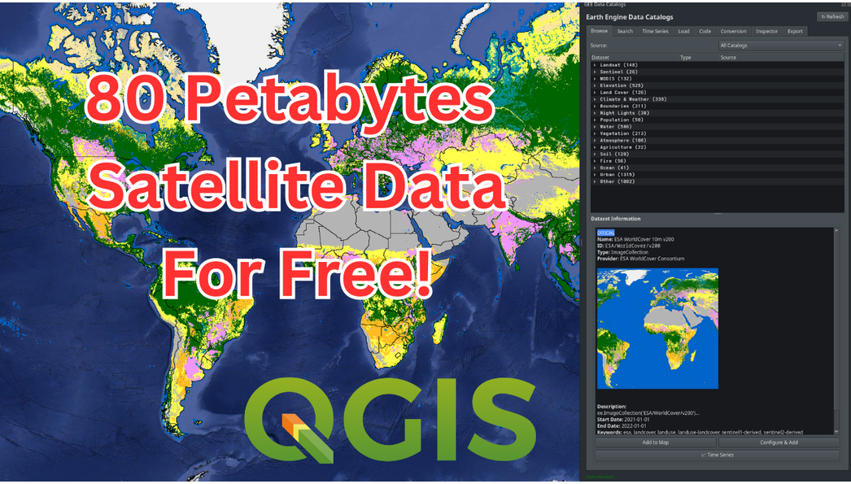

Slide 8
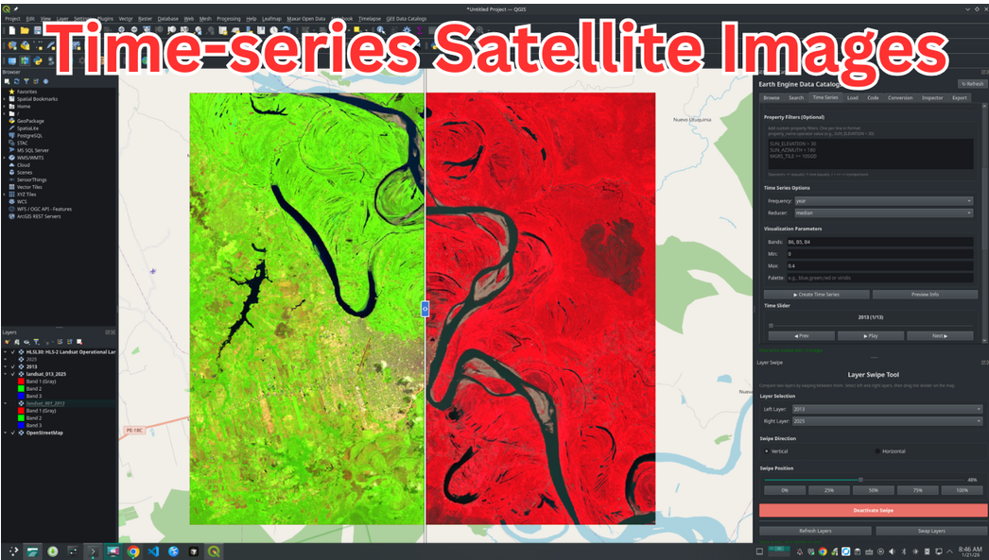

Slide 9
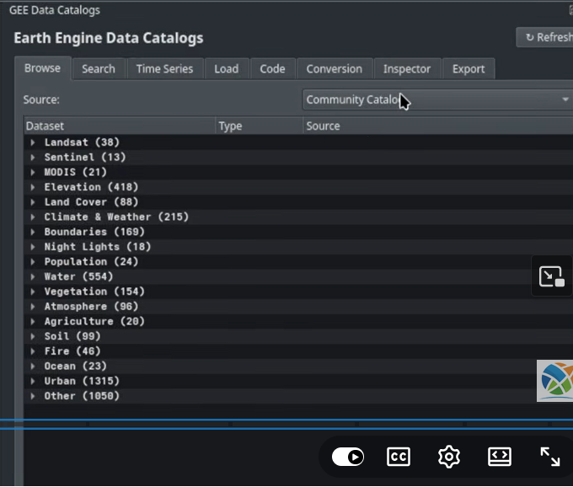

Slide 10
Approach II: Link AI with GEE
I can not write Java script, but I still need GEE to process my data
Let’s try ChatGPT and Claud
write the GEE Code Editor script to download bio1, bio5, and bio6 in WorldClim BIO Variables V1 from Google Earth Engine (GEE) for Guangdong Province, China, please download as multi-Band Raster at 10 km resolution.

Slide 11
write the GEE Code Editor script to download Daymet daily tmax and tmin temperature data from Google Earth Engine (GEE) for this area [-121.019709, 44.625742989505234, -117.580413, 48.54458101049476], please download as multi-Band Raster

Slide 12
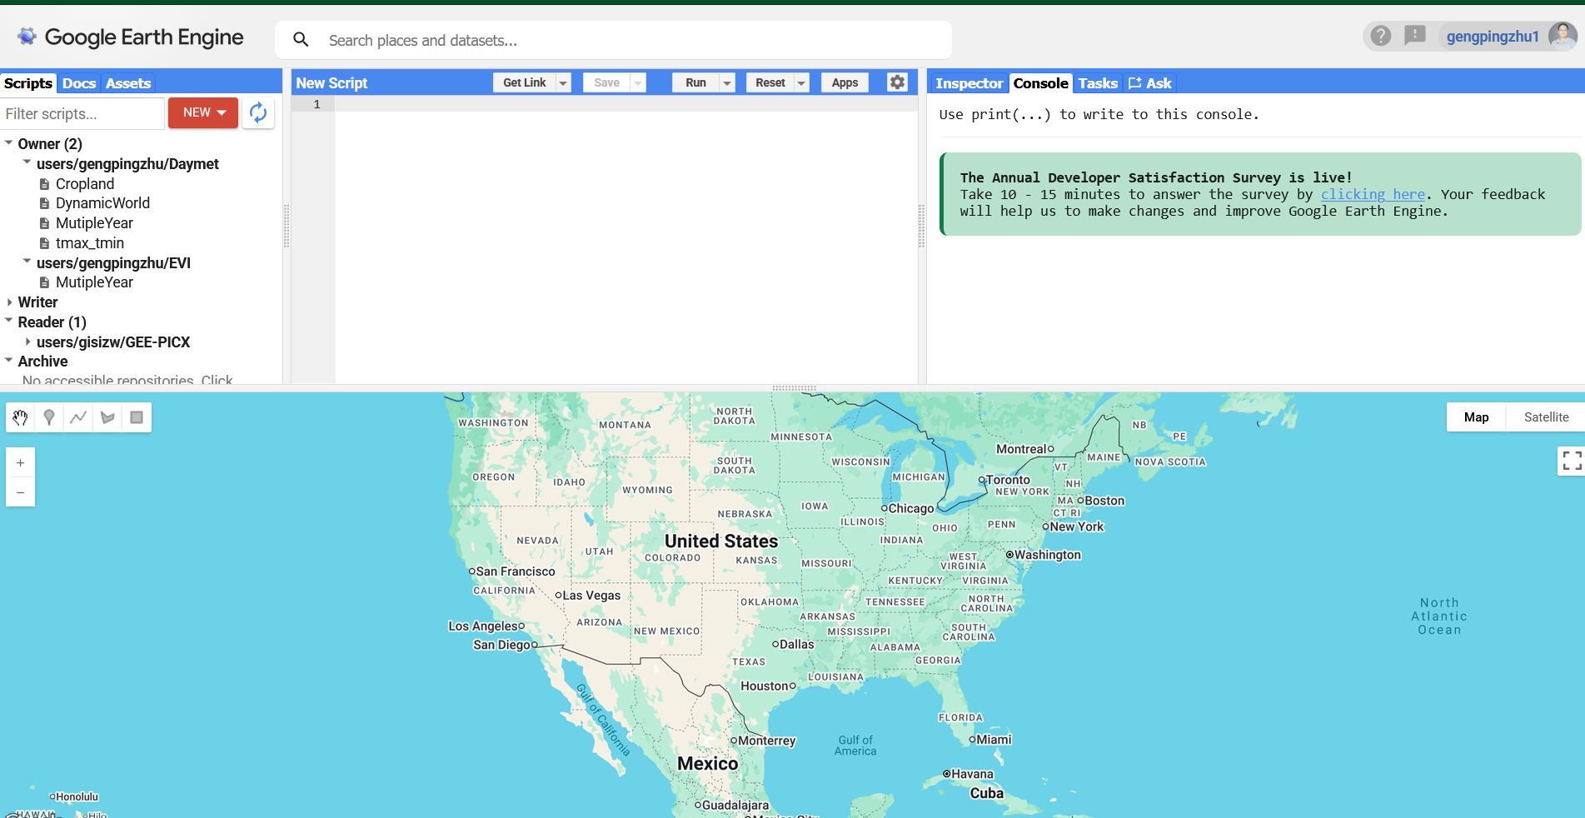
Demo

