Slide 1
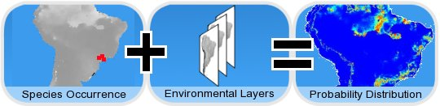
Occurrance data-Model strategy
openModeller
http://openmodeller.sourceforge.net

Slide 2
Input-occurrence data
Latitude/longitude
Format:
Degree/minute/second
Decimal format
Location/site → coordinates (lat/long)

Slide 3
Degree, minute, second
Decimal degrees
Pullman:
Latitude: 46° 43' 57.36" N
Longitude: 117° 10' 18.48" W
Latitude: 46.7298°
Longitude: -117.1817°

Slide 4
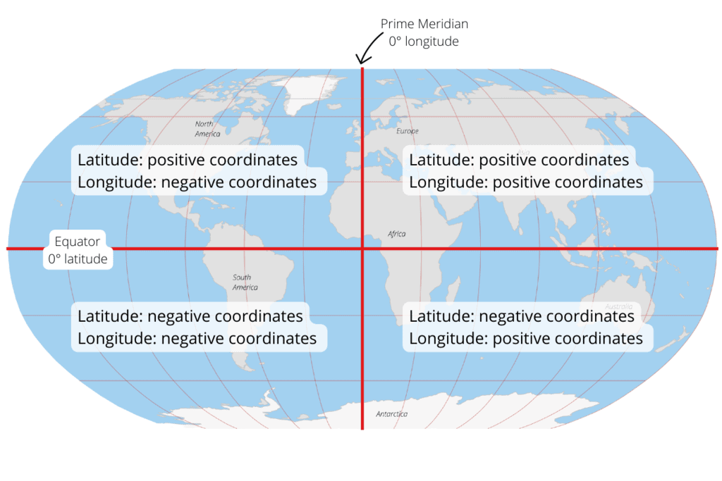

Slide 5
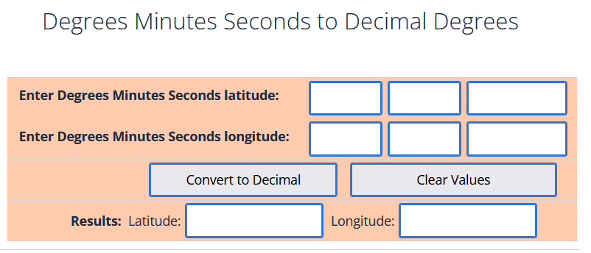
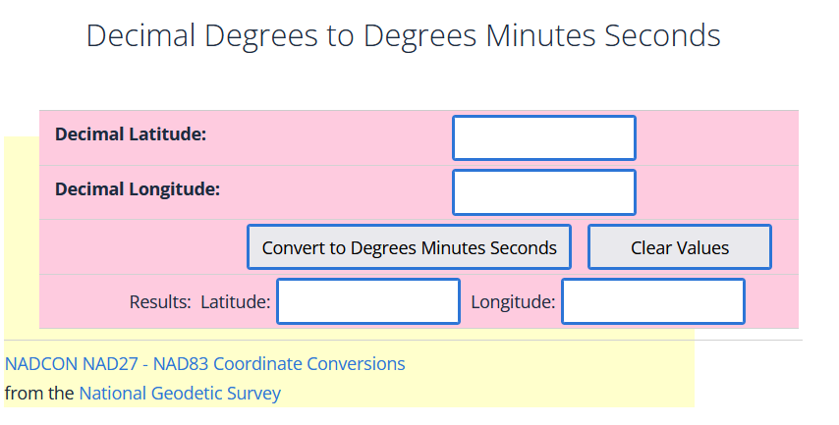
https://www.fcc.gov/media/radio/dms-decimal

Slide 6
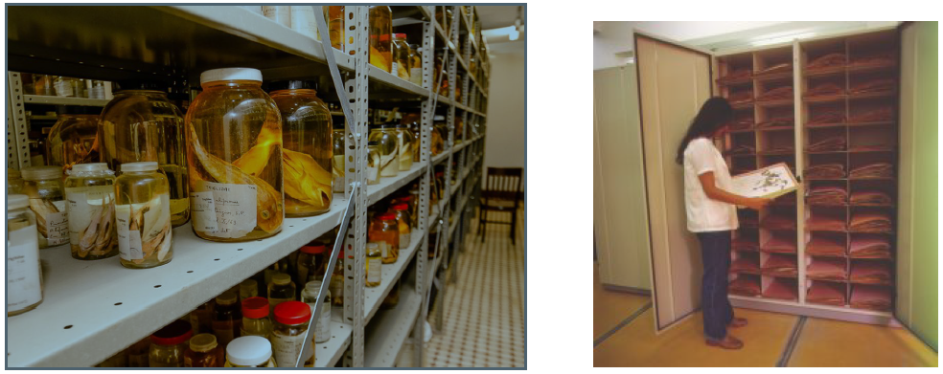
Where can you get these records?
Field survey, observation;
Published literatures, monographs, papers, atlases
Museum & herbaria:

Slide 7
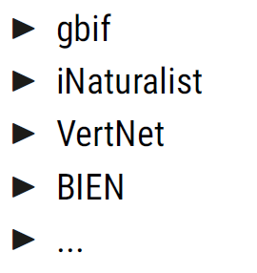

Slide 8
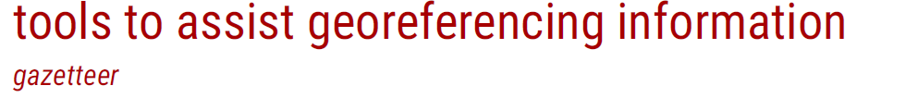
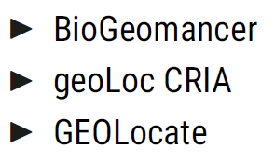
How to get longitude/latitude ?
longitude/latitude --> x/y
Online database -> longitude/latitude
Locality -> longitude/latitude

Slide 9
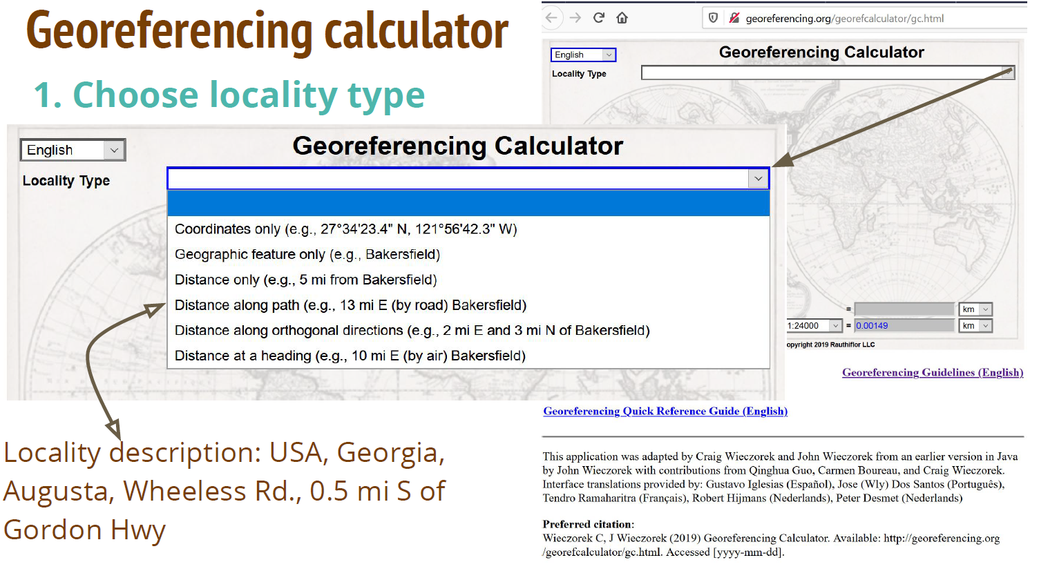
http://georeferencing.org/georefcalculator/gc.html

Slide 10
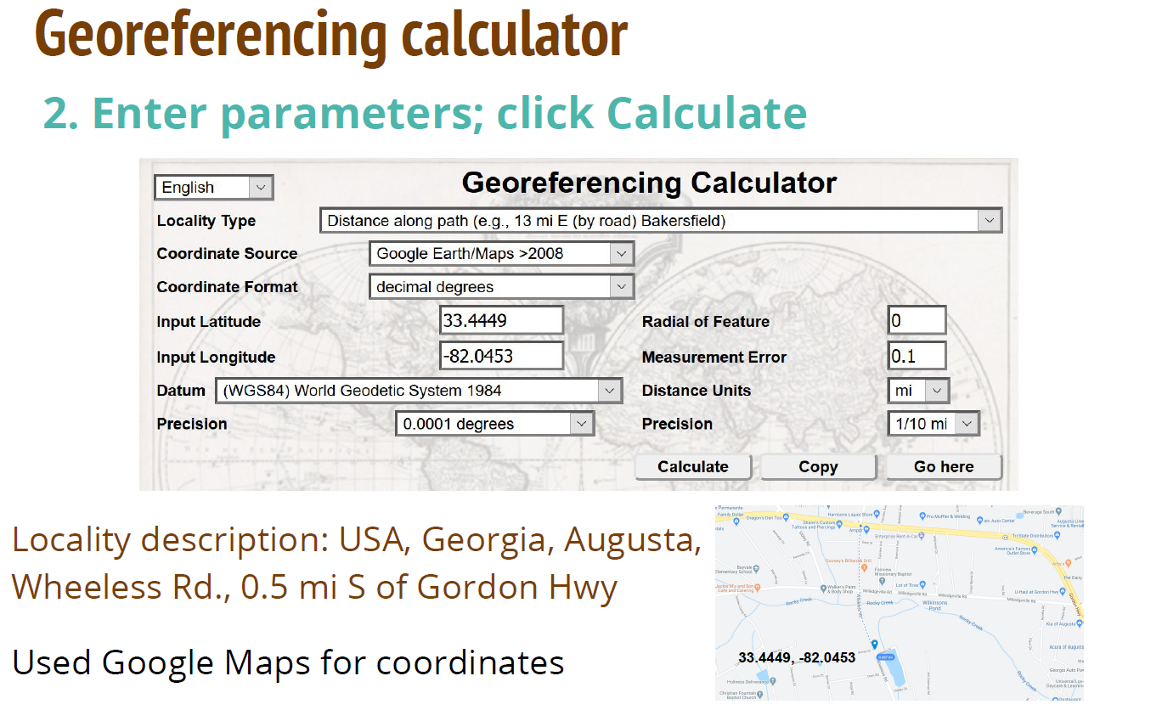

Slide 11
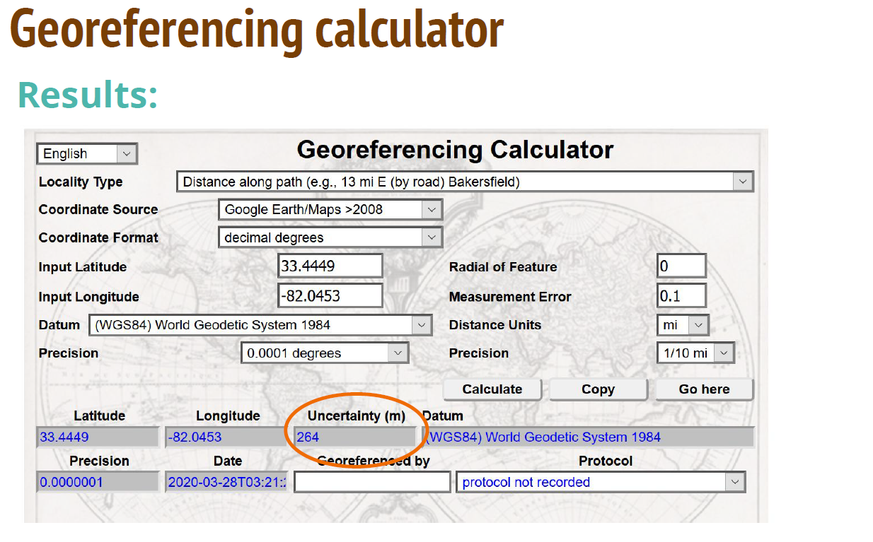

Slide 12
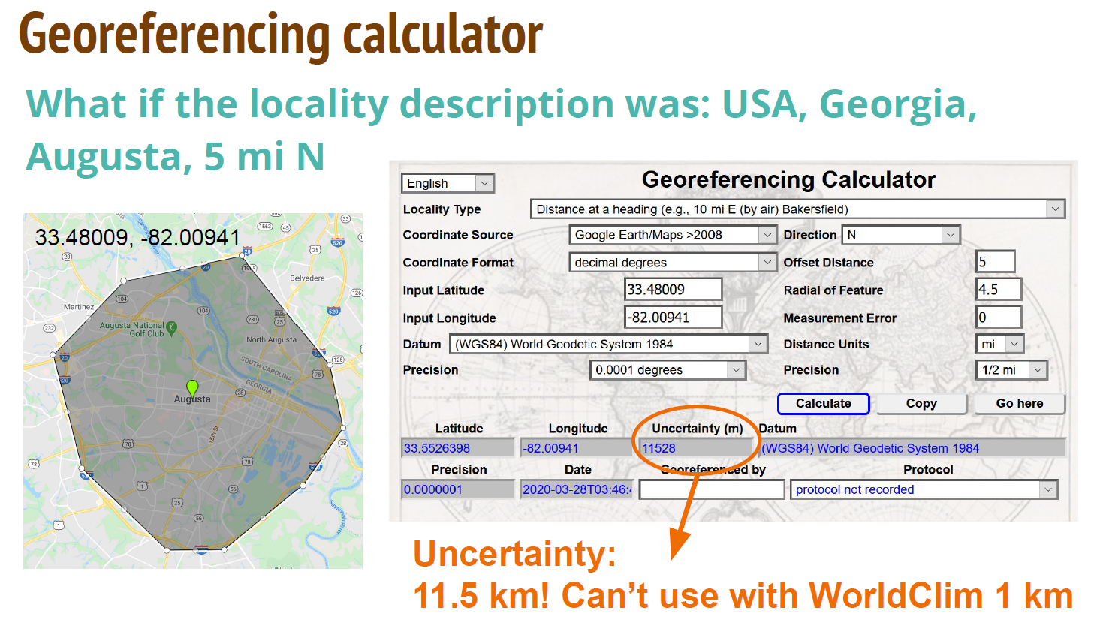

Slide 13

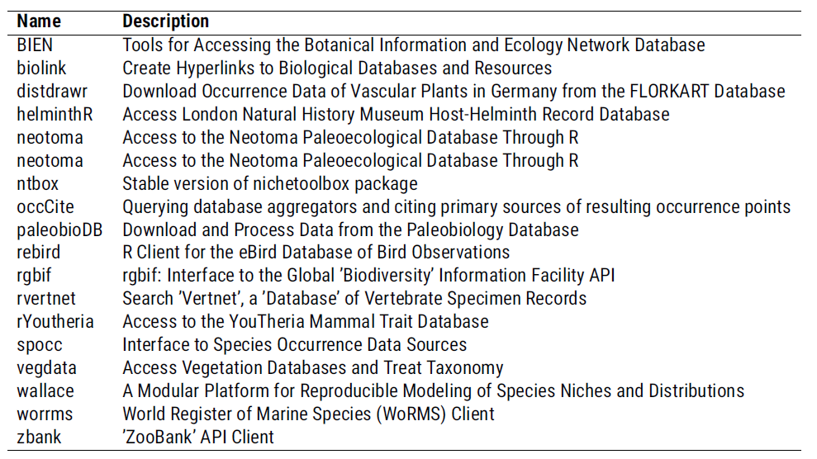

Slide 14
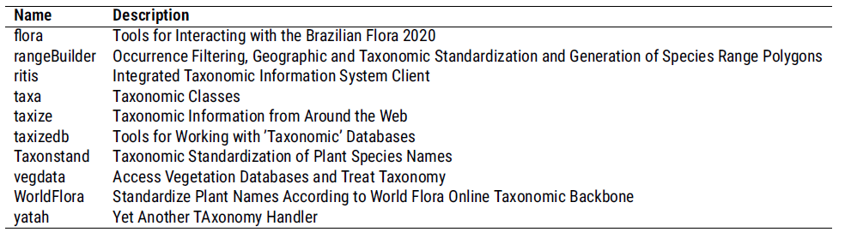
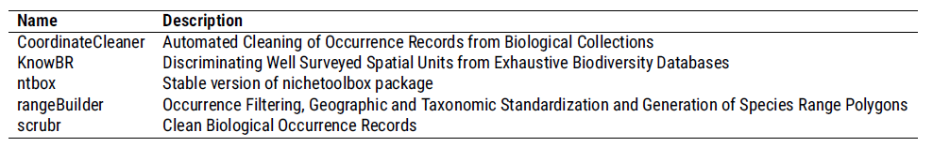

Slide 15
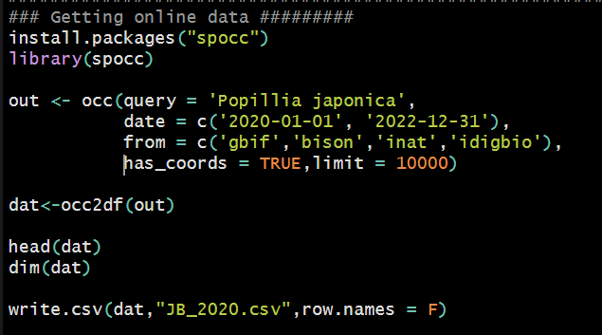
Getting online data:

Slide 16
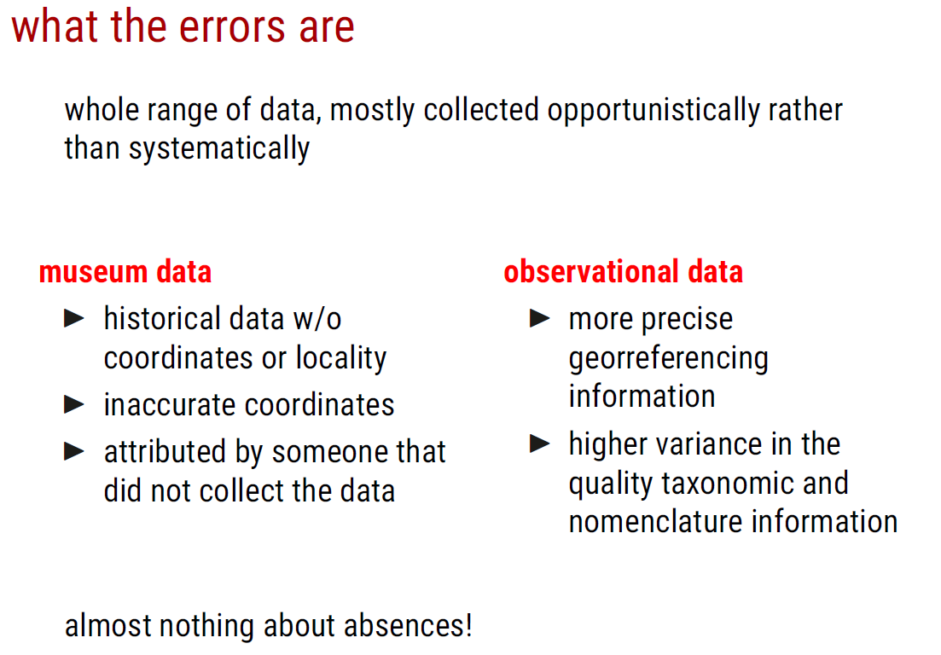

Slide 17
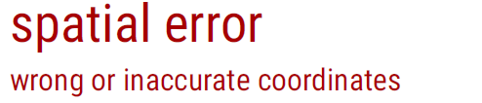
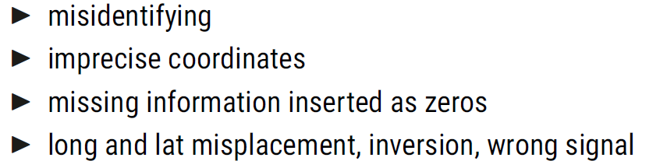
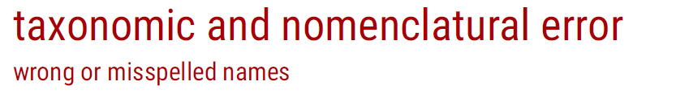
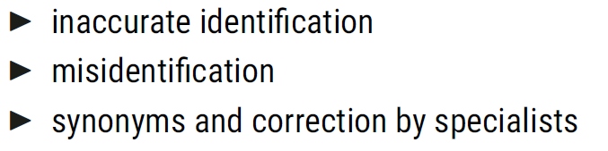

Slide 18
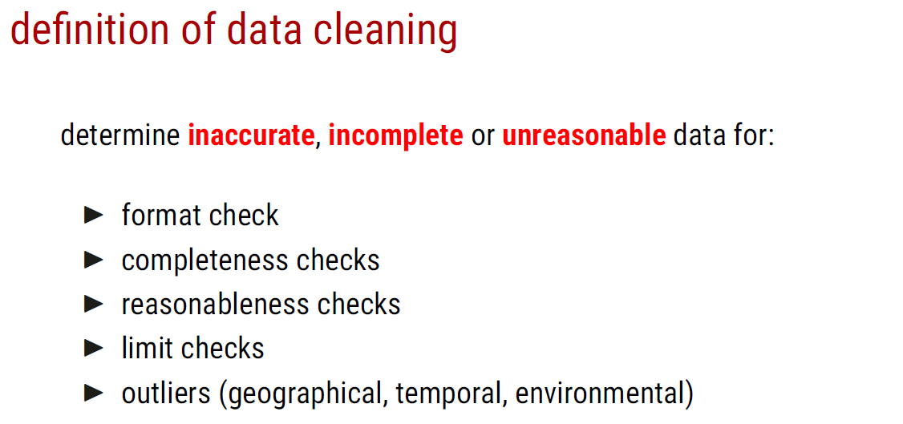
Step 1: Clean errors

Slide 19

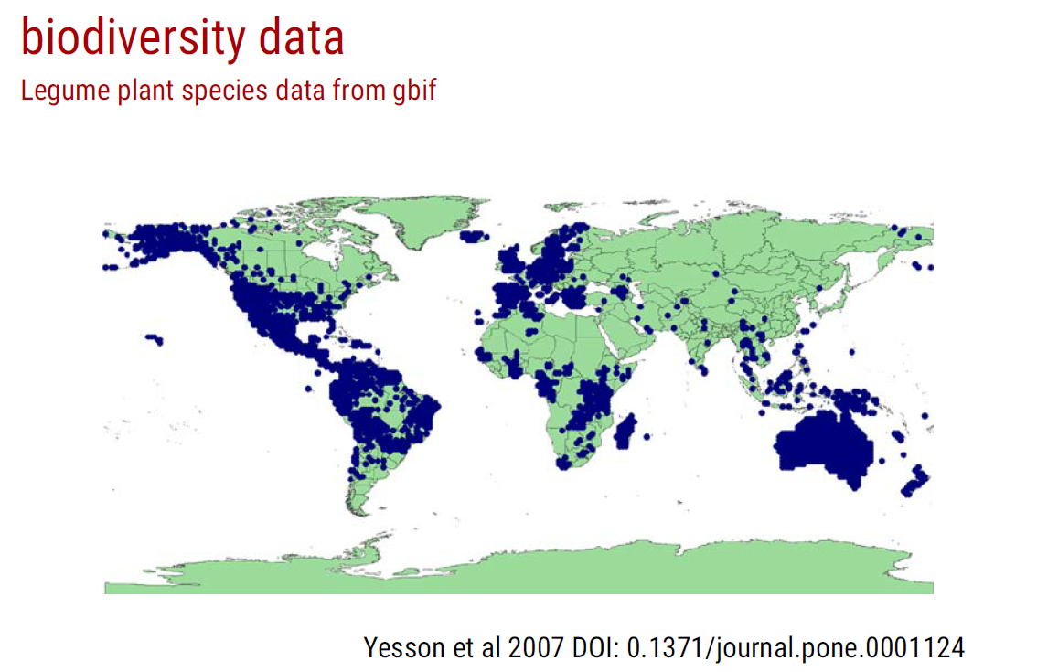
Any pattern / problem?

Slide 20
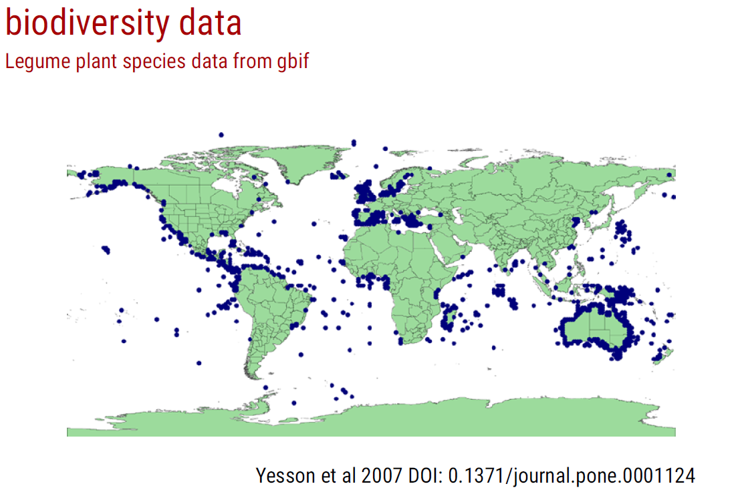
Any pattern / problem?

Slide 21
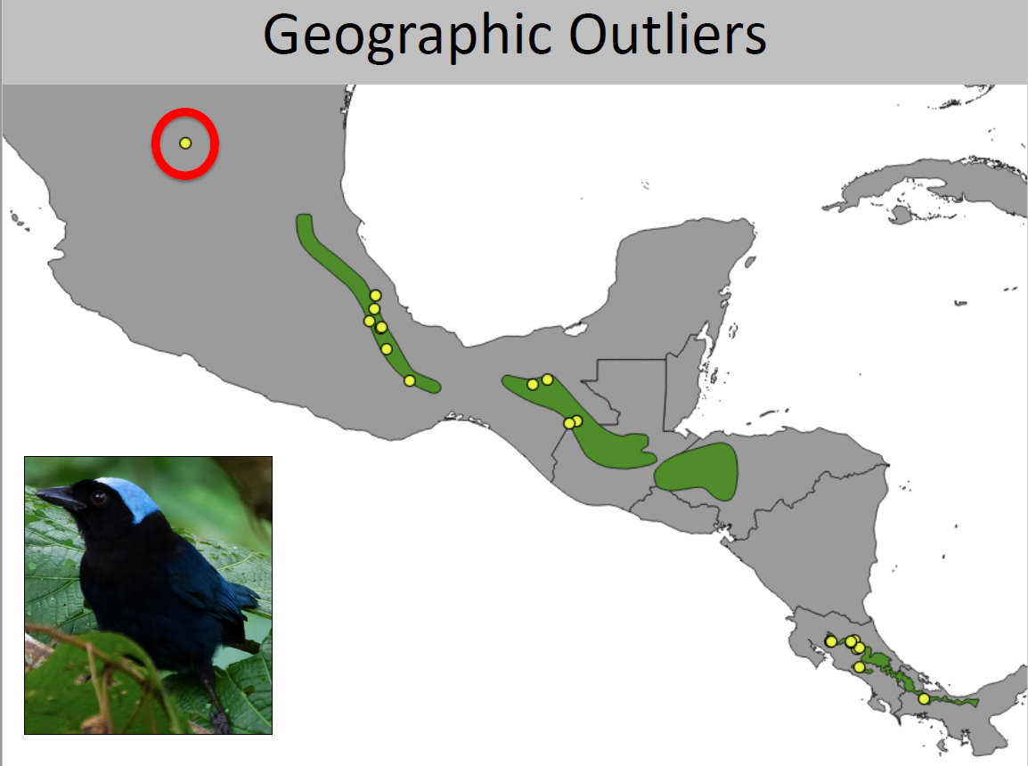

Slide 22
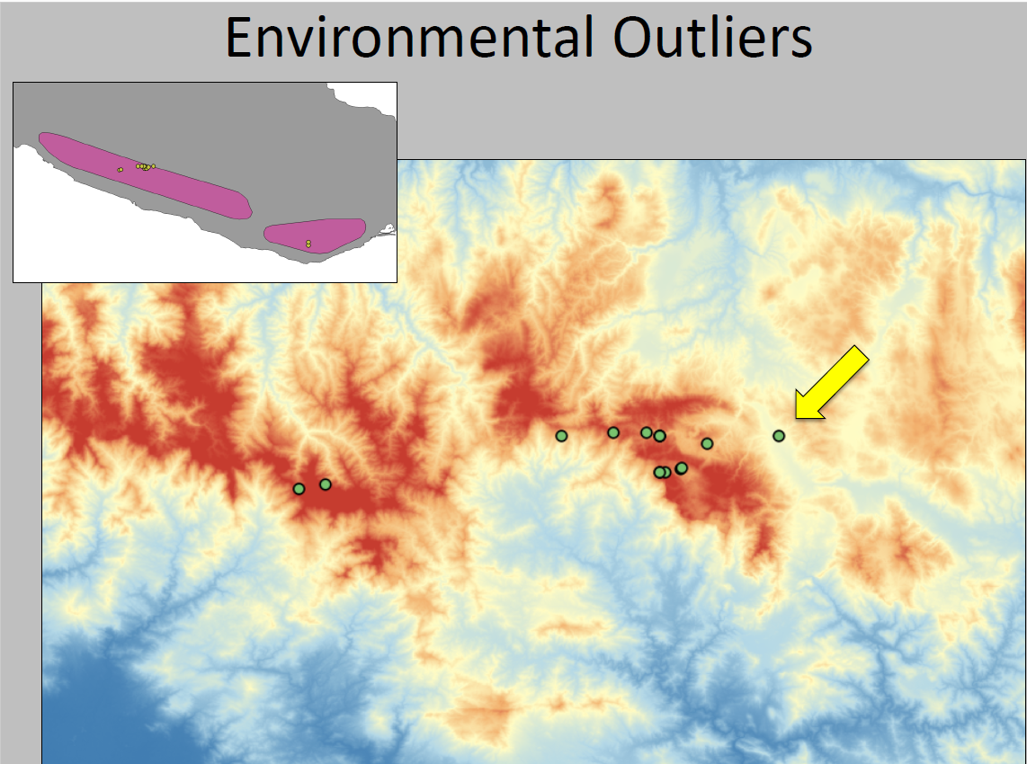

Slide 23
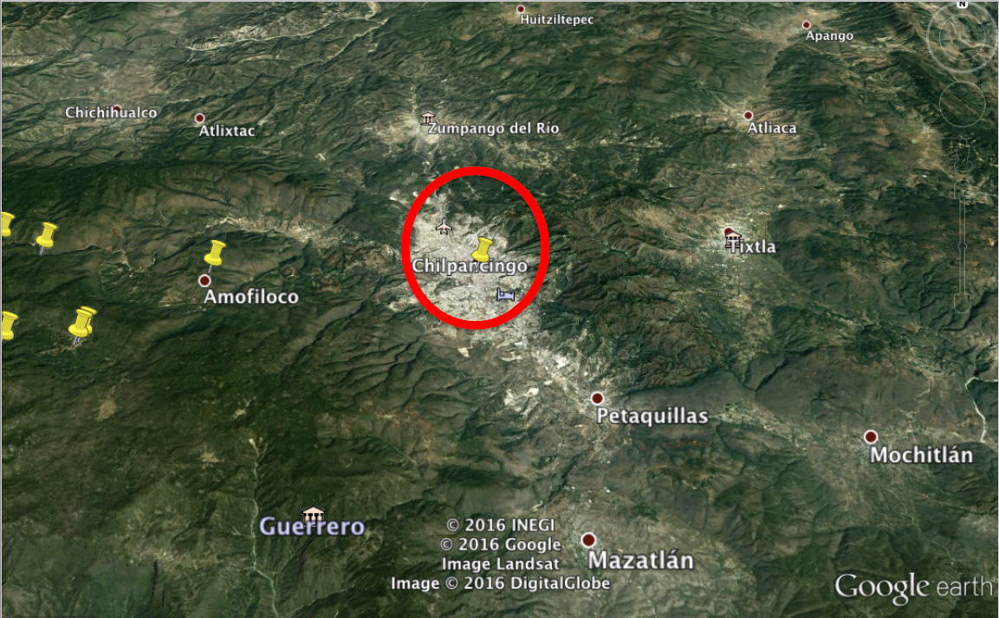

Slide 24
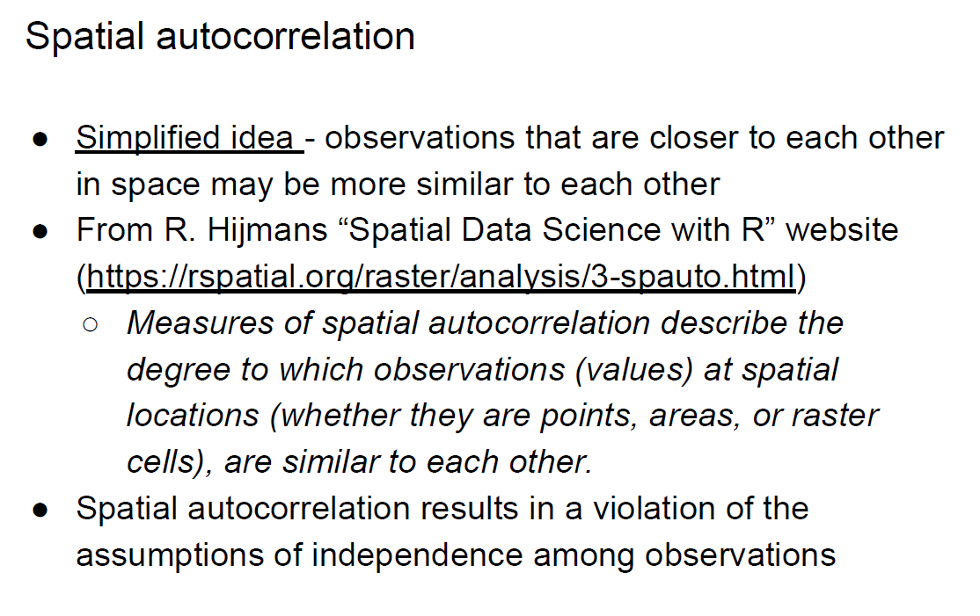
Step 2: Remove bias
Occurrence filtering and dealing with bias/autocorrelation
The First Law of Geography, according to Waldo Tobler, is "everything is related to everything else, but near things are more related than distant things."

Slide 26
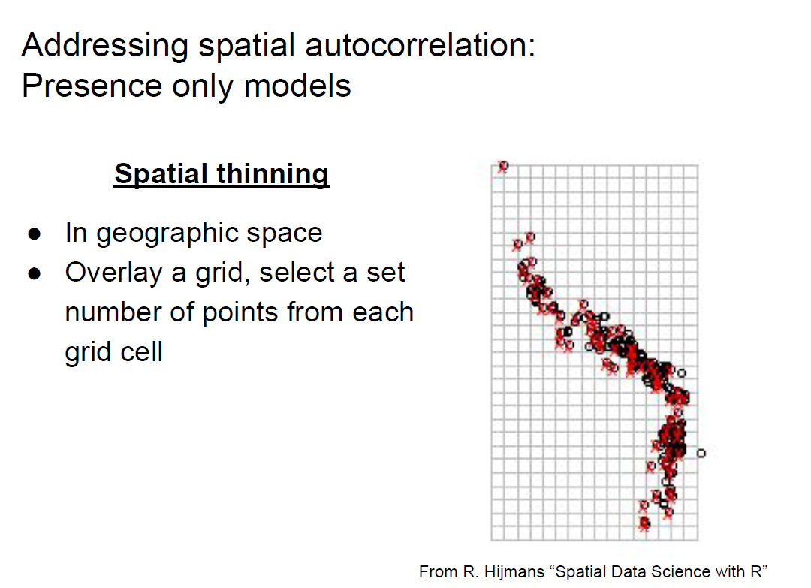

Slide 27
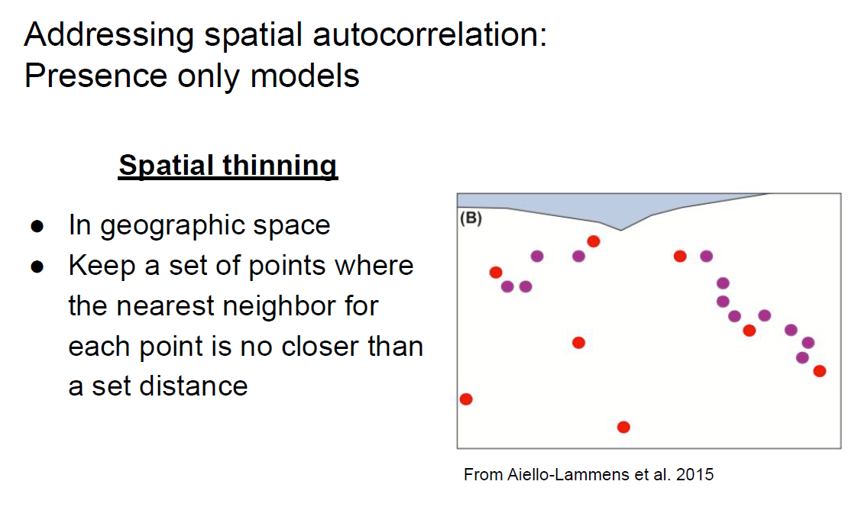

Slide 28
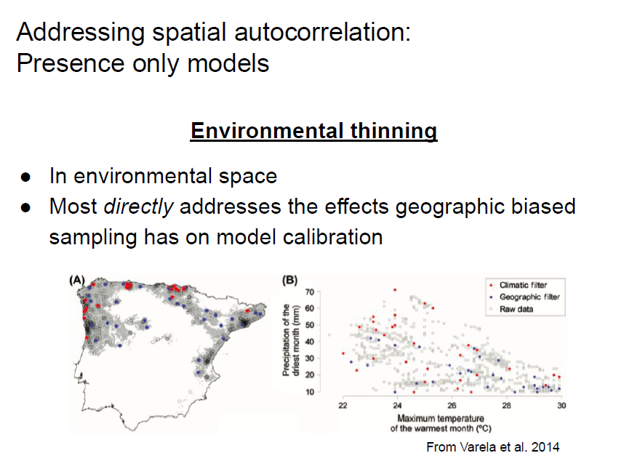

Slide 29
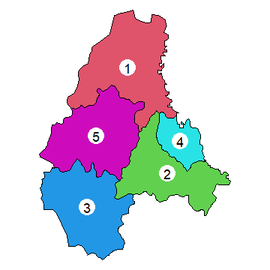
Addressing spatial autocorrelation
Presence only models
Area weighted method
Select the number of points according
the areas of administration unit;
Lage state -> reserve more points;

Slide 30
Model calibration and evaluation strategy:
Species with many records:
e.g., invasive species, data splitting (30/70%), checkboard, block, effect of replicate (machine learning);
Species with limited records:
e.g., rare and endemic species, ensemble of small model, Pearson method (Jackknife-1)

Slide 31
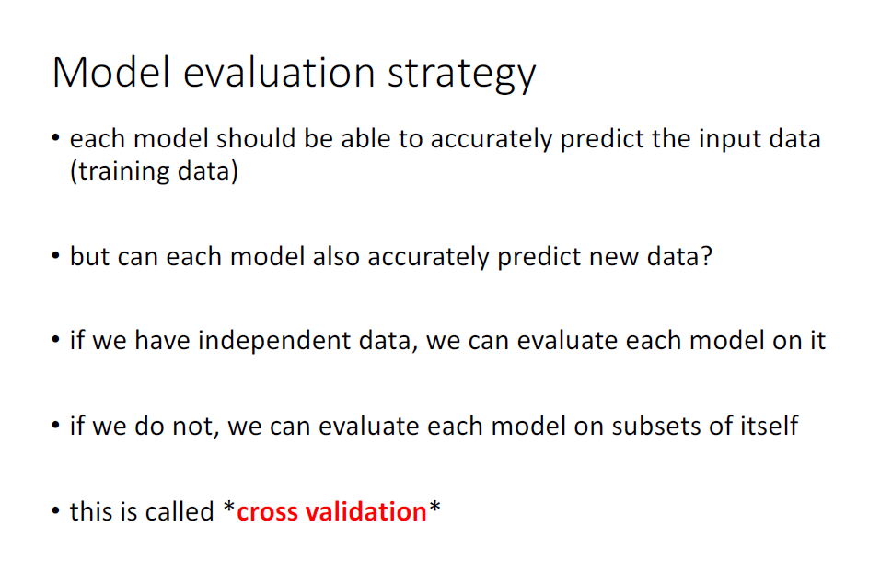
data splitting-species with many records
The simplest way is random data splitting (70% training, 30% testing), however they are not independent.

Slide 32
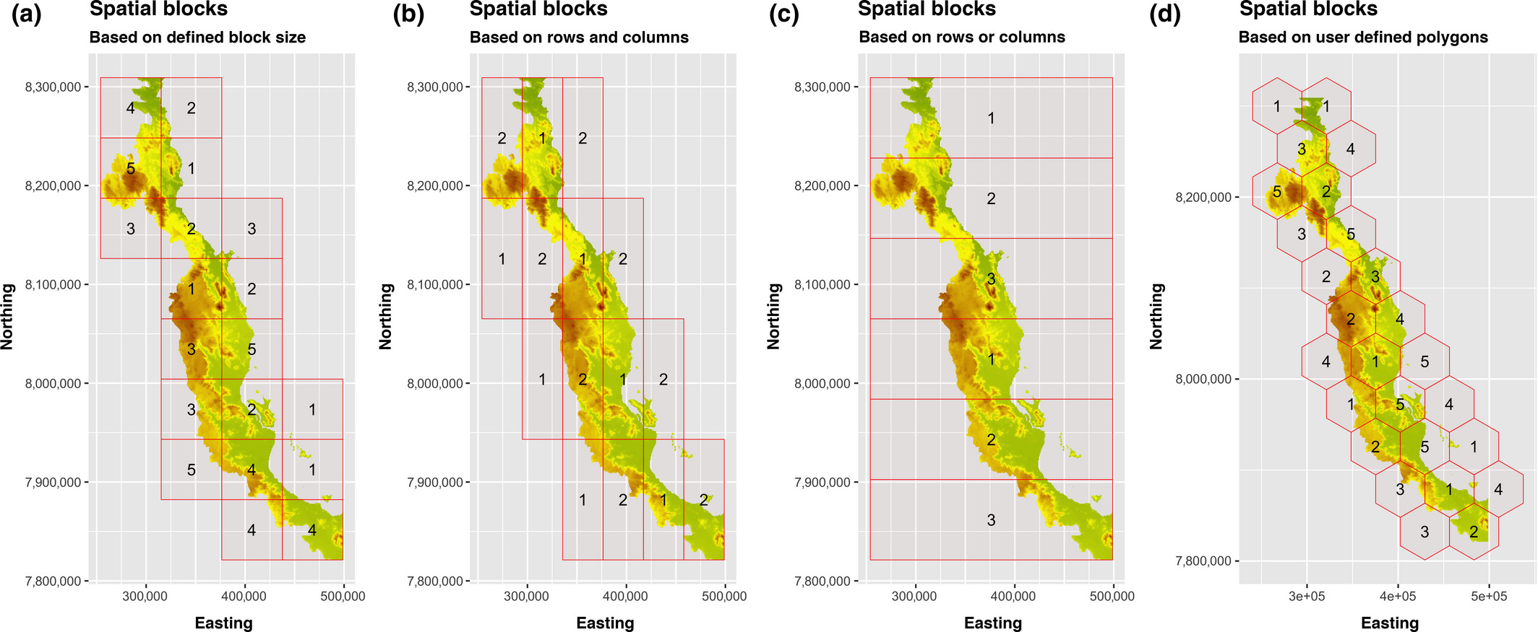
Method 1: Spatial block cross validations
R package: blockCV

Slide 33
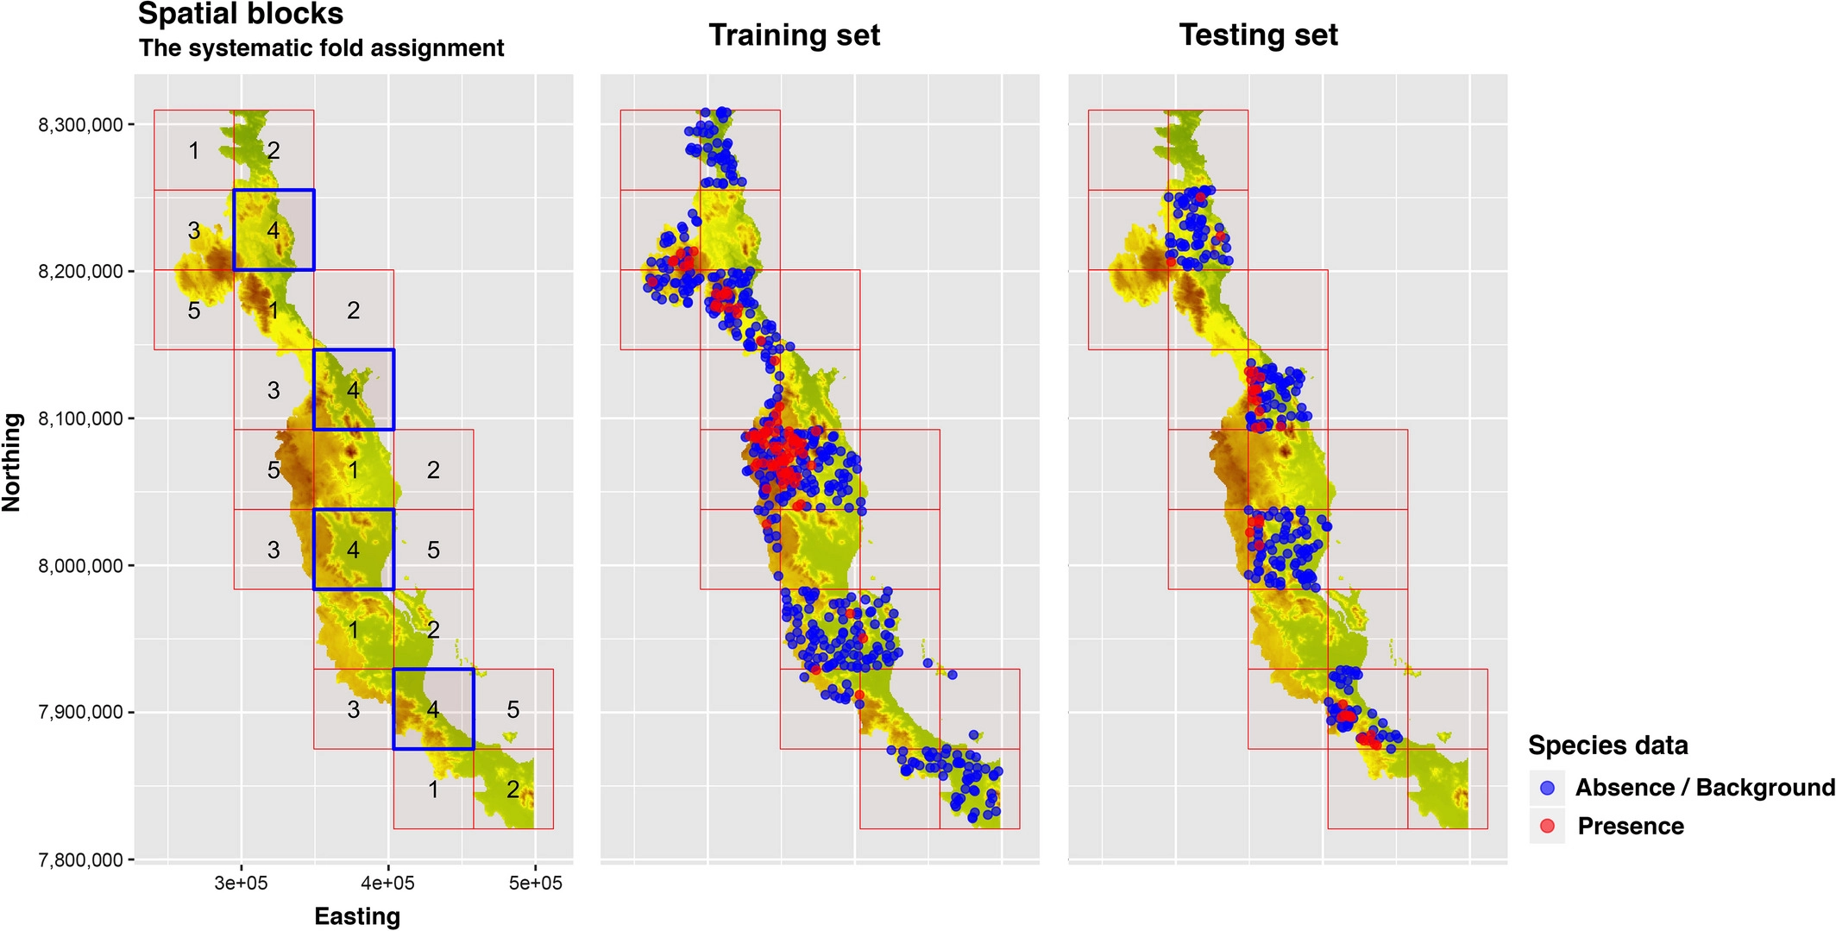

Slide 34
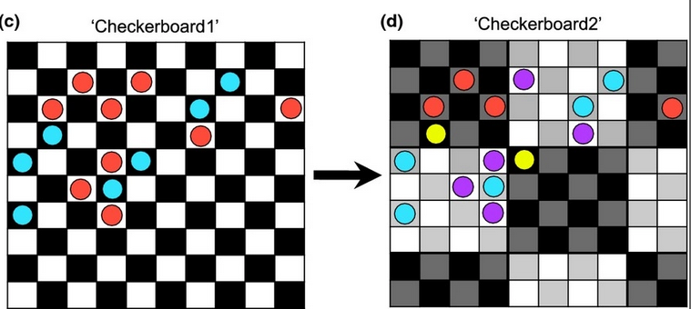
Method 2: Spatial checkerboard
R package: ENMeval

Slide 35
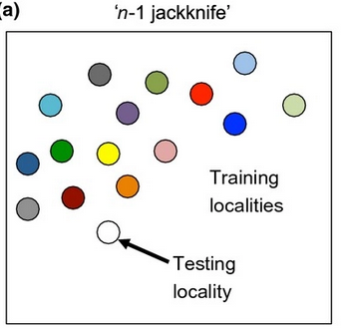
Rare, endemic species
Leaving-one-out method;
Propose by Richard Pearson et al. 2007
lowest presence threshold (LPT)
Ensemble of small model;
Proposed by Guisan group
ecospat package
leave-one-out (jackknife)

Slide 36
