Slide 1
SDM in Shiny
SDM in Web based platforms
Intro Shiny-Why ?
How it works in SDM?
Gengping Zhu
gengping.zhu@wsu.edu

Slide 2
What is Shiny (R)?
Shiny is an R package that enables building interactive web applications that can execute R code on the backend;
With Shiny, you can host standalone applications on a webpage, embed interactive charts in R Markdown documents, or build dashboards;

Slide 3
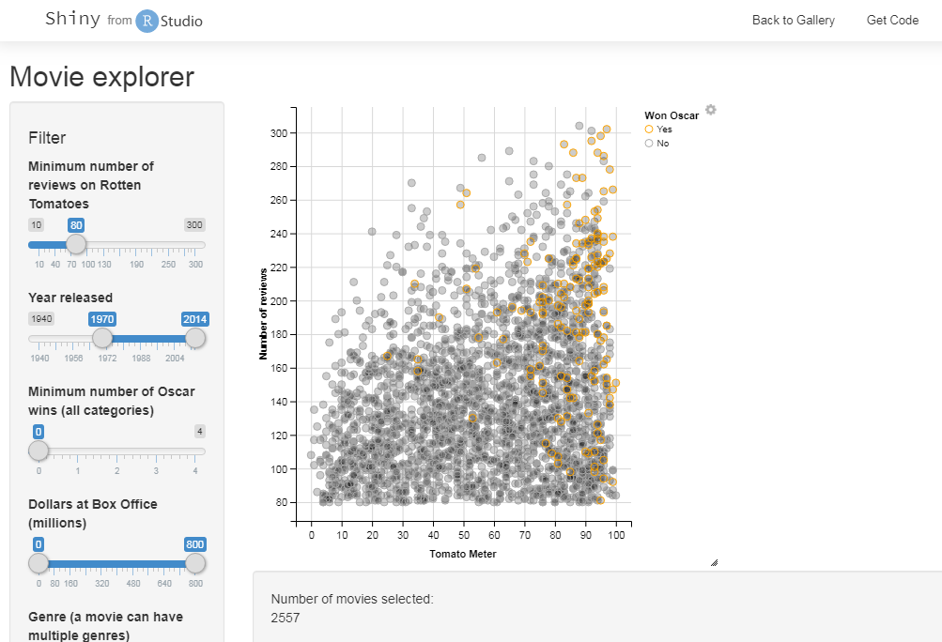

Slide 4
Web based platform in SDM
Wallace: very successful, widely used for conservation training
install.packages(“wallace”)
library(wallace)
run_wallace()
ntbox
run_ntbox
shinybiomod
Biomod2 is very successful but ShinyBiomod is still young
https://gitlab.com/IanOndo/shinybiomod

Slide 5
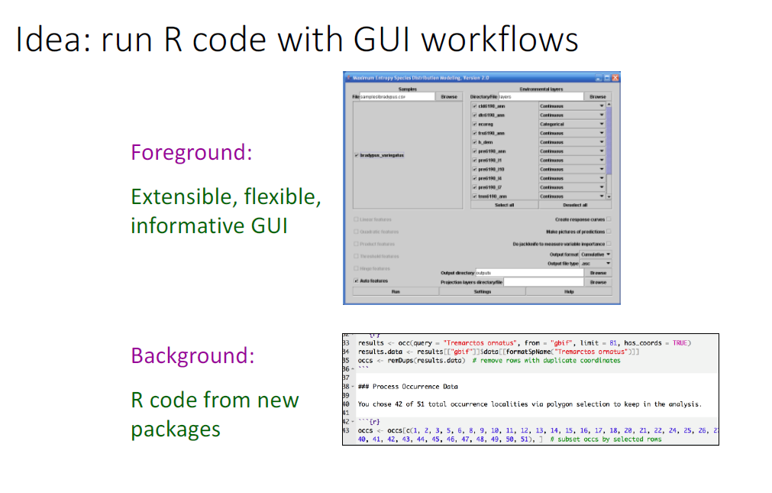

Slide 6
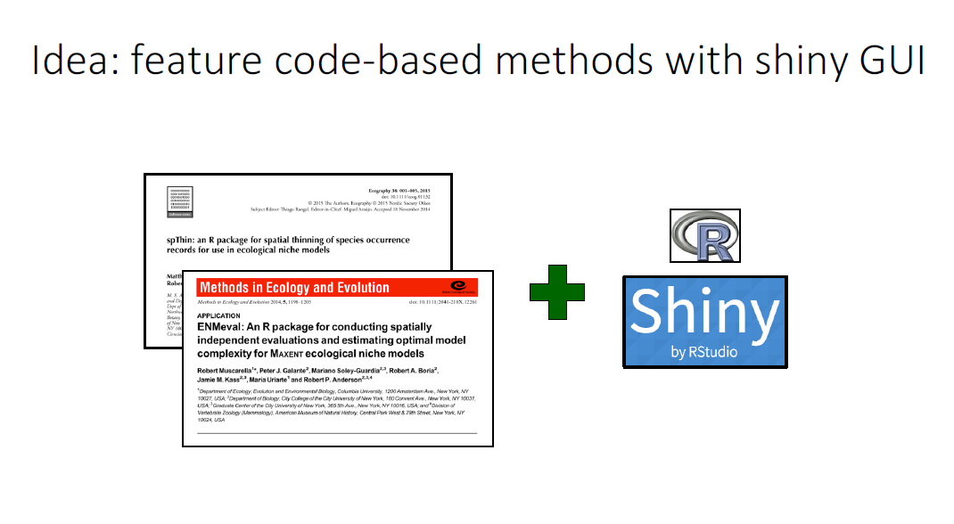

Slide 7
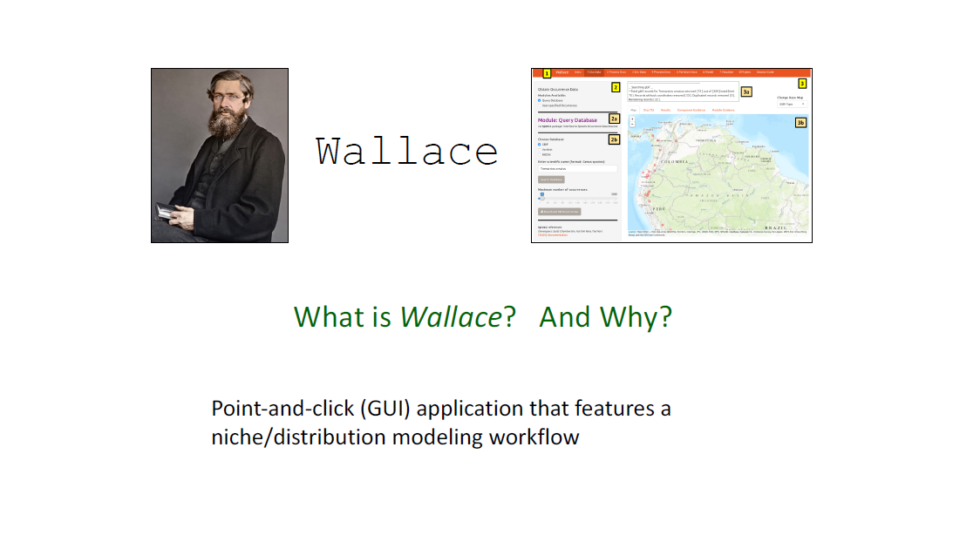
https://wallaceecomod.github.io/

Slide 8
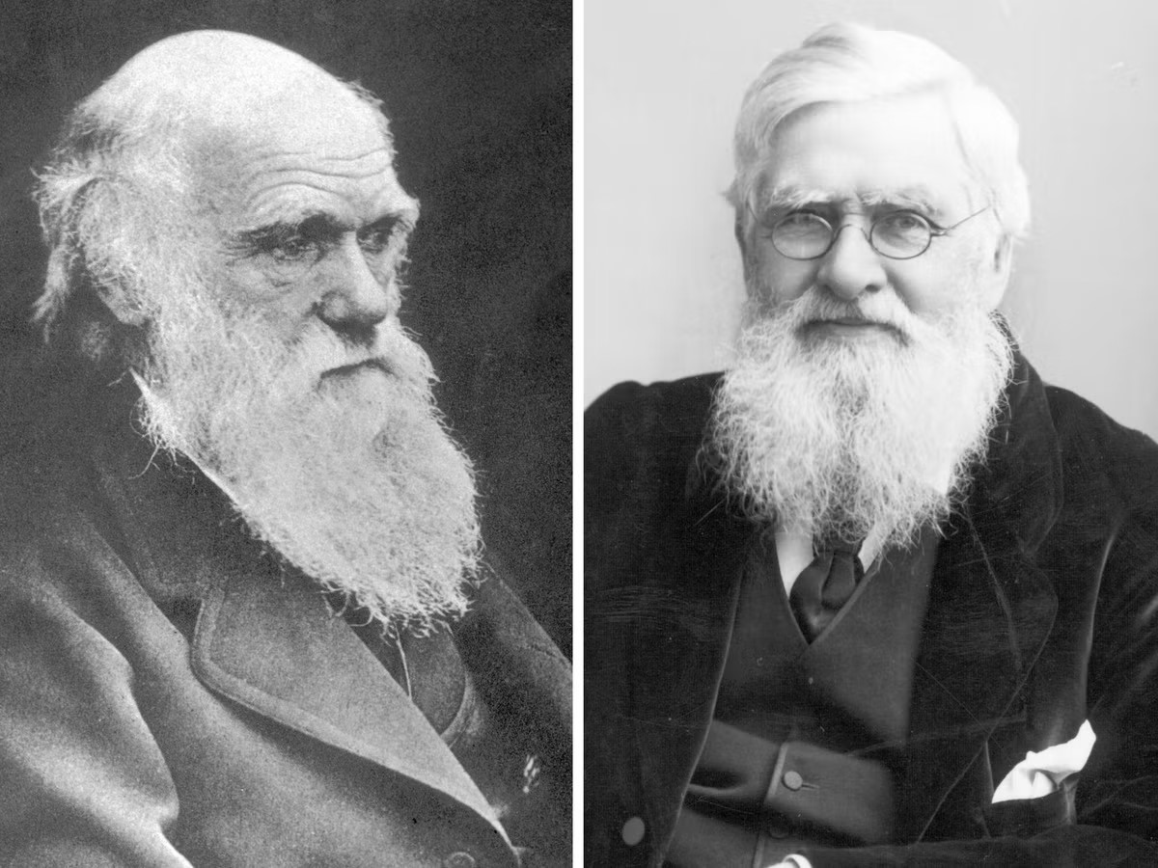
Charles Darwin
Alfred Russel Wallace

Slide 9
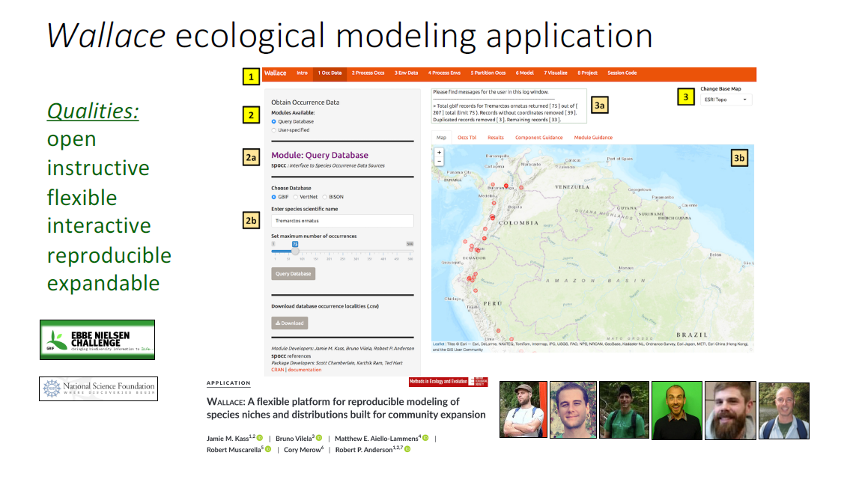
https://wallaceecomod.github.io/

Slide 10
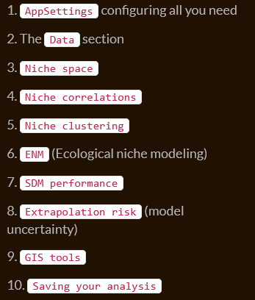
ntbox
library(ntbox)
run_ntbox()
https://luismurao.github.io/ntbox_user_guide.html

Slide 11
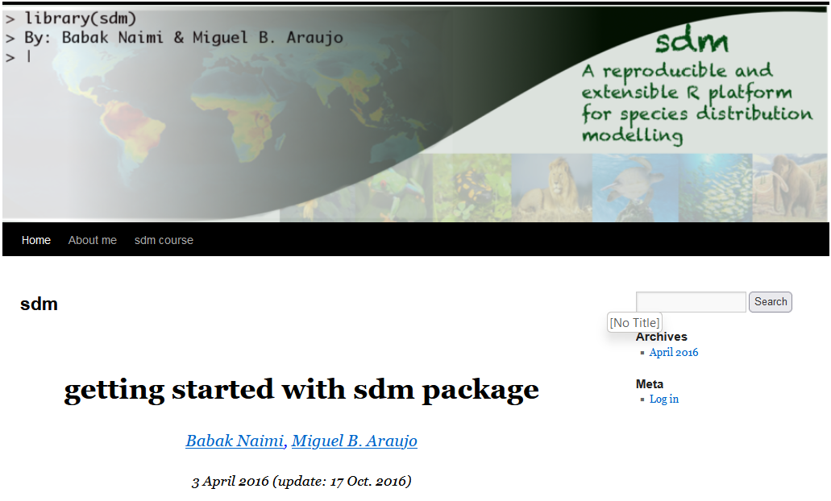
sdm package https://www.biogeoinformatics.org;
https://sdm.r-forge.r-project.org/
Simplized version of biomod2;
sdm is an object-oriented, reproducible and extensible, platform for species distribution modelling.
Developed by Babak Naimi and Miguel B. Araújo

Slide 12
library(sdm)
file <- system.file("external/model.sdm", package="sdm")
m <- read.sdm(file) # a sdmModels Object (fitted using sdm function)
m
gui(m)

Slide 13
What is the limitation?
It is very useful for beginners and training, but has limitations:
Many functions can not work out in the platform；
Some specific/personalized requirements still have to be work out in R code, like repetition running (loop)
limited capacity on computing, running big data
…

