Slide 1
ensemble model
&
ensemble of small model
“All models are wrong, some are useful”
Gengping Zhu
gengping.zhu@wsu.edu

Slide 2
In 1976, a British statistician named George Box wrote the famous line, “All models are wrong, some are useful.”
"Nothing in Biology Makes Sense Except in the Light of Evolution" is a 1973 essay by the evolutionary biologist Thodosius Dobzhansky;

Slide 3
Occ data → Model strategy
For species that have 1-10 points: No model, try ecoregion (ecoregion also can be used to delimit model calibration area).
For species that have > 20 points: ensemble model (I will show this with sdm).
For species that have 10-20 points: ensemble of small model (I will show this with FlexSDM)

Slide 4
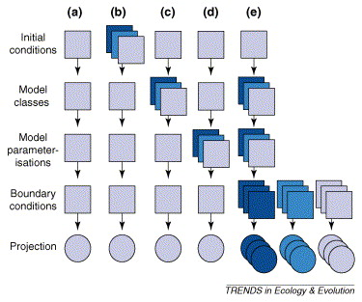
Why we need ensemble model ?

Slide 5
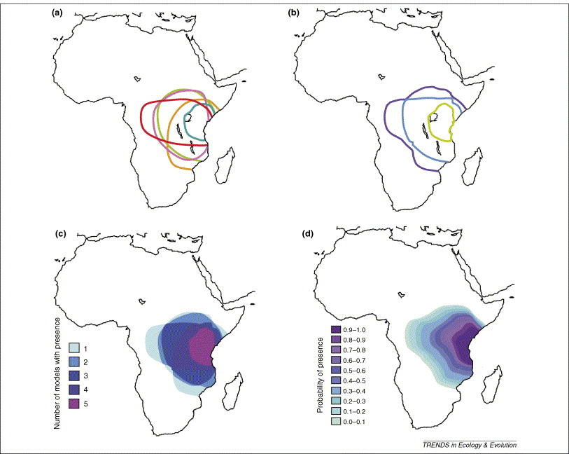
Why ensemble model ?

Slide 6
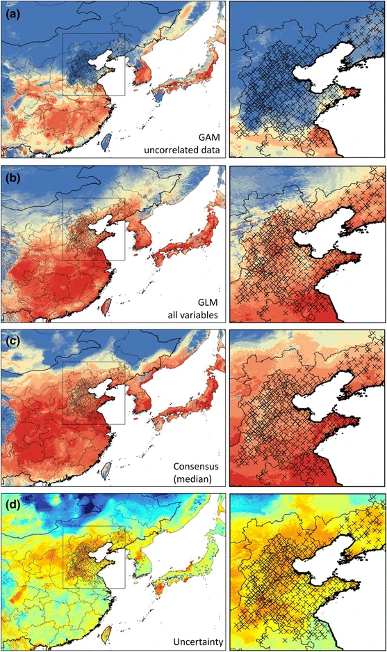
Individual and consensus models predictions of Fall Webworm in East Asia.
Zhu & Peterson 2017

Slide 7
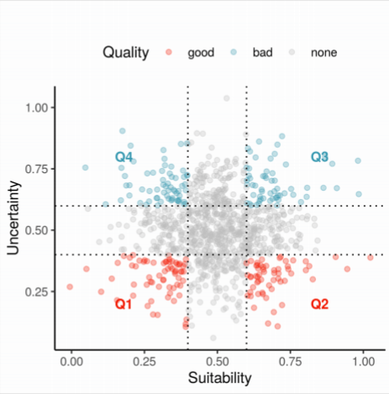
Why ensemble model?

Slide 8
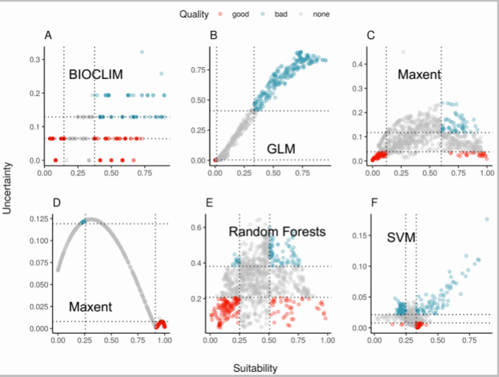

Slide 9
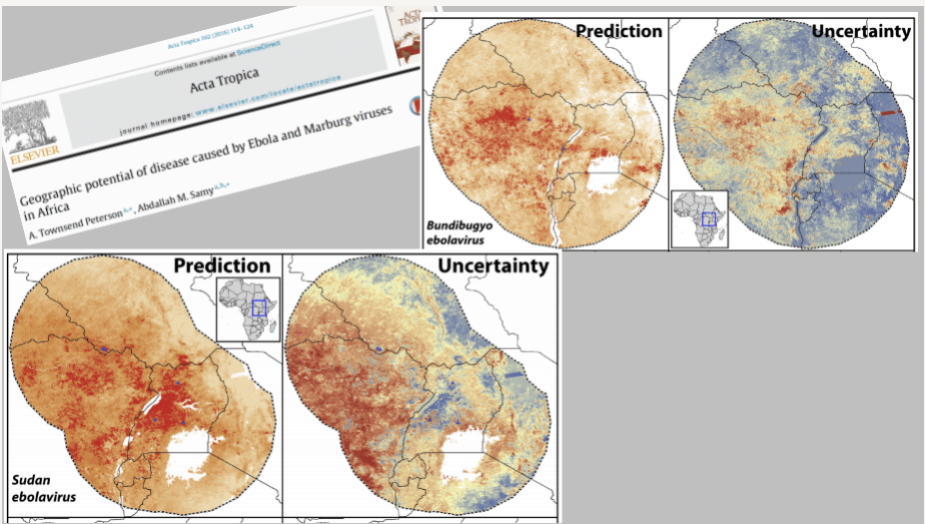

Slide 10
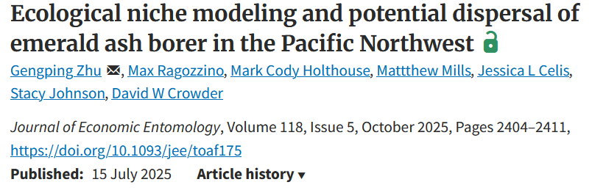
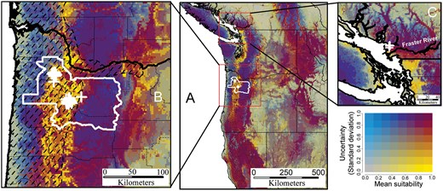
Fig. 3. Ensemble habitat suitability model prediction for emerald ash borer in the Pacific Northwest. Bivariate maps denote ensemble predictions and their uncertainty; the increasing intensities of yellow represent increasing habitat suitability, and increasing blue represent increasing uncertainty.

Slide 11

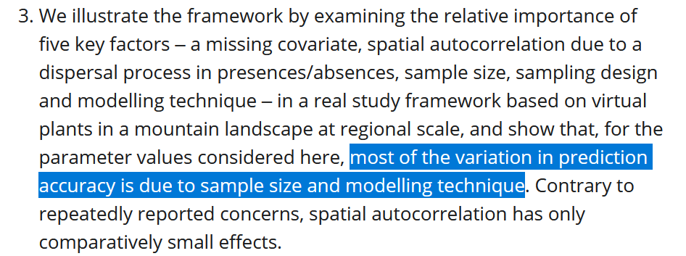
Where these variations came from ?

Slide 12
How to produce ensemble model?
Ensemble model should be fitted based on individual models…
These individual models could be fitted separately, by unique package,
then, a consensus model is produced, i.e., mean, median, weighted average..
….

Slide 13
Generalized linear model (GLM) parameters…
We can fit linear, quadratic or higher polynomial terms (check poly()) and interactions between predictors:
the term I() indicates that a variable should be transformed before being used as predictor in the formula;
poly(x,n) creates a polynomial of degree;
x1:x2 creates a two-way interaction term between variables x1 and x2, the linear terms of x1 and x2 would have to be specified separately;
x1*x2 creates a two-way interaction term between variables x1 and x2 plus their linear terms, i.e., x1*x2 == 1x + x2+ x1:x2
x1*x2*x3 creates the linear terms of the three variables, all possible two-way interactions between these variables and the three-way interaction
…

Slide 14
Generalized Additive Model (GAM) parameters… package: gam, mgcv
used when the linear predictor depends linearly on unknown smooth functions of some predictor variables. The distinction is blurry as you can represent numeric covariables e.g. by a spline also in a GLM
an adaptation that allows us to model non-linear data while maintaining explainability.
allows to either shrink the importance of variables depending on the significance, or it allows to shrink insignificant variables to ‘zero’, meaning that this represents a variable selection.
spline smoother s() is related to model complexity, with the complexity parameter k set to 3 for a simple shape, and k=-1 for letting mgcv optimizing the complexity.
….

Slide 15
Random Forest (RF) parameters… package: randomforest
Machine learning method…
use a bagging procedure for averaging the outputs of many different CARTs (classification and regression trees)
CARTs bootstrapped samples of the training data and then either average the results in case of regression trees or make a simple vote in case of classification trees (committee averaging)
An important feature of random forests are the out-of-bag samples, which means that the prediction/fit for a specific data point is only derived from averaging trees that did not include this data point during tree growing.
The output of Random Forests is essentially cross-validated!
Random forests estimate variable importance by a permutation procedure, which measures for each variable the drop in mean accuracy when this variable is permutated.

Slide 16
Maxent: maxnet package
maxnet: Fitting 'Maxent' Species Distribution Models with 'glmnet’
https://cran.r-project.org/web/packages/maxnet/index.html
Procedures to fit species distributions models from occurrence records and environmental variables, using 'glmnet' for model fitting.
Model structure is the same as for the 'Maxent' Java package, version 3.4.0, with the same feature types and regularization options.

Slide 17
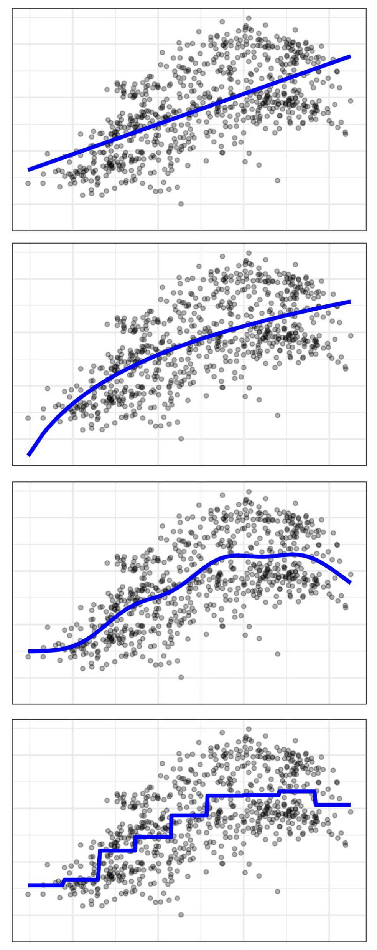
Linear model
Generalized linear model
Generalized additive model
Machine learning
Random forest
Boot regression
Maxent
..
Simple model
Complexity
Complex model

Slide 18
How to produce ensemble model?
Ensemble model should be fitted based on individual models…
These individual models could be fitted separately, by unique package, then produce a consensus model;
Now, these individual models can be fitted on single platform, example include:
dismo, Bimod2, sdm, flexsdm

Slide 19
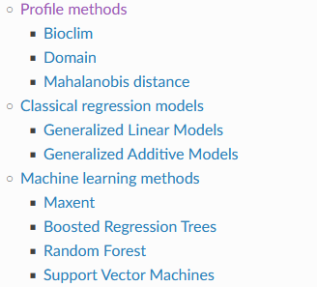
dismo package https://rspatial.org/raster/sdm/

Slide 20
Bimod2 package https://biomodhub.github.io/biomod2/index.html
Originate in 2009, the first ensemble model platform;
Very powerful in post model processing;
Most widely used climate change forecast;
Powerful in multiple species/big data;
Later, included Maxent, together with shinyapp;
Developed by Wilfried Thuiller, Damien Georges, Maya Gueguen, Robin Engler, Frank Breiner, Bruno Lafourcade, Remi Patin.

Slide 21
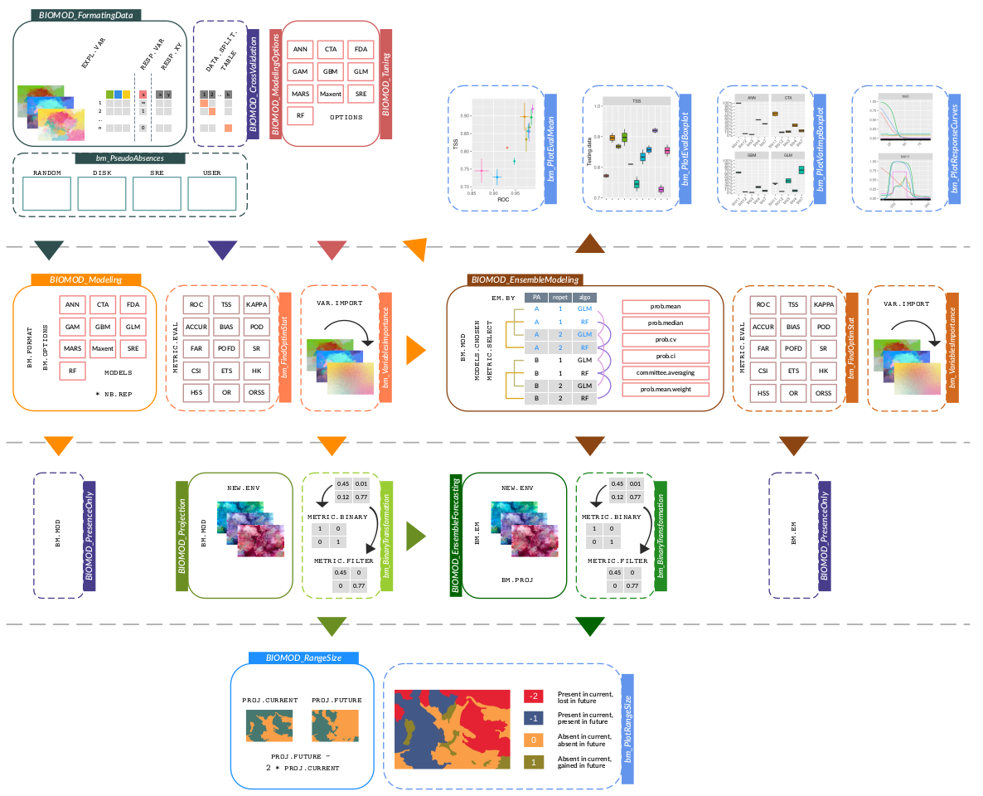
Bimod2

Slide 22
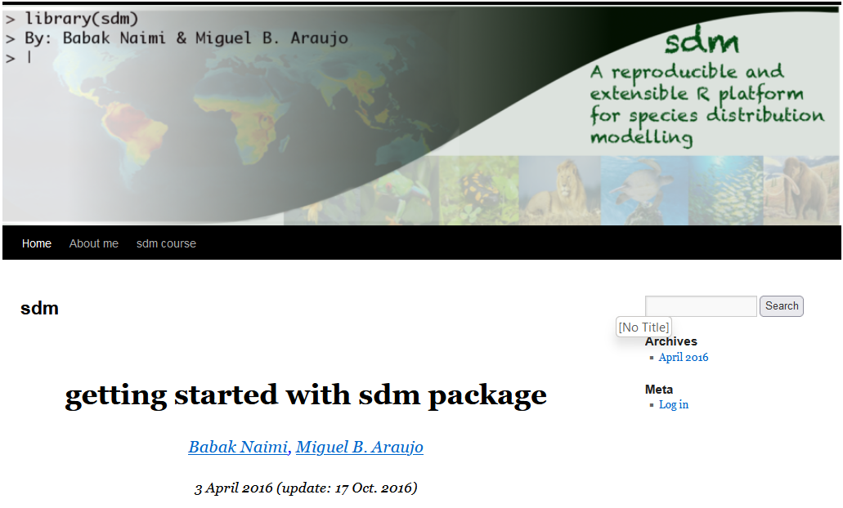
sdm package https://www.biogeoinformatics.org;
https://sdm.r-forge.r-project.org/
Simplized version of biomod2;
sdm is an object-oriented, reproducible and extensible, platform for species distribution modelling.
Developed by Babak Naimi and Miguel B. Araújo

Slide 23
flexsdm package https://sjevelazco.github.io/flexsdm/
Released last year 2022, still under development
Developed by Janet Franklin lab, former chief editor of Diversity and Distributions
Flexible:
  pre-model,
  modelling functions,
  Post-modelling functions,
Lack of function for summarizing model predictions;

Slide 24
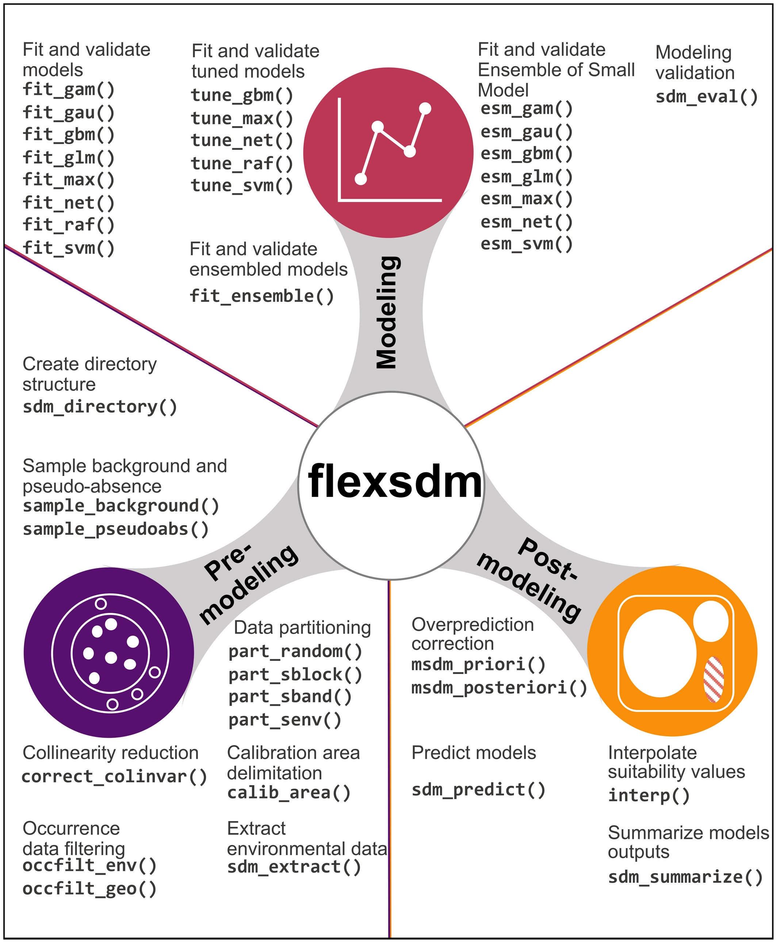

Slide 25
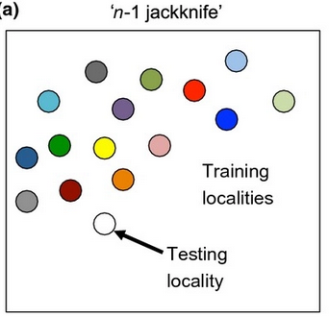
Rare, endemic species
Leaving-one-out method;
Propose by Richard Pearson et al. 2007
lowest presence threshold (LPT)
Ensemble of small model;
Proposed by Guisan group
ecospat package
leave-one-out (jackknife)

Slide 26
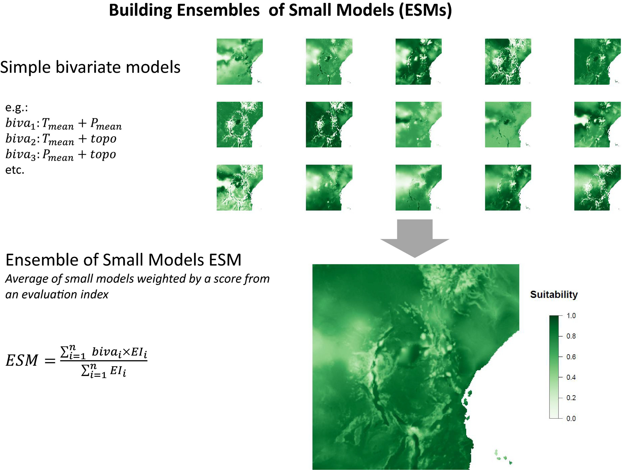

Slide 27
Demo
https://sjevelazco.github.io/flexsdm/articles/v05_Rare_species_example.html

Slide 28
