Slide 1
Model Threshold and Evaluation
Gengping Zhu
gengping.zhu@wsu.edu

Slide 2
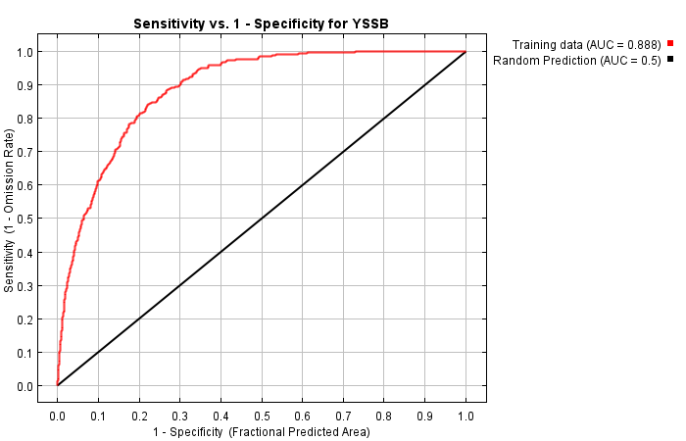
AUC value
Area Under the ROC Curve
ROC curve
Receiver Operating Characteristics

Slide 3
Input data for model evaluation
Testing point (long, lat, CSV)
data splitting strategy
Model suitability/binary predictions:
Threshold dependent approach
-> binary prediction
Threshold independent approach
-> suitability prediction
-> they still need “binary” predictions but summarize the metrics across the spectrum of thresholds.

Slide 4
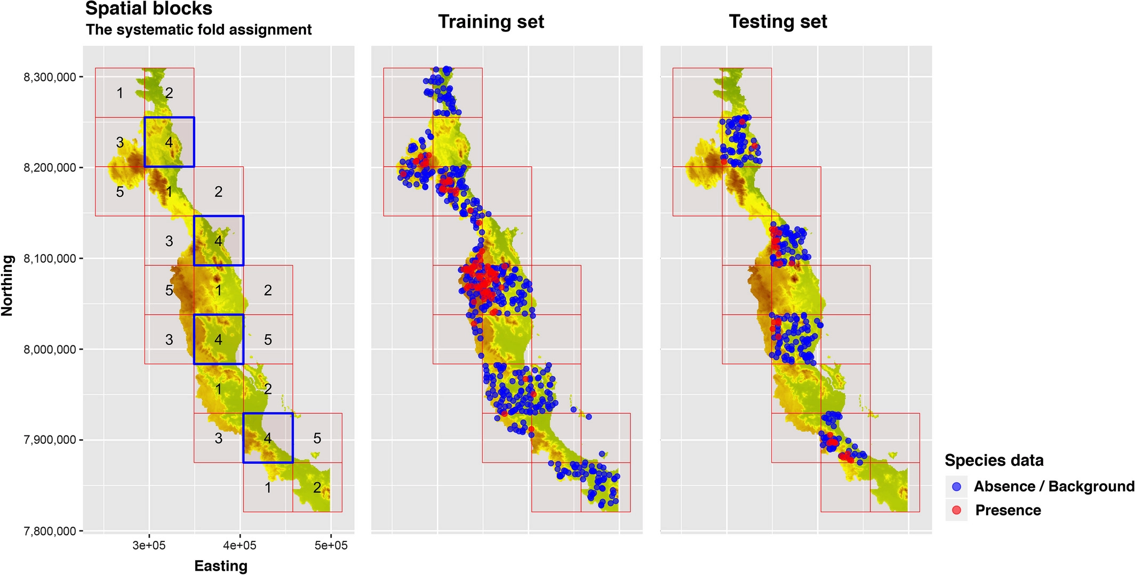
Method 1: Spatial block cross validations

Slide 5
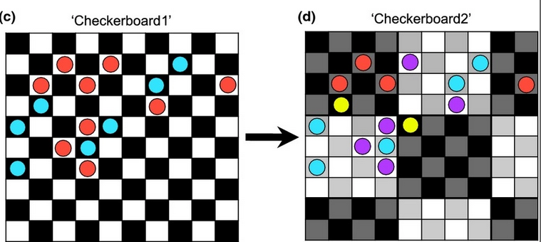
Method 2: Spatial checkerboard
R package: ENMeval

Slide 6
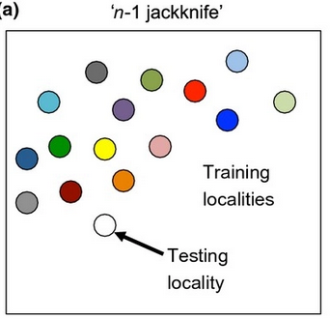
Rare, endemic species
Leaving-one-out method;
Propose by Richard Pearson et al. 2007
lowest presence threshold (LPT)
Ensemble of small model;
Proposed by Guisan group
ecospat package
leave-one-out (jackknife)

Slide 7
Model evaluation overview
Threshold dependent approach
Omission error (Type I), Commission error (Type II);
Sensitivity, Specificity, Kappa, True Skill Statistic (TSS)
…
Threshold independent approach
AUC, AUC ratio, Boyce index
Present-only model:
AUC ratio, Boyce index

Slide 8
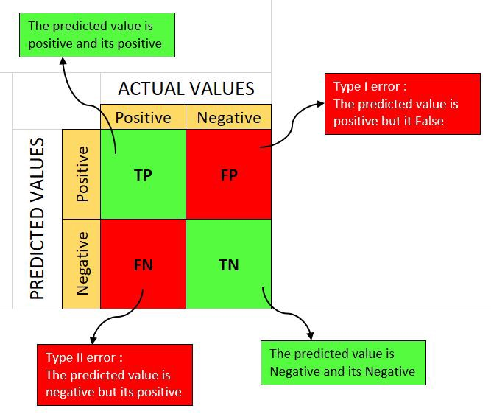
Confusion Matrix for Binary Data
True positive (TP)
False positive (FP)
True negative (TN)
False negative (FN)
Commission error
Omission error

Slide 10

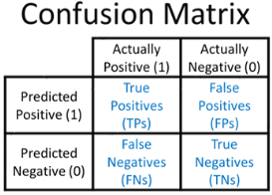

Sensitivity: true positive rate (TPR):
Specificity: true negative rate (TNR):
True Skill Statistic (TSS)
Sensitivity + Specificity – 1
ranges: −1 to 1
Widely used in medical diagnostic tests

Slide 11
Kappa
measure corrects the overall accuracy of model predictions by the accuracy expected to occur by chance, ranging from –1 to +1.

Slide 12
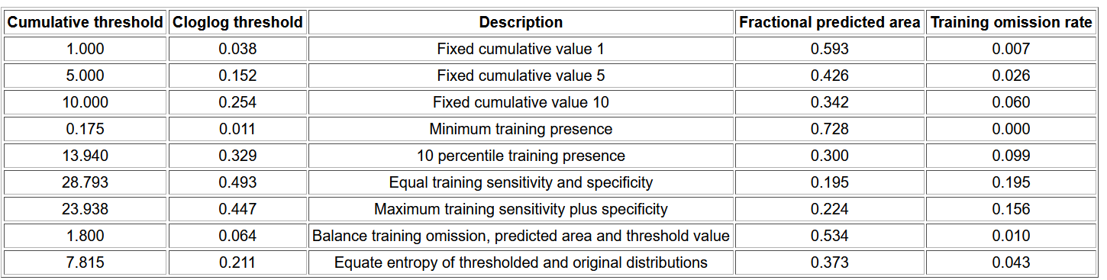
Threshold
value to use as the “cut-off”
apply a given cut-off value to model and output a raster with binary values for presence and absence.

Slide 13
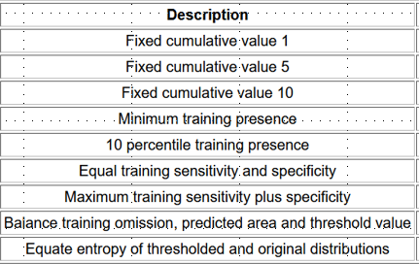
Threshold---testing records
Fixed value
Present-only
Present-background
/pseudo-absent
The “Balance” threshold minimizes|:
6 * training omission rate + .04 * cumulative threshold + 1.6 *fractional predicted area.

Slide 14
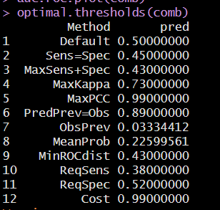
Threshold-provided by PresenceAbsence package

Slide 15
Minimum training presence (MTP)
This threshold finds the lowest predicted suitability value for an occurrence point.
it assumes that the least suitable habitat at which the species is known to occur is the minimum suitability value for the species.
all testing points would fall within the area of the binary prediction.
Suitable for rare and endemic species that have limited occurrence records.

Slide 16
10th percentile training presence
The P10, on the other hand, is a threshold which omits all regions with habitat suitability lower than the suitability values for the lowest 10% of occurrence records.
It assumes that the 10% of occurrence records in the least suitable habitat aren’t occurring in regions that are representative of the species overall habitat, and thus should be omitted.
This threshold omits a greater region, and is more conservative than the MTP.
What is the advantage of MTP and 10th training thresholds?
-> they have no requirement of absence testing data

Slide 17
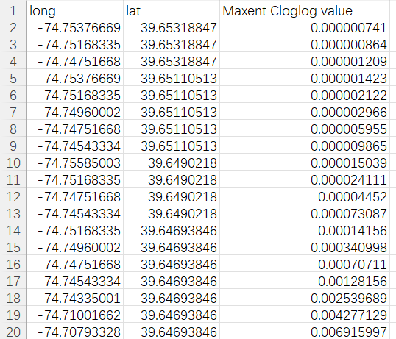
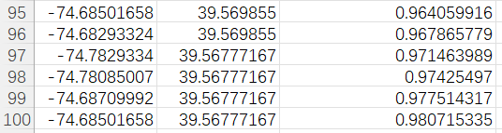
How to calculate MTP, 5th, and 10th training threshold?
Increasing
MTP
5th training
10th training
For example, we have 100 testing points:
……………

Slide 18
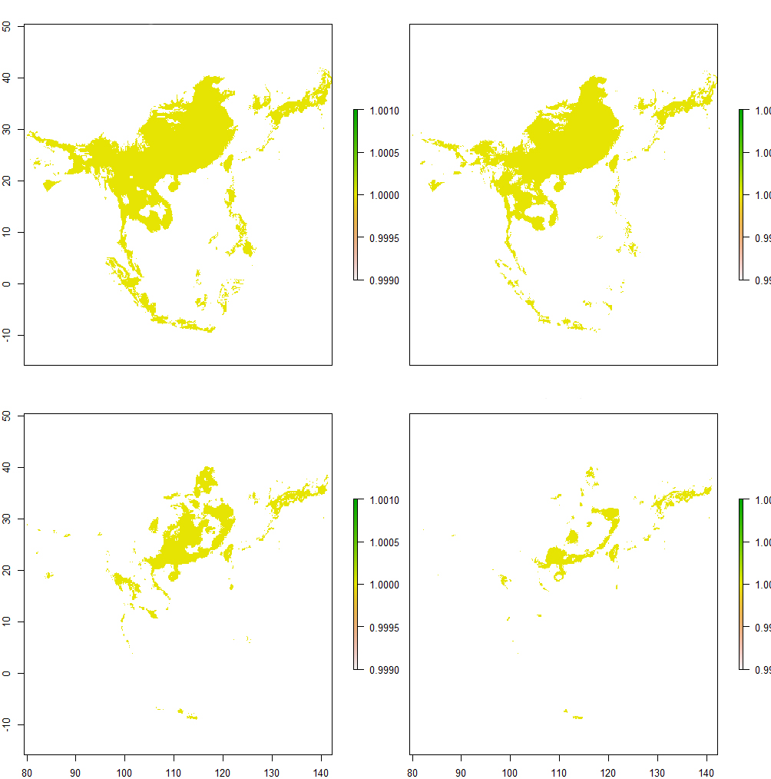
Threshold = 0.1
Threshold = 0.2
Binary predictions
Threshold = 0.5
Threshold = 0.7

Slide 19




Threshold = 0.1
Threshold = 0.2
Binary predictions
Threshold = 0.5
Threshold = 0.7

Slide 20
Threshold = 0.1
Threshold = 0.2
Sensitivity = 0.97
Specificity = 0.53
TSS = 0.50
Sensitivity = 0.96
Specificity = 0.63
TSS = 0.59
Binary predictions
Threshold = 0.5
Threshold = 0.7
Sensitivity = 0.74
Specificity = 0.83
TSS = 0.51
Sensitivity = 0.56
Specificity = 0.93
TSS = 0.49

Slide 21
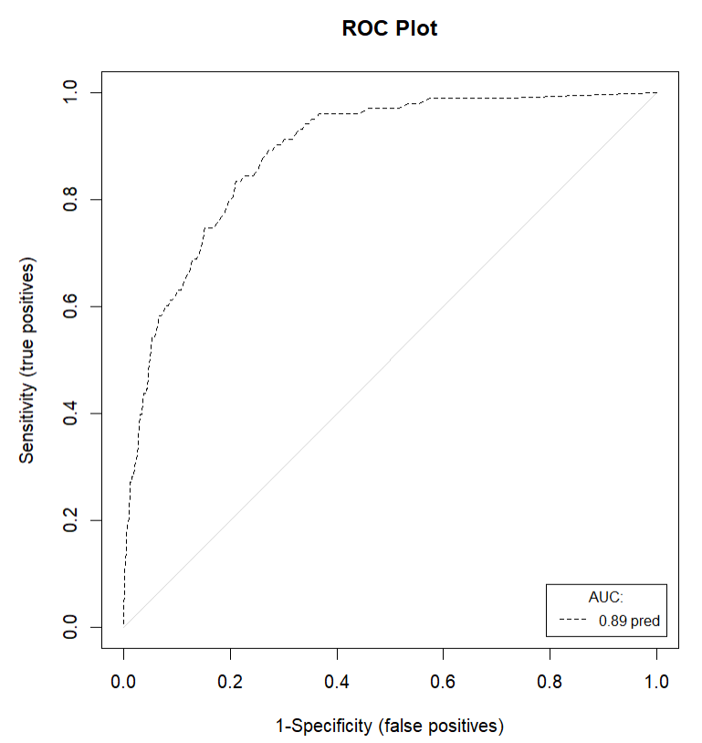
High<-Threshold -> low

Slide 22
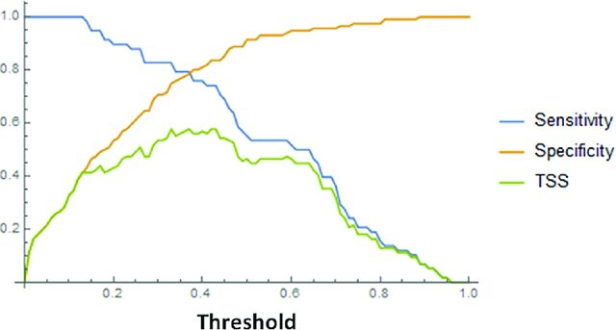
Sensitivity, specificity, and TSS plotted against threshold values.

Slide 23
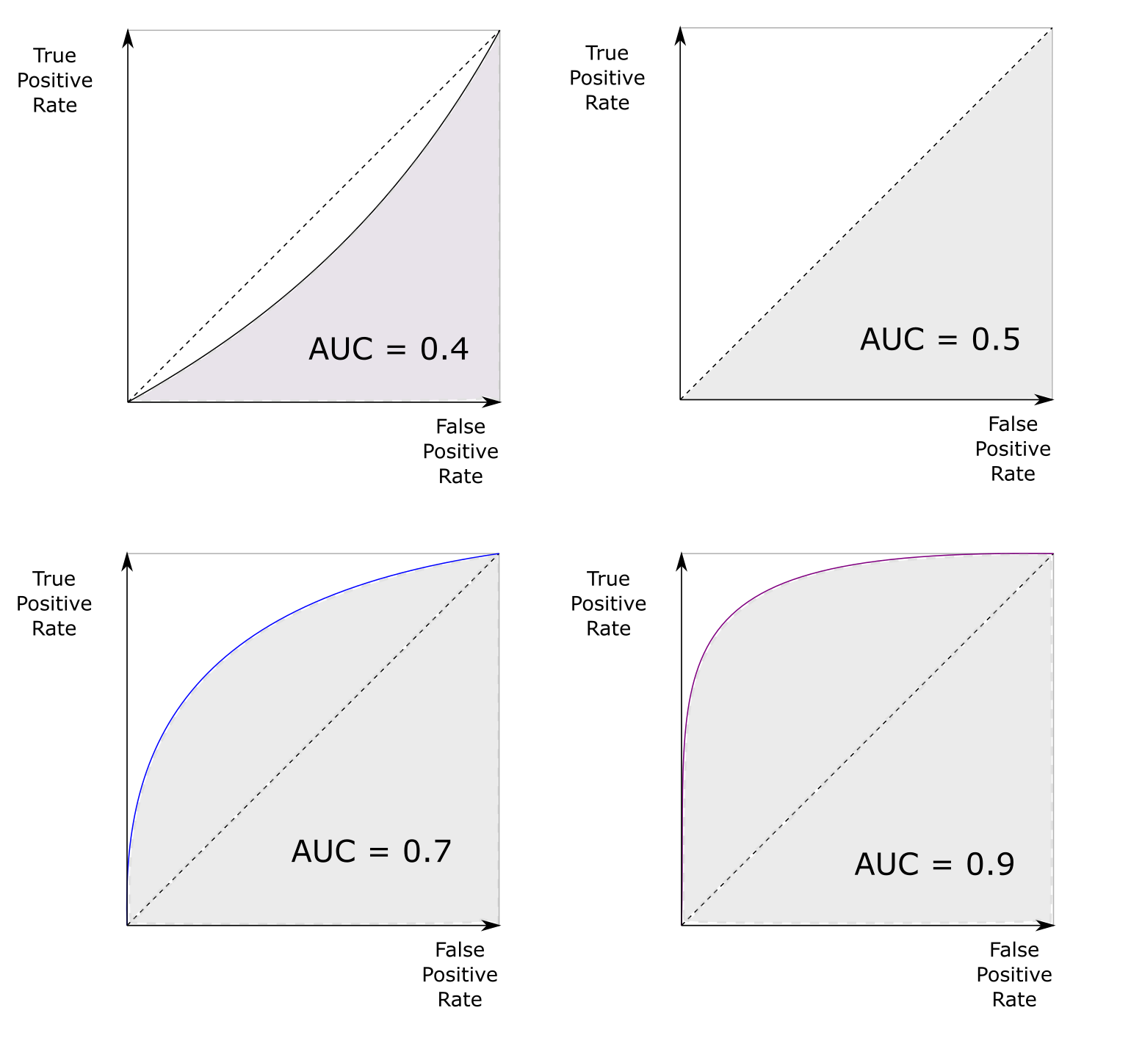

Slide 24

Kappa was questioned and TSS was proposed, mainly because of below paper:

Slide 25
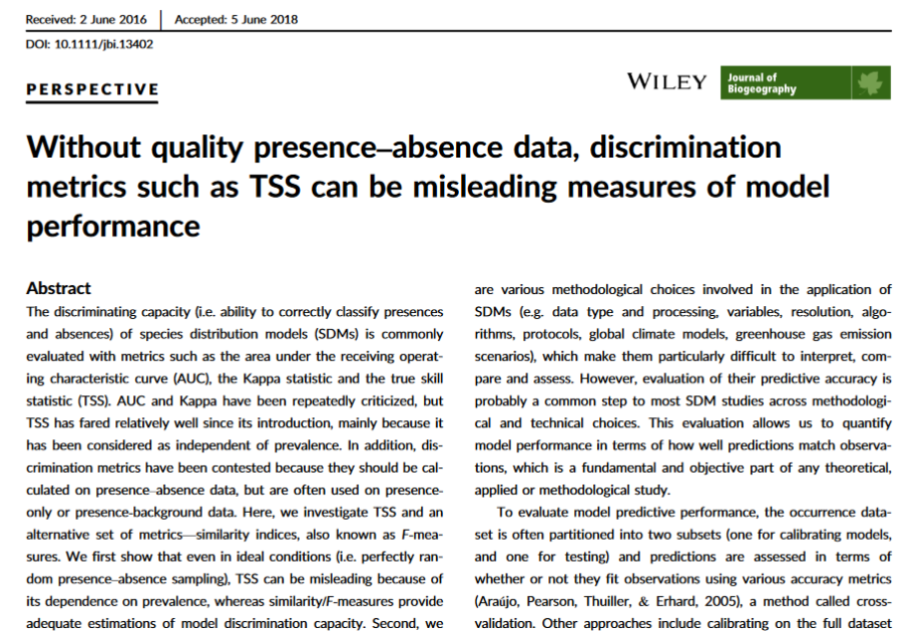
BUT TSS was also questioned recently:

Slide 26
Discussion
Are there problems with AUC ?

Slide 27
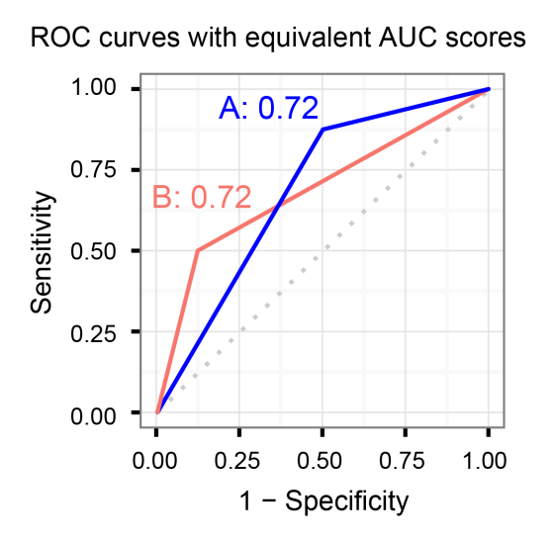
High<-Threshold -> low
Both “blue” model and “red” mode have AUC of 0.72, but are they the same?

Slide 28
Low threshold
High threshold

Slide 29
Partial ROC/AUC ratio
ROC has the advantage of being threshold-independent, and as such does not require decisions regarding thresholds;
Two errors (omission and commission errors) in AUC should not be weighted equally, as present data are more reliable than absence data;
Partial ROC is a modification of ROC, it use AUC ratio to evaluate model performance
AUC ratio range 0 to 2, > 1 indicate good model
Partial ROC accounts for occurrence data quality
R package: ntbox, kuenm

Slide 30
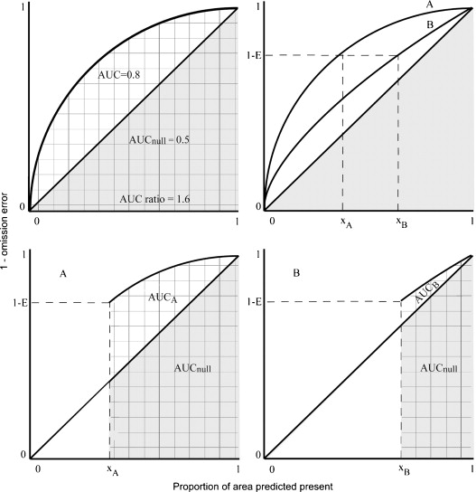

Slide 31
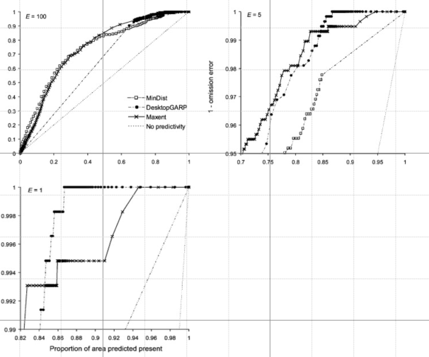
Partial ROC

Slide 32
Boyce index
presence-only metric for evaluating the predictions of species distribution
It measures the predicted-to-expected ratio of presences in each class of predicted values,
i.e., whether classes / regions with higher predicted values have indeed higher proportions of presences than expected by chance;
Boyce index ranges: -1 to 1
Package: ecospat, modEvA

Slide 33
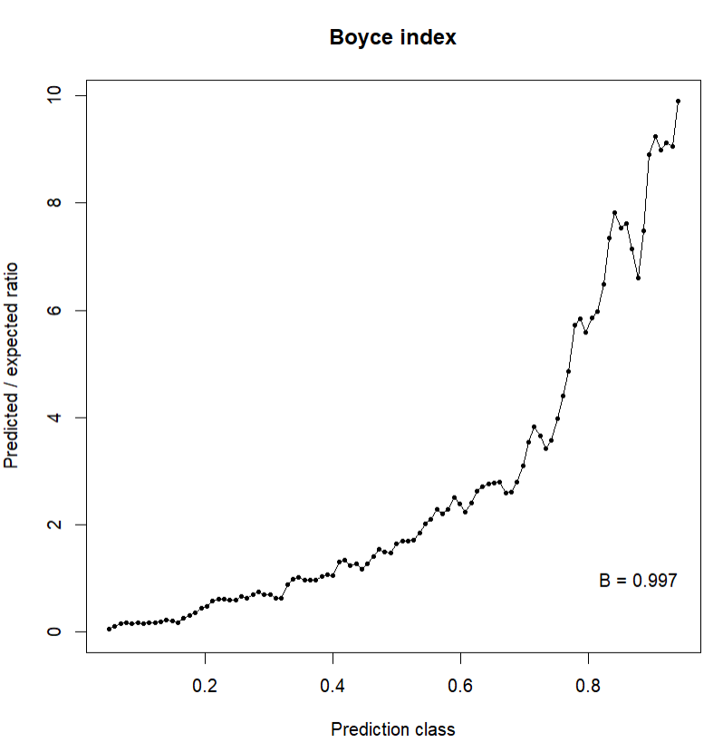

Slide 34
Demo

Slide 35
kuenm package to calculate Partial ROC-AUC ratio https://rdrr.io/github/manubio13/ku.enm/man/kuenm_proc.html
library(kuenm)
data("sp_test", package = "kuenm")
model <- raster::raster(system.file("extdata/sp_model.tif",
package = "kuenm"))
thres <- 5
rand_perc <- 50
iterac <- 500
p_roc <- kuenm_proc(occ.test = sp_test, model = model, threshold = thres, rand.percent = rand_perc, iterations = iterac)

Slide 36
ntbox package to calculate Partial ROC-AUC ratio https://github.com/luismurao/ntbox https://luismurao.github.io/ntbox/reference/pROC.html https://github.com/luismurao/ntbox/blob/master/R/pROC.R
# Load a continuous model
library(ntbox)
Here I use the same dataset as former kuenm, since I can not install this package
##Original
partial_roc <- pROC(continuous_mod=conti_model,
test_data = test_data,
n_iter=1000,E_percent=5,
boost_percent=50,
parallel=FALSE)
###
partial_roc <- pROC(continuous_mod=model, ##from kuenm
test_data = sp_data, ##from kuenm
n_iter=1000,E_percent=5,
boost_percent=50,
parallel=FALSE)

Slide 37
ecospat package to calculate Boyce index https://search.r-project.org/CRAN/refmans/ecospat/html/ecospat.boyce.html
library(ecospat)
obs <- (ecospat.testData$glm_Saxifraga_oppositifolia
[which(ecospat.testData$Saxifraga_oppositifolia==1)])
qq<-ecospat.boyce (fit = ecospat.testData$glm_Saxifraga_oppositifolia , obs, nclass=0, window.w="default", res=100, PEplot = TRUE)
qq$cor

Slide 38
modEvA to calculate Boyce index https://search.r-project.org/CRAN/refmans/modEvA/html/Boyce.html https://www.r-bloggers.com/2022/05/model-evaluation-with-presence-points-and-raster-predictions/
# load sample models:
library(modEvA)
data(rotif.mods)
# choose a particular model to play with:
mod <- rotif.mods$models[[1]]
# compute the Boyce index:
Boyce(model = mod, main = "My model Boyce plot")
Boyce(model = mod, main = "My model Boyce plot", rm.dup.classes = TRUE)
# you can also use vectors of observed and predicted values
# instead of a model object:
presabs <- mod$y
prediction <- mod$fitted.values
Boyce(obs = presabs, pred = prediction)
# 'obs' can also be a table of presence point coordinates
# and 'pred' a SpatRaster of predicted values

