Slide 1
投影
中科院动物所 乔慧捷
2026-9

Slide 2
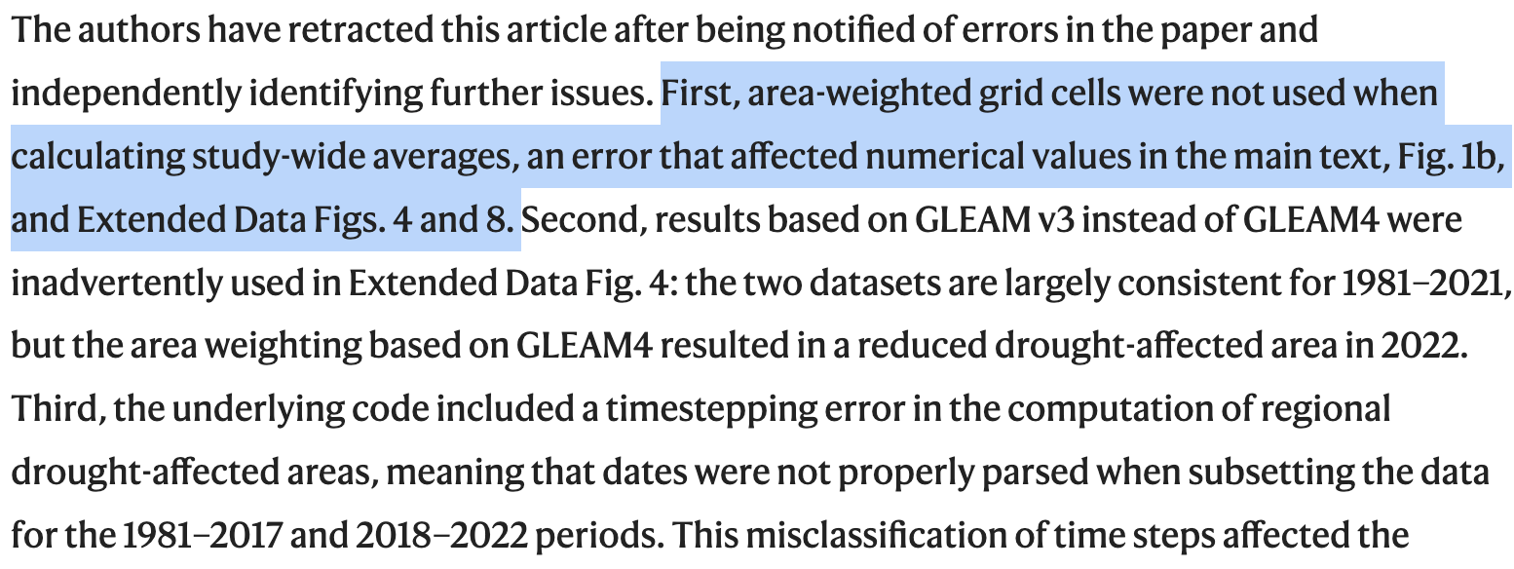
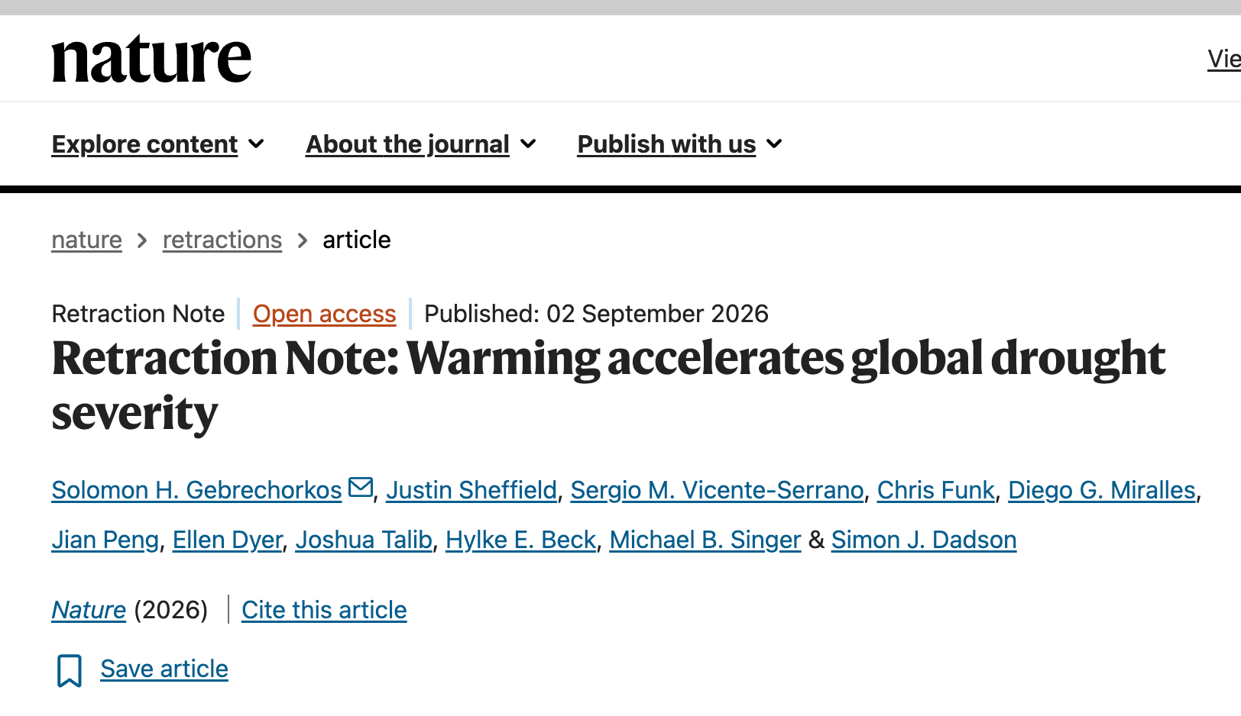
https://www.nature.com/articles/s41586-026-11027-z

Slide 3
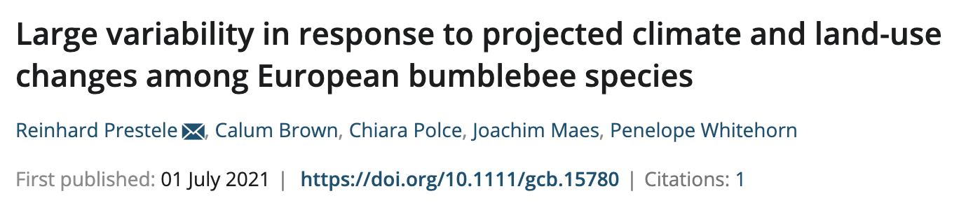
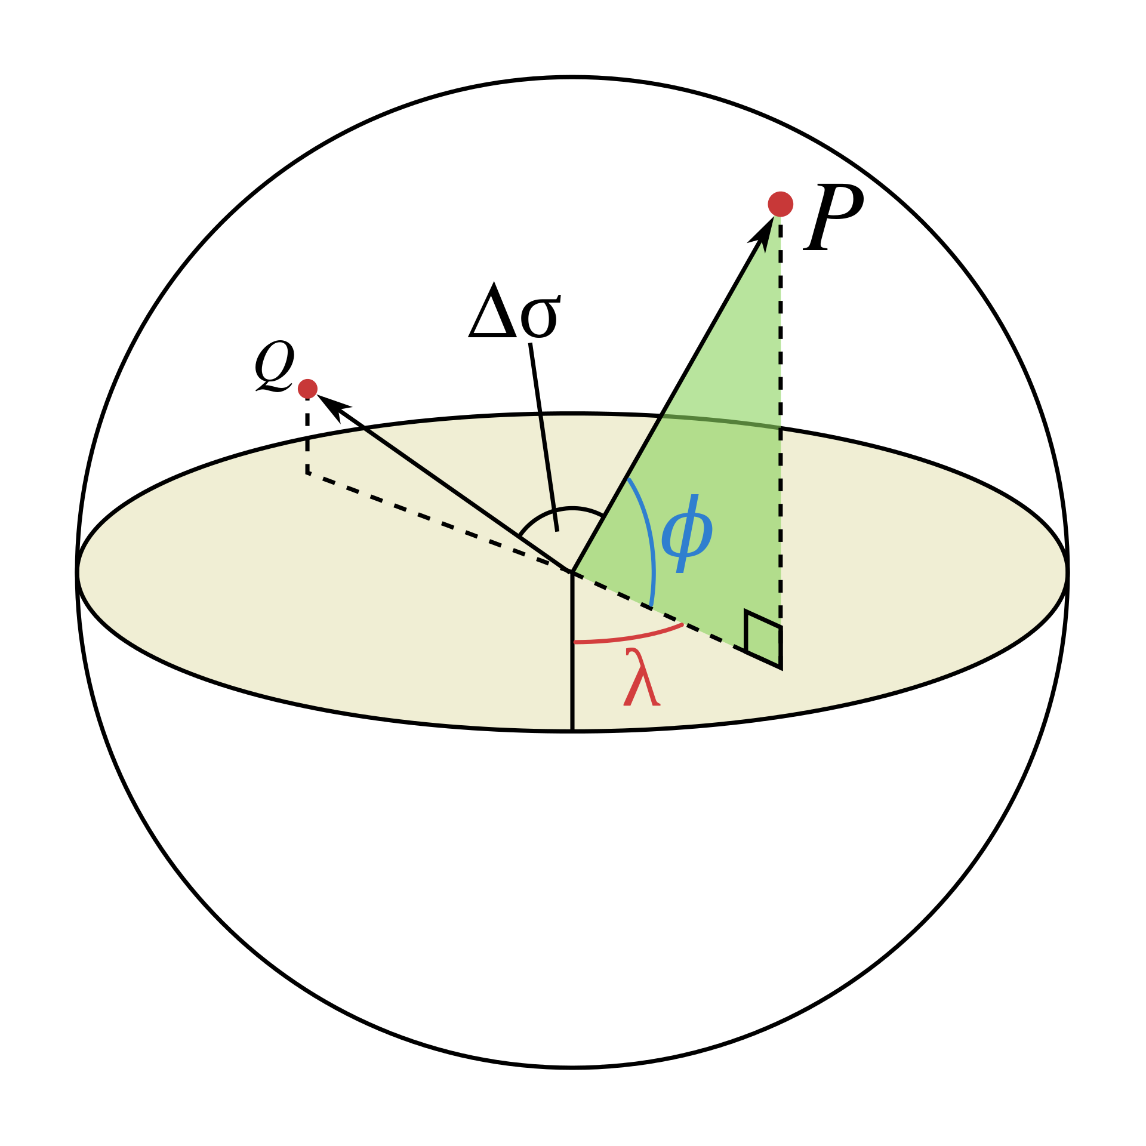
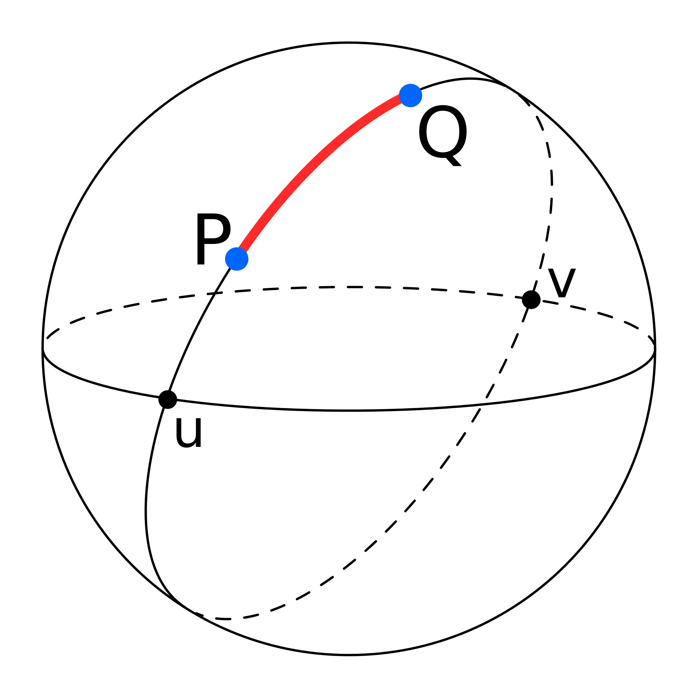
The native spatial resolution of the IAP2 at the European extent is 10 arcmin (WGS84; EPSG:4326). To obtain land uses for the 10 × 10 km grid, we overlaid polygons projected to WGS84 with the IAP2 maps and aggregated the IAP2 land uses weighted by the 10 arcmin cell contribution to these polygons.
ll climate data were downloaded from www.worldclim.org at 10 arcmin spatial resolution (WGS84; EPSG:4326) and projected to 10 × 10 km grids in Lambert azimuthal equal area projection (EPSG:3035) using bilinear interpolation.
https://onlinelibrary.wiley.com/doi/full/10.1111/gcb.15780
https://en.wikipedia.org/wiki/Great-circle_distance

Slide 4

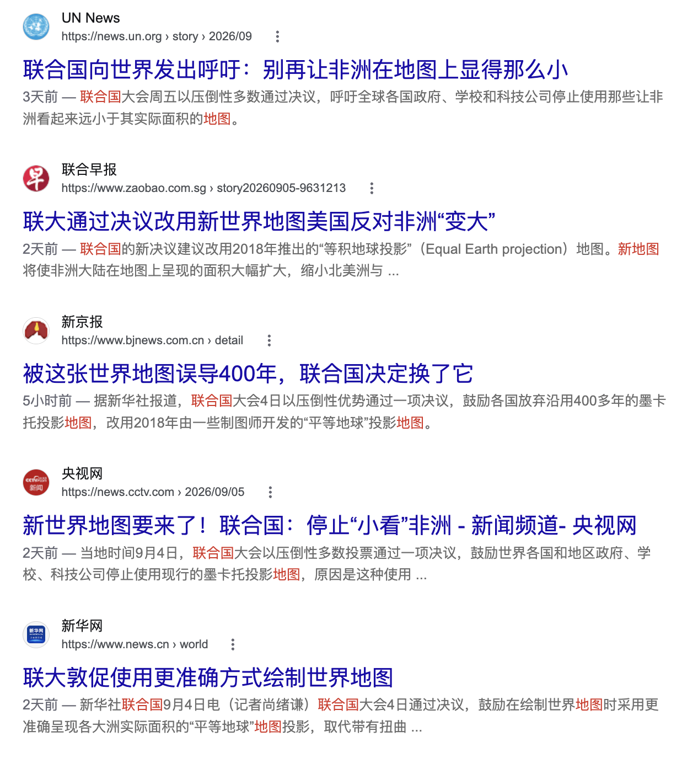
https://news.un.org/en/story/2026/09/1168284

Slide 5
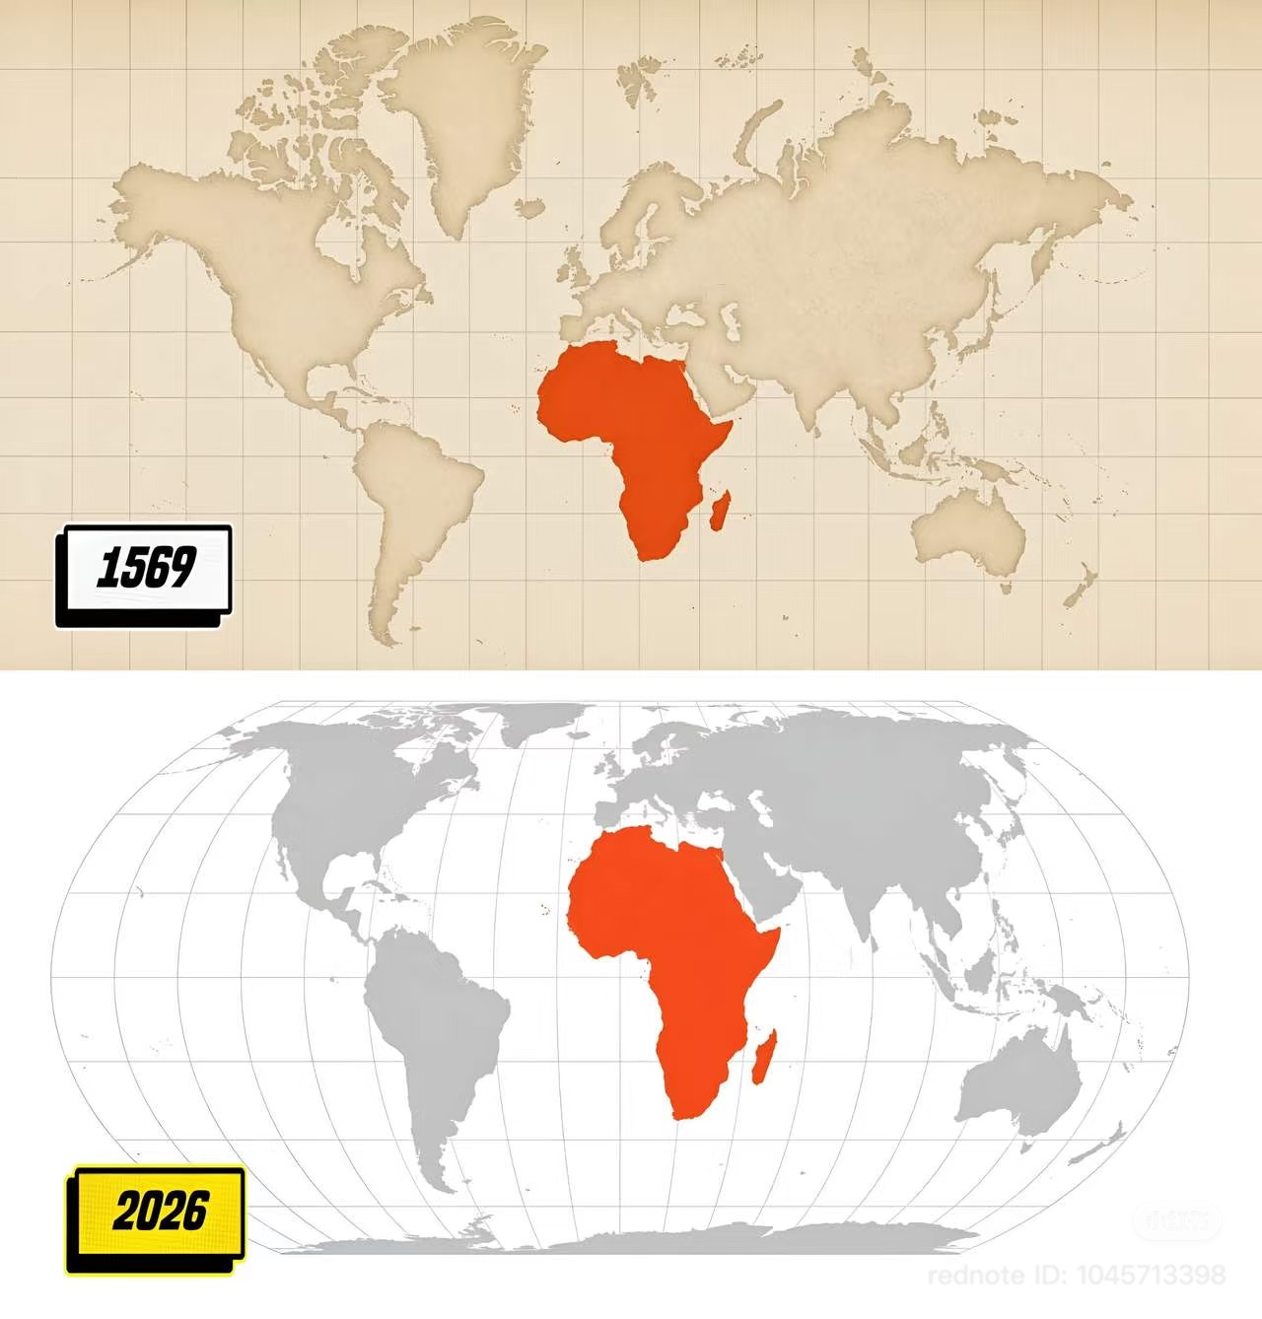

Slide 6
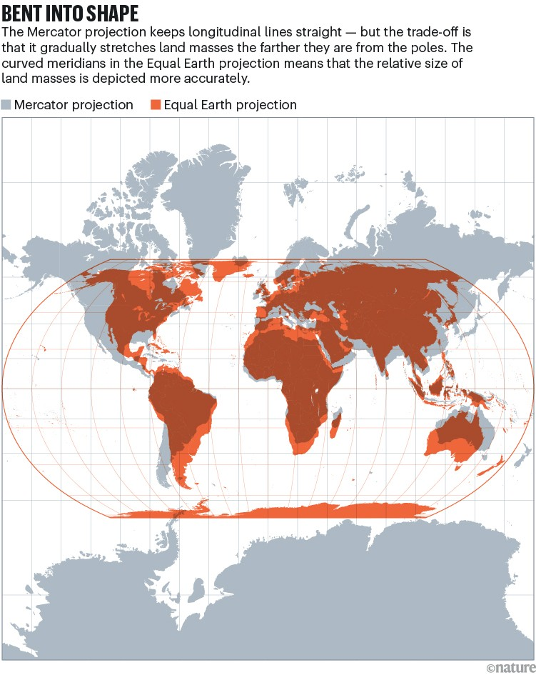
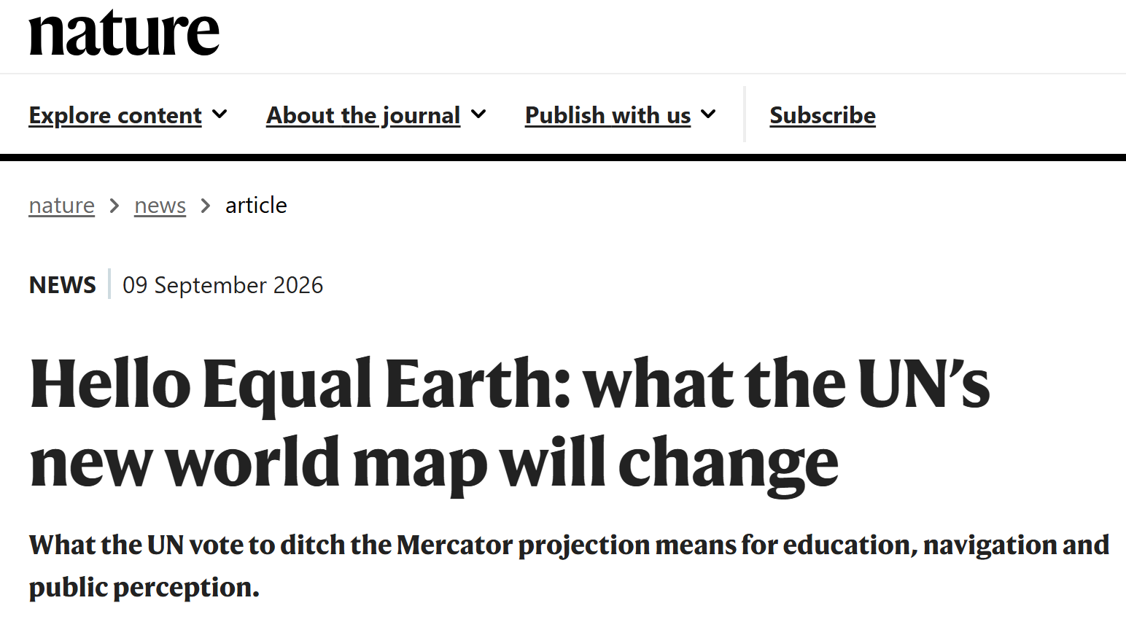
https://www.nature.com/articles/d41586-026-02820-x

Slide 7
Coordination and projection

Slide 8
Coordination and projection

Slide 9

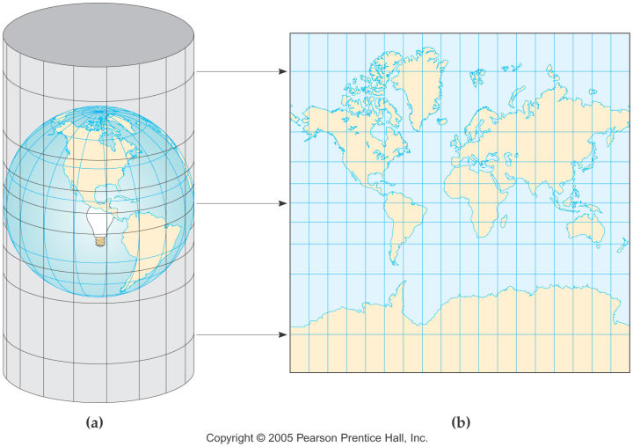
https://www.openstreetmap.org/

Slide 10
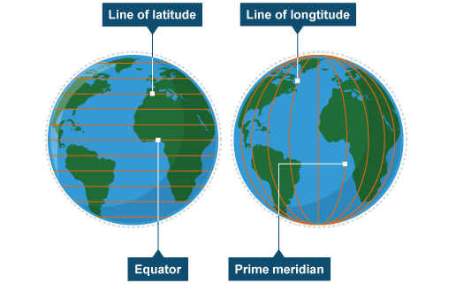
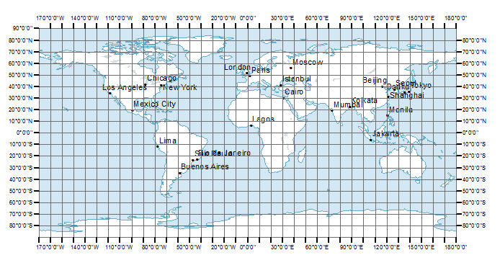
Lonlat projection

Slide 11
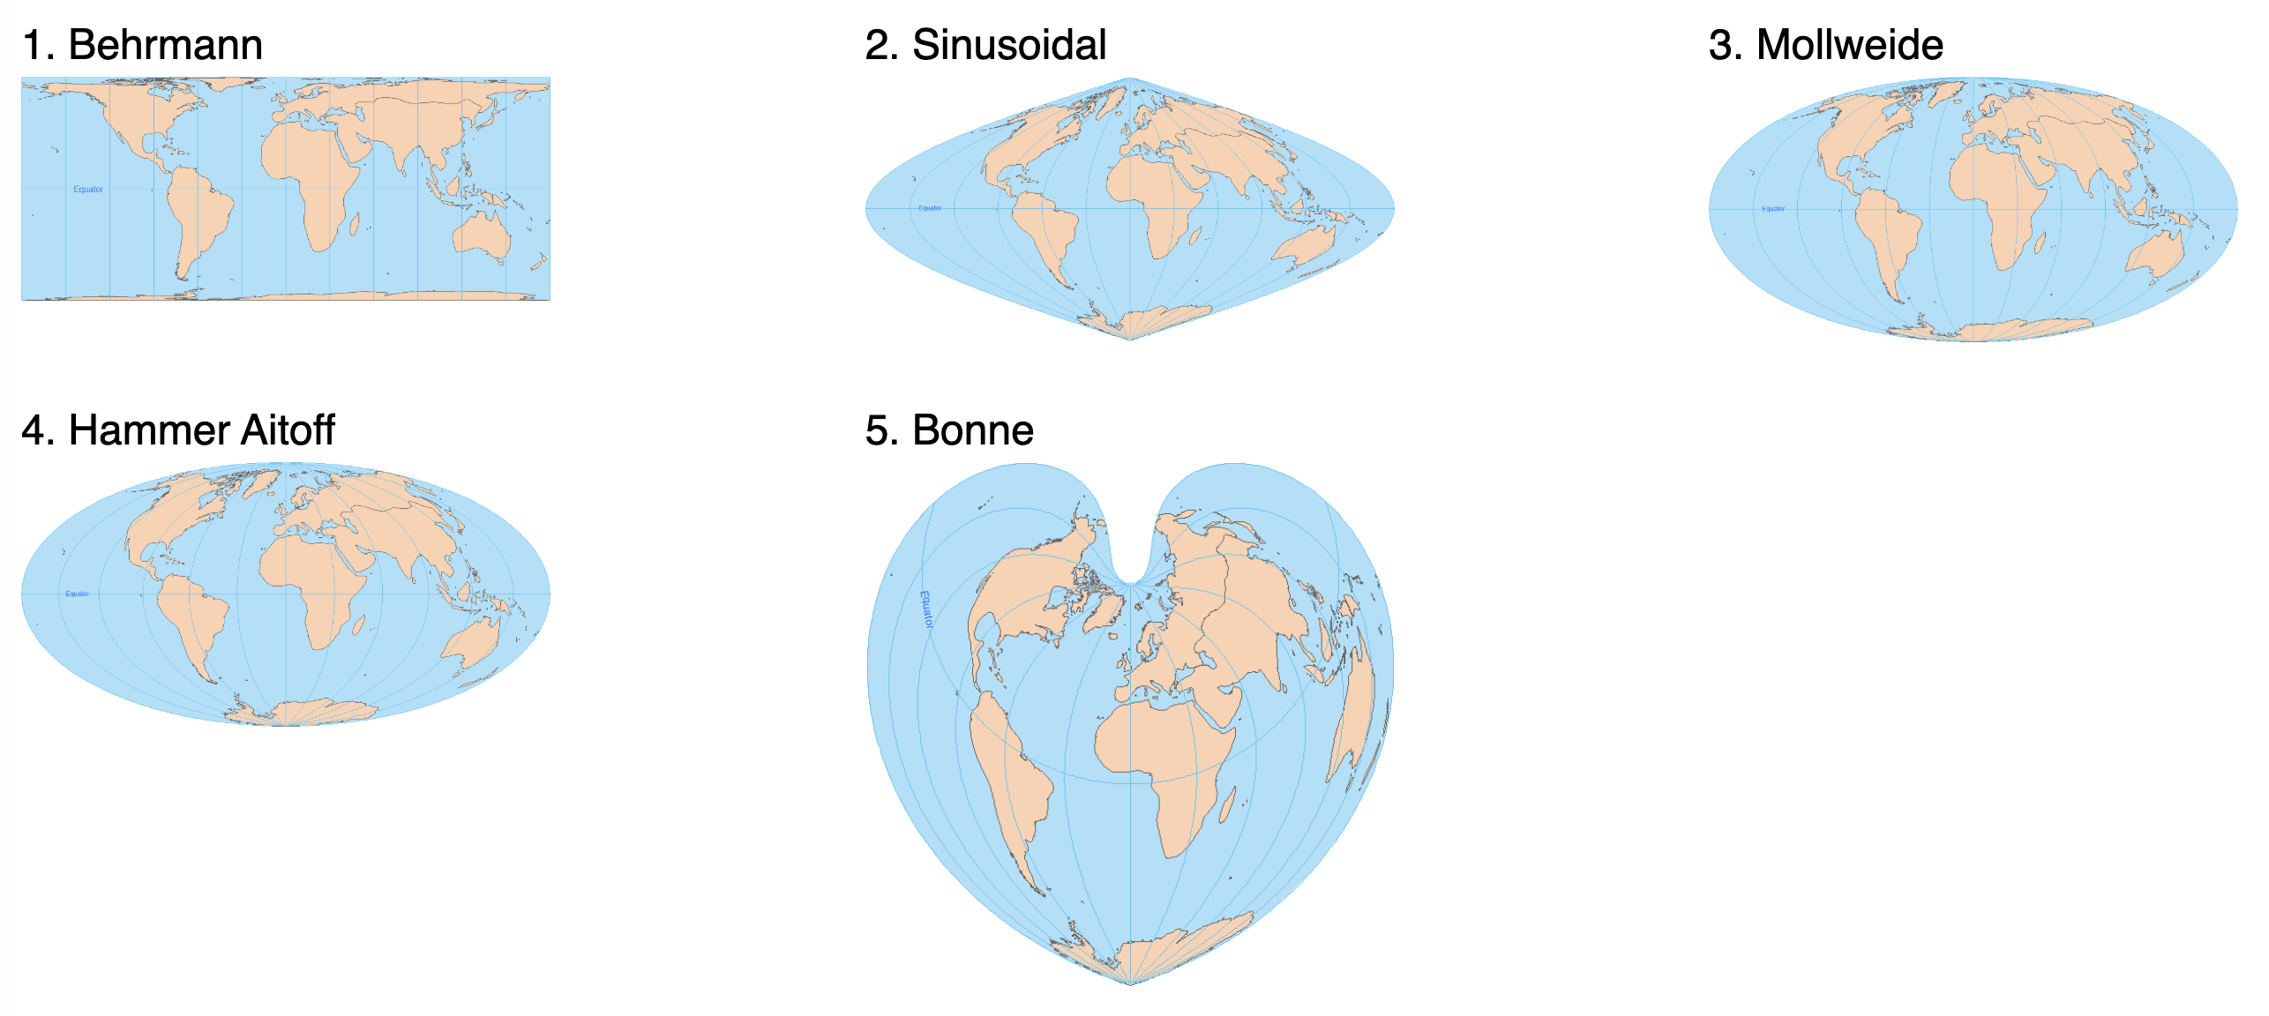
Equal area projection
https://math.univ-lyon1.fr/~alachal/diaporamas/diaporama_cartographie3/Equal_Area_Projection.htm

Slide 13

Equal distance projection
Notes:
#aeqd_proj2<-"+proj=aeqd +datum=WGS84 +lat_0=90 +no_defs"
#bio1_aeqd<-projectRaster(bio1, crs=aeqd_proj2, res=c(10000, 10000))
#plot(bio1_aeqd)

Slide 14

Equal area and distance projection
Regular icosahedron (pentagon and hexagon)

