Slide 1
AutoFigure Bot
AI-Powered Academic Diagram Generation on the Cloud
COMP7940 Cloud Computing | Group AE | 2026
Feiyang Wu
Developer & Testing
Liujun Peng
Prompt Engineer & Testing
Boyuan Zhang
Documentation & Testing
@HKBU_Fly_Bot
Google Gemini
AWS EC2
Docker Compose
DynamoDB
CloudWatch

Slide 2
Introduction
AutoFigure Bot is a cloud-native Telegram chatbot that automatically generates academic figures from paper descriptions using a multimodal LLM-Gemini.
Mode 1 (Text-Only): paste paper text → Figure output
Mode 2 (Reference-Guided): upload reference image + text → Style-matched figure

Slide 3
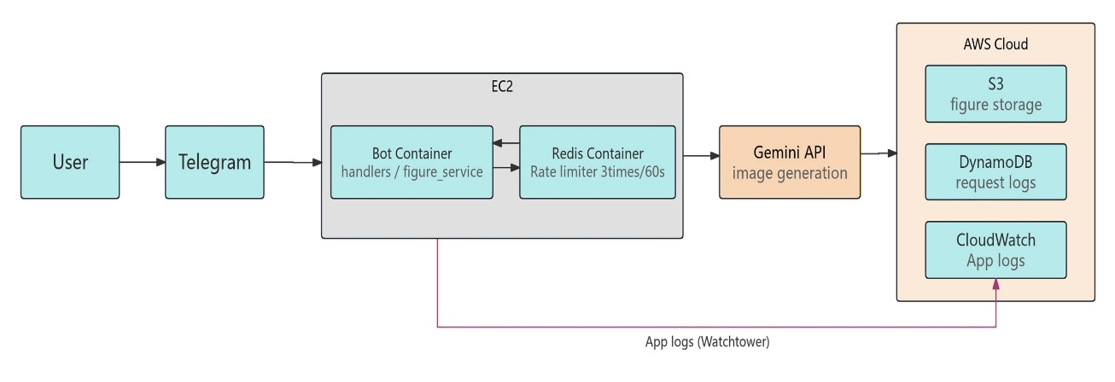
System Architecture
EC2 + Docker Compose (Bot & Redis)
Bot handles logic, Redis manages rate limiting
S3 stores images, DynamoDB logs requests, CloudWatch monitors system
CI/CD: push → auto deploy → rebuild → restart

Slide 4
All 7 Must-Have Technologies
Telegram Bot
/start /help /generate /history /cancel
Cloud Database
AWS DynamoDB · table: autofigure_requests · fields: user_id, timestamp, job_id, s3_url, status, has_reference, method_text
Cloud Deployment
AWS EC2 t2.micro · us-east-2c · 24/7 running · Public IP: 52.14.124.82
LLM API
Google Gemini · gemini-2.5-flash-image / gemini-3-pro-image-preview
Git Version Control
GitHub: https://github.com/Fly-cpu-source/COMP7940-LLM-Image
Container Tech
Docker Compose · Bot container + Redis container
Monitoring & Cost
CloudWatch log group /autofigure/bot · watchtower · AWS Budgets $10/mo alert · Total: HK$19.30

Slide 5
4 Nice-to-Have Features Implemented
CI/CD Pipeline (GitHub Actions)
Multi-Container Orchestration
This pipeline automates deployment by triggering on every code push, enabling fast and consistent updates without manual intervention.
The system uses Docker Compose to manage multiple containers, ensuring modular design, service isolation, and efficient resource utilization.
Redis Rate Limiting (Security)
AWS S3 Persistent Storage
Redis is used to enforce request limits per user, enhancing system security and preventing abuse while maintaining stable performance.
Generated images are stored in AWS S3 with structured paths and indexed in DynamoDB, ensuring persistent and scalable data management.

Slide 6
Cost Control & Cloud Monitoring
Service
Usage
Cost
AWS EC2 t2.micro
24/7 · us-east-2
Free Tier ($0.00)
AWS DynamoDB
Request logs · <25 GB
Free Tier ($0.00)
AWS S3
PNG storage · <5 GB
Free Tier ($0.00)
AWS CloudWatch Logs
Logs · <5 GB/month
Free Tier ($0.00)
Google Gemini API
Pay-as-you-go
HK$19.30
Total Project Spend
HK$19.30

Slide 7
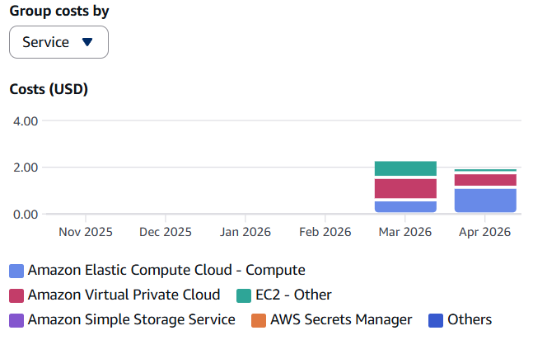
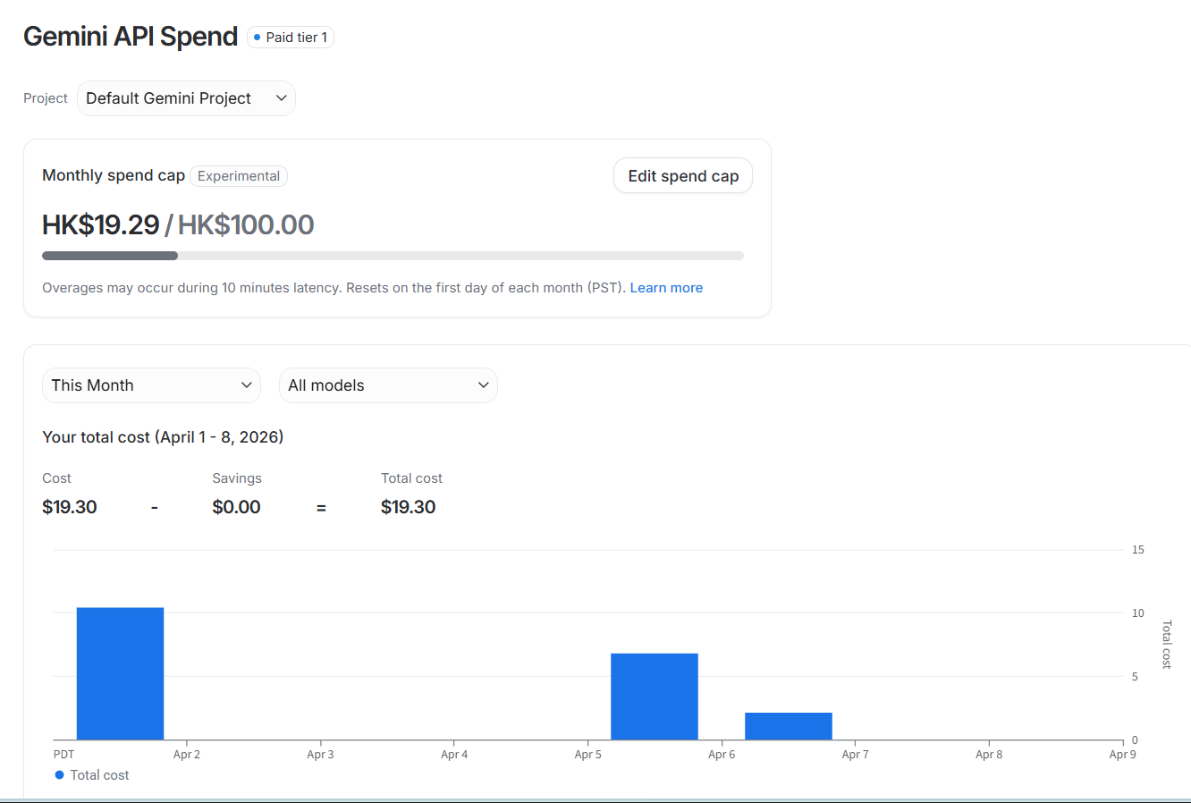
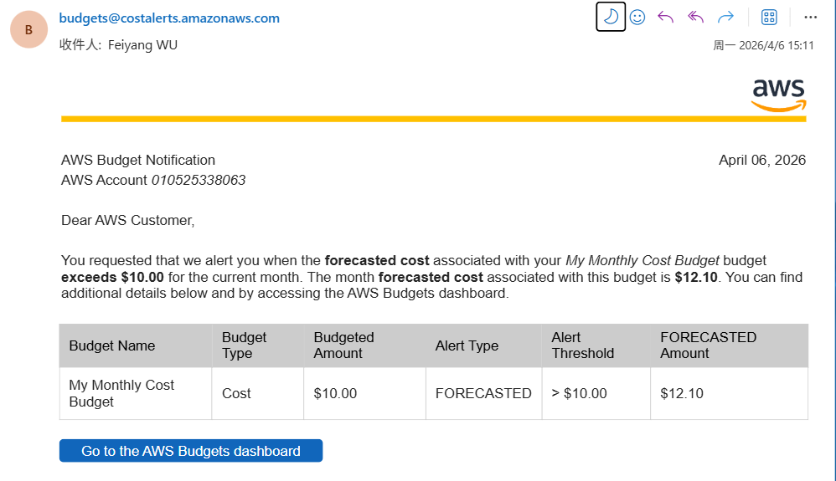
Monitoring
• CloudWatch group: /autofigure/bot
• Logs: generation results, S3 uploads, DynamoDB writes, rate-limit events, errors
• AWS Budgets: $10/mo alert → email notification
• Gemini cap: HK$100/mo configured

Slide 8
Live Demo
Open Telegram → search @HKBU_Fly_bot → send /start
Send /generate → bot shows InlineKeyboard: Mode 1 or Mode 2
1
2
Mode 1: paste paper method text → Gemini generates → PNG returned in ≤30 s
Mode 2: send reference diagram → paste method text → style-matched PNG
3
4
Send /history → bot fetches last 5 records from DynamoDB
Rate limit test: send 4 /generate requests in 60 s → 4th rejected with friendly message
5
6
Bot is live 24/7 at @HKBU_Fly_bot · github.com/Fly-cpu-source/COMP7940-LLM-Image

Slide 9
Prompt Engineering and Model Fine-Tuning
13 Rounds of Extreme Testing: From Text Generation to Publication-Grade Charts
Mode 1: Text-Only
Mode 2: Reference Diagram Guided
Vertical ArchitectureText Test
Basic Topology Reference Map Test
Problem: Severe spelling hallucinations occur under high-density text
Problem: Overfitting the reference diagram, causing the lines to be messy and cross each other.
Optimization: Introduce prompt with error-proofing instruction to achieve zero typos
Optimization: Add style restrictions to ensure the style is correct and avoid excessive imitation
Horizontal Flow Text Test
Complex Architecture Reference Diagram Test
Problem: Topological stacking causes extremely crowded and cramped layout
Problem: Internal structure is chaotic, with external captions and overflow appearing
Optimization: Add whitespace constraints to ensure proper layout
Optimization: Introduce prompt with centered text, prohibiting overflow and summarization to achieve hierarchical internal structure

Slide 10
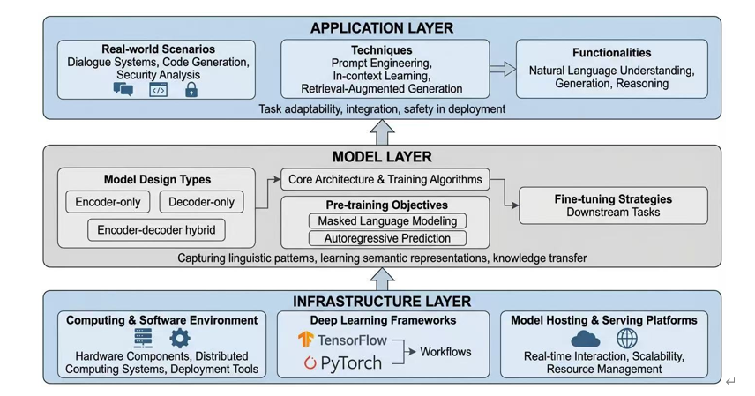
Output (Mode 1)

Slide 11
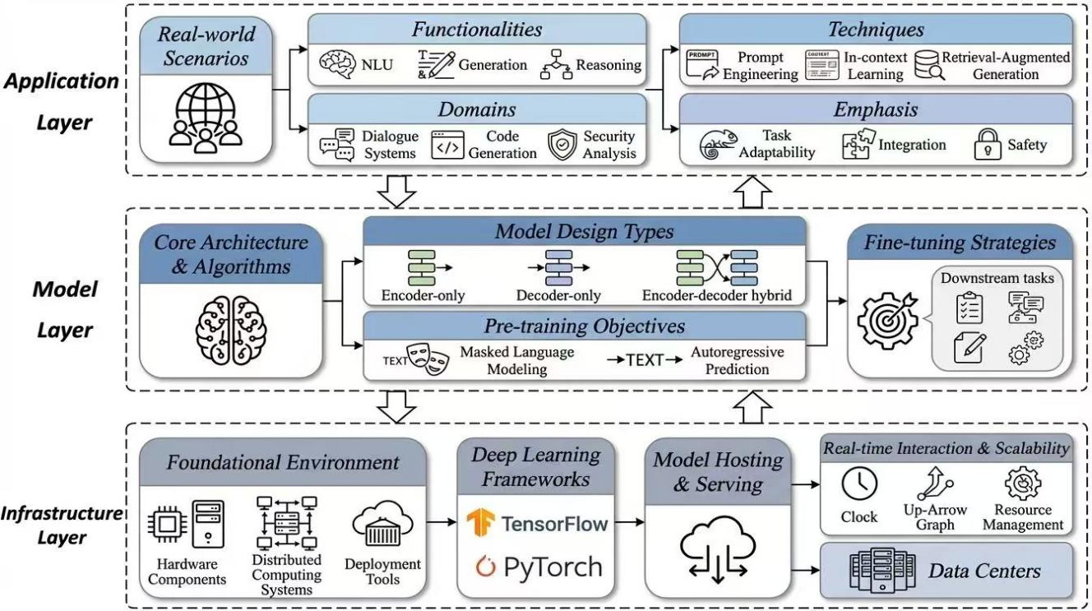
Output (Mode 2)

