Slide 1
Introduction to C++: Part 1 tutorial version 0.4
Brian Gregor
Research Computing Services

Slide 2

Getting started with the room B27 terminals
Log on with your BU username
If you don’t have a BU username:
Username: Choose tutm1-tutm18, tutn1-tutn18
Password: RCSfall2017
On the desktop is a link to MobaXterm. Double click to open it.

Slide 3
Getting started on the SCC
If you prefer to work on the SCC and have your own account, login using your account to the host scc2.bu.edu
On the room terminals there is a MobaXterm link on the desktop
Load the GCC compiler and the codeblocks module:
Make a folder in your home directory and copy in the tutorial files:
module load gcc/5.3.0
module load gdb/7.11.1
module load codeblocks/16.01
mkdir cpp_tutorial && cd !$
unzip /scratch/Intro_to_Cpp_Sprint2018_v0.4_Code.zip

Slide 4
Getting started with your own laptop
Go to:
http://www.bu.edu/tech/support/research/training-consulting/live-tutorials/
and download the Powerpoint or PDF copy of the unified presentation.
Easy way to get there: Google “bu rcs tutorials” and it’s the 1st or 2nd link.
Also download the “Additional Materials” file and unzip it to a convenient folder on your laptop.

Slide 5
Getting started with your own laptop
Download the Code::Blocks development environment:
http://www.codeblocks.org/downloads/26
Windows: get the codeblocks-16.01mingw-nosetup.zip file and unzip it to a convenient folder.
Linux: likely available from your Linux distro’s package management system
Mac OSX: get the CodeBlocks-13.12-mac.zip file and unzip it to a convenient folder.
Also you will need Apple’s Xcode software with the command line tools installed.
See: http://www.dummies.com/programming/cpp/how-to-install-c-codeblocks-in-macintosh/

Slide 6
Tutorial Outline: All 4 Parts
Part 1:
Intro to C++
Object oriented concepts
Write a first program
Part 2:
Using C++ objects
Standard Template Library
Basic debugging
Part 3:
Defining C++ classes
Look at the details of how they work
Part 4:
Class inheritance
Virtual methods
Available C++ tools on the SCC

Slide 7
Tutorial Outline: Part 1
Very brief history of C++
Definition object-oriented programming
When C++ is a good choice
The Code::Blocks IDE
Object-oriented concepts
First program!
Some C++ syntax
Function calls
Create a C++ class

Slide 8
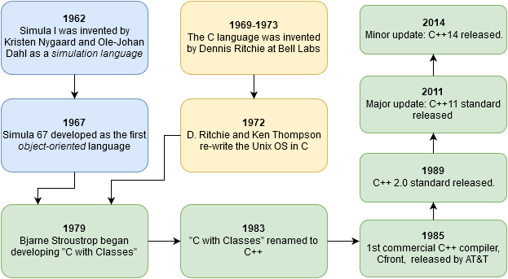


Very brief history of C++
Simula 67
C
C++
For details more check out A History of C++: 1979−1991
Quote: “C++ was designed to provide Simula’s facilities for program organization together with C’s efficiency and flexibility for systems programming. It was intended to deliver that to real projects within half a year of the idea. It succeeded.”

Slide 9
Object-oriented programming
class GasMolecule
Data:
molecular weight, structure, common names, etc.
Methods:
IR(wavenumStart, wavenumEnd) : return IR emission spectrum in range
Object-oriented programming (OOP) seeks to define a program in terms of the things in the problem (files, molecules, buildings, cars, people, etc.), what they need, and what they can do.
GasMolecule ch4
GasMolecule co2
spectrum = ch4.IR(1000,3500)
Name = co2.common_name
Objects (instances of a class)
“pseudo-code”

Slide 10


Object-oriented programming
“Class Car”
OOP defines classes to represent these things.
Classes can contain data and methods (internal functions).
Classes control access to internal data and methods. A public interface is used by external code when using the class.
This is a highly effective way of modeling real world problems inside of a computer program.
public interface
private data and methods

Slide 11
Characteristics of C++
“Actually I made up the term ‘object-oriented’, and I can tell you I did not have C++ in mind.”
– Alan Kay (helped invent OO programming, the Smalltalk language, and the GUI)
C++ is…
Compiled.
A separate program, the compiler, is used to turn C++ source code into a form directly executed by the CPU.
Strongly typed and unsafe
Conversions between variable types must be made by the programmer (strong typing) but can be circumvented when needed (unsafe)
C compatible
call C libraries directly and C code is nearly 100% valid C++ code.
Capable of very high performance
The programmer has a very large amount of control over the program execution
Object oriented
With support for many programming styles (procedural, functional, etc.)
No automatic memory management
The programmer is in control of memory usage

Slide 12
When to choose C++
“If you’re not at all interested in performance, shouldn’t you be in the Python room down the hall?”
― Scott Meyers (author of Effective Modern C++)
Despite its many competitors C++ has remained popular for ~30 years and will continue to be so in the foreseeable future.
Why?
Complex problems and programs can be effectively implemented
OOP works in the real world!
No other language quite matches C++’s combination of performance, expressiveness, and ability to handle complex programs.
Choose C++ when:
Program performance matters
Dealing with large amounts of data, multiple CPUs, complex algorithms, etc.
Programmer productivity is less important
It is faster to produce working code in Python, R, Matlab or other scripting languages!
The programming language itself can help organize your code
Ex. In C++ your objects can closely model elements of your problem
Access to libraries
Ex. Nvidia’s CUDA Thrust library for GPUs
Your group uses it already!

Slide 13
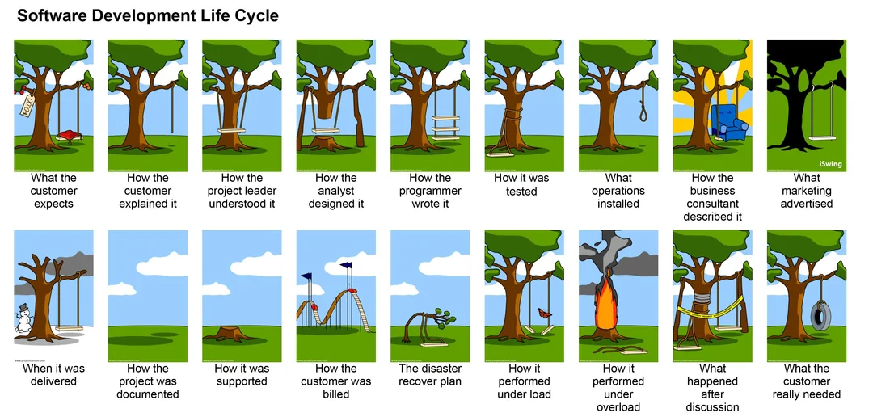

Slide 16
Code::Blocks
In this tutorial we will use the Code::Blocks integrated development environment (IDE) for writing and compiling C++
Run it right on the terminal or on the SCC (module load codeblocks)
About C::B
cross-platform: supported on Mac OSX, Linux, and Windows
Oriented towards C, C++, and Fortran, supports others such as Python
Short learning curve compared with other IDEs such as Eclipse or Visual Studio
Has its own automated code building system, so we can concentrate on C++
It can convert its build system files to make and Makefiles so you are not tied to C::B
Project homepage: http://www.codeblocks.org

Slide 17
IDE Advantages
IDEs available on the SCC
Code::Blocks (used here)
geany – a minimalist IDE, simple to use
Eclipse – a highly configurable, adaptable IDE. Very powerful but with a long learning curve
Spyder – Python only, part of Anaconda
Handles build process for you
Syntax highlighting and live error detection
Code completion (fills in as you type)
Creation of files via templates
Built-in debugging
Code refactoring (ex. Change a variable name everywhere in your code)
Higher productivity
Some Others
Xcode for Mac OSX
Visual Studio for Windows
NetBeans (cross platform)

Slide 18
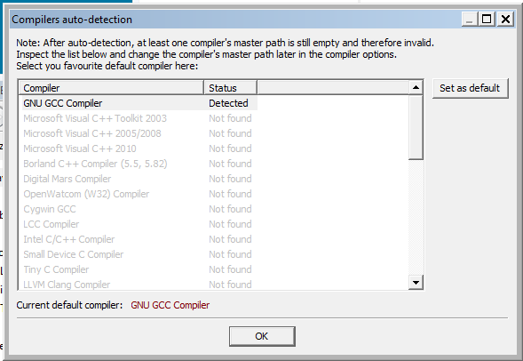
Opening C::B
The 1st time it is opened C::B will search for compilers it can use.
A dialog that looks like this will open. Select GCC if there are multiple options:
And click OK.

Slide 19
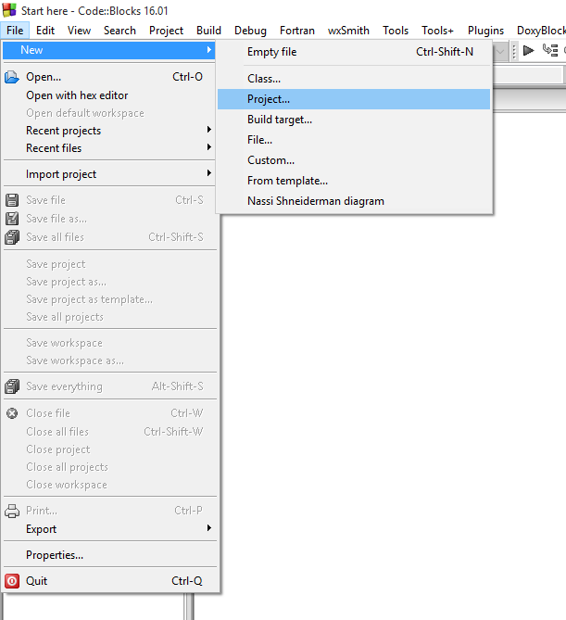
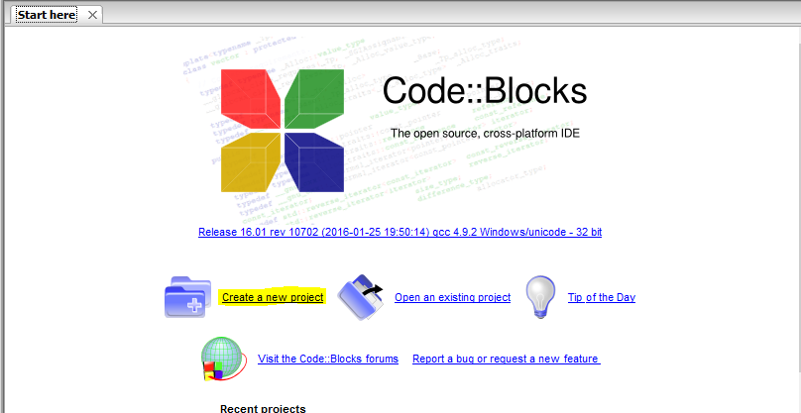
Opening C::B and creating a 1st C++ project…
Step 1. Create a project from the File menu or the Start Here tab:

Slide 20
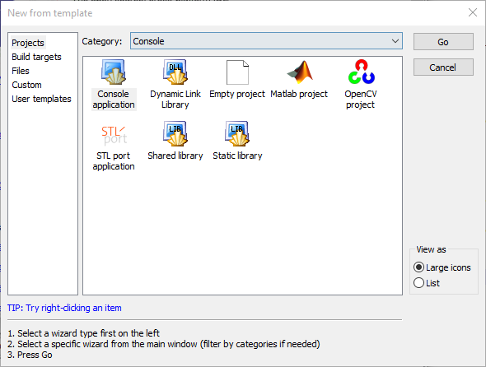
Step 2. Choose the Console category and then the Console application and click Go.

Slide 21
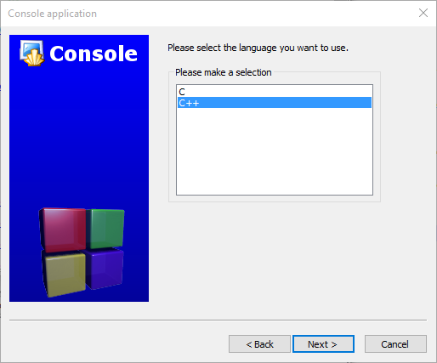
Step 3: Click Next on the “Welcome to the new console application wizard!” screen.
Step 4: Choose C++!
…then click Next.

Slide 22
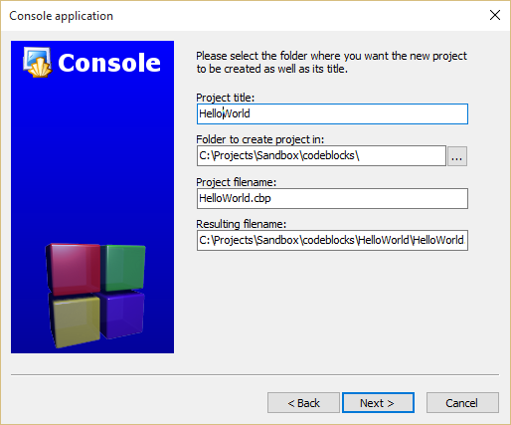
Step 5. Enter a project title. Let C::B fill in the other fields for you. If you like you can change the default folder to hold the project. Click Next.

Slide 23

Step 6: Choose the compiler. For this tutorial, choose GNU GCC as the compiler. Click Next.

Slide 24
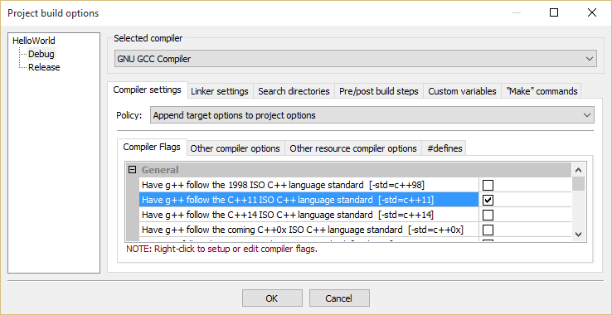
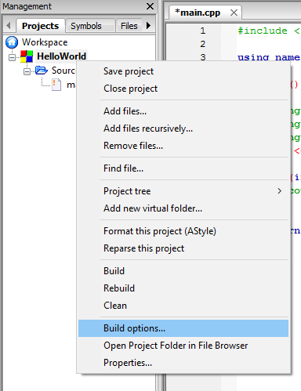
Enable C++11 standard
Step 7.l Right-click on your project name and choose Build options
Check off the C++11 option. Click Release on the left and do the same there as well.
Do this anytime we create a project in C::B

Slide 25
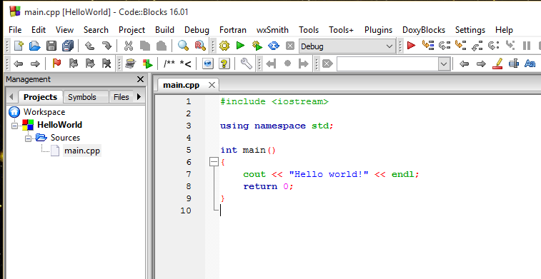
Step 8: Your project is now created! Click on Sources in the left column, then double-click main.cpp.
Click the icon in the toolbar or press F9 to compile and run the program.

Slide 26
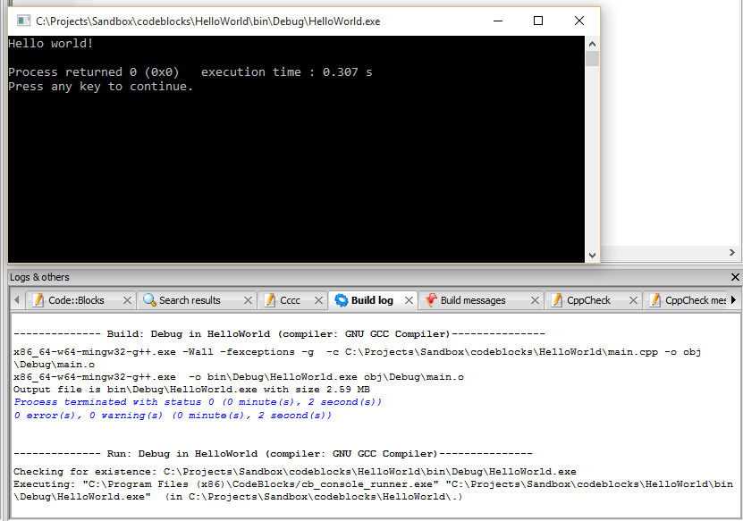
Hello, World!
Console window:
Build and compile messages

Slide 27
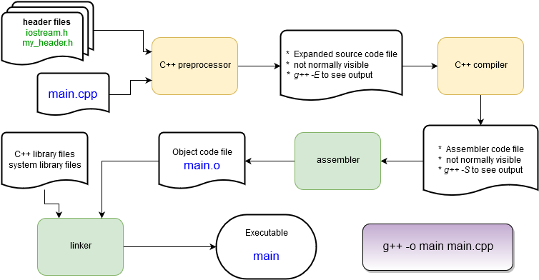
Behind the Scenes: The Compilation Process

Slide 28
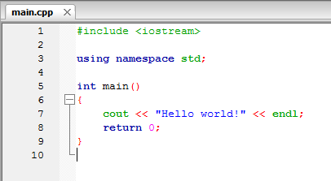
Hello, World! explained
The main routine – the start of every C++ program! It returns an integer value to the operating system and (in this case) takes no arguments: main()
The return statement returns an integer value to the operating system after completion. 0 means “no error”. C++ programs must return an integer value.

Slide 29
Hello, World! explained
loads a header file containing function and class definitions
Loads a namespace called std. Namespaces are used to separate sections of code for programmer convenience. To save typing we’ll always use this line in this tutorial.
cout is the object that writes to the stdout device, i.e. the console window.
It is part of the C++ standard library.
Without the “using namespace std;” line this would have been called as std::cout. It is defined in the iostream header file.
<< is the C++ insertion operator. It is used to pass characters from the right to the object on the left. endl is the C++ newline character.

Slide 30
Header Files
C++ language headers aren’t referred to with the .h suffix. <iostream> provides definitions for I/O functions, including the cout function.
C++ (along with C) uses header files as to hold definitions for the compiler to use while compiling.
A source file (file.cpp) contains the code that is compiled into an object file (file.o).
The header (file.h) is used to tell the compiler what to expect when it assembles the program in the linking stage from the object files.
Source files and header files can refer to any number of other header files.
#include <iostream>
using namespace std;
int main()
{
string hello = "Hello";
string world = "world!";
string msg = hello + " " + world ;
cout << msg << endl;
msg[0] = 'h';
cout << msg << endl;
return 0;
}

Slide 31

Slight change
Let’s put the message into some variables of type string and print some numbers.
Things to note:
Strings can be concatenated with a + operator.
No messing with null terminators or strcat() as in C
Some string notes:
Access a string character by brackets or function:
msg[0] → “H” or msg.at(0) → “H”
C++ strings are mutable – they can be changed in place.
Press F9 to recompile & run.
#include <iostream>
using namespace std;
int main()
{
string hello = "Hello";
string world = "world!";
string msg = hello + " " + world ;
cout << msg << endl;
msg[0] = 'h';
cout << msg << endl;
return 0;
}

Slide 32
A first C++ class: string
string is not a basic type (more on those later), it is a class.
string hello creates an instance of a string called “hello”.
hello is an object.
Remember that a class defines some data and a set of functions (methods) that operate on that data.
Let’s use C::B to see what some of these methods are….
#include <iostream>
using namespace std;
int main()
{
string hello = "Hello";
string world = "world!";
string msg = hello + " " + world ;
cout << msg << endl;
msg[0] = 'h';
cout << msg << endl;
return 0;
}

Slide 33
A first C++ class: string
Update the code as you see here.
After the last character is entered C::B will display some info about the string class.
If you click or type something else just delete and re-type the last character.
Ctrl-space will force the list to appear.
#include <iostream>
using namespace std;
int main()
{
string hello = "Hello";
string world = "world!";
string msg = hello + " " + world ;
cout << msg << endl;
msg[0] = 'h';
cout << msg << endl;
msg
return 0;
}

Slide 34
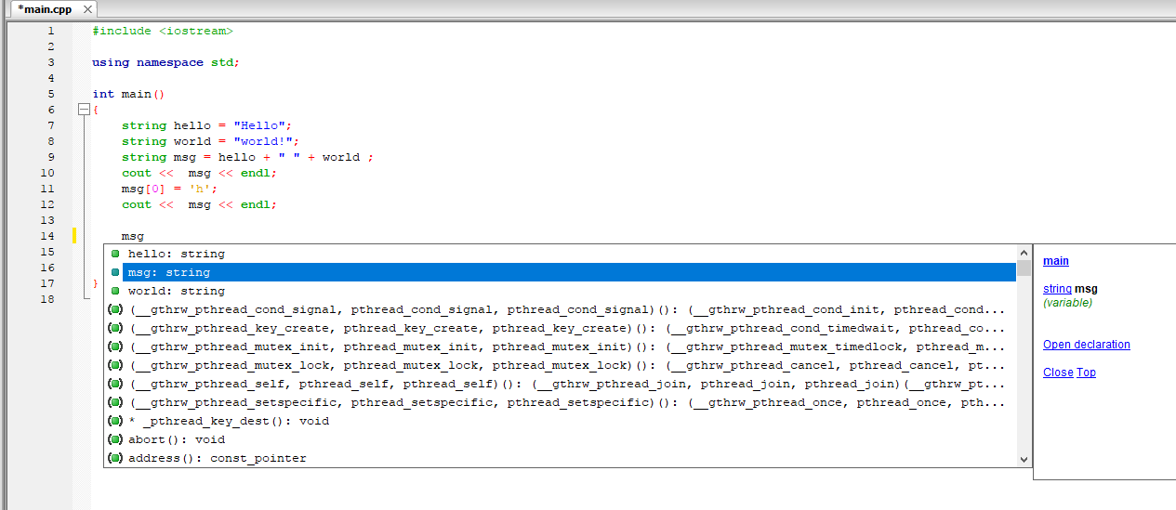
A first C++ class: string
Shows this function (main) and the type of msg (string)
List of string methods
List of other string objects
Next: let’s find the size() method without scrolling for it.

Slide 35
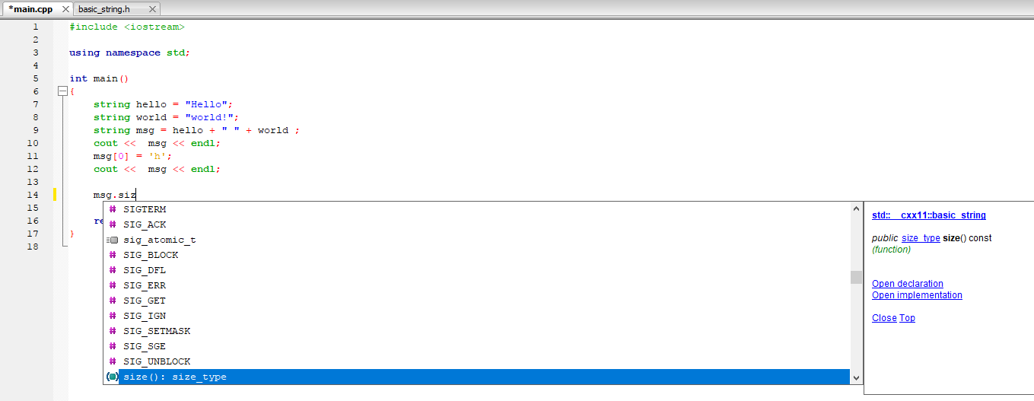
A first C++ class: string
Start typing “msg.size()” until it appears in the list. Once it’s highlighted (or you scroll to it) press the Tab key to auto-enter it.
On the right you can click “Open declaration” to see how the C++ compiler defines size(). This will open basic_string.h, a built-in file.

Slide 36
A first C++ class: string
#include <iostream>
using namespace std;
int main()
{
string hello = "Hello" ;
string world = "world!" ;
string msg = hello + " " + world ;
cout << msg << endl ;
msg[0] = 'h';
cout << msg << endl ;
cout << msg.size() << endl ;
return 0;
}
Tweak the code to print the number of characters in the string, build, and run it.
From the point of view of main(), the msg object has hidden away its means of tracking and retrieving the number of characters stored.
Note: while the string class has a huge number of methods your typical C++ class has far fewer!
Note that cout prints integers without any modification!

Slide 37
Break your code.
Remove a semi-colon. Re-compile. What messages do you get from the compiler and C::B?
Fix that and break something else. Capitalize string → String
C++ can have elaborate error messages when compiling. Experience is the only way to learn to interpret them!
Fix your code so it still compiles and then we’ll move on…

Slide 38
Basic Syntax
C++ syntax is very similar to C, Java, or C#. Here’s a few things up front and we’ll cover more as we go along.
Curly braces are used to denote a code block (like the main() function):
{ … some code … }
Statements end with a semicolon:
Comments are marked for a single line with a // or for multilines with a pair of /* and */ :
Variables can be declared at any time in a code block.
int a ;
a = 1 + 3 ;
// this is a comment.
/* everything in here
is a comment */
void my_function() {
int a ;
a=1 ;
int b;
}

Slide 39
Functions are sections of code that are called from other code. Functions always have a return argument type, a function name, and then a list of arguments separated by commas:
A void type means the function does not return a value.
Variables are declared with a type and a name:
int add(int x, int y) {
int z = x + y ;
return z ;
}
// No arguments? Still need ():
void my_function() {
/* do something...
but a void value means the
return statement can be skipped.*/
}
// Specify the type
int x = 100;
float y;
vector<string> vec ;
// Sometimes types can be inferred
auto z = x;

Slide 40
A sampling of arithmetic operators:
Arithmetic: + - * / % ++ --
Logical: && (AND) ||(OR) !(NOT)
Comparison: == > < >= <= !=
Sometimes these can have special meanings beyond arithmetic, for example the “+” is used to concatenate strings.
What happens when a syntax error is made?
The compiler will complain and refuse to compile the file.
The error message usually directs you to the error but sometimes the error occurs before the compiler discovers syntax errors so you hunt a little bit.

Slide 41
Built-in (aka primitive or intrinsic) Types
“primitive” or “intrinsic” means these types are not objects
Here are the most commonly used types.
Note: The exact bit ranges here are platform and compiler dependent!
Typical usage with PCs, Macs, Linux, etc. use these values
Variations from this table are found in specialized applications like embedded system processors.
Name | Name | Value
char | unsigned char | 8-bit integer
short | unsigned short | 16-bit integer
int | unsigned int | 32-bit integer
long | unsigned long | 64-bit integer
bool |  | true or false
Name | Value
float | 32-bit floating point
double | 64-bit floating point
long long | 128-bit integer
long double | 128-bit floating point
http://www.cplusplus.com/doc/tutorial/variables/

Slide 42
Need to be sure of integer sizes?
In the same spirit as using integer(kind=8) type notation in Fortran, there are type definitions that exactly specify exactly the bits used. These were added in C++11.
These can be useful if you are planning to port code across CPU architectures (ex. Intel 64-bit CPUs to a 32-bit ARM on an embedded board) or when doing particular types of integer math.
For a full list and description see: http://www.cplusplus.com/reference/cstdint/
#include <cstdint>
Name | Name | Value
int8_t | uint8_t | 8-bit integer
int16_t | uint16_t | 16-bit integer
int32_t | uint32_t | 32-bit integer
int64_t | uint64_t | 64-bit integer

Slide 43
Reference and Pointer Variables
The object hello occupies some computer memory.
string hello = "Hello";
string *hello_ptr = &hello;
string &hello_ref = hello;
The asterisk indicates that hello_ptr is a pointer to a string. hello_ptr variable is assigned the memory address of object hello which is accessed with the “&” syntax.
The & here indicates that hello_ref is a reference to a string. The hello_ref variable is assigned the memory address of object hello automatically.
Variable and object values are stored in particular locations in the computer’s memory.
Reference and pointer variables store the memory location of other variables.
Pointers are found in C. References are a C++ variation that makes pointers easier and safer to use.
More on this topic later in the tutorial.

Slide 44
Type Casting
C++ is strongly typed. It will auto-convert a variable of one type to another in a limited fashion: if it will not change the value.
Conversions that don’t change value: increasing precision (float → double) or integer → floating point of at least the same precision.
C++ allows for C-style type casting with the syntax: (new type) expression
But since we’re doing C++ we’ll look at the 4 ways of doing this in C++ next...
short x = 1 ;
int y = x ; // OK
short z = y ; // NO!
double x = 1.0 ;
int y = (int) x ;
float z = (float) (x / y) ;

Slide 45
Type Casting
double d = 1234.56 ;
float f = static_cast<float>(d) ;
// same as
float g = (float) d ;
static_cast<new type>( expression )
This is exactly equivalent to the C style cast.
This identifies a cast at compile time.
This will allow casts that reduce precision (ex. double → float)
~99% of all your casts in C++ will be of this type.
dynamic_cast<new type>( expression)
Special version where type casting is performed at runtime, only works on reference or pointer type variables.
Usually handled automatically by the compiler where needed, rarely done by the programmer.

Slide 46

Type Casting cont’d
Danger!
const_cast<new type>( expression )
Variables labeled as const can’t have their value changed.
const_cast lets the programmer remove or add const to reference or pointer type variables.
If you need to do this, you probably want to re-think your code.
reinterpret_cast<new type>( expression )
Takes the bits in the expression and re-uses them unconverted as a new type. Also only works on reference or pointer type variables.
Sometimes useful when reading in binary files and extracting parameters.
“unsafe”: the compiler will not protect you here!
The programmer must make sure everything is correct!

Slide 47

Functions
The function arguments L and W are sent as type float.
The return type is float.
Open the project “FunctionExample” in C::B files
Compile and run it!
Open main.cpp
4 function calls are listed.
The 1st and 2nd functions are identical in their behavior.
The values of L and W are sent to the function, multiplied, and the product is returned.
RectangleArea2 uses const arguments
The compiler will not let you modify their values in the function.
Try it! Uncomment the line and see what happens when you recompile.
The 3rd and 4th versions pass the arguments by reference with an added &
float RectangleArea1(float L, float W) {
return L*W ;
}
float RectangleArea2(const float L, const float W) {
// L=2.0 ;
return L*W ;
}
float RectangleArea3(const float& L, const float& W) {
return L*W ;
}
void RectangleArea4(const float& L, const float& W, float& area) {
area= L*W ;
}
Product is computed

Slide 48
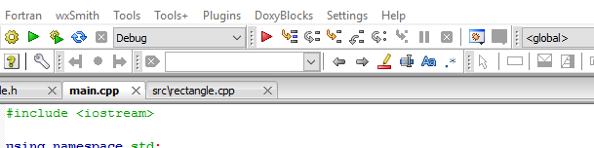
Using the C::B Debugger
To show how this works we will use the C::B interactive debugger to step through the program line-by-line to follow the function calls.
Make sure you are running in Debug mode. This turns off compiler optimizations and has the compiler include information in the compiled code for effective debugging.

Slide 49
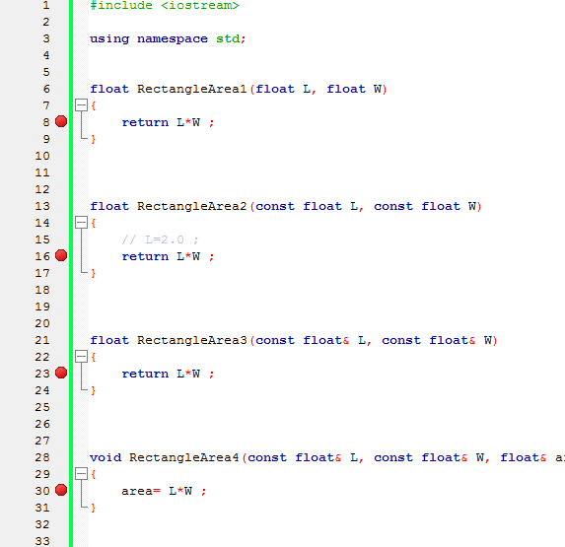

Add a Breakpoint
Breakpoints tell the debugger to halt at a particular line so that the state of the program can be inspected.
In main.cpp, double click to the left of the lines in the functions to set a pair of breakpoints. A red dot will appear.
Click the red arrow to start the code in the debugger.

Slide 50
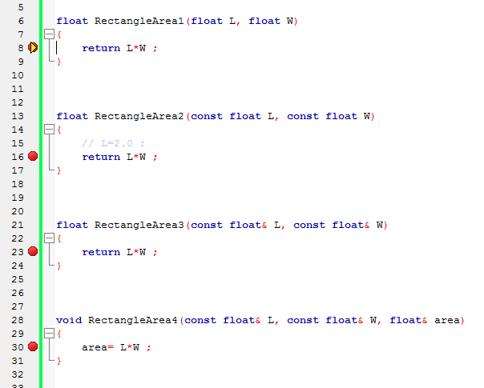
The debugger will pause in the first function at the breakpoint.

Slide 51
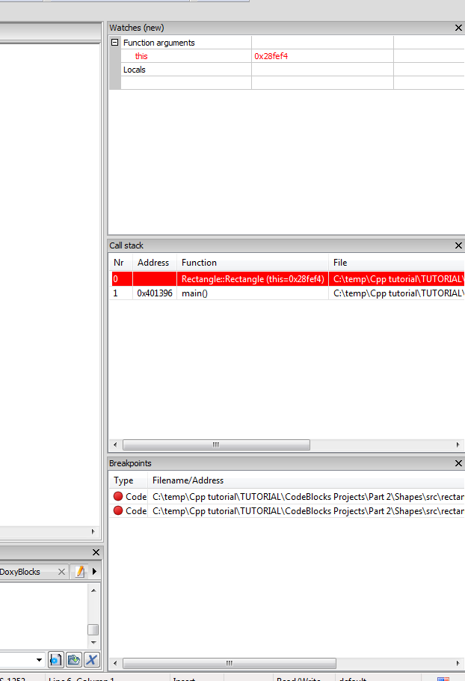
Click the Debug menu, go to Debugging Windows, and choose Call Stack. Drag it to the right, then go back and choose Watches. Drag it to the right. Do the same for the Breakpoints option. Your screen will look something like this now…
Controls (hover mouse over for help):
Watches shows the variables in use and their values
Call Stack shows the functions being called, newest on top.
Place the cursor in the function, click to run to the cursor
Run the next line
Step into a function call
Breakpoints lists the breakpoints you’ve created.
Step out of a function to the calling function.
Step by CPU instruction. Less useful, generally.

