Slide 1
Computer Graphics
Lecture 6: Numerical integration
Kartic Subr

Slide 2


Slide 3
Speed and distance

Slide 4
Integrals

Slide 5
Approximation?

Slide 6
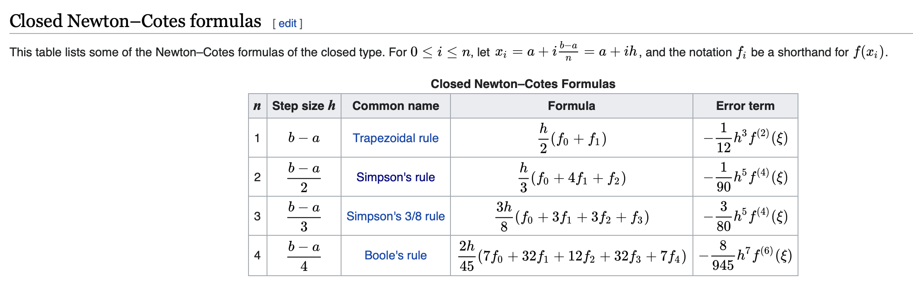
Newton-Cotes formulae
https://en.wikipedia.org/wiki/Newton–Cotes_formulas

Slide 7
Problems?

Slide 8
A random slide

Slide 9
Area of a circle

Slide 10
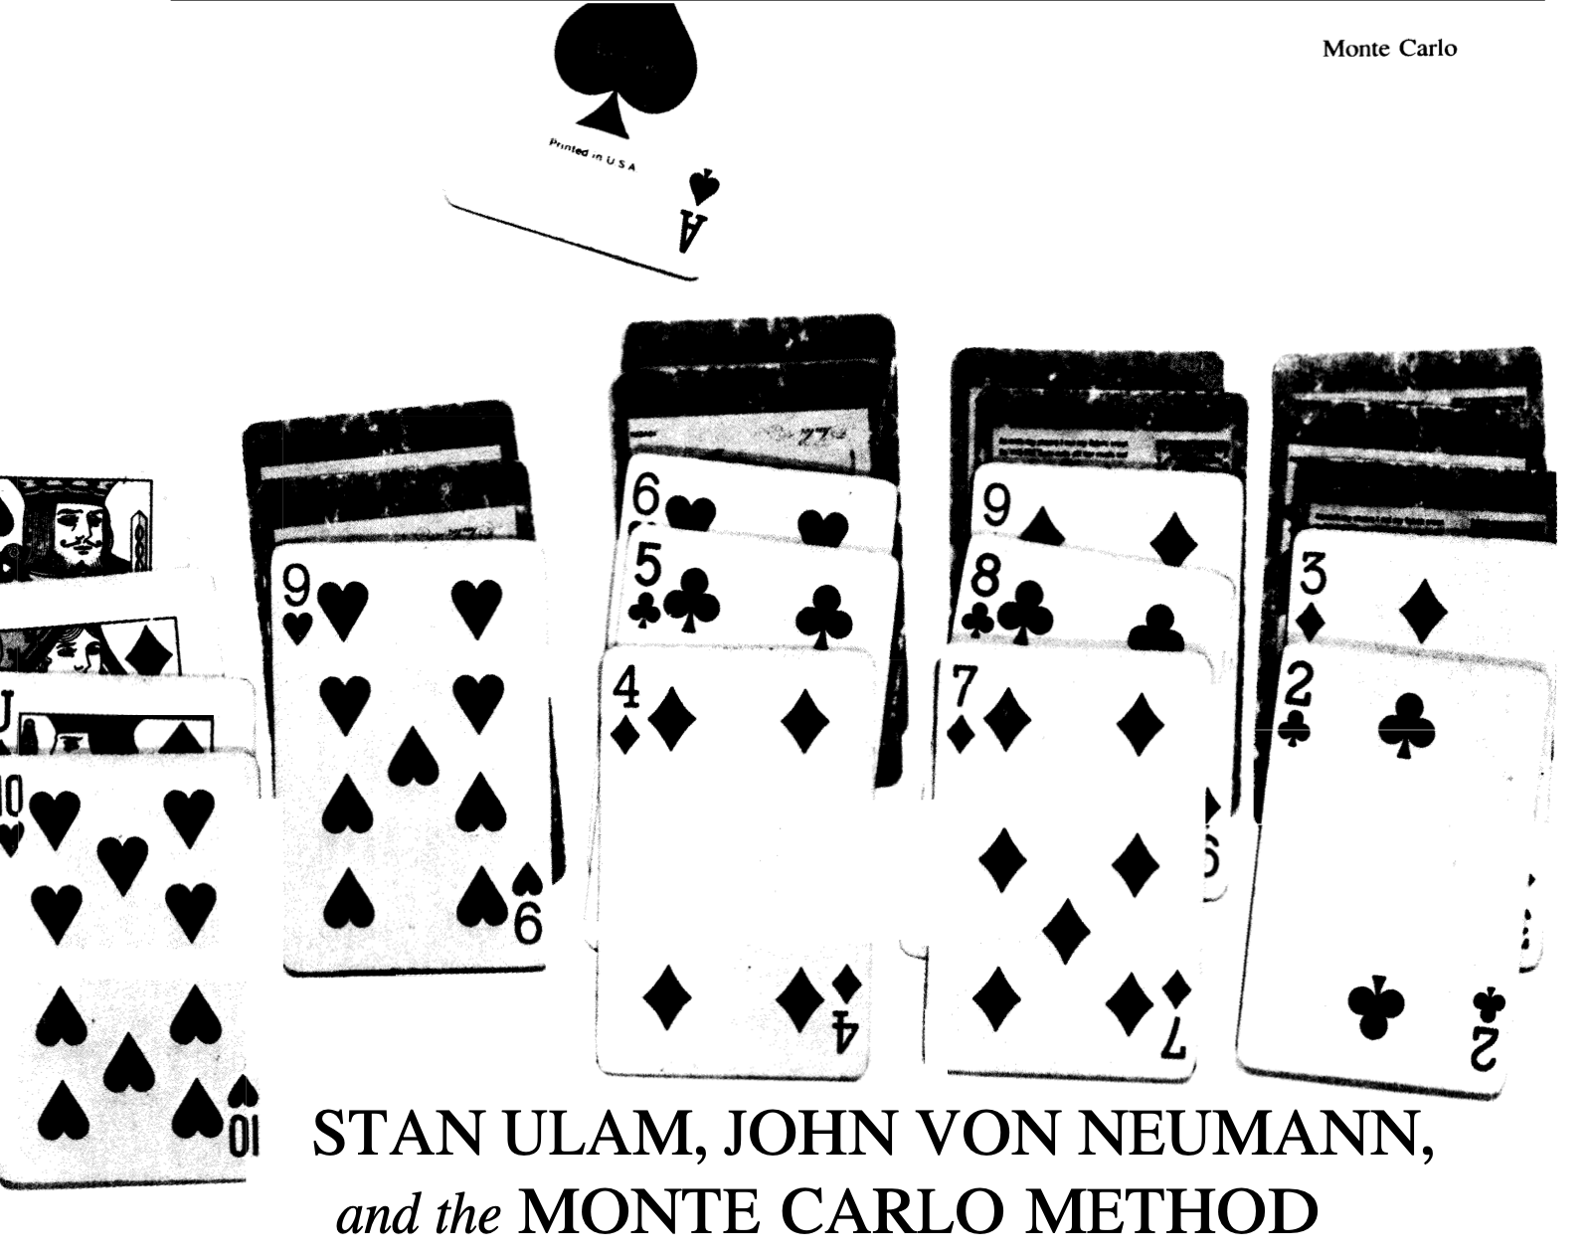
Monte Carlo method
http://www-star.st-and.ac.uk/~kw25/teaching/mcrt/MC_history_3.pdf

