Slide 1
Commerce on Rails
IT Capstone 2006
May 1, 2006

Slide 2




The Project Team
Rachel Messham
  Project Manager
Dick Granberg
  Database Design
Lukasz Karapuda
  Programmer, Client Liaison
Michael Mayer
  Programmer

Slide 3
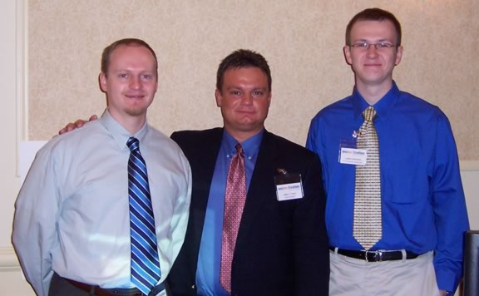
newline Creations
IT branch of McManis & Monsalve Associates
Located in Erie, PA
Provide managed software solutions for the WWW
http://www.thenewline.com/

Slide 4
Project Overview: The Requirements
Replace existing e-com platform: Litecommerce
Easily modify functionality on a per website basis
NLC moving to Ruby on Rails development

Slide 5

Project Overview: Our Solution
E-commerce Web application in Ruby on Rails
Components
  Customizable Storefront
  Commerce Manager
Features
  Store lifecycle management: product catalog, orders and customers
  Ships with full-featured default storefront

Slide 6
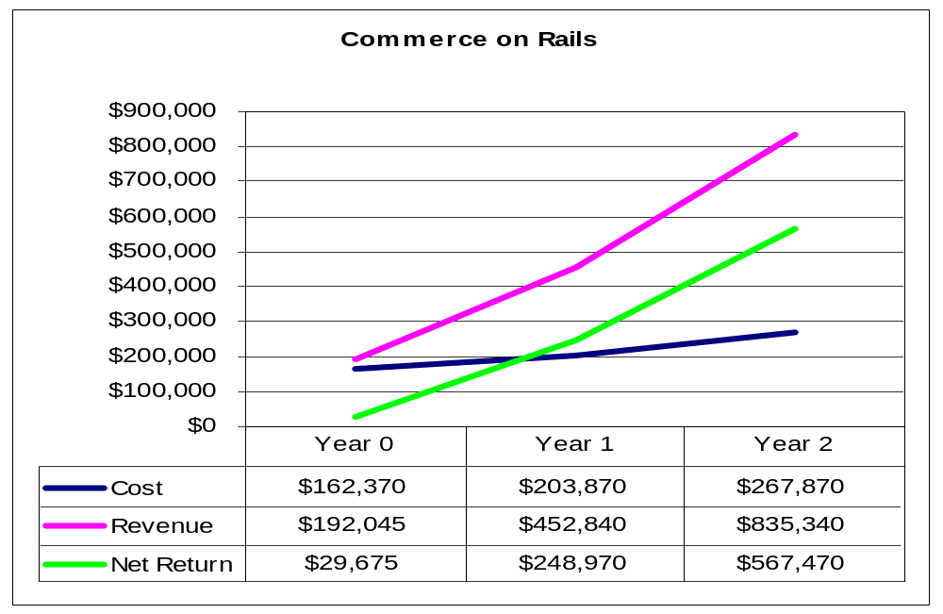
Project Overview: Financial Analysis

Slide 7
Demo
Link

Slide 8
Software Design: Methodology
Agile development imposed by the Rails framework
  Iterations
  Spin-off of RUP
Pair programming
Use-case driven development

Slide 9
Software Design: Platform
In line with NLC requirements
  Ruby on Rails
  MySQL
  Linux OS

Slide 10
Software Design: Components
Rails framework implies MVC pattern
Modular design
  Storefront
  Commerce Manager
  Web services API
    Transparent integration with existing websites
    Tested with XML-RPC and PHP

Slide 11
Software Design: UI
Web 2.0
  AJAX in default Storefront
  Fluid layout in Commerce Manager
Adherence to Web standards: XHTML/CSS
Storefront themes
  Partial templates
  Storefront CSS

Slide 12
Project Management
Tasks spread over iterations
Basecamp helped to maintain accountability
  Messaging
  Task lists
  Time tracking
  File sharing
  Wiki for collaboration on requirements
Skype meetings
Projected hours: 456
Worked hours: 420

Slide 13
Project Status
Full-featured e-commerce Web application delivered to NLC
Extensive source code documentation
Release notes
COR will become an NLC product
  Maintenance performed by NLC
  Product marketing initiated (www.commerceonrails.com)

