Slide 1
Data Communiqué
XBRL Project Database UI
Gino Gervasio
Theodora Kampelou
Nathalie Neptune
Anand Patil
James Wu
Group 3 | Data Communiqué

Slide 2
Agenda
Client
Problem/Solution
Project Management
Cost Benefit Analysis
IS Design/Demo
Results/Conclusions
Group 3 | Data Communiqué

Slide 3
Data Communiqué
Leading Technology Provider
Content Management Solutions
Financial, Pharmaceutical,
Health Care and Insurance Industries
Group 3 | Data Communiqué

Slide 4
eXtensible
Business
Reporting
Language
Group 3 | Data Communiqué

Slide 5
The Problem
XBRL is relatively new
XBRL involves many files
XBRL is not user friendly
Group 3 | Data Communiqué

Slide 6

The Solution
Aggregate XBRL files/data
Provide web interface
Export to Excel option
Group 3 | Data Communiqué

Slide 7
Project
Management
Group 3 | Data Communiqué

Slide 8
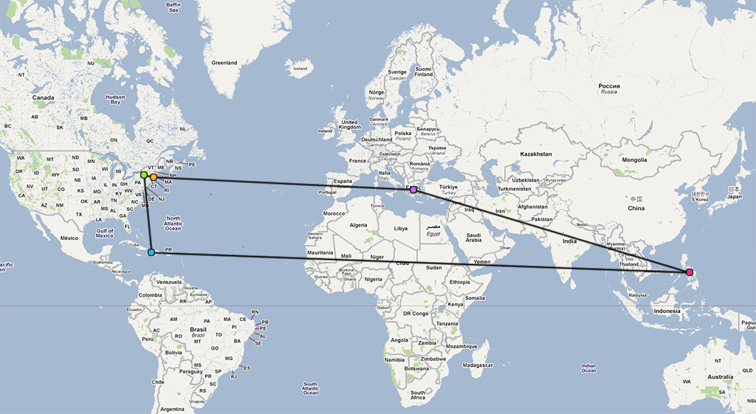
Team Dynamics
Group 3 | Data Communiqué

Slide 9
Unified Process
4 Phases
  Inception
  Elaboration
  Construction
  Transition
2 Week Iterations
Group 3 | Data Communiqué

Slide 10
Client-Team Communication
Transparency
Weekly Client Meetings
Meeting Minutes
Secured Shared Repository
Group 3 | Data Communiqué

Slide 11

Project Challenges
Baby!
  Change in Point-of-Contact
Learning Curve
  UBmatrix Querying Language
Group 3 | Data Communiqué

Slide 12
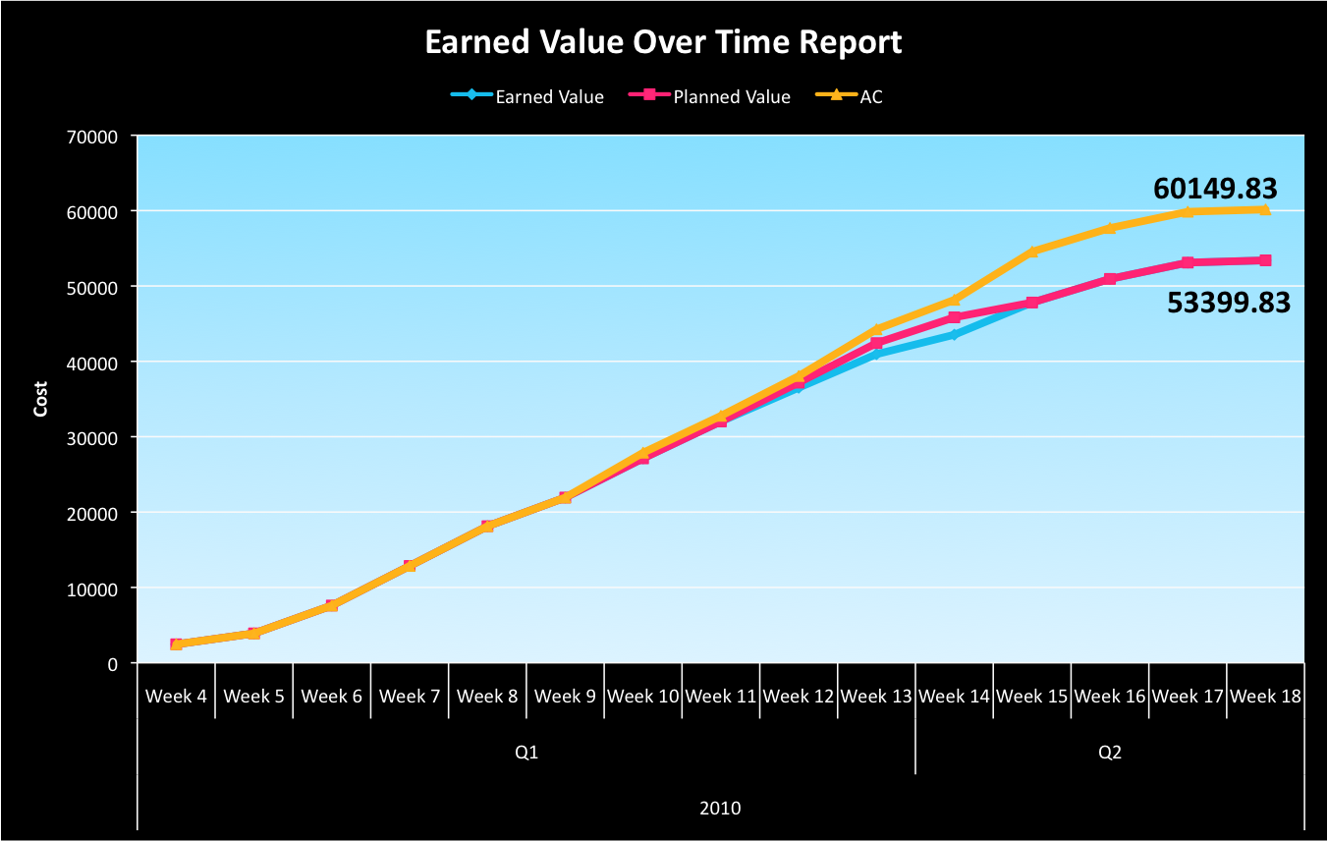
Earned Value Analysis
Group 3 | Data Communiqué

Slide 13
Cost Benefit
Analysis
Group 3 | Data Communiqué

Slide 14
Risk Adjusted Model
Why the risk adjusted model?
  Has a great deal of intuitive appeal for risk averse businesses.
  It helps businesses manage uncertainty.
  Simple to understand: 3 different risk levels for the estimation of costs.
Group 3 | Data Communiqué

Slide 15
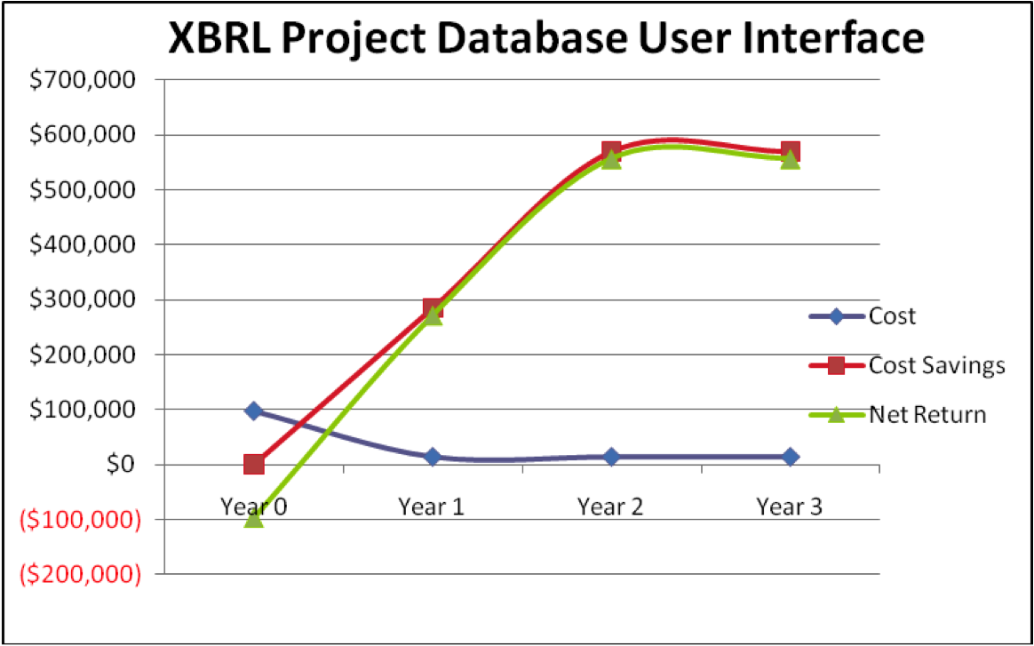
Risk Adjusted Model
$556,500
$97,000
Group 3 | Data Communiqué

Slide 16
Net Present Value
Total NPV of net return for the three-year period: $1,028,000
  Initial project costs: $97,000
  The positive value of NPV represents discounted cash inflow.
Total NPV of costs: $130,000
  Results in the very satisfactory ROI.
Group 3 | Data Communiqué

Slide 17
Return on Investment
Estimated ROI: 791%
  Based on a 57% reduction of time spent on analyzing XBRL documents.
  Results in an IRR of 341%.
  Results in a payback period of only 5 months.
Group 3 | Data Communiqué

Slide 18
Information Systems Design
Group 3 | Data Communiqué

Slide 19
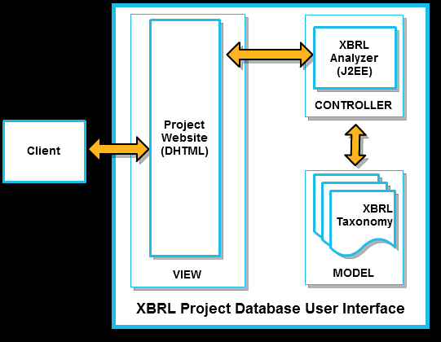
Architecture
Group 3 | Data Communiqué

Slide 20
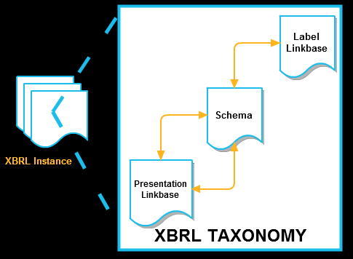
XBRL Framework
Group 3 | Data Communiqué

Slide 21
Results and
Conclusion
Group 3 | Data Communiqué

Slide 22
Results
Data Accuracy
  Readability
  99.999% data accuracy
Page Loading Times
  100 millisecond page load time
Group 3 | Data Communiqué

Slide 23
Benefits
  Reduced Analysis time
  High ROI
  Positive Net Revenues
Group 3 | Data Communiqué

Slide 24
Key Takeaways
  XBRL framework
  Working with very diverse team
  Scope modification during project execution
  Use of current web tools for collaboration
Group 3 | Data Communiqué

Slide 25
Questions?
Group 3 | Data Communiqué

Slide 26
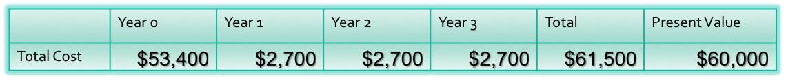
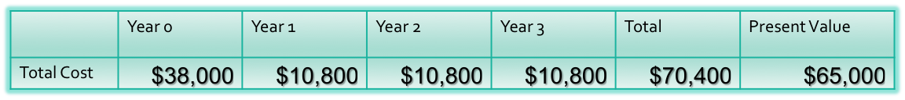
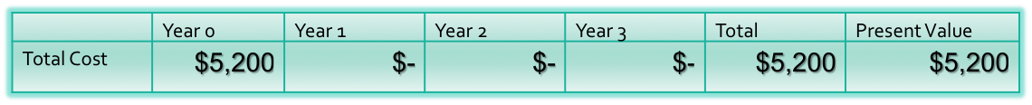
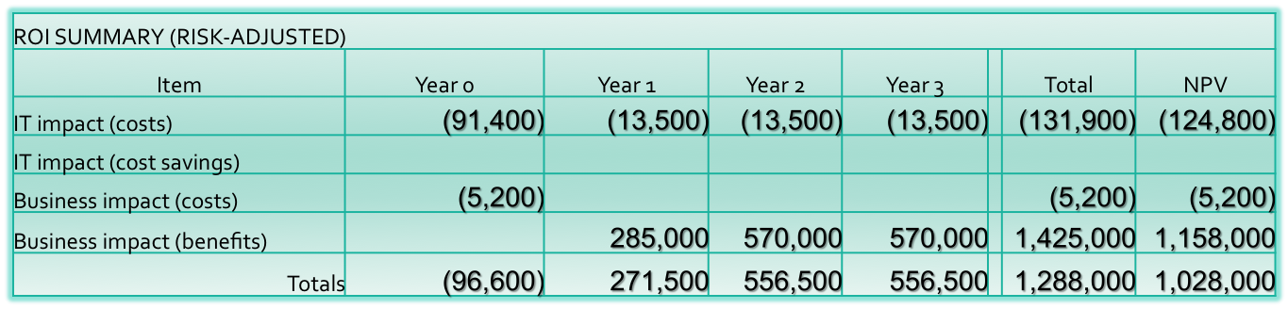
Risk-Adjusted Approach
Overhead Costs:
Labor Costs:
Training Costs:
Group 3 | Data Communiqué

Slide 27
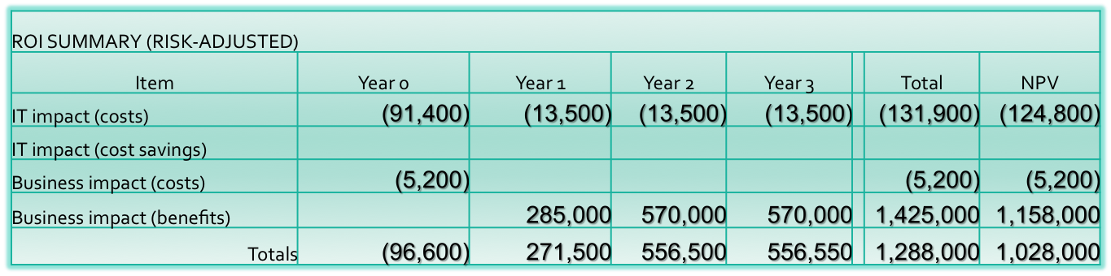
Return on Investment
ROI=Net Return Present Value/Cost Present Value= 791 %
Group 3 | Data Communiqué

Slide 28
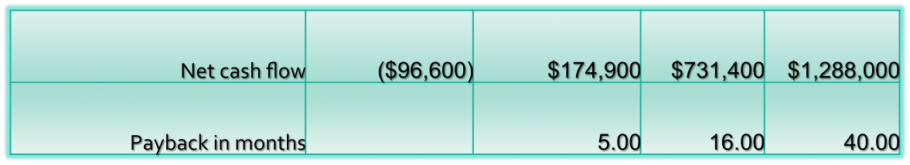
Payback Period
Payback period=
Net cash flow Year 0 -Net cash flow Year (n)
Net cash flow Year (n)
x 12
Group 3 | Data Communiqué

Slide 29

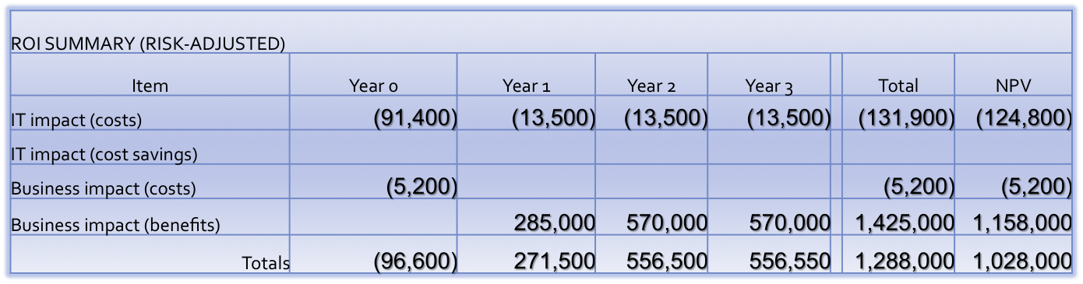
Internal Rate of Return
The IRR is the discount rate that makes the NPV (Net Present Value) equals to zero.
Group 3 | Data Communiqué

Slide 30
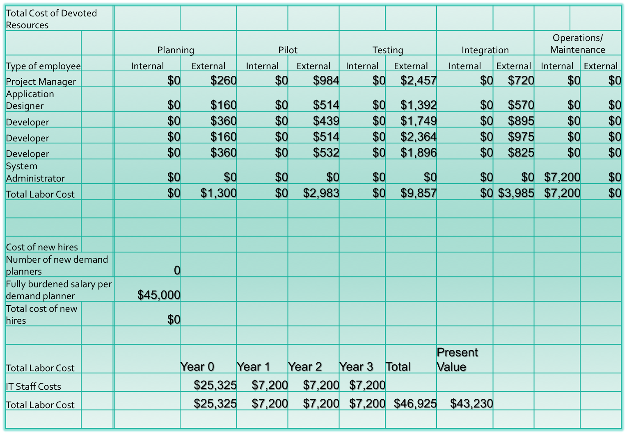
IT Labor Costs

