Slide 1
Monte Carlo Algorithms
Shusen Wang
Notes:
Monte Carlo is a family of randomized algorithms for approximating the exact values.
I am going to use a few examples to explain Monte Carlo algorithms.
这节课我们学习蒙特卡洛。
蒙特卡洛是一大类随机算法，通过随机样本来估算真实值。
这节课我用几个例子来讲解 蒙特卡洛算法。

Slide 2
Application 1: Calculating Pi
Notes:
The first example is calculating pi using uniform sampling.
第一个例子是通过均匀抽样来计算Pi。

Slide 3

Calculating Pi
We already know $π≈3.141592653589…$
Pretend we do not know the value of $π$.
Can we find it out (approximately) using a random number generator?
Notes:
We already know that pi is approximately 3.14159.
Now let’s pretend that we don’t know the value of pi.
Can we find it out approximately using a random number generator?
我们都知道Pi约等于$3.141592653589$。
现在假装我们不知道pi，我们要想办法近似估算pi值。
---
假设我们有随机数生成器，我们能不能用随机样本来近似Pi呢？

Slide 4







Calculating Pi
$$y$$
Assume $\left(x, y\right)$ is a point sampled from the square uniformly at random.
$$1$$
$$−1$$
$$x$$
$$1$$
$$−1$$
Notes:
Let’s use Monte Carlo to approximate π.
The idea is uniform sampling.
==============================
Assume we have a random number generator that can generate numbers uniformly distributed between -1 and +1.
Each time, we generate two numbers: x and y.
==============================
In this way, each time we uniformly sample one point from the blue square.
Everywhere in the square has the same probability density.
接下来我们用蒙特卡洛来近似计算pi。
假设我们有一个随机数生成器，
==============================
可以均匀生成 负一 到 正一 之间的实数。
我们每次生成两个随机数，一个作为x，另一个作为y。
于是每次就生成了一个平面坐标系中的点(x, y)。
==============================
所有点都会落在这个蓝色正方形里面。
由于x和y都是在 负一 到 正一 之间 均匀分布，所以正方形里所有的点都有相同的概率密度。

Slide 5
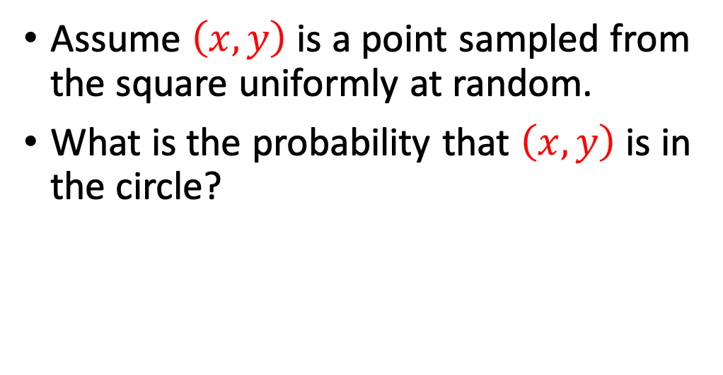
Calculating Pi
$$y$$
Assume $\left(x, y\right)$ is a point sampled from the square uniformly at random.
What is the probability that $\left(x, y\right)$ is in the circle?
$$1$$
$$−1$$
$$x$$
$$1$$
$$−1$$
Notes:
The green circle is contained by the blue square.
The circle is centered at the origin and has a radius of 1.
----
A randomly generated point may fall inside the circle and outside the circle.
Both are possible.
=======================
Think of this question: What is the probability that point $\left(x, y\right)$ is inside the circle?
Let me ask the question in another way:
If 1 trillion samples are randomly generated, then how many will fall inside the circle?
---------------------------
Because the points are uniformly sampled, the probability is the area of the circle divided by the area of the square.
正方形里面包含 这个绿色的圆。
半径等于1，圆心在原点。
刚才随机生成的点$(x,y)$可能落在圆里，也有可能落在圆外面。
=======================
思考这个问题：
这些点落在圆里的概率有多大？
换句话说，假如生成一亿个随机样本，有多少个样本会落在圆里面？
---------------------------
这个概率显然是 圆的面积 除以 正方形的面积。

Slide 6
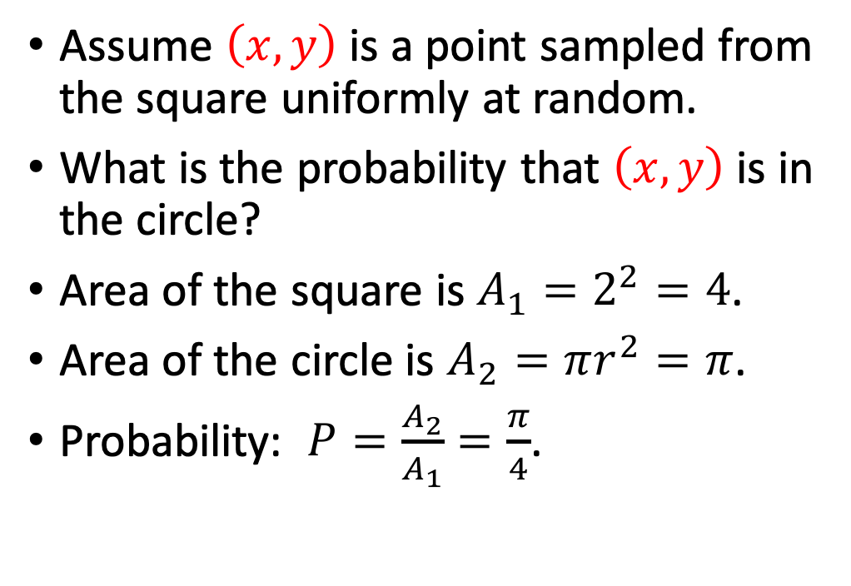
Calculating Pi
$$y$$
Assume $\left(x, y\right)$ is a point sampled from the square uniformly at random.
What is the probability that $\left(x, y\right)$ is in the circle?
Area of the square is $A_{1}=2^{2}=4$.
Area of the circle is $A_{2}=πr^{2}=π$.
Probability: $P=\frac{A_{2}}{A_{1}}=\frac{π}{4}$.
$$1$$
$$−1$$
$$x$$
$$1$$
$$−1$$
Notes:
The sides of the square have lengths of 2.
So the square has an area of $2^{2}$, which is equal to 4.
=========================
The circle has a radius of 1.
Its area is $πr^{2}$, which is equal to $π$.
=========================
The ratio of the two areas is $\frac{π}{4}$.
Thus a uniformly sampled point $\left(x, y\right)$ falls inside the circle with probability $P=\frac{π}{4}$.
Here, pretend that $π$ is unknown, and we seek to find $π$.
正方形边长是 2，所以面积$A_{1}$是2的平方等于4。
=========================
圆的半径是$r=1$，所以面积$A_{2}$ 等于 $πr^{2}=π$。
=========================
于是 概率 P 就等于 $A_{2}$ 除以 $A_{1}$ 等于 $\frac{π}{4}$。

Slide 7
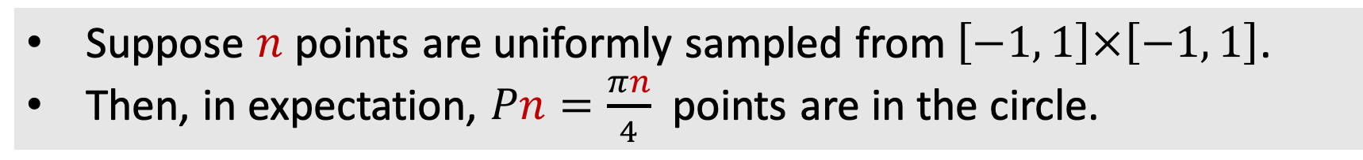

Calculating Pi
Suppose $n$ points are uniformly sampled from $\left[−1, 1\right]×\left[−1, 1\right]$.
Then, in expectation, $Pn=\frac{πn}{4}$ points are in the circle.
$$y$$
Assume $\left(x, y\right)$ is a point sampled from the square uniformly at random.
What is the probability that $\left(x, y\right)$ is in the circle?
Area of the square is $A_{1}=2^{2}=4$.
Area of the circle is $A_{2}=πr^{2}=π$.
Probability: $P=\frac{A_{2}}{A_{1}}=\frac{π}{4}$.
$$1$$
$$−1$$
$$x$$
$$1$$
$$−1$$
Notes:
Let’s uniformly sample n points from the square.
Every point falls inside the circle with probability P, and this process is repeated n times.
Thus, in expectation, the number of points in the circle is $Pn=\frac{πn}{4}$.
---------------
Be careful, this is the expectation, not the actual outcome.
If you sample 5 points randomly, all of the 5 points can be outside the circle.
This can happen.
假设我们从正方形的区域里均匀抽样 n 个点。
----
那么落在 圆中的点的数量的 期望是 P 乘以 n 。
这是因为 重复了n次，每次落在圆中的概率是P。
----
P 乘以 n 等于 $\frac{πn}{4}$。
期望有$\frac{πn}{4}$个点落在圆里。
----
注意，这只是期望，并不是实际发生的结果。
如果你抽n=5个点，可能全都不在圆里。

Slide 8
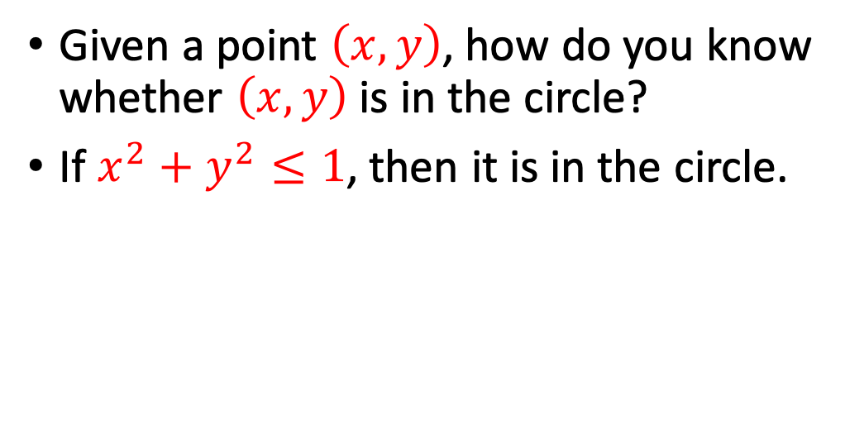
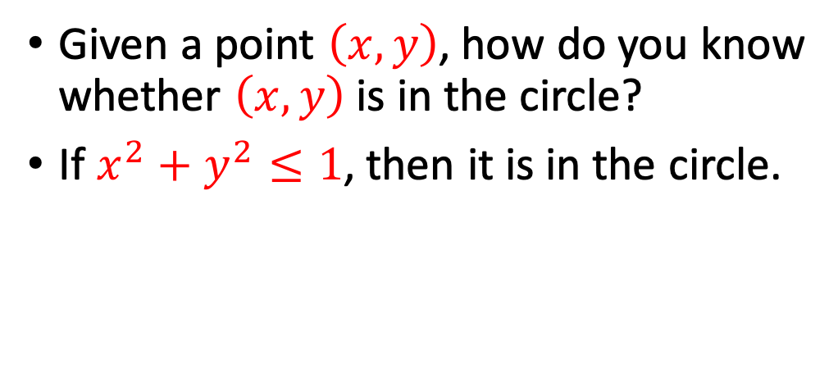
Calculating Pi
Suppose $n$ points are uniformly sampled from $\left[−1, 1\right]×\left[−1, 1\right]$.
Then, in expectation, $Pn=\frac{πn}{4}$ points are in the circle.
$$y$$
$$1$$
Given a point $\left(x, y\right)$, how do you know whether $\left(x, y\right)$ is in the circle?
If $x^{2}+y^{2}≤1$, then it is in the circle.
$$−1$$
$$x$$
$$1$$
$$−1$$
Notes:
Another question:
Given a point $\left(x, y\right)$, how do you know whether $\left(x, y\right)$ is inside the circle?
======
It’s actually easy to tell whether it is inside or outside.
Simply use the equation of the circle.
If $x^{2}+y^{2}$ is less than or equal to1, then we know the point is in the circle.
还有个问题。
给定一个点的坐标 $\left(x, y\right)$，你怎么知道这个点在圆里面还是外面呢？
=======
其实很容易判断，用一下圆的方程就好了。
圆心是原点，半径是1。
所以圆的方程是这个公式：$x^{2}+y^{2}≤1$。
-----
如果$x^{2}+y^{2}≤1$，就说明点在圆里面。
反之，就说明点在圆外面。

Slide 9
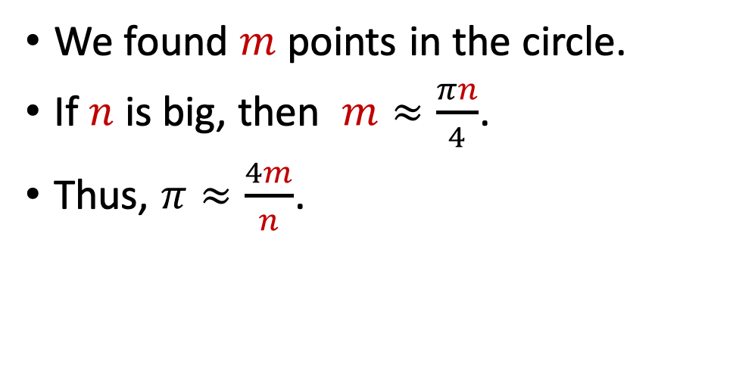
Calculating Pi
Suppose $n$ points are uniformly sampled from $\left[−1, 1\right]×\left[−1, 1\right]$.
Then, in expectation, $Pn=\frac{πn}{4}$ points are in the circle.
$$y$$
$$1$$
We found $m$ points in the circle.
If $n$ is big, then $m≈\frac{πn}{4}$.
Thus, $π≈\frac{4m}{n}$.
$$−1$$
$$x$$
$$1$$
$$−1$$
Notes:
We have sampled n points uniformly at random.
After completing the simulation, we found that there are m points in the circle.
==========
If n is big, then the actual observation m should be close to the expectation $\frac{πn}{4}$ .
Note that $\frac{πn}{4}$ is the expectation, while m is the actual observation.
The two are usually different.
They are close if n is big.
Let’s move n to the denominator,
==========
then we obtain this equation:
Pi is close to $\frac{4m}{n}$.
This is the equation we use for approximating pi.
我们随机均匀抽样了n个点。
通过使用圆的方程，我们发现一共有m个点落在圆里面。
=========
假如n非常大，那么真实观测值m 就会非常接近期望 $\frac{πn}{4}$ 。
我强调一下，$\frac{πn}{4}$是期望，而m是实际观测。
两者不一样。
但是当n非常大的时候，实际观测值 m 会接近 期望$\frac{πn}{4}$。
=========
把这个公式做个变换，把n移到分母上，就得到这个公式：$π≈\frac{4m}{n}$。
我们用这个公式来近似pi值。

Slide 10

Calculating Pi
Suppose $n$ points are uniformly sampled from $\left[−1, 1\right]×\left[−1, 1\right]$.
Then, in expectation, $Pn=\frac{πn}{4}$ points are in the circle.
$$y$$
$$1$$
Law of large numbers:
$\frac{4m}{n}→π$, as $n→∞$.
$$−1$$
$$x$$
$$1$$
$$−1$$
Notes:
The law of large numbers guarantees that as n grows to infinity, the estimate $\frac{4m}{n}$ approaches pi.
大数定律保证了蒙特卡洛的正确性：当n趋于无穷，$\frac{4m}{n}$ 就会等于 pi。

Slide 11
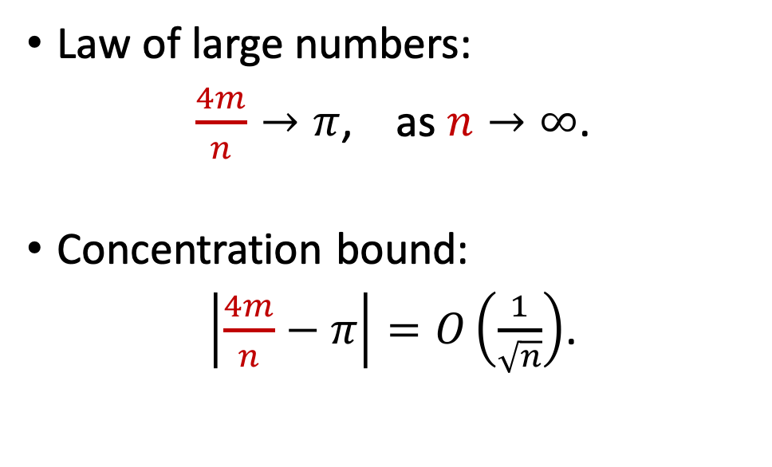
Calculating Pi
Suppose $n$ points are uniformly sampled from $\left[−1, 1\right]×\left[−1, 1\right]$.
Then, in expectation, $Pn=\frac{πn}{4}$ points are in the circle.
$$y$$
$$1$$
Law of large numbers:
$\frac{4m}{n}→π$, as $n→∞$.
Concentration bound:
$\left|\frac{4m}{n}−π\right|=O\left(\frac{1}{\sqrt{n}}\right)$.
$$−1$$
$$x$$
$$1$$
$$−1$$
Notes:
We can actually use concentration inequalities to bound the approximation error.
=======================
The approximation error is inversely proportional to square root n.
----
This means as n grows, the Monte Carlo estimate becomes more accurate.
But such a convergence rate is slow.
If n is 100 times larger, the error is only 10 times smaller.
----
In the next lecture, we will use a concentration inequality to analyze Monte Carlo.
其实还能进一步用“概率不等式”证明 估计值与真实pi 之间的 误差的上界。
用Bernstein概率不等式可以证明
=======================
误差的上界反比于 根号n。
----
这说明 样本数量 n 越大，蒙特卡洛近似就会越准确。
但是这个收敛率并不快。
样本多一万倍，精度才能提高100倍。

Slide 12
Calculating Pi
$n$ points are sampled from the square; $m$ are in the circle. Then $π≈\frac{4m}{n}$.
$$y$$
$$1$$
$$−1$$
$$x$$
$$1$$
$$−1$$
Notes:
This is our conclusion.
A total of $n$ points are sampled from the square.
We observe m points in the circle.
We approximate π by $\frac{4m}{n}$.
------
Note that the sampling must be uniform.
You need to make sure that everywhere in the blue square has the same probability.
If the sampling is not uniform, then the equation cannot be applied.
这是我们的结论：
从正方形中均匀抽样n个点，观测到其中有m个点落在圆里面。
可以把pi 近似为$\frac{4m}{n}$.
----
注意一下，抽样必须是均匀的，要保证点落在所有位置的概率相同。
否则 $π≈\frac{4m}{n}$ 这个公式就不成立。

Slide 13

Calculating Pi
$n$ points are sampled from the square; $m$ are in the circle. Then $π≈\frac{4m}{n}$.
$$y$$
Algorithm
$$1$$
User specifies a big $n$; reset counter $m=0$.
$$−1$$
$$x$$
$$1$$
$$−1$$
Notes:
With the equation, we are ready to write a computer program for estimating pi.
I am going to show the pseudo-code.
============================
Firstly, the user needs to specify the number n.
Big n can make the accuracy high, but big n means heavy computation.
It’s a trade-off.
----
M is used for counting.
Initialize m to be zero.
有了计算pi的公式，我们就可以编程计算pi。
下面我来解释一下伪代码。
============================
第一步要用户自己定一个 样本数量n。
N越大，计算量越大，计算出来的pi越准确。
把m初始化零，用来做计数。

Slide 14
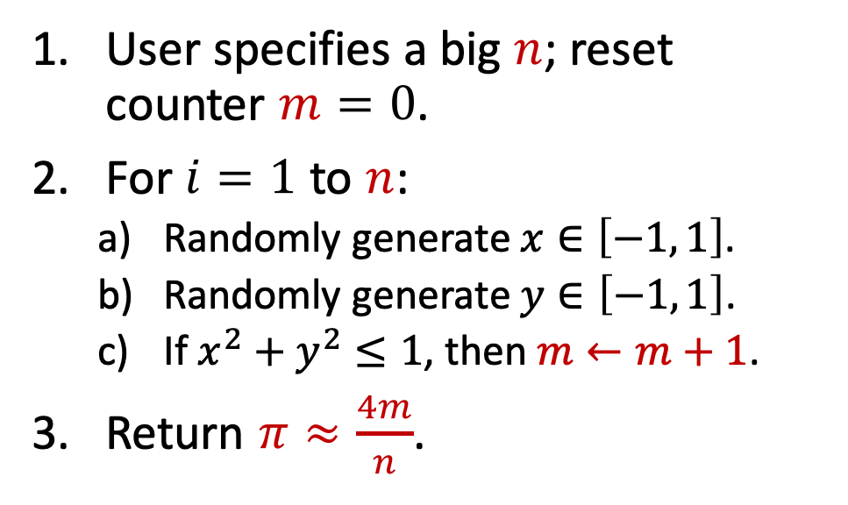
Calculating Pi
$n$ points are sampled from the square; $m$ are in the circle. Then $π≈\frac{4m}{n}$.
$$y$$
Algorithm
$$1$$
User specifies a big $n$; reset counter $m=0$.
For $i=1$ to $n$:
Randomly generate $x∈\left[−1, 1\right]$.
Randomly generate $y∈\left[−1, 1\right]$.
If $x^{2}+y^{2}≤1$, then $m←m+1$.
Return $π≈\frac{4m}{n}$.
$$−1$$
$$x$$
$$1$$
$$−1$$
Notes:
Secondly, repeat the random sampling n times.
In each round, sample a point (x, y) uniformly at random.
x and y are both from the interval between -1 and +1.
-----------------------
If the point (x, y) is in the circle, then increment m by 1.
After step 2, we know the number of points inside the circle.
The number is m.
=======================
Finally, return the estimate of π using m and n.
π is approximately 4 m over n.
第二步是把抽样重复n次。
每次从 -1 到 +1的区间里均匀抽样 得到x 和 y两个实数。
然后计算一下$x^{2}+y^{2}$。
如果$x^{2}+y^{2}$ 小于等于 1，说明点落在圆里面，那么就把m的值加一。
重复这个过程n轮之后就停止。
这时的 m 就是落在圆里面的点的数量。
=======================
最后返回 $\frac{4m}{n}$ 作为对 π 的估计。

Slide 15
Application 2: Buffon's Needle Problem
Notes:
Another example is Buffon’s needle problem.
It’s also a Monte Carlo method for calculating Pi.
第二个蒙特卡洛的例子是 “布封投针”，也是一种计算pi的方法。

Slide 16
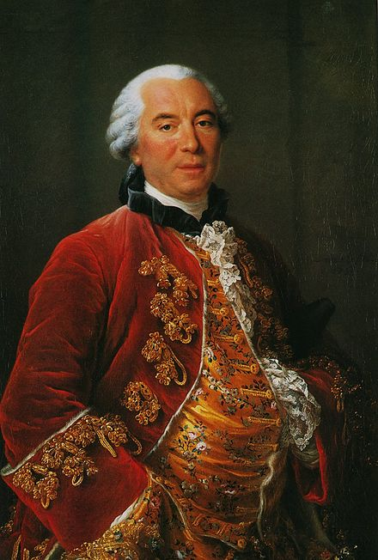
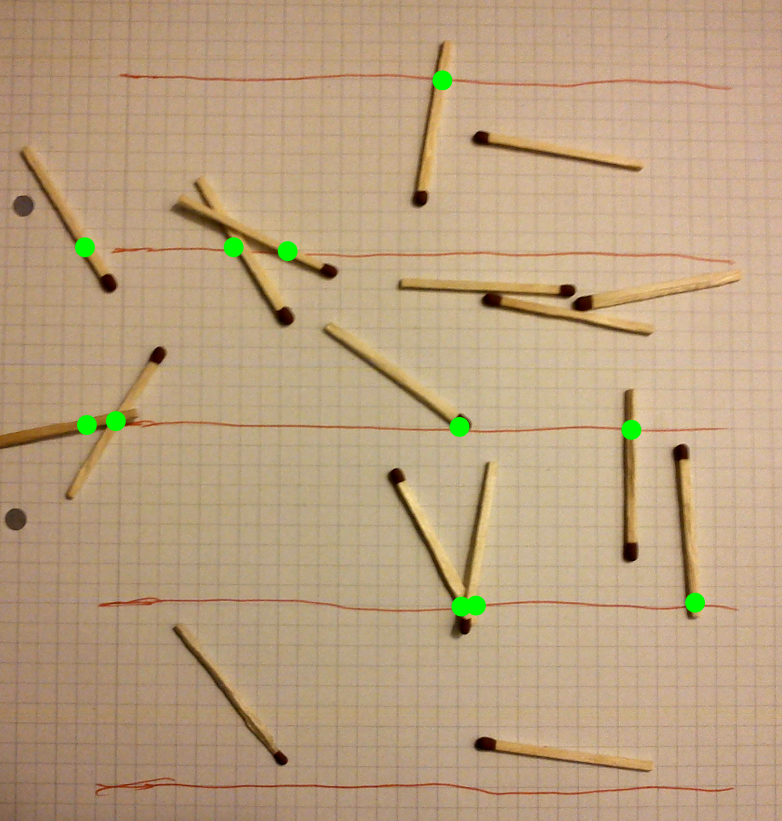
Buffon's Needle Problem
Buffon, 1707 – 1788
French scientist
Buffon's Needle Problem
Notes:
Buffon was born in 1707.
He was born about half a century later than Newton and Leibnitz.
In Buffon’s time, calculus was already popular.
The people in Buffon's time knew integrals.
----------
Buffon’s needle problem is about using Monte Carlo to calculate Pi.
Unlike our previous example, Buffon’s needle problem does not rely on a random number generator.
---------
You can draw parallel lines on paper and then throw needles.
Then, count the number of needles that lie across the parallel lines.
Such an experiment can be performed without using a computer.
布封是法国的博物学家。
布封生于1707年，大约比牛顿和莱布尼茨都小了50岁。
布封时代的人已经会用微积分了。
---------
布封投针 也是用蒙特卡洛来计算pi值。
好处在于不需要用电脑模拟，而是可以真的动手做，毕竟布封的时代没有随机数生成器。
拿一张纸，画出等距的平行线，然后撒一把针或者火柴棍，数一数有多少跟 针 与平行线相交。
通过相交的针的数量就能推算出pi。

Slide 17

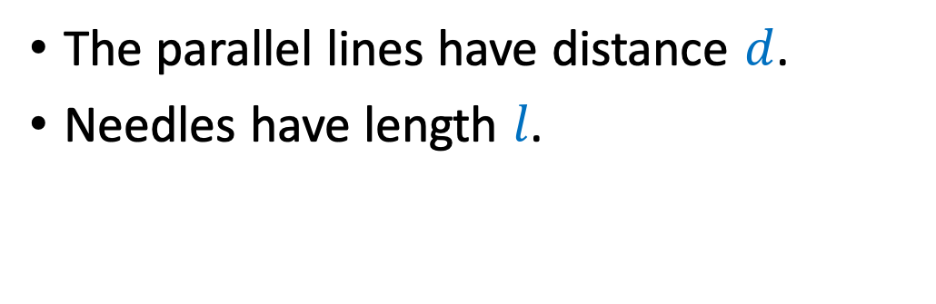
Buffon's Needle Problem
The parallel lines have distance $d$.
Needles have length $l$.
$$d$$
Notes:
To perform the experiment, let’s first drawn many parallel lines.
=====
Two neighboring lines have a distance of d.
=====
Prepare some needles of the same length.
Let the length be l.
想要做投针 实验，先画一些平行线。
=====
两条平行线之间的距离等于d。
=====
准备一些等长的针，长度全都是 L。

Slide 18

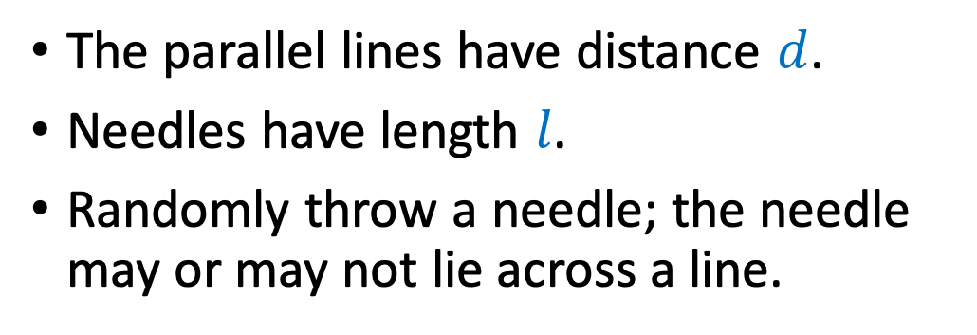
Buffon's Needle Problem
The parallel lines have distance $d$.
Needles have length $l$.
Randomly throw a needle; the needle may or may not lie across a line.
$$l$$
needle
$$d$$
Notes:
Randomly throw a needle on the paper.
=====
The needle has a length of l.
The needle may or may not lie across a line.
随机把针抛到纸上。
=====
针的长度是l。
针可能与平行线相交，也可能不相交。

Slide 19
Buffon's Needle Problem
The parallel lines have distance $d$.
Needles have length $l$.
Randomly throw a needle; the needle may or may not lie across a line.
$$l$$
needle
$$d$$
needle
Notes:
This needle lies across a line.
=====
Throw another needle.
This one does not lie across a line.
这根针与平行线相交了。
=====
再扔一根针，可能不相交。

Slide 20

Buffon's Needle Problem
The parallel lines have distance $d$.
Needles have length $l$.
Randomly throw a needle; the needle may or may not lie across a line.
$$l$$
needle
With probability $P=\frac{2l}{πd}$, they are across.
$$d$$
needle
It can be proved using integral.
Notes:
Assume the location and angle of the needles are uniformly distributed.
========================
Then, with probability $P=\frac{2l}{πd}$, a needle lies across a line.
The probability is related to $π$.
That’s why we can use this equation to approximate $π$.
========================
This equation can be proven using integrals.
Recall that calculus was invented by Newton and Leibnitz.
They were half a century older than Buffon.
Calculus was well known in Buffon’s time.
It’s not hard for them to find the probability is $P=\frac{2l}{πd}$.
----
The equation is very intuitive.
Using longer needles, the probability goes up, which means a needle is more likely to lie across a line.
If the distance between the lines increases, then it’s less likely for a needle to lie across a line, so the probability will go down.
假设针的位置和角度都是均匀随机的。
那么针与纸有一定概率相交。
========================
通过微积分可以算出 相交概率P等于$\frac{2l}{πd}$。
这个概率跟$π$有关，所以这个公式可以用来估算$π$。
========================
这个公式可以用积分给推导出来。
微积分是牛顿和莱布尼茨发明的。
我前面强调 布封 比 牛顿和莱布尼茨 小50岁，就是为了说明布封时代已经有了微积分，他们有能力算出这个公式。
----
这个公式有很直观的含义。
用更长的针，就越容易相交，相交的概率就会变大。
用更短的针，相交概率就会减小。
所以呢，针的长度L在分子上。
---
如果平行线之间的距离越远，就越不容易相交。
反之，平行线距离越近，就越容易相交。
所以距离D在分母上。

Slide 21
Buffon's Needle Problem
$$l$$
needle
With probability $P=\frac{2l}{πd}$, they are across.
$$d$$
needle
Notes:
We know the probability is $P=\frac{2l}{πd}$.
Now, let’s use this equation for calculating pi.
我们知道针与平行线相交的概率是$P=\frac{2l}{πd}$。
接下来用这个公式来近似求pi。

Slide 22


Buffon's Needle Problem
With probability $P=\frac{2l}{πd}$, they are across.
$$l$$
Randomly throw a total of $n$ needles.
In expectation, $Pn=\frac{2ln}{πd}$ needles lie across the lines.
needle
$$d$$
needle
Notes:
We can randomly throw a needle onto the paper, and repeat this process n times.
===============
Each needle lies across a line with probability P.
The experiment is repeated n times,
===============
so in expectation, Pn needles lie across the lines.
Using the probability P we derived,
===============
we have $Pn=\frac{2ln}{πd}$.
This is the expectation.
随机往纸上扔n根针。
=======
每根针 与平行线相交的概率都是P，所以 期望有 P 乘以 n 根针与平行线相交。
当然，这只是期望，与真实观测可能不一样。

Slide 23
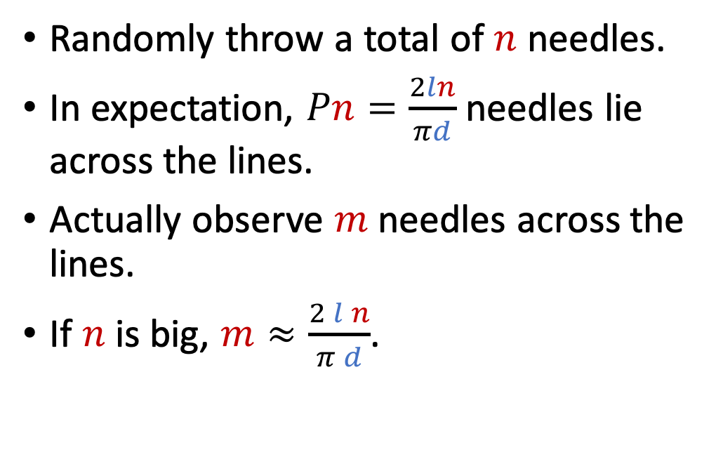
Buffon's Needle Problem
With probability $P=\frac{2l}{πd}$, they are across.
$$l$$
Randomly throw a total of $n$ needles.
In expectation, $Pn=\frac{2ln}{πd}$ needles lie across the lines.
Actually observe $m$ needles across the lines.
If $n$ is big, $m≈\frac{2 l n}{π d}$.
needle
$$d$$
needle
Notes:
Suppose we observe m needles across the lines.
======
If n is big, then the actual observation m should be close to the expectation.
======
The expectation is the right side of the equation.
We use this equation for estimating pi.
------
Let’s move m to the denominator and Pi to the numerator.
扔完针之后自己去数一下，发现一共有m跟针与平行线相交。
========
如果n足够大，那么真实观测值m 就会很接近期望值$\frac{2 l n}{π d}$。
可以拿这个公式来近似pi。

Slide 24
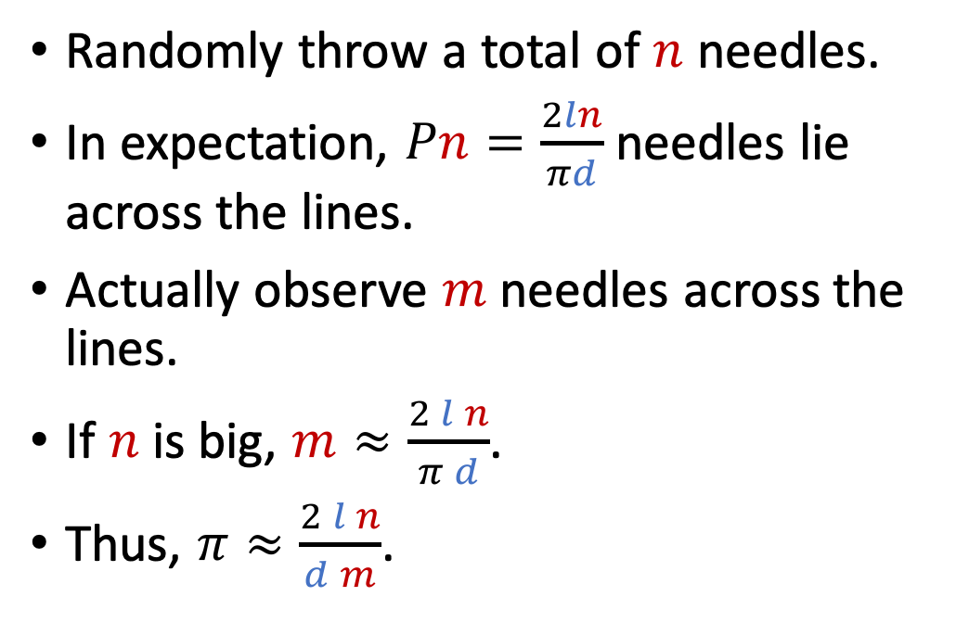
Buffon's Needle Problem
With probability $P=\frac{2l}{πd}$, they are across.
$$l$$
Randomly throw a total of $n$ needles.
In expectation, $Pn=\frac{2ln}{πd}$ needles lie across the lines.
Actually observe $m$ needles across the lines.
If $n$ is big, $m≈\frac{2 l n}{π d}$.
Thus, $π≈\frac{2 l n}{d m}$.
needle
$$d$$
needle
Notes:
Then, we obtain this equation.
𝜋 is approximately $\frac{2 l n}{d m}$.
Using m and n, we obtain an estimate of Pi.
把公式变换一下，把pi从分母 移到等式左边，得到这个求pi公式：$π≈\frac{2 l n}{d m}$。
我们知道距离d、针的长度 l、观测值 m、以及针的总数n。
所以，我们可以估算出Pi值。

Slide 25
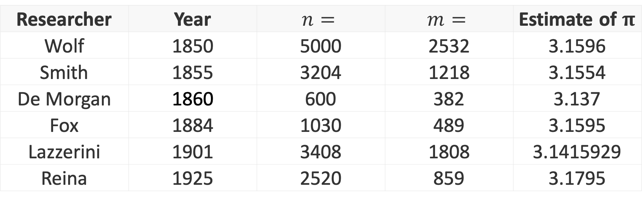
Buffon's Needle Problem
Researcher | Year | $$n=$$ | $$m=$$ | Estimate of $π$
Wolf | 1850 | 5000 | 2532 | 3.1596
Smith | 1855 | 3204 | 1218 | 3.1554
De Morgan | 1860 | 600 | 382 | 3.137
Fox | 1884 | 1030 | 489 | 3.1595
Lazzerini | 1901 | 3408 | 1808 | 3.1415929
Reina | 1925 | 2520 | 859 | 3.1795
Notes:
Many people have conducted experiments.
They have thrown hundreds or even thousands of needles.
Their estimates of π are not far from 3.14.
-----
I guess they were rich people.
They don’t need to work, so they have time to throw thousands of needles to verify a known result.
If they were even richer, they could hire more people to throw needles, maybe for a million times.
Then the estimate will be more accurate.
======================
Among them, this guy’s result is too good to believe.
People don’t trust his result.
Concentration inequalities show that the convergence rate is square root n.
It means if n becomes one million times larger, then the error is one thousand times smaller.
He repeated the experiment only 34 hundred times.
======================
Even if he repeated the experiment a billion times, the precision could not be that high.
历史上真的有很多闲的蛋疼的人，不用去工作，成天在家里投针。
这些人做了好几千次试验，然后用实验结果计算pi，得到这些数值。
他们发现算出来的结果真的很接近pi。
======================
这个人的结果是3.1415929，过于接近 Pi，大家不信他的结果。
现在有概率不等式，我们知道精度反比于根号n。
----
重复实验 n 等于 3408次，那么根号n等于不到60。
根号n分之一的精度，顶多也就是小数点后一两位的精度，不可能像他那样到小数点后6位。
就算重复实验一亿次也达不到他这么高的精度。
-----
这告诉我们学好概率不等式非常有用。
如果你姿势水平很高，会用概率不等式，那么你造假也可以按照基本法来，不会被识破。

Slide 26
Buffon's Needle Problem
Notes:
You can write a Python program to simulate the experiment.
-----
You can sample a point uniformly at random.
The needle’s head is at the random point.
Then, randomly sample a number between 0 and 360.
The random number is the needle’s angle.
Using the point and angle, the needle is uniquely determined.
-----
The figure is the outcome of a simulation.
It shows the convergence with the number of simulations.
你可以自己写个Python程序来模拟布封投针。
----
你从平面坐标系上均匀采样一个点作为针头的位置。
再从0到360度均匀采样一个角度。
这样就可以确定针的位置。
----
然后判断 针是否与平行线相交，从而得到相交的数量m，计算出pi。
----
这是别人模拟出来的结果。
只需要 一百多次，就能得到pi约等于3.

Slide 27
Application 3: Area of A Region
Notes:
The third application is to calculate the area of a region.
下一个应用是估计阴影部分的面积。

Slide 28
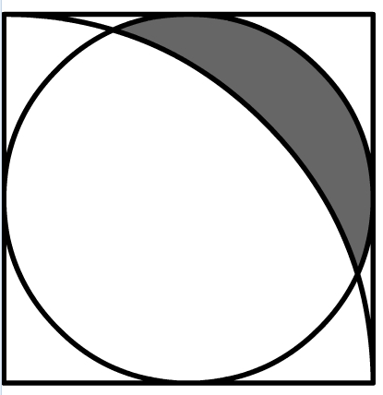






What is the area of the grey region?
$$y$$
$$2$$
$$1$$
$$x$$
$$1$$
$$2$$
Notes:
You may have seen this high-school math problem.
===========
There is a square,
===========
a circle,
===========
and a sector.
You are asked to calculate the area of the grey region.
---
I don’t know how to directly calculate the area without using calculus.
But I can approximately find the area using Monte Carlo.
你初中时候可能见过类似数学题。
图里有个正方形，有个圆，有个扇形。
几个形状相交。
要求计算阴影部分面积。
----
我不知道怎么样直接计算阴影部分面积，但是我会用蒙特卡洛近似计算。

Slide 29
What is the area of the grey region?
$$y$$
$$2$$
$$1$$
$$x$$
$$1$$
$$2$$
Notes:
Monte Carlo is based on random sampling.
We sample points uniformly at random from the square.
=============================
A point in the square can be inside or outside the circle.
We can use the circle’s equation to find whether a point is inside or outside.
在正方形里面做随机均匀抽样，得到很多点。
=============================
一个点$\left(x, y\right)$ 可能在绿色圆里面，也可能在圆外面。
通过圆的方程可以判断出来。

Slide 30


What is the area of the grey region?
$$y$$
If a point $\left(x, y\right)$ is in the circle, it must satisfy
${\left(x−1\right)}^{2}+{\left(y−1\right)}^{2}≤1$.
$$2$$
$$1$$
$$r=1$$
$$x$$
$$1$$
$$2$$
Notes:
The circle is centered at the point (1, 1),
=============================
and its radius is 1.
=============================
So the equation of the circle is this one: ${\left(x−1\right)}^{2}+{\left(y−1\right)}^{2}≤1$.
If a point is in the circle, it must satisfy this equation.
Using the equation, we can tell if a point is in the circle.
圆心的坐标是(1, 1)，
=============================
半径是1。
=============================
所以这个圆的方程是：${\left(x−1\right)}^{2}+{\left(y−1\right)}^{2}≤1$。
----
如果一个点(x, y)在这个绿色的圆里面，那么这个点需要满足这个方程。
通过这个方程就能筛选出圆中的点。

Slide 31
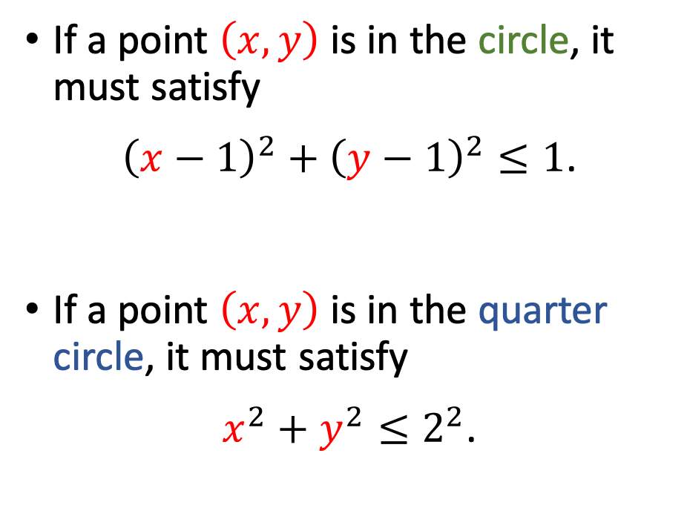
What is the area of the grey region?
$$y$$
If a point $\left(x, y\right)$ is in the circle, it must satisfy
${\left(x−1\right)}^{2}+{\left(y−1\right)}^{2}≤1$.
If a point $\left(x, y\right)$ is in the quarter circle, it must satisfy
$x^{2}+y^{2}≤2^{2}$.
$$2$$
$$1$$
$$x$$
$$1$$
$$2$$
Notes:
Note that if a point is in the grey region, it must be outside the blue sector.
All points in the sector must satisfy
=================
this equation: $x^{2}+y^{2}≤2^{2}$.
It is the circle centered at the origin and with a radius of 2.
我们还需要排除蓝色扇形里的点。
扇形里的点
=================
满足这个方程：$x^{2}+y^{2}≤2^{2}$。
这其实是个圆的方程；圆心在原点，半径是2。

Slide 32
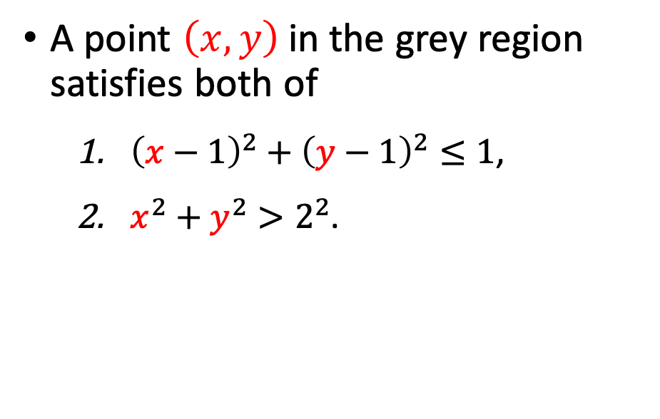
What is the area of the grey region?
$$y$$
$$2$$
A point $\left(x, y\right)$ in the grey region satisfies both of
${\left(x−1\right)}^{2}+{\left(y−1\right)}^{2}≤1$,
$x^{2}+y^{2}>2^{2}$.
$$1$$
$$x$$
$$1$$
$$2$$
Notes:
A point $\left(x, y\right)$ in the shadow must satisfy the two conditions.
=======================
First, it must be inside the circle.
(x, y) satisfies that ${\left(x−1\right)}^{2}+{\left(y−1\right)}^{2}≤1$.
阴影部分中的点必须满足两个条件。
第一，必须在这个半径等于1的圆形里面，
所以要满足方程${\left(x−1\right)}^{2}+{\left(y−1\right)}^{2}≤1$。

Slide 33
What is the area of the grey region?
$$y$$
$$2$$
A point $\left(x, y\right)$ in the grey region satisfies both of
${\left(x−1\right)}^{2}+{\left(y−1\right)}^{2}≤1$,
$x^{2}+y^{2}>2^{2}$.
$$1$$
$$x$$
$$1$$
$$2$$
Notes:
Second, the point must be outside the quarter circle.
Thus (x, y) satisfies that $x^{2}+y^{2}>2^{2}$.
----
All points satisfying the two conditions are in the grey region.
第二，不能在扇形里。
所以要满足方程$x^{2}+y^{2}>2^{2}$。
-----
阴影部分 由 同时满足两个方程的点 组成。

Slide 34

What is the area of the grey region?
$$y$$
$$2$$
Area of the square: $A_{1}=2^{2}=4$.
$$1$$
$$x$$
$$1$$
$$2$$
Notes:
We sample points from the square uniformly at random.
Everywhere in the square is sampled with the same probability.
Let’s calculate the probability.
=====================
The sides of the square have lengths of 2.
=====================
So the area of the square is $A_{1}=2^{2}=4$.
我们从正方形区域内 随机均匀抽样，得到的点有一定概率会落在阴影部分。
我们来计算这个概率。
=====================
这个边长等于2的正方形面积是$A_{1}=2^{2}=4$。
=====================
设阴影部分面积为$A_{2}$。

Slide 35
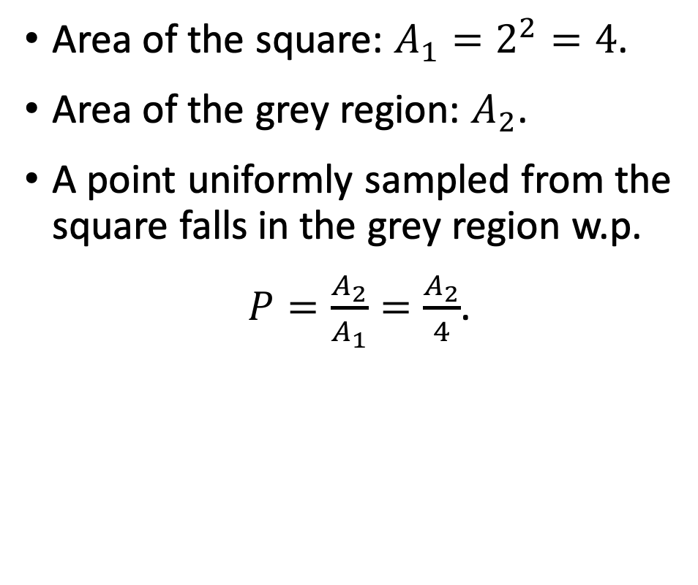
What is the area of the grey region?
$$y$$
$$2$$
Area of the square: $A_{1}=2^{2}=4$.
Area of the grey region: $A_{2}$.
A point uniformly sampled from the square falls in the grey region w.p.
$P=\frac{A_{2}}{A_{1}}=\frac{A_{2}}{4}$.
$$1$$
$$x$$
$$1$$
$$2$$
Notes:
Denote the area of the grey region by $A_{2}$.
$A_{2}$ is what we seek to find.
=====================
A point uniformly sampled from the square falls inside the grey region
=====================
w.p. $P=\frac{A_{2}}{A_{1}}=\frac{A_{2}}{4}$.
设阴影部分面积为$A_{2}$。
=====================
随机均匀抽样得到的点 落在阴影区域的
=====================
概率是$P=\frac{A_{2}}{A_{1}}=\frac{A_{2}}{4}$。

Slide 36

What is the area of the grey region?
$$y$$
Uniformly sample $n$ points from the square $\left[0, 2\right]×\left[0, 2\right]$.
In expectation, $nP=\frac{n A_{2}}{4}$ points fall in the grey region.
$$2$$
$$1$$
$$x$$
$$1$$
$$2$$
Notes:
Let’s uniformly sample n points from the square.
The number n is up to the user.
A big n is good for accuracy but bad for computation.
========
There are a total of n randomly sampled points.
Every point falls in the grey region with probability P.
========
Thus, In expectation, nP points fall in the grey region.
The probability P is equal to $\frac{ A_{2}}{4}$.
========
So nP is equal to $\frac{n A_{2}}{4}$.
It is the expected number of points in the grey region.
我们从这个正方形里随机抽n个点。
N越大越好，n越大 则 估计越准确。
=========
一共有n个点，每个点落在阴影部分的概率是P，所以期望一共有nP个点落在阴影区域。
$nP$ 等于 $\frac{n A_{2}}{4}$。

Slide 37
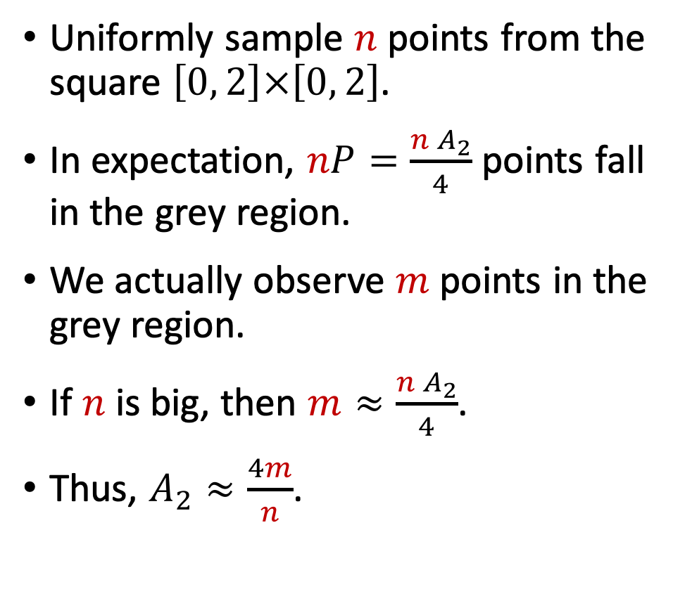
What is the area of the grey region?
$$y$$
Uniformly sample $n$ points from the square $\left[0, 2\right]×\left[0, 2\right]$.
In expectation, $nP=\frac{n A_{2}}{4}$ points fall in the grey region.
We actually observe $m$ points in the grey region.
If $n$ is big, then $m≈\frac{n A_{2}}{4}$.
Thus, $A_{2}≈\frac{4m}{n}$.
$$2$$
$$1$$
$$x$$
$$1$$
$$2$$
Notes:
We can write a program to randomly sample points.
We observe m points in the grey region.
=======
If n is big, then m is close to $\frac{n A_{2}}{4}$.
Recall that m is the actual observation, and $\frac{n A_{2}}{4}$ is the expectation.
=======
Equivalently, the area of the grey region, $A_{2}$, is approximately $\frac{4m}{n}$.
We use it as an estimate of the area.
我们可以用前面定义的两个方程来判断点在不在阴影部分。
我们运行程序，发现实际上有m个点落在阴影区域里。
============
如果n很大，那么m应该接近 期望。
前面计算出的期望等于 $\frac{n A_{2}}{4}$。
所以我们得到$m≈\frac{n A_{2}}{4}$。
===========
把等式变换一下，得到$A_{2}≈\frac{4m}{n}$。
这就是对阴影部分面积的估计。

Slide 38

What is the area of the grey region?
$$y$$
Algorithm
$$2$$
User specify a big $n$; reset counter: $m=0$.
For $i=1$ to $n$:
Randomly generate $x∈\left[0, 2\right]$.
Randomly generate $y∈\left[0, 2\right]$.
If both of the following conditions are satisfied, then $m←m+1$:
${\left(x−1\right)}^{2}+{\left(y−1\right)}^{2}≤1$.
$x^{2}+y^{2}>2^{2}$.
Return $area=\frac{4m}{n}$.
$$1$$
$$x$$
$$1$$
$$2$$
Notes:
I am going to explain the pseudo-code.
===========================
Firstly, specify the number n.
Bigger n will make the result more accurate, but it will incur heavier computation.
===========================
m is a counter.
Initially, reset m to zero.
如果你写代码实现，可以这样写代码。
===========================
首先需要设置一个n值。
N越大的话结果就越准确，但是计算量也会变大。
===========================
m 用来计数。
把它初始化为零。

Slide 39
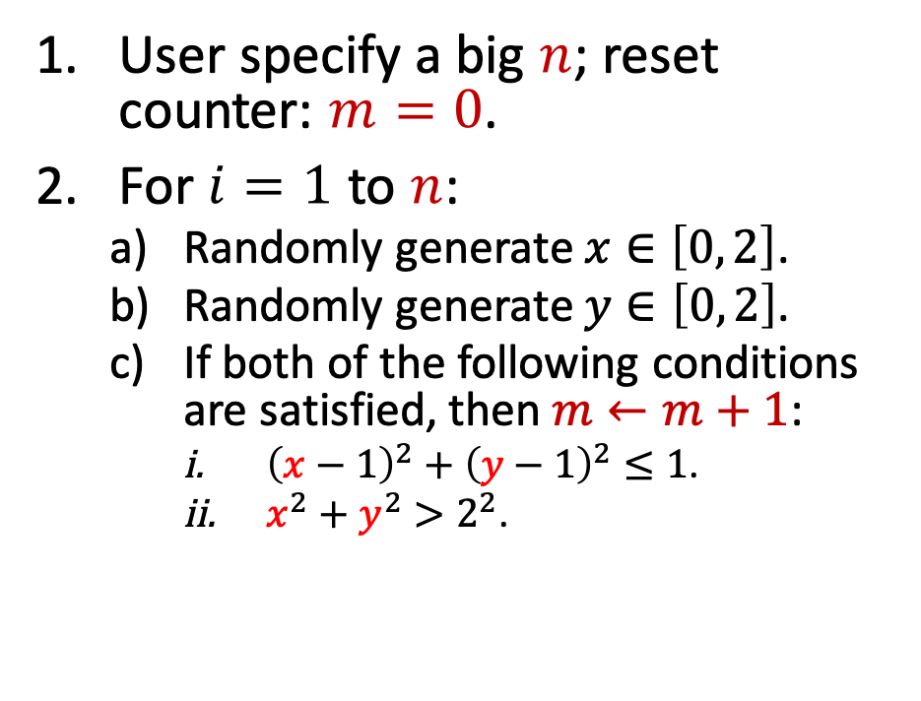
What is the area of the grey region?
$$y$$
Algorithm
$$2$$
User specify a big $n$; reset counter: $m=0$.
For $i=1$ to $n$:
Randomly generate $x∈\left[0, 2\right]$.
Randomly generate $y∈\left[0, 2\right]$.
If both of the following conditions are satisfied, then $m←m+1$:
${\left(x−1\right)}^{2}+{\left(y−1\right)}^{2}≤1$.
$x^{2}+y^{2}>2^{2}$.
Return $area=\frac{4m}{n}$.
$$1$$
$$x$$
$$1$$
$$2$$
Notes:
Secondly, repeat the simulations n times.
====================
Uniformly sample x and y from the interval between 0 and 2.
Equivalently, the point (x, y) is uniformly sampled from the square.
====================
We need to judge if a point is in the grey region.
If a point is in the circle and outside the quarter circle, then it is in the grey region.
====================
If both of the equations are satisfied, we know the point is in the grey region, so we increment m by 1.
然后重复下面的随机模拟。
====================
随机均匀抽样x和y，都在[0, 2]之间。
所以点(x, y)在这个正方形里面。
====================
然后用这两个方程来判断点是否在阴影区域里。
====================
如果点(x, y)同时满足两个方程，那么就认为点在阴影区域，把m的值加一。

Slide 40
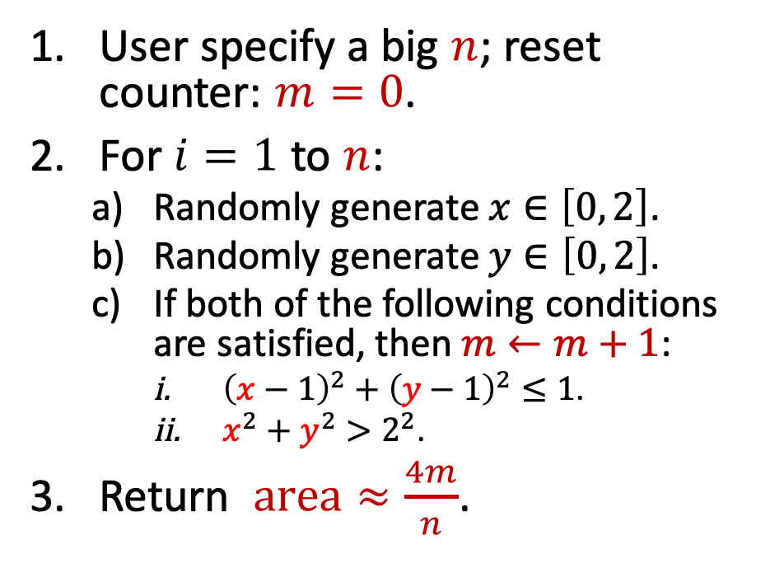
What is the area of the grey region?
$$y$$
Algorithm
$$2$$
User specify a big $n$; reset counter: $m=0$.
For $i=1$ to $n$:
Randomly generate $x∈\left[0, 2\right]$.
Randomly generate $y∈\left[0, 2\right]$.
If both of the following conditions are satisfied, then $m←m+1$:
${\left(x−1\right)}^{2}+{\left(y−1\right)}^{2}≤1$.
$x^{2}+y^{2}>2^{2}$.
Return $area≈\frac{4m}{n}$.
$$1$$
$$x$$
$$1$$
$$2$$
Notes:
Finally, return $\frac{4m}{n}$ as the estimate of the area of the grey region.
把 4m/n 作为估算出的面积，并输出这个值。

Slide 41
Application 4: Integration
Notes:
The 4th application is Monte Carlo Integration.
It has extensive applications in science and engineering.
近似求积分 是 蒙特卡洛最重要的应用之一。
它在科学和工程中有广泛的应用。

Slide 42

Integration
We are given a function, e.g., $f\left(x\right)=\frac{1}{1+\sin\left(x\right)⋅{\left(\log_{e}{x}\right)}^{2}}$.
Calculate the integral: $I=\int_{0.8}^{3}{f\left(x\right) dx}$.
Notes:
Here is an example.
===========================
We are given a sophisticated function like this one.
f(x) is equal to 1 over 1 plus (sin of x) times (log of x) square.
===========================
We are asked to calculate the definite integral.
===========================
It is the integral of function f(x) on the interval from 0.8 to 3.
我举个例子。
===========================
给你函数，比如$f\left(x\right)=\frac{1}{1+\sin\left(x\right)⋅{\left(\log_{e}{x}\right)}^{2}}$。
===========================
让你计算 这个定积分：
===========================
$f\left(x\right)$在区间0.8到3上的定积分，。

Slide 43
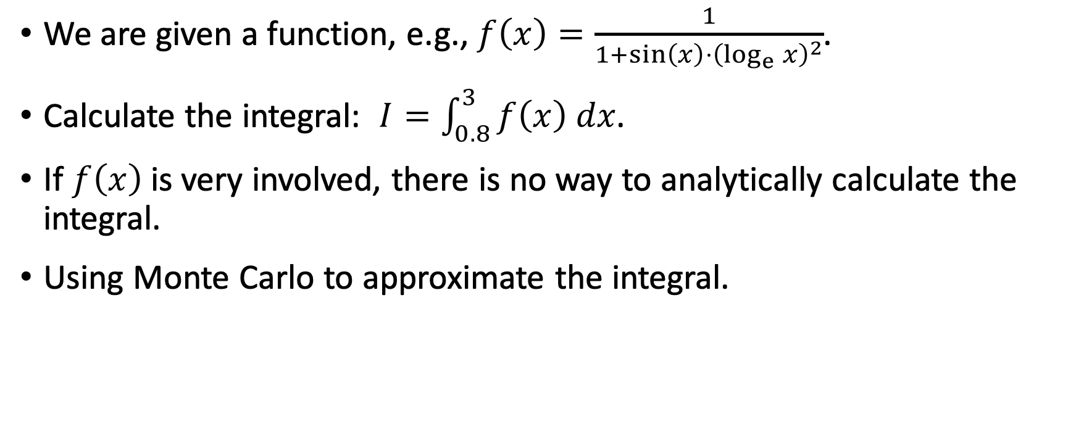
Integration
We are given a function, e.g., $f\left(x\right)=\frac{1}{1+\sin\left(x\right)⋅{\left(\log_{e}{x}\right)}^{2}}$.
Calculate the integral: $I=\int_{0.8}^{3}{f\left(x\right) dx}$.
If $f\left(x\right)$ is very involved, there is no way to analytically calculate the integral.
Using Monte Carlo to approximate the integral.
Notes:
Honestly speaking, I don’t know how to calculate the integral analytically.
I don’t even know whether an analytical solution exists.
=====
Many science and engineering problems require integration.
Oftentimes, the function $f\left(x\right)$ is highly involved.
Sometimes, there is no way to analytically calculate the integral.
So people resort to Monte Carlo for an approximate solution.
反正我是算不出来，这个函数太复杂了。
有可能这个函数的积分 没有解析表达式。
======
有很多科学和工程问题 需要求定积分。
但是 复杂的函数 通常没有解析的积分，所以只能用数值方法求出一个近似值。
蒙特卡洛就是最常用的数值方法。

Slide 44
Monte Carlo Integration (Univariate)
Task: Given a univariate function $f\left(x\right)$, calculate $I=\int_{a}^{b}{f\left(x\right) dx}$.
Notes:
Let’s begin with the easiest problem: Monte Carlo integration for univariate functions.
Univariate function means that the variable x is a scalar.
Given a univariate function f(x),
====================
we are asked to calculate the integral of f(x) on the interval from a to b.
Denote the integral by I.
Monte Carlo integration approximately calculates the integral in 3 steps.
我们先来解决一个比较简单的问题：用蒙特卡洛求 一元函数的定积分。
一元函数 的意思是 变量 x 是个标量 。
给定一元函数 f(x)，
====================
任务是 求函数$f\left(x\right)$ 在a到b区间上的 定积分。
把定积分结果记作 I。
具体这么做。

Slide 45
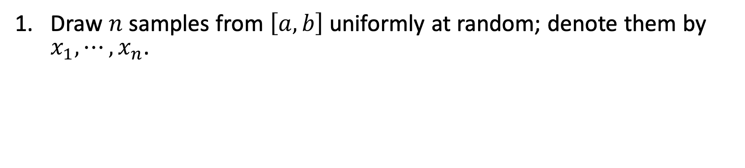
Monte Carlo Integration (Univariate)
Task: Given a univariate function $f\left(x\right)$, calculate $I=\int_{a}^{b}{f\left(x\right) dx}$.
Draw $n$ samples from $\left[a, b\right]$ uniformly at random; denote them by $x_{1}, ⋯, x_{n}$.
Calculate $Q_{n}=\left(b−a\right)⋅\frac{1}{n}\sum_{i=1}^{n}{f\left(x_{i}\right)}$.
Return $Q_{n}$ as an approximation to the integral $I=\int_{a}^{b}{f\left(x\right) dx}$.
Notes:
First, draw n random samples from the interval [a, b] uniformly at random.
=============================
Let the samples be the scalars $x_{1}, ⋯, x_{n}$.
首先做随机均匀抽样，从区间 a 到 b 中抽出n个样本，
=============================
记为$x_{1}, ⋯, x_{n}$。

Slide 46
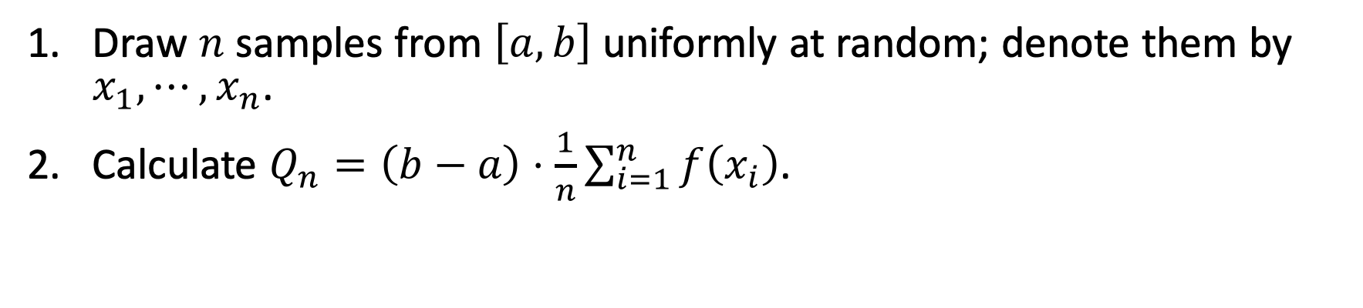
Monte Carlo Integration (Univariate)
Task: Given a univariate function $f\left(x\right)$, calculate $I=\int_{a}^{b}{f\left(x\right) dx}$.
Draw $n$ samples from $\left[a, b\right]$ uniformly at random; denote them by $x_{1}, ⋯, x_{n}$.
Calculate $Q_{n}=\left(b−a\right)⋅\frac{1}{n}\sum_{i=1}^{n}{f\left(x_{i}\right)}$.
Return $Q_{n}$ as an approximation to the integral $I=\int_{a}^{b}{f\left(x\right) dx}$.
Notes:
Second, evaluate the function $f\left(x_{i}\right)$ for all i from 1 to n.
=============================
Take the average of the n function values.
=============================
Scale the result by (b-a).
=============================
denote the outcome by $Q_{n}$.
第二，计算每个样本 $x_{i}$ 的函数值 $f\left(x_{i}\right)$，把这n个函数值求平均，再乘以定积分区间的大小 $\left(b−a\right)$ 。
把得到的结果记为$Q_{n}$。

Slide 47
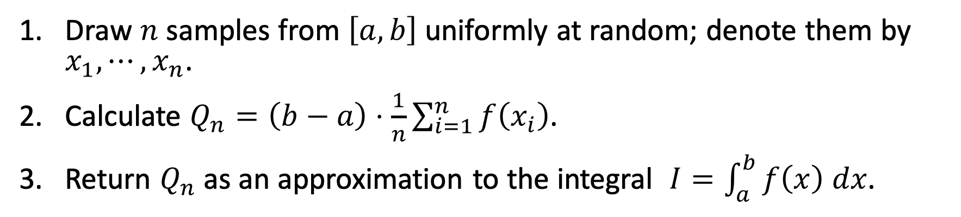
Monte Carlo Integration (Univariate)
Task: Given a univariate function $f\left(x\right)$, calculate $I=\int_{a}^{b}{f\left(x\right) dx}$.
Draw $n$ samples from $\left[a, b\right]$ uniformly at random; denote them by $x_{1}, ⋯, x_{n}$.
Calculate $Q_{n}=\left(b−a\right)⋅\frac{1}{n}\sum_{i=1}^{n}{f\left(x_{i}\right)}$.
Return $Q_{n}$ as an approximation to the integral $I=\int_{a}^{b}{f\left(x\right) dx}$.
Notes:
Finally, return $Q_{n}$ as an approximation to the integral $I$.
函数f 在a到b区间上的 定积分 记做 I。
可以拿 $Q_{n}$ 来近似 I。

Slide 48
Monte Carlo Integration (Univariate)
Task: Given a univariate function $f\left(x\right)$, calculate $I=\int_{a}^{b}{f\left(x\right) dx}$.
Draw $n$ samples from $\left[a, b\right]$ uniformly at random; denote them by $x_{1}, ⋯, x_{n}$.
Calculate $Q_{n}=\left(b−a\right)⋅\frac{1}{n}\sum_{i=1}^{n}{f\left(x_{i}\right)}$.
Return $Q_{n}$ as an approximation to the integral $I=\int_{a}^{b}{f\left(x\right) dx}$.
Theory: Law of large numbers guarantees $Q_{n}→I$, as $n→∞$.
Notes:
The correctness of Monte Carlo integration is guaranteed by the law of large numbers.
=================
As the number of samples, n, grows to infinity,
=================
the estimate $Q_{n}$ is equal to the actual integral $I$.
-----
We can further use concentration inequalities to find the convergence rate.
We can show that the difference between $Q_{n}$ and $I$ is inversely proportional to square root n.
大数定率 可以保证 蒙特卡洛的正确性。
=================
当样本数量 n 趋于无穷的时候，
=================
蒙特卡洛的结果 $Q_{n}$ 等于 定积分的值 $I$。
------
其实还可以进一步拿概率不等式来 求出收敛率。
可以证明 误差 反比与 根号N。
N越大，误差越小。

Slide 49
Monte Carlo Integration (Univariate): Example
Task: Given function $f\left(x\right)=\frac{1}{1+\sin\left(x\right)⋅{\left(\log_{e}{x}\right)}^{2}}$, calculate $I=\int_{0.8}^{3}{f\left(x\right) dx}$.
Notes:
Let's study this problem:
=======================
We are given the function $f\left(x\right)$ which is very involved.
=======================
We want to calculate the integral of $f\left(x\right)$ on the interval from 0.8 to 3.
It is very hard to do the calculation analytically.
Perhaps an analytical solution does not even exist.
A feasible approach is Monte Carlo integration.
来看一个具体的例子。
=======================
给定函数 f(x)。
这个函数很复杂，
=======================
我们想要求$f\left(x\right)$ 在区间 0.8到3上的定积分。
直接求定积分很困难，我不会求这个定积分。
有可能这个积分根本没有解析解。
于是我用蒙特卡洛近似。

Slide 50
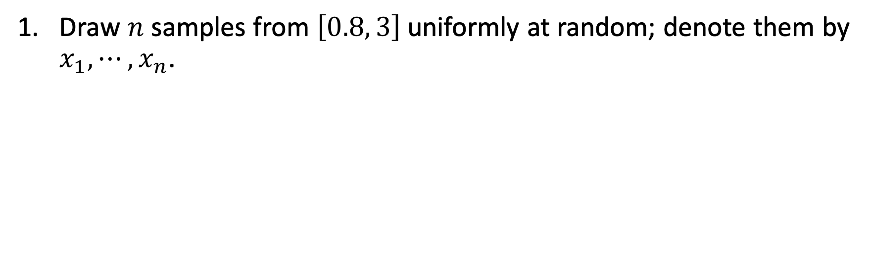
Monte Carlo Integration (Univariate): Example
Task: Given function $f\left(x\right)=\frac{1}{1+\sin\left(x\right)⋅{\left(\log_{e}{x}\right)}^{2}}$, calculate $I=\int_{0.8}^{3}{f\left(x\right) dx}$.
Draw $n$ samples from $\left[0.8, 3\right]$ uniformly at random; denote them by $x_{1}, ⋯, x_{n}$.
Notes:
First, draw n random samples from the interval between 0.8 and 3.
============================
Denote the samples by $x_{1}, ⋯, x_{n}$.
第一步是做随机抽样，在 0.8 到 3这个区间上随机均匀抽样，得到 n 个样本，
============================
记做 $x_{1}, ⋯, x_{n}$。
常用的编程语言 都有 随机数生成器，全都支持这种均匀抽样。

Slide 51
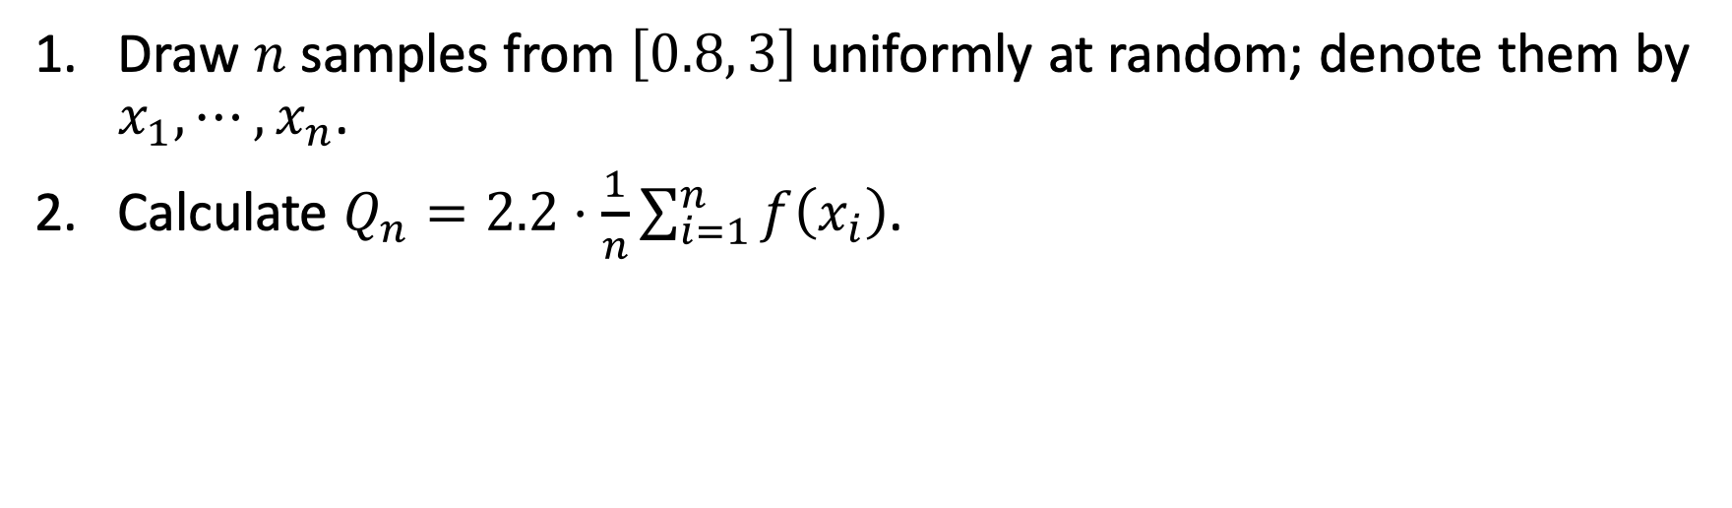
Monte Carlo Integration (Univariate): Example
Task: Given function $f\left(x\right)=\frac{1}{1+\sin\left(x\right)⋅{\left(\log_{e}{x}\right)}^{2}}$, calculate $I=\int_{0.8}^{3}{f\left(x\right) dx}$.
Draw $n$ samples from $\left[0.8, 3\right]$ uniformly at random; denote them by $x_{1}, ⋯, x_{n}$.
Calculate $Q_{n}=2.2⋅\frac{1}{n}\sum_{i=1}^{n}{f\left(x_{i}\right)}$.
Notes:
Second, evaluate the function values for all $x_{i}$.
============================
Average the n function values,
============================
and scale it by 2.2.
Here, 2.2 is the size of the interval between 0.8 and 3.
第二步是计算每个$x_{i}$的函数值$f\left(x_{i}\right)$，
============================
求平均，
============================
再乘以 2.2。
2.2这个数是区间 0.8到3的大小。
把结果记做$Q_{n}$。

Slide 52
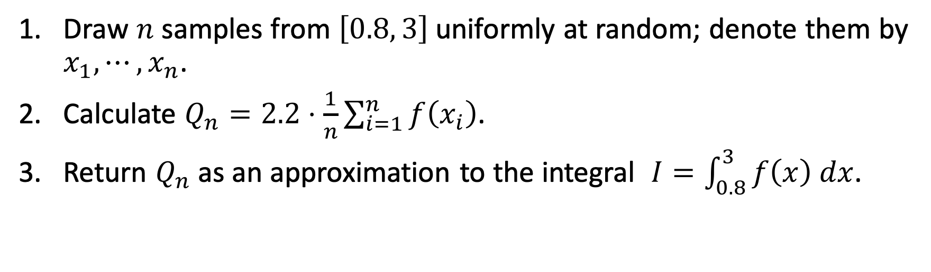
Monte Carlo Integration (Univariate): Example
Task: Given function $f\left(x\right)=\frac{1}{1+\sin\left(x\right)⋅{\left(\log_{e}{x}\right)}^{2}}$, calculate $I=\int_{0.8}^{3}{f\left(x\right) dx}$.
Draw $n$ samples from $\left[0.8, 3\right]$ uniformly at random; denote them by $x_{1}, ⋯, x_{n}$.
Calculate $Q_{n}=2.2⋅\frac{1}{n}\sum_{i=1}^{n}{f\left(x_{i}\right)}$.
Return $Q_{n}$ as an approximation to the integral $I=\int_{0.8}^{3}{f\left(x\right) dx}$.
Notes:
Finally, return $Q_{n}$ as an approximation to the integral.
最后输出$Q_{n}$，作为对定积分的近似。

Slide 53
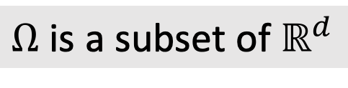

Monte Carlo Integration (Multivariate)
Task: Given a multivariate function $f\left(x\right)$, calculate $I=\int_{Ω}{f\left(x\right) dx}$.
$x∈ℝ^{d}$ is a vector
$Ω$ is a subset of $ℝ^{d}$
Notes:
We have learned Monte Carlo Integration for univariate functions.
Now, let’s do it for multivariate functions.
Multivariate functions are functions of vector variables.
============================
Denote the variable by vector x.
============================
We want to calculate the integral of $f\left(x\right)$ on the set $Ω$.
Analytically calculating the integral of multivariate functions is way harder than the univariate functions.
Oftentimes, an analytical solution does not exist.
Monte Carlo is perhaps the most useful method for computing high-dimensional integrals.
刚才讲了一元函数的蒙特卡洛积分，现在来看多元函数的积分。
函数f是个多元函数，变量是向量x。
要求计算 函数f 在集合 Omega上的定积分。
----
与刚才的一元函数相比，多元函数的定积分 更直接难求，很难找到积分的解析形式。
所以通常用蒙特卡洛来近似计算这个定积分。

Slide 54
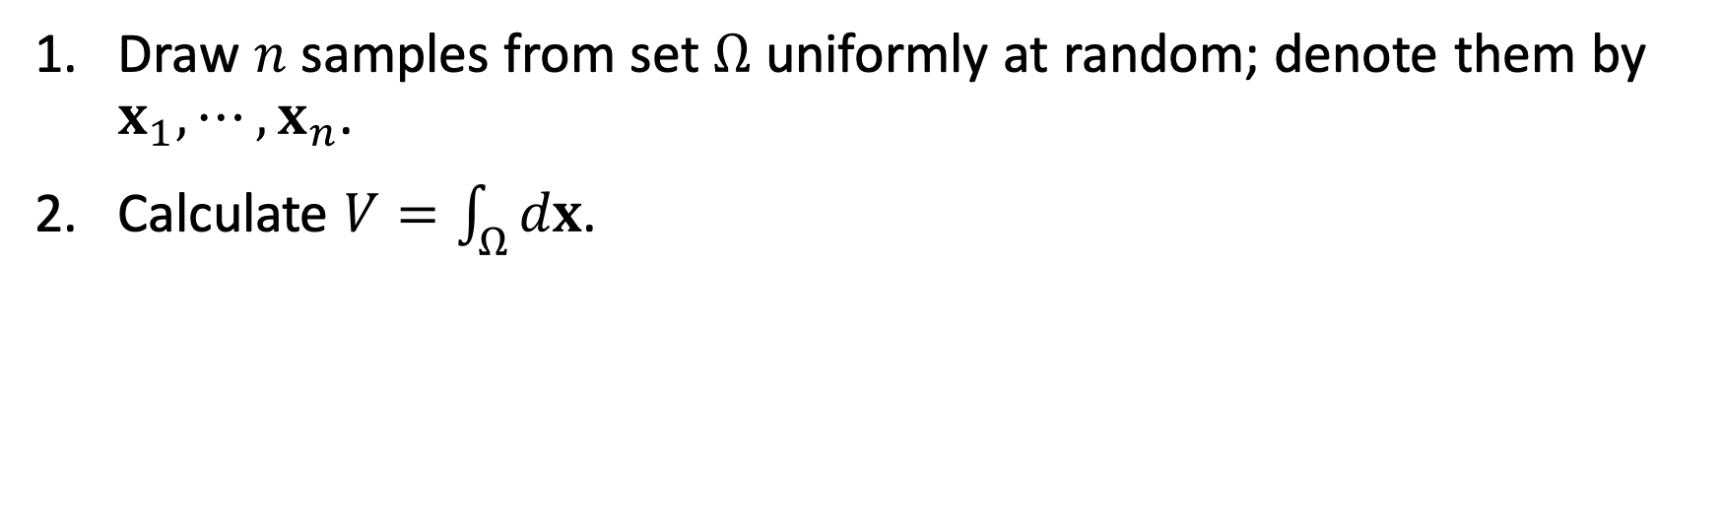
Monte Carlo Integration (Multivariate)
Task: Given a multivariate function $f\left(x\right)$, calculate $I=\int_{Ω}{f\left(x\right) dx}$.
Draw $n$ samples from set $Ω$ uniformly at random; denote them by $x_{1}, ⋯, x_{n}$.
Calculate $V=\int_{Ω}{dx}$.
Notes:
We do Monte Carlo integration in the 4 steps.
Firstly, draw $n$ samples from set $Ω$ uniformly at random.
===========================
Denote them by vectors $x_{1}, ⋯, x_{n}$.
===========================
Secondly, find the volume of set $Ω$; denote the volume by V.
In general, it takes another definite integral for calculating the volume, which is as hard as the original problem.
We must avoid calculating the integral.
We can make the set $Ω$ a simple shape such as cube and ball so that the volume can be easily found.
具体这样做蒙特卡洛积分。
第一步是随机抽样。
从集合Omega中随机均匀抽取n个样本，记做向量 $x_{1}, ⋯, x_{n}$。
===========================
第二步计算Omega集合的体积。
这个定积分中的函数是常数1。
常数1在集合Omega上的定积分就是Omega的体积，记做V。
---
注意，求体积V也需要定积分，这有可能与原问题同样困难。
假如Omega的形状很复杂，我们不知道Omega的体积V，于是就没办法求蒙特卡洛近似。
为了避免求这个定积分，必须让集合Omega是简单的形状，比如长方体、球体等等。
我们可以直接拿公式算出长方体、球体的体积，不用做积分求V。

Slide 55
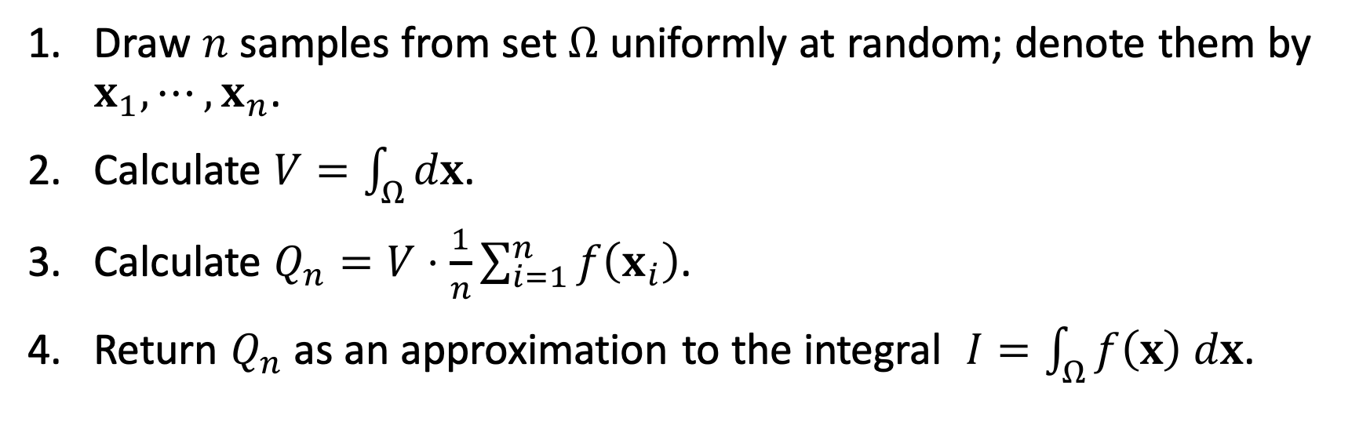
Monte Carlo Integration (Multivariate)
Task: Given a multivariate function $f\left(x\right)$, calculate $I=\int_{Ω}{f\left(x\right) dx}$.
Draw $n$ samples from set $Ω$ uniformly at random; denote them by $x_{1}, ⋯, x_{n}$.
Calculate $V=\int_{Ω}{dx}$.
Calculate $Q_{n}=V⋅\frac{1}{n}\sum_{i=1}^{n}{f\left(x_{i}\right)}$.
Return $Q_{n}$ as an approximation to the integral $I=\int_{Ω}{f\left(x\right) dx}$.
Notes:
Thirdly, evaluate the functions for all $x_{i}$
===========================
and take the average.
===========================
Then, scale the average by the volume, V.
===========================
Denote the outcome by $Q_{n}$.
===========================
Finally, return $Q_{n}$ as an approximation to the integral $I$.
接下来计算每个样本$x_{i}$的函数值$f\left(x_{i}\right)$，然后求所有n个函数值的平均，再乘以集合的体积V。
把计算出的结果记做$Q_{n}$。
===========================
最后拿$Q_{n}$ 作为定积分的近似估计。

Slide 56





Monte Carlo Integration: Bivariate Example
$$y$$
Let $f\left(x,y\right)=\left\{\begin{aligned}1, if x^{2}+y^{2}≤1; \\ 0, otherwise. \end{aligned}\right.$
$$1$$
$$−1$$
$$x$$
$$1$$
$$−1$$
Notes:
I’d like to use this bivariate example to demonstrate Monte Carlo integration.
I will use Monte Carlo integration to derive an algorithm for calculating π.
We have done exactly the same for approximating Pi.
The derived algorithms are the same, but the derivations are different .
==============
Define f as the bivariate function.
It has two variables: x and y.
==============
If the point (x, y) is in the green circle, then the function value is 1.
==============
Otherwise, the function value is zero.
我们来看一个 二元函数 的例子。
这是从另一个角度来解释 蒙特卡洛近似求 pi。
==============
函数f有两个变量：x和y。
==============
如果点(x, y)在这个圆里，那么函数值f就是1.
==============
如果点在圆外面，那么函数值就是0。

Slide 57

Monte Carlo Integration: Bivariate Example
$$y$$
Let $f\left(x,y\right)=\left\{\begin{aligned}1, if x^{2}+y^{2}≤1; \\ 0, otherwise. \end{aligned}\right.$
Let $Ω=\left[−1, 1\right]×\left[−1, 1\right]$.
What is $I=\int_{Ω}{f\left(x,y\right) dx dy}$?
$$1$$
$$−1$$
$$x$$
$$1$$
$$−1$$
Notes:
Define set $Ω$ as the blue square.
We will draw random samples from $Ω$.
The set $Ω$ is up to the user.
The set $Ω$ can be any shape, as long as it contains the green circle.
But we had better make it a simple shape, otherwise we won’t be able to find its area or volume.
==============
Question: What is the integral of $f\left(x,y\right)$ on the set $Ω$?
定义集合Omega为这个蓝色的正方形。
随机样本都是从这个正方形里抽取。
-----
Omega由我们自己定义，它可以是任何形状，只要它包含这个圆形就好。
但是要注意，集合Omega必须是简单形状，否则求不出它的面积或者体积。
==============
思考一下，函数 $f\left(x,y\right)$ 在这个正方形集合上的定积分 是什么？

Slide 58
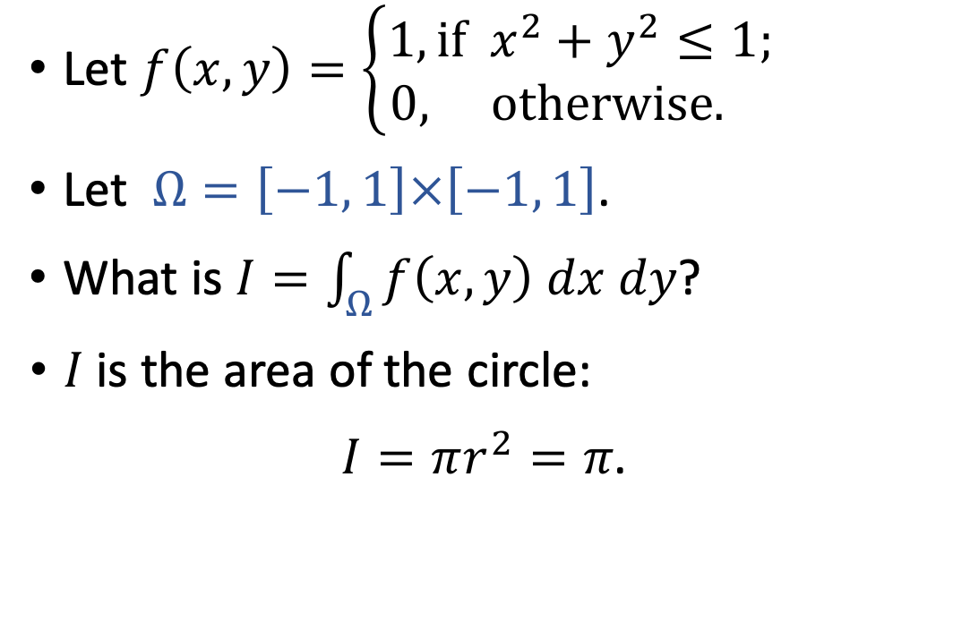
Monte Carlo Integration: Bivariate Example
$$y$$
Let $f\left(x,y\right)=\left\{\begin{aligned}1, if x^{2}+y^{2}≤1; \\ 0, otherwise. \end{aligned}\right.$
Let $Ω=\left[−1, 1\right]×\left[−1, 1\right]$.
What is $I=\int_{Ω}{f\left(x,y\right) dx dy}$?
$I$ is the area of the circle:
$I=πr^{2}=π$.
$$1$$
$$−1$$
$$x$$
$$1$$
$$−1$$
Notes:
Obviously, the integral is the area of the circle.
The area is $πr^{2}$.
The radius r is 1, so the area is equal to $π$.
-----
Monte Carlo can approximate the integral, I.
Since I is equal to π, the result of Monte Carlo integration is an estimate of π.
很显然，定积分就是圆的面积：$I=πr^{2}=π$.
用很基础的微积分就能算出来。
-----
既然我们知道定积分结果等于$π$，我们就可以用蒙特卡洛来近似计算$π$。
拿前面讲的蒙特卡洛方法来近似定积分，得到的结果就是对$π$的近似。

Slide 59

Monte Carlo Integration: Bivariate Example
$$y$$
Draw $n$ samples from set $Ω$ uniformly at random; denote them by
$\left(x_{1},y_{1}\right), ⋯,\left(x_{n}, y_{n}\right)$.
$$1$$
$$−1$$
$$x$$
$$1$$
$$−1$$
Notes:
Now, let’s perform Monte Carlo Integration.
Step 1 is random sampling.
We draw n samples from the set $Ω$ uniformly at random.
===================
Let the samples be $\left(x_{1},y_{1}\right), ⋯,\left(x_{n}, y_{n}\right)$.
现在我们来用蒙特卡洛近似 多元函数的定积分。
第一步是随机抽样，从集合Omega，也就是正方形中 随机抽样n的个点，
===================
记做$\left(x_{1},y_{1}\right), ⋯,\left(x_{n}, y_{n}\right)$。

Slide 60

Monte Carlo Integration: Bivariate Example
$$y$$
Draw $n$ samples from set $Ω$ uniformly at random; denote them by
$\left(x_{1},y_{1}\right), ⋯,\left(x_{n}, y_{n}\right)$.
Calculate $V=\int_{Ω}{dx dy}=4$. (It is the area of set $Ω$.)
$$1$$
$$−1$$
$$x$$
$$1$$
$$−1$$
Notes:
Step 2 is calculating the volume V.
Since the variable is 2-dimensional vector, V is area instead of volume.
The set $Ω$ is the blue square.
Its sides have lengths of 2,
==================
so its area is equal to 4.
第二步是计算集合Omega的面积，记做V。
集合Omega是个正方形，边长是2，
==================
所以面积等于4.

Slide 61
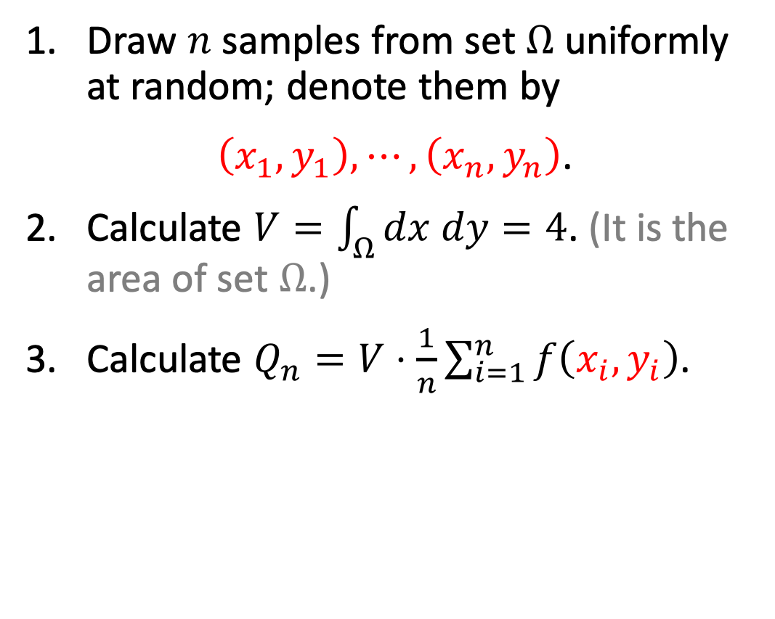
Monte Carlo Integration: Bivariate Example
$$y$$
Draw $n$ samples from set $Ω$ uniformly at random; denote them by
$\left(x_{1},y_{1}\right), ⋯,\left(x_{n}, y_{n}\right)$.
Calculate $V=\int_{Ω}{dx dy}=4$. (It is the area of set $Ω$.)
Calculate $Q_{n}=V⋅\frac{1}{n}\sum_{i=1}^{n}{f\left(x_{i},y_{i}\right)}$.
$$1$$
$$−1$$
$$x$$
$$1$$
$$−1$$
Notes:
Step 3 is to evaluate the function f for all the n points,
===================
take their average,
===================
and then scale it by V.
===================
Denote the outcome by $Q_{n}$.
第三步是求每个样本$\left(x_{i},y_{i}\right)$的函数值$f\left(x_{i},y_{i}\right)$。
===================
对n个函数值求平均，
===================
再乘以面积V，
===================
把结果记做$Q_{n}$。

Slide 62

Monte Carlo Integration: Bivariate Example
$$y$$
Draw $n$ samples from set $Ω$ uniformly at random; denote them by
$\left(x_{1},y_{1}\right), ⋯,\left(x_{n}, y_{n}\right)$.
Calculate $V=\int_{Ω}{dx dy}=4$. (It is the area of set $Ω$.)
Calculate $Q_{n}=V⋅\frac{1}{n}\sum_{i=1}^{n}{f\left(x_{i},y_{i}\right)}$.
Return $Q_{n}$ as an approximation to the integral $π=\int_{Ω}{f\left(x, y\right) dx dy}$.
$$1$$
$$−1$$
$$x$$
$$1$$
$$−1$$
Notes:
Finally, return $Q_{n}$ as an approximation to the integral, I.
====================
We know the integral is equal to $π$, so $Q_{n}$ is an approximation to $π$.
-----
The algorithm here is the same as what we used at the beginning of this class.
But the algorithm derivation is different.
最后拿$Q_{n}$作为定积分的蒙特卡洛近似。
====================
我们知道定积分就等于 pi，所以$Q_{n}$ 是 pi的蒙特卡洛近似。
----------
这节课最开始我们用同样的算法求pi，但是算法是从概率和期望的角度推导的。
现在我们从蒙特卡洛积分的角度推导出同样的算法。

Slide 63
Application 5: Estimate of Expectation
Notes:
The last application is the Monte Carlo Estimate of Expectation.
It is particularly useful for statistics and machine learning.
我要讲的最后一个应用是 用蒙特卡洛来近似期望。
这对统计学和机器学习特别有用。

Slide 64

Expectation
Let $X$ be a $d$-dimensional random vector.
Let $p\left(x\right)$ be a probability density function (PDF).
Notes:
Let uppercase X be a d-dim random variable.
People typically use upper case for random variable and lower case for its observation.
==================
Let $p\left(x\right)$ be a probability density function (PDF).
It describes the probability density at the point x.
定义X是d维的随机变量。
通常把随机变量记做大写字母，把观测值记做小写字母。
==================
函数 $p\left(x\right)$ 是概率密度函数，它描述 变量X 在某个取值点附近的可能性。

Slide 65

Expectation
Let $X$ be a $d$-dimensional random vector.
Let $p\left(x\right)$ be a probability density function (PDF).
Property: $\int_{ℝ^{d}}{p\left(x\right) dx}=1$.
Notes:
It has such a property:
=========================
The integral of $p\left(x\right)$ on the entire space is equal to 1.
它有这样的性质：
=========================
把$p\left(x\right)$ 关于所有可能的x取值 求定积分，结果等于1。

Slide 66

Expectation
Let $X$ be a $d$-dimensional random vector.
Let $p\left(x\right)$ be a probability density function (PDF).
Property: $\int_{ℝ^{d}}{p\left(x\right) dx}=1$.
E.g., PDF of uniform distribution is $p\left(x\right)=\frac{1}{t}$ , for $x∈\left[0, t\right]$.
Notes:
Here are some examples of PDFs.
========================
The PDF of the uniform distribution is $p\left(x\right)=\frac{1}{t}$,
========================
for x on the interval between 0 and t.
Everywhere on the interval from 0 to t has the same density.
举个例子，定义在0到t上 的 均匀分布的 概率密度函数 是常数 t 分之 1。
所有点的概率密度都是相同的，所以叫均匀分布。

Slide 67

Expectation
Let $X$ be a $d$-dimensional random vector.
Let $p\left(x\right)$ be a probability density function (PDF).
Property: $\int_{ℝ^{d}}{p\left(x\right) dx}=1$.
E.g., PDF of uniform distribution is $p\left(x\right)=\frac{1}{t}$ , for $x∈\left[0, t\right]$.
E.g., PDF of univariate Gaussian is $p\left(x\right)=\frac{1}{σ\sqrt{2π}}\exp\left[−\frac{{\left(x−μ\right)}^{2}}{2σ^{2}}\right]$.
Notes:
The PDF of univariate Gaussian distribution is this function.
It is determined by the mean mu and standard deviation sigma.
另一个例子，一元高斯分布的概率密度函数是这样的。
它由均值 mu 和 标准差 sigma 决定。

Slide 68

Expectation
Let $X$ be a $d$-dimensional random vector.
Let $p\left(x\right)$ be a probability density function (PDF).
Let $f\left(x\right)$ be any function of vector variable.
Expectation: $𝔼_{X\sim p}\left[f\left(X\right)\right]=\int_{ℝ^{d}}{f\left(x\right)⋅ p\left(x\right) dx}$.
Notes:
Let $f\left(x\right)$ be any function of a vector variable.
=======
The expectation of $f\left(x\right)$ is defined in this way.
X is treated as a random variable.
Its PDF is function p.
=======
It is equal to the integral of $f\left(x\right)$ by $p\left(x\right)$ on the entire d-dim space.
复习一下函数的期望。
$f\left(x\right)$ 是任意的多元函数，它的变量是 d 维的向量。
=======
函数 $f\left(x\right)$ 的期望是这样定义的。
把X作为随机变量，X的概率密度函数是p(x)。
=======
$f\left(x\right) 乘以 p\left(x\right)$ ，在 整个d维空间上 求定积分，结果就是 函数 $f\left(x\right)$ 的期望。

Slide 69
Monte Carlo Estimate of Expectation
Task: Estimate the expectation $𝔼_{X\sim p}\left[f\left(X\right)\right]=\int_{ℝ^{d}}{f\left(x\right)⋅p\left(x\right) dx}$.
Notes:
Directly and analytically computing the expectation is not easy, especially when x is high-dimensional.
So, in practice, the expectation is approximated using Monte Carlo.
直接求这个定积分不容易，尤其是当 变量 x 是高维向量的时候。
所以通常用蒙特卡洛来 近似求期望。

Slide 70

Monte Carlo Estimate of Expectation
Task: Estimate the expectation $𝔼_{X\sim p}\left[f\left(X\right)\right]=\int_{ℝ^{d}}{f\left(x\right)⋅p\left(x\right) dx}$.
Draw $n$ random samples from the probability distribution $p(x)$; denote them by $x_{1}, ⋯, x_{n}$.
Notes:
Monte Carlo estimate of expectation works in the three steps.
First, random sampling.
Draw $n$ random samples from probability distribution $p(x)$ and
==============================
denote them by vectors $x_{1}, ⋯, x_{n}$.
Note that here we do not perform uniform sampling; instead, the samples are drawn from
==============================
the probability distribution p(x).
For commonly used distributions such as Gaussian distribution, there are existing libraries for programming implementation.
Python and Matlab provide functions for sampling from all the commonly used distributions.
具体是这三步。
首先是做随机抽样。
现在不再是均匀抽样，而是要根据概率密度函数 $p(x)$ 来抽样。
对于高斯分布等常见的概率分布，有现成的 随机抽样函数。
Python和MATLAB都提供 随机抽样函数。
==============================
把刚才抽样得到的 随机样本记做向量$x_{1}, ⋯, x_{n}$。

Slide 71

Monte Carlo Estimate of Expectation
Task: Estimate the expectation $𝔼_{X\sim p}\left[f\left(X\right)\right]=\int_{ℝ^{d}}{f\left(x\right)⋅p\left(x\right) dx}$.
Draw $n$ random samples from the probability distribution $p(x)$; denote them by $x_{1}, ⋯, x_{n}$.
Calculate $Q_{n}=\frac{1}{n}\sum_{i=1}^{n}{f\left(x_{i}\right)}$.
Notes:
The second step is evaluating the function values for all $x_{i}$ and
===================
averaging the function values.
===================
Denote the average by $Q_{n}$.
第二步是计算每个样本$x_{i}$的函数值$f\left(x_{i}\right)$，
===================
然后求所有n个函数值的平均。
===================
把平均值记做$Q_{n}$。

Slide 72

Monte Carlo Estimate of Expectation
Task: Estimate the expectation $𝔼_{X\sim p}\left[f\left(X\right)\right]=\int_{ℝ^{d}}{f\left(x\right)⋅p\left(x\right) dx}$.
Draw $n$ random samples from the probability distribution $p(x)$; denote them by $x_{1}, ⋯, x_{n}$.
Calculate $Q_{n}=\frac{1}{n}\sum_{i=1}^{n}{f\left(x_{i}\right)}$.
Return $Q_{n}$ as an approximation to $𝔼_{X\sim p}\left[f\left(X\right)\right]$.
Notes:
Lastly, return $Q_{n}$ as an approximation to the expectation.
The larger n is, the more accurate the estimate is.
最后是返回 $Q_{n}$，把它作为对期望的估计。
样本数量 n 越大，蒙特卡洛估计越准确。

Slide 73
Monte Carlo and Beyond
Notes:
I have finished the technical content of this lecture.
In the end, I’d like to discuss the name of Monte Carlo and other randomized algorithms.
这节课的主要内容已经讲完了，你应该已经了解 蒙特卡洛 是什么了。
我最后解释一下蒙特卡洛这个名字，以及简单介绍其他的随机算法。

Slide 74

Monte Carlo
The term “Monte Carlo method" was firstly introduced in 1947 by Nicholas Metropolis.
Reference
Metropolis. The beginning of the Monte Carlo method. Los Alamos Science, 125–130, 1987.
Casino de Monte-Carlo, Monaco
Notes:
The name “Monte Carlo” is from the Grand Casino in Monaco /ˈmɒnəkəʊ/.
The casino is one and a half-a-century old.
It’s very famous.
----
The term “Monte Carlo method" was firstly introduced in 1947 by Nicholas Metropolis.
Nicholas Metropolis was one of the greatest statisticians.
If you are familiar with statistics, you must have heard of his name.
蒙特卡洛 这个名字来源于 摩纳哥的蒙特卡洛赌场。
这个赌场已经有一个半世纪的历史，非常有名。
-----
蒙特卡洛算法的名字 是由Nicholas Metropolis起的，首先出现在他1947年的论文里。
Metropolis是统计学大师，对统计学做出很多贡献。
如果你搞统计和机器学习，你肯定听说过 以Metropolis命名的蒙特卡洛算法。

Slide 75
Monte Carlo Algorithms
Monte Carlo refers to algorithms that rely on repeated random sampling to obtain numerical results.
The output of Monte Carlo algorithms can be incorrect.
In all of our examples, the algorithms’ outputs are incorrect.
But they are close to the correct solution.
Notes:
The term “Monte Carlo” refers to algorithms that rely on repeated random sampling to obtain numerical results.
Monte Carlo is a family of randomized numerical algorithms.
=======
The outputs of Monte Carlo algorithms can be incorrect, and they are typically incorrect.
In all of our examples, the algorithms’ outputs are incorrect.
For example, when approximating Pi based on thousands of Monte Carlo samples, the result is around 3.1 and 3.2.
They are never the same as the exact Pi value.
------
Nevertheless, the inexact results are useful, and they are close to the correct solution.
In many statistical and machine learning applications, a low precision estimate is good enough.
------
Monte Carlo is a kind of randomized algorithms and perhaps the most well-known randomized algorithms.
Besides Monte Carlo, there are many other types of randomized algorithms.
蒙特卡洛算法的定义是“algorithms that rely on repeated random sampling to obtain numerical results.”
蒙特卡洛是一种数值算法，靠随机样本来对目标做近似。
=======
蒙特卡洛 算法的 结果通常是错的。
比如对pi的近似，重复几千次也就能得到 3.1左右的精度，得不到精确的pi值。
------
既然蒙特卡洛 的结果通常是错的，为啥蒙特卡洛算法这么重要呢？
虽然结果是错的，但是离真实结果很近。
做统计和机器学习的时候，一个低精度的结果就足够用了，根本不需要精确的结果。
----
比如随机梯度下降就是一种蒙特卡洛算法。
拿随机梯度来近似真实的的梯度，虽然不精确，但是可以大幅减小计算量。
------
蒙特卡洛是一种随机算法。
除了蒙特卡洛，还有很多种随机算法。
研究随机算法的人都喜欢拿赌场来给算法命名。

Slide 76
Monte Carlo Algorithms
Monte Carlo refers to algorithms that rely on repeated random sampling to obtain numerical results.
The output of Monte Carlo algorithms can be incorrect.
Las Vegas algorithms are those always produce the correct answers.
E.g., random quicksort.
Atlantic City algorithms are polynomial-time randomized algorithms that answer correctly w.p. greater than 75%.
Notes:
Las Vegas algorithms are randomized algorithms that always produce the correct answer.
For example, randomized quicksort is a kind of Las Vegas algorithm.
The quicksort algorithm is random, but it always outputs the correct answer.
The randomness does hinder its correctness.
----------------
People love to name randomized algorithms after Casinos.
Monte Carlo and Las Vegas are both famous for gambling.
=======
Atlantic City is also famous for gambling.
Atlantic City algorithms are polynomial-time randomized algorithms that answer correctly w.p. greater than 75%.
If you repeat an Atlantic City algorithm many times, the success probability will approach 100%.
拉斯维加斯算法 指的是 结果总是正确的随机算法。
比如随机快排算法就是一种拉斯维加斯算法。
----
随机快排算法 随机选取 支点，所以有随机性。
但是随机性不影响算法正确性。
快排算法的输出总是正确的。
===========
还有 大西洋城算法，指的是一类 多项式时间复杂度 的随机算法，他们能保证正确率大于75%。
如果你重复这种算法很多次，正确率就可以接近100%。

Slide 77
Question
Notes:
I have finished the lecture.
I will leave two questions for you.

Slide 78








What is the area of the grey region?
$$y$$
$$2$$
$$1$$
$$x$$
$$0$$
$$1$$
$$2$$
Notes:
The first question is to estimate the area of the grey region using Monte Carlo.

Slide 79






What are the areas of the red and blue regions?
$$y$$
$$1$$
$$x$$
$$0$$
$$1$$
$$2$$
Notes:
The second question is to estimate the areas of the red and blue regions, respectively, using Monte Carlo.

Slide 80
Thank you!
Notes:
I have finished this lecture.
Thank you for watching.
The link to slides can be found below the video.
这节课就讲到这里，感谢大家观看。

