Slide 1
Policy-Based Reinforcement Learning
Shusen Wang
Notes:
In this lecture, we study policy-based reinforcement learning.
We will use a neural network for approximating the policy function.
The resulting neural network is called policy network.
It can be used for controlling the agent.
----
To train the policy network, we will use policy gradient algorithm.
这节课我们学习Policy-Based Reinforcement Learning “策略学习”。
我们要用一个神经网络 近似 策略函数；
这个神经网络叫做policy network策略网络。
它可以用来自动控制agent运动。
---------
想要训练这个神经网络 就要用到policy gradient算法。
policy gradient算法是这节课的重点。

Slide 2
Policy Function Approximation
Notes:
Let’s revisit policy function and build a neural network for approximating the policy function.
我们回顾一下policy function 策略函数，
然后看看怎么用神经网络近似策略函数。

Slide 3
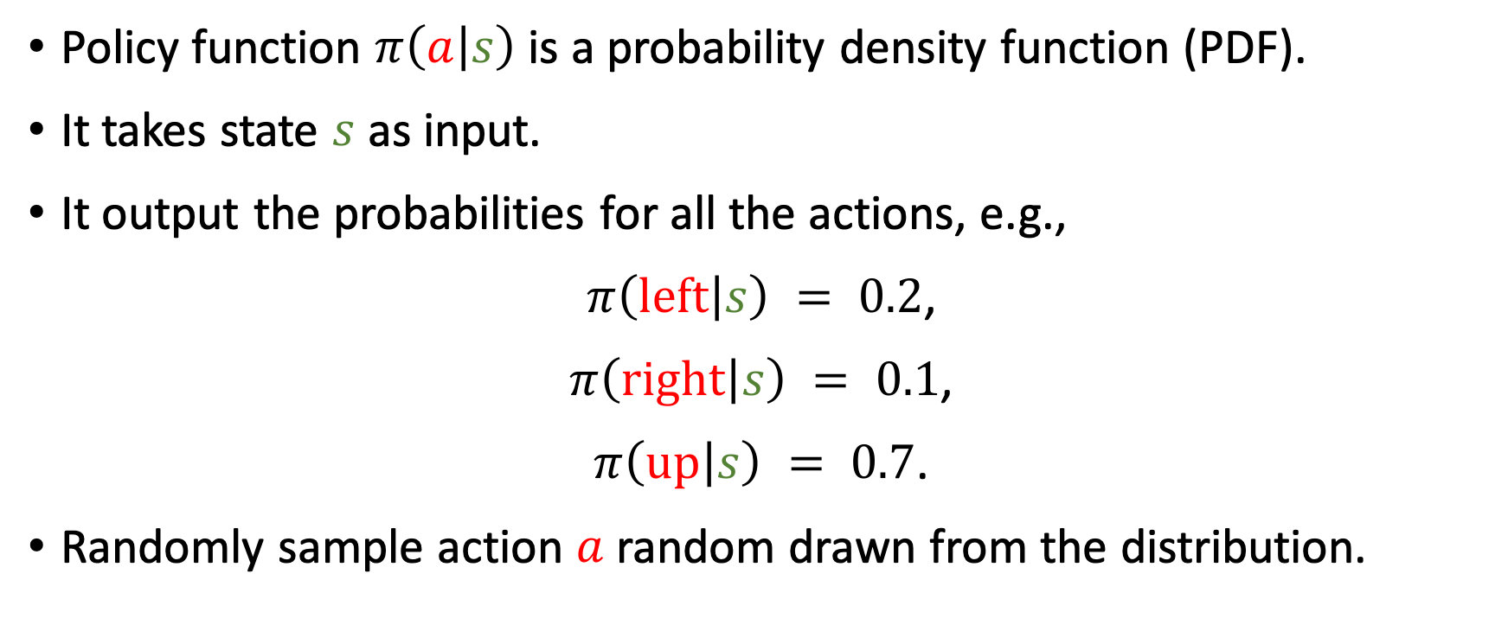
Policy Function $π\left(a | s\right)$
Policy function $π\left(a | s\right)$ is a probability density function (PDF).
It takes state $s$ as input.
It output the probabilities for all the actions, e.g.,
$π\left(left | s\right) = 0.2$,
$π\left(right | s\right) = 0.1$,
$π\left(up | s\right) = 0.7$.
Randomly sample action $a$ random drawn from the distribution.
Notes:
We have learned policy functions.
It is a probability density function.
It can be used for controlling the agent.
======
Its input is the state s.
======
The output is a probability distribution.
It assigns a probability to every action.
In the example of Super Mario, there are 3 different actions: left, right, and up.
The policy function gives each action a probability value.
Action “left” gets 0.2, action “right” gets 0.1, and action “up” gets 0.7.
There are 3 actions, so the output of the policy function are 3 numbers, and they add up to one.
=======
The agent performs action $a$ which is random sampled from the distribution.
All of the three actions can be sampled.
But the action “up” has the highest probability.
前面我们学过策略函数了。
策略函数记做pi (a given s)，它是个概率密度函数，可以用它来自动控制agent运动。
=======
策略函数的输入是当前状态s。
======
（讲慢一点。）
它的输出是一个概率分布，给每一个动作a一个概率值。
举个超级玛丽的栗子。
把当前状态s作为输入，pi函数会输出三个概率值，每个动作对应一个。
比如，向左动作概率是0.2，
向右概率是0.1，
向上概率是0.7。
这个例子里面，pi函数的输入是状态s，输出是个三维向量，每个元素是一个动作的概率。
=======
有了这三个概率值，agent就会做一次随机抽样，得到一个动作a。
左、右、上 这三个动作都有可能被抽到，
但是向上 被抽到的概率最大。
随机抽样得到了动作a，agent就做a这个动作就好了。

Slide 4
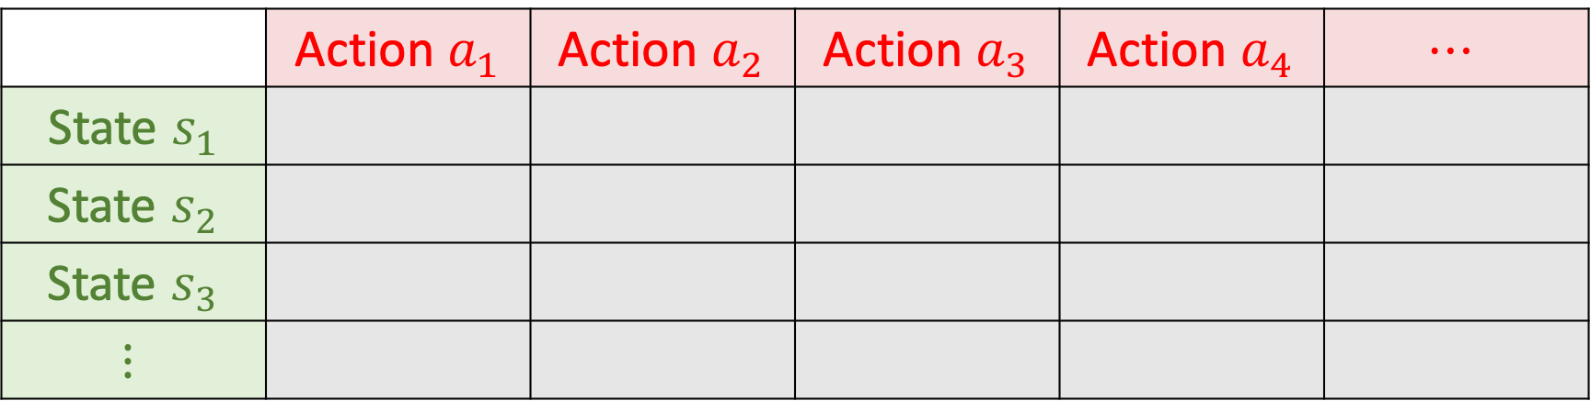
Can we directly learn a policy function $π\left(a | s\right)$?
If there are only a few states and actions, then yes, we can.
Draw a table (matrix) and learn the entries.
 | Action $a_{1}$ | Action $a_{2}$ | Action $a_{3}$ | Action $a_{4}$ | $$⋯$$
State $s_{1}$
State $s_{2}$
State $s_{3}$
$$⋮$$
Notes:
Once we have a good policy function $π$, we can use it for controlling the agent.
Can we directly learn a policy function?
-----
If there are only a few states and actions, then yes, we can directly learn the policy function.
--------
We can draw a table and learn the entries using the experience gained from the game.
只要有了一个好的策略函数$π$，我们就可以用$π$ 来自动控制agent运动。
但问题是 我们怎么样才能得到 这样一个策略函数呢？
---
假如一个游戏只有5个状态、10个动作，那很好办。
我们画一张5乘10的表，表中每一格对应一个概率。
通过玩游戏把这50个概率值给算出来就行了。

Slide 5
Can we directly learn a policy function $π\left(a | s\right)$?
If there are only a few states and actions, then yes, we can.
Draw a table (matrix) and learn the entries.
What if there are too many (or infinite) states or actions?
 | Action $a_{1}$ | Action $a_{2}$ | Action $a_{3}$ | Action $a_{4}$ | $$⋯$$
State $s_{1}$
State $s_{2}$
State $s_{3}$
$$⋮$$
Notes:
However, what if there are too many states or too many actions?
In the Super Mario Game, there are almost infinite states.
It’s impossible to learn such a table.
假如状态或者动作的数量太多了呢？
比如，超级玛丽这样的游戏有无数个状态，
根本不可能把“每个状态”和“每个动作” 对应的概率 记录在一张表里。
想要agent自动玩超级玛丽这种游戏，我们没办法直接算策略函数，

Slide 6
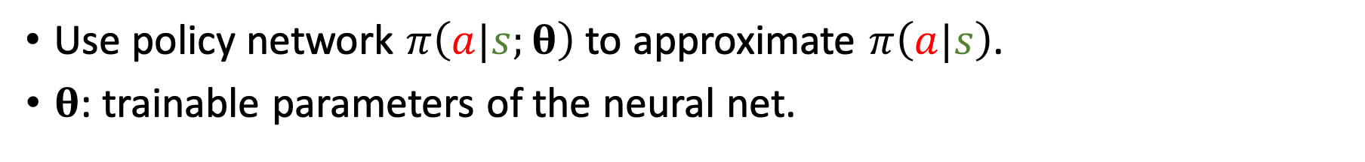
Policy Network $π\left(a | s;θ\right)$
Policy network: Use a neural net to approximate $π\left(a|s\right)$.
Use policy network $π\left(a|s;θ\right)$ to approximate $π\left(a|s\right)$.
$θ$: trainable parameters of the neural net.
Notes:
A commonly used method is function approximation, that is, learn a function for approximating the policy function.
---
There are numerous ways of function approximation.
You can use linear function, kernel function, or neural networks.
-----
If neural networks are used, then the approximate function is called policy network.
Denote is by function $π\left(a|s;θ\right)$.
Here, $θ$ contains the model parameters.
$θ$ is randomly initialized and then learned by policy gradient algorithm.
一种常用的方法是做函数近似，学出来一个函数来近似策略函数。
---
函数近似的方法多种多样，可以用线性函数，可以用kernel函数，也可以用神经网络。
如果用神经网络的话，我们就把这个神经网络称作policy network策略网络。
把它记做$π\left(a|s;θ\right)$。
这里的$θ$是神经网络的参数。
一开始$θ$是随机初始化，然后通过学习来改进$θ$。

Slide 7


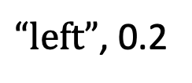
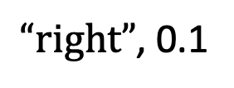
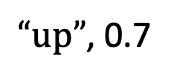
Policy Network $π\left(a | s;θ\right)$
Policy network: Use a neural net to approximate $π\left(a|s\right)$.
Use policy network $π\left(a|s;θ\right)$ to approximate $π\left(a|s\right)$.
$θ$: trainable parameters of the neural net.
$“left”$, 0.2
Conv
Dense
Softmax
$“right”$, 0.1
$“up”$, 0.7
state $s_{t}$
feature
Notes:
For the Super Mario game, we can define such a policy network.
Its input is the state $s_{t}$.
A convolutional neural network extracts features from a screenshot.
Then dense layers with softmax activation outputs a probability distribution over the actions.
-------
Here, $π\left(a|s;θ\right)=0.2$ means that observing $s$, the agent selects action $a$ with probability 0.2.
如果是超级玛丽这个问题，我们可以把 ”策略网络“ 设计成这个样。
输入是状态s，也就是当前屏幕上显示的画面，也可以是几帧最近的画面。
然后一个或者几个 卷积层 把画面变成特征向量。
全连接层把特征映射到一个3维向量。（由于有3个动作，所以维度是3.）
随后要用Softmax 激活函数，这样输出的才是一个概率分布。
---
输出的是一个3维向量，每一个元素对应一个动作，里面的值都是动作的概率。
比如第一个值等于0.2， 意思是向左的概率是0.2.
第二个值是0.1，对应向右的动作。
第三个值是0.7，对应向上的动作。

Slide 8
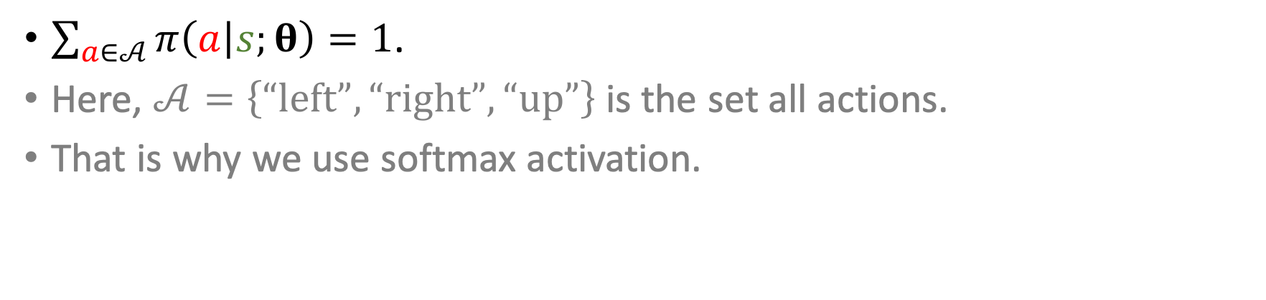
Policy Network $π\left(a | s;θ\right)$
$\sum_{a∈𝒜}{π\left(a | s;θ\right)}=1$.
Here, $𝒜=\left\{“left”, “right”, “up”\right\}$ is the set all actions.
That is why we use softmax activation.
$“left”$, 0.2
Conv
Dense
Softmax
$“right”$, 0.1
$“up”$, 0.7
state $s_{t}$
feature
Notes:
The probabilities add up to 1; that’s why we use softmax activation.
Here, $𝒜$ is the set containing all the actions, e.g., $𝒜=\left\{“left”, “right”, “up”\right\}$.
In this example, the 3 probabilities add up to 1.
由于策略函数pi是一个概率密度函数，所以pi必须满足这个性质：
对于所有可能的动作a，比如左、右、上，把pi函数的输出都加起来，必须等于1。
这个例子里面，0.2 加 0.1 加 0.7 等于1.
这是概率密度函数的性质。
-----
这就是为啥一定要在这里放softmax激活函数。
Softmax可以让输出的都是正数，而且加和等于1.

Slide 9
State-Value Function Approximation
Notes:
We have defined the policy network.
In the rest of this lecture, we will discuss how to learn the policy network.
To derive the policy gradient algorithm, we will use state-value function.
我们已经搭建了一个策略网络。
这节课其余的内容都是怎么样学习策略网络。
为了推导策略梯度算法，我们先来回顾一下State-Value Function状态价值函数，并且对它做函数近似。

Slide 10
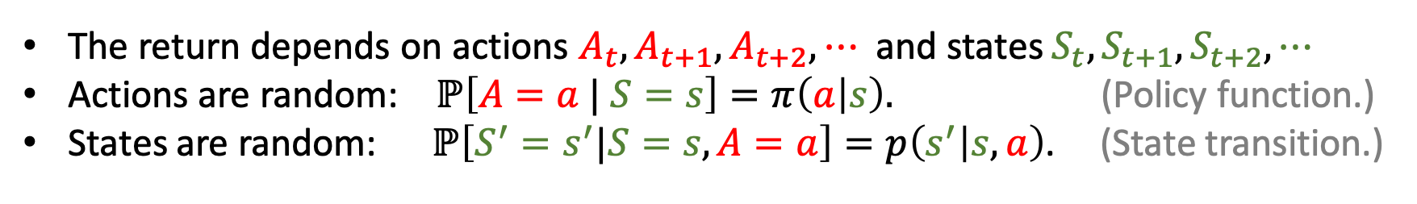
Action-Value Function
Definition: Discounted return.
$U_{t}=R_{t}+γ⋅R_{t+1}+γ^{2}⋅R_{t+2}+γ^{3}⋅R_{t+3}+⋯$
The return depends on actions $A_{t},A_{t+1},A_{t+2}, ⋯$ and states $S_{t},S_{t+1}, S_{t+2}, ⋯$
Actions are random: $ℙ\left[A=a | S=s\right]=π\left(a | s\right).$ (Policy function.)
States are random: $ℙ\left[S^{′}=s^{′}|S=s, A=a\right]=p\left(s^{′} | s, a\right)$. (State transition.)
Notes:
Let’s first revisit the discounted return, $U_{t}$.
$U_{t}$ is the weighted sum of all the rewards R since time t.
----
At time t, the rewards are unknown and random, so we denote them by uppercase letter R.
They are random variables, and their randomness is from the future actions and states.
Since $U_{t}$ is the sum of random variables, $U_{t}$ is also a random variable.
$U_{t}$ depends on all the future states and actions.
首先回顾一下Discounted return折扣回报$U_{t}$。
它的定义是从t时刻开始，未来所有奖励R 的加权求和。
---
在t时刻，未来的奖励R 还没观测到，他们都是随机变量，所以用大写字母表示。
每个奖励R的随机性都来自于前一时刻的动作A和状态S。
动作的随机性来自于 策略函数pi。
状态的随机性来自于 状态转移函数p。
---------
由于$U_{t}$ 是所有奖励的加和，
$U_{t}$的随机性来自于未来所有的动作和状态。

Slide 11
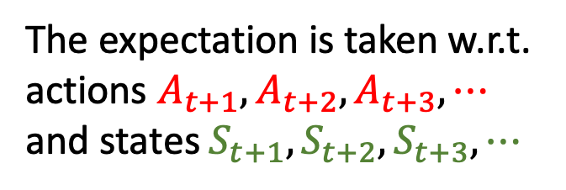
Action-Value Function
Definition: Discounted return.
$U_{t}=R_{t}+γ⋅R_{t+1}+γ^{2}⋅R_{t+2}+γ^{3}⋅R_{t+3}+⋯$
Definition: Action-value function.
$Q_{π}\left(s_{t},a_{t}\right)=𝔼 \left[U_{t}|S_{t}=s_{t},A_{t}=a_{t}\right]$.
The expectation is taken w.r.t. actions $A_{t+1},A_{t+2},A_{t+3}, ⋯$ and states $S_{t+1},S_{t+2}, S_{t+3}, ⋯$
Notes:
Action-value function, $Q_{π}$, is the conditional expectation of $U_{t}$.
The expectation eliminates all the futures states and actions, except $S_{t}$ and $A_{t}$.
The resulting $Q_{π}$ function depends only on policy $π$, current state $S_{t}$, and action $A_{t}$.
For given policy $π$ and state $S_{t}$, the $Q_{π}$ function can evaluate how good the action A is.
（讲慢一点）
Action-value function动作价值函数$Q_{π}$是U_t的条件期望。
这个期望把t+1时刻以后的 动作A 和 状态S 都消掉了。
$Q_{π}$只依赖于当前时刻的状态s_t 和 动作a_t。
$Q_{π}$还依赖于策略函数$π$；用不同的$π$ ，得到的$Q_{π}$就会不一样。
$Q_{π}$可以评价在状态s_t的情况下做出动作a_t的好坏程度。

Slide 12
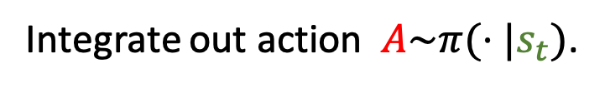
State-Value Function
Definition: Discounted return.
$U_{t}=R_{t}+γ⋅R_{t+1}+γ^{2}⋅R_{t+2}+γ^{3}⋅R_{t+3}+⋯$
Definition: Action-value function.
$Q_{π}\left(s_{t},a_{t}\right)=𝔼 \left[U_{t}|S_{t}=s_{t},A_{t}=a_{t}\right]$.
Definition: State-value function.
$V_{π}\left(s_{t}\right)=𝔼_{A} \left[Q_{π}\left(s_{t}, A\right)\right]=\sum_{a}{π\left(a | s_{t}\right)⋅Q_{π}\left(s_{t}, a\right)}$.
Integrate out action $A\sim π(⋅|s_{t})$.
Notes:
The next concept is state-value function $V_{π}$.
It is the expectation of $Q_{π}$ w.r.t. action A.
Here, the action A is treated a random variable, and its probability density function is policy function $π$.
----------
Action-value function $Q_{π}$ evaluates how good the action $a_{t}$ is at the state $s_{t}$.
State-value function $V_{π}$ evaluates how good the current situation $s_{t}$ is, disregarding the actions.
----------
Besides, the state-value function $V_{π}$ also evaluate how good the policy function $π$ is.
For fixed state $s_{t}$, a good policy function $π$ leads to big $V_{π}$.
If the policy function $π$ is good, then the agent has a big chance to win, so $V_{π}$ is big.
下一个概念，state-value function 状态价值函数$V_{π}$。
$V_{π}$是$Q_{π}$的期望，把$Q_{π}$中的动作A给积分掉，
这里动作A被当成随机变量，概率密度函数是pi。
---
把动作A给消掉了，这样一来$V_{π}$只跟策略函数pi和当前状态s有关了。
给定策略函数$π$， $V_{π}$可以评价当前状态的好坏；$V_{π}$越大说明当前的胜算越大。
-----
给定状态s，$V_{π}$可以评价策略$π$ 的好坏。
如果$π$很好，$V_{π}$就会比较大，说明胜算大。
反之，如果$π$ 不好，$V_{π}$就比较小，说明胜算小。

Slide 13
State-Value Function
Definition: Discounted return.
$U_{t}=R_{t}+γ⋅R_{t+1}+γ^{2}⋅R_{t+2}+γ^{3}⋅R_{t+3}+⋯$
Definition: Action-value function.
$Q_{π}\left(s_{t},a_{t}\right)=𝔼 \left[U_{t}|S_{t}=s_{t},A_{t}=a_{t}\right]$.
Definition: State-value function.
$V_{π}\left(s_{t}\right)=𝔼_{A} \left[Q_{π}\left(s_{t}, A\right)\right]=\sum_{a}{π\left(a | s_{t}\right)⋅Q_{π}\left(s_{t}, a\right)}$.
Integrate out action $A\sim π(⋅|s_{t})$.
Notes:
The expectation can be expressed in this way.
If the action is discrete, then the expectation is the sum of the policy $π$ times action-value function $Q_{π}$.
Here, the policy function $π$ is the probability mass function.
The summation eliminates the variable $a$.
------
If action is continuous variable, then we need to use integral to replace the sum.
（讲慢一点）
如果a是离散变量，比如向左、向右、向上这样的动作，$Q_{π}$期望可以这样展开。
对于所有动作a，把$Q_{π}$与 概率密度pi 的內积 做连加。
这样a就被消掉了。
-----
假如a是连续变量，比如从0到1之间所有的实数，这样的话就要用积分代替连加。

Slide 14
Policy-Based Reinforcement Learning
Definition: State-value function.
$V_{π}\left(s_{t}\right)=𝔼_{A} \left[Q_{π}\left(s_{t}, A\right)\right]=\sum_{a}{π\left(a | s_{t}\right)⋅Q_{π}\left(s_{t}, a\right)}$.
Notes:
Now, we are ready to study policy-based reinforcement learning.
We have expressed the state-value function $V_{π}$ as the sum.
In the summands, there is a policy function $π$.
We will replaced it by the policy network.
下面讲Policy-Based Reinforcement Learning 可以翻译成 “策略学习”。
刚才我们得到了State-value function状态价值函数$V_{π}$。
现在我们来用神经网络近似$V_{π}$。

Slide 15
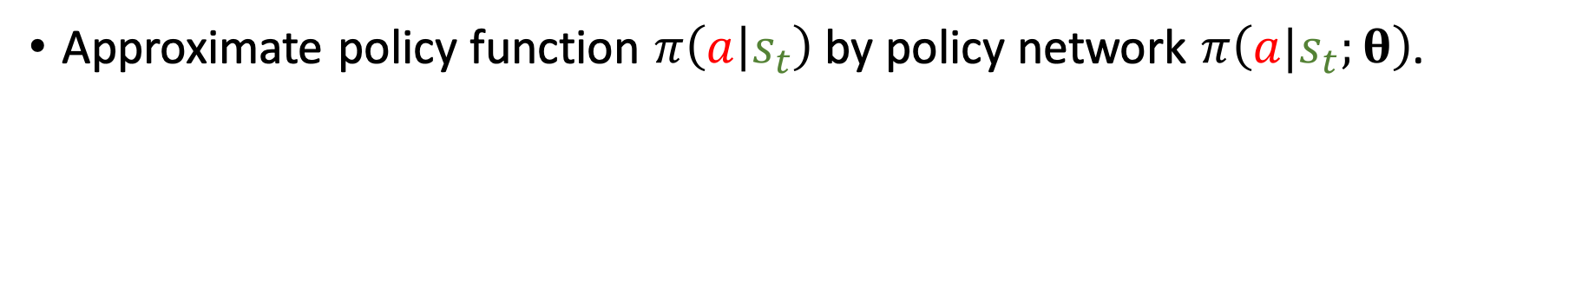
Policy-Based Reinforcement Learning
Definition: State-value function.
$V_{π}\left(s_{t}\right)=𝔼_{A} \left[Q_{π}\left(s_{t}, A\right)\right]=\sum_{a}{π\left(a | s_{t}\right)⋅Q_{π}\left(s_{t}, a\right)}$.
Approximate state-value function.
Approximate policy function $π\left(a | s_{t}\right)$ by policy network $π\left(a|s_{t};θ\right)$.
Notes:
Previously, we have built a neural network for approximating the policy function.
刚才我们已经用神经网络来近似policy函数pi。

Slide 16
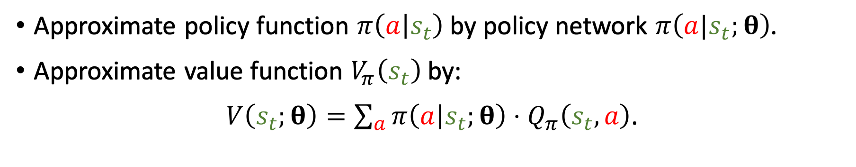
Policy-Based Reinforcement Learning
Definition: State-value function.
$V_{π}\left(s_{t}\right)=𝔼_{A} \left[Q_{π}\left(s_{t}, A\right)\right]=\sum_{a}{π\left(a | s_{t}\right)⋅Q_{π}\left(s_{t}, a\right)}$.
Approximate state-value function.
Approximate policy function $π\left(a | s_{t}\right)$ by policy network $π\left(a|s_{t};θ\right)$.
Approximate value function $V_{π}\left(s_{t}\right)$ by:
$V\left(s_{t};θ\right)=\sum_{a}{π\left(a | s_{t};θ\right)⋅Q_{π}\left(s_{t}, a\right)}$.
Notes:
Let’s replace the policy function in the summand by the neural network.
-----
In this way, the state-value function $V_{π}\left(s_{t}\right)$ becomes $V\left(s_{t};θ\right)$.
Here, $θ$ is the parameter of the policy network.
（讲慢点）
我们把$V_{π}$中的策略函数pi替换成神经网络，
------
$V_{π}$就变成了 $V\left(s_{t};θ\right)$。
这里的$θ$ 是神经网络中的参数。

Slide 17
Policy-Based Reinforcement Learning
Definition: Approximate state-value function.
$V\left(s;θ\right)=\sum_{a}{π\left(a | s;θ\right)⋅Q_{π}\left(s, a\right)}$.
Policy-based learning: Learn $θ$that maximizes $J\left(θ\right)=𝔼_{S}\left[V\left(S;θ\right)\right]$.
Notes:
Now, let’s discuss the main idea of policy-based reinforcement learning.
---
We have used policy network to replace policy function.
In this way, the state-value function is approximated by $V\left(s;θ\right)$.
---
For fixed state s, $V\left(s;θ\right)$ can evaluate how good the policy network is.
The better the policy π, the bigger the state-value function $V$.
----
How can we improve the policy network?
We can update parameter $θ$ so that on average, $V\left(S;θ\right)$ becomes bigger.
========
Let $J\left(θ\right)$ be the expectation of $V\left(S;θ\right)$ w.r.t. state S.
Here, the state S is treated as a random variable and gets eliminated.
So the resulting $J\left(θ\right)$ depends only on policy network’s parameter $θ$.
----
$J\left(θ\right)$ is the objective function of policy based reinforcement learning.
Our goal is to find $θ$ that maximizes $J\left(θ\right)$.
Big $J\left(θ\right)$ means on average, the expected return is big.
现在我要讲策略学习的主要思想。
----
我们刚才用“策略网络” 近似了 策略函数，
这样一来“状态价值函数”就 可以近似成 $V\left(s;θ\right)$ 。
$V$可以评价状态s和策略网络 的好坏。
给定状态s，策略网络越好，那么$V\left(s;θ\right)$就越大。
-----
那怎么样让“策略网络” 变得越来越好的？
我们可以改进模型参数$θ$，让$V\left(s;θ\right)$变大。
=======
基于这个想法，我们就可以把目标函数定义为$V\left(s;θ\right)$的期望，记做$J\left(θ\right)$。
这个期望是关于状态s求的。
这里把状态s作为一个随机变量，用期望去掉，这样一来变量就只剩$θ$了。
目标函数$J\left(θ\right)$就是对“策略网络”的评价；“策略网络” 越好，$J\left(θ\right)$就越大。
所以呢，策略学习Policy-based learning目标就是改进$θ$，使得 $J\left(θ\right)$越大越好。

Slide 18
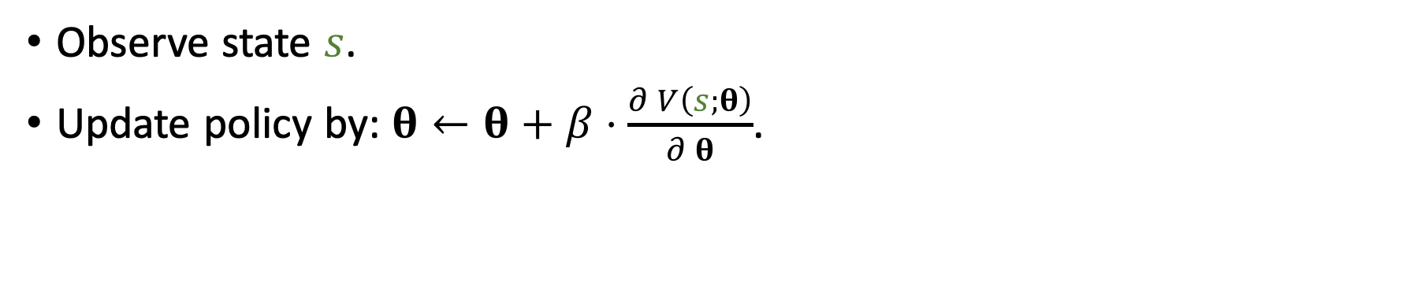
Policy-Based Reinforcement Learning
Definition: Approximate state-value function.
$V\left(s;θ\right)=\sum_{a}{π\left(a | s;θ\right)⋅Q_{π}\left(s, a\right)}$.
Policy-based learning: Learn $θ$that maximizes $J\left(θ\right)=𝔼_{S}\left[V\left(S;θ\right)\right]$.
How to improve $θ$? Policy gradient ascent!
Observe state $s$.
Update policy by: $θ←θ+β⋅\frac{∂ V\left(s;θ\right)}{∂ θ}$.
Policy gradient
Notes:
How do we improve $θ$?
We can perform policy gradient ascent.
----
Let the agent play a game.
In every step, the agent observes a state s.
The state is randomly sampled from the state transition.
----
Observing s, we take the derivative of $V$ w.r.t. $θ$, and obtain a gradient.
The gradient is called policy gradient.
Here, $β$ is the learning rate.
-----
This is like stochastic gradient ascent.
The full gradient is the derivative of $J\left(θ\right)$ w.r.t. $θ$.
It’s hard to compute the full gradient.
So we randomly sample one state s and use it to calculate a stochastic gradient.
The randomness is from the sampling of s.
This is actually a stochastic gradient.
怎么样改进$θ$呢？
我们要用到policy gradient算法，翻译成“策略梯度”算法。
------
让agent玩游戏，每一步都会观测到一个不同的状态s，这个s就相当于是从 状态的概率分布中 随机抽样出来的。
观测到状态s，把$V\left(S;θ\right)$关于$θ$求导，得到一个梯度。
然后用梯度上升来更新$θ$。
这里的$β$是学习率。
------
其实这就像是随机梯度上升。
我们算的不是梯度；真正的梯度是目标函数$J\left(θ\right)$关于$θ$的导数。
这里我们算的是 $V$关于$θ$的导数，其实就是个随机梯度；随机性来源于s。
-------
为什么用梯度上升呢？因为我们想让目标函数$J\left(θ\right)$ 越来越大。
================
这里$V$关于$θ$的导数 就被叫做policy gradient，策略梯度。
我接下来要讲 具体怎么计算policy gradient。

Slide 19
Policy Gradient
Reference
Sutton and others: Policy gradient methods for reinforcement learning with function approximation. In NIPS, 2000.
Notes:
We will use policy gradient algorithm for learning the policy network.
I am going to derive the policy gradient.
想要学习“策略网络”需要用到“策略梯度”算法。
“策略梯度”是V函数对神经网络参数$θ$的 导数。
接下来我讲怎么求导，怎么近似计算“策略梯度”。

Slide 20
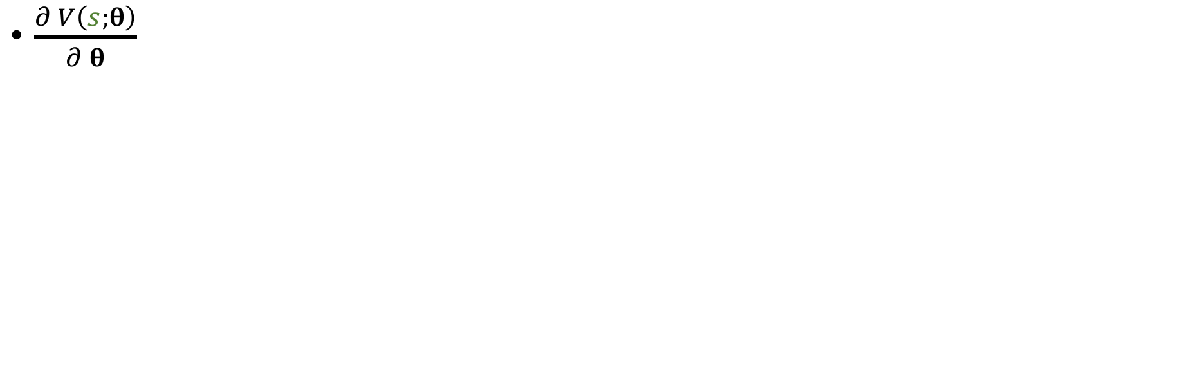
Policy Gradient
Definition: Approximate state-value function.
$V\left(s;θ\right)=\sum_{a}{π\left(a | s;θ\right)⋅Q_{π}\left(s, a\right)}$.
Policy gradient: Derivative of $V\left(s;θ\right)$ w.r.t. $θ$.
$\frac{∂ V\left(s;θ\right)}{∂ θ}=\sum_{a}{\frac{∂π(a|s;θ)⋅Q_{π}\left(s, a\right)}{∂ θ}}=\sum_{a}{\frac{∂π(a|s;θ)}{∂ θ}⋅Q_{π}\left(s, a\right)}$
Notes:
We have defined the V function.
It is parameterized by $θ$
It is an approximation to the state-value function.
------
Policy gradient is the derivative of $V\left(s;θ\right)$ w.r.t. $θ$.
Let’s do the mathematics.
刚才我们定义了$V\left(s;θ\right)$，它是对state-value function的近似。
这里的$π\left(a | s;θ\right)$是“策略网络”，$θ$是神经网络的参数。
----
“策略梯度”就是$V$对$θ$ 的导数。
下面我来做数学推导，把导数算出来。

Slide 21
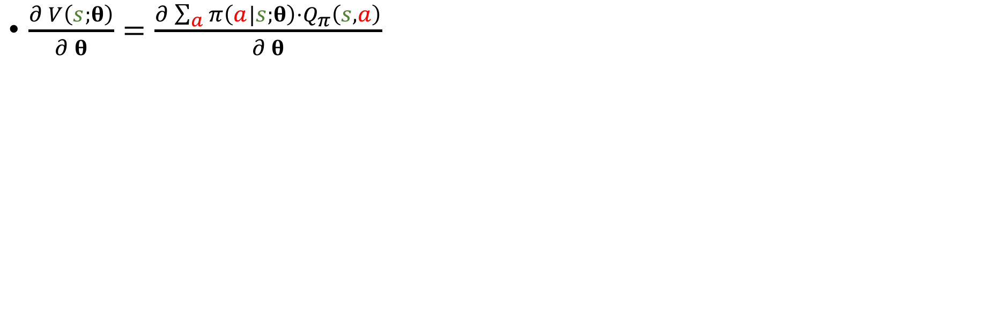
Policy Gradient
Definition: Approximate state-value function.
$V\left(s;θ\right)=\sum_{a}{π\left(a | s;θ\right)⋅Q_{π}\left(s, a\right)}$.
Policy gradient: Derivative of $V\left(s;θ\right)$ w.r.t. $θ$.
$\frac{∂ V\left(s;θ\right)}{∂ θ}=\frac{∂\sum_{a}{π\left(a|s;θ\right)⋅Q_{π}\left(s, a\right)}}{∂ θ}$
Notes:
By definition, $V\left(s;θ\right)$ is the sum.
The gradient is the derivative of the sum w.r.t. $θ$.
根据定义，V就是这个连加
------
V对$θ$求导，就是这个连加 对$θ$求导。

Slide 22
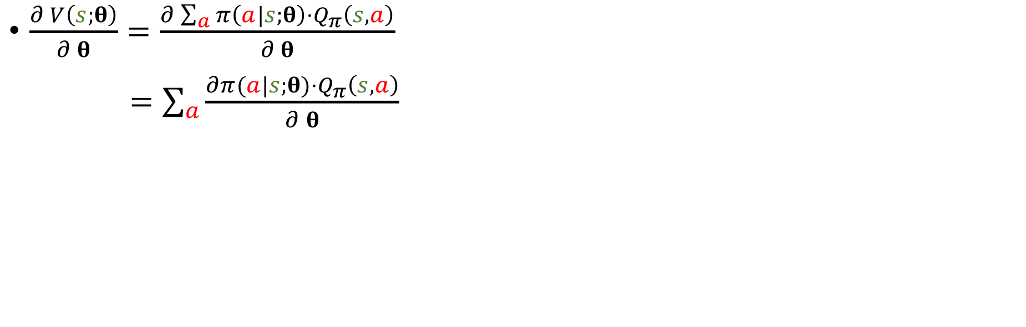
Policy Gradient
Definition: Approximate state-value function.
$V\left(s;θ\right)=\sum_{a}{π\left(a | s;θ\right)⋅Q_{π}\left(s, a\right)}$.
Policy gradient: Derivative of $V\left(s;θ\right)$ w.r.t. $θ$.
$\frac{∂ V\left(s;θ\right)}{∂ θ}=\frac{∂\sum_{a}{π\left(a|s;θ\right)⋅Q_{π}\left(s, a\right)}}{∂ θ}$
$=\sum_{a}{\frac{∂π(a|s;θ)⋅Q_{π}\left(s, a\right)}{∂ θ}}$
Push derivative inside the summation
Notes:
The summation is taken w.r.t. action a.
The derivative is taken w.r.t. $θ$.
They are different.
-----
So we can push the derivative into the summation.
In this way, the derivative of sum becomes the sum of derivative.
(讲慢一些）
可以把“求导的运算”推到 连加里面去。
这样一来，连加 的导数，就成了 这些导数的连加。

Slide 23
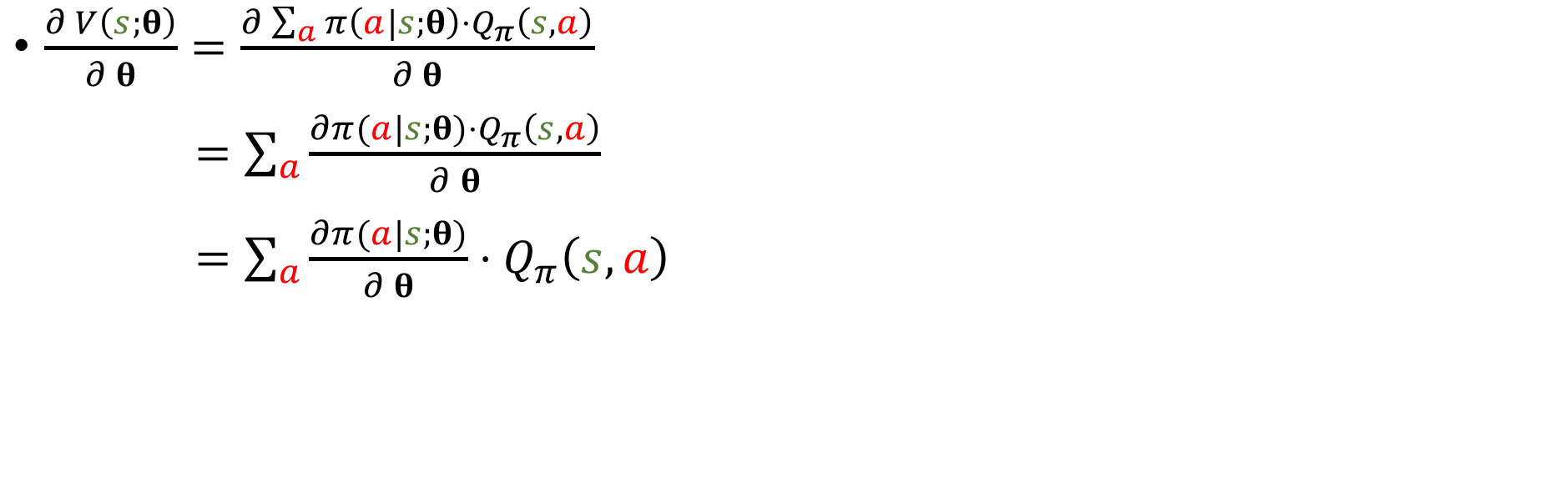
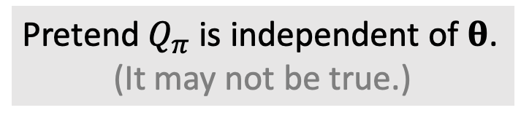
Policy Gradient
Definition: Approximate state-value function.
$V\left(s;θ\right)=\sum_{a}{π\left(a | s;θ\right)⋅Q_{π}\left(s, a\right)}$.
Policy gradient: Derivative of $V\left(s;θ\right)$ w.r.t. $θ$.
$\frac{∂ V\left(s;θ\right)}{∂ θ}=\frac{∂\sum_{a}{π\left(a|s;θ\right)⋅Q_{π}\left(s, a\right)}}{∂ θ}$
$=\sum_{a}{\frac{∂π(a|s;θ)⋅Q_{π}\left(s, a\right)}{∂ θ}}$
$=\sum_{a}{\frac{∂π(a|s;θ)}{∂ θ}⋅Q_{π}\left(s, a\right)}$
Pretend $Q_{π}$ is independent of $θ$.
(It may not be true.)
Notes:
To make the math easier, let’s pretend that the action-value function $Q_{π}$ is independent of $θ$.
In this way, we can treat $Q_{π}$ as a constant and move it out of the derivative.
I got this equation: compute the derivative of policy network $π$ w.r.t. $θ$, multiply it by $Q_{π}$, and then take the sum.
-------
Here, I made an assumption that $Q_{π}$ is independent of $θ$.
This assumption is unreasonable because $Q_{π}$ depends on the policy, and the policy is parameterized by $θ$.
$Q_{π}$ actually depends on $θ$.
------
So my deduction is not rigorous.
I made the simplification to make it easier to understand.
为了简化推导，我假设$Q_{π}$不依赖于$θ$。
这样就可以把$Q_{π}$当成一个常数，从求导运算里提取出来，放到导数的外面。
于是我们就得到了等式右边：把pi关于$θ$ 求导，再乘以 $Q_{π}$，然后做连加。
--------
这里我$做了个假设，Q_{π}$不依赖于$θ$。
这个假设其实不太对，因为$Q_{π}$跟$π$有关；$θ$是$π$的参数，所以$Q_{π}$跟$θ$还是有关的。
这个推导并不严谨。
我做这个简化只是为了让你们容易理解。

Slide 24
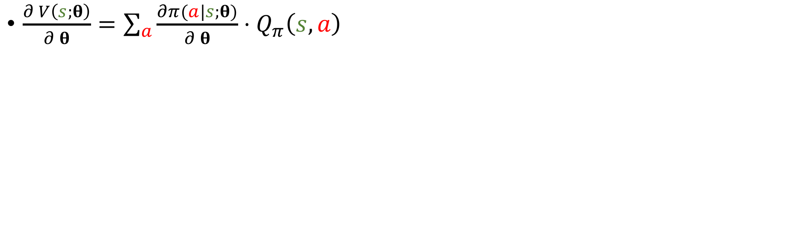
Policy Gradient
Definition: Approximate state-value function.
$V\left(s;θ\right)=\sum_{a}{π\left(a | s;θ\right)⋅Q_{π}\left(s, a\right)}$.
Policy gradient: Derivative of $V\left(s;θ\right)$ w.r.t. $θ$.
$\frac{∂ V\left(s;θ\right)}{∂ θ}=\sum_{a}{\frac{∂π(a|s;θ)}{∂ θ}⋅Q_{π}\left(s, a\right)}$
Policy Gradient
Notes:
In this way, I got the policy gradient.
It is the derivative of policy network $π$ w.r.t. parameter $θ$, multiply it by $Q_{π}$, and then take the sum.
-----
If action a is discrete, then we can directly use this equation to calculate the policy gradient.
For all action a, evaluate this term, and then take the sum.
这样我就得到了这个“策略梯度”的公式。
策略梯度 等于 函数pi 关于$θ$ 求导，乘以$Q_{π}$，然后关于a做连加。
--------
如果动作a是离散的，直接用这个公式 就能把“策略梯度”给算出来。
------

Slide 25
Policy Gradient
Definition: Approximate state-value function.
$V\left(s;θ\right)=\sum_{a}{π\left(a | s;θ\right)⋅Q_{π}\left(s, a\right)}$.
Policy gradient: Derivative of $V\left(s;θ\right)$ w.r.t. $θ$.
$\frac{∂ V\left(s;θ\right)}{∂ θ}=\sum_{a}{\frac{∂π(a|s;θ)}{∂ θ}⋅Q_{π}\left(s, a\right)}$
Policy Gradient
Note: This derivation is over-simplified and not rigorous.
Notes:
As I said, this kind of deduction is over-simplified and not rigorous.
It is only part of the deduction.
-----
In fact, we need to further take the derivative of $Q_{π}$ w.r.t. $θ$.
However, even if you do the deduction rigorously, the outcome is the same as this equation.
----
This equation is right, although my deduction is over-simplified.
前面我说了，我这种推导过于简化了，其实是不严谨的。
这个推导只是帮助大家理解“策略梯度”是怎么来的。
----
实际上还有一项，要把$Q_{π}$也关于$θ$求导。
不过你也不用太在意这个细节；即使把$Q_{π}$也对$θ$求导考虑进去，得到的最终结果也是一样的。
如果你只是实际用一下策略梯度算法，你就这么理解算法推导就行了。

Slide 26
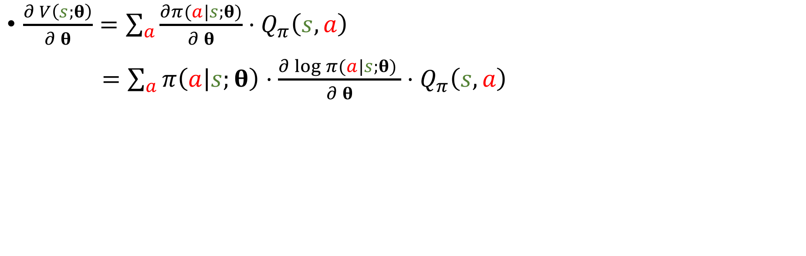
Policy Gradient
Definition: Approximate state-value function.
$V\left(s;θ\right)=\sum_{a}{π\left(a | s;θ\right)⋅Q_{π}\left(s, a\right)}$.
Policy gradient: Derivative of $V\left(s;θ\right)$ w.r.t. $θ$.
$\frac{∂ V\left(s;θ\right)}{∂ θ}=\sum_{a}{\frac{∂π(a|s;θ)}{∂ θ}⋅Q_{π}\left(s, a\right)}$
$=\sum_{a}{π\left(a | s;θ\right)⋅\frac{∂\log{π(a|s;θ)} }{∂ θ}⋅Q_{π}\left(s, a\right)}$
Notes:
In practice, another form is more commonly used.
=======
This term can be equivalently written in this way.
=======
The derivative of $π$ w.r.t. $θ$ is equal to $π$ times the derivative of $log π$ w.r.t. $θ$.
----------
How is this equation obtained?
Going from left to right is not easy, but going from right to left is obvious.
实际应用的时候，通常不会 用这个公式来算“策略梯度”。
实际用的通常是这个策略梯度的“蒙特卡洛近似”。
我接下来的推导就是为了做近似。
=======
（讲的很慢）
$π$关于$θ$的导数，可以写成 $π$ 乘以 $\log{π}$ 关于$θ$的导数。
---------
这一步怎么来的呢？
“从上往下”不太好推，但是“从下往上”验证会很容易。

Slide 27
Policy Gradient
Definition: Approximate state-value function.
$V\left(s;θ\right)=\sum_{a}{π\left(a | s;θ\right)⋅Q_{π}\left(s, a\right)}$.
Policy gradient: Derivative of $V\left(s;θ\right)$ w.r.t. $θ$.
$\frac{∂ V\left(s;θ\right)}{∂ θ}=\sum_{a}{\frac{∂π(a|s;θ)}{∂ θ}⋅Q_{π}\left(s, a\right)}$
$=\sum_{a}{π\left(a | s;θ\right)⋅\frac{∂\log{π(a|s;θ)} }{∂ θ}⋅Q_{π}\left(s, a\right)}$
Chain rule: $\frac{∂\log\left[π\left(θ\right)\right]}{∂θ}=\frac{1}{π\left(θ\right)}⋅\frac{∂ π\left(θ\right)}{∂ θ}$.
Notes:
Let’s verify this equation.
Using the chain rule, the derivative of $\log\left[π\left(θ\right)\right]$ w.r.t. $θ$ is $\frac{1}{π\left(θ\right)}⋅\frac{∂ π\left(θ\right)}{∂ θ}$.
-----
How’s the term $\frac{1}{π\left(θ\right)}$ obtained?
It is the derivative of log function.
The derivative of log x w.r.t. x is equal to 1/x.
我们来验证一下。
用一下$链式法则和log函数的性质，\log\left[π\left(θ\right)\right]$关于$θ$求导，可以写成$π\left(θ\right)$分之一、再乘以 $π\left(θ\right)$关于$θ$的导数，
------
这个$π\left(θ\right)$分之一 是怎么来的呢？
这是log函数的性质
你拿log x关于x求导，就会得到x分之一。

Slide 28
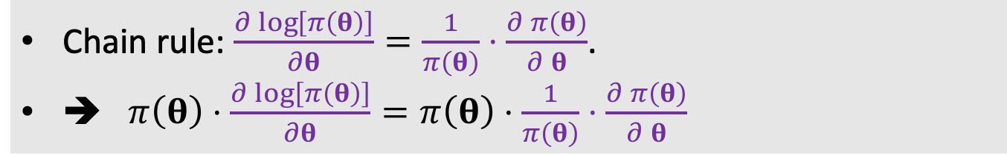
Policy Gradient
Definition: Approximate state-value function.
$V\left(s;θ\right)=\sum_{a}{π\left(a | s;θ\right)⋅Q_{π}\left(s, a\right)}$.
Policy gradient: Derivative of $V\left(s;θ\right)$ w.r.t. $θ$.
$\frac{∂ V\left(s;θ\right)}{∂ θ}=\sum_{a}{\frac{∂π(a|s;θ)}{∂ θ}⋅Q_{π}\left(s, a\right)}$
$=\sum_{a}{π\left(a | s;θ\right)⋅\frac{∂\log{π(a|s;θ)} }{∂ θ}⋅Q_{π}\left(s, a\right)}$
Chain rule: $\frac{∂\log\left[π\left(θ\right)\right]}{∂θ}=\frac{1}{π\left(θ\right)}⋅\frac{∂ π\left(θ\right)}{∂ θ}$.
➔ $π\left(θ\right)⋅\frac{∂\log\left[π\left(θ\right)\right]}{∂θ}=π\left(θ\right)⋅\frac{1}{π\left(θ\right)}⋅\frac{∂ π\left(θ\right)}{∂ θ}$
Notes:
Multiplying both sides by $π\left(θ\right)$.
拿$π\left(θ\right)$ 乘以这个导数，
把导数展开，就得到了“$π\left(θ\right)$” 乘以 “$π\left(θ\right)$分之一” 再乘以 “$π\left(θ\right)$关于$θ$的求导”。

Slide 29
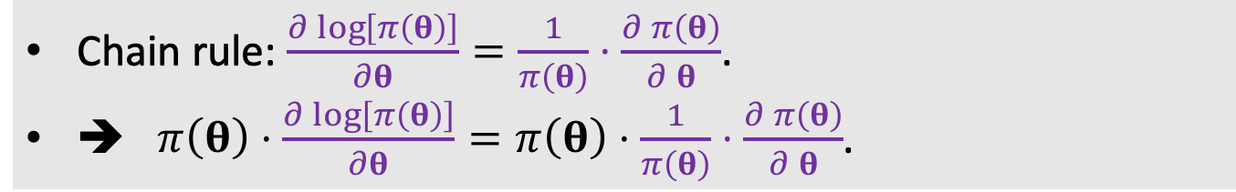
Policy Gradient
Definition: Approximate state-value function.
$V\left(s;θ\right)=\sum_{a}{π\left(a | s;θ\right)⋅Q_{π}\left(s, a\right)}$.
Policy gradient: Derivative of $V\left(s;θ\right)$ w.r.t. $θ$.
$\frac{∂ V\left(s;θ\right)}{∂ θ}=\sum_{a}{\frac{∂π(a|s;θ)}{∂ θ}⋅Q_{π}\left(s, a\right)}$
$=\sum_{a}{π\left(a | s;θ\right)⋅\frac{∂\log{π(a|s;θ)} }{∂ θ}⋅Q_{π}\left(s, a\right)}$
Chain rule: $\frac{∂\log\left[π\left(θ\right)\right]}{∂θ}=\frac{1}{π\left(θ\right)}⋅\frac{∂ π\left(θ\right)}{∂ θ}$.
➔ $π\left(θ\right)⋅\frac{∂\log\left[π\left(θ\right)\right]}{∂θ}=π\left(θ\right)⋅\frac{1}{π\left(θ\right)}⋅\frac{∂ π\left(θ\right)}{∂ θ}$.
Notes:
The two $π\left(θ\right)$ terms will cancel.
Only $\frac{∂ π\left(θ\right)}{∂ θ}$ is left.
In this way, I proved that $π\left(θ\right)⋅\frac{∂\log\left[π\left(θ\right)\right]}{∂θ}$ is equal to $\frac{∂ π\left(θ\right)}{∂ θ}$.
$π\left(θ\right)$和 “$π\left(θ\right)$分之一” 可以抵消，
只剩下“$π$关于$θ$的导数”。
这样，我就证明了$π\left(θ\right)$ 乘以 $log π$ 关于 $θ$ 的导数，等于 $π\left(θ\right)$关于 $θ$ 的导数。

Slide 30
Policy Gradient
Definition: Approximate state-value function.
$V\left(s;θ\right)=\sum_{a}{π\left(a | s;θ\right)⋅Q_{π}\left(s, a\right)}$.
Policy gradient: Derivative of $V\left(s;θ\right)$ w.r.t. $θ$.
$\frac{∂ V\left(s;θ\right)}{∂ θ}=\sum_{a}{\frac{∂π(a|s;θ)}{∂ θ}⋅Q_{π}\left(s, a\right)}$
$=\sum_{a}{π\left(a | s;θ\right)⋅\frac{∂\log{π(a|s;θ)} }{∂ θ}⋅Q_{π}\left(s, a\right)}$
Chain rule: $\frac{∂\log\left[π\left(θ\right)\right]}{∂θ}=\frac{1}{π\left(θ\right)}⋅\frac{∂ π\left(θ\right)}{∂ θ}$.
➔ $π\left(θ\right)⋅\frac{∂\log\left[π\left(θ\right)\right]}{∂θ}=π\left(θ\right)⋅\frac{1}{π\left(θ\right)}⋅\frac{∂ π\left(θ\right)}{∂ θ}$.
Notes:
I have proved that the 2 terms are equal.
That’s why the equation is valid.
我已经完成了“从下往上”的推导。
我证明了“圈出来的这两项”相等，所以等式成立。

Slide 31
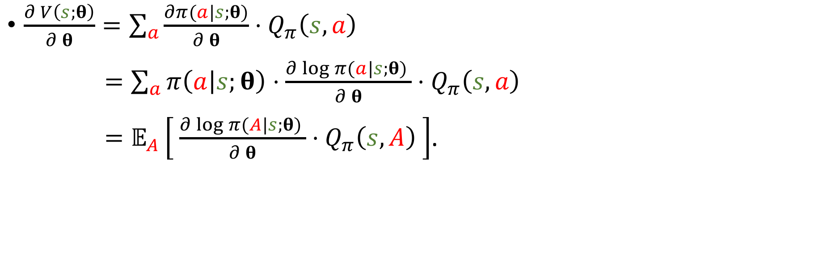
Policy Gradient
Definition: Approximate state-value function.
$V\left(s;θ\right)=\sum_{a}{π\left(a | s;θ\right)⋅Q_{π}\left(s, a\right)}$.
Policy gradient: Derivative of $V\left(s;θ\right)$ w.r.t. $θ$.
$\frac{∂ V\left(s;θ\right)}{∂ θ}=\sum_{a}{\frac{∂π(a|s;θ)}{∂ θ}⋅Q_{π}\left(s, a\right)}$
$=\sum_{a}{π\left(a | s;θ\right)⋅\frac{∂\log{π(a|s;θ)} }{∂ θ}⋅Q_{π}\left(s, a\right)}$
$=𝔼_{A}\left[ \frac{∂\log{π(A|s;θ)} }{∂ θ}⋅Q_{π}\left(s, A\right) \right]$.
The expectation is taken w.r.t. the random variable $A\sim π(⋅|s;θ)$.
Notes:
The final equation is easy to understand.
The policy network $π\left(a | s;θ\right)$ is a probability mass function.
======
So the sum is the expectation of this term w.r.t. the random variable $A$.
The probability mass function of A is $π$.
最后这个等式比较容易理解。
$π$ 是个概率密度函数。
========
$π$ 乘以圈出来的这一项 再关于动作a做连加，
就等于 对圈出来的这一项求期望。
------
求期望的时候把动作A当成随机变量，$π$是动作A的概率密度函数。

Slide 32
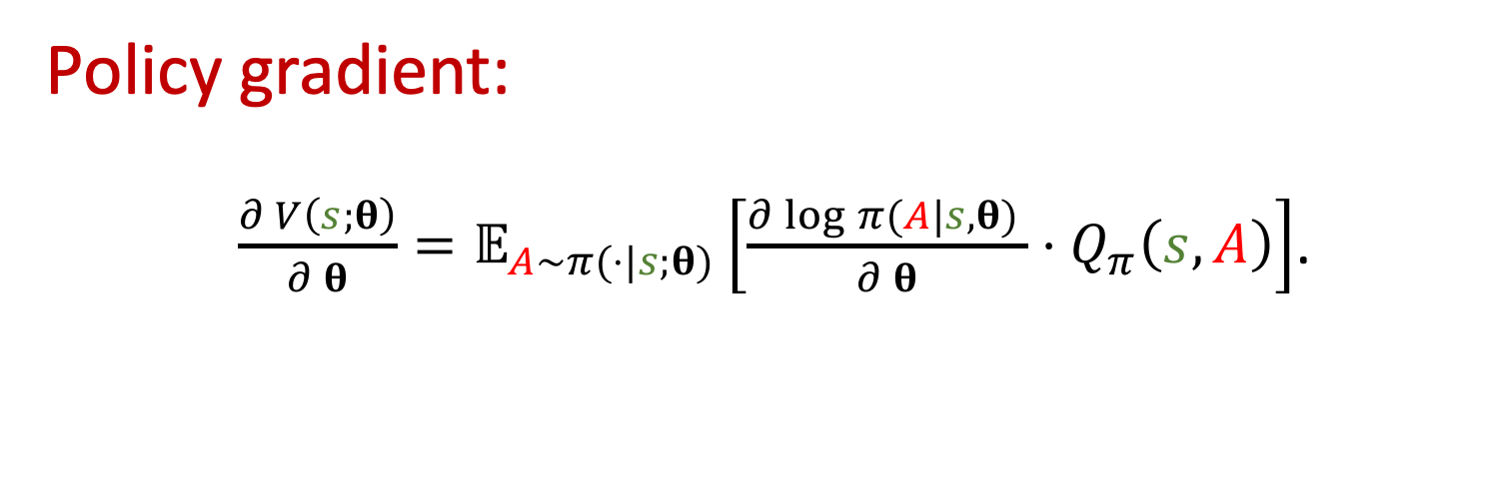
Policy Gradient
Policy gradient:
$\frac{∂ V\left(s;θ\right)}{∂ θ}=𝔼_{A\sim π(⋅|s;θ)}\left[\frac{∂\log{π(A|s,θ)} }{∂ θ}⋅Q_{π}\left(s, A\right)\right]$.
Notes:
To this end, we have derived the policy gradient.
The policy gradient is the expectation of $\frac{∂\log{π(A|s,θ)} }{∂ θ}⋅Q_{π}\left(s, A\right)$.
我们已经推导出了策略梯度的两种等价形式。
第一种是“$π$ 关于 $θ$ 的导数” 乘以 $Q_{π}$，再做连加。
第二种是“$log π$ 关于 $θ$ 的导数”乘以 $Q_{π}$，再关于随机变量A求期望。
这两种形式是等价的。

Slide 33
Calculate Policy Gradient
Policy Gradient: $\frac{∂ V\left(s;θ\right)}{∂ θ}=𝔼_{A\sim π(⋅|s;θ)}\left[\frac{∂\log{π(A|s,θ)} }{∂ θ}⋅Q_{π}\left(s, A\right)\right]$.
Notes:
The policy gradient is the expectation of $\frac{∂\log{π(A|s,θ)} }{∂ θ}⋅Q_{π}\left(s, A\right)$.
We can use Monte Carlo to approximate the expectation.
我们可以用策略梯度的第二种公式来减小计算代价。
公式是策略梯度等于 “$log π$ 关于 $θ$ 的导数”，乘以 $Q_{π}$，再关于随机变量A求期望。
---
有了这种积分形式，我们就可以做蒙特卡洛近似。

Slide 34
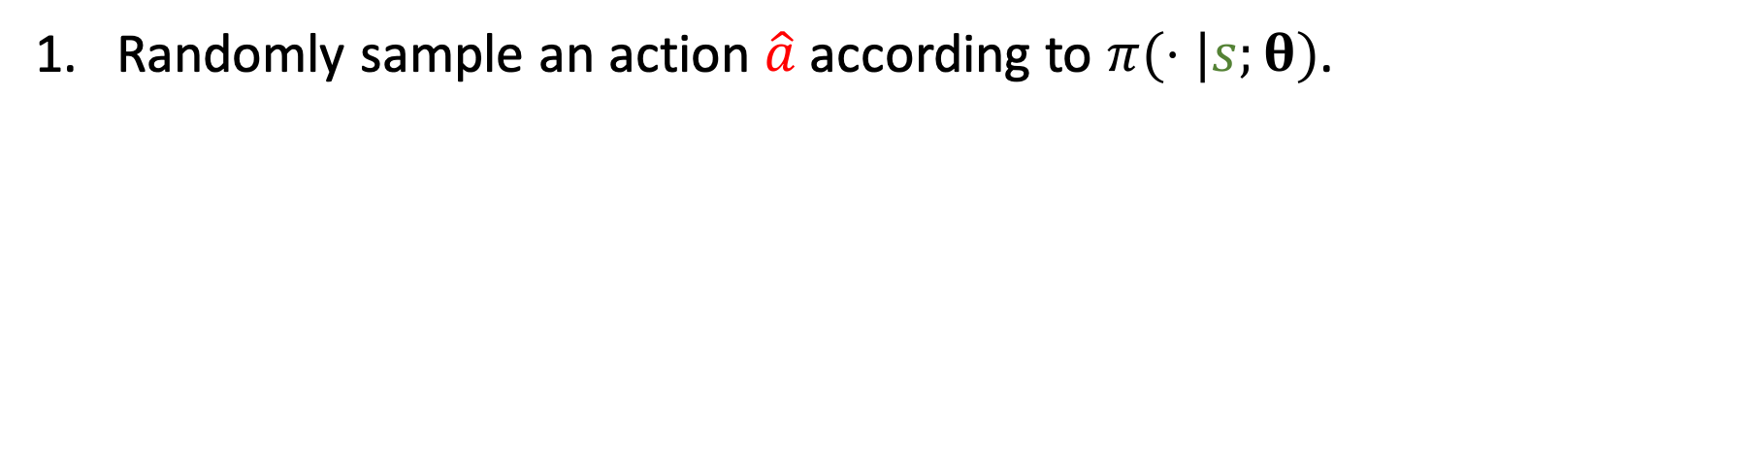
Calculate Policy Gradient
Policy Gradient: $\frac{∂ V\left(s;θ\right)}{∂ θ}=𝔼_{A\sim π(⋅|s;θ)}\left[\frac{∂\log{π(A|s,θ)} }{∂ θ}⋅Q_{π}\left(s, A\right)\right]$.
Randomly sample an action $\hat{a}$ according to $π(⋅|s;θ)$.
Notes:
Monte Carlo works in this way.
Randomly sample an action $\hat{a}$ from the distribution, $π$.
蒙特卡洛近似是这么做的。
随机抽样得到一个动作$\hat{a}$，抽样是根据概率密度函数pi抽的。
比如从0到1这个集合里抽样，我碰巧得到0.2，就用0.2作为动作$\hat{a}$。

Slide 35
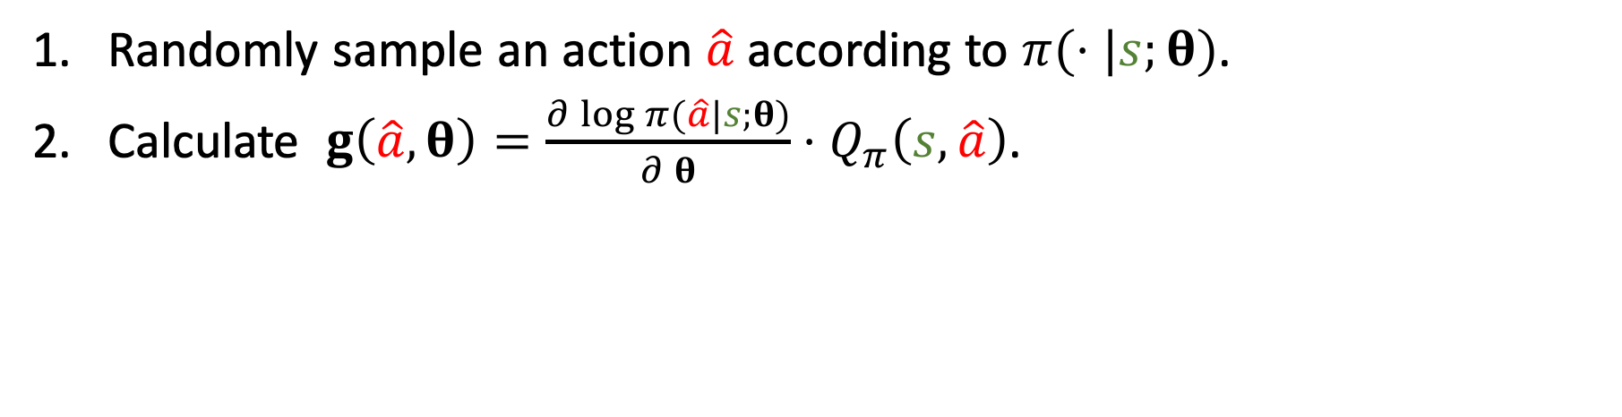
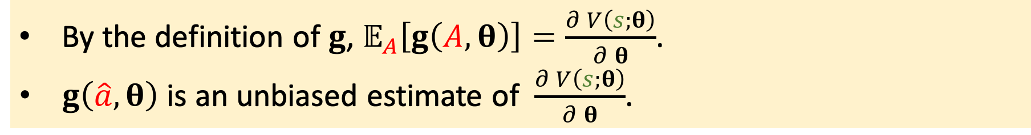
Calculate Policy Gradient
Policy Gradient: $\frac{∂ V\left(s;θ\right)}{∂ θ}=𝔼_{A\sim π(⋅|s;θ)}\left[\frac{∂\log{π(A|s,θ)} }{∂ θ}⋅Q_{π}\left(s, A\right)\right]$.
Randomly sample an action $\hat{a}$ according to $π(⋅|s;θ)$.
Calculate $g\left(\hat{a},θ\right)=\frac{∂\log{π(\hat{a}|s;θ)}}{∂ θ}⋅Q_{π}\left(s,\hat{a}\right)$.
By the definition of $g$, $𝔼_{A}\left[g\left(A,θ\right)\right]=\frac{∂ V\left(s;θ\right)}{∂ θ}$.
$g\left(\hat{a},θ\right)$ is an unbiased estimate of $\frac{∂ V\left(s;θ\right)}{∂ θ}$.
Notes:
Let’s take a look at the equation.
Inside the bracket is a gradient.
=====
Let’s denote it by $g$.
Here, $\hat{a}$ is not a random variable; instead, it is an observation, for example, the action “left”.
Knowing $\hat{a}$, we can evaluate the g function and get $g\left(\hat{a},θ\right)$.
=====
By the definition of g, the expectation of g is the policy gradient.
The action $\hat{a}$ is a random sample, so $g\left(\hat{a},θ\right)$ is an unbiased estimate of the policy gradient.
我们看一下这个公式。
期望 括号里面 是 “$log π$ 关于 $θ$ 的导数” ，乘以 $Q_{π}$ 。
=========
我们把期望括号里面的 “$log π$ 关于 $θ$ 的导数 ，乘以 $Q_{π}$” 的记为 $g\left(\hat{a},θ\right)$ ，
---
这里的$\hat{a}$是一个确定的动作，比如$\hat{a}=0.2$。
有了$\hat{a}$，直接算一下$g\left(\hat{a},θ\right)$的值就好了。
===========
根据函数g的定义，很显然$g\left(A,θ\right)$ 关于A求期望就等于“策略梯度”。
由于 $\hat{a}$ 是根据概率密度函数$π$ 随机抽出来的，所以呢，$g\left(\hat{a},θ\right)$是“策略梯度”的一个无偏估计。

Slide 36
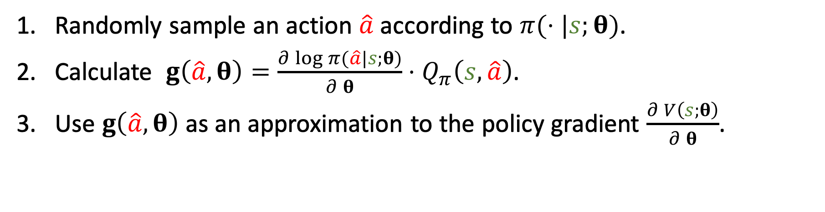
Calculate Policy Gradient
Policy Gradient: $\frac{∂ V\left(s;θ\right)}{∂ θ}=𝔼_{A\sim π(⋅|s;θ)}\left[\frac{∂\log{π(A|s,θ)} }{∂ θ}⋅Q_{π}\left(s, A\right)\right]$.
Randomly sample an action $\hat{a}$ according to $π(⋅|s;θ)$.
Calculate $g\left(\hat{a},θ\right)=\frac{∂\log{π(\hat{a}|s;θ)}}{∂ θ}⋅Q_{π}\left(s,\hat{a}\right)$.
Use $g\left(\hat{a},θ\right)$ as an approximation to the policy gradient $\frac{∂ V\left(s;θ\right)}{∂ θ}$.
Notes:
Because $g\left(\hat{a},θ\right)$ is an unbiased estimate, we can use it to approximate the policy gradient.
This is how Monte Carlo works.
We can use one Monte Carlo sample, or we can repeat this process multiple times and use the average of multiple Monte Carlo samples.
------
Typically, we use only one Monte Carlo sample for approximating the policy gradient.
由于$g\left(\hat{a},θ\right)$是”策略梯度”的无偏估计，所以可以用$g\left(\hat{a},θ\right)$ 来近似”策略梯度”。
这叫做蒙特卡洛近似。
蒙特卡洛就是抽一个或很多个随机样本，用随机样本来 近似期望。
---
更新模型$参数θ$的时候，用$g\left(\hat{a},θ\right)$来 作为近似的梯度 就行了。

Slide 37
Update policy network using policy gradient
Notes:
To this end, we have derived the policy gradient.
Let use the policy gradient to update policy network.
我们已经推导出了policy gradient”策略梯度”，并且知道怎么样用”策略梯度”来学习policy network”策略网络”。
下面我来总结一下”策略梯度”算法。

Slide 38

Algorithm
Observe the state $s_{t}$.
Randomly sample action $a_{t}$ according to $π\left(⋅ | s_{t};θ_{t}\right)$.
Notes:
Here is a description of the policy gradient algorithm.
First, at time t, we observe the state $s_{t}$.
----
Second, randomly sample action $a_{t}$ according to the policy network $π\left(⋅ | s_{t};θ_{t}\right)$.
For example, $a_{t}$ can be the action of moving left.
在第t个时间点，观测到了状态$s_{t}$。
接下来我们用“蒙特卡洛近似”来计算”策略梯度”。
-----
把”策略网络”$π$作为概率密度函数，用它来随机抽样得到一个动作$a_{t}$。
比如说$a_{t}$是向左的动作。

Slide 39
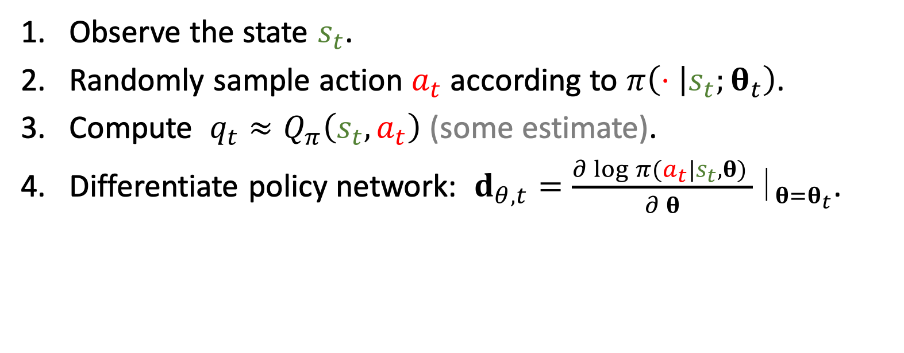
Algorithm
Observe the state $s_{t}$.
Randomly sample action $a_{t}$ according to $π\left(⋅ | s_{t};θ_{t}\right)$.
Compute $q_{t}≈Q_{π}\left(s_{t}, a_{t}\right)$ (some estimate).
Differentiate policy network: $d_{θ,t}=\frac{∂\log{π(a_{t}|s_{t},θ)} }{∂ θ}￨_{θ=θ_{t}}$.
Notes:
Third, estimate the action value function $Q_{π}\left(s_{t}, a_{t}\right)$ and get $q_{t}$.
======
Fourth, differentiate the policy network.
Take the derivative of $\log{π}$ w.r.t. $θ$.
The shape of the derivative is the same as $θ$.
If $θ$ is a $1000×1000$ matrix, then $d_{θ,t}$ is also a $1000×1000$ matrix.
-----
Libraries such as TensorFlow and PyTorch can automatically perform the differentiation.
第三步是计算价值函数$Q_{π}$的值，把结果记做小$q_{t}$。
======
第四步是对”策略网络”$π$求导，算出$log π$ 关于参数$θ$的导数。
得到的结果$d_{θ,t}$ 是向量、矩阵、或者张量；
$d_{θ,t}$的大小跟$θ$是一样的；
如果$θ$是 $1000×1000$ 的矩阵，那么$d_{θ,t}$也是$1000×1000$的矩阵。
----
TensorFlow和PyTorch这些系统都支持 自动求梯度。
你告诉系统$a_{t}$、$s_{t}$、还有当前参数$θ_{t}$，系统可以自动求出来梯度$d_{θ,t}$。

Slide 40
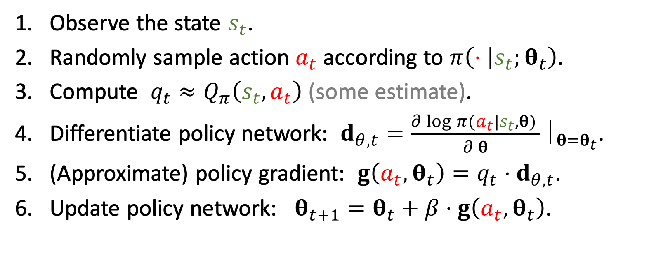
Algorithm
Observe the state $s_{t}$.
Randomly sample action $a_{t}$ according to $π\left(⋅ | s_{t};θ_{t}\right)$.
Compute $q_{t}≈Q_{π}\left(s_{t}, a_{t}\right)$ (some estimate).
Differentiate policy network: $d_{θ,t}=\frac{∂\log{π(a_{t}|s_{t},θ)} }{∂ θ}￨_{θ=θ_{t}}$.
(Approximate) policy gradient: $g\left(a_{t},θ_{t}\right)=q_{t}⋅d_{θ,t}$.
Update policy network: $θ_{t+1}=θ_{t}+β⋅g\left(a_{t},θ_{t}\right)$.
Notes:
Fifth, compute the stochastic policy gradient.
Here, $a_{t}$ is randomly sampled, so $g$ is a Monte Carlo approximation to the policy gradient.
========
Finally, update the policy network using policy gradient ascent.
$β$ is the learning rate.
The goal of policy gradient ascent is to increase the state-value function V.
--------------------
This is the policy gradient algorithm; every iteration repeats the 6 steps.
第五步是近似地算”策略梯度“。
之前我们已经推导过怎么用 “一个随机样本a” 来算 ”策略梯度“的 蒙特卡洛近似。
定义$g\left(a_{t},θ_{t}\right)$ 等于小$q_{t}$乘以 $d_{θ,t}$。
由于$a_{t}$ 是根据 $π$ 随机抽样 得到的样本，$g\left(a_{t},θ_{t}\right)$ 就是 ”策略梯度“的蒙特卡洛近似。
======
最后一步，有了近似的”策略梯度“，就可以用它来更新”策略网络“的参数$θ$。
旧的参数$θ_{t}$加上 $β$乘以 梯度$g$，就得到了新的参数$θ_{t+1}$。
这是一步梯度上升，目的是让“状态价值函数”V变大。
----------
这就是”策略梯度“算法。
每一轮迭代都做这6步。

Slide 41
Algorithm
Observe the state $s_{t}$.
Randomly sample action $a_{t}$ according to $π\left(⋅ | s_{t};θ_{t}\right)$.
Compute $q_{t}≈Q_{π}\left(s_{t}, a_{t}\right)$ (some estimate).
Differentiate policy network: $d_{θ,t}=\frac{∂\log{π(a_{t}|s_{t},θ)} }{∂ θ}￨_{θ=θ_{t}}$.
(Approximate) policy gradient: $g\left(a_{t},θ_{t}\right)=q_{t}⋅d_{θ,t}$.
Update policy network: $θ_{t+1}=θ_{t}+β⋅g\left(a_{t},θ_{t}\right)$.
How?
Notes:
There is an unsolved question.
To apply policy gradient, we need to know the action-value function $Q_{π}$.
Unfortunately, we don’t know $Q_{π}$?
Is there any way to approximately know $Q_{π}$?
算法里还有个没解决的问题。
Action-value function动作价值函数$Q_{π}$ 是什么呢？
我们并不知道$Q_{π}$，所以没办法算这个函数值。
-----
我们该怎么样近似算 函数值小$q_{t}$呢？

Slide 42

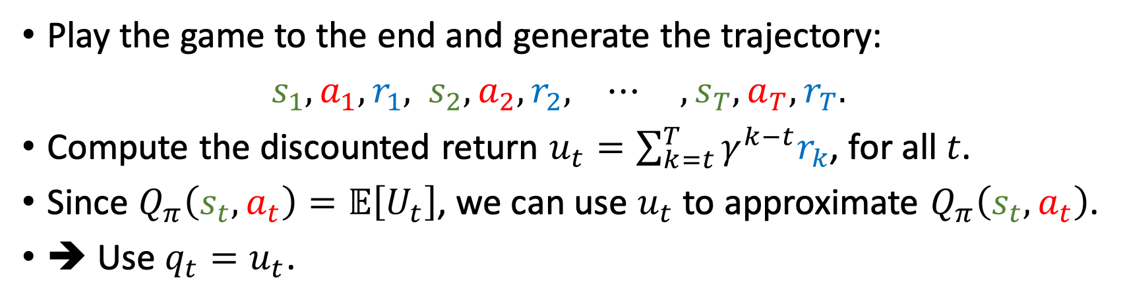
Algorithm
Observe the state $s_{t}$.
Randomly sample action $a_{t}$ according to $π\left(⋅ | s_{t};θ_{t}\right)$.
Compute $q_{t}≈Q_{π}\left(s_{t}, a_{t}\right)$ (some estimate).
Differentiate policy network: $d_{θ,t}=\frac{∂\log{π(a_{t}|s_{t},θ)} }{∂ θ}￨_{θ=θ_{t}}$.
(Stochastic) policy gradient: $\tilde{g}\left(θ_{t}\right)≈q_{t}⋅d_{θ,t}$.
Update policy network: $θ_{t+1}=θ_{t}+β⋅\tilde{g}\left(θ_{t}\right)$.
How?
Option 1: REINFORCE.
Play the game to the end and generate the trajectory:
$s_{1}, a_{1}, r_{1},$ $s_{2}, a_{2}, r_{2}, ⋯ , s_{T}, a_{T}, r_{T}.$
Compute the discounted return $u_{t}=\sum_{k=t}^{T}{γ^{k−t}r_{k}}$, for all $t$.
Since $Q_{π}\left(s_{t}, a_{t}\right)=𝔼\left[U_{t}\right]$, we can use $u_{t}$ to approximate $Q_{π}\left(s_{t}, a_{t}\right)$.
➔ Use $q_{t}=u_{t}$.
Notes:
There are 2 options.
One is called the REINFORCE algorithm.
----
We play the game to the end and observe the trajectory: $s_{1}, a_{1}, r_{1},$ $s_{2}, a_{2}, r_{2}, ⋯ , s_{T}, a_{T}, r_{T}.$
==============
At the end of the game, all the rewards are observed, then we will be able to compute the discounted return $u_{t}=\sum_{k=t}^{T}{γ^{k}r_{k}}$.
They are no longer random variables; they are observed.
So we represent the return by lowercase $u_{t}$.
==============
Recall that the action-value function $Q_{π}$ is the expectation of $U_{t}$.
Here, uppercase $U_{t}$ is a random variable, while lowercase $u_{t}$ is the observation.
We can simply use the observation small $u_{t}$ to approximate the expectation, that is, $Q_{π}\left(s_{t}, a_{t}\right)$.
This is actually Monte Carlo approximation.
============
We use lowercase $u_{t}$ as a Monte Carlo approximation to the action-value function.
So, let $q_{t}$ in the algorithm be small $u_{t}$.
有两个办法近似小$q_{t}$。
----
第一个办法叫做REINFORCE算法。
算法是这样的。
-----
用“策略网络”pi来控制agent运动，从一开始一直玩到游戏结束。
把整个游戏的轨迹记录下来：$s_{1}, a_{1}, r_{1},$ $s_{2}, a_{2}, r_{2}, ⋯ , s_{T}, a_{T}, r_{T}$
==========
观测到了所有的奖励r ，我们就可以算出来 return $u_{t}$，用这个公式。。。。。
$u_{t}$ 是所有奖励r 的加权求和。
==========
由于价值函数$Q_{π}\left(s_{t}, a_{t}\right)$ 是$U_{t}$的期望，
我们可以用$U_{t}$的观测值小$u_{t}$来近似$Q_{π}$。
所以，REINFORCE 算法就是用观测到$的小u_{t}$来代替$Q_{π}$函数。
-----
REINFORCE 算法 需要玩完 一局游戏，观测到所有的奖励，然后才能更新“策略网络”。

Slide 43
Algorithm
Observe the state $s_{t}$.
Randomly sample action $a_{t}$ according to $π\left(⋅ | s_{t};θ_{t}\right)$.
Compute $q_{t}≈Q_{π}\left(s_{t}, a_{t}\right)$ (some estimate).
Differentiate policy network: $d_{θ,t}=\frac{∂\log{π(a_{t}|s_{t},θ)} }{∂ θ}￨_{θ=θ_{t}}$.
(Stochastic) policy gradient: $\tilde{g}\left(θ_{t}\right)≈q_{t}⋅d_{θ,t}$.
Update policy network: $θ_{t+1}=θ_{t}+β⋅\tilde{g}\left(θ_{t}\right)$.
How?
Option 2: Approximate $Q_{π}$ using a neural network.
This leads to the actor-critic method.
Notes:
Another method is to approximate $Q_{π}$ using a neural network.
We have approximated the policy function using policy network.
We can further approximate the action-value function by a value network.
----
This leads to the actor-critic method.
The policy network is called actor, while the value network is called critic.
We will learn the actor-critic method in the next lecture.
计算价值函数$Q_{π}$的另一种方法是“用一个神经网络来做函数近似”。
原本已经用神经网络近似“策略函数”pi。
现在拿另一个神经网络来近似价值函数$Q_{π}$。
这样就有了2个神经网络。
一个被称为actor，另一个被称为critic。
这样就有了actor-critic 方法。
我下节课讲actor-critic 方法。

Slide 44
Summary
Notes:
总结一下这节课的内容。

Slide 45
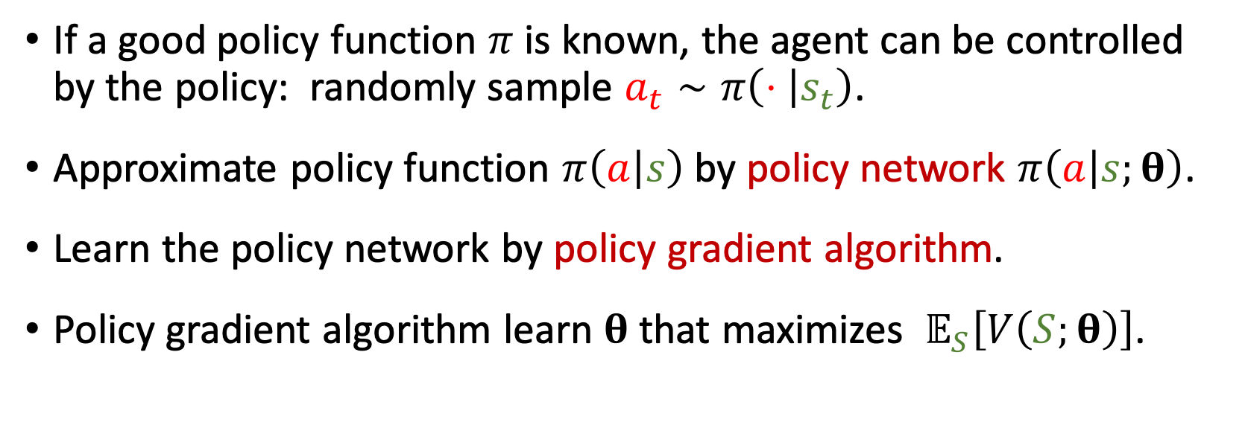
Policy-Based Learning
If a good policy function $π$ is known, the agent can be controlled by the policy: randomly sample $a_{t}∼π\left(⋅ | s_{t}\right)$.
Approximate policy function $π\left(a | s\right)$ by policy network $π\left(a | s;θ\right)$.
Learn the policy network by policy gradient algorithm.
Policy gradient algorithm learn $θ$ that maximizes $𝔼_{S}\left[V\left(S;θ\right)\right]$.
Notes:
We have studied policy-based learning.
We seek to find a good policy function $π$.
Once we have $π$, we can use it to control the agent.
Upon observing the current state $s_{t}$, we can use the policy function to compute probability distribution, and randomly sample an action accordingly.
======
Directly learning the policy function can be difficult, especially when the number of states is too big.
We can approximate the policy function by policy network.
The network is parameterized by $θ$.
======
We have derived the policy gradient.
It is the gradient of the state-value function w.r.t. $θ$.
We can learn the policy network by policy gradient ascent.
======
The objective function is the expectation of the state-value function V w.r.t. the state S.
Policy gradient ascent increases the objective function over time.
It means the policy network gets better.
这节课讲了Policy-Based Method策略学习。
------
我们希望得到策略函数pi，然后用pi自动控制agent运动。
每当agent观测到状态s_t，agent就用pi函数算一个概率分布，然后随机抽样得到动作a_t。
==========
直接求“策略函数”比较困难，所以我们要用神经网络来近似策略函数。
这个神经网络被称为policy network策略网络，记做 $π\left(a | s;θ\right)$。
==========
$θ$是神经网络的参数，一开始随机初始化，然后通过policy gradient “策略梯度”算法来学习参数$θ$。
这节课的主要内容就是推导“策略梯度”和 计算“策略梯度”。
==========
策略梯度，是价值函数$V$关于$θ$的导数。
算出了“策略梯度”，就做梯度上升来更新参数$θ$。
---
为什么要做梯度上升呢？
因为我们希望价值函数$V$越大越好；
目标函数是$V$关于状态S的期望。
这个目标函数可以 理解为 使用“策略函数”pi，agent的平均胜算有多大。
策略函数越好，这个目标函数就会越大，agent的平均胜算越大。

Slide 46
Thank you!
Notes:
这节课就到这里，感谢大家观看。
---
上节课讲了“价值学习”，这节课讲了“策略学习”。
要是把“价值学习”和“策略学习”结合起来，就有了actor critic方法。
我们下节课讲actor critic方法。

