Slide 1
ENGI 301 Air Quality Data Module PCB Proposal
16 October 2021
Samuel Xu

Slide 2
Background Information
What is being proposed?
Pictures of prototype
Links to your Hackster page / GitHub
What changes (if any) are you going to make based on your prototype?

Slide 3
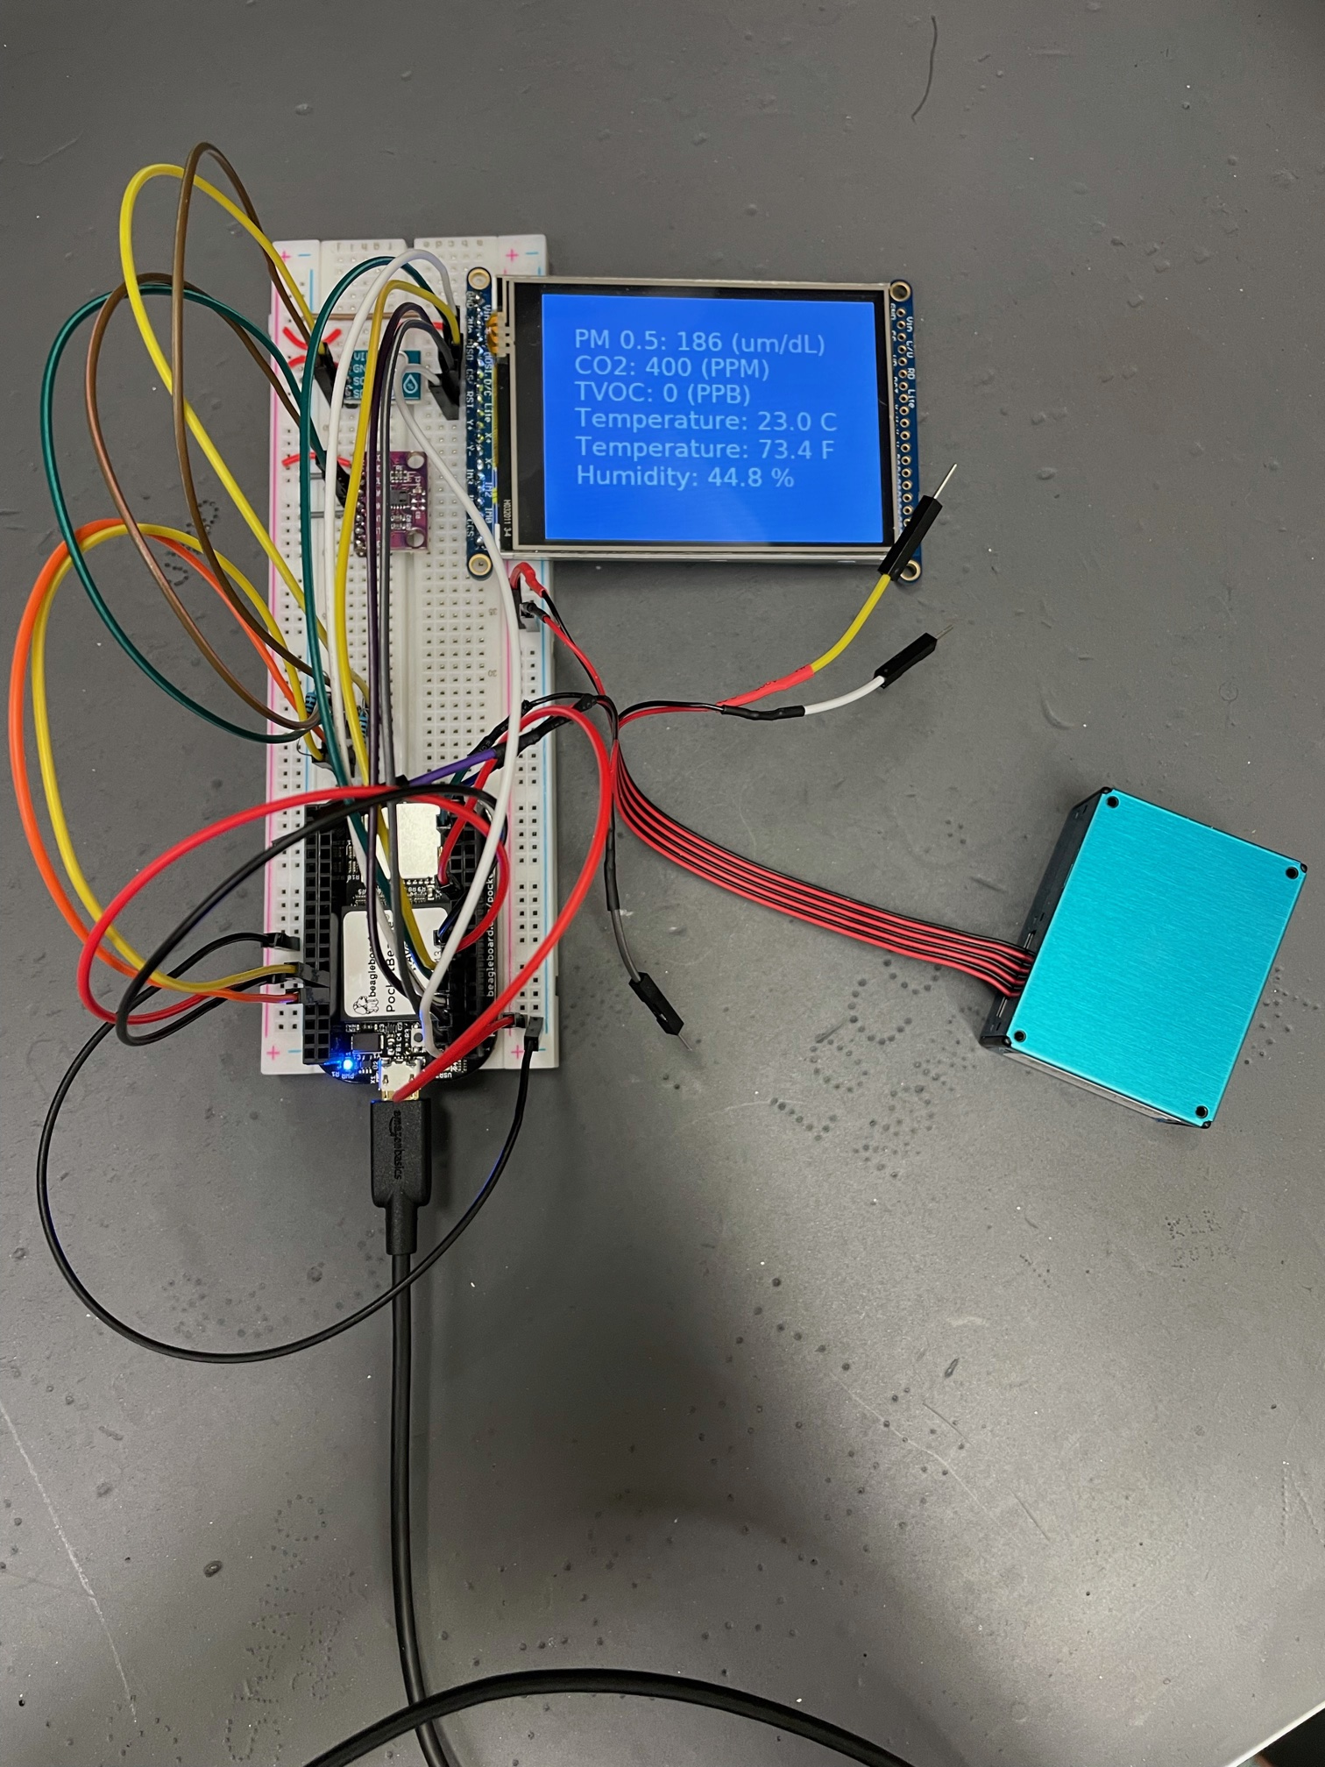
Background Information
Proposal of an air quality data collection and display system that includes:
PMx.x (generally 2.5 or 10 is used), humidity (%), temperature (both C and F), CO2 (PPM) and TVOC (PPB).
Planned Improvements
Run on startup
PCB adaptation
Creation of 3D printable / laser cut case
Exploring alternate or new sensors (ie: PMSA003I, which uses I2C instead of serial) to fix dust particle reading issues

Slide 4
System Block Diagram
Humidity & Temp (AHT10)
CO₂ & TVOC Sensor (CCS811)
PocketBeagle
Contains:
OSD3358
I2C1
Computer / 5V USB Power Supply
2.2” LCD Display
USB0
SPI0
Dust Sensor (PMS5003)
TX/RX
UART0

Slide 5
Mechanical Drawing
4”
2.2” LCD Display (3 ½” x 2 7/16”)
Pocket Beagle
2 1/8” x 1 3/8”
5V Power Supply (Optional)
USB
3.5”
PMS5003
1 15/16” x 13/16”
CCS811 (3/4” x 5/8”)
AHT10 (3/8” x 9/16”)
2”
FRONT
MIDDLE

Slide 6
Mechanical Drawing Pt. 2
The Mechanical Drawing is spread out over three stacked layers for more efficient packaging
The power supply and air quality sensor are much thicker in the unspecified dimension than the PocketBeagle.
A PCB may not be sufficient for every connection, some wires may need to be integrated.
4”
5V Power Supply (Optional)
3.5”
PMS5003 / PMSA0031
1 15/16” x 13/16”
BACK

Slide 7
Components Required
All the components required consist of:
PocketBeagle (already have)
CCS811 CO2 and TVOC sensor(already have)
AHT10 temperature and humidity sensor (already have)
ILI9341 LCD screen (already have)
PMS5003 Dust Sensor (already have)
PMSA0031 Dust Densor (try to replace)
PCB (to be designed and commissioned)
Wires / through hole pins / resistors (assuming not integrated to PCB) to join components
5V USB power supply (optional and mechanical drawing subject to change depending on sizes available

