Slide 1




Week 3 : Day 3 : Integration with ROS
#farcnitk

Slide 2

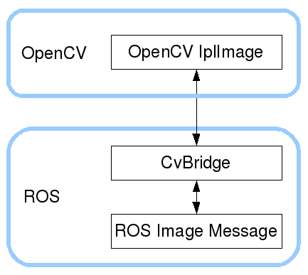
cv_bridge
This package contains CvBridge, which converts between ROS Image messages and OpenCV images.
Other packages we will need are
`ros-melodic-usb-cam`
`ros-melodic-image-view`
Problem - Write a node with some functionality that subscribes and publishes ROS Image Messages using a Python script.
Subscribe to /usb_cam/image_view
Publish to /image_topic
Name of the node node_image_converter
#farcnitk

