Slide 1




Week 3 : Day 2 : OpenCV Terminology
#farcnitk

Slide 2

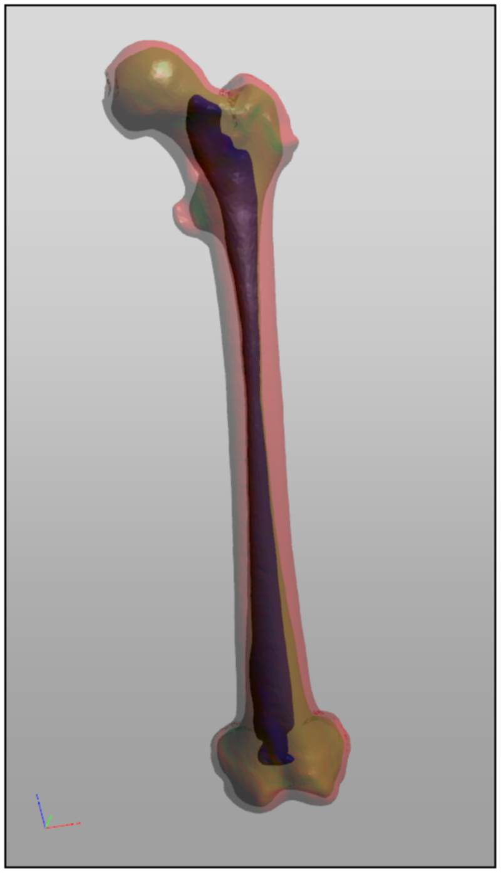

Image Segmentation
The process of partitioning a digital image into multiple segments (sets of pixels, also known as image objects).
The goal of segmentation is to simplify and/or change the representation of an image into something that is more meaningful and easier to analyse.
Some ways to segment an image are
Thresholding
Edge Detection
Model-based Segmentation
Others…
#farcnitk

Slide 3
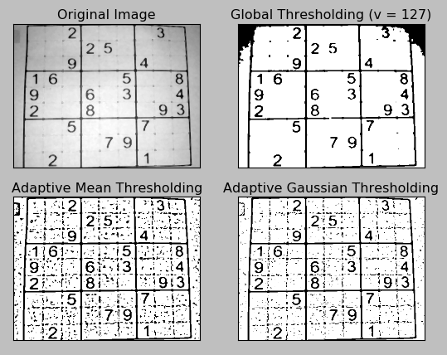
Thresholding
The simplest method of image segmentation.
This method is based on a clip-level (or a threshold value) to turn a grayscale image into a binary image.
The key of this method is to select the threshold value (or values when multiple-levels are selected).
Some ways to threshold an image are
cv.THRESH_BINARY
cv.THRESH_BINARY_INV
cv.THRESH_TRUNC
cv.THRESH_TOZERO
cv.THRESH_TOZERO_INV
#farcnitk

Slide 4
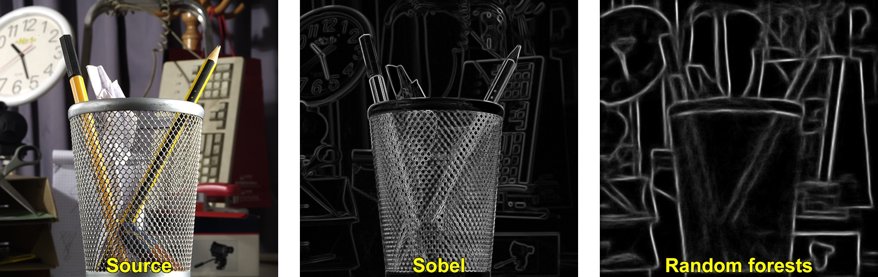
Edge Detection
Region boundaries and edges are closely related, since there is often a sharp adjustment in intensity at the region boundaries.
This method is generally used as a pre-process.
Some usages are in contour detection, object recognition, etc.
Some ways to perform edge detection on image are
cv.SOBEL
cv.CANNY
cv.LAPLACIAN
#farcnitk

Slide 5
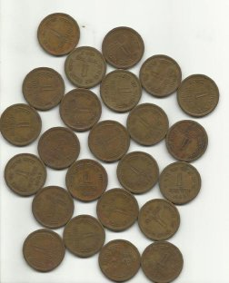
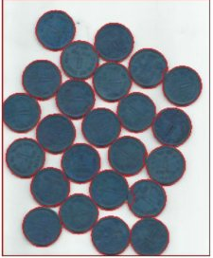
Model Based Segmentation
Used when the structures of interest have a tendency towards a particular shape.
One can seek a probabilistic model that characterizes the shape and its variation. When segmenting an image, constraints can be imposed using this model as a prior.
Some usages are in crime-scene analysis, general object detection.
#farcnitk

