Slide 1
UAM Trajectory Optimisation

Slide 2
Background
Urban Air Mobility Vehicles are an emerging field within aerospace and transportation
Increased air traffic, specifically within urban centres could have negative effects
Most previous research involves optimising design to minimise noise output, for example propellor design
There is significant work from Clarke M et Al performing different comparisons of noise footprint of the main UAM configurations utilising SUAVE

Slide 3
Project Goal and Aims
Implement and utilize previous SUAVE work by Clarke M et al for the analysis of UAM vehicles
Create a representational analysis using SUAVE to represent the landing approach of a typical UAM vehicle configuration
Carry out a minimization of the noise the surrounding area experience by altering various elements of the approach path in order to determine an optimal path that can be implemented by operational planners (eg ATC)

Slide 4
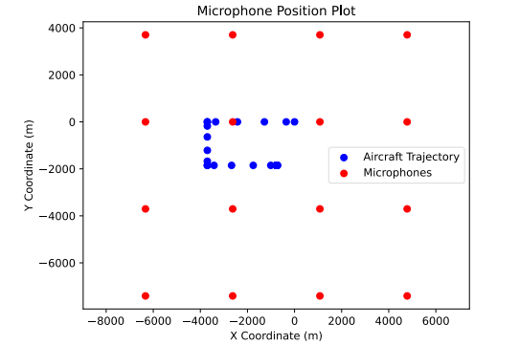
Noise
SUAVE uses a Frequency-Domain approach solving Ffowcs-Williams and Hawking's Governing equation.
Noise calculated utilizing a grid of microphones set up around the approach path at ground level
Two different methods were used to quantify the overall noise experienced and then passed into a PSO.

Slide 5
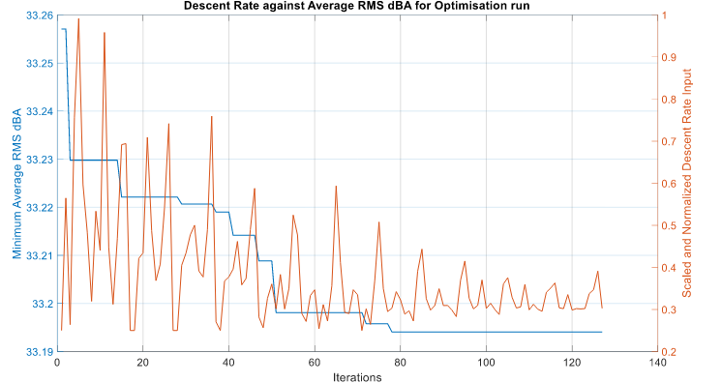
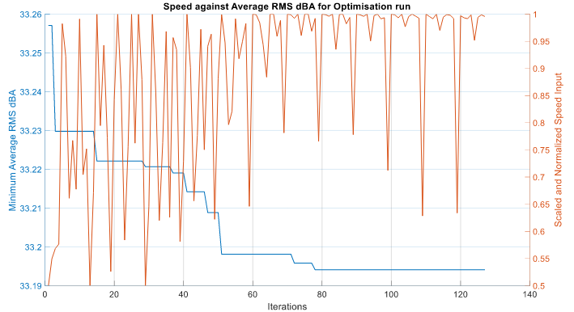
Results
A Continuous Descent Approach found to be optimal when considering the RMS of the A-Weighted dBA
When considering the average of the maximum recorded dBA, the optimal path involved a very different approach

