Slide 1
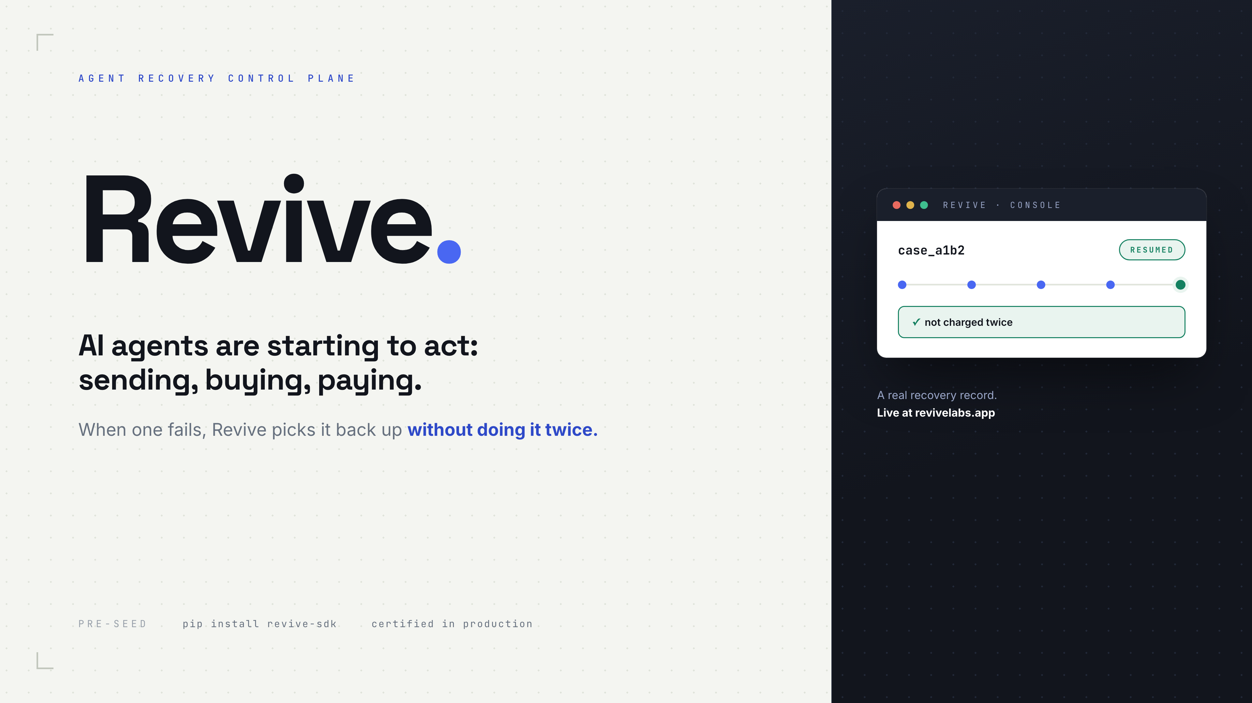

Slide 2
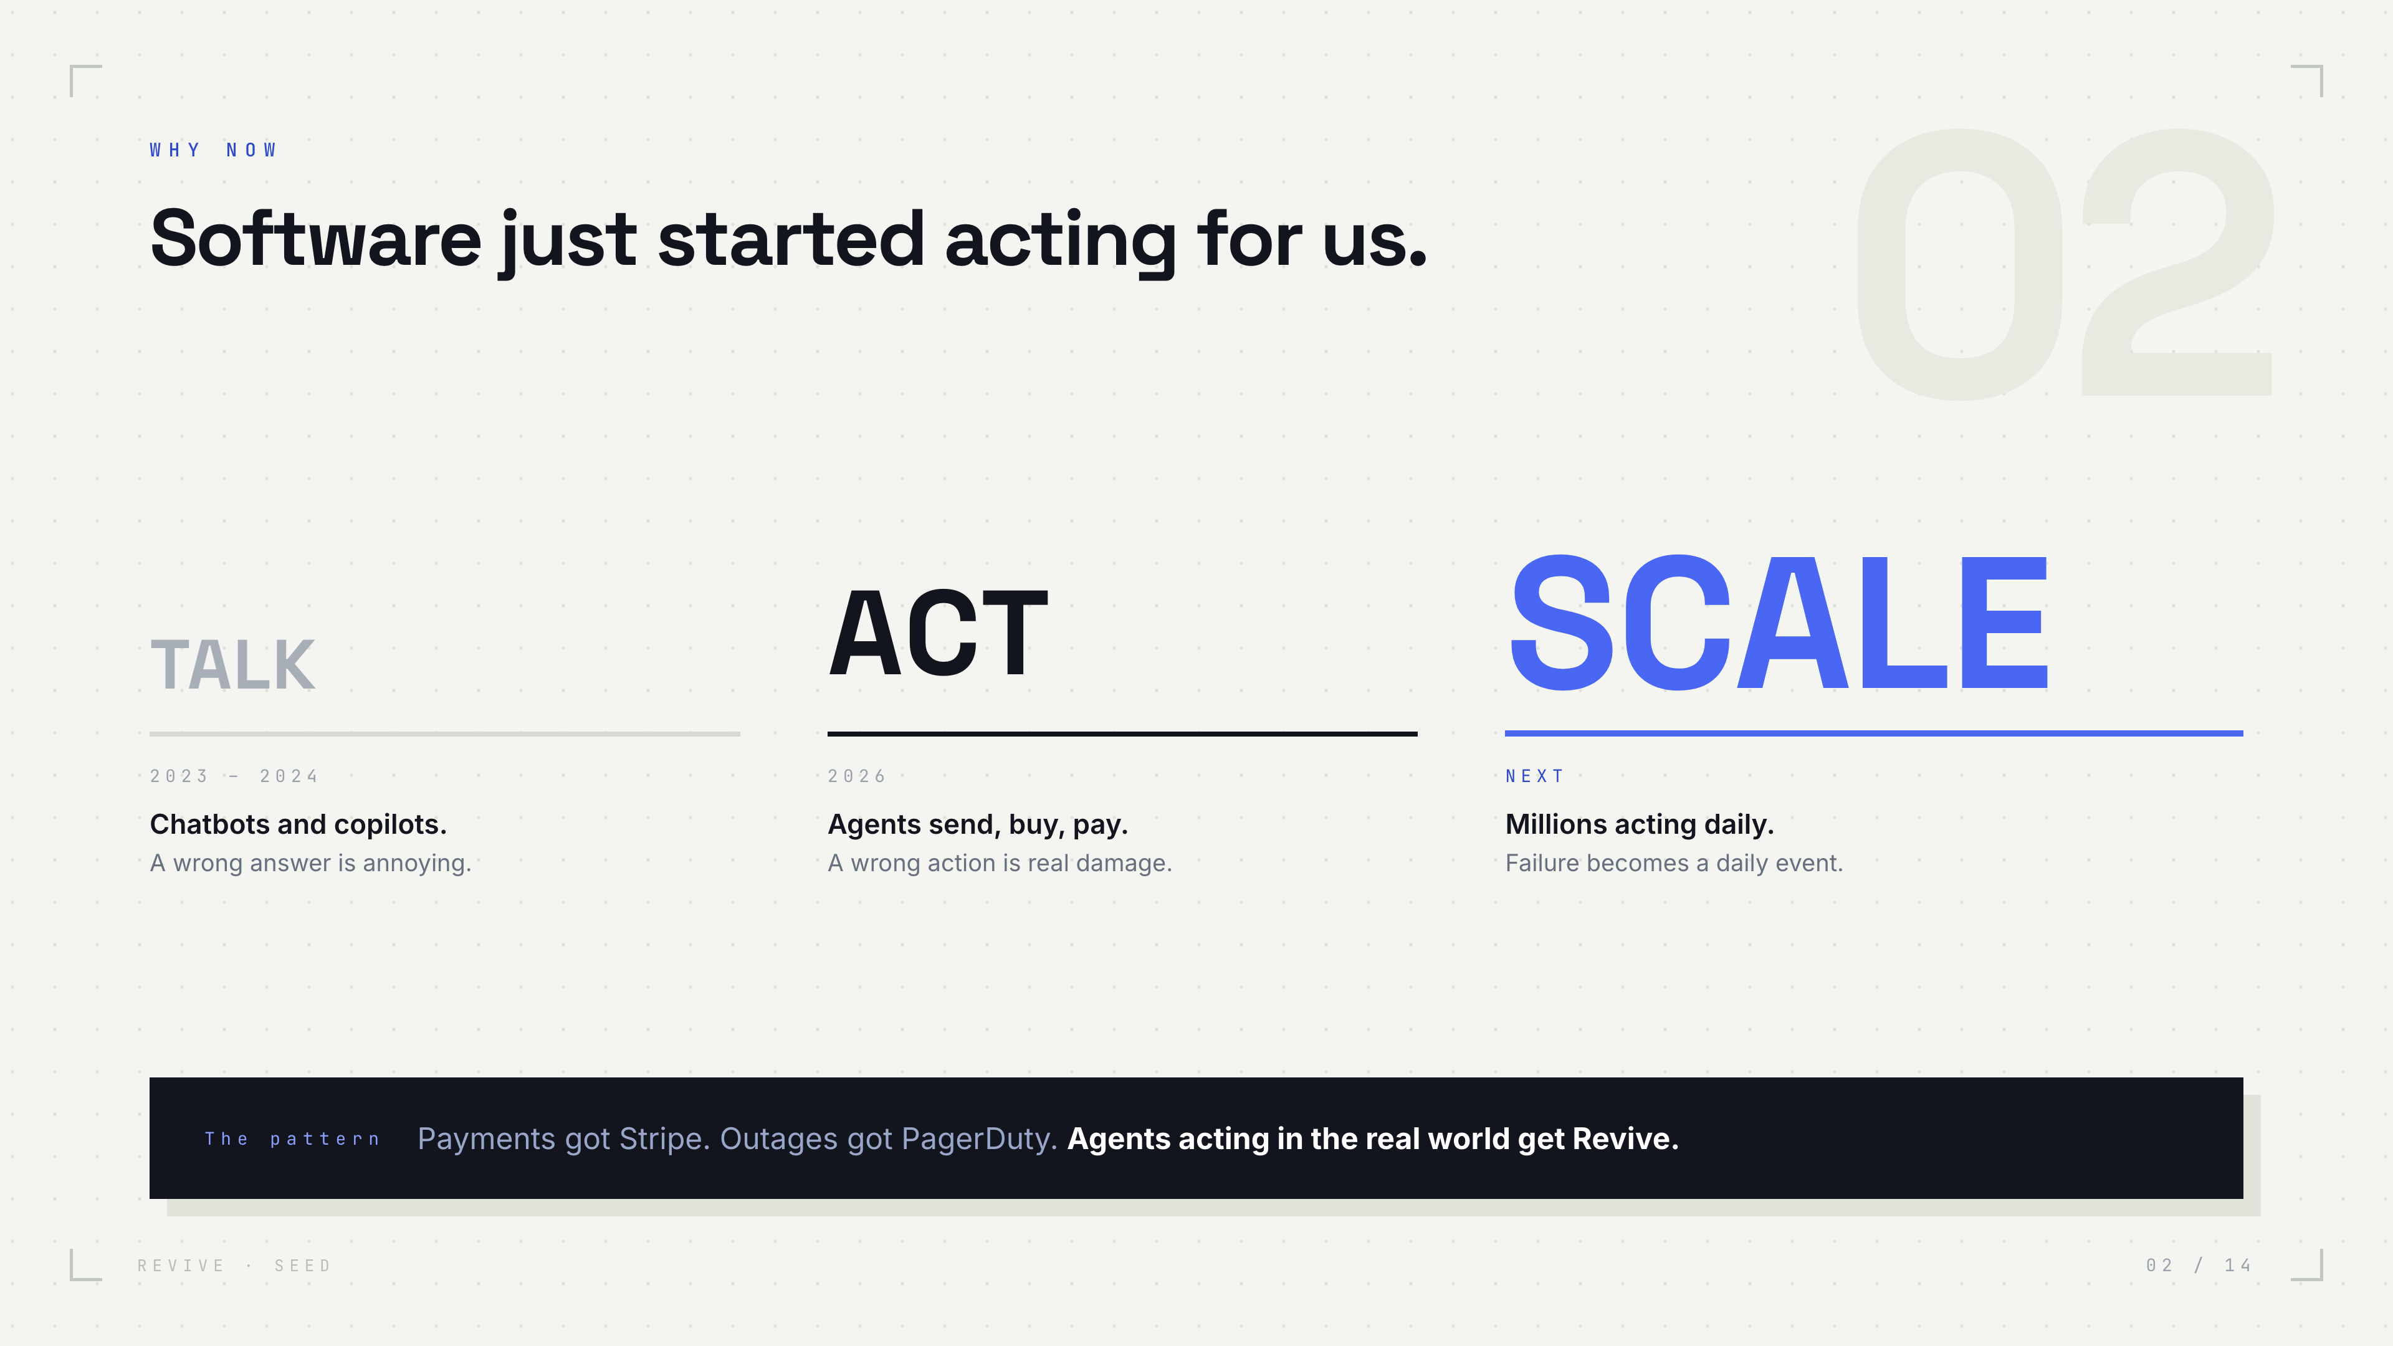

Slide 3
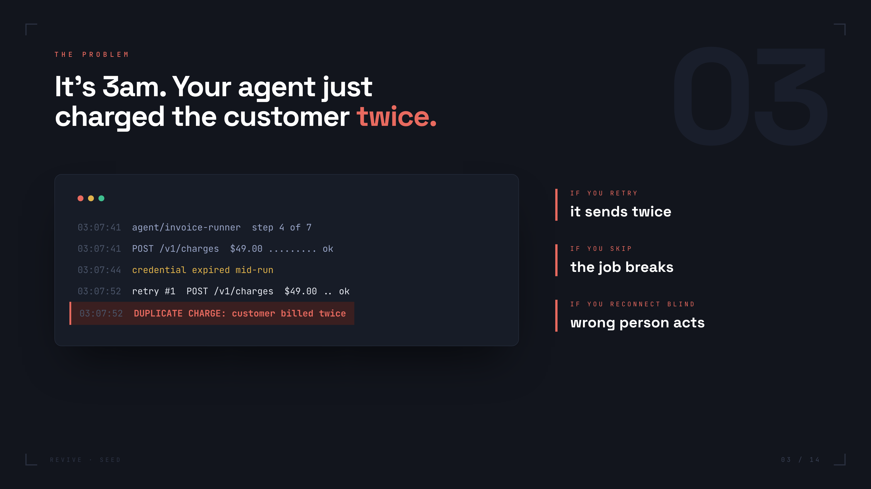

Slide 4
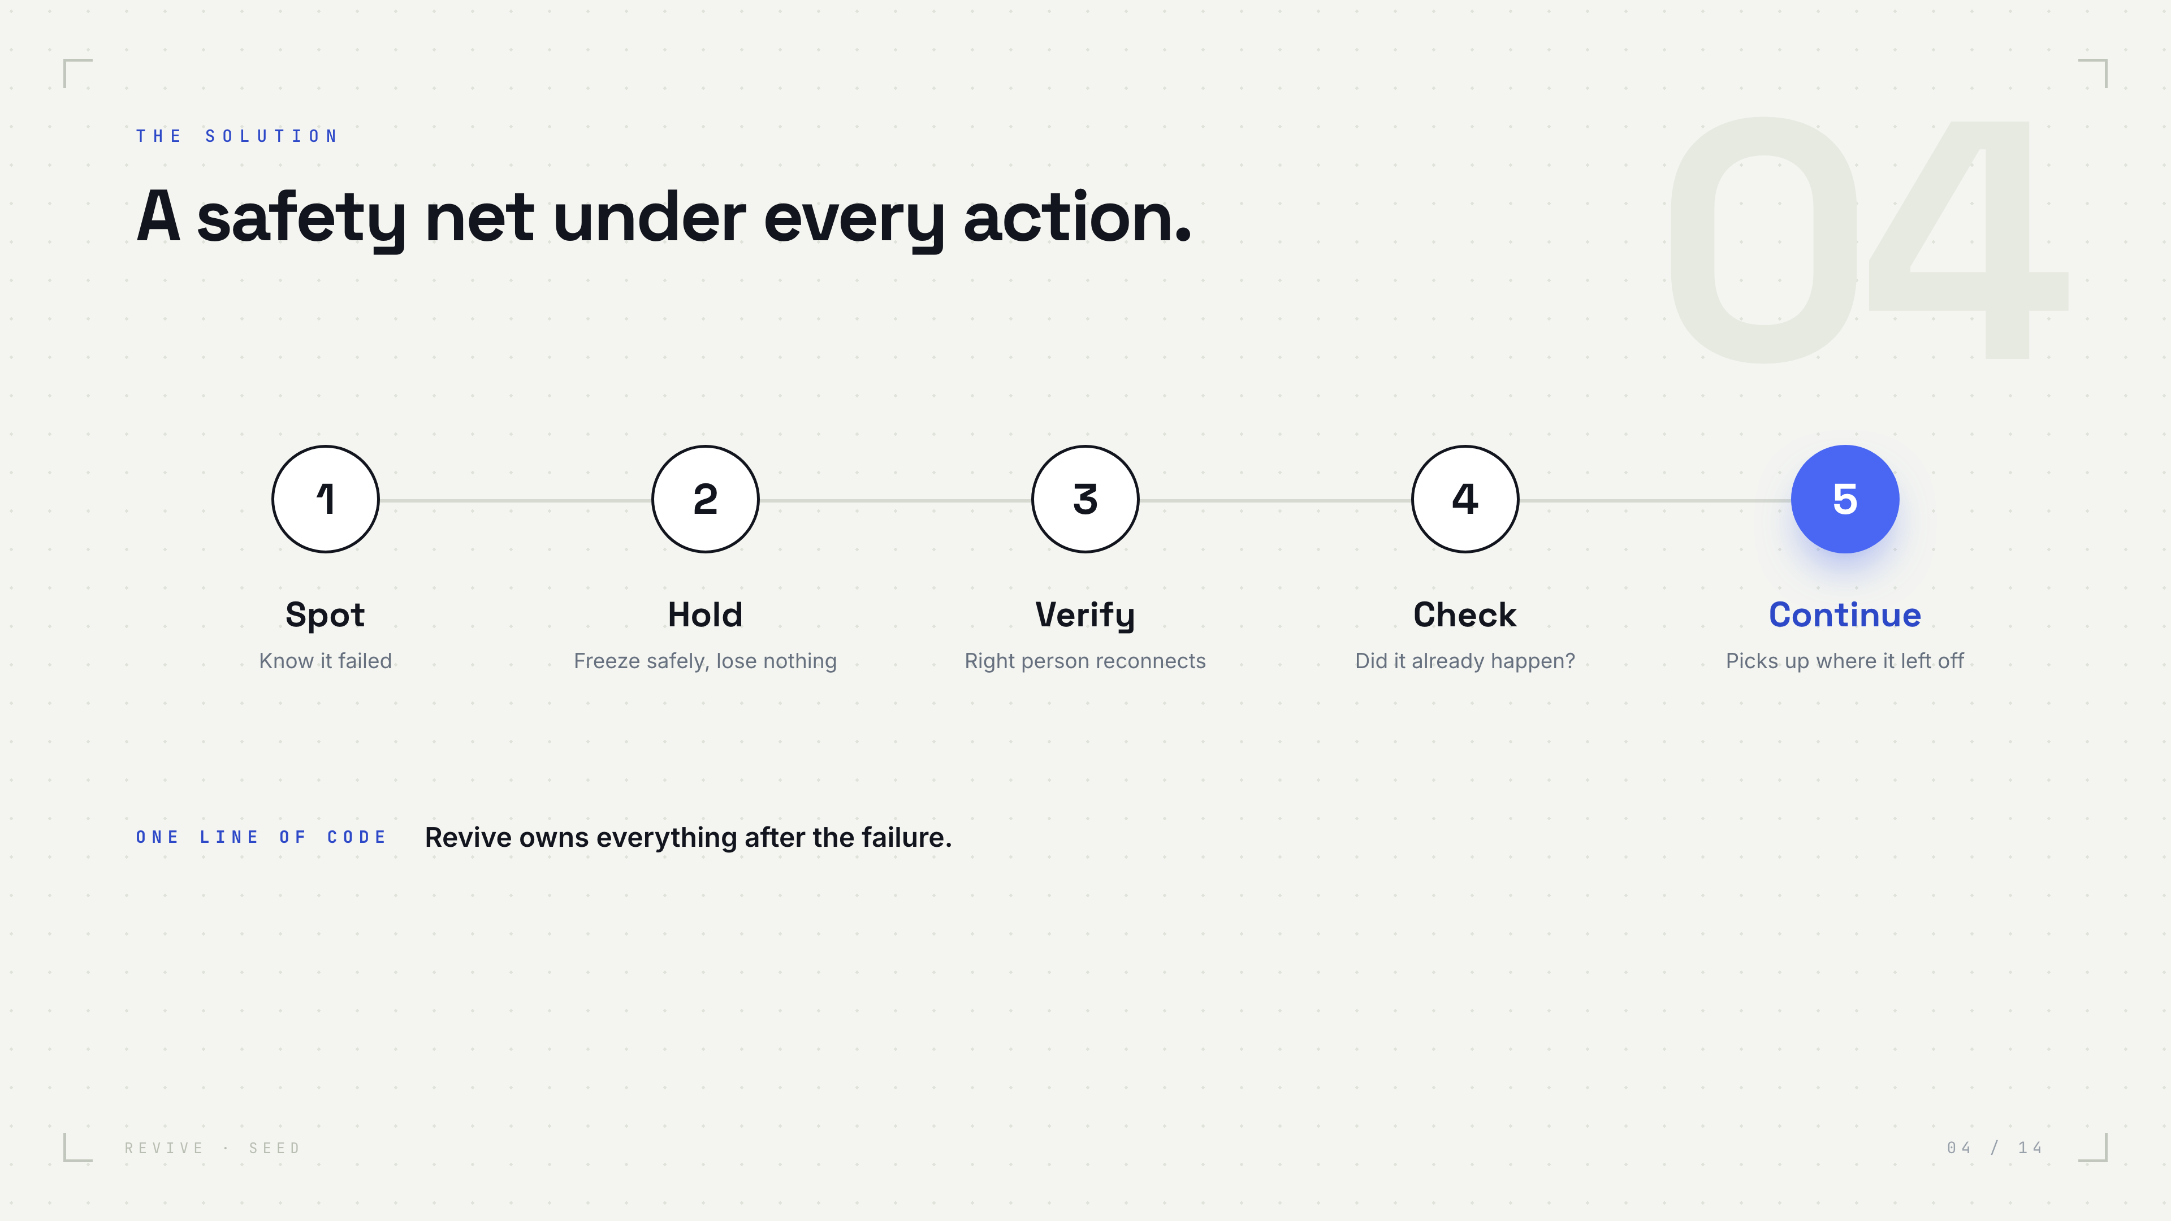

Slide 5
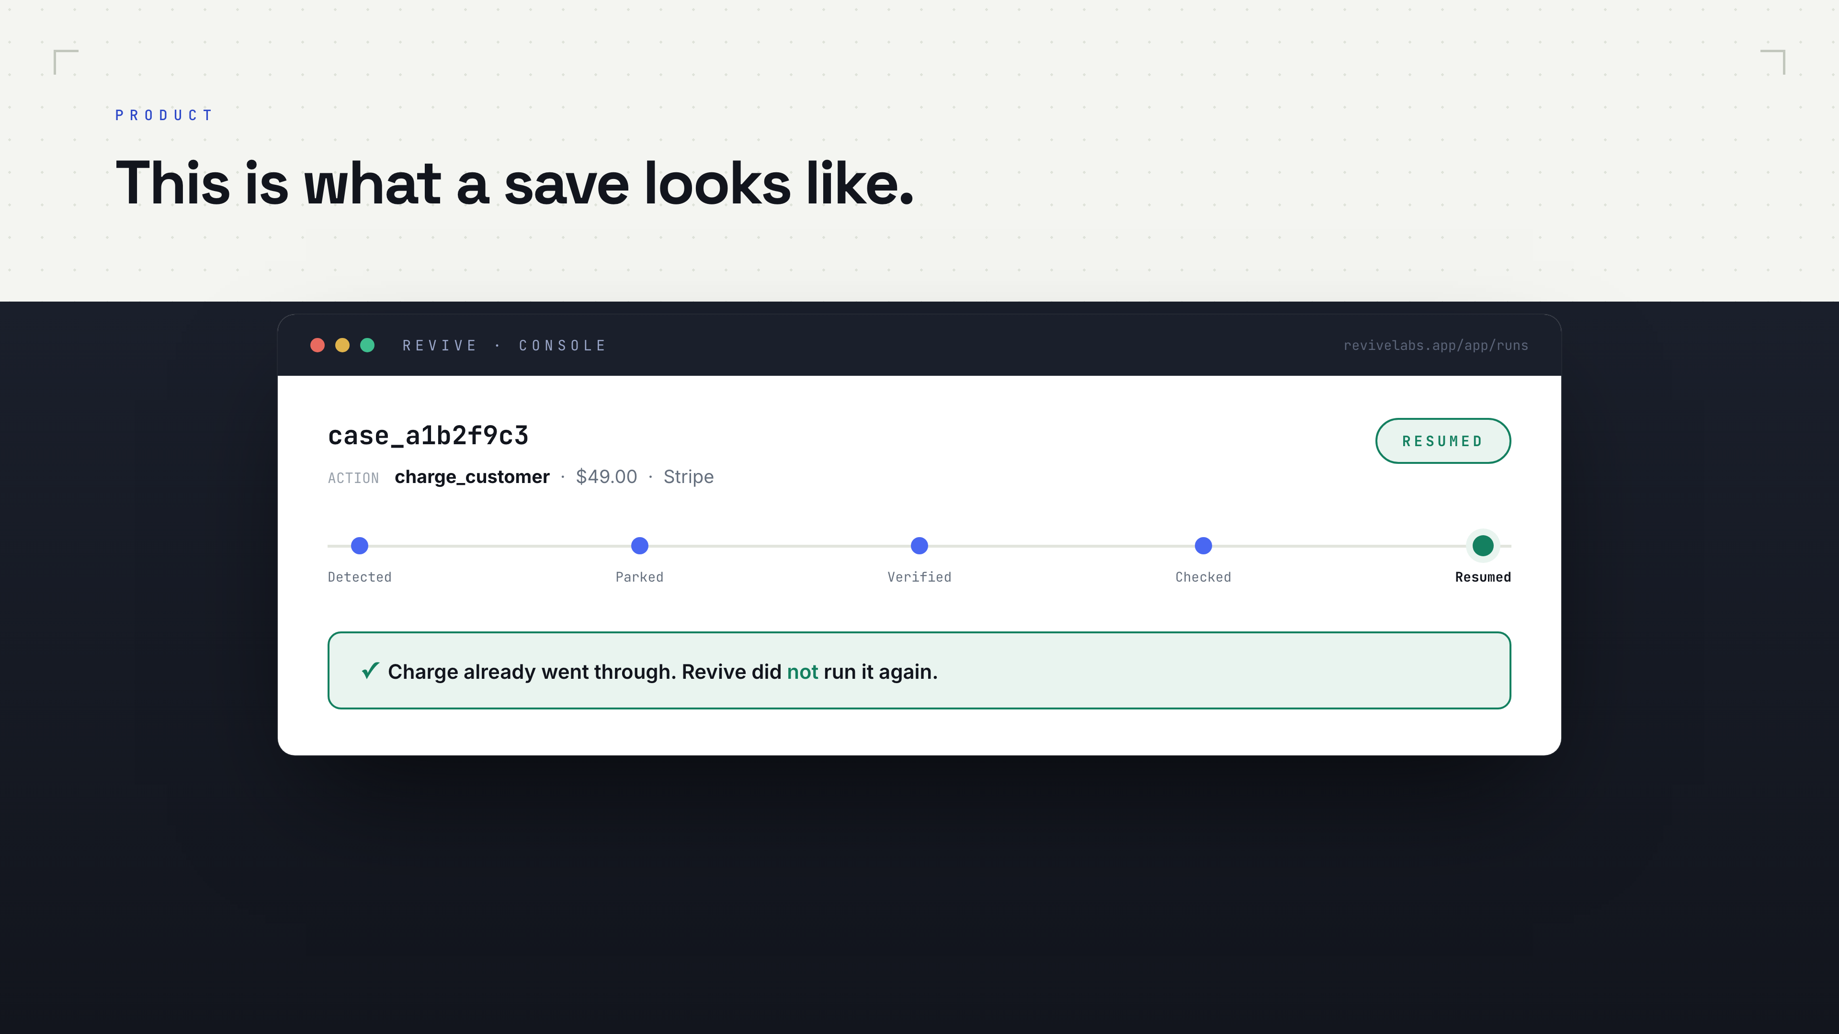

Slide 6


Slide 7


Slide 8
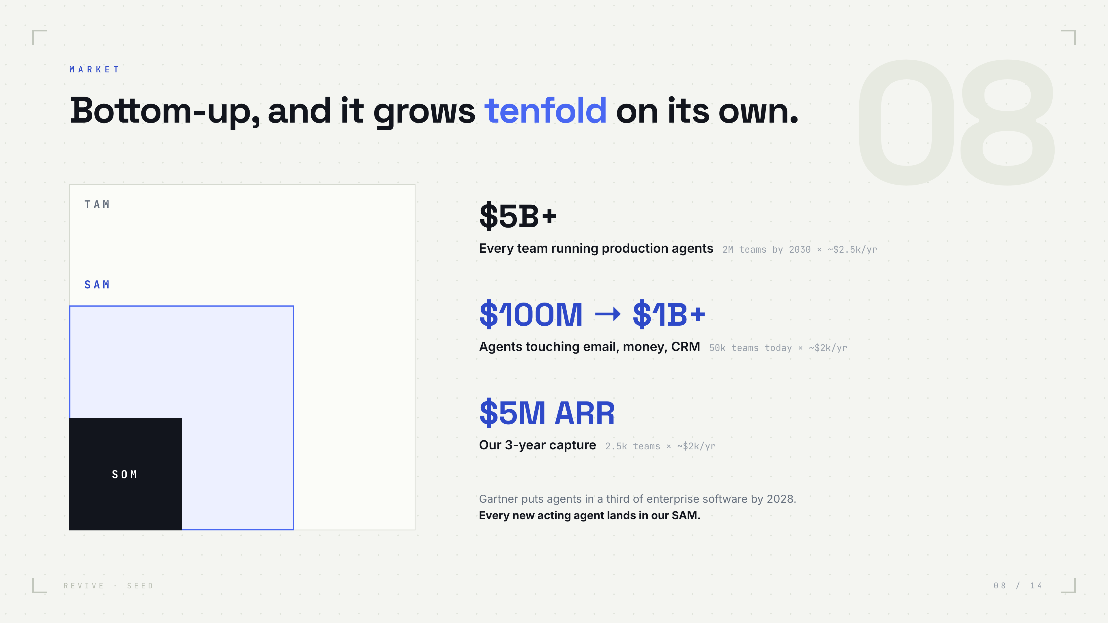

Slide 9


Slide 10


Slide 11
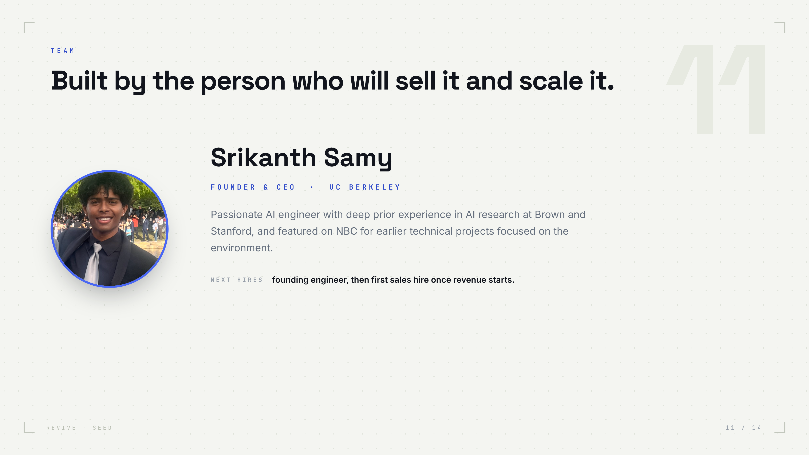
Notes:
TO FINISH: drop headshots into decks/photos/ss.png, rg.png, ap.png and rerun python3 html_deck.py. Add one real credential per founder line. Titles: Srikanth CEO, Revanth CTO, Aarush Eng.

Slide 12


Slide 13
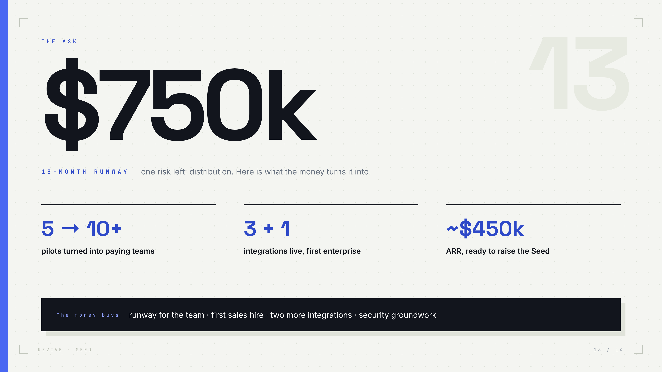

Slide 14
