Slide 1
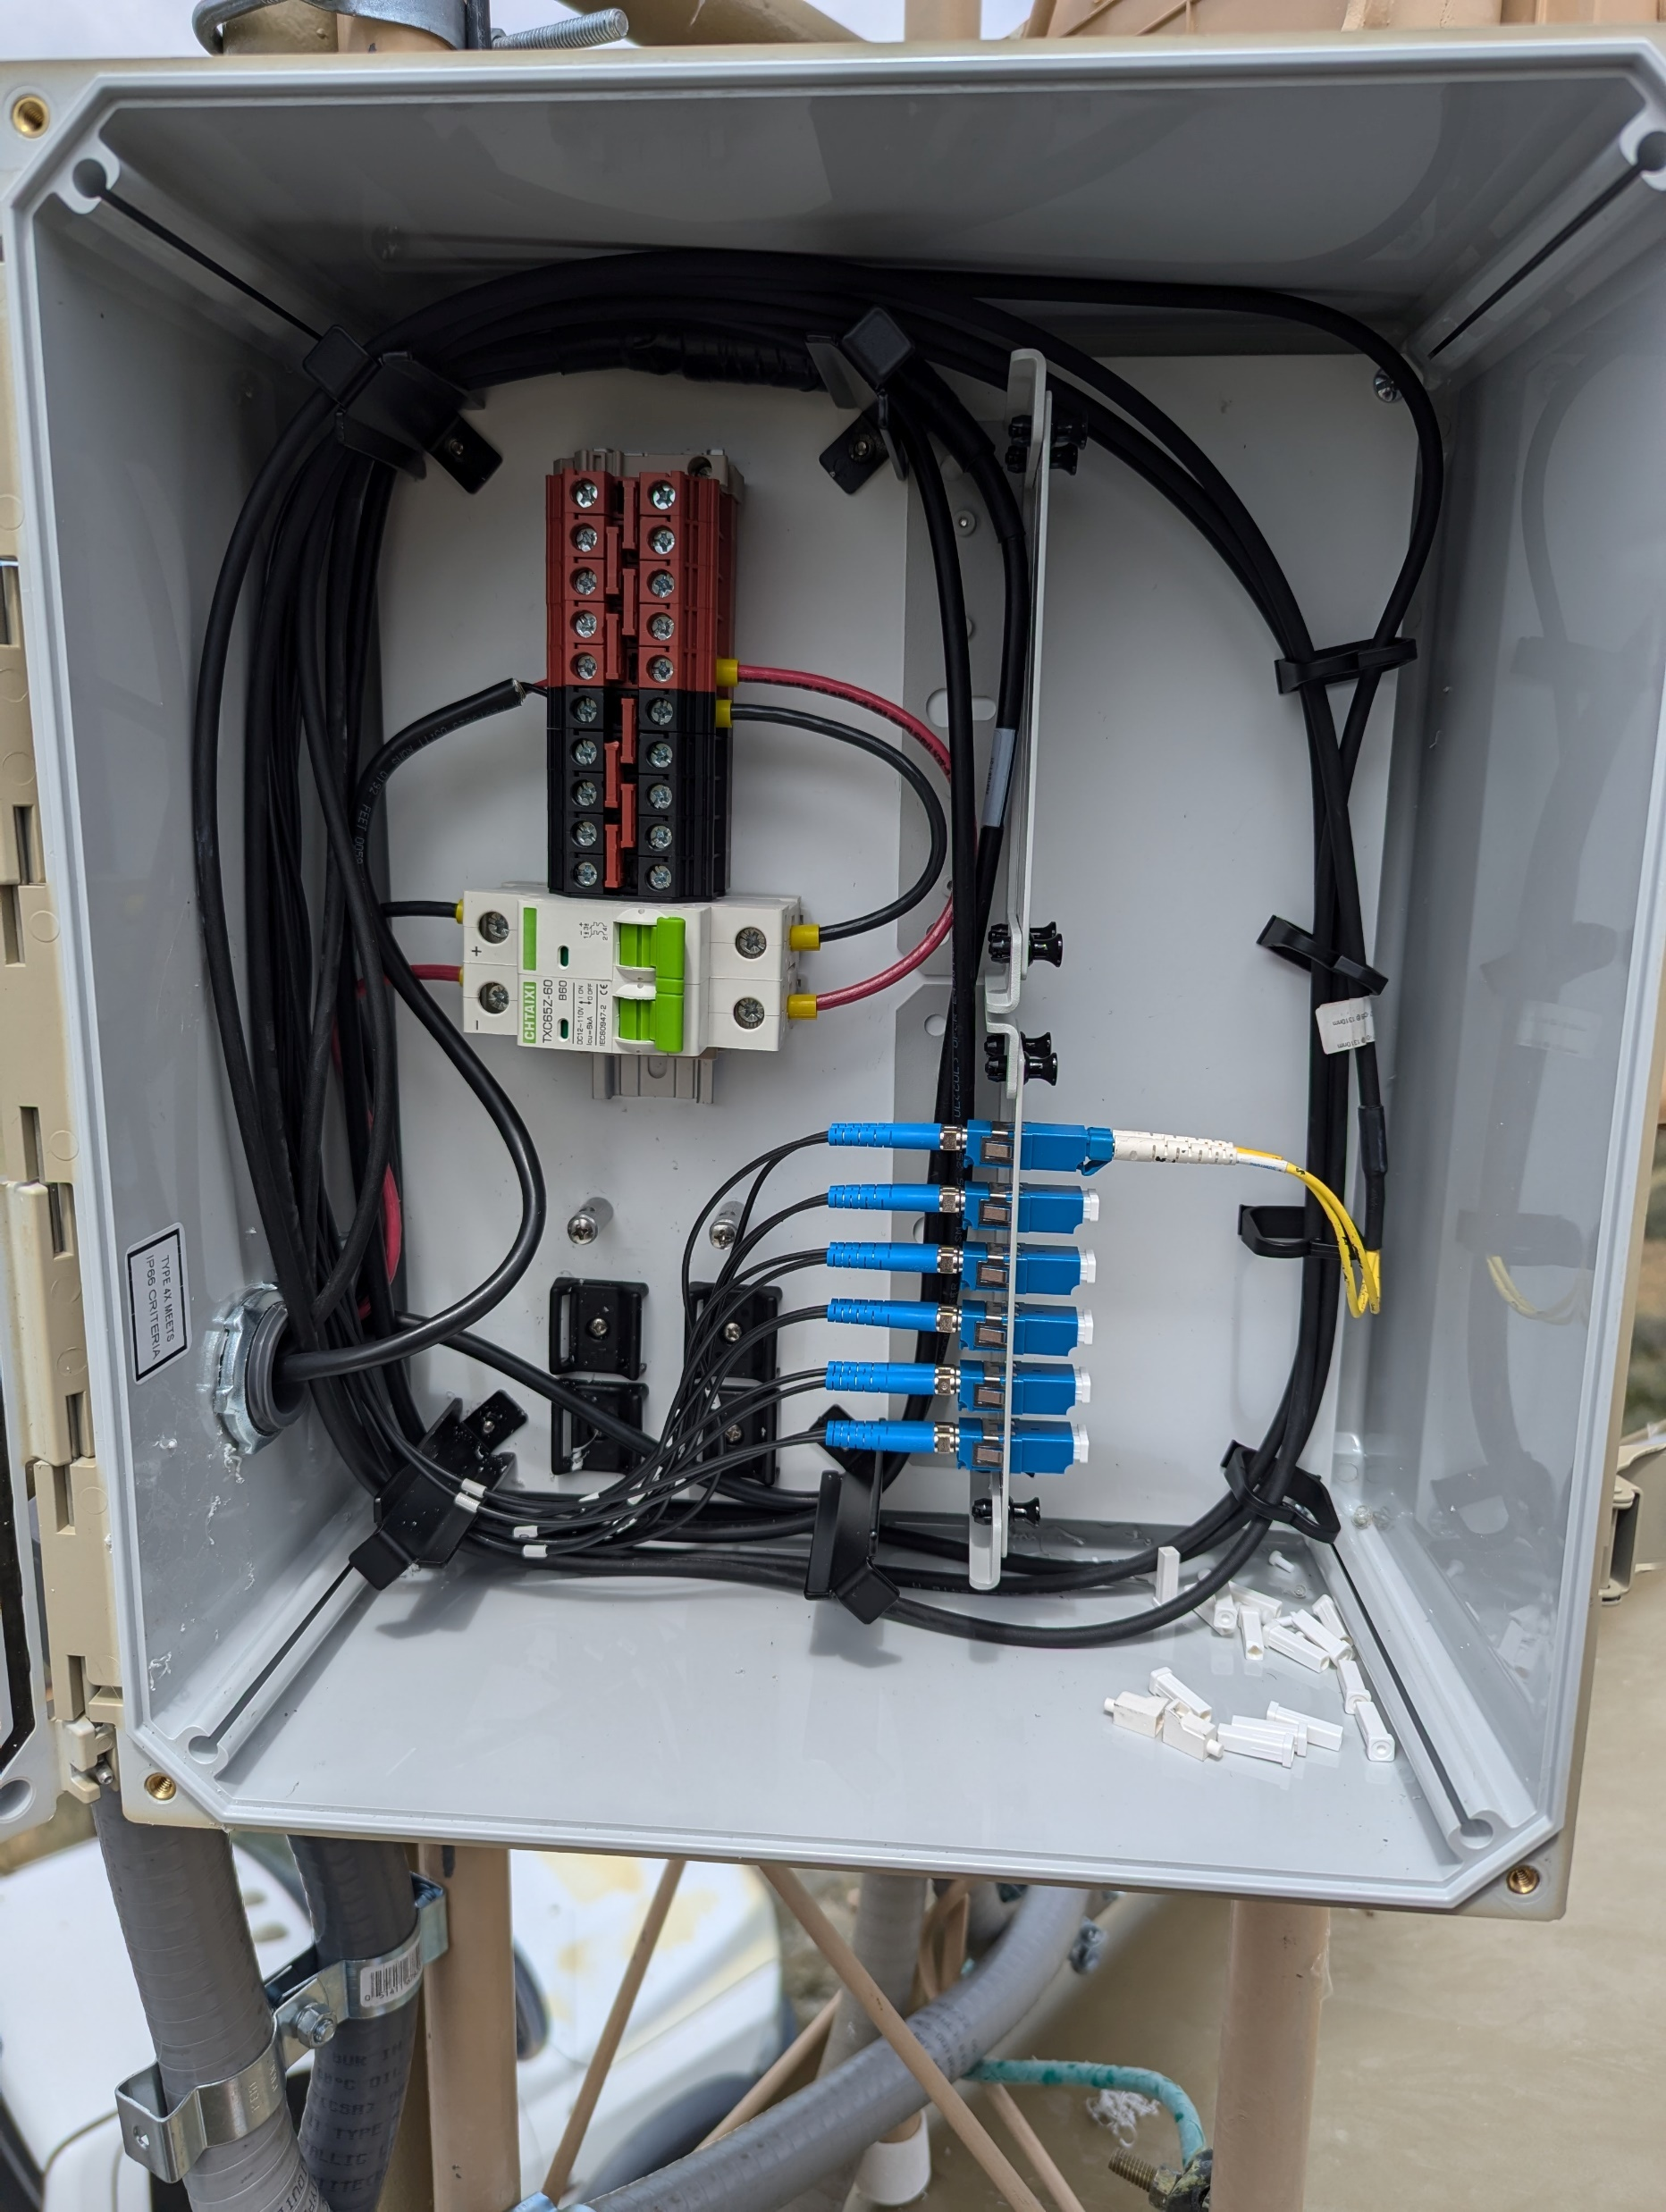
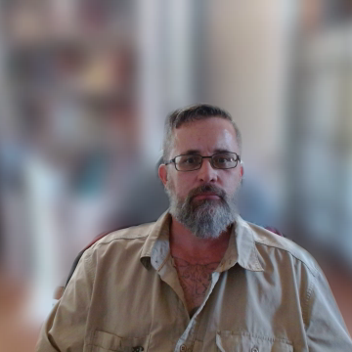
Intelligent Tower Mounted Distribution Node
Caleb Quisenberry
University of Advancing Technology
SIP Majors; Network Engineering and Network Security
SME - Dr. Becote
Notes:
Hello and welcome, my name is Caleb Quisenberry, and I’m presenting my project on the Intelligent Tower-Mounted Distribution Node. This project is part of my work at the University of Advancing Technology, where I’m majoring in both Network Engineering and Network Security. Today, I’ll be taking you through the key problems facing RF communications infrastructure, the solution I’ve developed, and the innovations that make it unique.

Slide 2
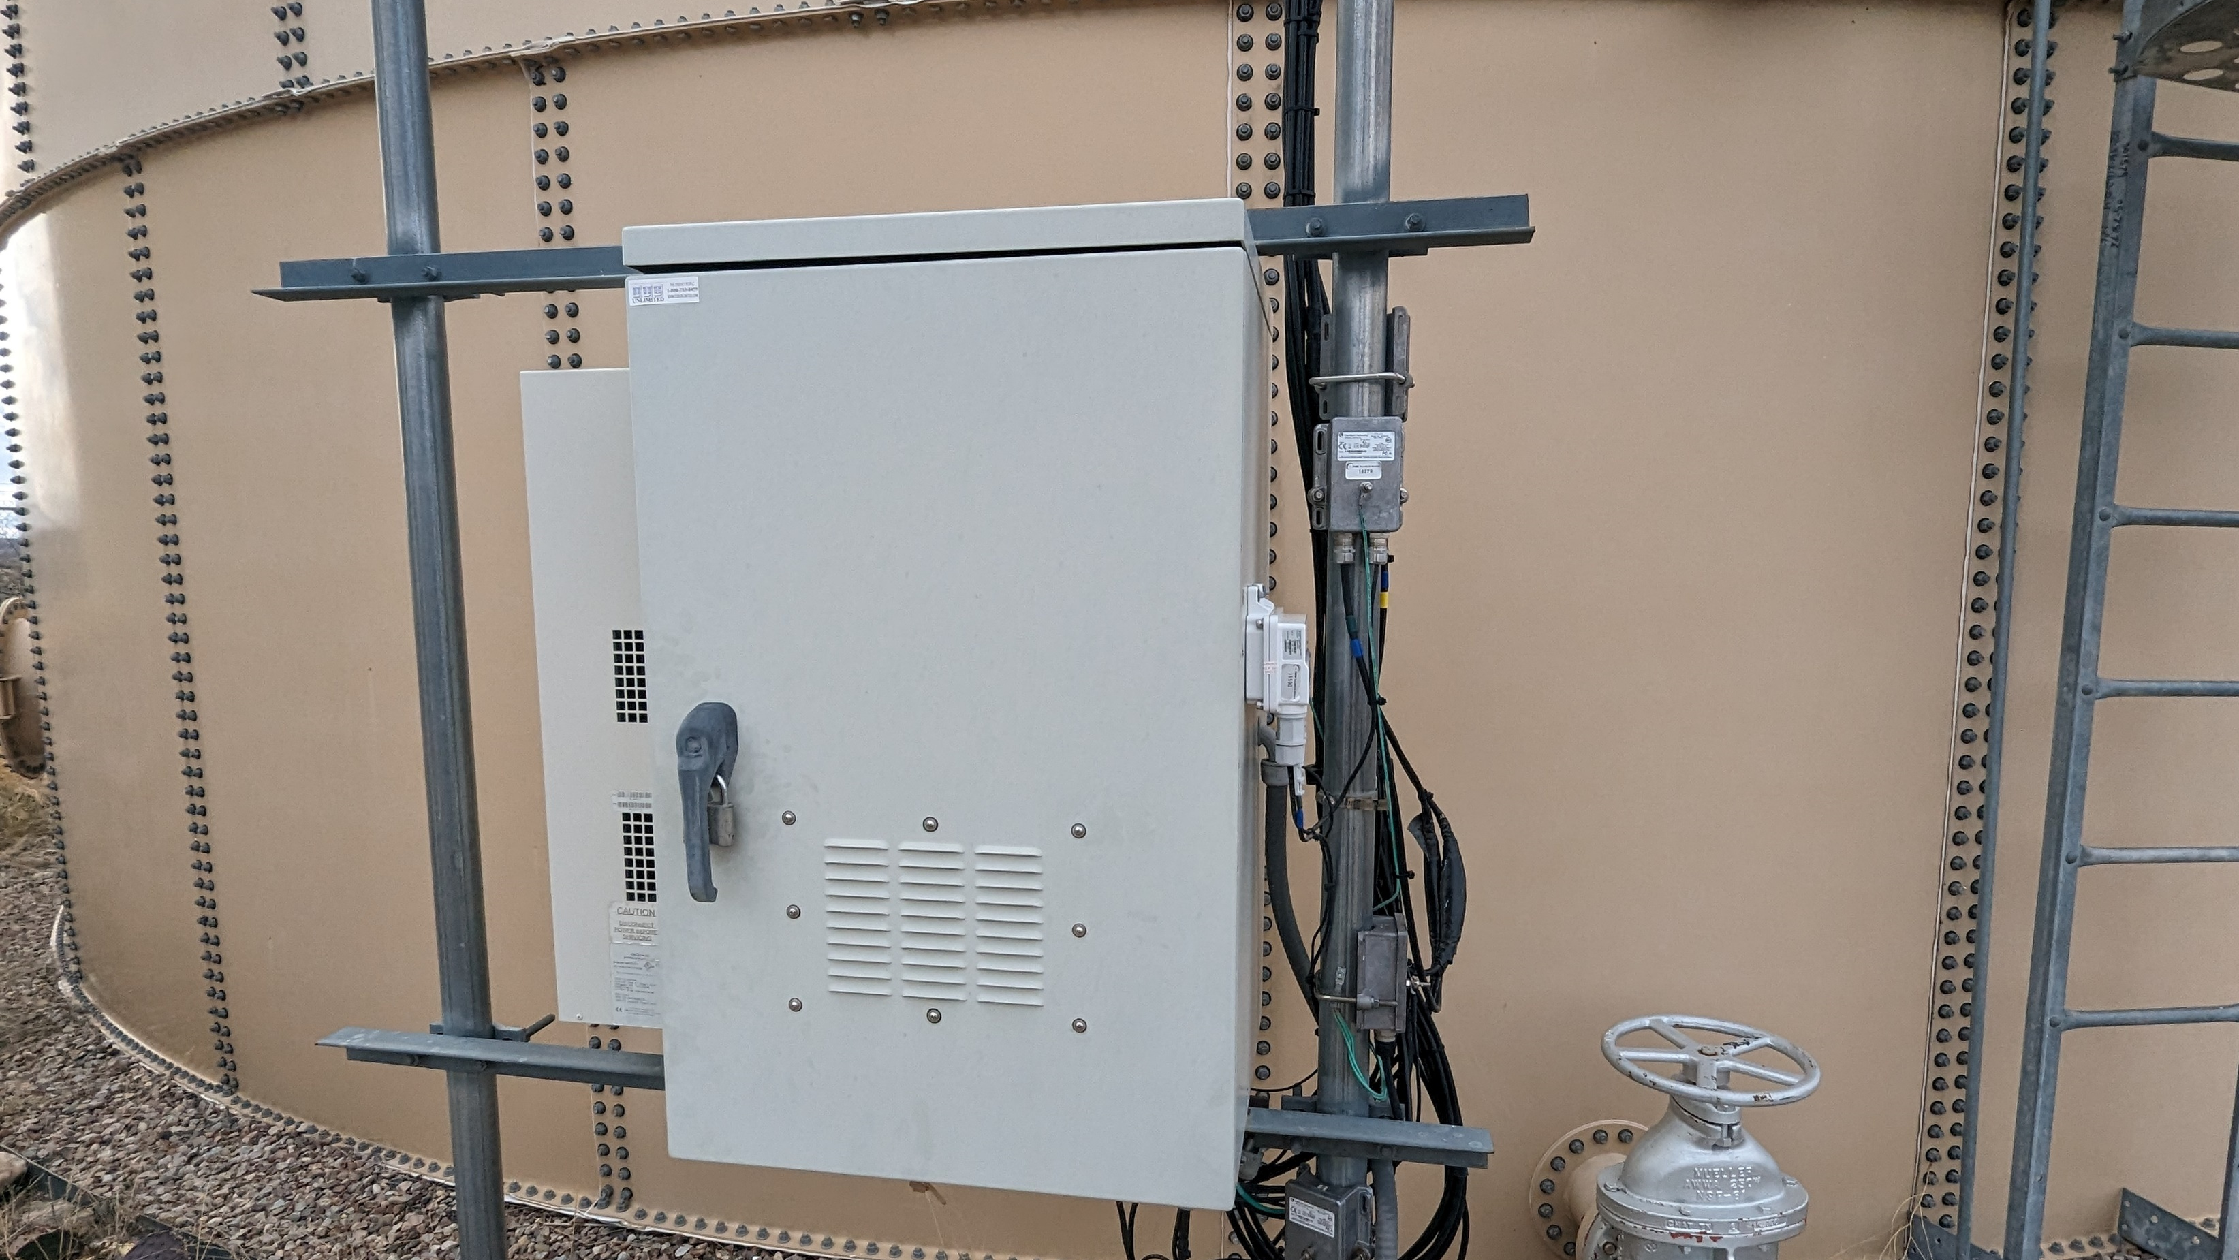
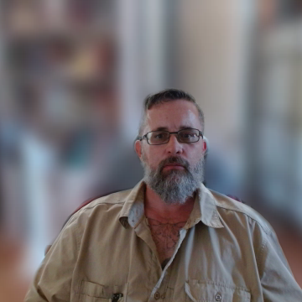
Infrastructure Challenges in RF Communications
Notes:
To begin, let’s discuss the primary problem. Current RF communications towers suffer from high costs and disorganization, largely due to the need for multiple cable runs for each radio on a tower. This creates complex maintenance requirements and poses significant challenges when expanding sites. The disorganized cabling can also become a potential security issue, which means there’s a real need for cost-effective solutions that simplify power and fiber distribution while maintaining security and ease of expansion.

Slide 3
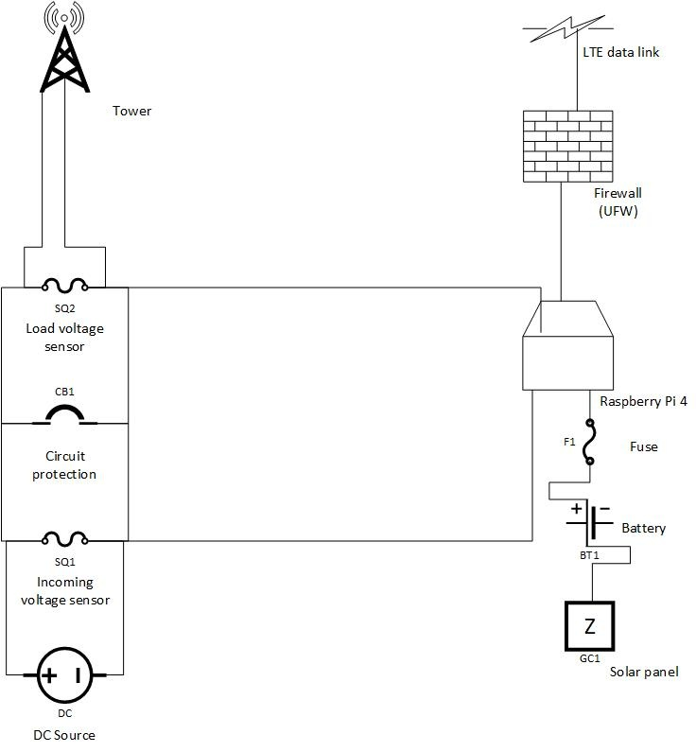

Intelligent Tower Mounted Distribution Node
Notes:
My solution is the Intelligent Tower-Mounted Distribution Node. It’s an integrated system designed to handle both power and fiber distribution in a single, efficient unit. What makes this solution stand out is the inclusion of DC circuit monitoring and remote diagnostics. By monitoring the system remotely, we reduce the need for expensive and dangerous climbs up the tower for maintenance. This significantly enhances tower safety, reduces operational costs, and improves overall site security.

Slide 4

Key Innovations
Notes:
Here are some of the key innovations that my project brings to the table. First, the design is cost-efficient and modular, allowing for easy expansion as site demands grow. By offering remote diagnostics, we can drastically cut down the time and expense associated with sending technicians up the tower. There’s also the potential to add further functionality, such as monitoring environmental conditions or physical security sensors, like cameras. Overall, this solution improves safety, speeds up deployments, and keeps expansion costs manageable.

Slide 5
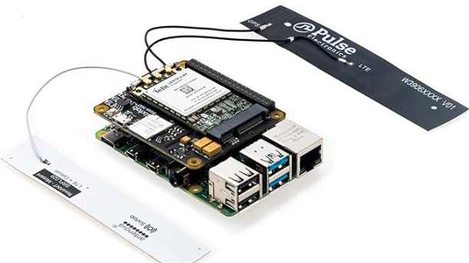
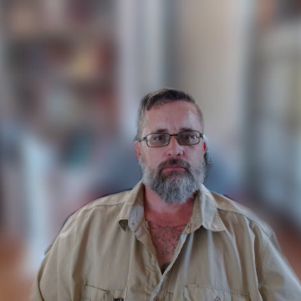
Skills and Technologies
Notes:
To implement this solution, I’m using several technologies. The microcontroller will be programmed in Python, handling both the circuit monitoring and alerting functions. I’ve also incorporated IoT security measures like firewalls and secure permission management. The alerts will be sent via email and SMS, ensuring that tower operators are always informed of any issues with the power distribution system.

Slide 6
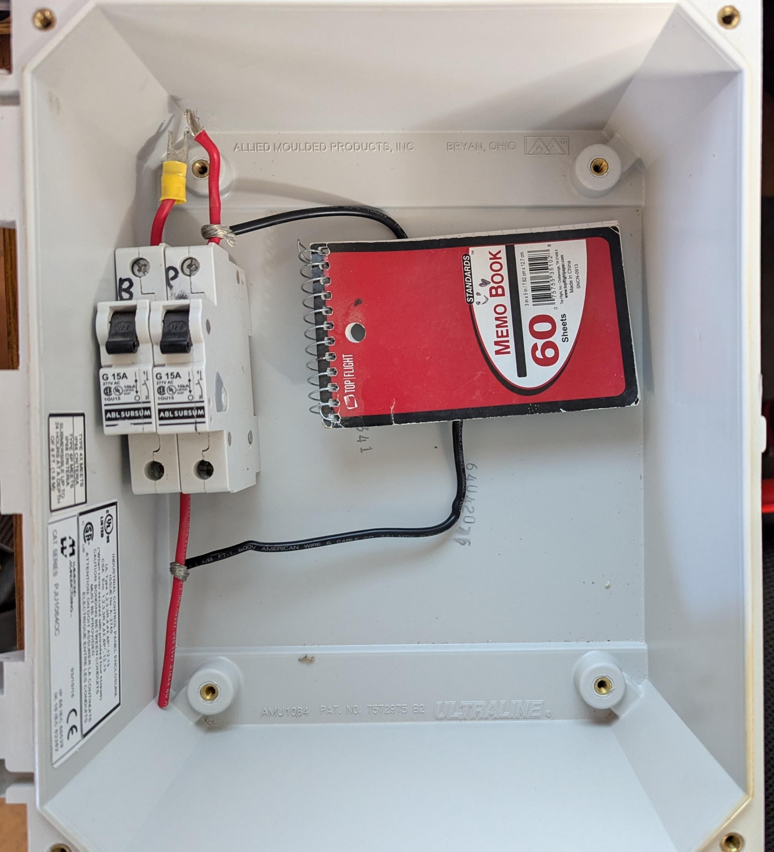
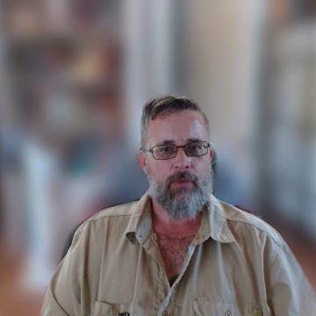
Design-Phase Prototype
Notes:
Here, you can see a physical representation of the design. At this point in development, a notebook stands in for the microcontroller as the hardware is still being shipped. While this is still a work in progress, I’m excited to finalize the prototype and see the system in action. Much of the hard work is yet to come, but I’m confident in the direction we’re heading.

Slide 7
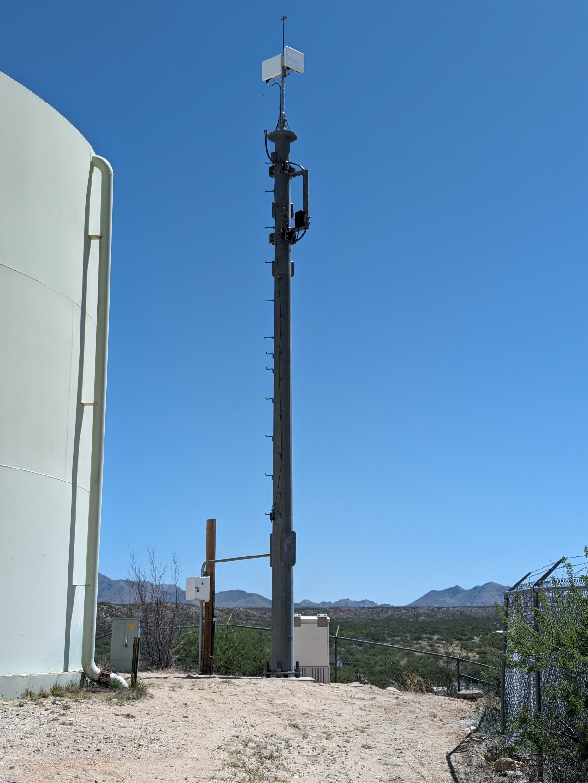
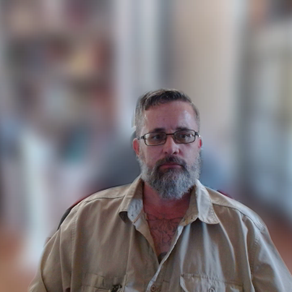
Target Market and Use Cases
Notes:
This solution is applicable to any service provider using tower-based infrastructure, whether for 5G, fixed wireless, or other forms of communication. The modular design makes it scalable and efficient, and with its flexibility, it could be adapted for use in monitoring environmental conditions or physical security sensors. The goal is to create a cost-effective infrastructure solution that can expand with minimal investment.

Slide 8
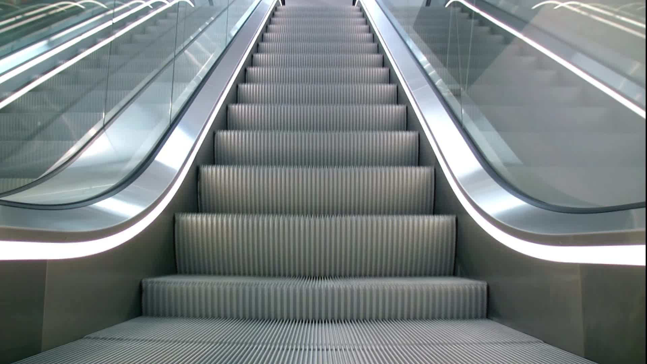

Conclusion & Next Steps
Notes:
In conclusion, I’ve already deployed early-stage prototypes in the field and will continue working on implementing the circuit monitoring and reporting systems. The next steps involve refining the microcontroller programming and expanding the solution’s capabilities. I’m eager to push this project forward and explore further potential for deployment in the growing RF communications sector."

Slide 9


Thank you for your time!
Notes:
Thank you for your time and attention, please reach out on Teams if there are any questions.

