Slide 1


Modular Tower-Mounted Solution for Integrated Power and Fiber Distribution with DC Circuit Monitoring and Notification
Caleb Quisenberry
University of Advancing Technology
Network Engineering and Cybersecurity, SIP311

Slide 2
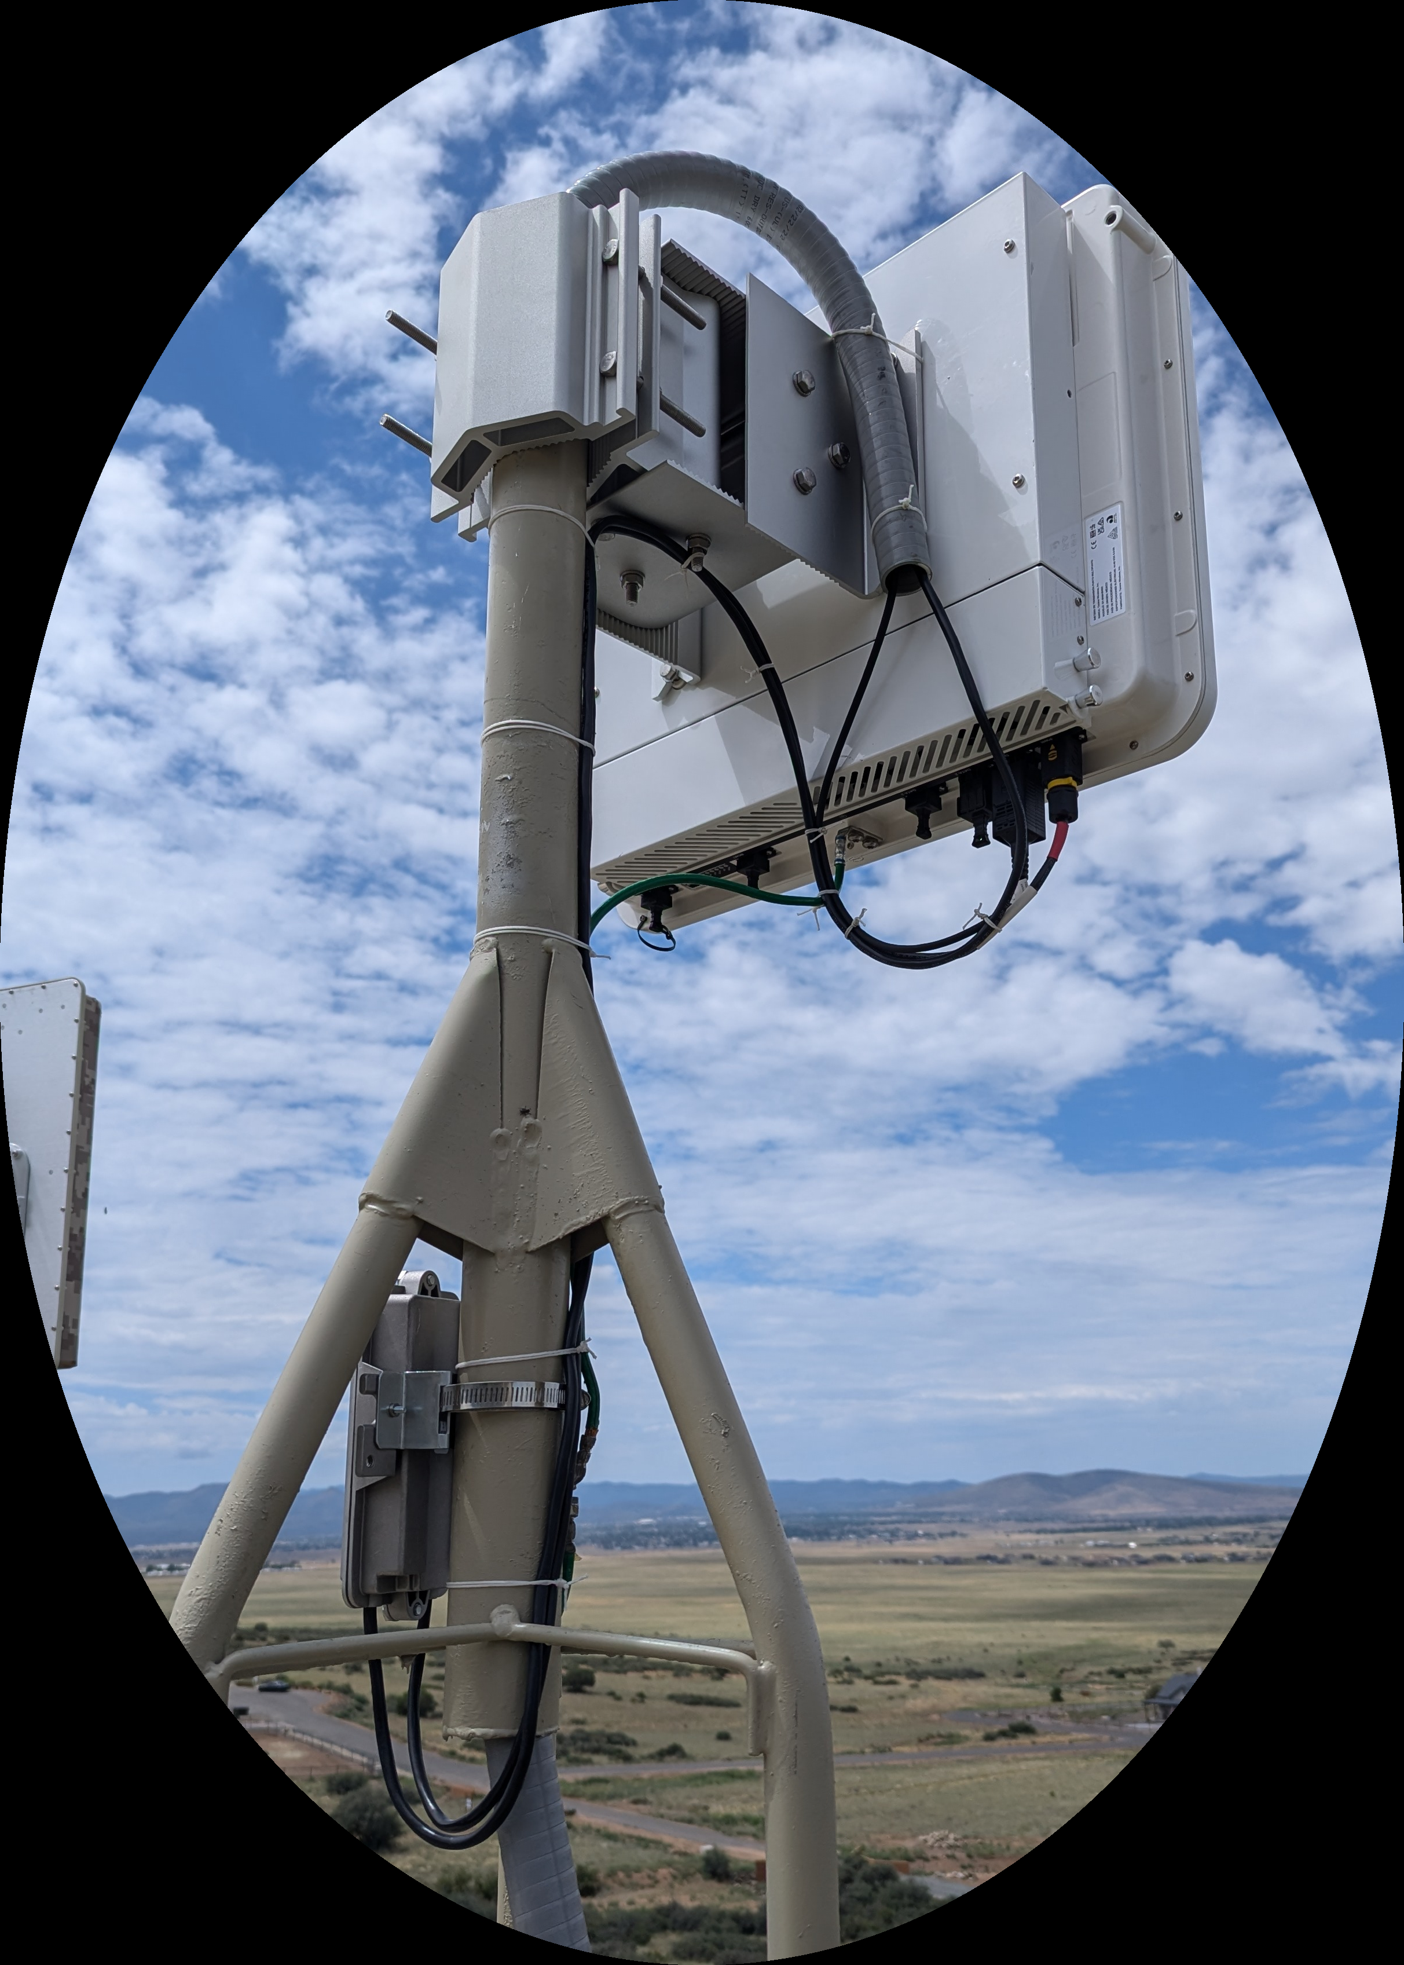
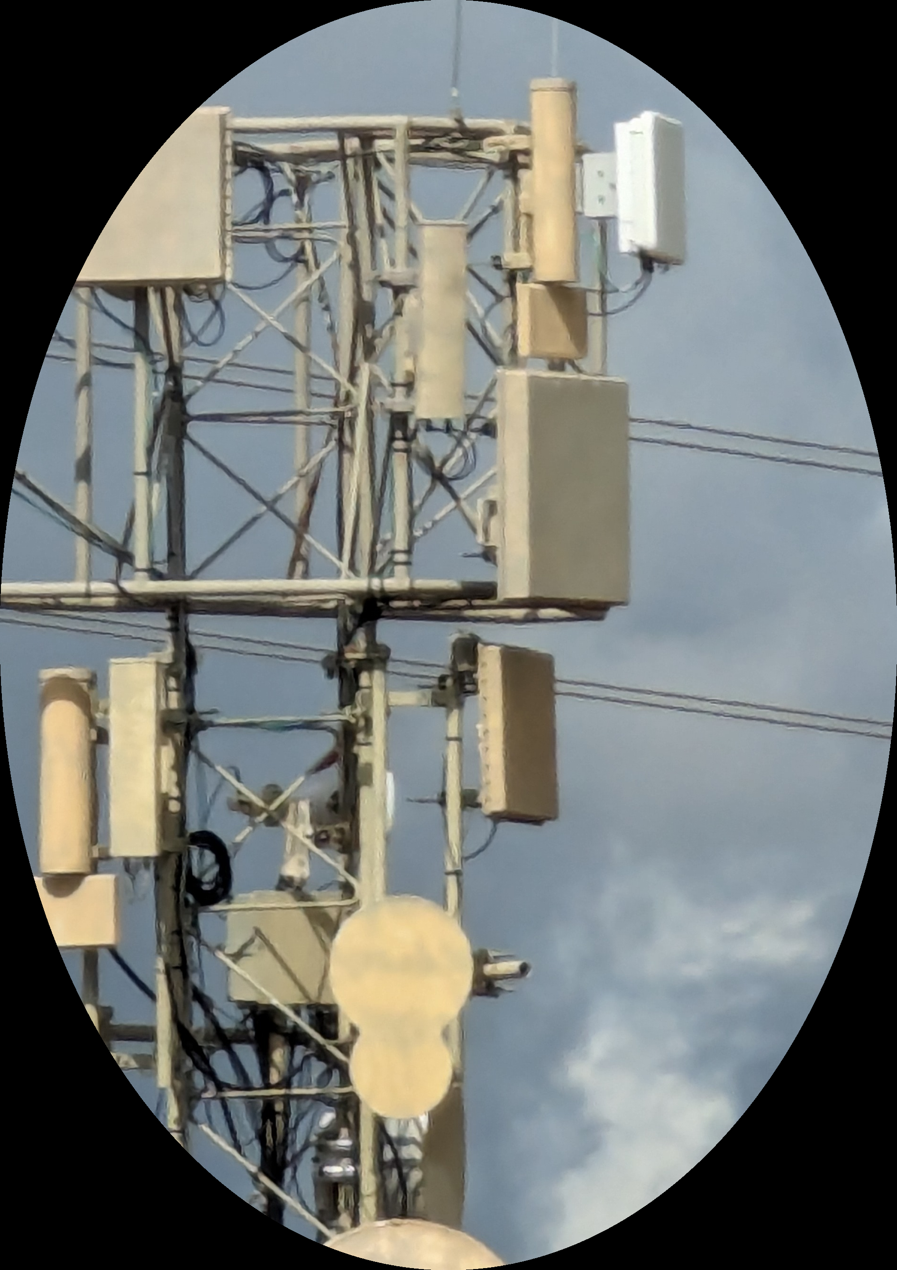
Problem Statement
With tower space at a premium, radio operators need an infrastructure management system that can lower costs, reduce maintenance, and still provide reliable and secure backhaul and power delivery to critical radio systems. Most solutions currently on the market require multiple cable runs for each radio, or expensive custom-built cabling. On a site with multiple cells, this can create a disorganized and potentially insecure cabling environment. Adding cells or otherwise expanding such a site can be challenging and expensive.
Notes:
Guidelines:

Slide 3
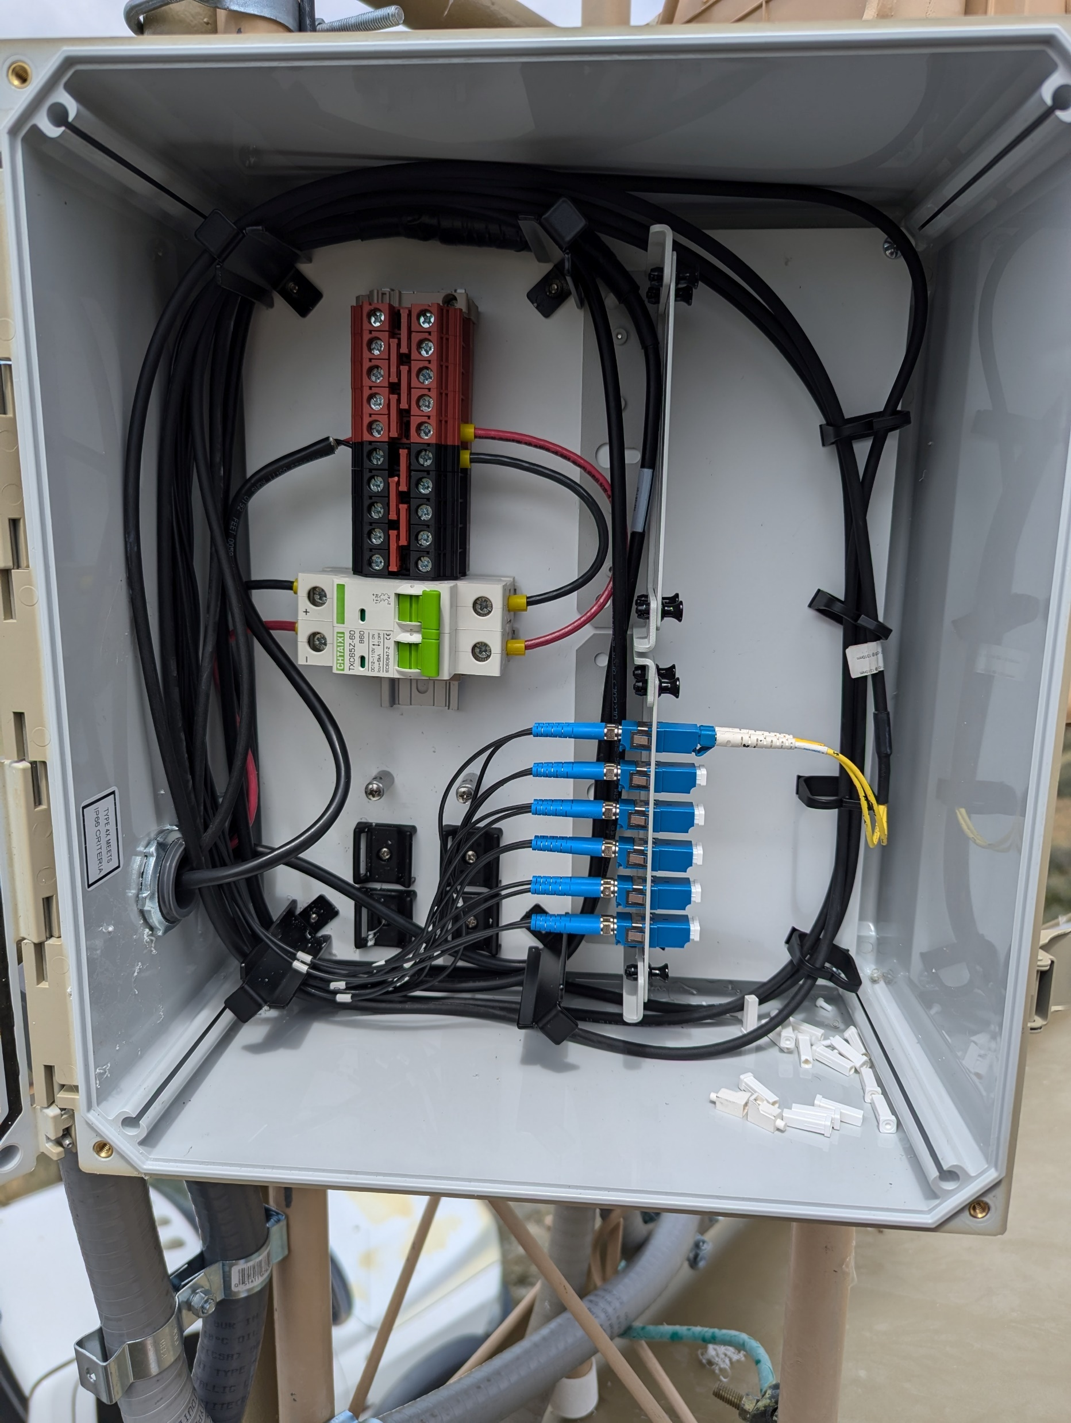
Innovation Claim
An integrated power and fiber distribution unit allows for efficient use of cabling and tower space. This lowers infrastructure costs, time to deploy, and allows for site expansion with minimal investments. Further innovations for this solution include power monitoring and email notifications of power disruptions both before and after the built in circuit protection. This allows for diagnostics of the power circuit without the need to send a climber up the tower. External visual indicators that show power present or not present at two points in the circuit are another innovation to reduce the need to climb. This would enhance safety, save time, and reduce costs.

Slide 4
Technical Expertise & Skills
This innovation applies to Network Engineering at Layer One of the OSI model, without the physical connections, there is no network to engineer. The same idea applies to the field of Network Security. Security of cabling and physical assets is a vital part of defense in depth strategies.
Courses not taken yet that would be beneficial include; CSC230, CSC235, CSC285, NTW233, and RBT173. Most of these are to learn about the microcontroller that would be used for monitoring and email alarm functionality.
A list of required skills to complete this project include; physical engineering skills, Python to program the microcontroller, IoT and IoT security skills, and the understanding of multiple layers of network security, as this device connects to and communicates through secure networks.
Notes:
Guidelines: Refer to the Tech Resources document provided by your SIP Instructor

Slide 5
Project Description & Scope
This project aims to add advanced features to an existing innovative prototype. This prototype has been a work in progress to fill a void encountered while designing and standing up fixed wireless sites. This is a solo project where I will wear all the hats. I will need to enhance my knowledge of microcontrollers, programming, and how to secure IoT devices. Between self study and coursework, the timeline to develop the necessary skills should align with a natural progression of the SIP framework and allow for an MVP by the end.
The app suite used for time management will be the Google family of apps in conjunction with the Microsoft platform.
Notes:
PM: Project Management

Slide 6
Target Market
This product will appeal to any consumer in the field of RF communications. This will be a vendor agnostic solution that allows for an efficient delivery, distribution, and monitoring of fiber and power to the top of the tower.
The rapidly expanding field of RF networking demands a focus on efficient infrastructure build out. Technologies such as 5G and ngFWA require base node sites in difficult locations. Reducing the need to visit the site for basic monitoring and maintenance can have an outsized impact on expenses.

Slide 7
Prior Art
OptiFlex Hybrid Cables: This product is a solution to one aspect of the problem addressed by my solution. It does not address distribution, power circuit protection, or monitoring.
Eupen Cable USA Power and Fiber Distribution Junction Box: This product addresses power distribution and protection as well as fiber distribution. The innovations offered by my solution include monitoring and alarm notifications as well as a more cost effective and modular design.
References
OptiFlex hybrid cables and wireless tower solutions. (2021, February 4). Cables Unlimited Inc. https://www.cables-unlimited.com/products/optiflex-hybrid-cables-and-wireless-tower-solutions/
Power and fiber distribution Junction boxes. (2024, February 23). Eupen Cable USA. https://eupen.us/products/power-and-fiber-distribution-junction-boxes/

Slide 8
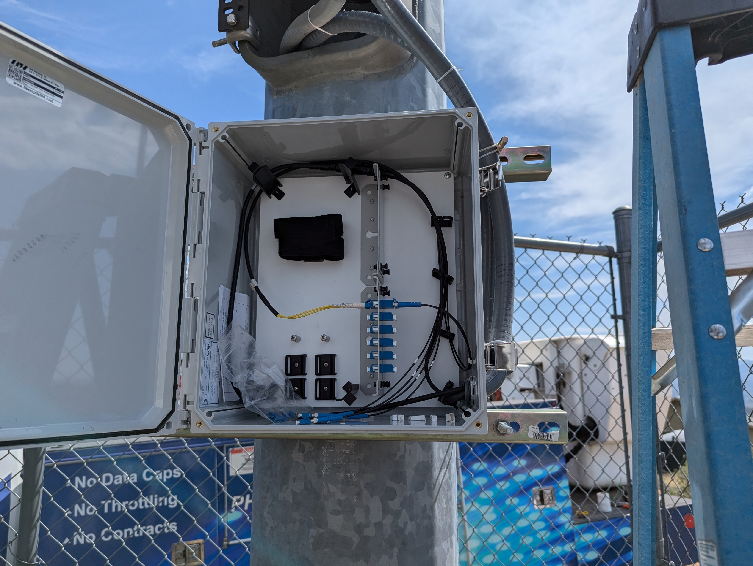
Proof of Concept/Early-Stage Prototype
These images are early prototypes that are deployed on towers near Prescott Valley, Arizona. The first did not include power distribution. The second iteration addressed this need. Future iterations will include the features that I need to develop skills to implement. A microcontroller will be programmed to monitor the status of relays on the power delivery circuit. Email notification will also need to be programmed.
Notes:
Note: add more slides as needed

Slide 9
Q&A
Caleb Quisenberry, Network Engineering, Network Security
Modular Tower-Mounted Solution for Integrated Power and Fiber Distribution with DC Circuit Monitoring and Notification

