Slide 1
Proposal for a parametrized circulating potential field for obstacle avoidance
Presented by: Garrett Clem
Advisor: Dr. Jay Wilhelm

Slide 2
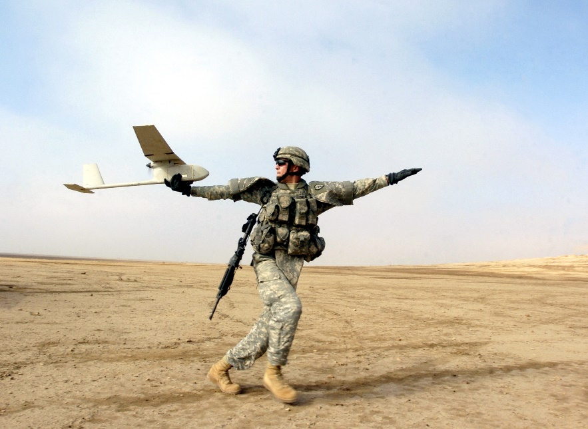
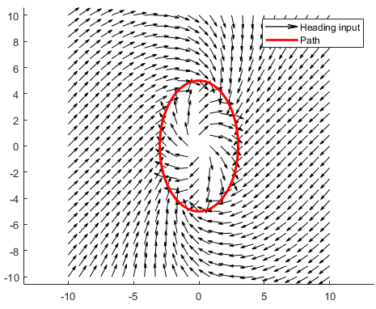
Introduction
Problem Statement: Improve the use of vector field for obstacle avoidance by eliminating singularities and saturated control conditions through the use of scalar time parametrized circulation function.
Fixed wing unmanned aerial vehicle (UAV)
Navigation, Guidance, and Control
Complex path following
Feedback control traditionally used
Vector field guidance
Figure 1:Hand launched fixed wing
Figure 2: Path Planning

Slide 3
Problem Statement and Objectives
Objectives:
Phase I: Characterize vector field summing singularity and UAV control saturation
Phase II: Discover what combination of flight parameters has the most positive effect on obstacle avoidance
Phase III: Validate parametrized vector field circulation model through mobile robot experiments

Slide 4
Success Criteria
Objectives:
Phase I: Reproduce singularities and control saturation described in literature for vector field summation
Phase II: Demonstrate that a parametrized vector field prevents singularities and reduces the control effort in comparison to a non parametrized field
Phase III: Validate simulation results with a ground robot simulating a fixed wing UAV constraints

Slide 5
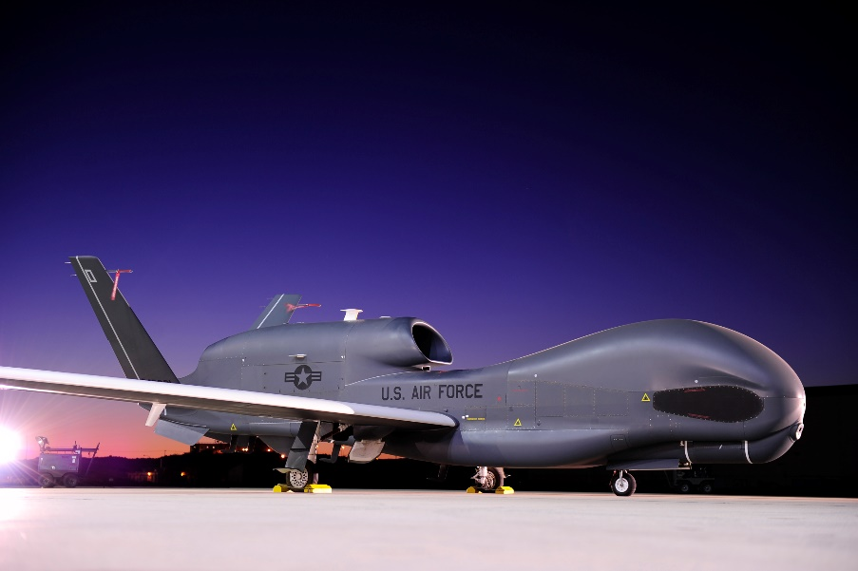
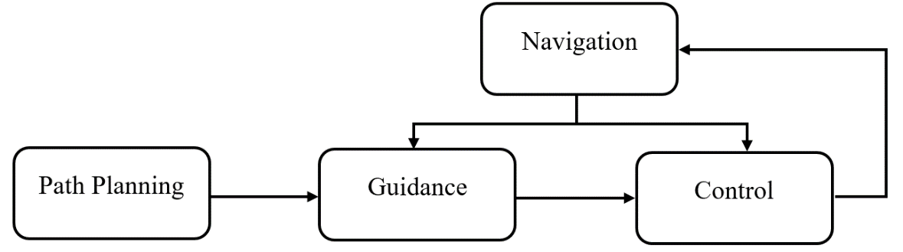
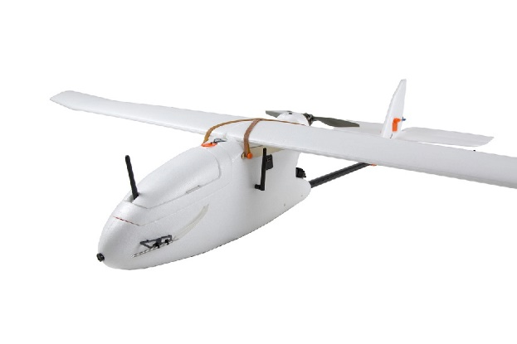
Literature Review
Fixed wing UAVs
Large and hand-launched varieties
Gas and battery powered
Long endurance and range
Heavy payloads
Operated by military and civilians
All classes share same operational sub systems
Navigation
Path Planning
Guidance
Control
Figure 3: Global hawk
Figure 4: UAV Autopilot Flowchart
Figure 5: 3DR Aero

Slide 6
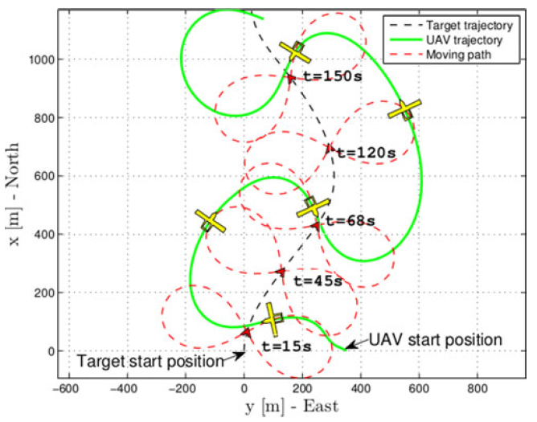
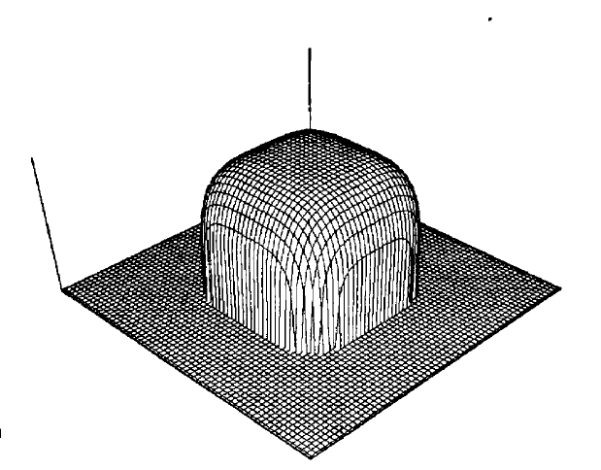
Literature Review
Traditional Control for path following [Oliveira et al 2016]
Direct control commands to following a moving path
Low tracking error
Complex and difficult to analyze
Real-Time Obstacle Avoidance for Manipulators and Mobile Robots [Khatib, 1986]
Goal seeking and obstacle avoidance
Workspace represented as a gradient potential of attractive and repulsive forces
Useful for point-to-point
Path following requires more calculations
Figure 6: Following mobile path
Figure 7: Potential Field Obstacle

Slide 7
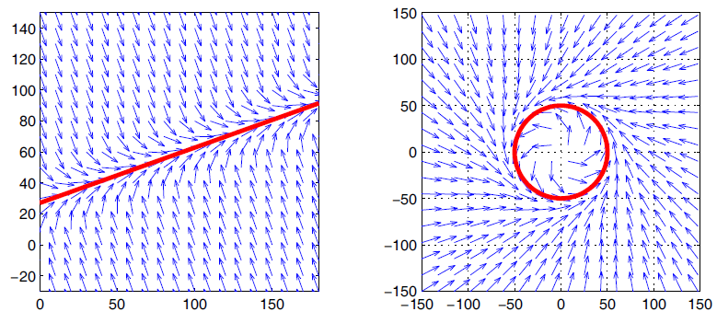
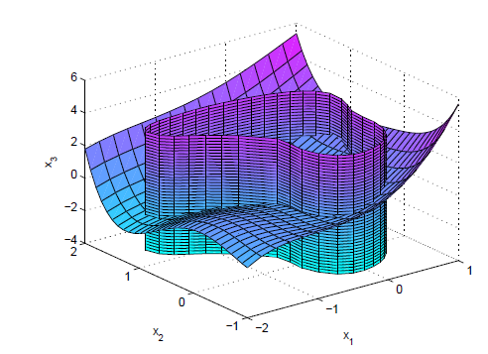
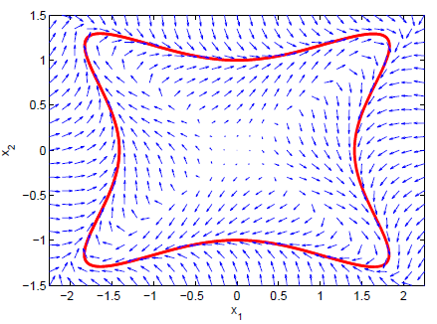

Literature Review
Vector Field Path Following for Miniature Air Vehicles [ Nelson et al.]
Vector field ideal for path following
Converge and follow
Built from Lyapunov equations for primitives
Stitched together to combine flight path
Predicted singularities as “dead zones”
Vector field for robot navigation along n-dimensions [Goncalves et al]
Guidance for converging and following a path
Disturbance rejection
Prevents singularities for single path field
Each component weighted by scaling factor
Figure 8: Vector field for primitives
Figure 9:Intersection of surfaces
Figure 10: Arbitrary vector field

Slide 8
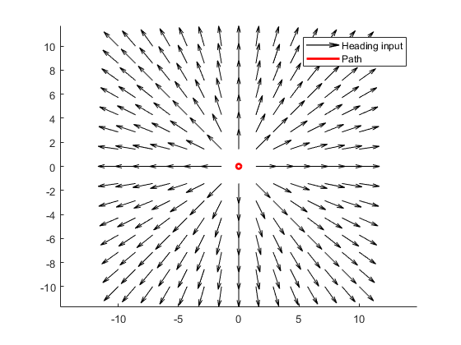
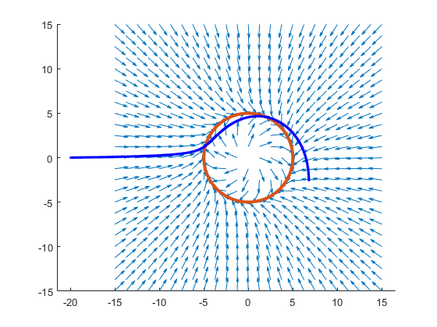
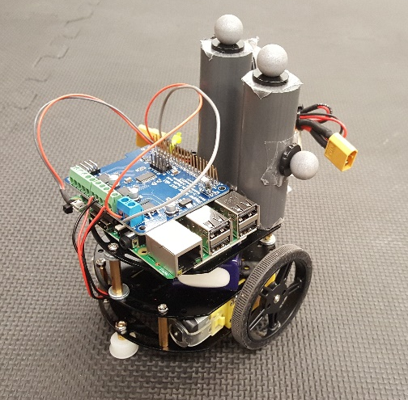
Methodology
Phase I:
Recreate vector fields from literature
Show predicted singularity case by summing obstacles and goal field
Simulate fixed wing for head-on obstacle to show input saturation
Phase II:
Set H equal to a function dependent on flight parameters
Closing velocity, position, heading, heading rate
Calculate cost (distance) and compare to unmodified circulation
Phase III:
Program modified vector field into python
Run on mobile robot with simulated fixed wing constraints
Compare experimental with simulation results
Figure 11: Repulsive Field
Figure 12: Saturation
Figure 13: Ground robot

Slide 9
Timeline

Slide 10
Questions?

