Slide 1
TITLE
Name

Slide 2
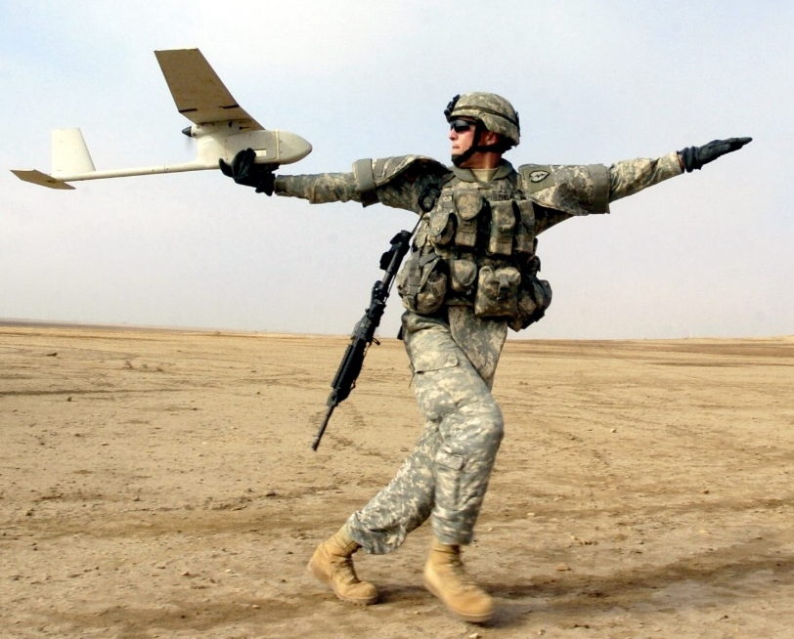
Introduction
Unmanned Aerial Vehicles (UAVs)
Fixed wing
Rotorcraft
Unmanned Aerial System (UAS)
Aircraft
Ground station
Transmitter
Waypoint navigation
Obstacle Avoidance

Slide 3
Problem Statement and Objectives
Problem Statement: Determine vector field weighting functions that enable optimal obstacle avoidance for fixed wing UAVs
Objectives
Phase 1
Phase 2
Phase 3

Slide 4
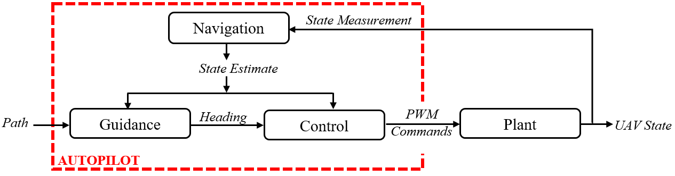
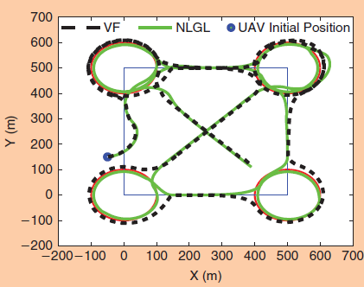
Literature Review

Slide 5
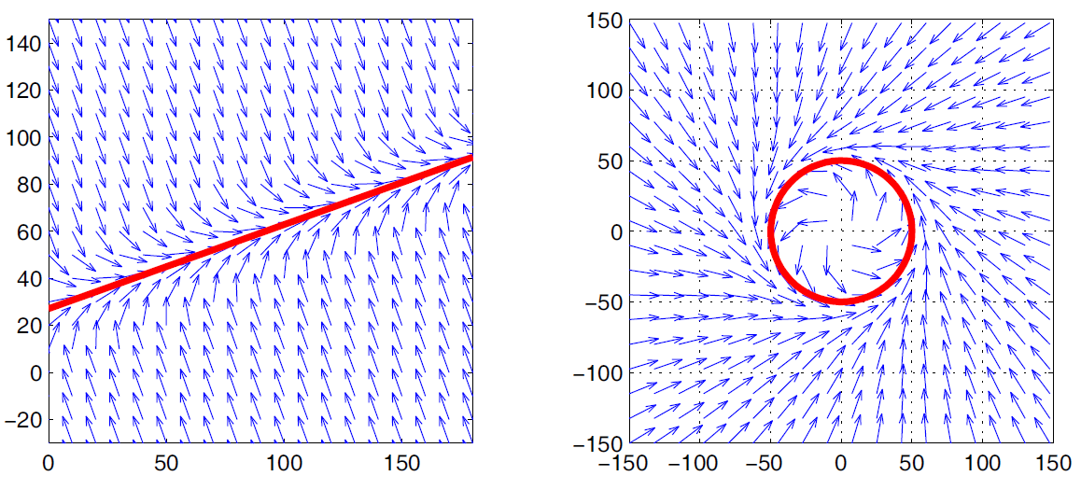
Literature Review

Slide 6
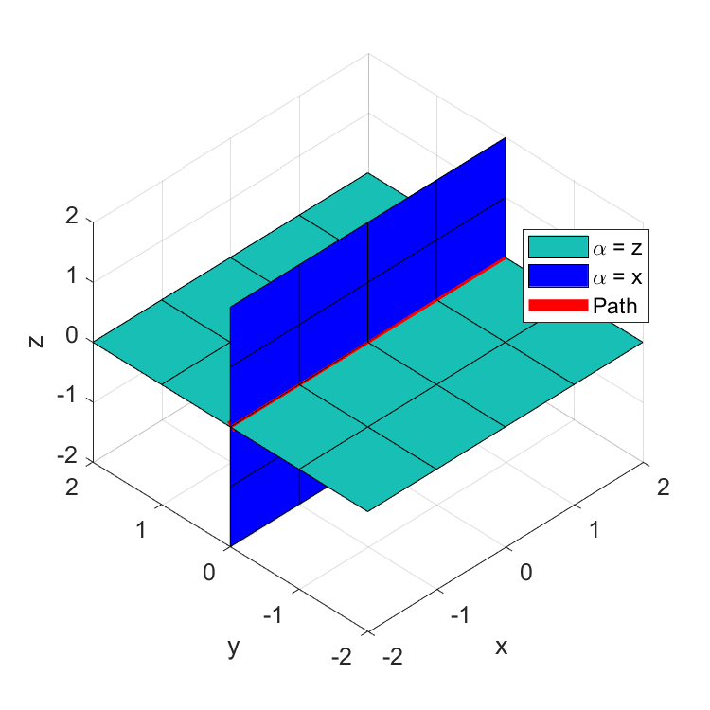
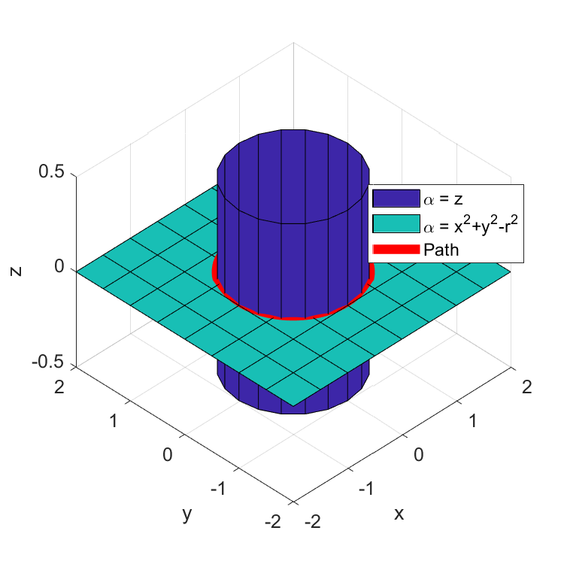
Literature Review

Slide 7
Literature Review

Slide 8
Phase 1:
Goal:
Objective:
Tasks:
Demonstrate gradient vector field singularities for circular obstacles
Identify specific set of conditions that yields guidance singularity when summing attractive and repulsive GVFs
Build GVF simulation environment
Evaluate scenarios where singularities are expected
Characterize location of singularities

Slide 9
Phase 2:
Goal:
Objective:
Tasks:
Determine GVF weighting functions that improve obstacle avoidance
Investigate weighting functions dependent on UAV state
Formulate circulation and convergence weights as functions of UAV state
Determine combination of GVF weights that produces optimal guidance in simulation

Slide 10
Phase 3:
Goal:
Objective:
Tasks:
Demonstrate GVF obstacle avoidance with ground robot experiments
Validate modified GVF guidance on mobile robot platform simulating fixed wing constraints
Build differential drive robot
Program robotic framework to take guidance commands
Repeat experiments performed in phase 2 on ground robot

Slide 11
Success Criteria
Phase 1:
Phase 2:
Phase 3:

Slide 12
Deliverables

Slide 13
Timeline

Slide 14
Thanks

