Slide 1
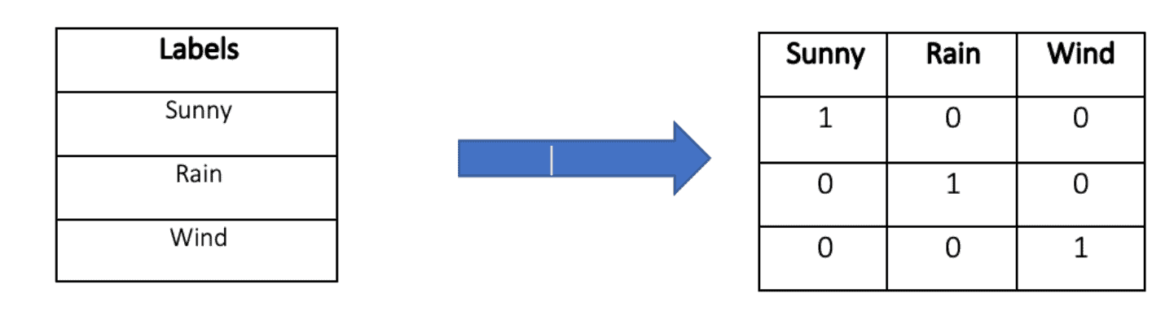
Features of a component
Data Type
Maximum Input Offset Voltage
Maximum Single Supply Voltage
Minimum Single Supply Voltage
Number of Channels per Chip
Supplier_Package
Typical Gain Bandwidth Product
float
float
float
One-hot encoding
float
Many algorithms cannot directly process non-numeric data. We can use the One-Hot Encoding to convert categorical feature into numerical feature.
category
float
Example:
One-hot encoding

Slide 2
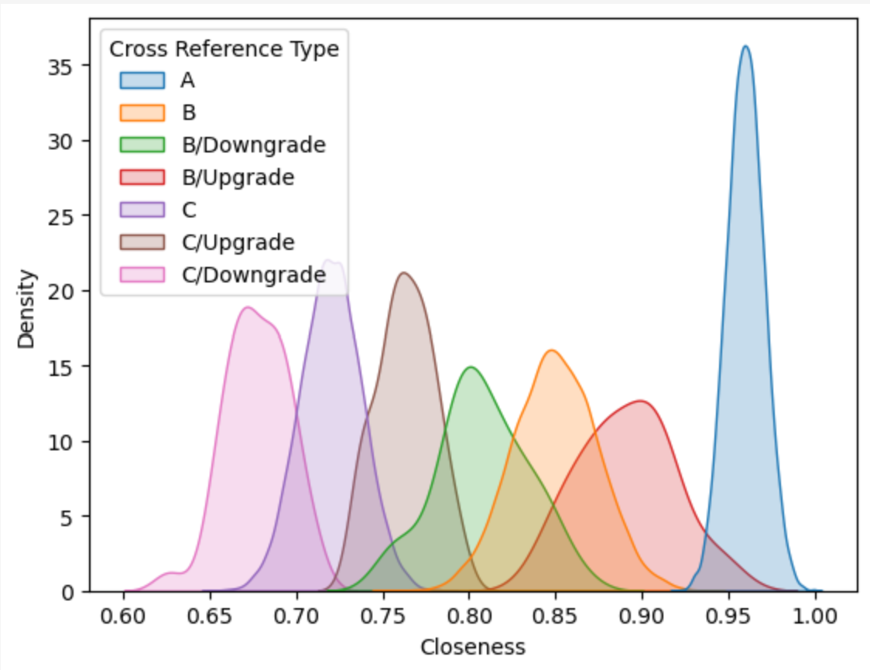
Other possible input formats
Features of
a component
Features of
another component
1.
2.
3.
……
-
Input
=
difference between the two
Machine Learning Model
The most important part.
Many algorithms we can try.
Output
Similarity score
Use “closeness” as the label
when training the model

Slide 3
Regression Problem: The target variable (Similarity score) is a continuous value.
Classic machine learning models:
Relatively simple structure
Relying on manual feature engineering, data preprocessing are critical to the model.
Example:
Linear regression.
Support vector machine (SVM)
Random forest
……
Deep learning models:
Complex structure based on artificial neural networks
The model can automatically extract features from raw data
Example:
Fully Connected Neural Network (FCNN)
Convolutional neural network (CNN)
Recurrent neural network (RNN)
Transformer
……

Slide 4
Setting:
Machine Learning Model
Similarity score
Features of
a component
Features of
another component
Output
Input
Loss function:
Mean square error (MSE)
Use “closeness” as the label
when training the model
Results of some models:
Models in the “sklearn”：
try different hyperparameters for the model
Model I designed myself
 | Random Forest | Gradient Boosting Regressor | Support Vector Regression | Fully Connected Neural Network
MSE on the test set | 0.0005 | 0.0012 | 0.0066 | 0.0064

