Slide 1
Max Flow Image Segmentation
Charles Mo, Darren Eldredge, Do Hun Ji

Slide 2
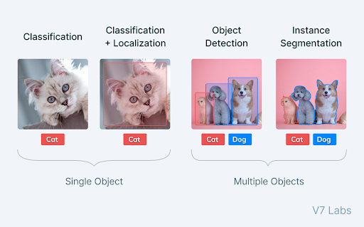
What is Image Segmentation?
Image segmentation aims to group similar regions or segments of an image under their respective class labels or masks, combining classification and localization.
https://www.v7labs.com/blog/image-segmentation-guide

Slide 3
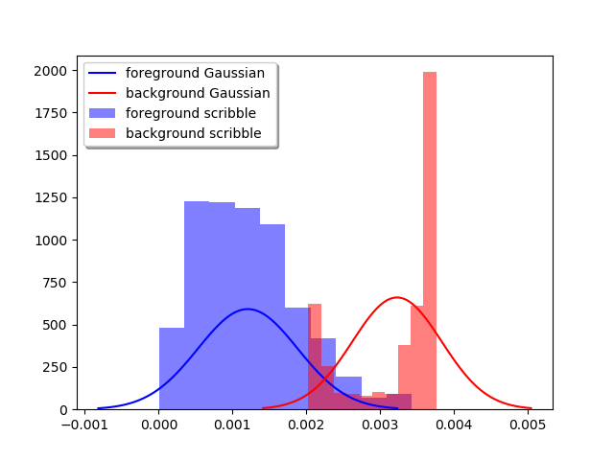
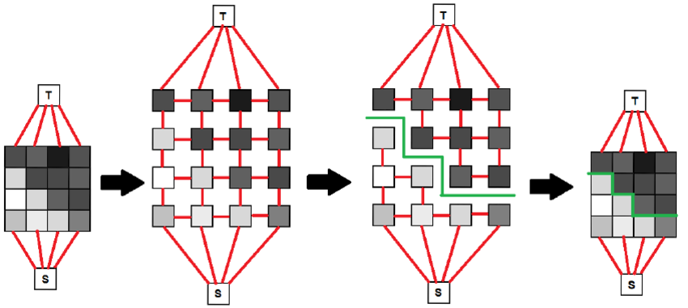
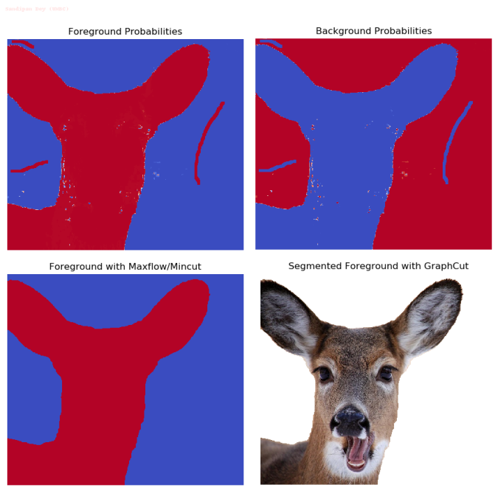
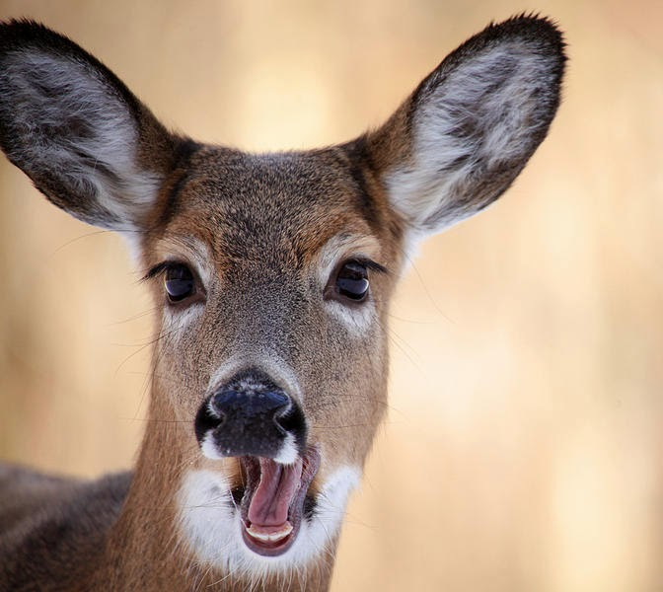

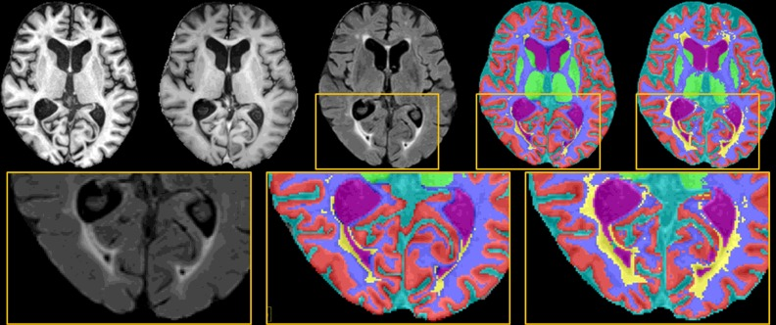
How is max flow currently used for image segmentation?
Examples:
Photoshop Magnetic Lasso
Automatic partitioning of an image into multiple clinically relevant regions
https://www.sciencedirect.com/science/article/pii/S1361841515000729
https://sandipanweb.wordpress.com/2018/02/11/interactive-image-segmentation-with-graph-cut/

Slide 4
Proposal
Idk just jotting down notes:
Clustering methods: Kmeans, Meanshift, Gaussian Mixtures, etc
Deep learning methods: Unet (probably not plausible to cover)
Compression methods: Huffman coding
Edge-based methods: Active contour model
Region-based methods Watershed
Misc. Otsu’s method (binary threshold)

Slide 5
Overview

Slide 6
Implementation

Slide 7
References
https://julie-jiang.github.io/image-segmentation/ (useful explanation but same algorithms as those in prof. Brower’s example presentation)

